Slide 1
MAIN BLOOD SUPPLY OF THE UTERUS
Group 1
Emanuel Nyerewa Mzimba DHO
Richard Nyirenda Mzimba DHO
Chikondi Mchazime Mzuzu Central Hospital
26/05/2013

Slide 2
OBJECTIVE
To understand the blood supply of the uterus

Slide 3
IMPORTANCE
Minimize medical errors
Understand some obstetric procedures like abdominal compression

Slide 4
What are the vessels that supply the uterus?

Slide 5
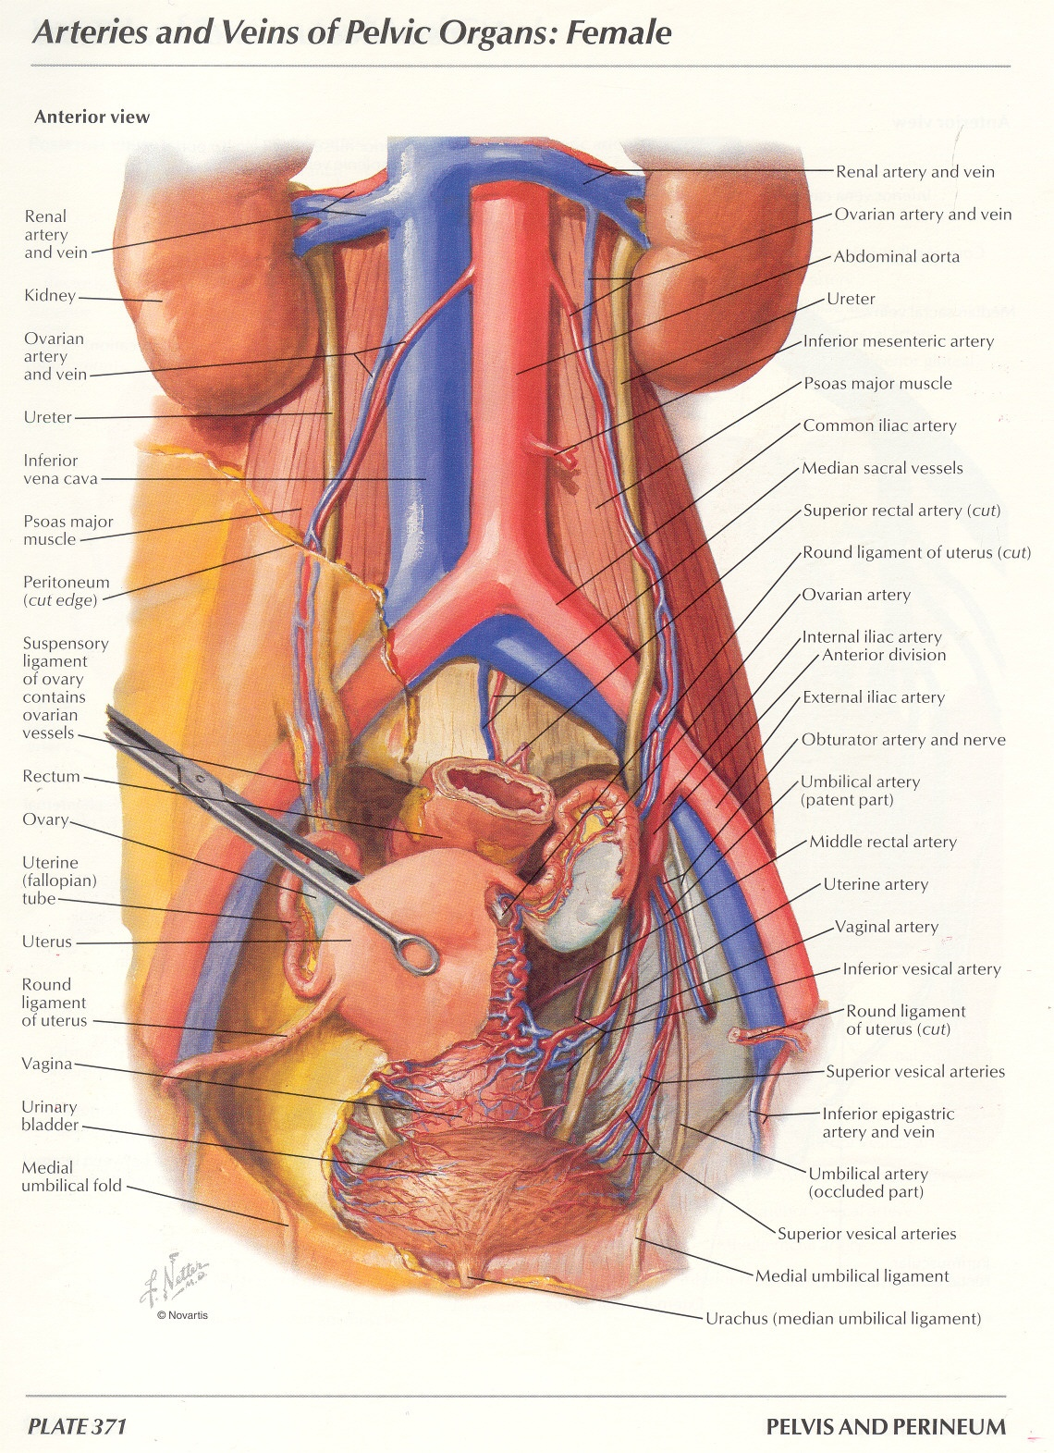

Slide 6
CONCLUSION
Important to know the blood supply of the uterus
Trace uterine vessels from the abdominal aorta

Slide 7
REFERENCE
Richard Snells. Atlas of Anatomy and Physiology.

