Slide 1
IDENTIFICATION AND MANAGEMENT ABORTION
Prepared by:
Loveness Mwase
Kaweche Mwase
Ackson Chandula
Warwick-Etatmba

Slide 2
OUTLINE
Introduction
Objectives
Incidence
Classification
Causes
Diagnosis
Complications
Management
Prevention
Warwick-Etatmba

Slide 3
INTRODUCTION
Definition
A process where a woman has threat or termination of (intrauterine) pregnancy by any means below 28 weeks safely or unsafely.
More than half of abortions in developing country are unsafe.
It may occur legally or illegally in safe, less safe, unsafe and very unsafe situations.
One of a major contributing factor to maternal mortality rate with epidemiological evidence as a public health problem national wide and globally.
Warwick-Etatmba

Slide 4
OBJECTIVES
Understand definition, causes, prevention and management of Abortion
Appreciate magnitude.
Recognize presentation of complications.
Practice effective management.
Warwick-Etatmba

Slide 5
INCIDENCE
Directly-9%
Indirectly-43%(Hemorrhage +Sepsis
Warwick-Etatmba

Slide 6
CLASSIFICATION
It may be spontaneous or induced
According outcome
Safe
Unsafe
Clinically
Threatening
Complete
Incomplete
Missed
Warwick-Etatmba

Slide 7
CAUSES
Includes
Maternal conditions e.g. infections, uterine defects, cervical incompetence and malaria
Fetal conditions e.g. maldevelopment of ovum, Chromosomal abnormality and defective implantation.
Underlining causes e.g. Nutritional status.
Warwick-Etatmba

Slide 8

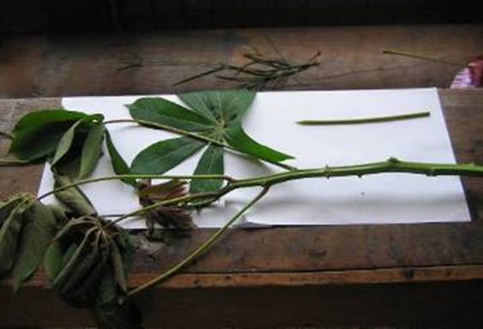


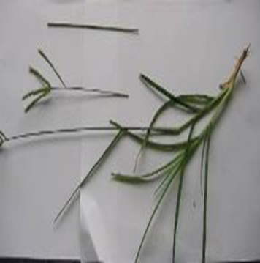

Tools used for abortion(unsafe)
Cassava plant
Alligator pepper, chalk and alum
Bahaman grass
Bleach
Quinine and other Drugs

Slide 9
DIAGNOSIS
Patient presentation.
Comprehensive history taking and physical examination.
Laboratory tests and radiological assessment.
Warwick-Etatmba

Slide 10
COMPLICATIONS
Short term
Retained product of conception
Hemorrhage
Instrumental injury
Shock
Warwick -Etatmba

Slide 11
Complications Cont...d
Long Term
Pelvic Inflammatory Disease
Tubal Occlusion
Infertility
Ectopic Pregnancy
Chronic Pelvic Pain
Warwick-Etatmba

Slide 12
MANAGEMENT
It is done according to gestation age and classification using National guidelines.
All abortions occurring at < 12 weeks; do Manual Vacuum Aspiration{MVA} and those occurring >12 weeks do evacuation and this include:
History taking and full physical examination.
Postal abortal care.
Give Family planning
Warwick-Etatmba

Slide 13
PREVENTION
Counseling and Health Education
Access to Family Planning methods
Antenatal Services– Screening for risk groups
Warwick-Etatmba

Slide 14
REFERENCES
WHO Systemic Review of Causes of Maternal Death
US Agency for International Development
Life Saving Skills Manual.
THANK YOU.

