Slide 1
POST PARTUM HAEMORHAGE
BY Francis Mitungwi Joseph Kasola Samuel Simfukwe

Slide 2
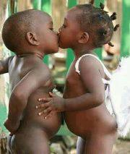
YOU HAVE TWO CHOICES IN LIFE
STAY SINGLE AND BE MISERABLE
OR
GET MARRIED AND WISH YOU WERE DEAD
TODAY’S WORDS OF WISDOM

Slide 3
OBJECTIVES
By the end of the presentation, participants will be able to:
Define PPH.
List risk factors of PPH.
List causes of PPH.
Prevent PPH.

Slide 4
DEFINITION
Bleeding more than 500mls following vaginal delivery and 1000mls following c/s.
Constant trickling of blood after delivery
Blood loss sufficient to cause hemodynamic instability.
It is unpredictable – be prepared!

Slide 5
PPH RISK FACTORS
Preeclampsia.
Nulliparity.
Multiple gestation.
Previous Cesarian section
Prolonged third stage (>30min)
Assisted delivery.
Grand multiparity.
Placenta prevea.
Polyhydramnious.
Episiotomy.

Slide 6
CAUSES OF PPH
Commonly known as 4Ts
Arranged according to frequency
Tone (70%)
Trauma (20%)
Tissue (9%)
Thrombin (1%)

Slide 7
PPH PREVENTION
Treat anaemia during prenatal care.
Avoid routine episiotomy
Actively manage third stage of labour
Re-examine after completing delivery paperwork.
Give Misoprostol 600 mcg po to every woman with risk factor of PPH after the active management of third stage of labour

Slide 8
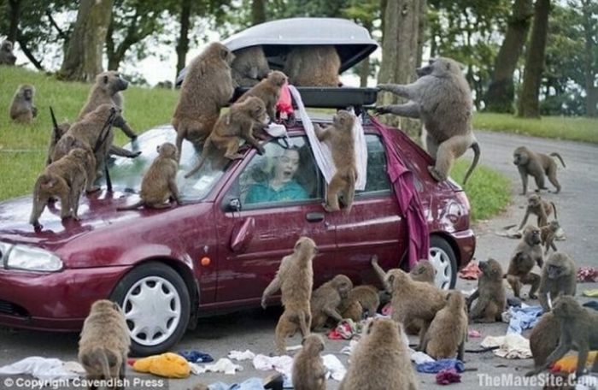
TEAM WORK NEEDED IN PPH

