Slide 1
Syphilis
Dr Gregg Eloundou
UHCW

Slide 2


Slide 3
Mr X
32 year old white male
Oct 2004 develops fevers, hair loss, rash
HIV test negative
Jan 2005 develops deafness and eye pain
March 2005 optic neuritis diagnosed in Eye clinic

Slide 4
Number of new diagnoses of selected STIs, GUM clinics, UK: 2006
 |  | % change
 | 2006 | 2005-2006 | 1995-2006
Chlamydia | 113,585 | 5% | 222%
1st Genital warts | 83,745 | 3% | 32%
Gonorrhoea | 19,007 | -1% | 111%
1^{ry} Genital herpes | 21,698 | 9% | 15%
Syphilis-infectious | 2,766 | -1% | 1497%
Notes:
Slide 2: Number of new diagnoses of selected STIs, GUM clinics, United Kingdom: 2004
Large increases in many STIs have contributed to the overall increase in all new episodes. Diagnoses of chlamydia, gonorrhoea and infectious syphilis have more than doubled since 1995. Chlamydia is the most commonly diagnosed STI in the UK.

Slide 5
Clinical stages
Early (infectious)
  Primary
  Secondary
  Early latent
Late
  Late latent
  Gummatous
  CVS / CNS

Slide 6
Serology
  - ELISA – screening or diagnosis
    IgG, IgM
Non-treponemal tests
  Venereal Disease Research Laboratory – VDRL
  Rapid Plasma Reagin - RPR
Treponemal tests –
  fluorescent treponemal antibody – FTA
  T.pallidum haemaglutination assay -TPHA

Slide 7
Primary
Duration of 9–90 days
Macule – papule - painless ulcer
Indurated with clear exudate
Heal spontaneously in 2-6 weeks
Up to 50% may be atypical in some way (multiple, painful, purulent, or extragenital)
The most common sites are the coronal sulcus / glans penis / cervix / vulva / anus (+ rectum in homosexual men).

Slide 8
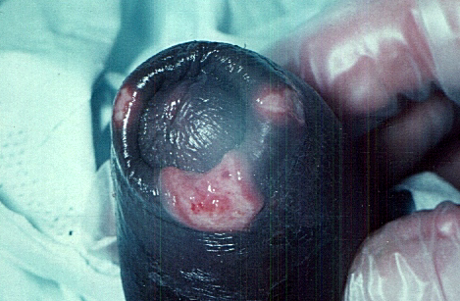

Slide 9
Primary syphilis
Diagnosis of early disease the exudate from lesions should be examined by dark field microscopy for spirochaetes
Serological tests do not become positive for at least 10 – 14 days after the appearance of the primary lesion.
If strong suspicion repeat with FTA in 2 weeks.
Repeat serology after 3 months in any case of undiagnosed genital ulceration

Slide 10
Secondary syphilis 2–6 months
Clinical features result from a systemic vasculitis.
A generalised polymorphic rash characteristically involves the palms and soles.
Condylomata lata - warty type lesions of the genitals
Mucosal ulceration
Alopecia
Generalised lymphadenopathy
Rarely visceral involvement which can include granulomatous hepatitis, nephrotic syndrome, optic neuritis and meningovascular syphilis.
Left untreated, the secondary syphilis will resolve spontaneously within one to two months of onset

Slide 11
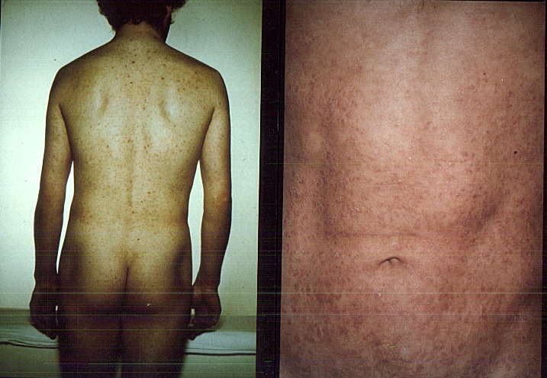

Slide 12
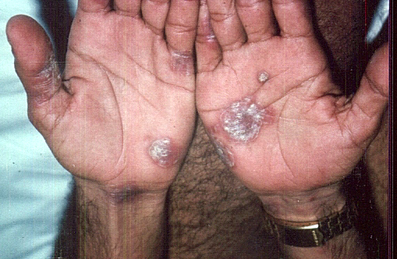

Slide 13
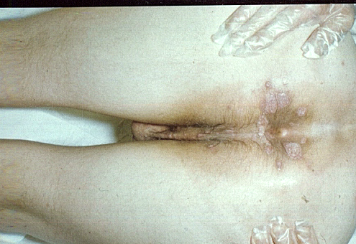

Slide 14
Latent & late Syphilis
- Diagnosis of late syphilis is based on a combination of positive T.pallidum serology
  FTA and TPHA
With or without positive non-treponemal tests
  Venereal Disease Research Laboratory – VDRL
  Rapid Plasma Reagin – RPR
And clinical assessment focusing on
  previous syphilis treatment,
  Possible symptoms of early and late manifestations of syphilis
  Clinical examination to exclude both early syphilis, clinical manifestations of late or congenital infection.

Slide 15
Vertical transmission
Most often occurs in first 2 years after infection but may occur at any time within 10 years of initial infection.

Slide 16
Management of syphilis in pregnancy
All women should be screened for syphilis at the initial antenatal visit
All pregnant women with positive treponemal serology should be evaluated for clinical evidence of syphilis.
All women with +ve FTA require treatment unless clear documentation of previous adequate treatment

Slide 17
Perinatal transmission
Occurs in 2nd and 3rd trimesters
10% 18 – 22 weeks
50% >23 weeks
Untreated 1º and 2º syphilis in pregnancy affects almost 100% fetuses with 50% premature delivery or fetal death
Early latent syphilis - 40% prem delivery or fetal death
May remain infectious to fetuses for many years

Slide 18
Treatment - complications
Pregnant women who have a Jarisch Herxheimer reaction after initiation of treatment for early syphilis have may have precipitous onset of labour.
  affected 65% women with 1 or 2 syphilis with 67% having signs of fetal distress and uterine contractions. Onset symptoms 2- 8 hours – resolved at 24 hours
  none with early latent
- US recommendations recommend hospitalisation of women with primary of secondary syphilis being treated >20 weeks for fetal monitoring

Slide 19
Previous syphilis
  - Women who have documented treatment for syphilis in the past do not need retreatment during current or subsequent pregnancies if
    - There is no clinical evidence of syphilis
    - VDRL or RPR titre is negative or in low titre compared to previous results
  - However it is important to exclude reinfection - Partner and babies should be followed up by a paediatrician to exclude congenital syphilis

Slide 20
Monitoring treatment
Successful treatment of early syphilis should show four fold drop in titres at 3 months
Partner notification is mandatory

Slide 21
Treatment
Penicillin or Erythromycine
All patients diagnosed by serology should have repeat serology and full history before further investigation and treatment.

Slide 22
Any Questions??

