Slide 1
HEALTHWORKERS MOTIVATION-RETENTION
Dr G.Mbaruku

Slide 2
Motivated providers can influence performance directly & indirectly
Motivating providers may reduce the know-do gap¹
Motivated providers can mobilize social, cultural and symbolic capital to overcome work-related problems²
Women value respectful provider attitude when choosing place of delivery³
Leonard K and Masatu M. Professionalism and the know-do gap: exploring intrinsic motivation among health workers in Tanzania. Health Econ 2010;19:1461-1477.
Gross K, Pfeiffer C, Obrist B. “Workhood”-a useful concept for the analysis of health workers’ resources? An evaluation from Tanzania. BMC Health Services Research 2012; 12:55.
Kruk M, Paczkowski M, Mbaruku G, de Pinho H, Galea. Women’s preferences for place of delivery in rural Tanzania: A population-based discrete choice experiment. AJPH 2009;99:1666-1672.
Notes:
Leonard, results summary: “The average clinician in our sample displays a significant know-do gap suggesting an untapped resource for improving performance. This gap is apparent by two measures: (1) the difference between what a clinician knows how to do and what he actually does and (2) the difference between what a clinician does when first observed by a peer and what he does after he accustomed to the presence of the peer.4 Thus, significant improvements in the quality of care are possible by addressing the motivation of these clinicians. Both intrinsic and extrinsic incentives can improve the quality of care provided without requiring an increase in the capacity of clinicians.”
Gross, results summary: “The study showed that lack of physical, human, cultural and financial capital constrained health workers’ capacity to act. In particular, weak health infrastructure and health system failures led to the lack of sufficient drug and supply stocks and chronic staff shortages at the health facilities. However, health workers’ capacity to mobilize social, cultural and symbolic capital played a significant role in their ability to overcome work related problems.”
Kruk, results summary: The most important facility attributes were a respectful provider attitude and availability of drugs and medical equipment.
Policy simulations suggested that if these attributes were improved at existing facilities, the proportion of women preferring facility delivery would rise from 43% to 88%.

Slide 3
Shortage: skilled providers
Africa:1 million additional health workers needed to meet the MDGs
Tanzania
  Nurse:Patient = 1:4,000
  Doctor:Patient=1:20,000
  Obstetrician:Patient=1:400,000
“At current rate of training, will take >20 yrs to achieve adequate health workers”
Recent health worker strikes in Tanzania
Chen L, Evans T, Anand S, et al. Human resources for health: overcoming the crisis. Lancet 2004; 364: 1984-1990.
Lancet 2008.

Slide 4
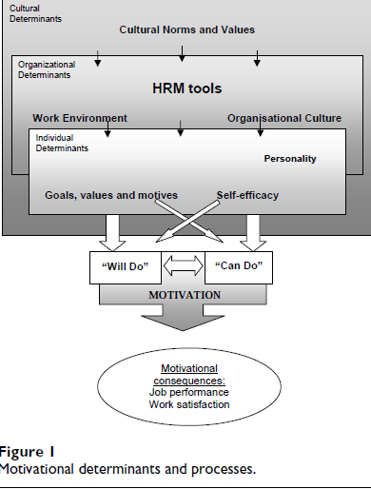

Slide 5
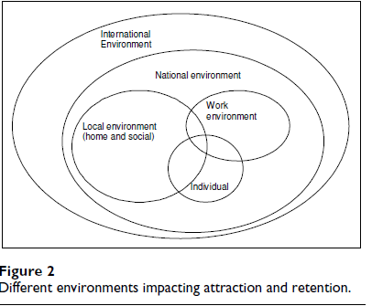

Slide 6
Burnout Inventory
Average scores on subscales by cadres
Notes:
Looking at the burnout inventory by carder, we found significant differences between cadres on all 3 scales
In EE , significant differences between cadre 1 and 3(p=.000); cadre 1 and 4(p=.000); cadre 2 and 3 (p=.001); cadre 2 and 4(p=.05)
RGNs/Midwives are the most emotionally exhausted cadre. COs/AMOs have lower levels of emotional exhaustion than doctors and nurses.
In PA, significant difference between cadre 1 and cadre 3 (p=.05)
There are no significant differences in personal accomplishment between RGNs, enrolled nurses, COs/AMOS and doctors.
The low levels of personal accomplishment for all of these cadres is concerning as a low sense of personal accomplishment can impact negatively on motivation and performance.
5

Slide 7
Research question
Identify the key factors that drive provider satisfaction in primary health clinics in rural Tanzania.

Slide 8
Data collection
Self-administered survey
Included a 19-question index that asked providers to state their agreement:
  Strongly agree, Somewhat agree, Somewhat disagree, Strongly disagree
Data collected from November 2011-April 2012
100 eligible providers in 24 dispensaries
  70 participated in the survey

Slide 9
Data analysis
Calculated descriptive statistics
Conducted principal component analysis of 19-question index
  Retained 12 questions that loaded strongly

Slide 10
Provider Characteristics

Slide 11
Proportion of providers who strongly agreed with the statement (n=70)
Notes:
Most respondents strongly agreed that in general they are satisfied with their job (51 respondents, 73.9%). Fewer respondents (37 respondents, 54.4%) strongly agreed that most people in their job are very satisfied with it.
Overall, 69.1% of respondents strongly agreed that they would like to continue working for their current health facility for quite some time.
The only demographic and employment characteristic (from table 1) that was significantly associated with satisfaction was age. Providers over 40.8 years of age were 27.75 times as likely to be very satisfied with their job as providers 40.8 years old and younger (95% confidence interval: 2.1-371.6). Female providers were 11.2 times as likely to be very satisfied as their male counterparts (0.5-230.8).

Slide 12
Two Themes (subscales) arose from PCA
 |  | Strongly agreed, % (No.)
1: Tools to get the job done (Explains 31.7% of variance)
 | Consistent availability of supplies and medications to perform my duties | 7.9 (5)
 | I am satisfied with my pay compared to similar jobs in other organisations. | 9.5 (6)
 | Enough staff to provide quality patient care | 12.7 (8)
 | Enough staff to get the work done | 6.3 (4)
 | I feel that my workload is manageable (not too heavy) | 28.6 (18)
 | Functioning equipment and infrastructure to perform my duties | 3.2 (2)
2: Supportive interpersonal environment (Explains 21.5% of variance)
 | Freedom to make important patient care and work decisions | 73.0 (46)
 | Clinical officers, nurses and other health workers have good working relationships | 63.5 (40)
 | District health managers support and value health workers | 47.6 (30)
 | I find that my opinions are respected at work. | 66.7 (42)
 | Adequate clinical supervision in this position | 41.3 (26)
 | Adequate access to referral to a higher-level facility for sick patients | 57.1 (36)
Notes:
When we drill down into the specifics of the providers work, two themes (subscales) arose: The first subscale identified a factor related to the availability of adequate “tools to get the job done” and the second factor is related to supportive interpersonal environments. Both subscales correlate positively with providers overall indication of satisfaction with their jobs. A higher factor loading indicates a higher weight in the component (e.g. “consistent availability of supplies and medications to perform my duties” contributes the most information to the component “Tools to get the job done”
If you look at the final column, we can see that providers were more satisfied with factors related to the interpersonal environment, than the tools to get the job done (see next slide for more information).

Slide 13
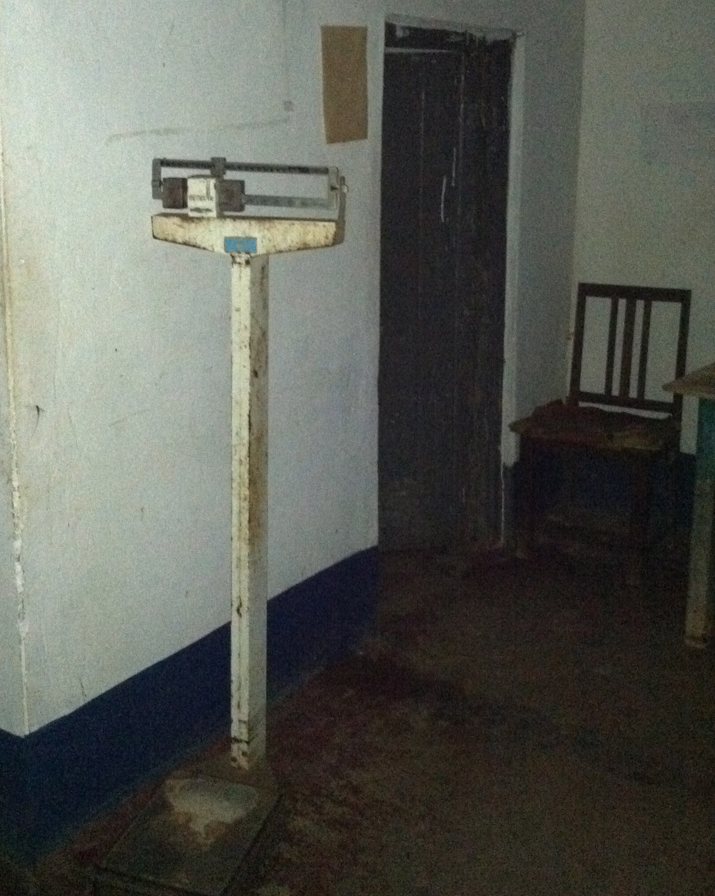
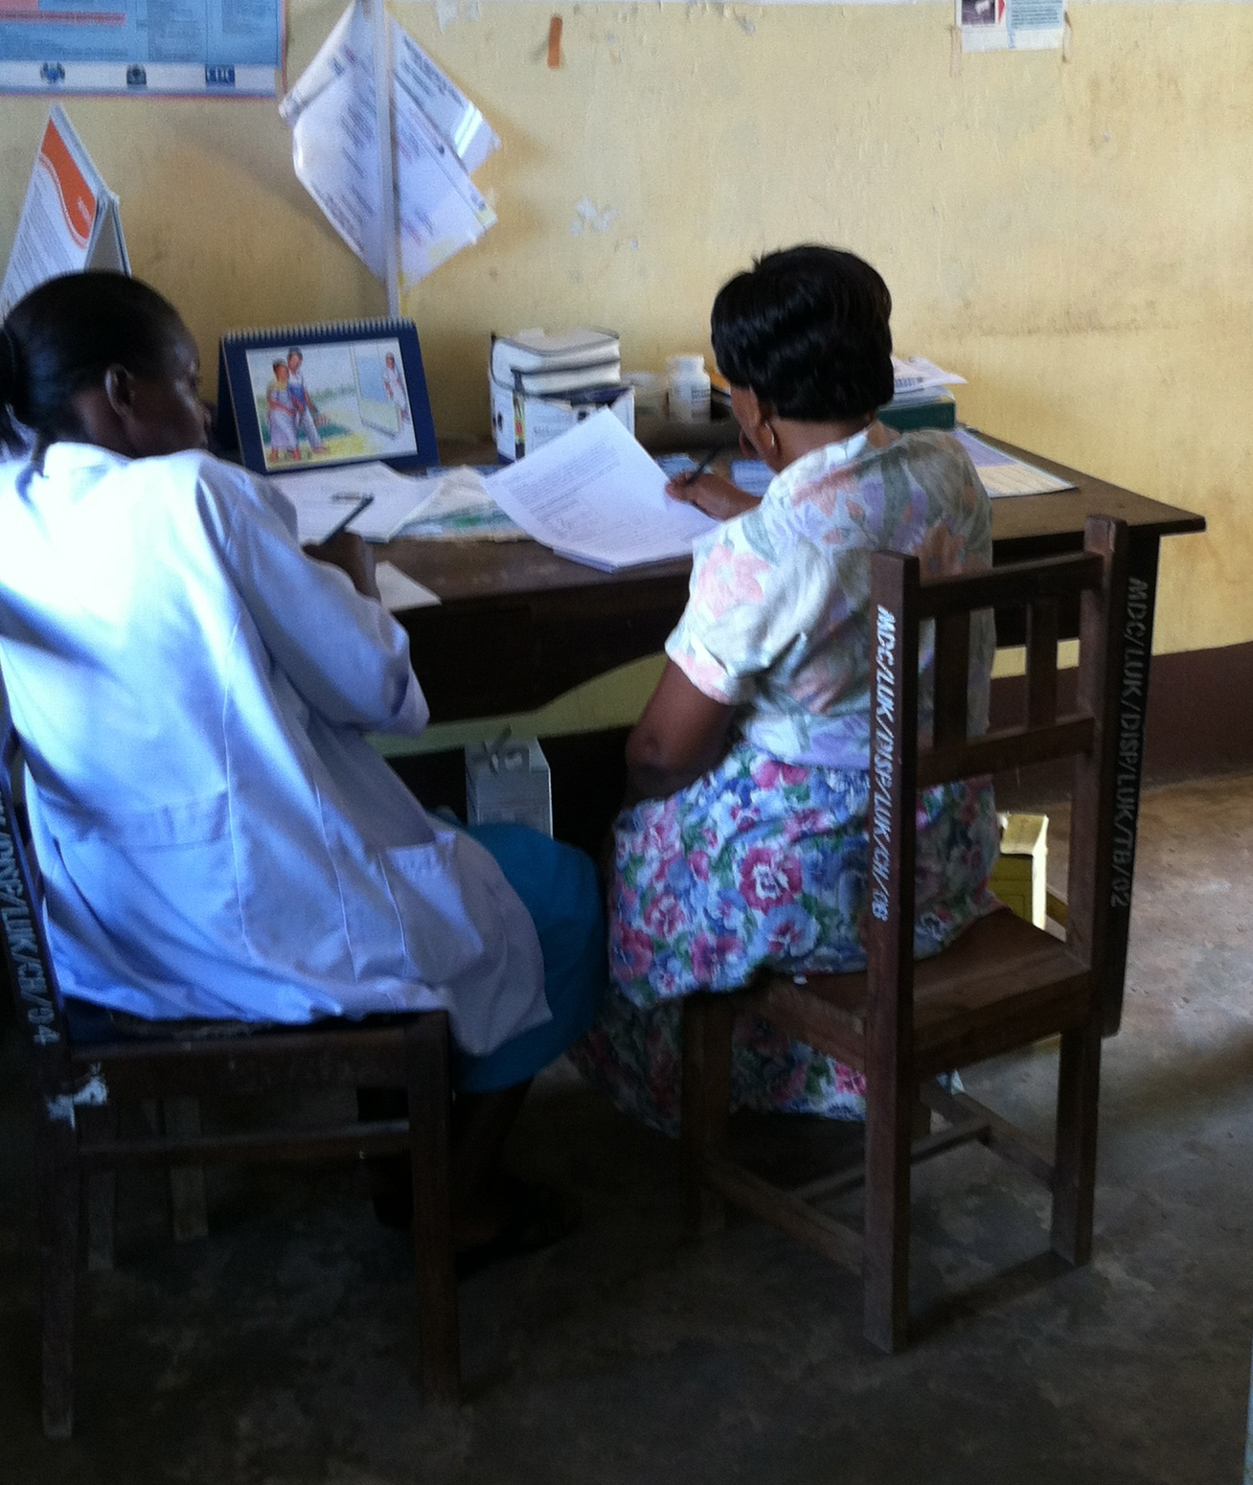
Interpersonal environment
Tools to get the job done
12%: enough staff
3%: enough functioning equipment/infrastructure
73%: had freedom to make important decisions
67%: felt opinions were respected
Notes:
Providers tended to be more satisfied with the environment in which they worked compared to the tools of their job: 73.4% of providers strongly agreed that they had the freedom to make important decisions and 67.2% felt that their opinions were respected, but only 12.5% strongly agreed that there were enough staff and only 3.1% strongly agreed that there was enough functioning equipment and infrastructure.

Slide 14
Providers strongly agreeing they have adequate education
Notes:
While providers seem to be satisfied with their training, their results from the knowledge test that Redempta showed demonstrate that there are knowledge deficiencies. The trained providers only scored 45% on average. Education may be affecting motivation in ways they don’t realize.

Slide 15
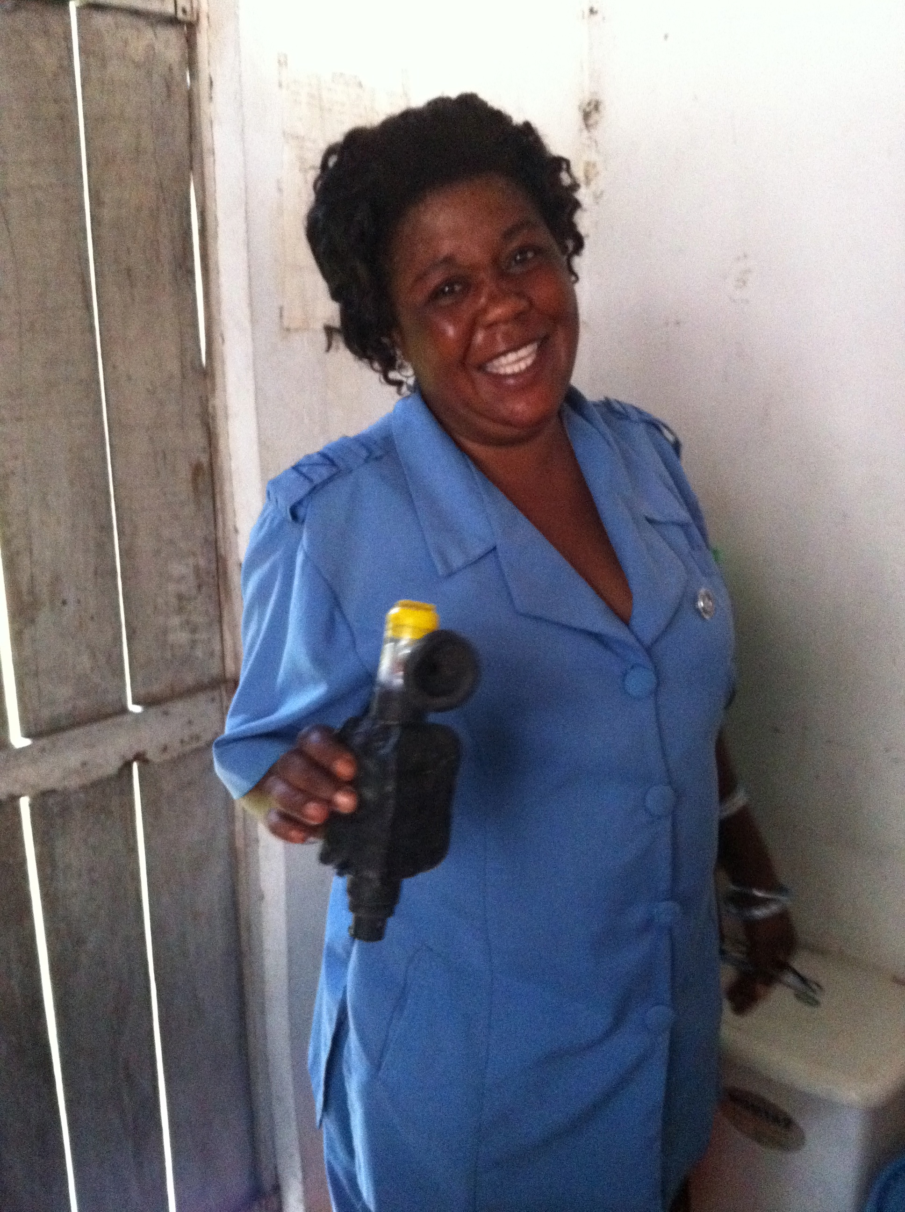
Conclusions
Tools needed for work + Positive interpersonal environment = Motivated providers
Notes:
Supporting healthcare providers with the tools they need to get the job done and a positive interpersonal environment can help motivate them, increasing their job satisfaction and potentially leading to improved quality of care and increased utilization of the healthcare system!

Slide 16
Implications
“tools of the job” are essential for patient care AND provider motivation
Notes:
We need to think about “tools of the job”, like equipment & supplies, as not just essential for patient care, but also for provider motivation

Slide 17
Future Research
Rigorous research into the associations between provider motivation and quality of care or outcomes
Assess correlation of the subscales with patient quality indicators
Assess changes of providers’ motivation overall with introduction of QI interventions

Slide 18
Thank you!

