Slide 1
May Measurement Month 2017
An analysis of blood pressure screening results in the United Kingdom and Republic of Ireland
Francesco P Cappuccio, MD DSc FRCP FFPH FBIHS FESC FAHA
President
British and Irish Hypertension Society
University of Warwick, Warwick Medical School, Coventry

Slide 2
A GLOBAL BURDEN
Raised blood pressure continues to be the biggest contributor to the global burden of disease and to global mortality, leading to 10.7 million deaths each year.¹
In the UK and RoI, age-standardised prevalence of hypertension in 2014 were 15.2% and 27.9%, respectively.²
In the Health Survey for England, however, in 2011, the prevalence of hypertension was already recorded at 30% (32% in men and 28% in women).³
¹Poulter et al. Lancet 2015; ²WHO Global Health Observatory; ³Falaschetti et al. Lancet 2014.

Slide 3
BUT THERE IS LOW AWARENESS
Less than ½ of people with high blood pressure
know they have it!
Hypertension: Awareness, Treatment & Control† by National Income: 2003 – 2009. PURE Study
Income level | n | Aware (%) | Treated (%) | Controlled (%)
High | 6263 | 49.0 | 46.7 | 19.0
Upper Middle | 18123 | 52.5 | 48.3 | 15.6
Lower Middle | 23269 | 43.6 | 36.9 | 9.9
Low | 10185 | 40.8 | 31.7 | 12.7
Total | 57840 | 46.5 | 40.6 | 13.2
Chow et al. JAMA 2013
† <140/90

Slide 4
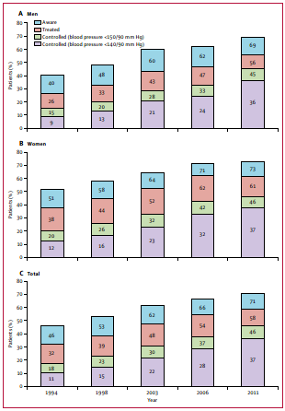
Hypertension management in England from 1994 to 2011
In the period 1991 to 2011:
the prevalence of hypertension remained at 30%
awareness improved from 46% to 71%
BP treatment increased from 32% to 58%
However, BP control improved from 11% to 37% to tight targets and from 18% to 46% to Audit targets
Still, more than half of hypertensives do not have BP controlled
Falaschetti E et al. Lancet 2014

Slide 5
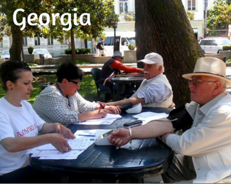
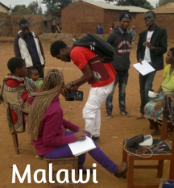
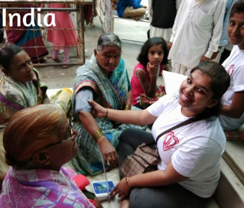
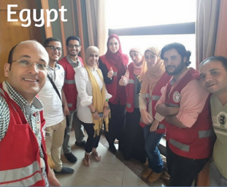
SO IN 2017, MMM WAS LAUNCHED
May Measurement Month (MMM) is an initiative led by the International Society of Hypertension (ISH) aimed at raising awareness around blood pressure worldwide and took place for the first time during May 2017.

Slide 6
Aims and objectives
AIMS
To highlight the importance of measuring blood pressure
OBJECTIVES
To recruit participants, aged > 18 years, who ideally have not had their BPs measured in the previous 12 months
To supply diet and lifestyle treatment advice to all those screened who have BPs in the Hypertensive range
To use the data on untreated hypertension to motivate governments to improve screening facilities and policies

Slide 7
Design: mmm Questionnaire & BP measurement
The MMM Questionnaire was designed to anonymously capture key information pertaining to hypertension
The Questionnaire was available to screening sites in 3 formats; via MMM WebApp, Excel or in hard copy via a printable Word doc
Participating Countries were required to use automated electronic devices or conventional sphygmomanometers
Countries with limited BP equipment were offered new devices donated by Omron UK to the campaign
Blood pressure was measured using a standardised methodology with training videos, manuals and support material available to all volunteers
Mean of 2nd and 3rd BP reading used in analyses. Imputed when not available

Slide 8
CHARACTERISTICS OF THE PARTICIPANTS IN THE UNITED KINGDOM AND REPUBLIC OF IRELAND IN MMM17
TOTAL United Kingdom England Wales Scotland Northern Ireland Republic of Ireland Unreported | 7,714 4,935 (64.0%) 1,689 1,233 1,755 258 2,661 (34/5%) 118
Men Women | 38.9% 60.7%
Ethnicity White Black South Asian East Asian Other | 71.9% 3.3% 3.7% 1.6% 19.5%
Age (yrs) | 49.8 (sd 16.8)
BMI (kg/m²) | 26.5 (sd 5.1)
Smokers | 13.1%
On BP Rx | 21.9%
Diabetes | 5.1%
Previous M.I. | 2.3%
Previous stroke | 2.0%

Slide 9
LEVELS OF AWARENESS, MANAGEMENT AND CONTROL OF HYPERTENSION IN MMM17 (UK AND ROI)
Total sample (n=7,695 after imputation)
Hypertensives
3,099 or 40.3%
Not on Rx
1,406 or 45.5%
(23.4% of total)
On Rx
1,683 or 54.5%
Normotensives
4,596 or 59.7%
Controlled
1,001 or 59.5%
Uncontrolled
682 or 40.5%
(22.1% of hypertensives)

Slide 10
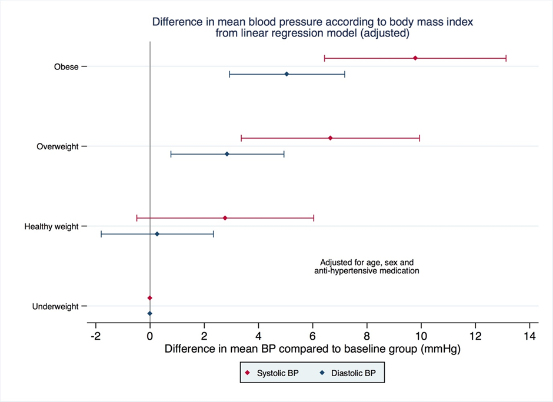
DIFFERENCE IN MEAN BP ACCORDING
TO BODY MASS INDEX

Slide 11
SUMMARY
MMM17 the largest synchronised standardised multinational screening of any CV risk factor.
MMM17 largest BP screening campaign undertaken in the UK and Republic of Ireland.
Relatively inexpensive (at <1$ per ‘case’ the campaign was cost-effective).
Volunteer-based observers, convenience community sampling.
Identification of 40% of hypertensives, 1 in 4 not receiving treatment.
Of those receiving treatment, 2 out of 5 still do not have their BP controlled.
Overweight and obesity are still major determinants of high BP in the community.

Slide 12
