Slide 1

Non-scientific threats to public health policies
Campbell NRC ¹ Cappuccio FP ³
He FJ ² MacGregor GA ²
¹ University of Calgary, Alberta, Canada
² Barts and The London, Queen Mary University of London, United Kingdom
³ University of Warwick, WHO CC for Nutrition, Coventry, United Kingdom
Prepared from Current Nutrition Reports 2021; on-line June 19.

Slide 2
Declarations
Campbell reports personal fees from Resolve to Save Lives (RTSL) and the World Bank. Unpaid member of World Action on Salt, Sugar and Health and unpaid consultant on dietary sodium and hypertension control to numerous governmental and non-governmental organizations. Unpaid Chair of the International Consortium for Quality Research on Dietary Sodium/Salt (TRUE).
He is unpaid member of Action of Salt and World Action on Salt, Sugar and Health. She is partially funded by the NIHR and the MRC.
Cappuccio reports speaker fees from Omron Healthcare and book royalties from OUP, both for unrelated topics. Immediate Past-President of the BIHS (2017-19). Unpaid member of Action on Salt, Sugar and Health, and TRUE Consortium, Advisor to the World Health Organization and Head of the WHO Collaborating Centre for Nutrition at the University of Warwick.
MacGregor is unpaid Chair of Action on Salt, Sugar and Health, World Action on Salt, Sugar and Health, and Blood Pressure UK. He is partially funded by the NIHR and the MRC.

Slide 3
Background
High sodium intake
leading dietary risk for death globally
>1.8m deaths and ~45m DALYs, globally (2019)
raises blood pressure (BP)
High BP(or hypertension) first cause of cardiovascular disease (CVD)
Reducing high BP reduces risk of death, morbidity and disability from CVD
A reduction in dietary sodium in the range 2,300-4,100mg/day (equivalent to 5.75-10.25g of salt/day)
lowers BP
lowers CVD and total mortality
global health organizations support public health policy to reduce sodium consumption in populations to help prevent CVD.
WHO recommends to reduce sodium consumption by 30% by 2025, aiming at <2,000mg per day (<5g of salt per day).

Slide 4
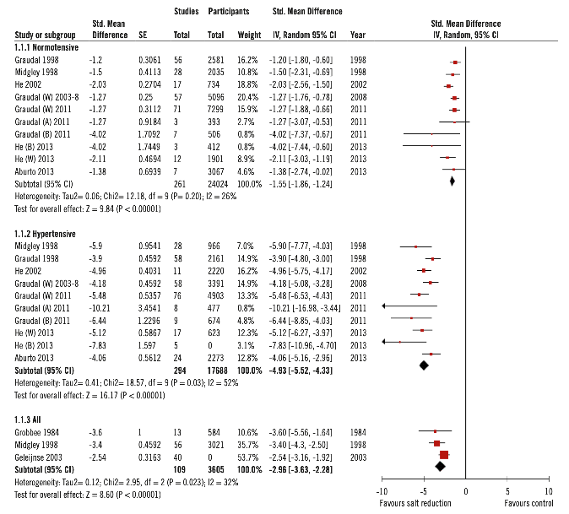
Consensus: A reduction in sodium intake lowers BP
Summary of
meta-analyses
of RCTs
European Heart Network, 2017

Slide 5
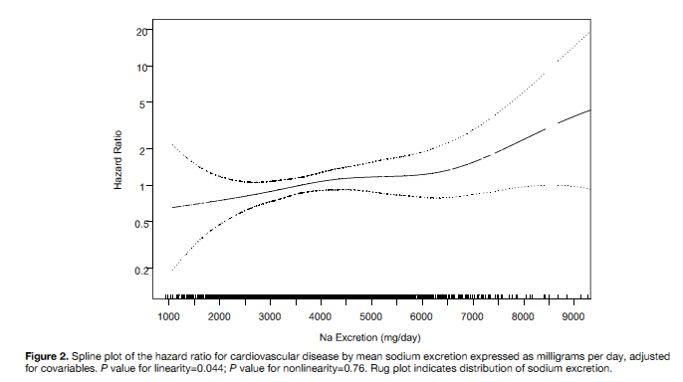
‘Graded and linear’ association between sodium intake and outcomes
Urinary sodium measured with repeated 24h urine collections
Cardiovascular disease
All-cause mortality
Cook NR et al. Circulation 2014; 129: 981-9
Cook NR et al. J Am Coll Cardiol; 2016; 68: 1609-17
Notes:
In further prospective studies, the relationship between salt consumption, measured by multiple 24h urine collections for sodium determination, and both cardiovascular outcomes (LEFT PANEL) and all-cause mortality (RIGHT PANEL) proved to be graded and linear across the range of salt consumption seen in most populations.

Slide 6
Salt reduction lowers cardiovascular risk:
meta-analysis of outcome trials
Intake-response meta-analysis for CVD risk in the range of sodium intake 2,300-4,100 mg/day
Stallings VA et al. US National Academy of Sciences (2019)
Notes:
Finally, few randomized clinical trials where it was possible to measure the effect of a period of salt reduction on vital cardiovascular outcomes, clearly indicate a statistically significant 20% reduction in total cardiovascular events, as predicted from observational studies.

Slide 7
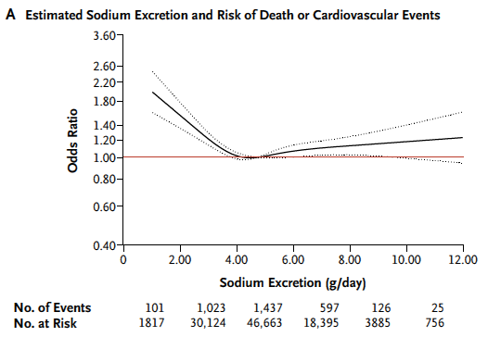
Controversy: reducing sodium intake will increase risk of death
5-10g salt/day
O’Donnell M et al. et al. NEJM 2014:371:612-23

Slide 8
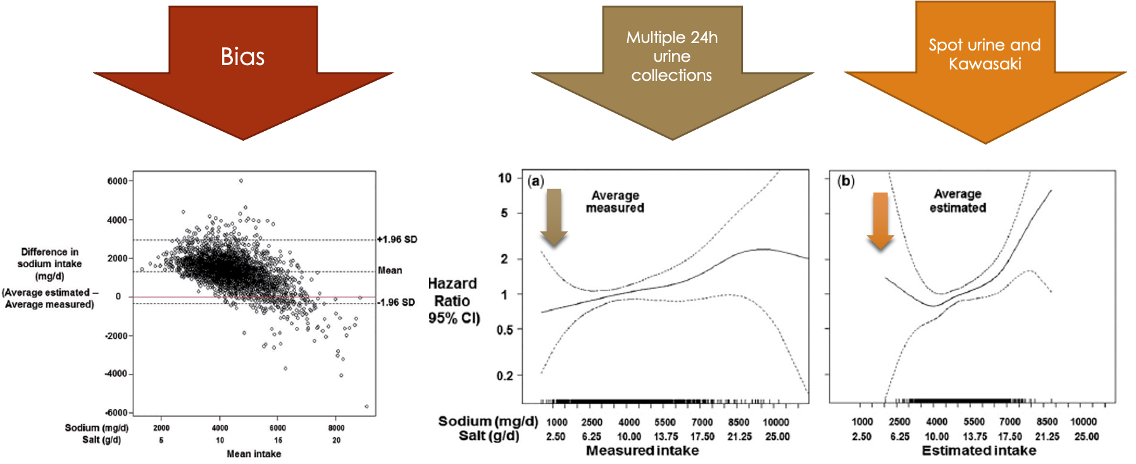
Concerns about advocacy ‘against’ reducing dietary sodium intake.
Use of inappropriate research methods and lack of rigor in research
Low-quality or inappropriate methods and research designs prone to spurious results.
Example: the use of formulas to estimate sodium excretion (as measure of intake) from spot urine collections produces biased estimates that alter the relation between sodium and outcomes (He FJ et al. Int J Epidemiol 2018; 47: 1784-95).

Slide 9
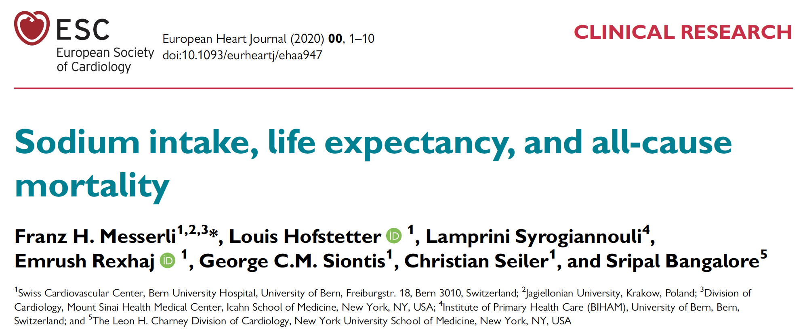
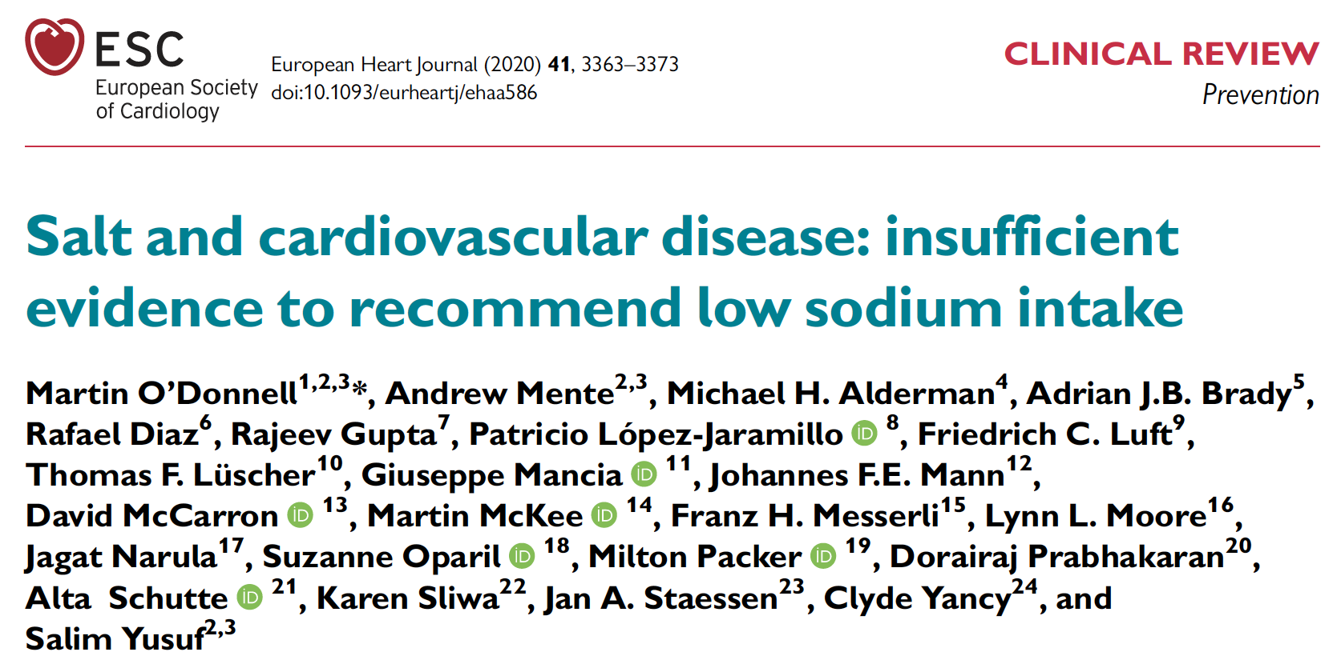
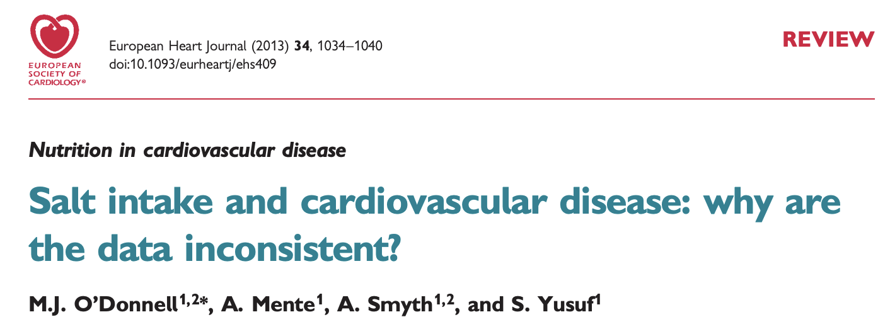
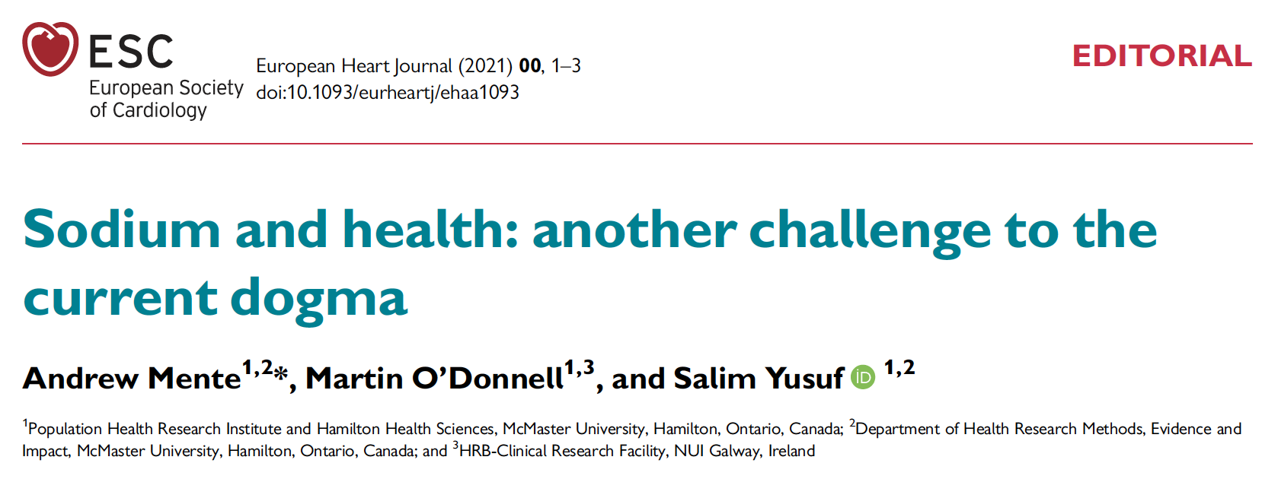
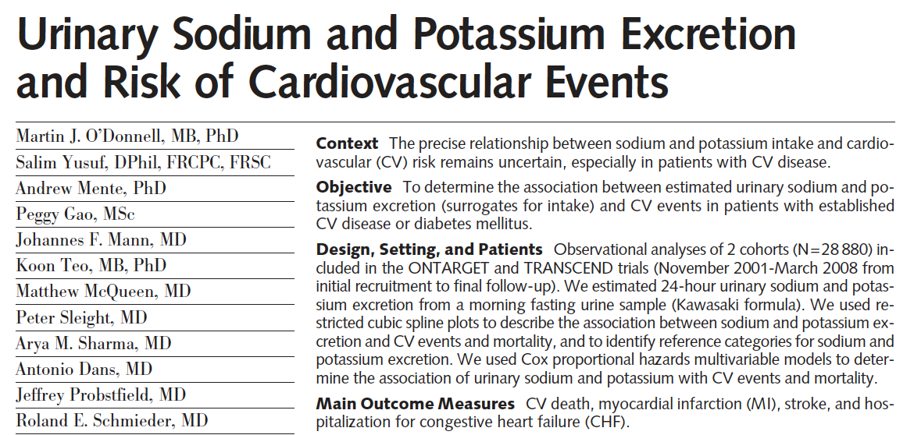
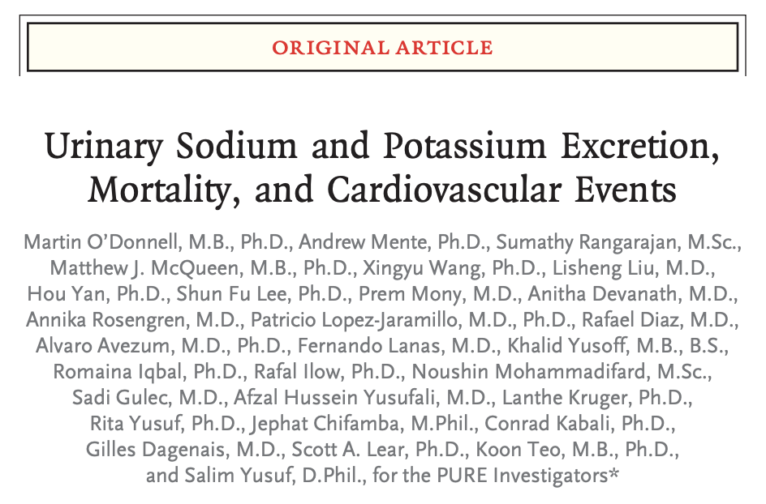
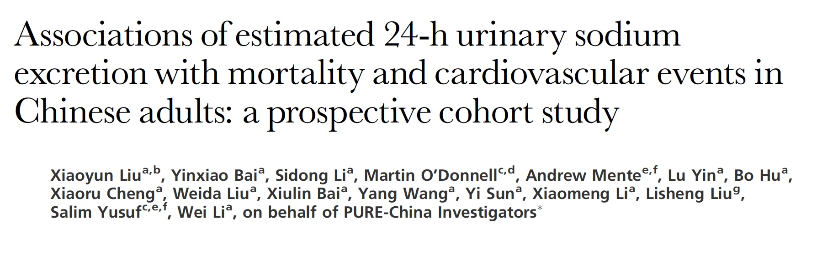
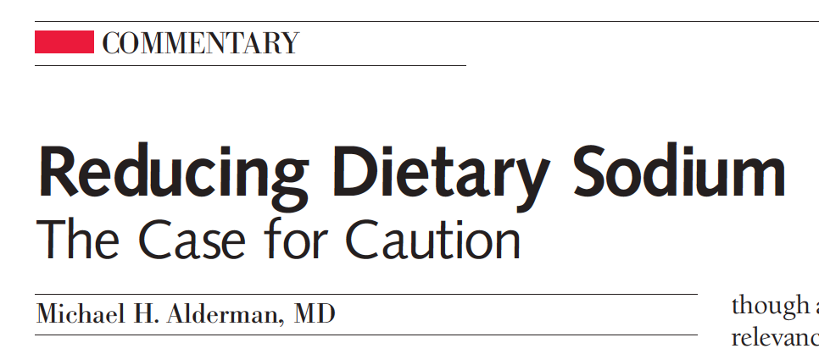
Concerns about advocacy ‘against’ reducing dietary sodium intake.
Nevertheless, studies of low quality are numerous and often in high-impact journals, bypassing critical reviews, even featuring Editorials by dissenting scientists with known (often undeclared) CoI.
Journal of Hypertension 2021, 39:484–493
JAMA, Feb 3, 2010 – vol.303, No.5, 448-9
JAMA, November 23/30, 2011—Vol 306, No. 20
N Engl J Med 2014;371:612-23

Slide 10
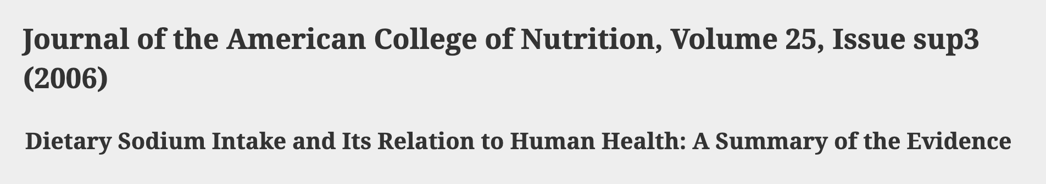
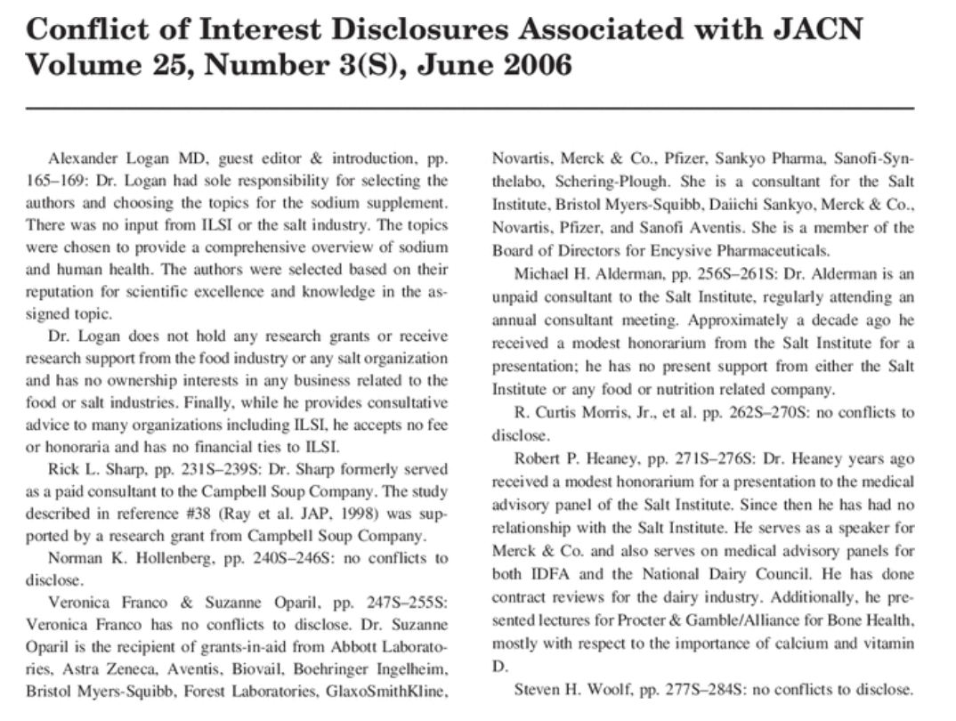
Concerns about advocacy ‘against’ reducing dietary sodium intake.
Conflicts of Interest and Commercial Bias
Example: JACN supplement 2006; 25(3) funded by industry, participants advisors and consultants for food industry, no disclosures provided.
Although omissions violated journal policies, identified and notified to Editor, no corrective action by the journal other than post-hoc disclosure by the publisher in 2013 (!).
Lack of public access to data supporting research
Some databases from studies claiming adverse effects of sodium reduction are not publicly available, although mostly publicly funded, hence results cannot be independently verified (e.g. recent refusal from the PURE Study).
In one case (NHANES III), where independent verification was carried out, the original spurious result was identified (J Gen Int Med 2008;23:1297; Arch Int Med 2011;171:1183).
In one instance a standard formula to assess urine completeness was altered inflating the proportion of complete samples and data on validation not disclosed even after request (Int J Epidemiol 2016; 46: 362, 367 and 2018; 47: 670, 673).

Slide 11
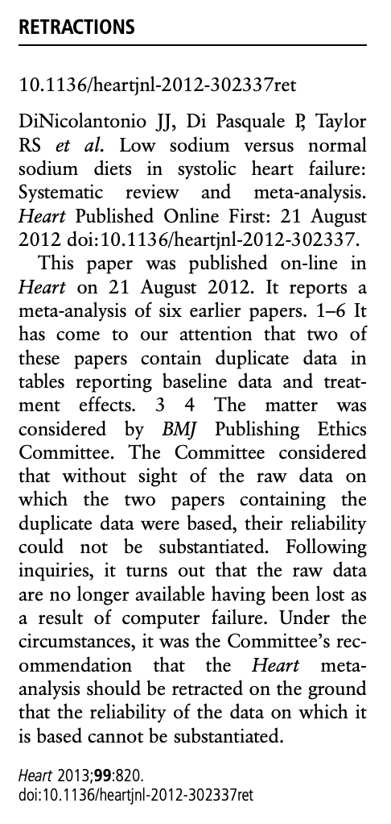
Concerns about advocacy ‘against’ reducing dietary sodium intake.
Scientific and Professional conduct
Responsible granting agencies and scientific and ethics review processes approving weak and inappropriate research designs (e.g. post-hoc secondary analyses not originally planned and reviewed by granting and ethics committees).
Journals delay in investigating, and where needed, retracting papers based on dubious or fabricated data. Once retracted, cited in support of controversial views even after retraction date (e.g. Sodium intake in heart failure. Heart 2013; 99: 820)
Failure of peer-review system, lack of scientific rigor and professional conduct of authors and journals.
Journal, Granting Agencies, Research and Ethics Committees
Outright rejection of correspondence to Editor pointing to serious methodological flaws and false statements in published manuscripts.
Flawed evidence used in introductions, reviews and presentations, supporting the aura of controversy and encouraging polarizations.
In one case, we were unable to confirm or refute if a grant agency had received, reviewed and approved plans for specific secondary analyses.

Slide 12
Concerns about advocacy ‘against’ reducing dietary sodium intake.
Health and Scientific Organizations
Debates on dietary sodium as platforms for low-quality research and erroneous and misleading statements.
False sense of equipoise and credibility for dissenting scientists, creating an aura of controversy.
By allowing “equal representation” these debates “…only succeed in creating false equivalence” between two sides of an issue (polarization) even when there is only one credible side. (McIntyre L. Post-Truth. MTP Press 2018).
Dissenting scientists achieve high-level positions in these organizations, some using them as platforms to advocate against dietary sodium.
Governments
Complacent about threats to evidence-based public policy.
Industry lobbying delays or deters policy implementations, despite clear evidence to the contrary.

Slide 13
Action to support evidence-based dietary sodium public policies
In nutritional science, long-standing lack of ethical guidance for all stakeholders.
Many millions of lives at stake -> guidance on standards of acceptable and unacceptable conduct needed.
Academic organizations: strict guidelines on (i) research funding and (ii) personal financial gain from those opposing important public policies such as reducing sodium intake and reducing tobacco use.
Funding bodies: (i) rigorous designs and methods, (ii) accessible databases in areas of research impacting public policy such as dietary sodium; (iii) invest in scientific impact of financial interests, low research quality, misinformation, professional conduct.
Editors: sometimes negligent in publishing low-quality research on dietary sodium. Update and Enforce guidelines on Publication Ethics (see COPE and Individual Journals’ policies).

Slide 14
Conclusions
We discussed experiences and observations that relate to undermining the evidence supporting a moderate reduction in dietary sodium as a public health policy to reduce the burden of CVD, first killer in the world.
We reported concerns that plague science even outside the health field (e.g. climate change).
We raised issues critical for society to address, to maintain public trust.
We share with many scientists the desire to discover the true relationship between sodium intake and health outcome, particularly given that millions of lives are at risk.
We all play a role in safeguarding science. We need to collaborate with ethics groups to develop, implement and enforce higher standards to safeguard public policy.

Slide 15
Thank you

