Slide 1
Hypertension – how to detect, investigate and manage
NICE (NG136, 2019)
Francesco P Cappuccio, MD MSc DSc FRCP FFPH FBIHS FAOP FAHA FESC
Professor of Cardiovascular Medicine & Epidemiology,
University of Warwick
Consultant Physician, UHCW NHS Trust
Past-President
British and Irish Hypertension Society (2017-19)
GP Gateway: Hypertension
https://www.coventryrugbygpgateway.nhs.uk/pages/hypertension/

Slide 2
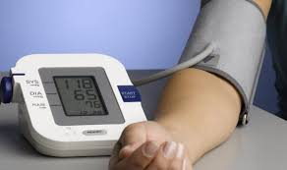
Synopsis
What is new or updated ?
diagnosing hypertension
starting antihypertensive drug treatment
monitoring treatment and blood pressure targets
choosing antihypertensive drug treatment (steps 1 to 4)
who to refer for same-day specialist review
What is unchanged ?
measuring blood pressure
assessing cardiovascular risk and target organ damage
lifestyle interventions

Slide 3
Important warning!
NG136, 2019 may not apply to adults with
CKD
Type 1 diabetes
Pregnancy
Pre-existing cardiovascular disease
Need to cross-referencing to specific NICE guidelines
CKD in adults: assessment and management (CG182, 2014)
Type 1 diabetes in adults: diagnosis and management (NG17, 2015)
Hypertension in pregnancy: diagnosis and management (NG133, 2019)
Multimorbidity: clinical assessment and management (NG56, 2016)

Slide 4
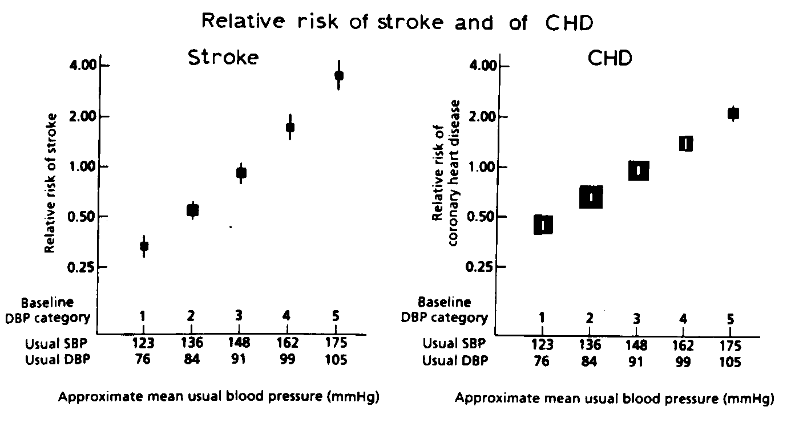
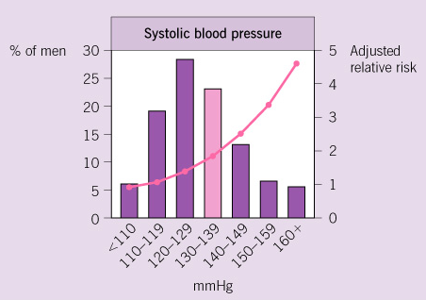
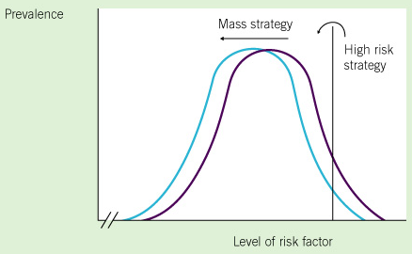
Definition of hypertension
Blood pressure (BP) normally distributed in the population (bell-shaped curve).
The higher the BP the greater the risk of CV events (strokes and MI).
BP lowering causes a reduction in the risk of CV events.
Hypertension …. a blood pressure level above which investigation and treatment do more good than harm (G Rose 1971)
Definition changes with time and between countries.
Drug v non-drug therapy: ‘high-risk’ v ‘population’ approach

Slide 5
Why bother?
3/5 deaths in the UK are from vascular disease
blood pressure predicts risk of vascular disease
risks of high blood pressure can be reversed by treatment

Slide 6
Long term consequences of uncontrolled high blood pressure
Myocardial Infarction; Arrhythmias; Atrial Fibrillation; Heart Failure; Cardiomyopathy.
Stroke (Ischaemic, Haemorrhagic)
Kidney Failure
Retinopathy
Peripheral Vascular Disease
Notes:
Hypertension may damage all blood vessels of the body, large, medium and small, and therefore, the subsequent reduction in blood flow and oxygen supply will damage all organs provided by such vessels. Target organs, therefore, are typically the heart, the brain, the kidneys, the eye and the other large vessels outside these organs.

Slide 7
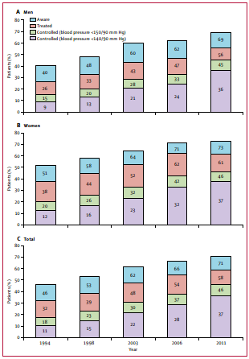
Hypertension management in England from 1994 to 2011
In the period 1991 to 2011:
the prevalence of hypertension remained at 30%
awareness improved from 46% to 71%
BP treatment increased from 32% to 58%
However, BP control improved from 11% to 37% to tight targets and from 18% to 46% to Audit targets
Still, more than half of hypertensives do not have BP controlled
Falaschetti E et al. Lancet 2014

Slide 8
Hypertension control in the UK
*self-reported in Biobank
**<140/90mmHg
Percentage
Tapela N, et al. OpenHeart 2021; 8: e001461
NCD-RisC. Lancet 2019; 394: 639-51

Slide 9
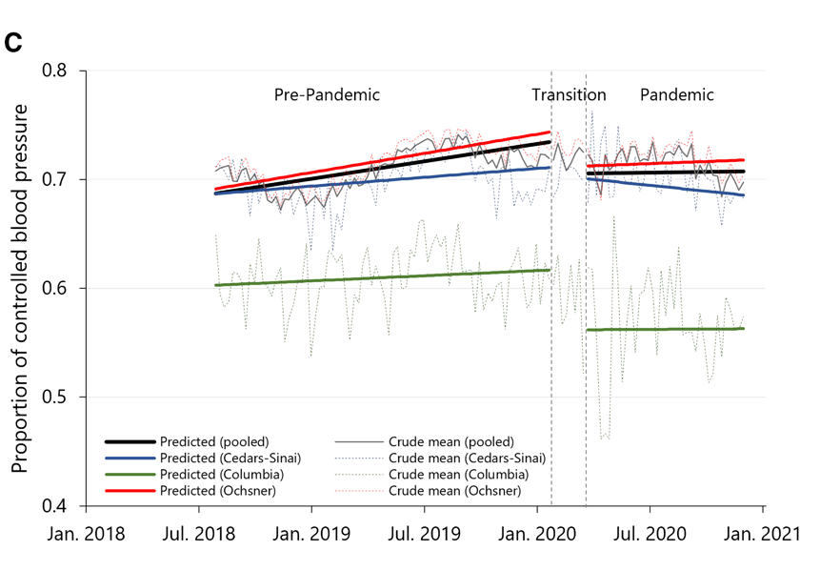
Impact of COVID-19 pandemic on hypertension control
Data from Electronic Records of 3 large US health care systems
N=137,593 adults with hypertension - interrupted time-series analysis
During the pandemic
% of controlled* HPT fell by 3.43%
SBP rose by 1.79mmHg
DBP rose by 1.30mmHg
Trend of increasing control flattened
*<140/90mmHg
Gotanda H, et al. Hypertension 2022; 79: 2733-42

Slide 10
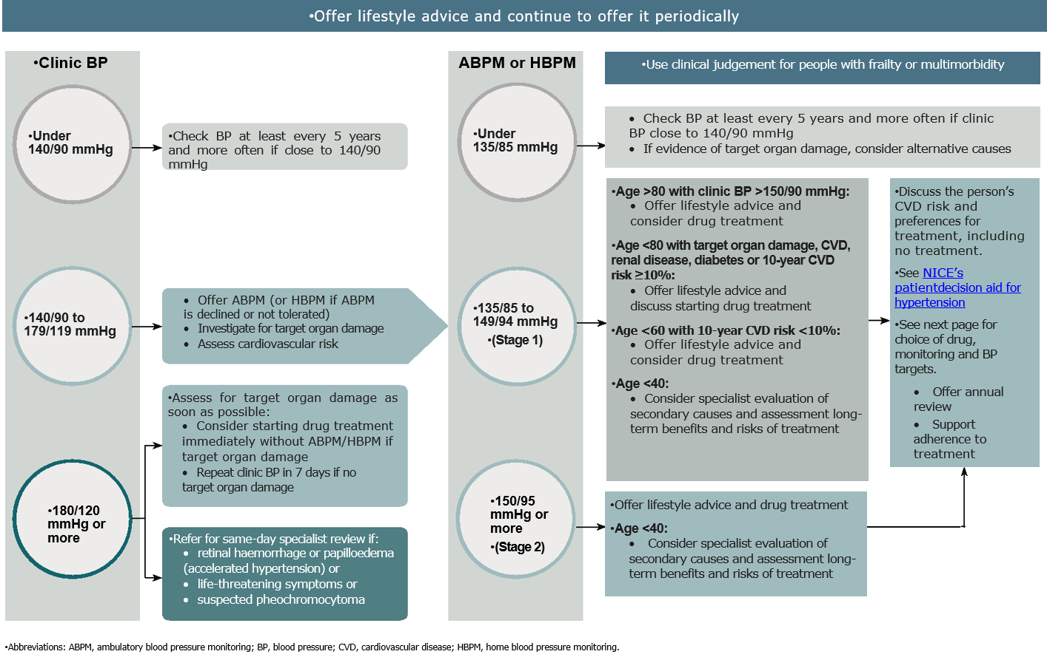
1. Diagnosing hypertension
 | Office BP (mmHg) | ABPM or HBPM (mmHg)
Normal | < 140/90 | < 135/85
Stage 1 | 140/90 to 159/99 | 135/85 to 149/94
Stage 2 | 160/100 to 179/119 | > 150/95
Stage 3 | SBP >180 or DBP >120 | -

Slide 11
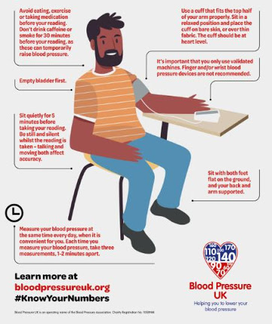
1. Diagnosing hypertension
Accurate BP measurement paramount!
Measure BP in both arms * if Δ>15 mmHg, repeat * if still different, use arm with higher readings
If BP >140/90, take 3 readings, average the last 2 readings as the Office BP
If BP >140/90 <180/120, confirm with ABPM or HBPM (using standard protocol)
Investigate for TOD (urinary protein, HbA1c, fundi, ECG) and assess CV Risk (QRISK-2)
Consider the need for specialist investigations in people with signs and symptoms suggesting a secondary cause of hypertension. [2004, amended 2011]
Notes:
No food, coffee, exercise, Rx, cigarettes 30 min before BP
Empty bladder
Sit quietly for at least 5min – no chatting-talking
Sit with feet flat on ground, back and arm supported
Use validated devices and appropriate sized cuff on bare skin – no fabrics – palm up

Slide 12

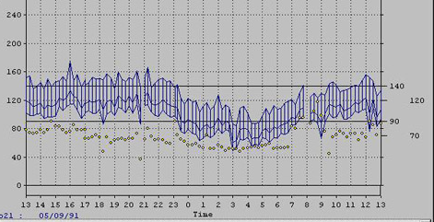
Hypertension
Hypertension
Morning rise
Hypertension
Nocturnal
dip

Slide 13
‘day-time’ Office BP vs ABPM
Hypertensive
Masked
White Coat
Normotensive

Slide 14
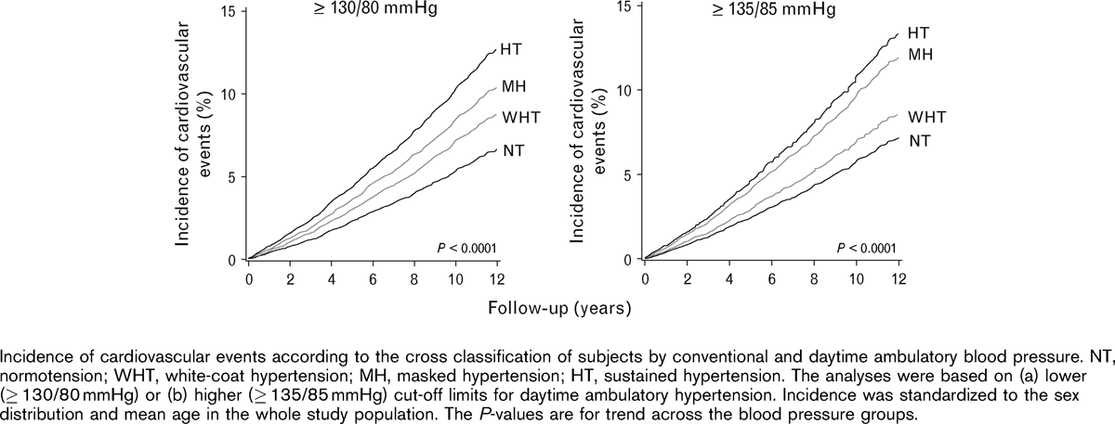
CVD risk by ABPM categories
Hypertension
Masked
White-coat
Normotensive
Follow-up (years)
Hansen TW et al. J Hypertens. 2007;25(8):1554-64.

Slide 15
Mrs JR, 61 years (a)
Retired secretary, living with husband
Non-smoker; ETOH: <5 units/wk; no LTPA; adds Salt to food; sleeps ~7-8 hpn
FH: Father T2D and hypertension + fatal MI at 63
BMI 45.3 kg/m²
Office BP: 142/94 mmHg (three readings in sitting position); HR 105 bpm reg (confirming previous office readings)
Notes:
Obesity
High DBP confirmed twice on different occasions

Slide 16
Mrs JR, 61 years (b)
Investigations
Urinary protein: 2+
HbA1c 60; FBG 7.9; TC 4.0; U+Es: normal
Echo-cardiogram: LVH
24 ABPM: 147/89 day-time; 139/85 night-time (non-dipper)
RX: Metformin 500mg bd
Atorvastatin 20mg od
a. Would you start drug therapy?
Notes:
Stage 1 hypertension on ABPM
TYPE 2 diabetes
TOD: LVH + Proteinuria
ACEi or ARB ideal start as T2D with proteinuria – age does not matter !
Start therapy

Slide 17
2. Starting antihypertensive drug treatment
Offer drug treatment
at any age in persistent Stage 2 hypertension
<80 years in persistent Stage 1 hypertension with one or more of the following:
Target organ damage (e.g. LVH, proteinuria, fundi changes, high HbA1c, reduced eGFR etc)
Renal disease or diabetes
Established cardiovascular disease
Estimate 10-y risk of CVD >10% (QRISK2)
Use clinical judgement if frailty or multimorbidity

Slide 18
2. Starting antihypertensive drug treatment
Consider treatment
<60 years and Stage 1 hypertension with QRISK2 <10%
<80 years and Stage 1 hypertension if Office BP >150/90 mmHg
<40 years, consider seeking specialist advice
Consider the need for specialist investigations in people with signs and symptoms suggesting a secondary cause of hypertension.

Slide 19
Mrs JR, 61 years (a)
Investigations
Urinary protein: 2+
HbA1c 60; FBG 7.9; TC 4.0; U+Es: normal
Echo-cardiogram: LVH
24 ABPM: 147/89 day-time; 139/85 night-time (non-dipper)
RX: Metformin 500mg bd
Atorvastatin 20mg od
Losartan 100mg od added on
b. How would you monitor treatment?
c. How would you monitor BP targets?

Slide 20
3. Monitoring treatment
Use office BP measurements to monitor the response to Rx
Measure standing as well as seated BP in people with
type 2 diabetes or
symptoms of postural hypotension or
aged 80 and over.
In people with postural drop or symptoms of postural hypotension, treat to a BP target based on standing BP
Consider ABPM or HBPM, in addition to office BP, for people identified as having a white-coat or masked hypertension
NG136, 2019 may not apply to adults with CKD, type 1 diabetes, pregnancy, pre-existing CVD (cross-referencing to specific NICE guidelines)

Slide 21


3. BP targets
Reduce office BP to
When using ABPM or HBPM use the average ‘day-time’ BP
Use clinical judgement for people with frailty or multimorbidity
same targets in people with type 2 diabetes
Age <80 years
<140/90
Age >80 years
<150/90
Age <80 years
<135/85
Age >80 years
<145/85
NG136, 2019 may not apply to adults with CKD, type 1 diabetes, pregnancy, pre-existing CVD (cross-referencing to specific NICE guidelines)

Slide 22
Mr BS, 74 years (b)
Emergency admission to MDU for Orthostatic hypotension.
Co-morbidities: Depressive episodes; Essential hypertension; History of self-harm; cardiac and vascular implants and grafts.
Clinical summary
Referred via GP following high BP readings (212/110 mmHg) and 10-day history of dizziness on standing.
BP on admission 208/95 mmHg
Home BP the day before admission 170/53 mmHg
Fluctuations in BP 2 years earlier with admission
Current therapy: Perindopril (no dose reported)

Slide 23
Mr BS, 74 years (c)
Actions
Bloods: NAD
Stop Perindopril
Start Doxazosin 2 mg BD
Advised to monitor BP at home
To see GP next week
To be seen in Hypertension Clinic in 4 weeks
Any comments?
Notes:
Pt 74 reporting orthostatic hypotension –
doxazosin not indicated
never doxazosin as monotherapy
Amlodipine?

Slide 24
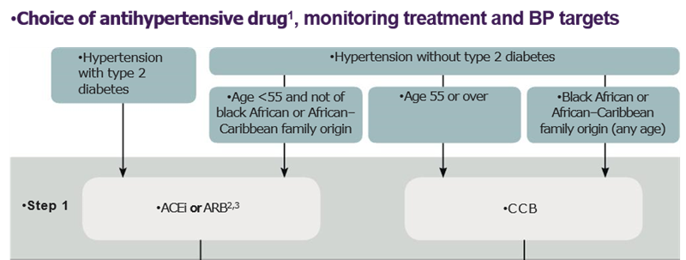
4. Choosing antihypertensive drug treatment
Choosing drugs for newly diagnosed patients: step 1
NICE Hypertension on adults NG136 (August 2019)

Slide 25
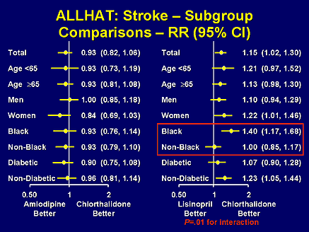
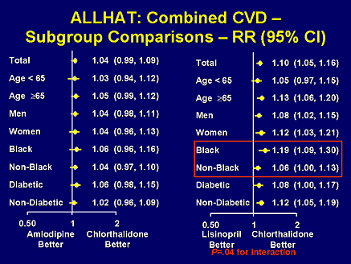

ALLHAT: effects of mono-therapy by ethnic background
CCB vs Diuretic
ACE-i vs Diuretic
CCB vs Diuretic
ACE-i vs Diuretic
Doxazosin monotherapy arm stopped early due to excess heart failure deaths!
ALLHAT. J.A.M.A. 2002; 288: 2981-97

Slide 26

Multiple agents are needed to reach BP goal
Trial (SBP achieved)
ASCOT-BPLA (136.9 mmHg)
ALLHAT (138 mmHg)
IDNT (138 mmHg)
RENAAL (141 mmHg)
UKPDS (144 mmHg)
ABCD (132 mmHg)
MDRD (132 mmHg)
HOT (138 mmHg)
AASK (128 mmHg)
1
2
3
4
Average no. of antihypertensive medications
Adapted from Bakris et al. Am J Med 2004;116(5A):30S–8
Dahlöf et al. Lancet 2005;366:895–906
Notes:
Major clinical trials have demonstrated that patients typically needed treatment with multiple antihypertensive agents to get to, and stay at, BP goal.
The number of antihypertensive agents required for BP control in many patients typically averages 2−4, with co-morbid conditions (such as kidney disease or diabetes mellitus) imposing greater drug requirement.¹
For example, in the Hypertension Optimal Treatment (HOT) study, an average of 3.3 drugs were required to attain a diastolic BP goal of <80 mmHg, and in the Anglo-Scandinavian Cardiac Outcomes Trial-Blood Pressure Lowering Arm (ASCOT-BPLA), most patients were taking at least two antihypertensive agents by the end of the trial.^{1,2}

Slide 27
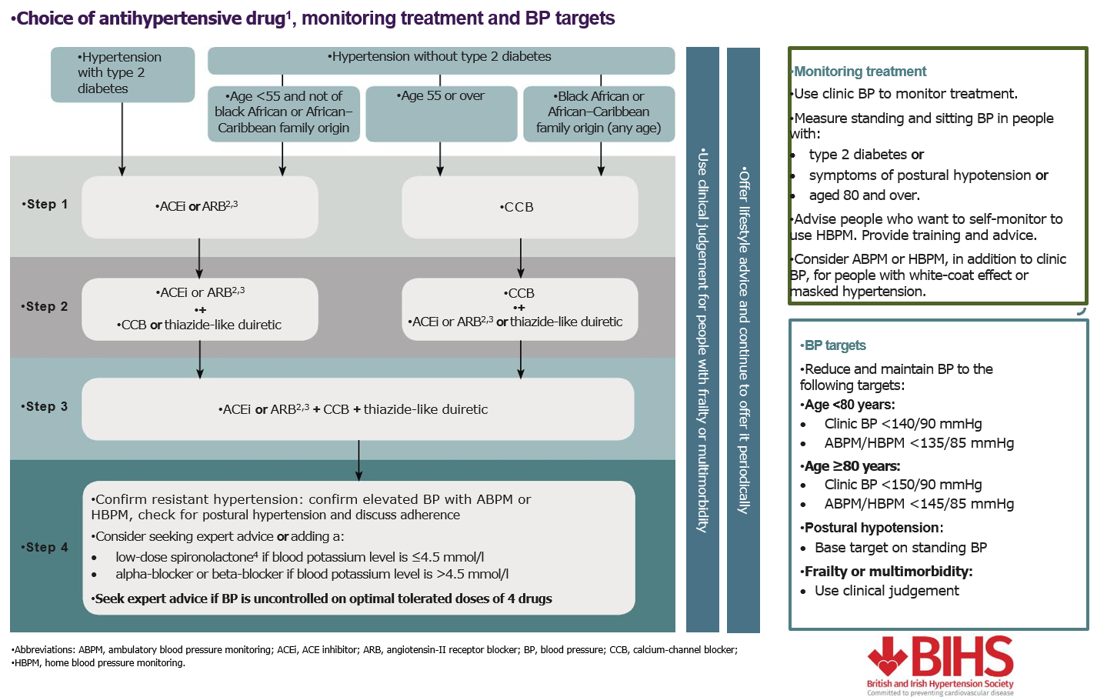
Choosing drugs for combination therapy: step 2
NICE Hypertension on adults NG136 (August 2019)

Slide 28
Choosing drugs for combination therapy: step 3
NICE Hypertension on adults NG136 (August 2019)

Slide 29
Choosing drugs for combination therapy: step 4
NICE Hypertension on adults NG136 (August 2019)

Slide 30
Resistant hypertension: Definition & Estimates
“defined when a patient’s BP is not controlled to recommended BP goals, i.e. <140/90 mmHg, despite treatment with an appropriate combination of three drug therapies, i.e. A+C+D, prescribed at their maximum recommended and/or tolerated doses.”
Not synonymous with uncontrolled BP
Approx. 1.5m people in the UK are on 3+ BP-lowering drugs
55% of them remain uncontrolled (~825,000)
Estimated prevalence of resistant hypertension 0.5 – 1.0m
Most resistant hypertension is due to systolic hypertension

Slide 31
Resistant hypertension: Clinical assessment
BP appropriately measured? (pseudo-resistant)
Could the patient have white coat hypertension? (pseudo-resistant)
Is Rx optimal according to Step 3 of the NICE/BIHS algorithm?
Is the patient adhering to the treatment? (pseudo-resistant)
Is the patient taking other medications that may be contributing to their resistant hypertension? (e.g. OC, NSAIDs, steroids, excess liquorice, cyclosporine, erythropoietin, sympathomimetic agents,…)
Could the patient have a secondary cause of hypertension?
Myat A et al. BMJ 2012;345:e7473

Slide 32
Miss MLE (44 yrs)
1
2
1
2
3
1
2
3
4
1
2
3
4
5
1
2
3
4
5
6
1
2
3
1
2
3
4
1
2
3
10/2009
09/2010
11/2011
05/2012
01-09/2013
10/2014
DNA
DNA
mmHg
Direct observation
Admission
Admission
GTN
Admission
Admission
GTN
D1=Bendrofluazide; D2 = Spironolactone
C1 = Nifedipine m/r; C2 = Amlodipine; C3 = Verapamil SR
A = Olmesartan
X1 = Doxazosin

Slide 33
Mr IMV (43 yrs)
A1 15
C1 2.5
A1 20
C1 10
D1 12.5
B1 50
X1 6
A1 20
C1 10
D1 12.5
B1 100
X1 4
D2 50
X2 10
A2 20
C2 10
D1 12.5
B1 100
X1 4
D2 25
A2 20
C2 10
D2 25
A2 40
C2 10
D2 25
X1 8
D3 2.5
B2 10 x
A3 150 x
A2 40
C4 60 90
D2 100 50
X1 8
D3 2.5
mmHg
b/min
60 60 90 73 82 97 74 70 93
mmHg
D1=HCTZ; D2 = Spironolactone; D3 = Indapamide
C1 = Felodipine; C2 = Amlodipine; C3 = Verapamil SR; C4 = Nifedipine MR
A1 = Lisinopril; A2 = Olmesartan; A3 = Aliskiren
B1 = Atenolol; B2 = Carvedilol
X1 = Doxazosin; X2 = Minoxidil

Slide 34
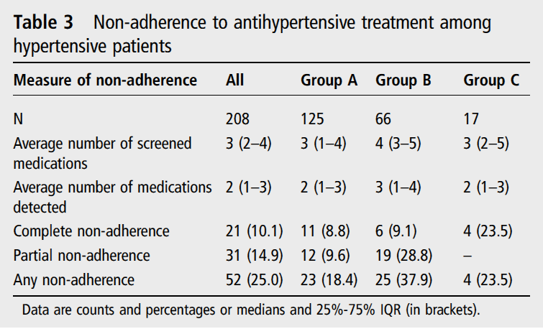
Patients may not take their tablets!
Urine analysis by high-performance liquid chromatography-tandem mass spectrometry (HPLC-MS/MS)
Tomaszewski M et al. Heart 2014;100:855-61

Slide 35
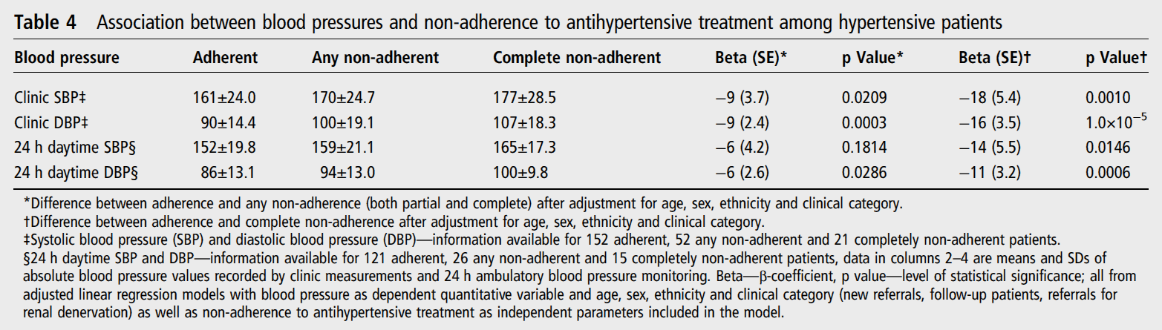
Non-adherence is associated with uncontrolled BP !
Urine analysis by high-performance liquid chromatography-tandem mass spectrometry (HPLC-MS/MS)
Tomaszewski M et al. Heart 2014;100:855-61

Slide 36
What is clinical and therapeutic inertia?
Clinical inertia. Failure of health-care providers to initiate or intensify therapy when indicated (therapeutic goals are not reached) and recognition of problem, but failure to act.¹
Therapeutic inertia. Failure of providers to begin new medications when an abnormal clinical parameter is recorded.²
Other terms. Patient’s inertia, Health Authorities inertia, Physician inertia, Clinical Myopia, Therapeutic momentum, Diagnostic inertia, […]³
¹Phillips LS, et al. Ann Intern Med 2001; 135: 825-34.
²Okonofua EC, et al. Hypertension 2006; 47: 345-51.
³Lebeau J-P, et al. BMC Fam Pract 2014; 15: 130.
Notes:
Clinical inertia was initially defined in 2001 by Phillips.
The term applies to the management of risk factors, when therapeutic targets are clearly defined and the benefits to reach those targets are well established.
Clinical inertia appears whenever the health-care provider does not initiate or intensify therapy appropriately when therapeutic goals are not reached.
With the exact same definition, Okonofua et al. introduced the terms “therapeutic inertia” in 2006.
Other terms have since been used to describe this fact. However, the recent use of these terms is imprecise, and conceptual models in theory and evidence have been proposed, as I shall describe soon.

Slide 37
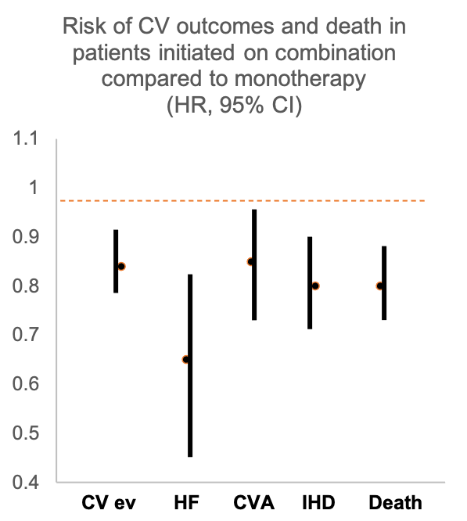
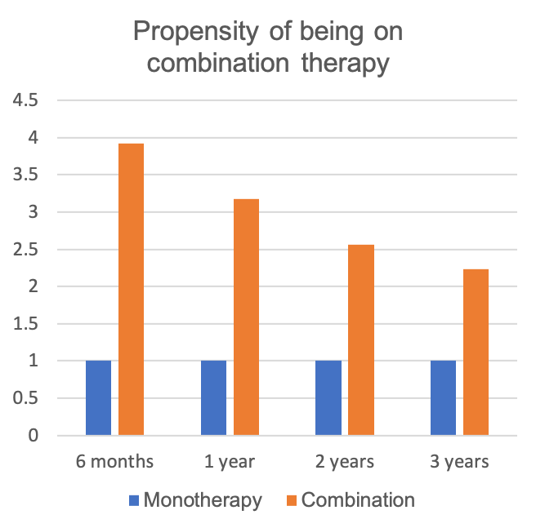
Why bother?
Rea F, et al. Hypertension 2018; 72: 846-53.
Notes:
In a prospective study carried out in 125,635 patients (40-85 yrs) in Northern Italy, therapeutic inertia as a contributor to failure to achieve BP control in hypertension was studied by comparing the proportion of BP control and the risk of death in two groups, one that started treatment with one drug (n=100,982) and one in whom a 2-drug fixed-dose or free combination was used (n=24,653). Follow-up was up to 3 years.
Patients on initial combination therapy showed a significant and marked increase in the propensity of being on combination treatment than patients under initial monotherapy, when allowing for confounders (left).
Compared to patients with initial monotherapy (right), patients prescribed an initial fixed-dose 2-drug combination (n=19 627) displayed a significant reduction in the risk of hospitalization for all considered outcomes. The risk reduction was largest for heart failure and smallest for cerebrovascular events, but for all events it was statistically significant.

Slide 38
Consequences of clinical inertia
Uncontrolled hypertension and progression to more severe one
Target organ damage (LVH, vascular stiffness, albuminuria)
CVD events (AMI, stroke, CHF, CKD)
Impaired cognitive function & dementia
Emergency hospital admissions
Disability (reduced QoL)
High healthcare costs
Loss of productivity

Slide 39
Therapy in resistant hypertension
Evidence-free zone (until recently!)
Seek specialist advice
Considered:
Alpha-blocker (doxazosin)
Further diuretic (spironolactone, amiloride)
Beta-blocker (atenolol, bisoprolol, carvedilol)
Invasive procedures (not for Primary Care!)
Non-effective: moxonidine; aliskiren
Obsolete: hydralazine; minoxidil; methyl-dopa; reserpine; clonidine (no evidence of benefits with RCTs)

Slide 40
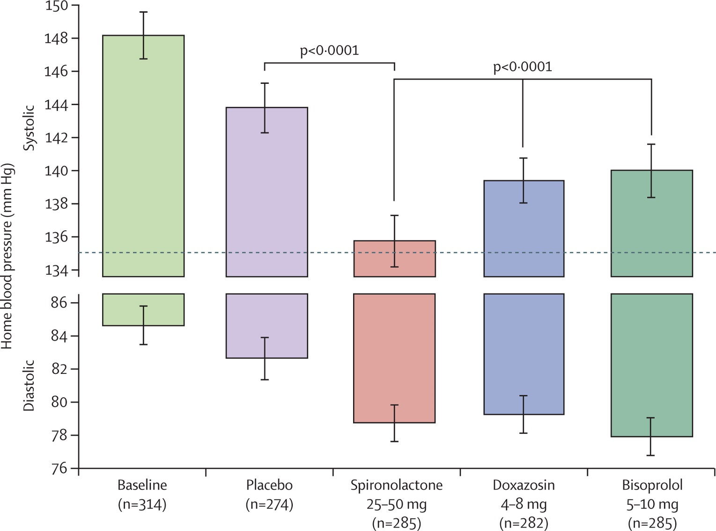
Figure 2
PATHWAY 2
Resistant hypertension
On 3 drugs
BP uncontrolled
18-79 yrs
N=335 randomized
N=230 complete all cycles
Williams B et al. Lancet 2015; 386: 2059-68
Notes:
Home systolic and diastolic blood pressures comparing spironolactone with each of the other cycles
The top and bottom of each column represents the unadjusted home systolic and diastolic blood pressures, respectively, averaged across the mid-cycle (low-dose) and end-of-cycle (high-dose) visits (6 weeks and 12 weeks) in which patients received the drug. Error bars represent 95% CI. Comparisons are as described under methods for the primary endpoint.

Slide 41
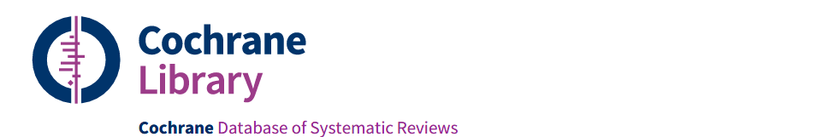
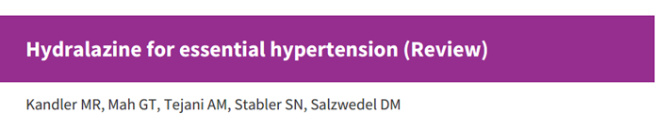
Hydralazine for essential hypertension?
No randomized controlled trials comparing hydralazine to placebo.
Uncertain the effects of hydralazine vs placebo on mortality, morbidity, withdrawals due to adverse effects, serious adverse events, systolic and diastolic BP.
Effects on BP based on before and after studies, not RCTs.
Uncertain effects on clinical outcomes.
Kandler MR et al. Cochrane Review 2011; 11: CD004934
Notes:
BNF Indications and dose
Moderate to severe hypertension (adjunct)
By mouth
For Adult Initially 25 mg twice daily, increased if necessary up to 50 mg twice daily.
Heart failure (with long acting nitrate) (initiated in hospital or under specialist supervision)
By mouth
For Adult Initially 25 mg 3–4 times a day, subsequent doses to be increased every 2 days if necessary; usual maintenance 50–75 mg 4 times a day.
Hypertensive emergencies (including during pregnancy), Hypertension with renal complications
By intravenous infusion
For Adult Initially 200–300 micrograms/minute; usual maintenance 50–150 micrograms/minute.
By slow intravenous injection
For Adult 5–10 mg, to be diluted with 10 mL sodium chloride 0.9%; dose may be repeated after 20–30 minutes.
Contra-indications
Acute porphyrias ; cor pulmonale; dissecting aortic aneurysm; high output heart failure; idiopathic systemic lupus erythematosus; myocardial insufficiency due to mechanical obstruction; severe tachycardia
Cautions
Cerebrovascular disease; coronary artery disease (may provoke angina, avoid after myocardial infarction until stabilised); occasionally blood pressure reduction too rapid even with low parenteral doses
Side-effects
Common or very common
Angina pectoris; diarrhoea; dizziness; flushing; gastrointestinal disorders; headache; hypotension; joint disorders; lupus-like syndrome (after long-term therapy with over 100 mg daily (or less in women and in slow acetylator individuals)); myalgia; nasal congestion; nausea; palpitations; tachycardia; vomiting
Rare or very rare
Acute kidney injury; agranulocytosis; anaemia; anxiety; appetite decreased; conjunctivitis; depression; dyspnoea; eosinophilia; eye disorders; fever; glomerulonephritis; haematuria; haemolytic anaemia; hallucination; heart failure; hepatic disorders; leucocytosis; leucopenia; lymphadenopathy; malaise; nerve disorders; neutropenia; oedema; pancytopenia; paradoxical pressor response; paraesthesia; pleuritic pain; proteinuria; skin reactions; splenomegaly; thrombocytopenia; urinary retention; vasculitis; weight decreased
Side-effects, further information
The incidence of side-effects is lower if the dose is kept below 100mg daily, but systemic lupus erythematosus should be suspected if there is unexplained weight loss, arthritis, or any other unexplained ill health.

Slide 42
Moxonidine for essential hypertension?
Centrally acting drug similar to clonidine.
Only as add-on therapy to further lower blood pressure if combination therapy with first- and second-line agents is insufficient or unsuitable. However, evidence limited¹.
Be ware of combination with beta-blockers (rebound hypertension)
The effect on cardiovascular morbidity and mortality has not been tested in clinical trials.
Do not prescribe in heart failure of any grade², bradycardia, arrhythmia, as it has been associated with increased mortality and adverse events.
Reduce the dose in renal impairment.
¹Chazova I & Schlaich MP. Int J Hypert 2013; 2013:541689
²Cohn JN, et al. Eur J Heart Fail 2003; 5: 659-67

Slide 43
Management of hypertensive crisis: BIHS Position document
Lack of robust data
Considerable heterogeneity and inconsistency in clinical practice
Non-adherence to antihypertensive medications
common (30%-50% of patients one year after)
sub-optimal BP control
pseudo-resistance to medications
increased emergency hospital admissions, CVD risk, healthcare costs
Kulkami S et al. J Hum Hypert 2022; Nov 22

Slide 44
Hypertensive crisis: definitions by the BIHS Position document
Acute severe hypertension
elevation of BP of >200/120mmHg without evidence of acute and/or life-threatening EOD (referred in NICE 2019 as Severe Hypertension)
NB: avoid using ‘hypertensive urgency’ in asymptomatic patients as not useful creating unnecessary anxiety, healthcare cost with low associated morbidity.
Hypertension emergency
elevated BP, which when sustained over few hours may lead to progressive life-threatening EOD.
e.g. acute pulmonary oedema, hypertensive encephalopathy, acute RF, aortic dissection, ICH, severe preeclasmpsia / eclampsia, phaeo, ACS
Malignant* hypertension (MHT)
distinct pathophysiology with vascular damage resulting from failure or loss of autoregulation of blood flow, usually in pts with uncontrolled chronic HPT.
Pathophysiological hallmark: fibrinoid arteriolar necrosis in vascular tissue beds, onion skinning of resistance vessels.
Clinical diagnosis: DBP >120mmHg; concurrent bilateral grade 3 or 4 retinopathy
NB: ‘uncomplicated’ MHT is not a hypertension emergency
*synonymous to ‘accelerated’
Kulkami S et al. J Hum Hypert 2022; Nov 22

Slide 45

5. Who to refer for same-day specialist review
A hypertensive emergency is present when severe hypertension is associated with signs and symptoms of acute end-organ damage. Uncommon (1-2 per million per year)
Severe hypertension * >180/120
No symptoms or signs
Retinal haemorrhage or papilloedema
(Accelerated or malignant hypertension)
Life-threatening symptoms
(confusion, chest pain, HF, AKI)
Assess TOD
Suspected phaeo
(headache, palpitations, pallor, sweating etc)
*However, a BP pf >200/120mmHg is severe
Kulkami S et al. BIHS Position document J Hum Hypert 2022; Nov 22

Slide 46


Thank you!
Any question?
Notes:
46

