Slide 1



FENS 2023 - The 14th European Nutrition Conference
Monitoring population salt intake: analytical methods and worldwide status
Francesco P Cappuccio,
MD, MSc, DSc, FRCP, FFPH, FBIHS, FAOP, FESC, FAHA
Professor of Cardiovascular Medicine & Epidemiology & Consultant Physician University of Warwick and UHCW NHS Trust, Coventry, UK
Head, WHO Collaborating Centre for Nutrition (2008-2023)
https://www2.warwick.ac.uk/go/cappuccio/who
https://fens2023.org/
14 November 2023
https://fens2023.org/

Slide 2

Conflict of Interest Disclosure
I have to report conflict of interest in relation to this presentation:
I have been Head of the WHO Collaborating Centre for Nutrition since 2008 and Technical Advisor to WHO for the implementation of population salt reduction programmes in different world regions (PAHO/WHO; EMRO WHO; WHO Office for Europe).
I am an unpaid member of CASSH and WASSH.

Slide 3
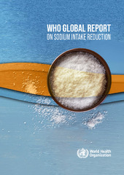
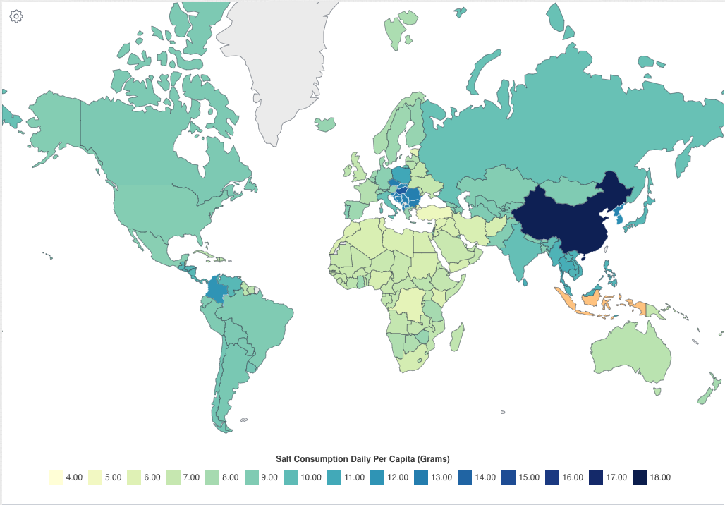

Global estimates of salt intake
WHO target
<5g per day
2023

Slide 4
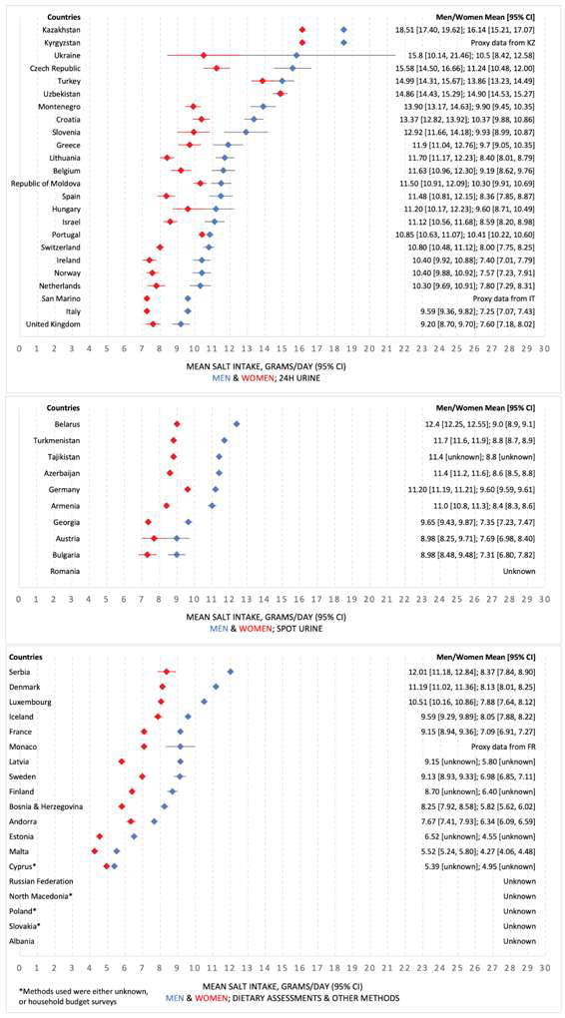
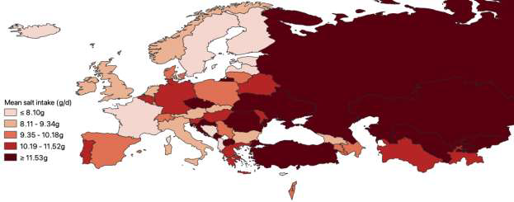
Salt intake in the WHO European Region
Kwong EJL et al. Public Health Nutr 2022; Oct 20;1-14.
doi: 10.1017/S136898002200218X.

Slide 5
Components of a strategy to reduce population salt intake
Communication
Public Awareness Campaigns
Food industry
Reformulation
Setting Targets
Monitoring & Surveillance
Population salt intake
Reformulation progress
Decision makers
Media
Health Professionals
Motivation
Costs & Benefits
Consumer awareness
Wider support
Corporate responsibility
Labelling
Effectiveness of communication and intervention
Urinary sodium
Dietary surveys
Salt content of foods (databanks; self-reporting by industry; market surveys)
Benchmarking food categories
Consumers
Measuring ….
Attitudes and behaviour changes
Research
Epidemiology
Nutrition
Public Health
Food technology
Behavioural
Voluntary vs Regulatory
Evaluation
Policy
[…]
Industry Engagement
Reformulation
Minimum standards in common foods
Advocacy
Economics
[…]
Effectiveness
Sociology
Awareness of campaigns
Changes in population salt intake
Street vendors
Three-pillar
(pronged)
approach
Cappuccio FP et al. Br. Med. J. 2010; 343: 402-405

Slide 6
Monitoring and Surveillance
Population salt intake
Urinary sodium (potassium, creatinine, iodine)
Knowledge, attitudes and behaviour (KAB)
Reformulation progress
Salt content of foods (databanks; self-reporting by industry; market surveys; food industry engagement)
Effectiveness of intervention
Measuring ….
Changes in population salt intake
Knowledge, attitudes and behavioural changes
Effectiveness of communication
Impact of awareness campaigns on salt consumption and consumer’s choices

Slide 7
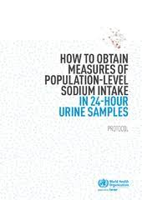
Training of field workers in survey methodology
PAHO/WHO 2013
EMRO WHO 2018
WHO EUROPE 2021
Notes:
These are the front pages of three documents PAHO/WHO 2013, EMRO WHO 2018 and WHO EUROPE 2021

Slide 8
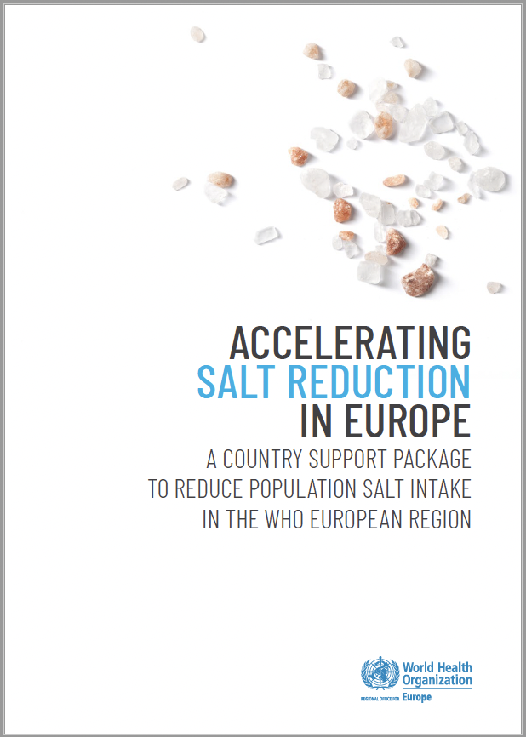
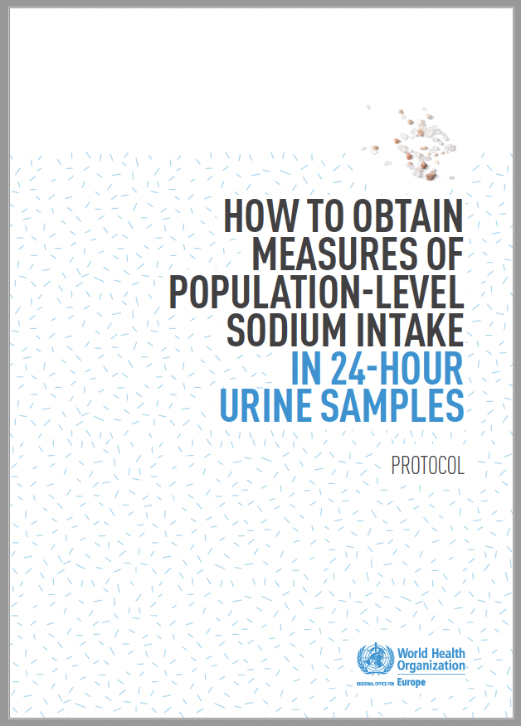
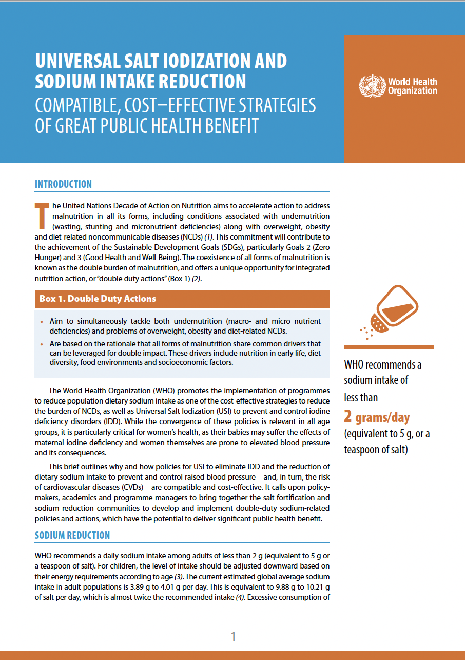
WHO EUROPE 2020
WHO EUROPE 2021
WHO EUROPE 2022

Slide 9
How to measure salt (sodium) intake in populations?
Approximately 93% of dietary sodium is excreted in urine
Strong support for using 24‐hour urine collections to assess average dietary sodium intake (accounting for the loss of ~7% of dietary sodium)
Note: dietary sodium varies from meal to meal and day to day; therefore, to determine a person’s usual salt intake, multiple 24‐hour urine samples are required
Q: can we use of spot urine collections to estimate sodium intake?
Lucko AM et al. J Clin Hypertens 2018; 20: 1220–9

Slide 10
Common methodological errors
Systematic errors in sodium assessment
Single or incomplete 24h urine collection
Spot urine collections
Dietary assessment
Reverse causality
Sick populations in low sodium group
Potential for residual confounding
Incomplete adjustment for confounding
Incomplete follow-up
Random error in sodium assessment
Insufficient statistical power
Inconsistent results with same datasets
Cobb LK et al. Circulation 2014; 129: 1173-86

Slide 11
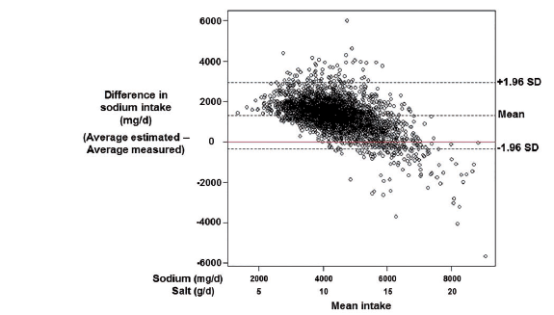
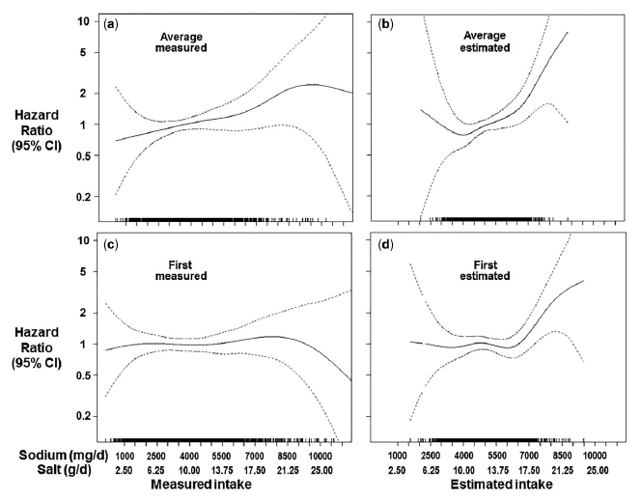
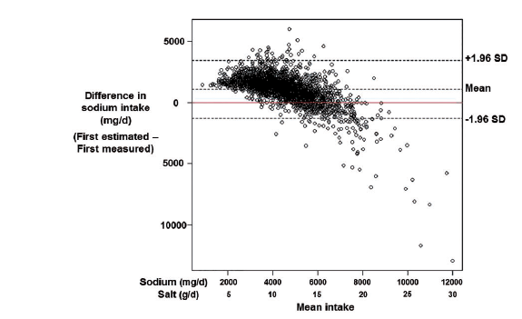
‘Estimating’ salt intake by formulas using ‘spot’ urine collections alters the relationship of salt intake with health outcomes
Bias
Multiple 24h urine collections
Spot urine and Kawasaki
He FJ et al. Int J Epidemiol 2018; 47: 1784-95

Slide 12
‘Estimating’ salt intake by formulas using ‘spot’ urine collections is inadequate to monitor changes in population salt reduction programmes
24h
Tanaka
Kawasaki
Average population salt reduction (g/day)
Huang L et al. Int J Epidemiol 2018; 47: 1811-20
Cappuccio FP et al. Nutr Metab Cardiovasc Dis 2019; 29: 107-14
Cappuccio FP et al. J Hypertens 2023; 41: 869-71

Slide 13
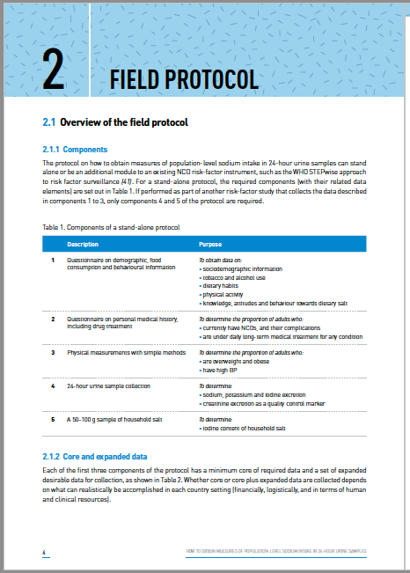
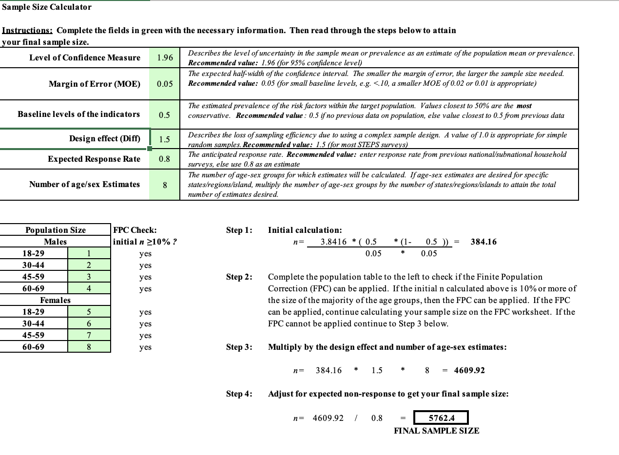
WHO EUROPE 2021
Sample size calculator
https://cdn.who.int/media/docs/default-source/ncds/ncd-surveillance/steps/sample-size-calculator.xls?sfvrsn=ee1f4ae8_2
Notes:
These are the front pages of three documents PAHO/WHO 2013, EMRO WHO 2018 and WHO EUROPE 2021

Slide 14
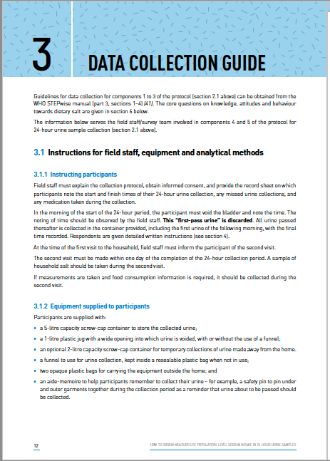
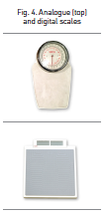
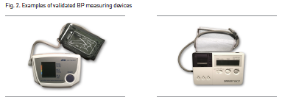
WHO EUROPE 2021
Instructions for field staff, equipment and analytical methods
Guide to physical measurements
Measuring blood pressure and heart rate
Measuring height, weight
Measuring waist and hip circumference (optional)
Notes:
These are the front pages of three documents PAHO/WHO 2013, EMRO WHO 2018 and WHO EUROPE 2021

Slide 15
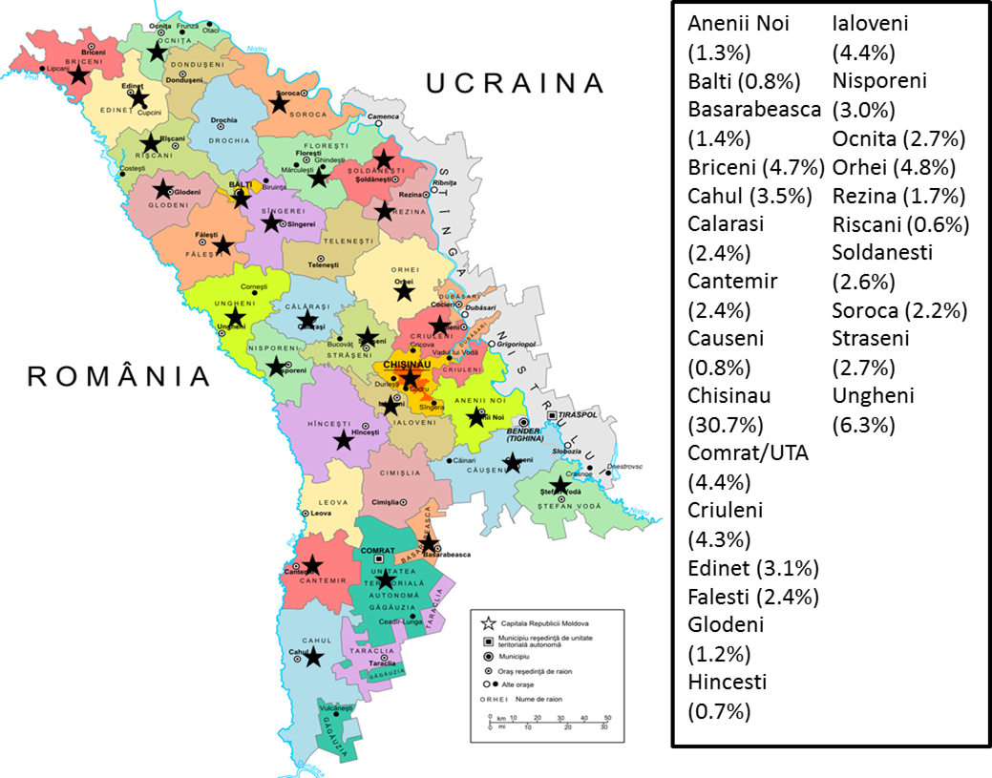
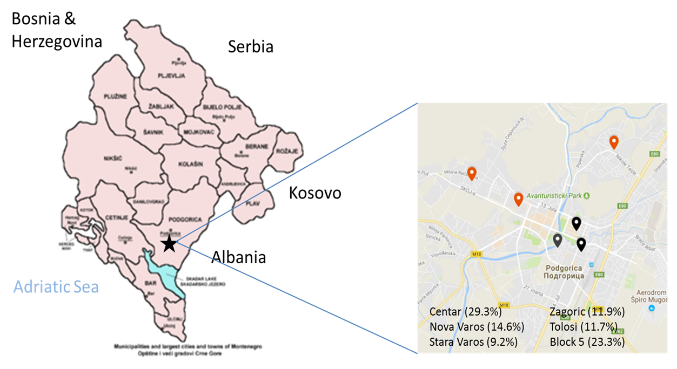
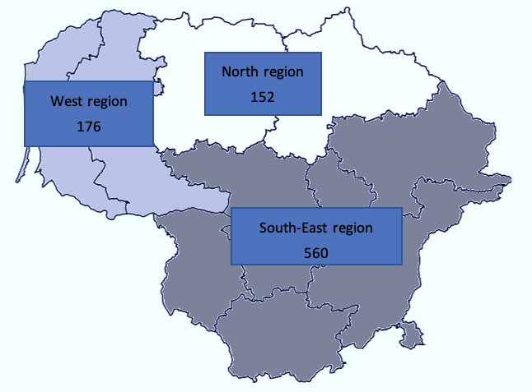
Geographical sampling
Moldova
Montenegro
Lithuania
Survey design in 3 STEPS (based on WHO STEPS): 24h urine collections.
Residents of all districts and municipalities
Initial total sample 1,307.
Field work 21 Jul – 5 Sep 2016.
After exclusions, final sample of 858 (66%).
326 men and 532 women.
Six units of primary health centres in Podgorica. Stratified random sampling.
Initial total sample 1,008.
Field work 15 Sept – 15 Dec 2017.
After exclusions, final sample of 639 (63%).
285 men and 354 women.
National proportional sampling.
Stratified random sampling.
Invited 2,492; consented 1,082 (44%)
Field work Sep 2019 – Nov 2020.
After exclusions, final sample of 888 (82%).
422 men and 466 women.
D’Elia L et al. Nutrients 2019; 11: 2896
D’Elia L et al. Nutrients 2019; 11: 160
Zakauskiene U et al. Nutrients 2022; 14: 3817

Slide 16
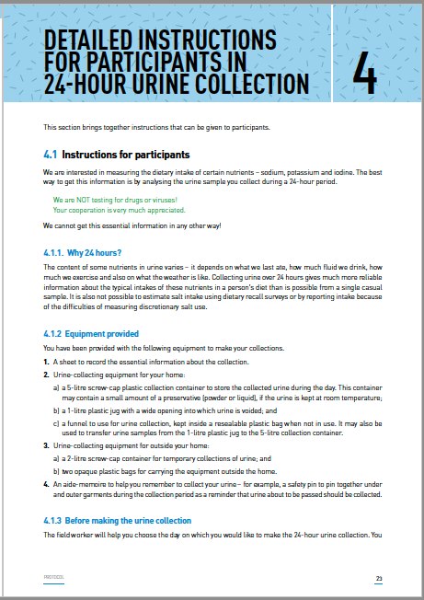
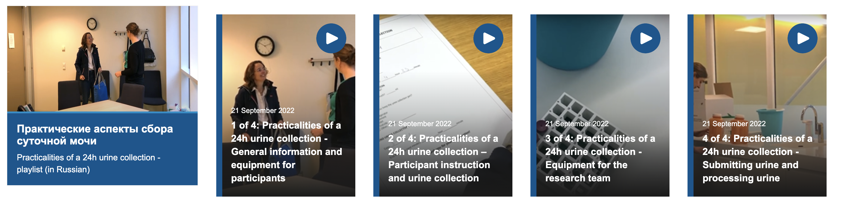
Practicalities of a 24h urine collection: training videos
Instructions for participants
Training videos on-line (in English with Russian sub-titles)
https://www.who.int/europe/activities/reducing-salt-consumption

Slide 17
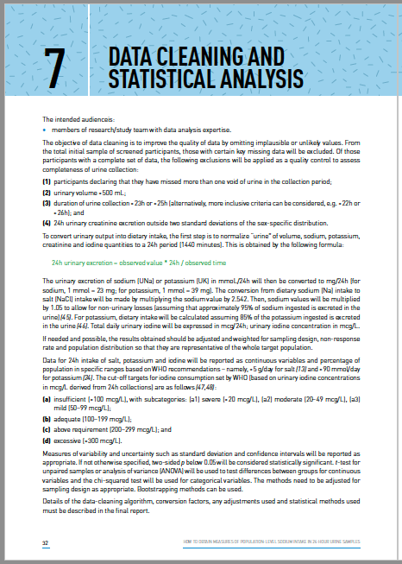
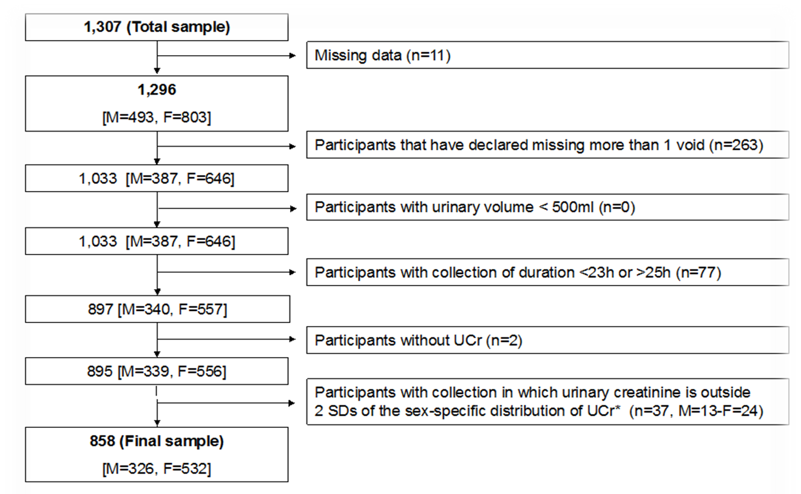
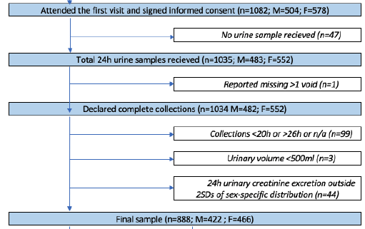
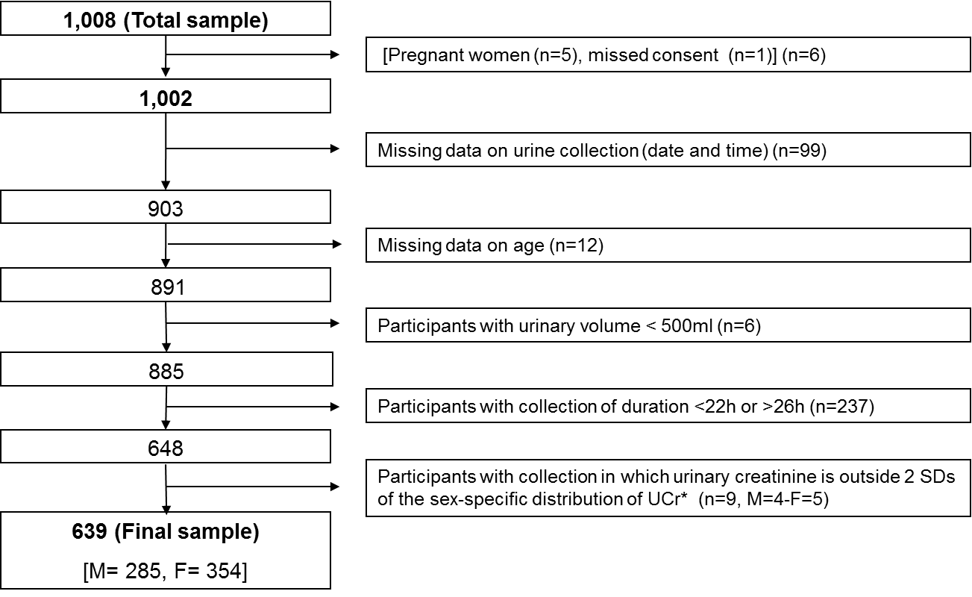
Stepwise quality control of complete urine collections
Moldova
Montenegro
Lithuania
66%
63%
82%
D’Elia L et al. Nutrients 2019; 11: 2896
D’Elia L et al. Nutrients 2019; 11: 160
Zakauskiene U et al. Nutrients 2022; 14: 3817

Slide 18
Population salt intake (g per day)
D’Elia L et al. Nutrients 2019; 11: 2896
D’Elia L et al. Nutrients 2019; 11: 160
Zakauskiene U et al. Nutrients 2022; 14: 3817

Slide 19
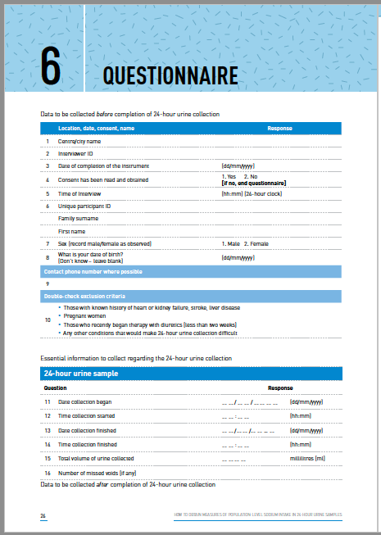
Knowledge, Attitude and Behaviour (KAB) towards salt consumption in Montenegro
*
**
†
Results are means. *p=0.009; **p=0.007; †p=0.006 vs men
D’Elia L et al. Nutrients 2019; 11: 160
Notes:
Three out of four participants add salt to food at the table on a regular basis (men more often than women)
Conversely only 1 out of 5 say they use salt when cooking (important to find out whether they use stock cubes, for instance, or other salt-blended seasoning). They may not be aware of the high salt content of them. More frequent in men than women
One third of the sample thinks they eat too much salt (equally in men and women)
The majority of participants, independent of sex, perceive the health risk associated with high salt intake
However, less than half believe it is important to reduce its consumption and less than a third (fewer men) admit doing anything to reduce it.

Slide 20
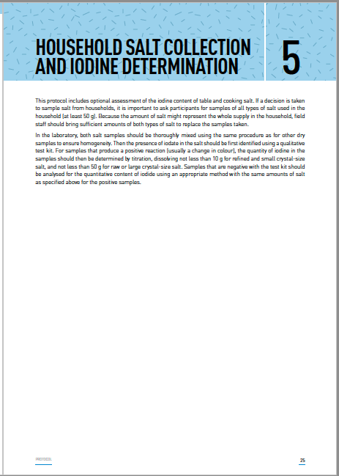
Proportions of participants meeting WHO targets for iodine consumption* in Moldova
Group (mcg/L) | All (n=856) | Men (326) | Women (530) | Urban (327) | Rural (529)
 | N (%) | N (%) | N (%) | N (%) | N (%)
Insufficient (<100) Severe (<20) Moderate (20-49) Mild (50-99) | 245 (28.6) 20 (2.3) 60 (7.0) 165 (19.2) | 95 (29.1) 6 (1.8) 24 (7.4) 65 (19.9) | 150 (28.2) 14 (2.6) 36 (6.8) 100 (18.8) | 104 (31.8) 4 (1.2) 28 (8.6) 72 (22.0) | 141 (26.6) 16 (3.0) 32 (6.0) 93 (17.5)
Adequate (100-199) | 351 (40.9) | 132 (40.5) | 219 (41.2) | 131 (40.1) | 220 (41.4)
Above requirement (200-299) | 152 (17.7) | 59 (18.1) | 93 (17.5) | 58 (17.7) | 94 (17.7)
Excessive (>300) | 108 (12.6) | 40 (12.3) | 68 (12.8) | 34 (10.4) | 74 (13.9)
*based on urinary iodine concentrations in mcg/L derived from 24h collections rather than from spot urines
D’Elia L et al. Nutrients 2019; 11: 2896

Slide 21
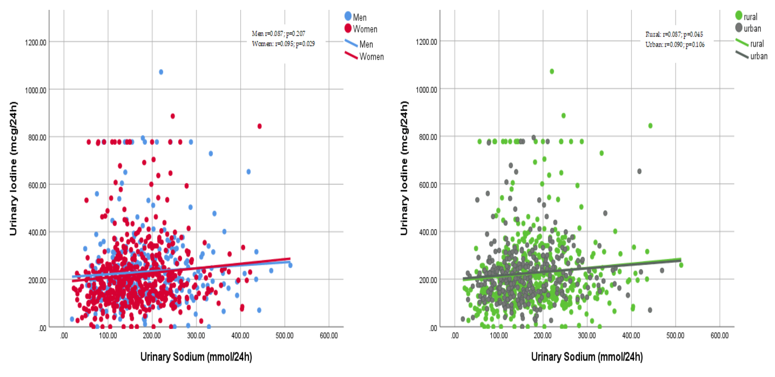
Correlations between urinary sodium and iodine excretions in Moldova
By sex
By area of residence
D’Elia L et al. Nutrients 2019; 11: 2896

Slide 22
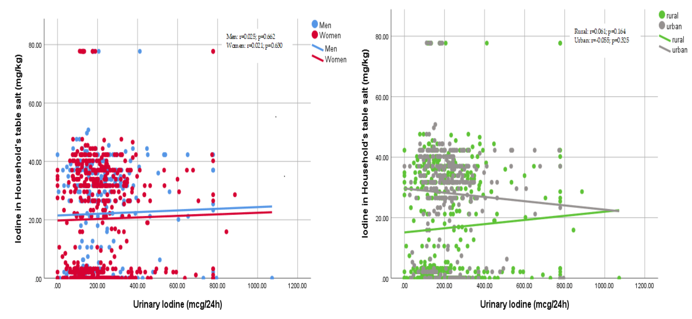
Correlations between urinary iodine excretion and iodine content of household’s table salt in Moldova
By sex
By area of residence
D’Elia L et al. Nutrients 2019; 11: 2896

Slide 23
Added value of 24-h iodine measurements in the general population for harmonization of policies
Unbiased measurement of total iodine consumption
Evidence-based assessment of iodine intake/status in the general population, not just children and pregnant women
Evidence-based assessment of population coverage by direct measurement rather than from average sales
More accurate tailoring of salt iodization
More accurate information for use of iodized food grade salt from food manufacturers

Slide 24


Thank you!
Any question?
Notes:
24

