Slide 1
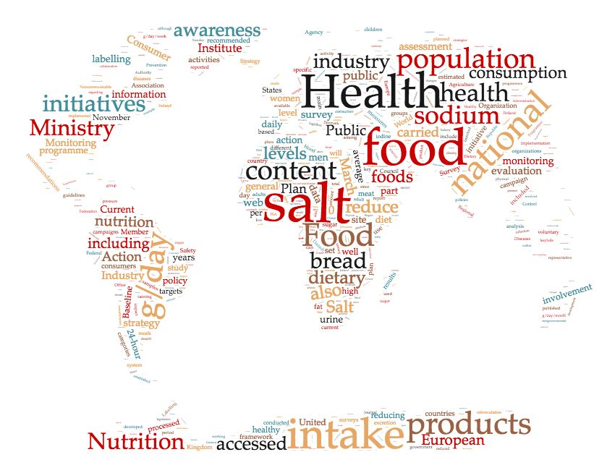
Francesco P Cappuccio MBBS, MD MSc DSc DLSHTM FRCP FFPH FBHS FESC FAHA
Professor of Cardiovascular Medicine & Epidemiology & Consultant Physician
Director, ESH Centre of Excellence
Head, WHO Collaborating Centre
President, British and Irish Hypertension Society
University of Warwick and UHCW NHS Trust, Coventry, UK
Parallel session 3: NCD surveillance

Slide 2
Salt or Sodium
Salt refers to sodium chloride (NaCl).
Please note the following conversions:
2.5 g (or 2,500 mg) of salt =
1.0 g (or 1,000 mg) of sodium

Slide 3
Where in our diet does salt come from?
In regions where most food
is processed or eaten in
restaurants
12% natural content of foods
“hidden” salt: 77% from processed food – manufactured and restaurants
“conscious” salt: 11% added at the table (5%) and in cooking (6%)
J Am College of Nutrition. 1991;10:383-93.
Notes:
3

Slide 4
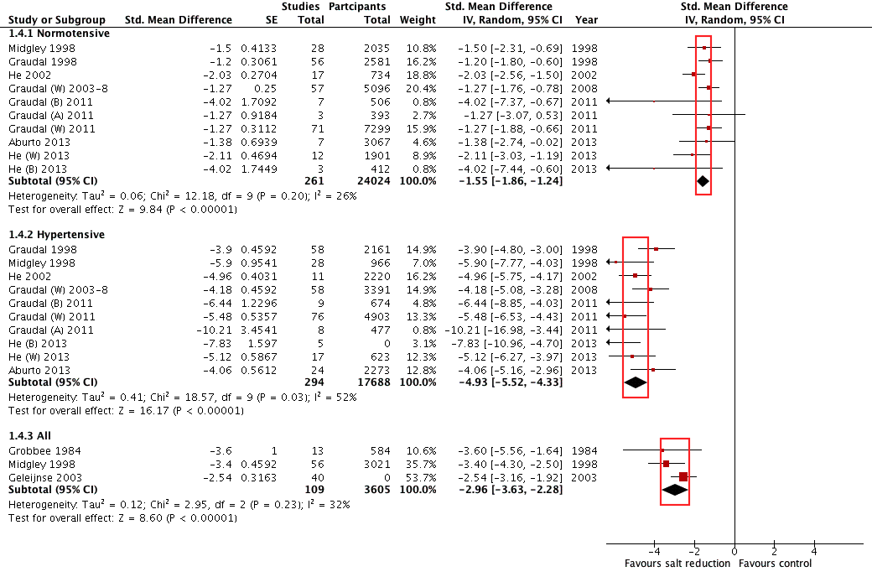
A reduction in dietary salt intake reduces blood pressure
Consistency – agreement
across several meta-analyses
of RCTs
Cappuccio FP . NDT 2016; 31: 1392-6

Slide 5
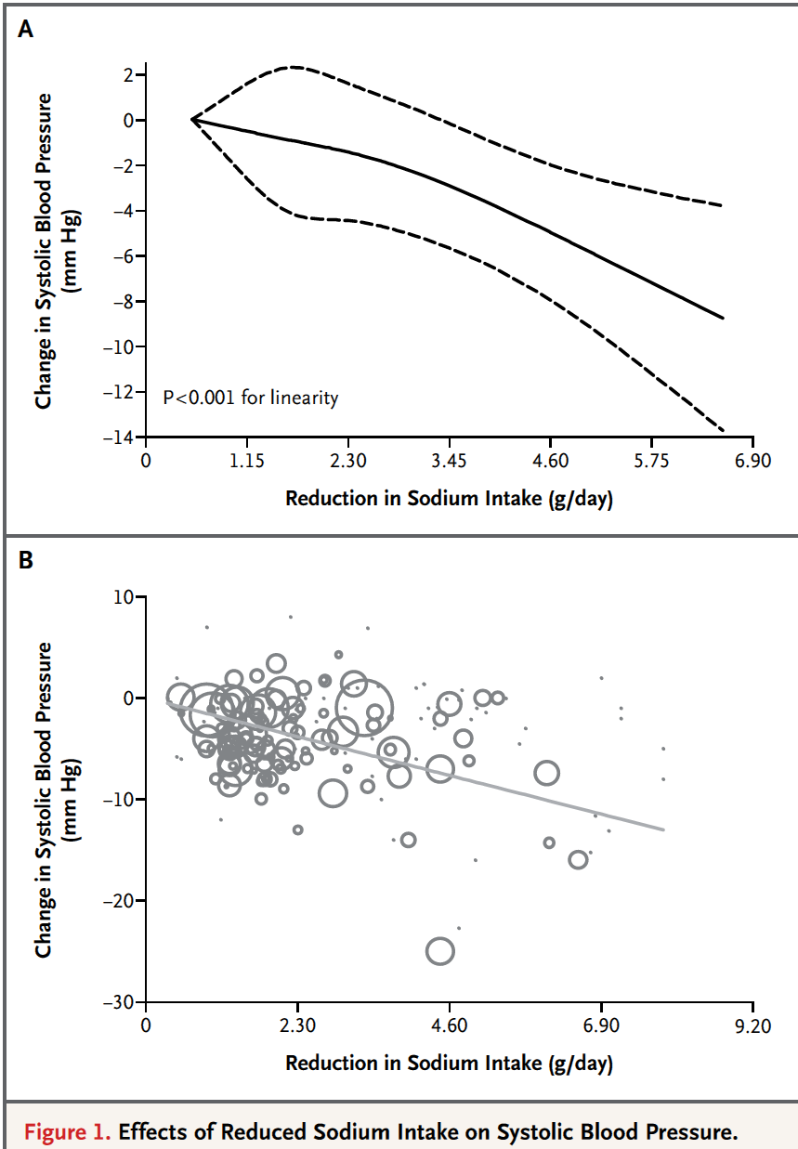
The greater the reduction in salt intake, the greater the reduction in blood pressure
Mozaffarian D et al. N Engl J Med 2014: 371: 624-34

Slide 6
Stroke and Ischemic Heart Disease (CHD) as a function of Systolic BP
Stroke
Age at risk
CHD
Age at risk
256
256
80–89 y
80–89 y
128
128
70–79 y
70–79 y
64
64
60–69 y
60–69 y
32
32
50–59 y
Mortality*
50–59 y
16
16
40–49 y
8
8
4
4
2
2
1
1
0
120 140 160 180
0
120 140 160 180
Usual SBP (mmHg)
Usual SBP (mmHg)
Lewington et al. Lancet 2002;360:1903–13
Notes:
These data are taken from a meta-analysis of 61 prospective observational studies on deaths from vascular disease among subjects without vascular disease at baseline. The results demonstrated that the relationship of stroke mortality (left panel) and ischemic heart disease (IHD) mortality (right panel) to usual BP is strong and direct at all ages.
As highlighted on the following slide, each difference of 20 mmHg in usual SBP is associated with a two-fold difference in the risk of stroke mortality and IHD mortality (between ages 40–69 years). The annual absolute difference in risk is greater in old age.
Reference
Lewington S, et al. Age-specific relevance of usual blood pressure to vascular mortality: a meta-analysis of individual data for one million adults in 61 prospective studies. Lancet 2002;360:1903–13.
Prospective Studies Collaboration. Age-specific relevance of usual blood pressure to vascular mortality: a meta-analysis of individual data for one million adults in 61 prospective studies. Lancet. 2002;360:1903-1913.

Slide 7
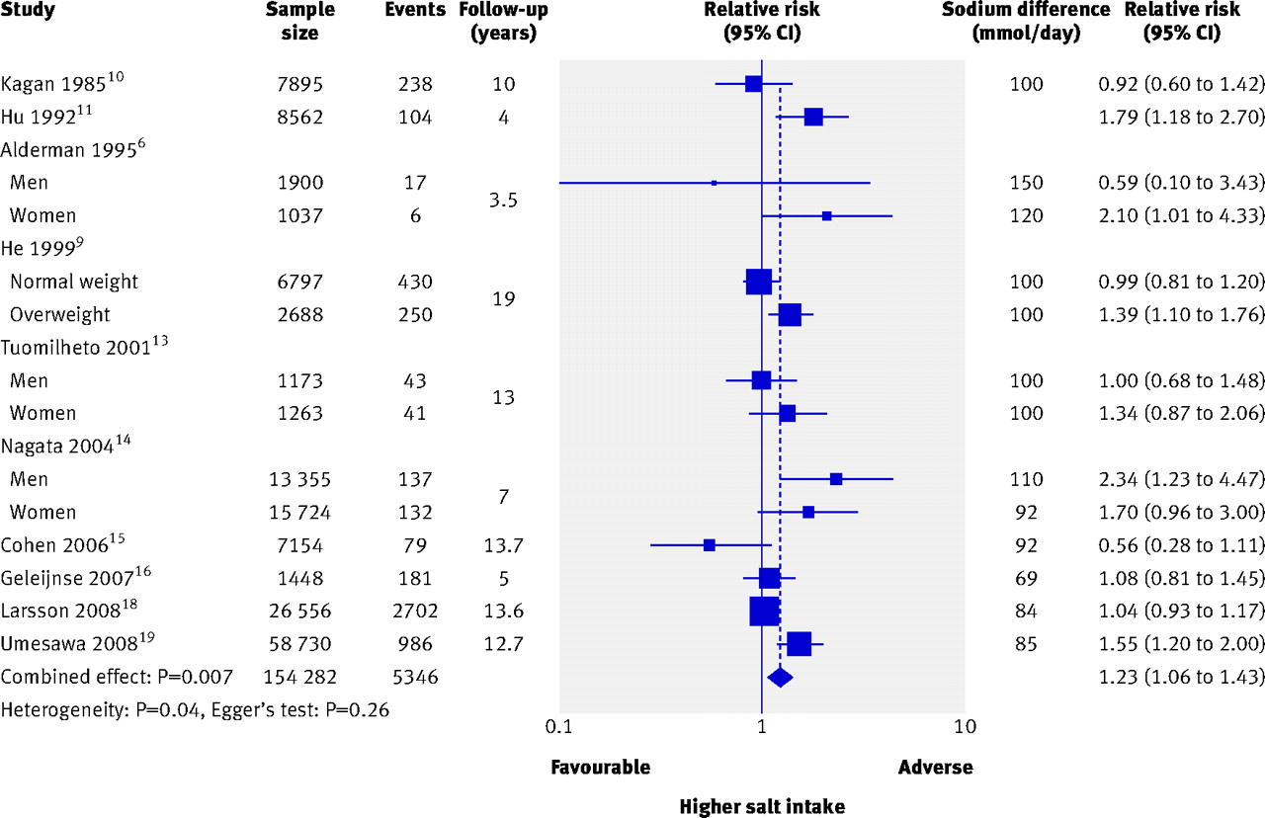
Higher salt intake predicts increased risk of stroke
Strazzullo P et al. BMJ 2009; 339: b4567

Slide 8
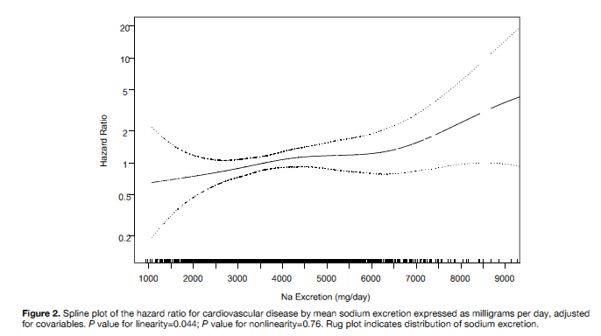
‘Graded’ and ‘linear’ association between salt intake and outcomes
Cardiovascular disease
All-cause mortality
LEFT: Cook NR et al. Circulation 2014; 129: 981-9
RIGHT: Cook NR et al. J Am Coll Cardiol; 2016; 68: 1609-17

Slide 9
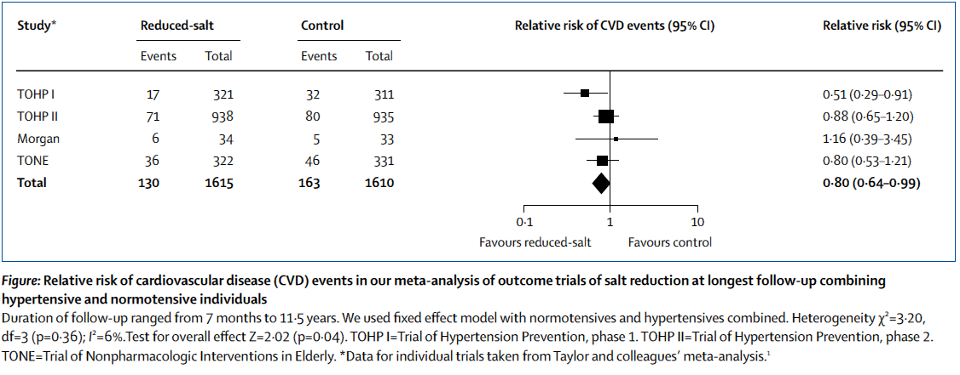
Salt reduction lowers cardiovascular risk: meta-analysis of outcome trials
He FJ, MacGregor GA. Lancet 2011: 378: 380-2

Slide 10
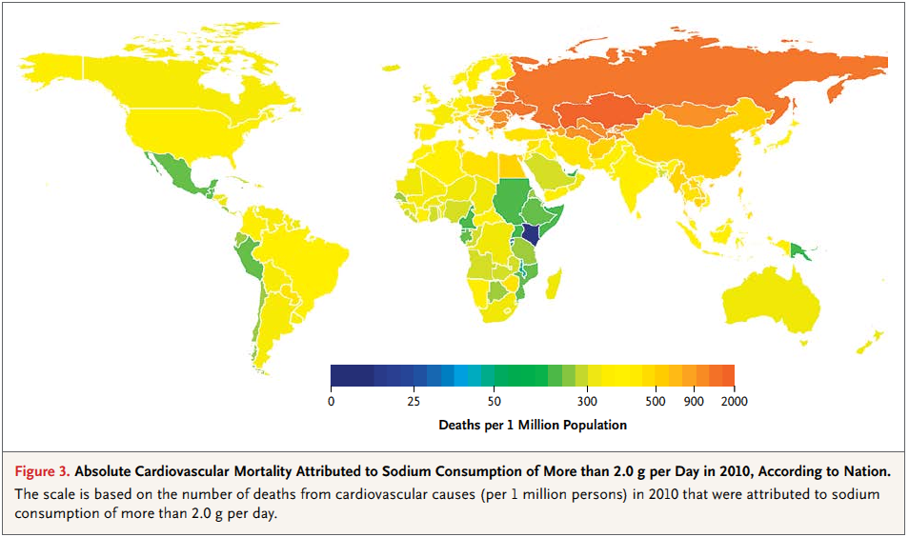
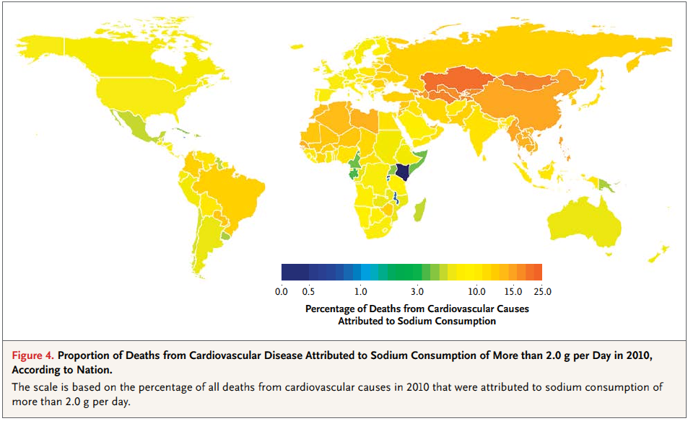
Absolute and proportional CV deaths attributable to sodium intake >2g per day (salt >5g per day)
In 2010, global sodium consumption estimated at 3.95g per day (9.875g salt per day)
Globally, 1.65m annual CV deaths attributed to sodium intake >2g per day (>5g salt per day)
These deaths accounted for nearly 10% of CV deaths
85% of these deaths occurred in LMICs and 40% were premature (<70 years)
Mozaffarian D et al. NEJM 2014:371:624-34

Slide 11
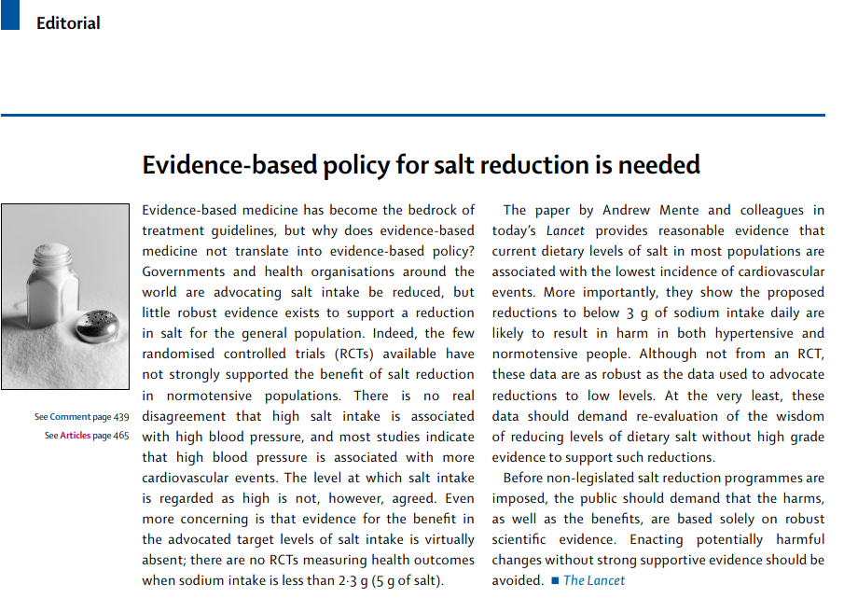
The ‘new’ salt debate
Lancet 2016; 388: 438
Is there a J-shape relationship between sodium intake and CV events?
Is there any harm in reducing salt intake towards recommended targets?

Slide 12
Common methodological errors
Systematic errors in sodium assessment
    Single or incomplete 24h urine collection
    Spot urine collections
    Dietary assessment
Reverse causality
  Sick populations in low sodium group
Potential for residual confounding
    Incomplete adjustment for confounding
    Incomplete follow-up
Random error in sodium assessment
Insufficient statistical power
Inconsistent results with same datasets
Cobb LK et al. Circulation 2014; 129: 1173-86

Slide 13
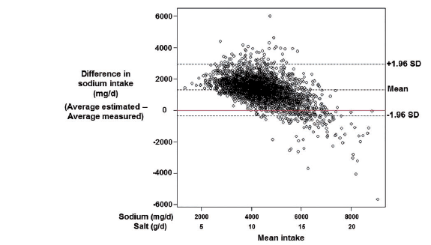
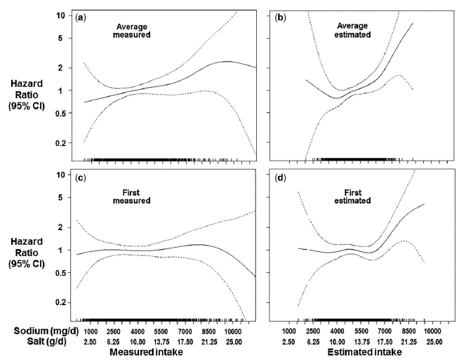
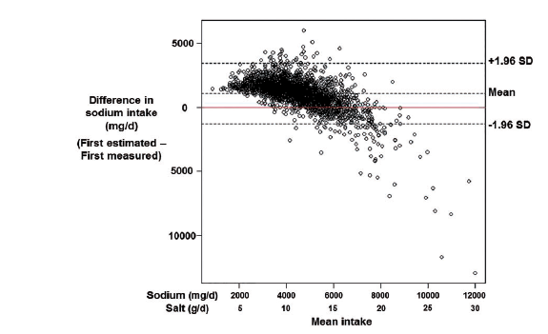
Errors in estimating usual sodium intake by the Kawasaki formula alter its relationship with mortality
Bias
Multiple 24h urine collections
Spot urine and Kawasaki
He FJ et al. Int J Epidemiol 2018; 47: 1784-95
Cappuccio FP et al. NMCD 2019; 29: 107-14

Slide 14
Spot urine collections inadequate to monitor changes in population salt reduction programmes
24h
Tanaka
Kawasaki
Average population salt reduction (g/day)
Huang L et al. Int J Epidemiol 2018; 47: 1811-20
Cappuccio FP et al. NMCD 2019; 29: 107-14

Slide 15

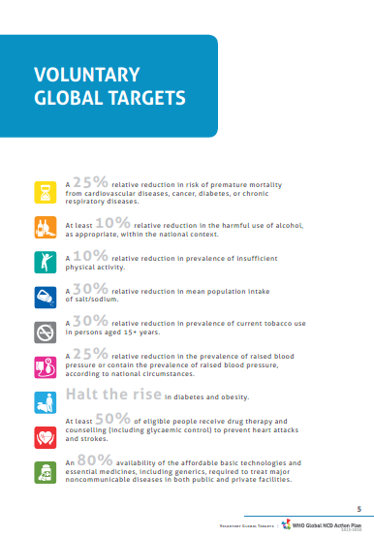
World Health Organization Global Action Plan for NCD (2013-2020)
Salt reduction

Slide 16
Components of a strategy to reduce population salt intake
Communication
Public Awareness Campaigns
Food industry
Reformulation
Setting Targets
Industry Engagement
Monitoring
Population salt intake
Reformulation progress
Decision makers
Media
Health Professionals
Motivation
Costs & Benefits
Consumer awareness
Wider support
Corporate responsibility
Reformulation
Labelling
Effectiveness of communication
Urinary sodium
Dietary surveys
Salt content of foods (databanks; self-reporting by industry; market surveys)
Benchmarking food categories
Consumers
Measuring awareness of campaigns
Measuring attitudes and behaviour changes
Research
Epidemiology
Nutrition
Public Health
Food technology
Behavioural
Voluntary vs Regulatory
Evaluation
Policy
Cappuccio FP et al. BMJ 2010; 343: 402-5

Slide 17
Changes in salt intake, blood pressure, stroke and IHD mortality in England from 2003 to 2011
-40%
-42%
Health Survey for England
aged ≥16 years
2003 N=9183
2006 N=8762
2008 N=8974
2011 N=4753
-3.0 mmHg
-1.4 mmHg
-1.4 g/d
He FJ et al. BMJ Open 2014; 4: e004549

Slide 18
Cost-effectiveness
A reduction in salt intake of 3g per day would save 194,000-392,000 QALYs and $10-24b in health care costs annually in the US, i.e. a return of $6-12 for every $ spent¹
Even modest reduction of 1g per day would be cost saving and more cost-effective that using medications to lower blood pressure¹
Population reductions in salt intake through food reformulation from industry would be cost-saving.
However, whilst ‘voluntary ‘ action by the food industry is cost-effective, population health benefits could be 20 times greater with Government legislation of moderate salt limits in processed foods²
¹Bibbins-Domingo K et al. NEJM 2010; 362: 590-9
²Cobiac LJ et al. Heart 2010; 96: 1920-5

Slide 19
Effectiveness hierarchy of dietary salt reduction policies
DOWNSTEAM (Agentic) UPSTREAM (Structural)
Hyseni L et al. PLoS ONE 2017; 12: e0177535

Slide 20
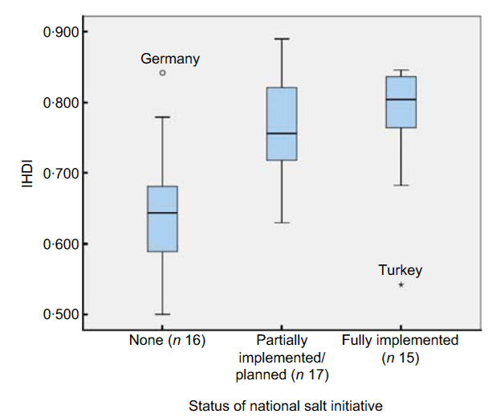
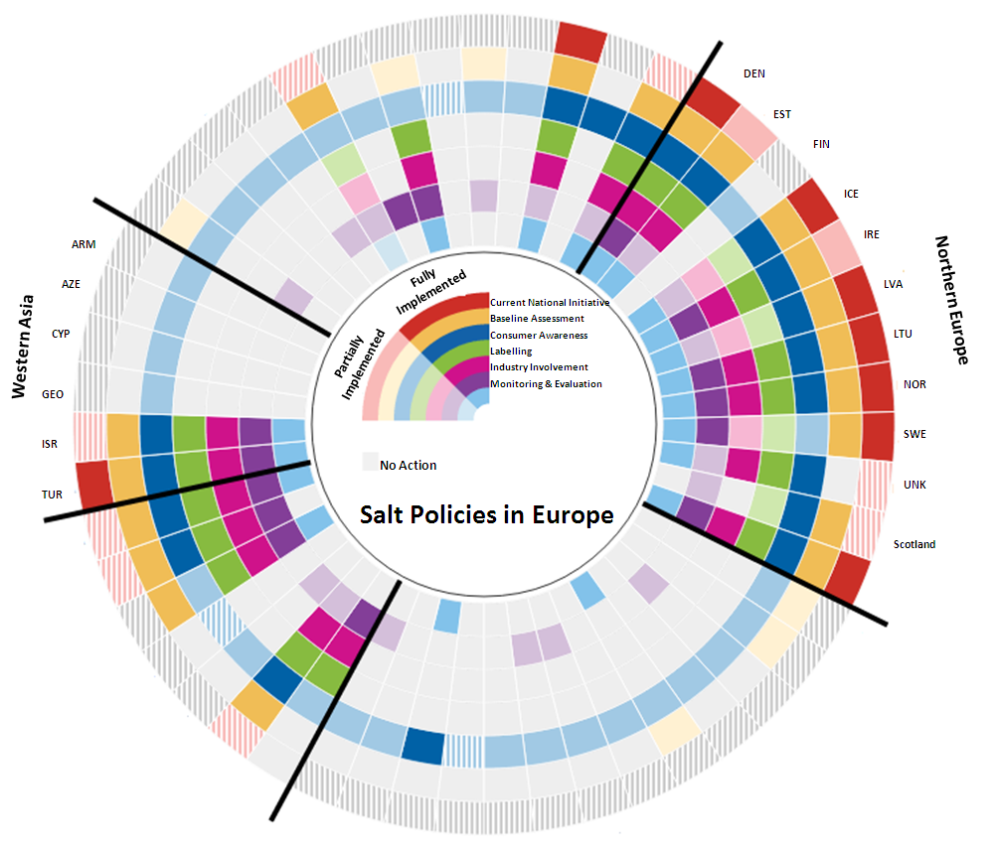
Inequalities in salt reduction policies in WHO Region for Europe
IHDI=Inequality-adjusted Human Development Index
Rodriguez-Fernandez R et al. Public Health Nutr 2014;17:1894-1904

Slide 21
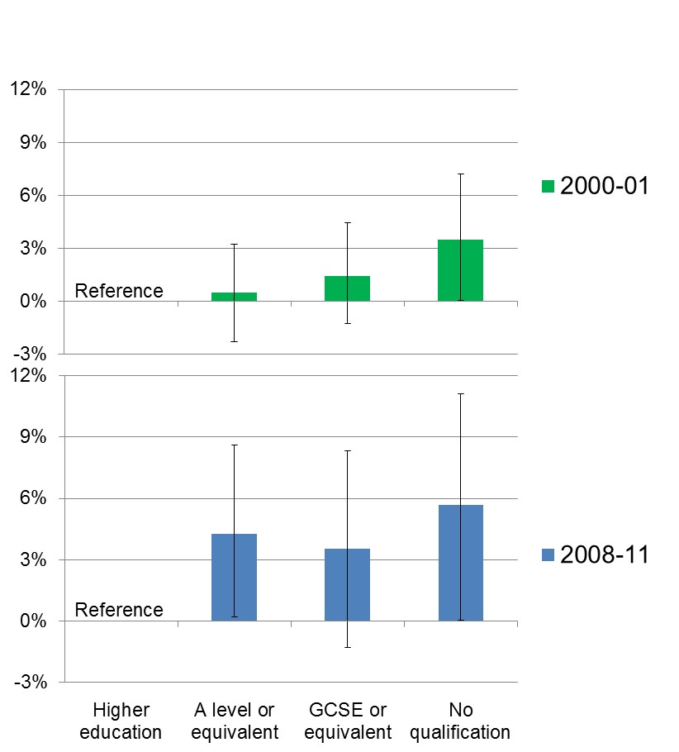
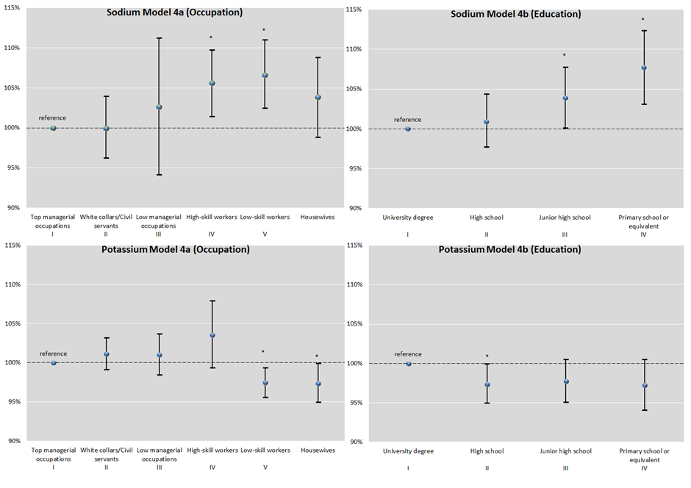
Social inequalities in salt intake
Great Britain
Italy
P linear<0.001
n=2,105
n=3,857
P linear<0.0001
n=1,027
n=3,857
Ji C et al BMJ Open 2013; 3: e002246
Ji C & Cappuccio FP. BMJ Open 2014; 4: e005683
Cappuccio FP et al. BMJ Open 2015;5:e007467

Slide 22
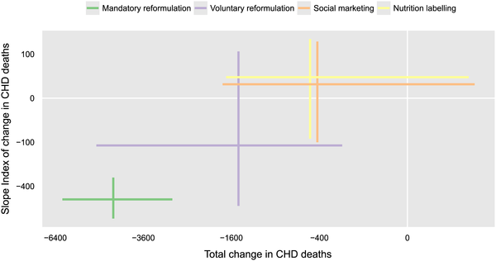
Policy forecast for England up to 2025:
health equity and effectiveness
Greater reduction in low SES
Gillespie DOS et al. PLoS ONE 2015; 10: e0127927

Slide 23
Conclusions
Salt consumption is much higher than needed
High salt intake increases BP in humans
A reduction in salt consumption causes a dose-dependent reduction in BP
Lower salt intake is associated with lower morbidity and mortality from CVD
Population salt reduction programmes are
  feasible and effective (preventive imperative)
  cost-saving in all settings (economic imperative)
  powerful, rapid, equitable (political imperative)
  life saving (moral imperative)
Reduction in salt recommended for the prevention of CVD, especially stroke (WHO 30% reduction by 2025, aim <5g per day)
Global action is under way

