Slide 1
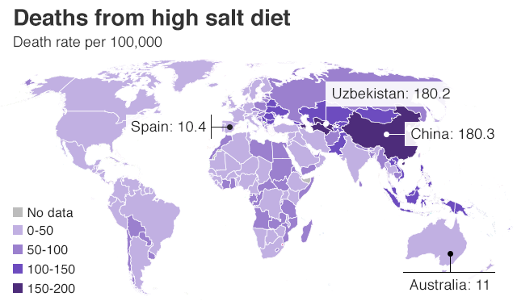
Francesco P Cappuccio MBBS, MD MSc DSc DLSHTM FRCP FFPH FBHS FESC FAHA
Professor of Cardiovascular Medicine & Epidemiology & Consultant Physician
Director, ESH Centre of Excellence
Head, WHO Collaborating Centre
President, British and Irish Hypertension Society
University of Warwick and UHCW NHS Trust, Coventry, UK
Parallel Session 1: Salt

Slide 2
Plan
Preventive imperative: the evidence linking salt, blood pressure and cardiovascular outcomes
Methodological imperative: 24h vs spot urine collections
Profit vs Public benefit: who gains from controversies?
Economic imperative: cost-effectiveness
Political imperative: global action
Moral imperative: Lives saved
Feasibility: case studies from Moldova and Montenegro

Slide 3
SALT
BP
CVD
75% or more of salt in food derives from salt added in the manufacturing process.
Individuals only control a small part of the salt they eat.
A reduction in salt intake causes a dose-dependent fall in BP.
The fall is greater as we get older, as a function of baseline BP and in people of black African ancestry.
High salt intake is associated with high mortality from stroke, CHD and CVD.
A reduction in salt intake reduces the incidence of vascular events.
Long-term surveillance confirms benefits of reduced salt on CV outcomes
Cappuccio FP. Chapter 44.6. ESC Textbook of Cardiovascular Medicine. 3rd ed. 2018

Slide 4
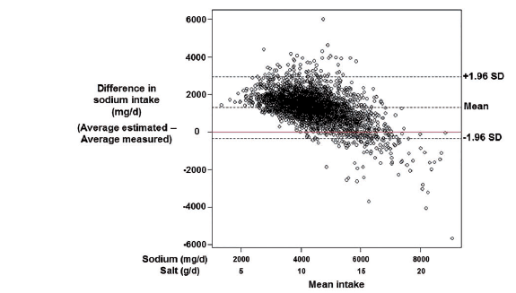
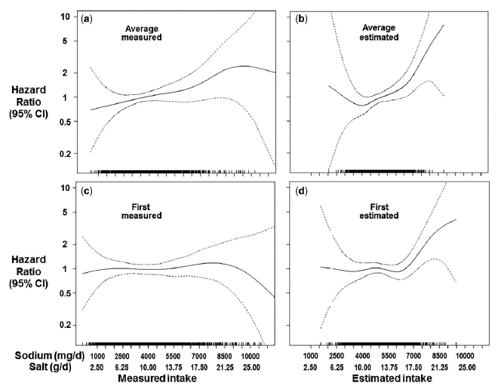
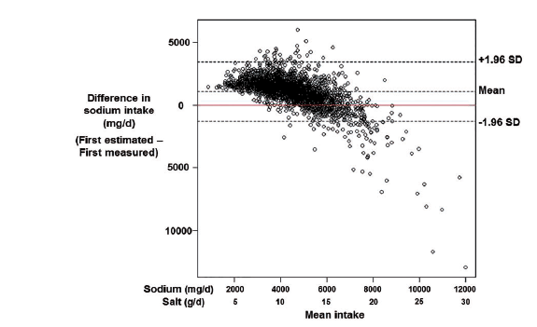
Errors in estimating usual sodium intake by the Kawasaki formula alter its relationship with mortality
Bias
Multiple 24h urine collections
Spot urine and Kawasaki
He FJ et al. Int J Epidemiol 2018; 47: 1784-95

Slide 5
Spot urine collections inadequate to monitor changes in population salt reduction programmes
24h
Tanaka
Kawasaki
Average population salt reduction (g/day)
Huang L et al. Int J Epidemiol 2018; 47: 1811-20

Slide 6
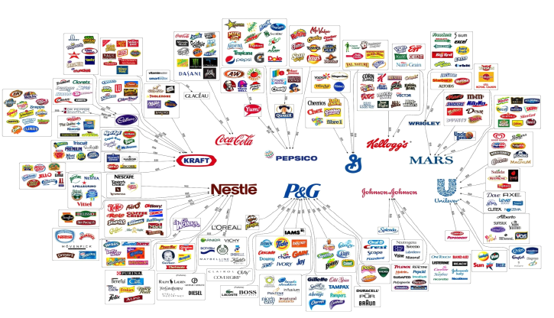
Who owns what in the food industry?
Source: Fritz Kreiss/Occupy Monsanto
“The world’s 10 largest food and non-alcoholic beverage companies feed daily an estimated
global population of several hundred million in >200 countries, generating a combined annual
revenue of >$422b” (Source: IFBA, 2012)

Slide 7
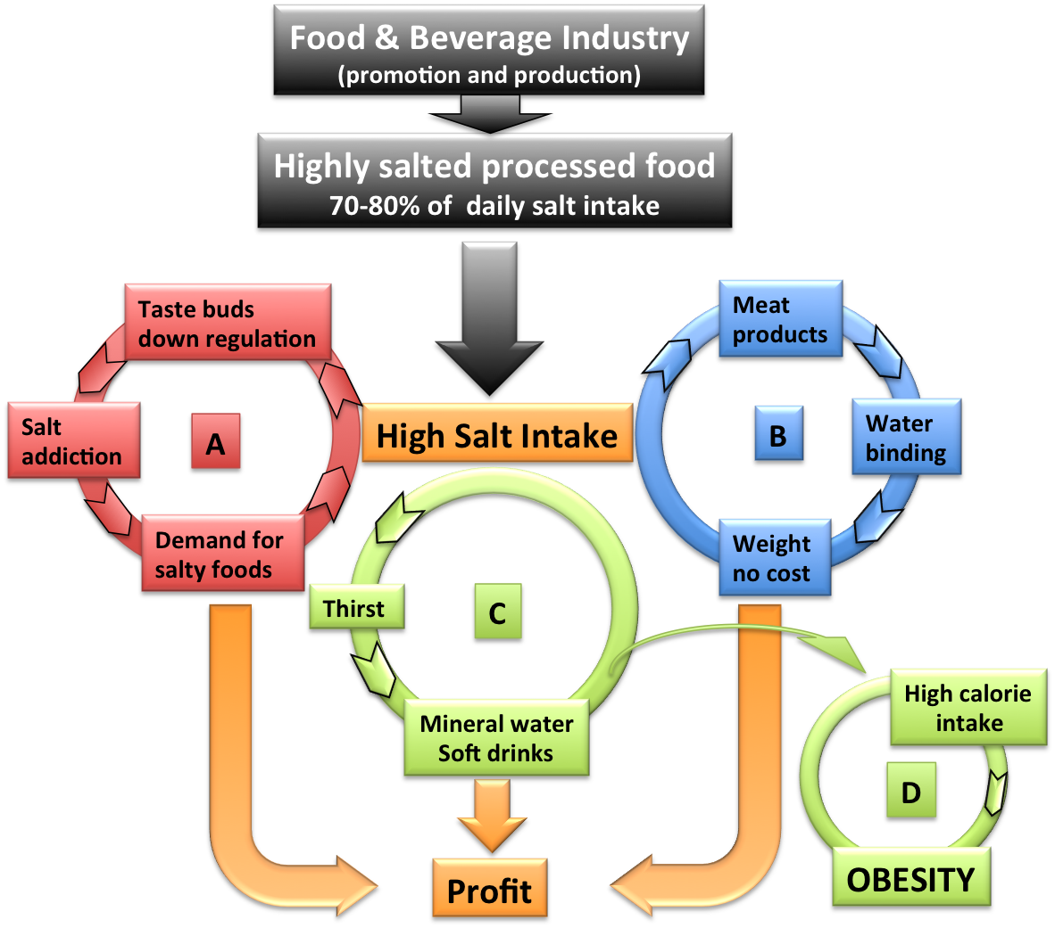
Profit vs Public Benefit
High salt in processed and manufactured food leads to profit to industry, not to health benefits!
Palatability – bad food edible
Taste addiction – demand
Hygroscopic properties – weight at extra cost
Thirst - drinks (sugary, carbonated, alcoholic)
Obesity
Cappuccio FP, Capewell S. Functional Food Reviews 2015; 7(1): 41-61.

Slide 8
Cost-effectiveness
A reduction in salt intake of 3g per day would save 194,000-392,000 QALYs and $10-24b in health care costs annually in the US, i.e. a return of $6-12 for every $ spent¹
Even modest reduction of 1g per day would be cost saving and more cost-effective that using medications to lower blood pressure¹
Population reductions in salt intake through food reformulation from industry would be cost-saving.
However, whilst ‘voluntary ‘ action by the food industry is cost-effective, population health benefits could be 20 times greater with Government legislation of moderate salt limits in processed foods²
¹Bibbins-Domingo K et al. NEJM 2010; 362: 590-9
²Cobiac LJ et al. Heart 2010; 96: 1920-5

Slide 9
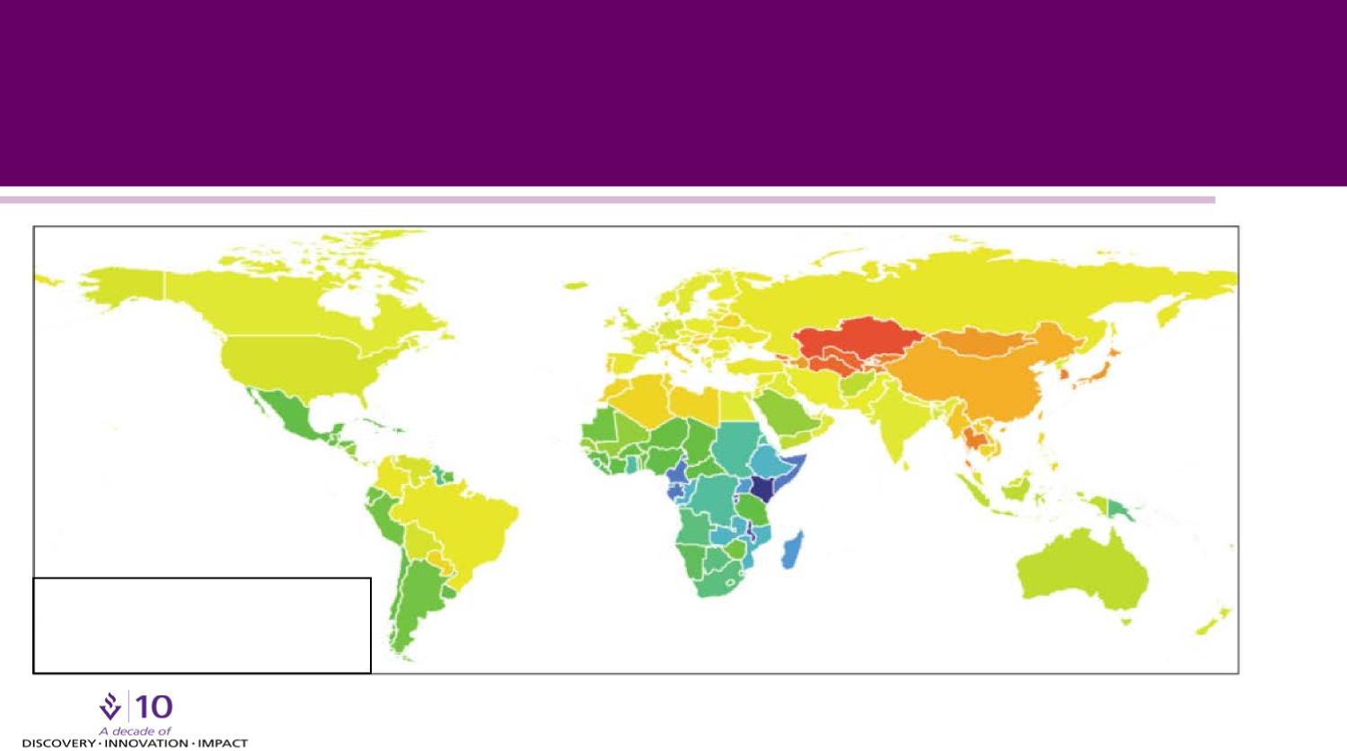
High salt consumption around the world – mostly estimated!
10.0 g/day
12.5 g/day
7.5 g/day
WHO target
5 g/day max.
Average Global Consumption 10.2 g/day
Powles J et al. BMJ Open 2013;3:e003733
Notes:
Prospective Studies Collaboration. Age-specific relevance of usual blood pressure to vascular mortality: a meta-analysis of individual data for one million adults in 61 prospective studies. Lancet. 2002;360:1903-1913.

Slide 10
Components of a strategy to reduce population salt intake
Communication
Public Awareness Campaigns
Food industry
Reformulation
Setting Targets
Industry Engagement
Monitoring
Population salt intake
Reformulation progress
Decision makers
Media
Health Professionals
Motivation
Costs & Benefits
Consumer awareness
Wider support
Corporate responsibility
Reformulation
Labelling
Effectiveness of communication
Urinary sodium
Dietary surveys
Salt content of foods (databanks; self-reporting by industry; market surveys)
Benchmarking food categories
Consumers
Measuring awareness of campaigns
Measuring attitudes and behaviour changes
Research
Epidemiology
Nutrition
Public Health
Food technology
Behavioural
Voluntary vs Regulatory
Evaluation
Policy
Cappuccio FP et al. BMJ 2010; 343: 402-5

Slide 11
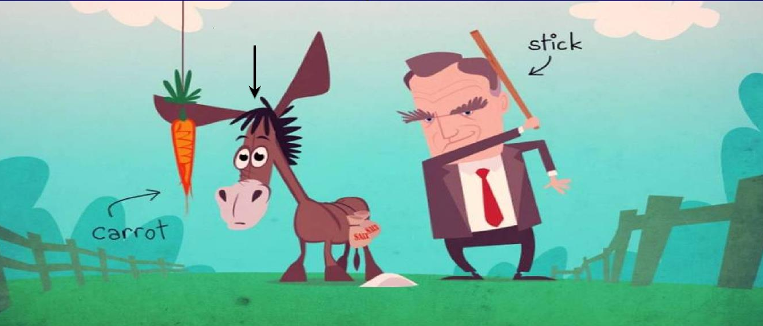
The voluntary ‘carrot and stick’
approach
food
industry

Slide 12
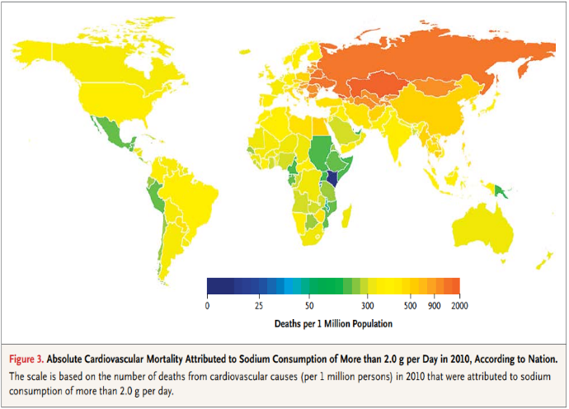
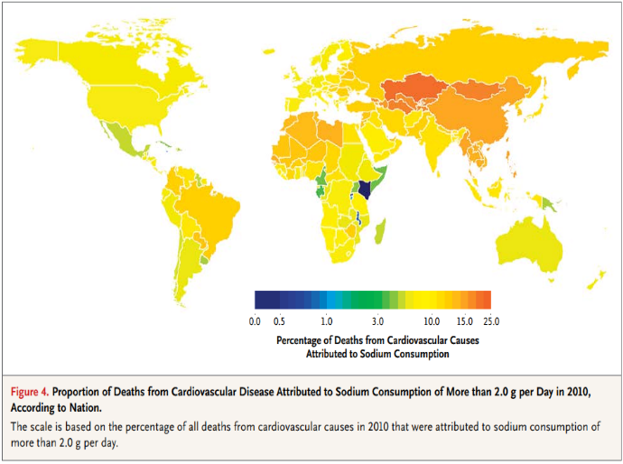
Absolute and proportional CV deaths attributable to sodium intake >2g per day (salt >5g per day)
In 2010, global sodium consumption estimated at 3.95g per day (9.875g salt per day)
Globally, 1.65m annual CV deaths attributed to sodium intake >2g per day (>5g salt per day)
These deaths accounted for nearly 10% of CV deaths
85% of these deaths occurred in LMICs and 40% were premature (<70 years)
1.0g lower salt intake reduces CHD and stroke by 4.8%
12.9m CV deaths averted in the world every year
At least as many non-fatal events each year
Mozaffarian D et al. NEJM 2014:371:624-34

Slide 13
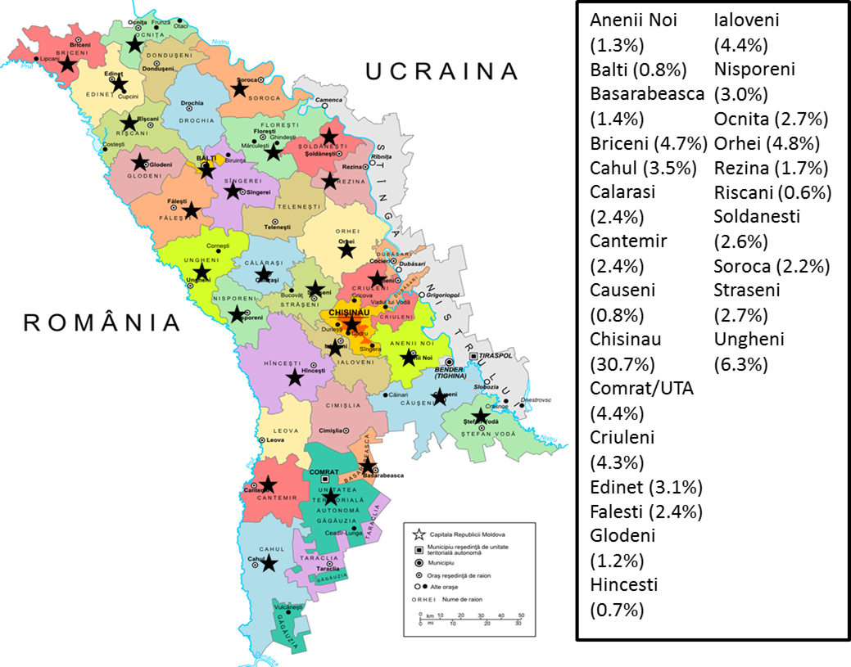
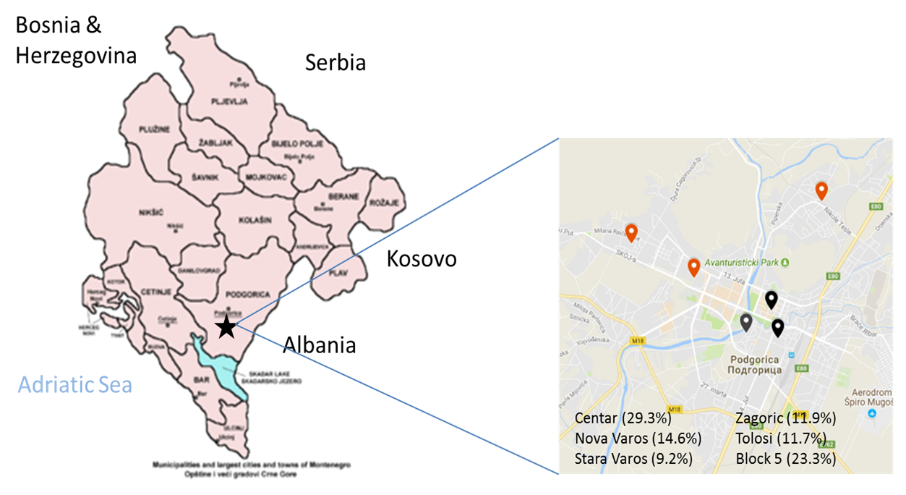
Geographical sampling
Moldova
Montenegro
Survey design in 3 STEPS (based on WHO STEPS): Questionnaire, physical measurements, 24h urine collections.
Selection from residents of all districts and municipalities
Initial total sample 1,307.
Field work 21 Jul – 5 Sep 2016.
After exclusions, final sample of 858 (66%).
326 men and 532 women.
Selection from registered patients in six units of primary health centres in Podgorica.
Sex- and age-stratified random sampling.
Initial total sample 1,008.
Field work 15 Sept – 15 Dec 2017.
After exclusions, final sample of 639 (63%).
285 men and 354 women.

Slide 14
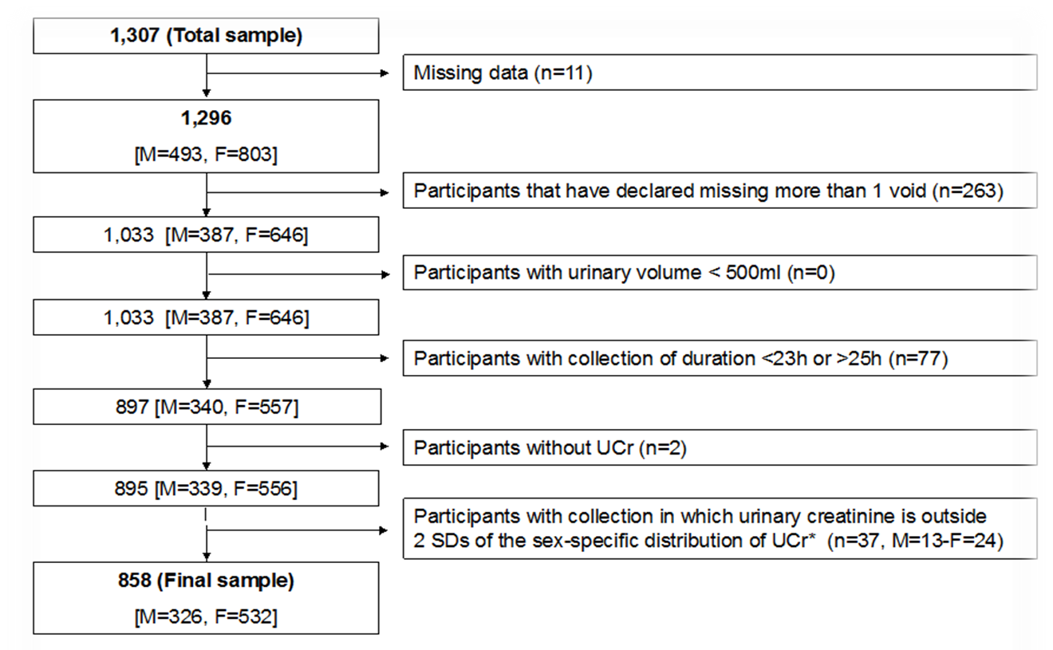
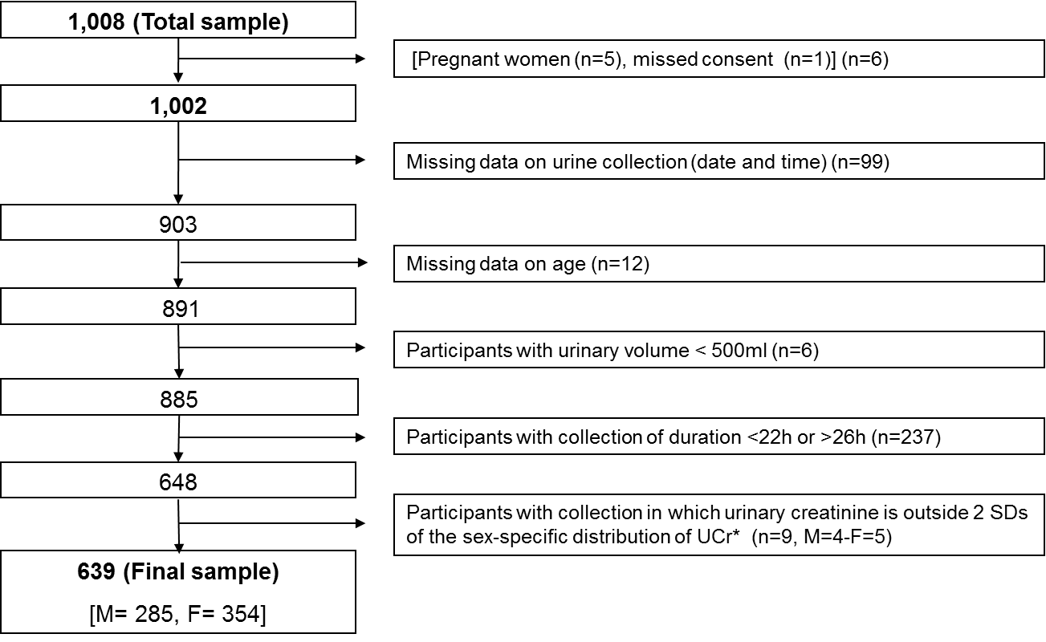
Stepwise quality control of complete urine collections
Moldova
Montenegro
66%
63%

Slide 15
Population salt intake (g per day)
P<0.001
P<0.001

Slide 16
Impact of population salt reduction
In both Moldova and Montenegro, salt intake in high and potassium consumption is low, both in men and women.
In Moldova
Only 11.3% of the population meets WHO salt targets whilst an encouraging 49.7% meets WHO potassium targets.
To meet WHO targets by 2025, a reduction of 3.24 g per day is needed.
It would predict a 7.9% fewer CVD events and 10.7% fewer strokes per year.
In Montenegro
Only 7% of the population meets WHO salt targets and only 13% meets WHO potassium targets.
To meet WHO targets by 2025, a reduction of 3.6g per day is needed.
It would predict a 12.2% fewer CVD events and 16.5% fewer strokes per year.

Slide 17
Conclusions
Salt consumption is much higher than needed
High salt intake increases BP in humans
A reduction in salt consumption causes a dose-dependent reduction in BP
Lower salt intake is associated with lower morbidity and mortality from CVD
Population salt reduction programmes are
  feasible and effective (preventive imperative)
  cost-saving in all settings (economic imperative)
  powerful, rapid, equitable (political imperative)
  life saving (moral imperative)
Reduction in salt recommended for the prevention of CVD, especially stroke (WHO 30% reduction by 2025, aim <5g per day)
Global action is under way

