Slide 1
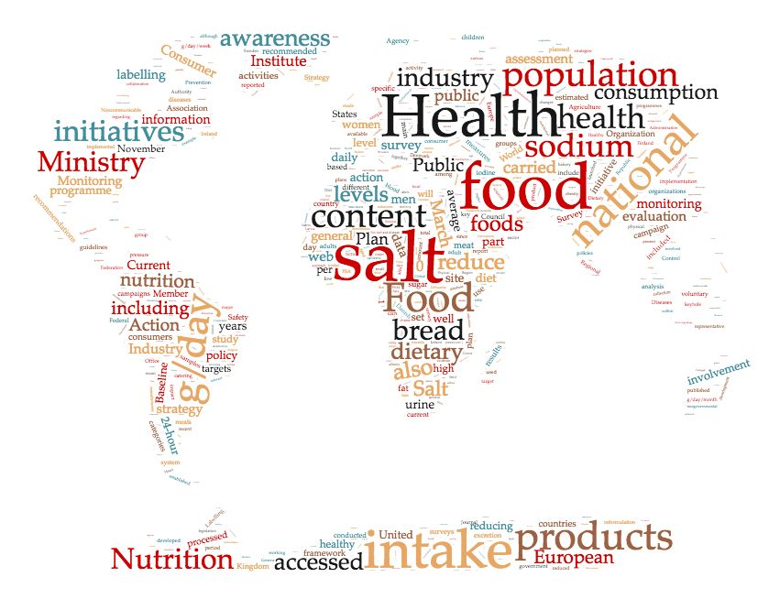
Reduction in sodium (salt) intake to reduce CVD:
implications for actions in children and adolescents
Francesco P Cappuccio
MBBS MD MSc DSc FRCP FFPH FBIHS FESC FAHA
Professor of Cardiovascular Medicine & Epidemiology Head, WHO Collaborating Centre for Nutrition Past-President, British and Irish Hypertension Society University of Warwick, Coventry, UK
https://www2.warwick.ac.uk/go/cappuccio/who
Preventive
Economic
Political
Moral

Slide 2
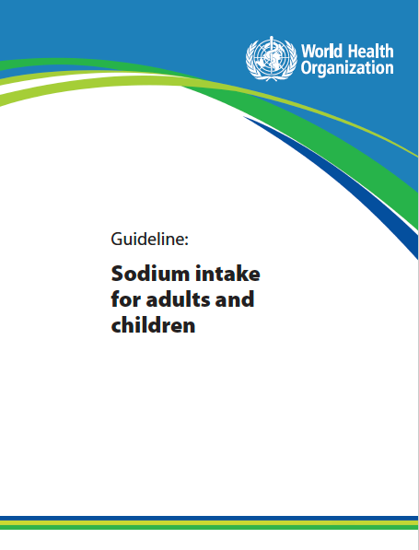

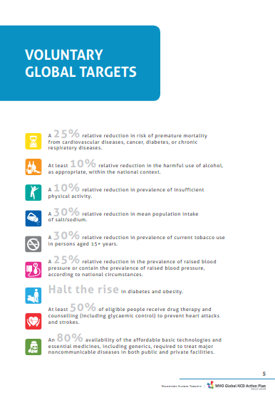
World Health Organization position on population
dietary sodium reduction
Reduction in sodium intake to reduce BP and CVD in adults to <2g per day (5g salt per day)♰.
To control BP in children targets should be adjusted downwards based on the energy requirements of children relative to those of adults.
Salt reduction
♰1g of sodium in 2.5g of salt
Notes:
In 2012 WHO published evidence-based guidelines with recommendations for a reduction in sodium intake to reduce BP and CVD in adults to <2g per day (5g salt/day). Furthermore, to control BP in children the maximum targets for adults should be adjusted downwards based on the energy requirements of children relative to those of adults.
Population sodium reduction is one of the priorities worldwide is to reduce the burden of CVD, which is the first killer in the world with coronary heart disease and stroke. One of the priorities to achieve that goal is to reduce population salt consumption by at least 30% by 2025, with a long-term aim to reaching no more than 5g of salt per day.
What is the evidence to justify this public health measure?

Slide 3
Sodium (Salt)♰ reduction: key facts
High sodium consumption (>2 g/day, equivalent to 5g salt/day) causes high blood pressure and increases the risk of CVD.
The main source of dietary sodium is salt (also from MSG, soy sauce, other condiments used in many parts of the world).
Most people consume too much salt (on average 9–12 g/day).
The principal benefit of lowering salt intake is a reduction in high blood pressure (hypertension).
Salt intake <5 g/day for adults helps to reduce blood pressure and risk of CVD.
WHO Member States agreed to reduce the global population’s intake of salt by a relative 30% by 2025.
Reducing salt intake is one of the most cost-effective measures to improve population health outcomes.
About 2.5 million deaths per year could be prevented if global salt consumption were reduced to the recommended level.
♰1g of sodium in 2.5g of salt
https://www.who.int/news-room/fact-sheets/detail/salt-reduction

Slide 4
Salt reduction: imperatives and implications for children and adolescents
Population salt reduction programmes are
feasible and effective (preventive imperative)
cost-saving in all settings (economic imperative)
powerful, rapid, equitable (political imperative)
life saving (moral imperative)
Effects on BP start early in life and are sustained during childhood and adolescence.
Recommended maximum intake of salt for children should be adjusted downwards.
High salt may contribute to obesity and low peak bone mass.
Preventive
Economic
Political
Moral

Slide 5
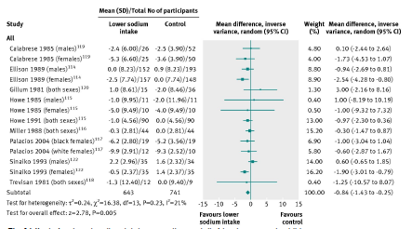
A reduction in sodium intake reduces blood pressure
in children and adolescents
Aburto NJ et al. BMJ 2013; 346: f1326

Slide 6
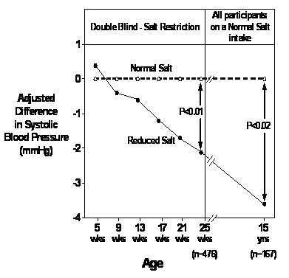
A reduction in salt intake for 6 months reduced the rise in blood pressure in newborn babies.
15 years later, the difference in blood pressure between the two groups originally assigned to different salt intakes remained (long-lasting memory effect?)
Adapted from: Hofman A, et al. JAMA 1983; 250: 370-3 and Geleijnse JM, et al. Hypertension 1997; 29: 913-7

Slide 7
School-based salt education to reduce salt intake in children and their families in northern China
Cluster RCT in 28 primary schools in urban Changzhi, northern China
279 children (mean age 10.1 years)
553 adult family members (mean age 43.8 years)
Intervention: salt education to children → children educating families
Duration: 3.5 months
Baseline salt intake:
children 7.3 (I) v 6.8 (C) g/day
adults 12.6 (I) v 11.3 (C) g/day
Salt intake
(g/day)
SBP
(mmHg)
children
children
adults
adults
He FJ, et al. BMJ 2015; 350: h770

Slide 8
Components of a strategy to reduce population salt intake
Three-pillar approach
Communication
Public Awareness Campaigns
Food industry
Reformulation
Setting Targets
Industry Engagement
Monitoring
Population salt intake
Reformulation progress
Decision makers
Media
Health Professionals
Motivation
Costs & Benefits
Consumer awareness
Wider support
Corporate responsibility
Reformulation
Labelling
Effectiveness of communication
Urinary sodium
Dietary surveys
Salt content of foods (databanks; self-reporting by industry; market surveys)
Benchmarking food categories
Consumers
Measuring awareness of campaigns
Measuring attitudes and behaviour changes
Research
Epidemiology
Nutrition
Public Health
Food technology
Behavioural
Voluntary vs Regulatory
Evaluation
Policy
Cappuccio FP et al. Br. Med. J. 2010; 343: 402-405

Slide 9
Where does sodium come from in our diet?
In regions where most food is processed or eaten in restaurants
Natural
’Consciously’
added
‘Hidden’
J Am College of Nutrition 1991;10: 383-93.
Notes:
Most of the sodium we eat (>75%) derives from sodium added to food rather than from natural sources. Only about 12% is natural and another 11% is added by us when we cook or at the table before eating our food.
9

Slide 10
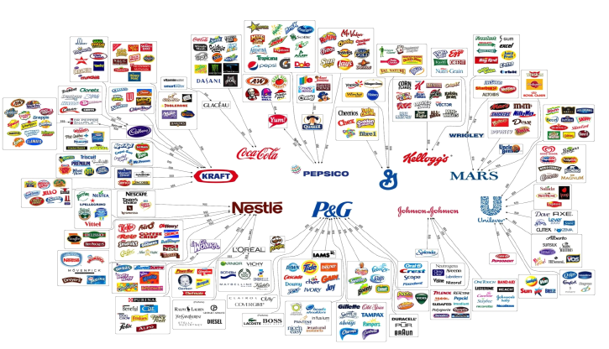
Who owns what in the food & beverage industry?
“The world’s 10 largest food and non-alcoholic beverage companies feed daily an estimated global population of several hundred million in >200 countries, generating a combined annual revenue of >$422b” (Source: IFBA, 2012)
Source: Fritz Kreiss/Occupy Monsanto

Slide 11
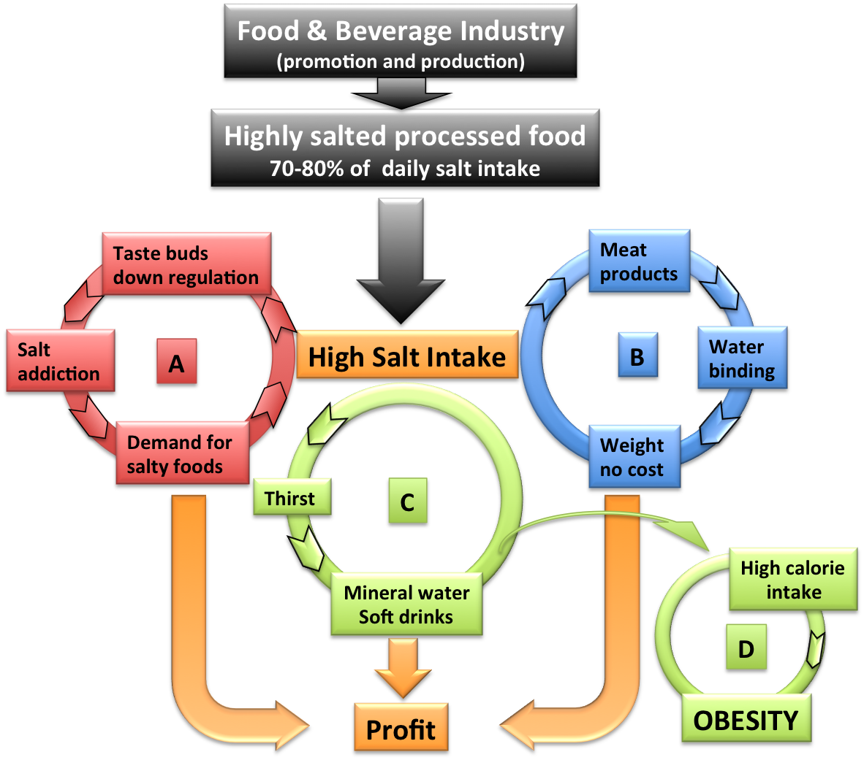
The ‘cycle of profit’ vs public health
High salt in processed and manufactured food leads to profit to industry, not to health benefits!
Palatability – bad food edible
Taste addiction – demand
Hygroscopic properties – weight at extra cost
Thirst - drinks (sugary, carbonated, alcoholic)
Obesity
Cappuccio FP, Capewell S. Functional Food Reviews 2015; 7(1): 41-61.
Notes:
High salt in processed and manufactured food leads to profit to industry for several reasons.
This “cycle of profit scheme” illustrates how salt in foods generates profit: by increasing PALATABILITY and TASTE ADDICTION (in RED), it makes bad food edible and increases demand; through its HYGROSCOPIC PROPERTIES (in BLUE), it increases the water content of meat products with increase in weight at no extra costs; by generating THIRST (in GREEN), it increases drinking, including high-energy sugary as well as alcoholic drinks. This latter effect is now known to be a contributing factor in fueling obesity, both in adults and in children and adolescents.

Slide 12
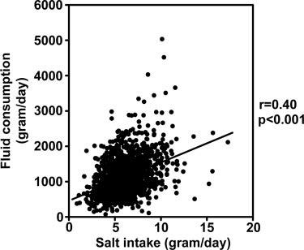
Effect of salt intake on thirst and fluid intake.
Implications for childhood obesity?
In adults, reducing salt intake by half (eg: from ~10 g/d to 5 g/d), would reduce fluid intake by ~350 mL/d per person.¹
In children, a difference in 1 g/d in salt intake is associated with a difference of 100 ml and 27 g/d in total fluid and sugar-sweetened soft drink consumption, respectively.²
If salt intake in children in the United Kingdom was reduced by half (mean decrease: 3 g/d), there would be an average reduction of ~2.3 sugar-sweetened soft drinks per week per child.²
¹He FJ et al. Hypertension 2001; 38: 317-20 ²He FJ et al. Hypertension 2008; 51: 629-34
Notes:
In adults, reducing salt intake by half (eg: from ~10 g/d to the WHO recommended 5 g/d), would reduce fluid intake by ~350 mL/d per person. This is equivalent to a can of soft drink per person per day.
In children, a difference in 1 g/d in salt intake is associated with a difference of 100ml and 27 g/d in total fluid and sugar-sweetened soft drink consumption, respectively.
If salt intake in children in the United Kingdom was reduced by half (mean decrease: 3 g/d), there would be an average reduction of ~2.3 sugar-sweetened soft drinks per week per child.
You can rapidly work out the profit loss to the soft-drink industry!

Slide 13
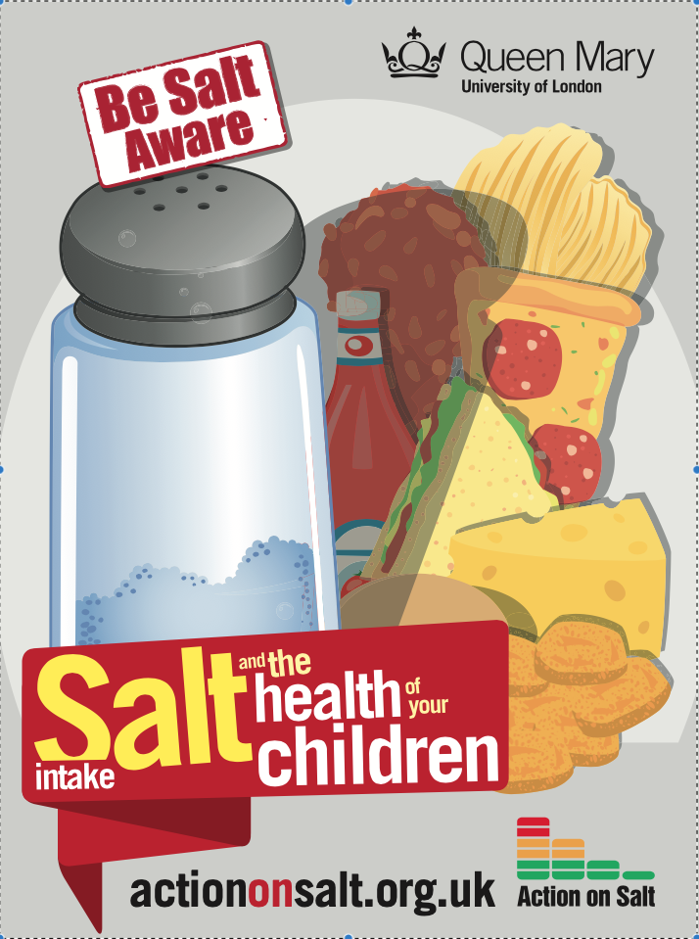
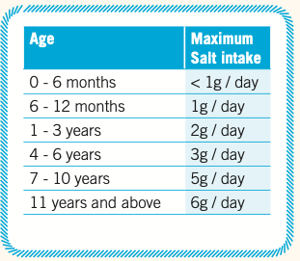
How much salt should children eat?

Slide 14
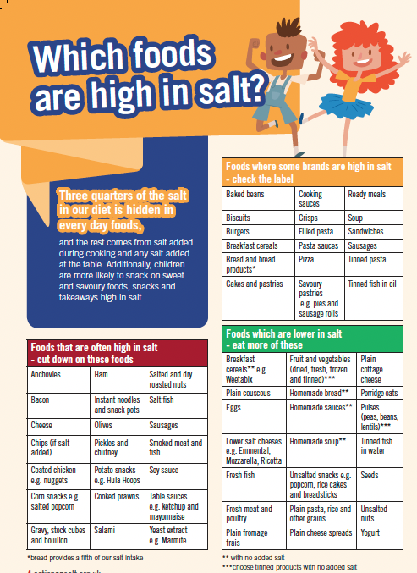
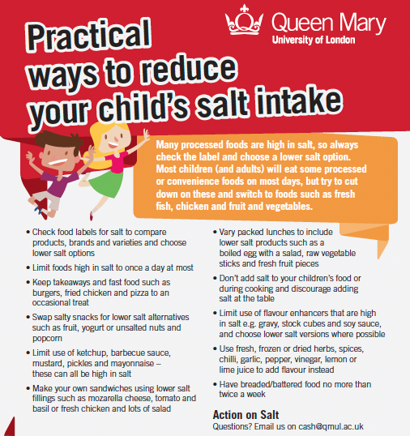
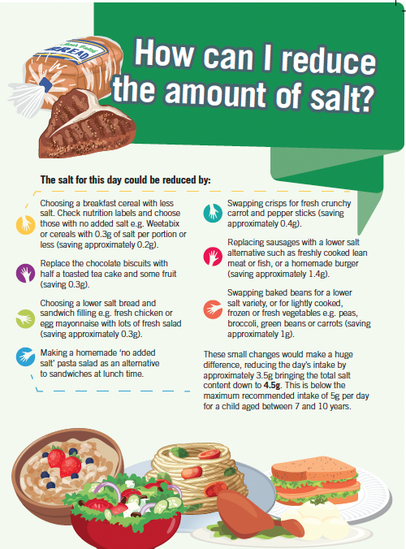
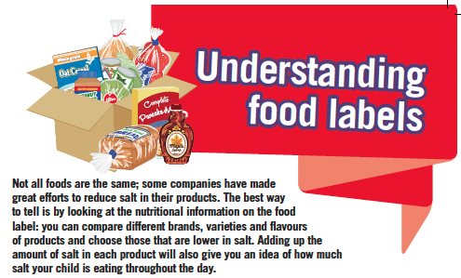

How can we enable them and their parents?

Slide 15
Effectiveness hierarchy of dietary
salt reduction policies
DOWNSTEAM (Agentic) UPSTREAM (Structural)
Hyseni L et al. PLoS ONE 2017; 12(5): e0177535
Notes:
The effectiveness of population salt reduction programmes, measured by the amount of salt reduction achieved (seen on the Y axis), becomes greater and cheaper the more upstream measures are implemented, like the involvement of the industry with either voluntary or mandatory food reformulation of benchmark food categories.

Slide 16
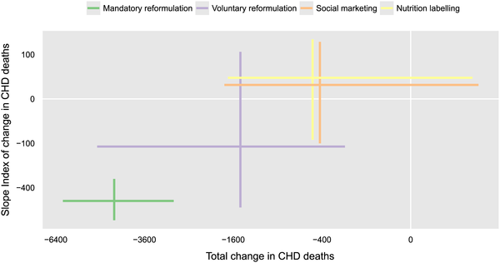
Policy forecast♰ of different policies on
health equity and effectiveness
Greater reduction in low SES
Gillespie DOS et al. PLoS ONE 2015; 10: e0127927
♰Modelling based on England up to 2025
Notes:
As for other unhealthy dietary patterns, salt consumption in unequally distributed in society, being highest in the most socio-economic deprived groups. One of the reasons whereby social inequalities in salt consumption were not reduced or abolished in England & Wales, for example, despite a successful national programme leading to 1.6g average reduction between 2003 and 2011 is, in part, attributable to the fact that in Britain there were no mandatory measures for reformulating. This graph clearly shows using different modelling scenarios, that the socio-economic gap can only be significantly reduced if mandatory reformulation is considered (GREEN ESTIMATE).
CONCLUSIONS: combat poverty, increase access to school education, increase health literacy of adult population, front-of-package labelling for salt, mandatory regulation of food processing as far as salt content is concerned, sugar tax and levy on high-energy drinks, stricter regulation on advertising junk food to children, are only some of the measures of an effective health policy to protect children from exposure to high salt intake.
You will notice the analogy with policies in other areas of nutrition….

