Slide 1

Introduction to the Warwick Chemistry Diversity Book Club
Introduction to Book 4 – Unconscious Bias

Slide 2



Why we started the Diversity Book Club
To improve diversity in the chemical sciences we must first educate ourselves and be aware of the diversity issues that prevail within our community
The Diversity Book Club provides an opportunity to work together to connect, communicate and reflect on these topics.
STEM & Diversity Group

Slide 3

The diversity themes
Theme | Corresponding Book | Corresponding RSC Report
Race | Superior - Angela Saini | Diversity Landscape of the Chemical Sciences
Gender | Invisible Women - Caroline Criado Perez | Breaking the Barriers
Sexual Orientation | Straight Jacket: How to be gay and happy - Matthew Todd | Exploring the Workplace for LGBT+ Physical Scientists
Unconscious Bias | Sway - Dr Pragya Agarwal | Is publishing in the chemical sciences gender biased?

Slide 4



Expectations for Discussion Sessions
In order to get as much out of the Book Club as possible, this is what is expected of each participant:
Read
Each month you will be given a portion to read
Reflect
Answer the questions in the Question Booklet BEFORE the session
Attend
Make sure to come along once a month to your 1-hour Book Club discussion
Want to emphasise: just do what you can!!

Slide 5
Opportunity to contribute EDI initiatives
After each book, there will be an optional brainstorming session on ED&I initiatives in the department, evaluating what exists, what works well and if we can apply our learnings from the book to action within the department.
We’d love you to attend this and help drive for change!
Details of how to report an issue can be found in the Participant Guide

Slide 6
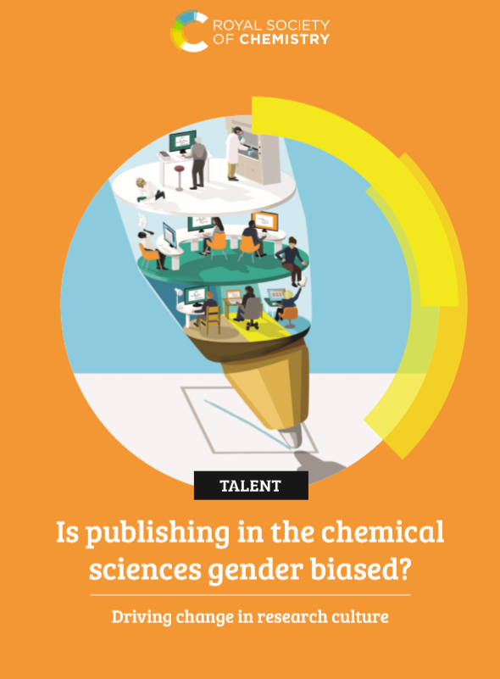
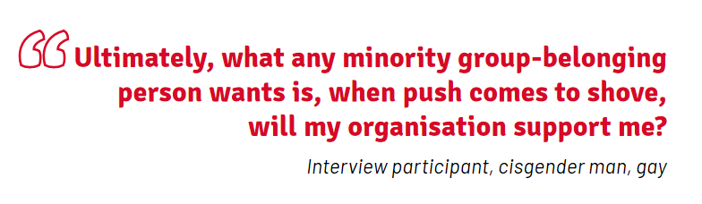
Fourth diversity theme: UNCONSCIOUS BIAS
“We found that there is a complex interaction of subtle biases occurring
throughout the publishing pipeline, which combine to put women at a
disadvantage when disseminating their research. We must recognise where this happens.”
Study conducted as an extension of “Diversity Landscape of the Chemical Sciences” Report (Book 2)
Analyses the gender profile of the publishing pipeline of the Royal Society of Chemistry’s journals between 2014 and 2018
Notes not all biases are unconscious
Call for action in publishing
Biases exist at each step of the publishing profile. Many of these biases appear minor in isolation, yet their combined effect puts women at a significant disadvantage.

Slide 7
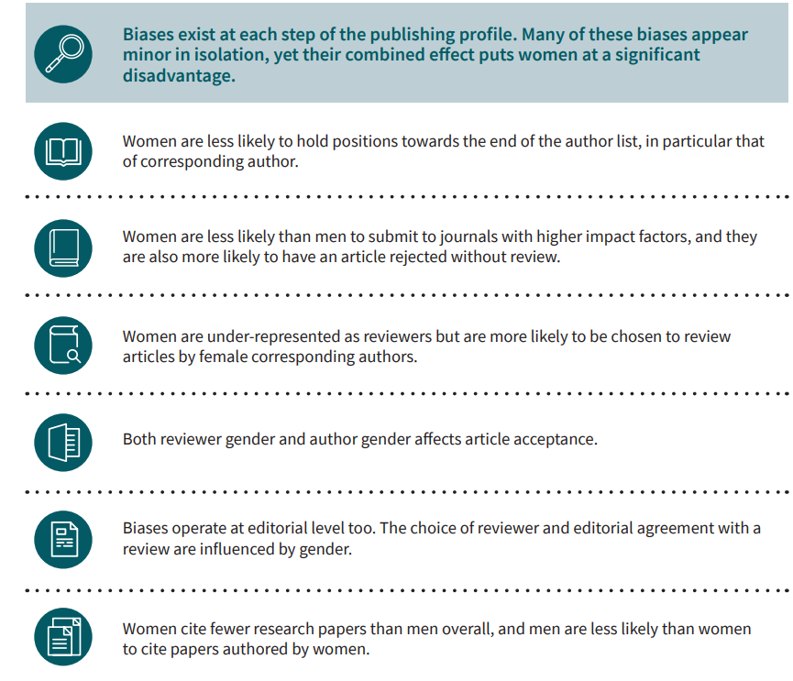
The bias in chemical science publishing

Slide 8

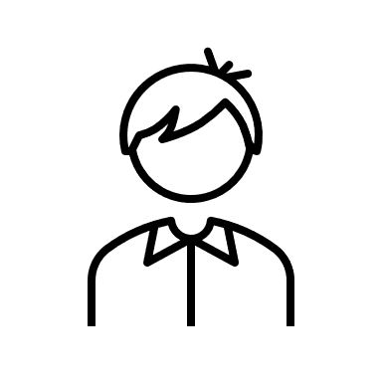

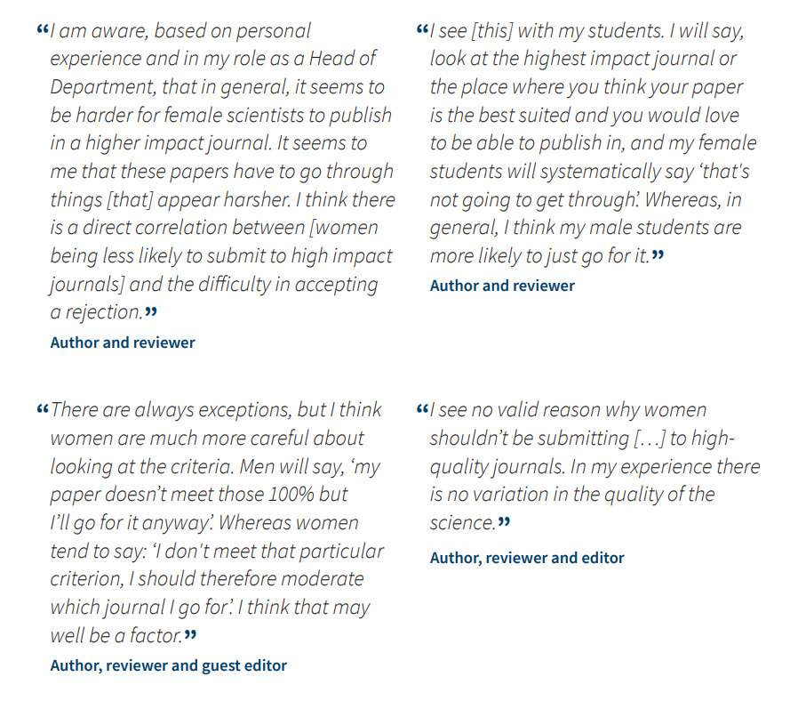
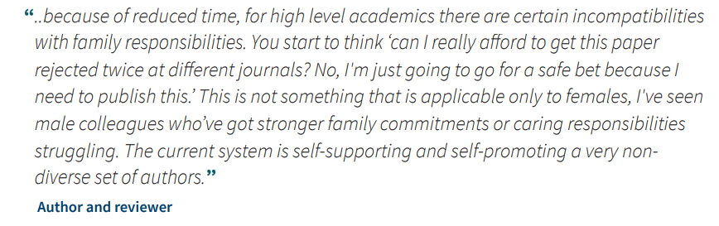
On Impact Factor

Slide 9
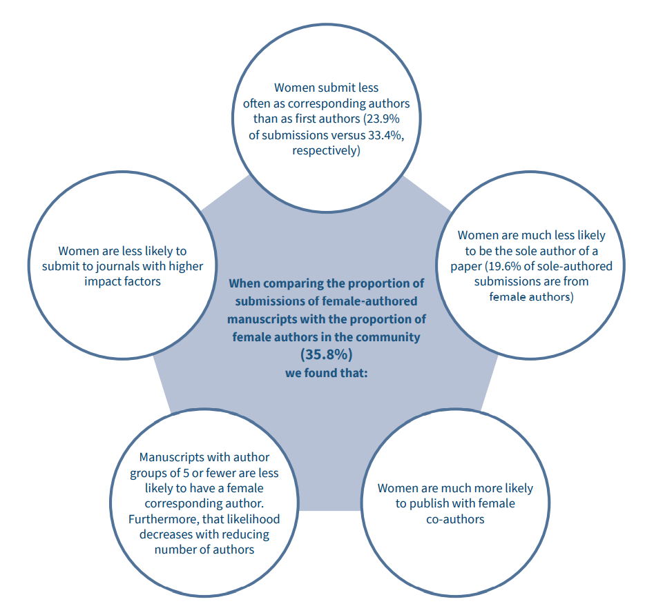
Gender patterns of manuscript submissions
Corresponding authors more likely to be senior academics.
Women lack confidence to submit to higher impact factor journals? Women have less funding to do the “big impact” projects?
Are women more collaborative? Is this by choice or necessity?
Tight-knit groups of men are less likely to have female colleagues?
Do women inspire women to work with them? Do they get more support from female colleagues?

Slide 10
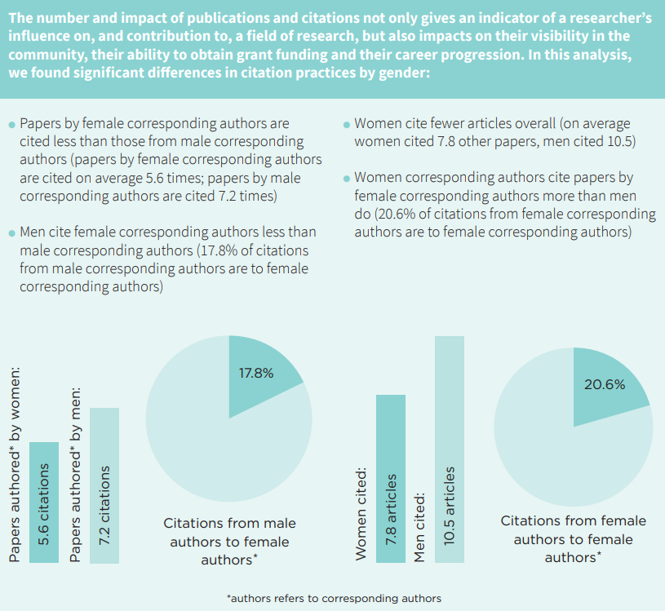
Citation needed

Slide 11
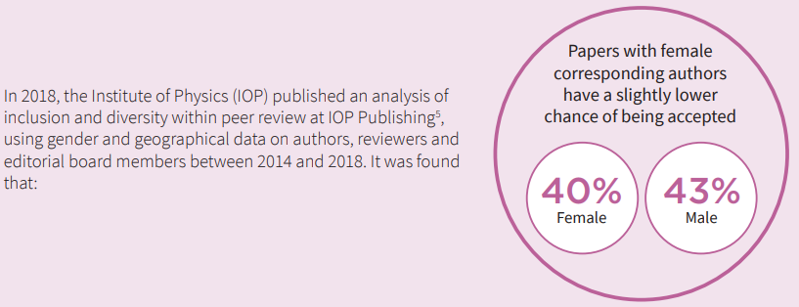
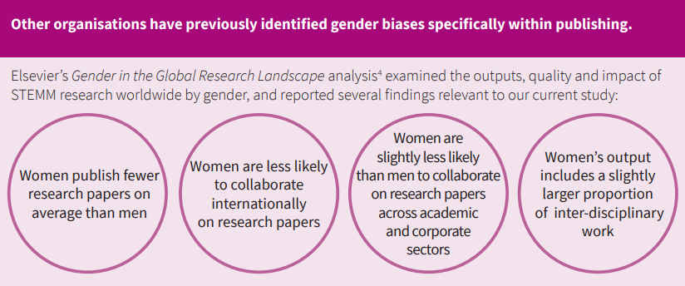
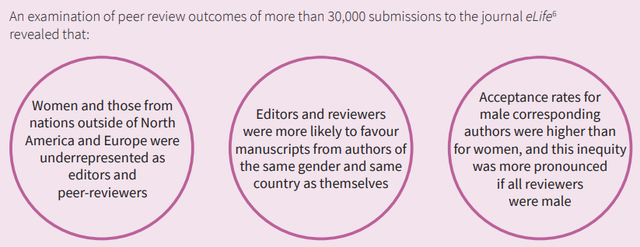
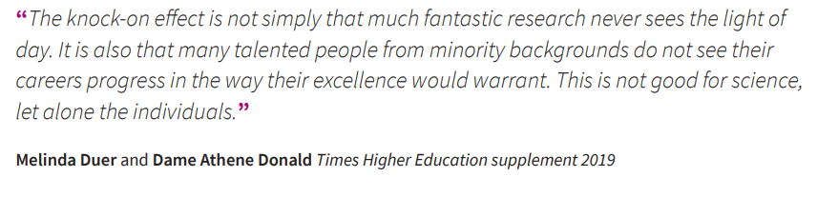
Not just the RSC

Slide 12
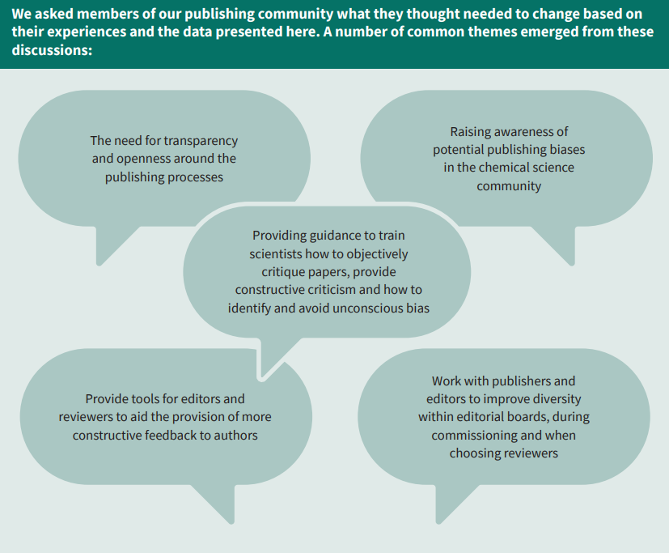
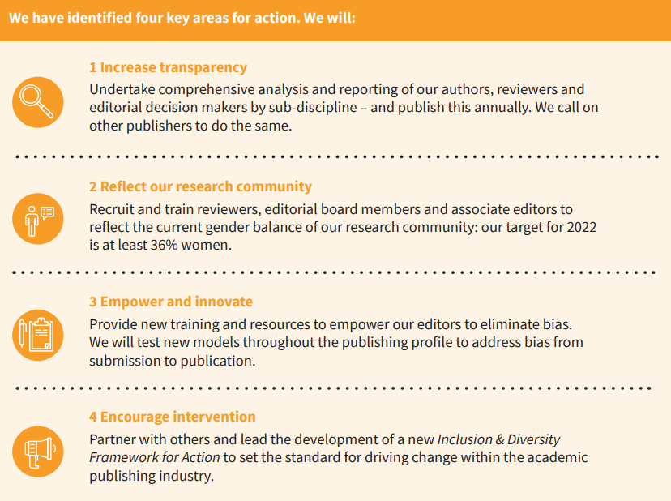
How to improve things?
How do these biases impact the career progression and retention of women in the chemical sciences?

Slide 13
So how can we help?

Slide 14

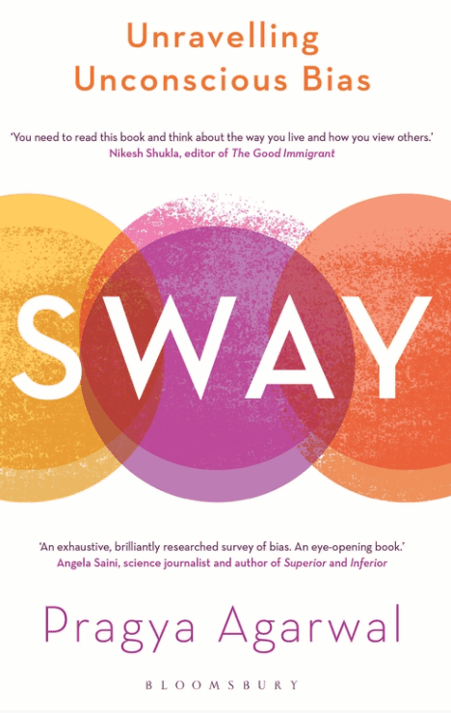
On the Subject of Unconscious Bias
Published April 2020
Uncovers the science behind our "unintentional" biases using real world stories underpinned by scientific theories and research.
“Passionate and Urgent" - The Guardian
“Sway is a truly comprehensive review of what unconscious bias is, how it works, and how we can try to fight it back.”
An eye-opening book that I hope will be widely read.' Angela Saini
It covers a huge number of sensitive topics - sexism, racism, ageism, homophobia, colourism - with tact, and combines statistics with stories to paint a fuller picture and enhance understanding.

Slide 15

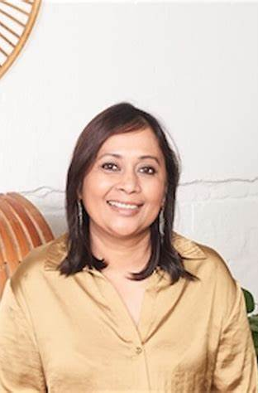
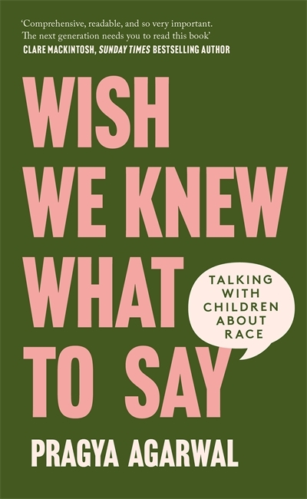
About the author
Prof. Pragya Agarwal
Award winning author| Behavourial Scientist | Academic
Freelance journalist for Forbes, The Guardian, Huffington Post etc.
Works as a consultant and speaker with organisations around the world, including universities and schools, delivering talks and workshops on bias, anti-racism, social inclusion, power and privilege.
A Senior Academic in US and UK universities, she has held the prestigious Leverhulme Fellowship, following a PhD from the University of Nottingham.
Two-time TEDx speaker herself, Pragya organised the first ever TEDxWoman event in the north of the UK
Speaks on racism, sexism, women’s rights, inequities, fairer and happier workplaces, motherhood, reproductive justice, bodies and healthcare bias, and technology and AI.

Slide 16
Thank you!
We really hope you enjoy Book 4!

