Slide 1

Introduction to the Warwick Chemistry Diversity Book Club
Introduction & First Topic Overview

Slide 2



Why we started the Diversity Book Club
To improve diversity in the chemical sciences we must first educate ourselves and be aware of the diversity issues that prevail within our community
The Diversity Book Club provides an opportunity to work together to connect, communicate and reflect on these topics.
STEM & Diversity Group

Slide 3
How the Book Club will work
Based on your time slot choices you have been assigned a Book Club time and group facilitator
Your group facilitator will be in contact to organise the meeting
Will meet monthly (last week of every month)
Each book session will have an accompanying Discussion Booklet
This will enable you to think about the content as you read
It will form the basis of the Book Club discussion

Slide 4
The diversity themes
Theme | Corresponding Book | Corresponding RSC Report
Race | Superior - Angela Saini | Diversity Landscape of the Chemical Sciences
Gender | Invisible Women - Caroline Criado Perez | Breaking the Barriers
Sexual Orientation | Straight Jacket: How to be gay and happy - Matthew Todd | Exploring the Workplace for LGBT+ Physical Scientists
Unconscious Bias | Sway - Dr Pragya Agarwal | Is publishing in the chemical sciences gender biased

Slide 5
What you have been provided with
Group assignment
The group you will participate in the Book Club with
Facilitator
The volunteer who will lead your Book Club session
Book to read
Provided free of charge, to be returned after Book Club concludes
Participant Guide
Containing Code of Conduct, FAQs and contact information
Discussion Booklet
Questions to get you thinking for the first book

Slide 6



Expectations for Discussion Sessions
In order to get as much out of the Book Club as possible, this is what is expected of each participant:
Read
Each month you will be given a portion to read
Reflect
Answer the questions in the Question Booklet BEFORE the session
Attend
Make sure to come along once a month to your 1-hour Book Club discussion

Slide 7
Code of Conduct
During the Warwick Chemistry Diversity Book Club series, we will be discussing a range of different diversity and inclusion themes. The topics that will be discussed include, but may not be limited to: Race, Gender, Sexual Orientation and Unconscious Bias.
It is important to us that you are in a safe, supportive environment to discuss these issues.
By agreeing to be part of the Warwick Chemistry Diversity Book Club you agree to operate under the “Dignity at Warwick” policy at all times.

Slide 8
Code of Conduct
Behave in a way that respects the rights and dignity of others.
Treat others fairly.
Display courtesy and good manners in every interaction appreciating that individuals have different styles and expectations.
Value differences in others and the contribution they make.
Work and study within the University on a co-operative basis.
Demonstrate a commitment to upholding the University's policies on Equality, Diversity & Inclusion.
Details of how to report an issue can be found in the Participant Guide

Slide 9
What to do if inappropriate behaviour arises
In cases of minor breach of code of conduct, speak to your session facilitator after the session.
If you do not feel comfortable speaking to your session facilitator please report the incident to the Book Club facilitators Zoë Ayres (z.ayres.1@warwick.ac.uk) or Bo Kelestyn (bo.kelestyn@warwick.ac.uk)
If you deem it inappropriate to contact Zoë or Bo for any reason, please report the incident via the Warwick Report and Support webpage

Slide 10
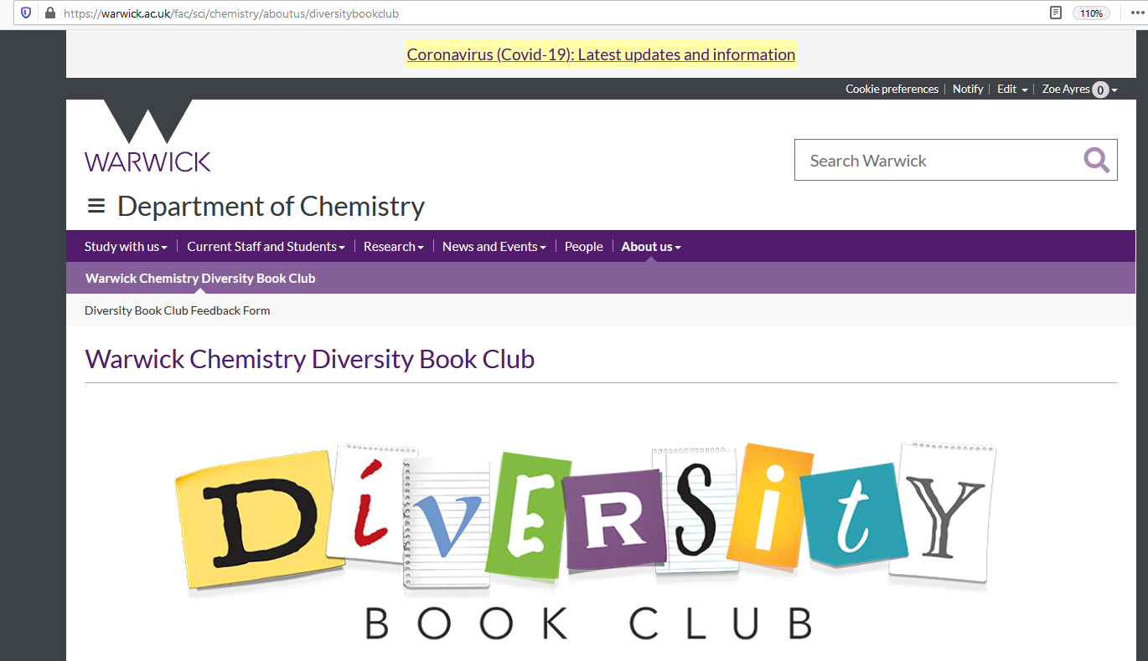
Providing anonymous feedback

Slide 11
Opportunity to contribute EDI initiatives
After each book, there will be an optional brainstorming session on ED&I initiatives in the department, evaluating what exists, what works well and if we can apply our learnings from the book to action within the department.
We’d love you to attend this and help drive for change!
Details of how to report an issue can be found in the Participant Guide

Slide 12
We are learning too!
Q & A time

Slide 13

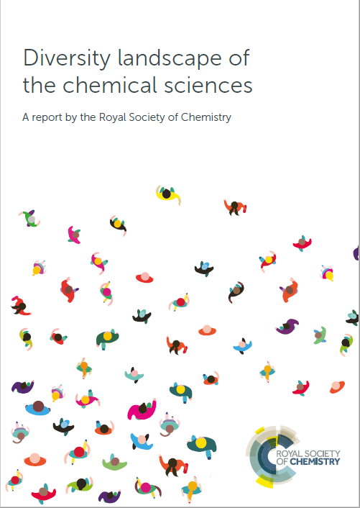
First diversity theme: RACE
"Diverse talent will thrive in an inclusive culture where everybody is valued and treated equally with respect and dignity without any form of discrimination. That’s real inclusion. And what we do know is that if we get the ‘I’ [inclusion] bit right, then the ‘D’ [diversity] bit will follow." - Dame Angela Strank, Chief Scientist, BP, November 2017
Diversity and Equality in race is a key factor in many areas of society, the chemical sciences included, as highlighted by recent world events.
Why might we want to be diverse in Chemistry?
The chemical sciences should represent our society.
Diverse teams produce better science.

Slide 14
First diversity theme: RACE
Our reading list:
"Diverse talent will thrive in an inclusive culture where everybody is valued and treated equally with respect and dignity without any form of discrimination. That’s real inclusion. And what we do know is that if we get the ‘I’ [inclusion] bit right, then the ‘D’ [diversity] bit will follow." - Dame Angela Strank, Chief Scientist, BP, November 2017
Diversity and Equality in race is a key factor in many areas of society, the chemical sciences included, as highlighted by recent world events.
"The chemical sciences should represent our society. Diverse teams produce better science."

Slide 15
Objectives
"The chemical sciences should represent our society.
Diverse teams produce better science."
Motivation behind the work:
In this report, we identify themes around mental health, disability, ethnicity, sexual orientation, gender identity and socioeconomic background where we need to do better. These themes are systemic and interrelated. Most importantly, data are often limited.
There is more work to do and we are impatient for change.
Data are a limiting factor.
Gender equality has received most attention. Although the chemical science community has made progress, it remains a persistent problem.
We cannot do this alone. How do we fit into this as everyday Chemists/working within the field of Chemistry?

Slide 16
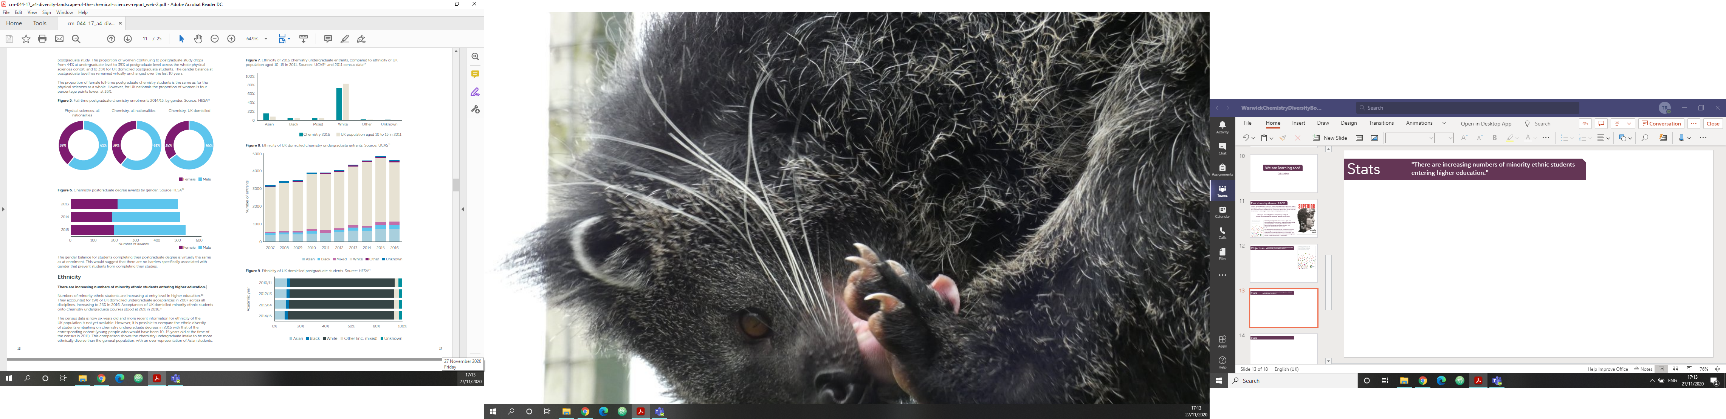
Stats
"There are increasing numbers of minority ethnic students entering higher education."
19% of all UK domiciled undergraduate acceptances in 2007 were from minority ethnic groups, increasing to 25% in 2016.
26% of acceptances onto chemistry undergraduate courses were UK domiciled minority ethnic students in 2016.
Comparison of 2016 data with young people who would have been 10-15 at the time of the 2011 census shows chemistry intake to be more diverse than the general population, with particularly increased representation of Asian students.
(1) UCAS 2016 end of cycle data resources, National level table set – DR3 Applications and acceptances for types of higher education courses, UCAS, 2016, https://www.ucas.com/corporate/data-and-analysis/ucas-undergraduate-releases/ucas-undergraduate-end-cycle-dataresources/applications-and-acceptances-types-higher-education-course-2016
(2) 2011 Census, Office for National Statistics, 2011, https://www.ons.gov.uk/census/2011census

Slide 17
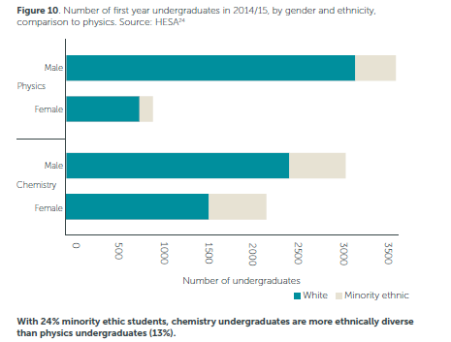
Stats
"Chemistry undergraduates are more ethnically
diverse than physics undergraduates"
Undergraduate Minority ethnic representation by subject:
Chemistry 24%
Physics 13%
For both chemistry (9%) and physics (4%) the proportion of minority ethnic women is higher than for men
A comment on “Othering”: All ethnic groups have been “bundled” together. Is this fair?
Higher education student and staff records, HESA, 2017, https://www.hesa.ac.uk/data-andanalysis. All HESA data has been treated according to the HESA anonymization methodology HESA methodology https://www.hesa.ac.uk/about/regulation/data-protection/rounding-andsuppression-anonymise-statistics

Slide 18
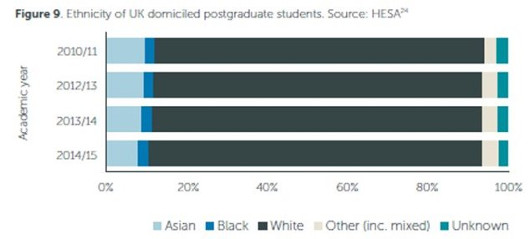
Stats
Postgraduate drop-off?
The proportion of minority ethnic students falls from 26% at undergraduate level to 14% at postgraduate level.
The data show that white students are slightly more likely to progress to postgraduate study than their Asian or black peers.
The proportion of minority ethnic chemical scientists appears to drop dramatically with increasing academic career stage (based on limited/incomplete data).
Higher education student and staff records, HESA, 2017, https://www.hesa.ac.uk/data-andanalysis. All HESA data has been treated according to the HESA anonymization methodology HESA methodology https://www.hesa.ac.uk/about/regulation/data-protection/rounding-andsuppression-anonymise-statistics

Slide 19
HOW to improve diversity
Strong and Visible Leadership
More Research and Analysis
This calls for individuals and organisations to take a lead role in:
• nurturing the next generation of scientists to reach their full potential
• encouraging different leadership styles and cultures
• sharing stories that showcase people from diverse backgrounds, and
• seeking out new thought leadership opportunities, raising a voice with key influencers.
Address gaps in the current evidence base and create a clearer picture of the benefits of a more diverse and inclusive chemical science community.
• Better understanding of areas where we are successful, such as relative diversity among chemistry undergraduates, and
• Better understanding of workplace cultures, including incidents of harassment.
• Sharing of good practice across academia and industry
• Further insight into the interplay between forms of discrimination
Measure Impact
• improving the collection and scrutiny of diversity data across all sectors
• reviewing metrics and indicators for monitoring diversity, inclusion, equality and impact
• identifying new opportunities for sharing strategies, targets and progress
• establishing new levels of transparency on policies for progression and promotion, and
• tracking and reducing pay inequality.
Effective Collaboration
Cultural Change
We need to work together to inspire the scientific community to accelerate the pace for greater inclusion and diversity:
• deepening existing partnerships and networks
• identifying new partnerships and routes to more innovative forms of collaboration, and
• drawing on the wide range of knowledge and good practice in other sectors.
"We need to promote and encourage different sectors and institutions to change the way they work – not just their processes, but the values and behaviours that support them. In the absence of a changing culture, diversity policies alone will not enhance people’s lives.
Inclusion is essential."

Slide 20

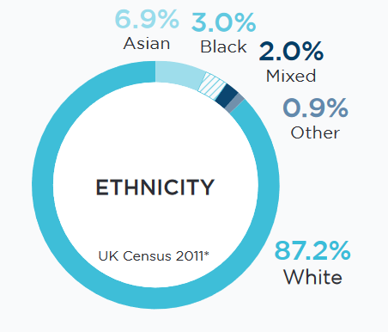
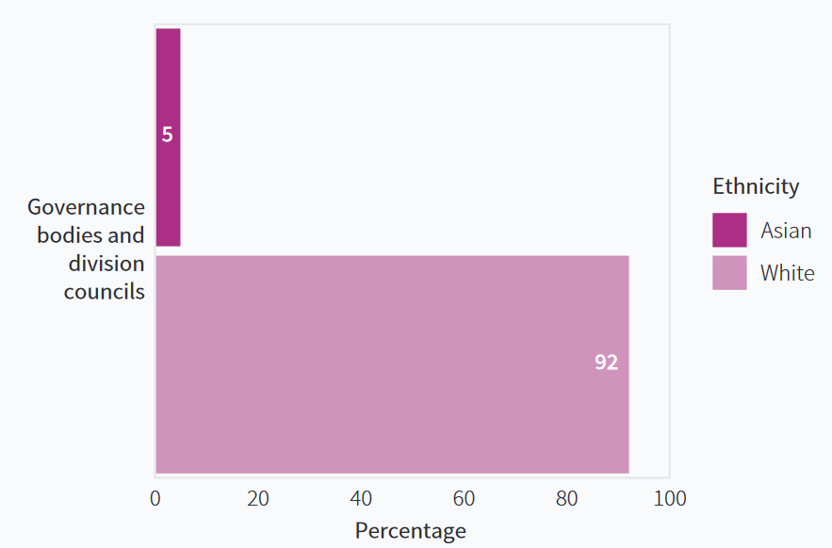
Critically reviewing the RSC
The RSC is making great strides in EDI efforts…reflecting inward is important too
Does systemic racism exist within the RSC itself?
We can use the UK population benchmark as a target for representational diversity
Looking at the Board of Trustees and Division Councils we can see that more representation is needed

Slide 21

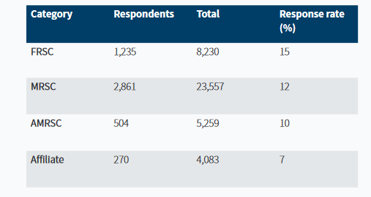
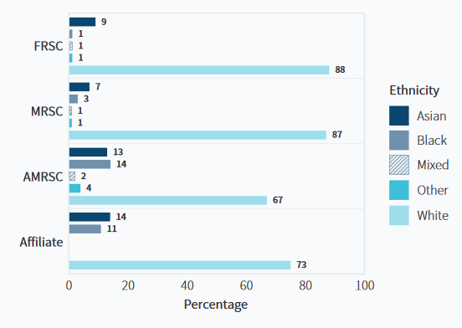
Critically reviewing the RSC
Membership to the RSC goes from Affliate to AMRSC to MRSC to FRSC as you gain experience
Representation drops off rapidly at MRSC and above
What does this mean for Chemistry?

Slide 22
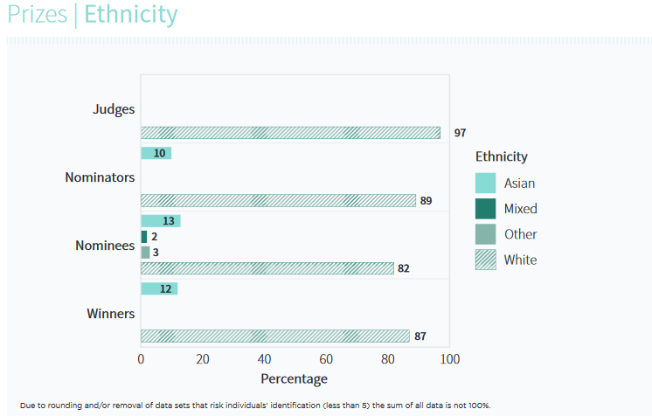
Critically reviewing the RSC
Judges for prizes are predominantly white
Winners are majority white (with very few individuals getting prizes from other ethnicities)
What does this mean for career progression, promotions and recognition?

Slide 23
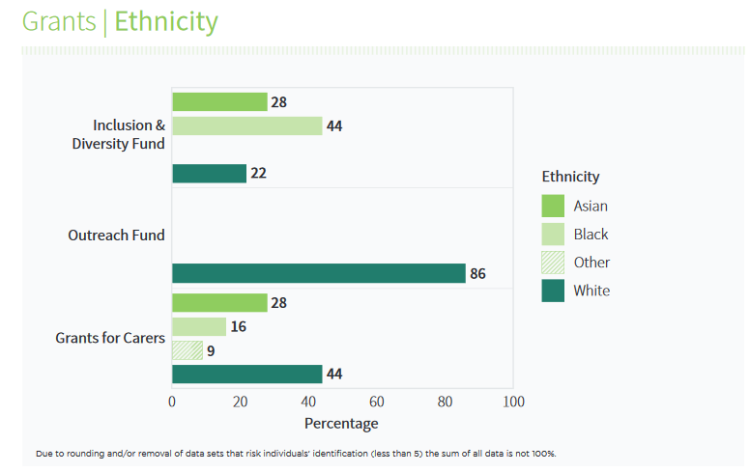
Critically reviewing the RSC
The majority of applicant for the Inclusion and Diversity Fund are Black. Are people supporting their Black colleagues in their endeavours?
The outreach fund applications are majority white. What does this mean for representation at schools?
Chartered Status is primarily white. What does this mean for career progression and recognition?
By publishing data the RSC enables critical review but also a benchmark for change

Slide 24
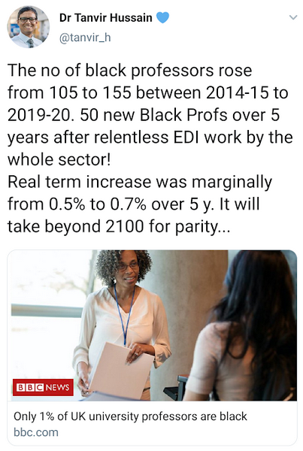
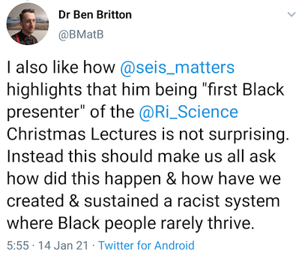
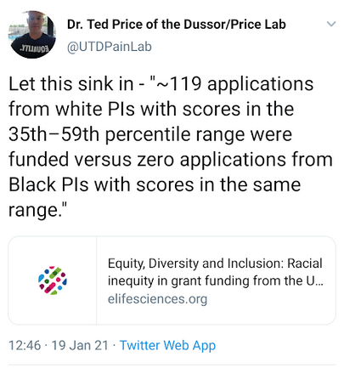
Ethnicity impact in Chemistry – a wider lens
Some examples from social media THIS WEEK re: ethnicity
Please note these are the personal views of the Tweeters
Reflections on the first Black presenter for the RI Christmas lectures
Grant Applications
Representation

Slide 25

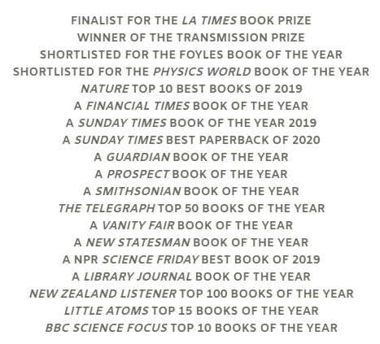


"This is an essential book on an urgent topic by one of our most authoritative science writers."
- Sathnam Sanghera, author of The Boy with the Topknot
On the Subject of Race
Published May 2019
Angela Saini's latest book explores the murky history of race science and the ways in which it is being resurrected in the 21st century. Combining science, history and politics, it explains how race maps out biologically and how those on the far-right are attempting to repackage racism.
Award Winning
"Magisterial, forensic." - The Telegraph
Critically Acclaimed
"Angela roundly debunks racism's core lie - that inequality is do with genetics rather than political power."
- Reni Eddo-Lodge, author of Why I'm No Longer Talking to White People about Race

Slide 26
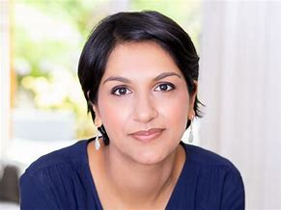
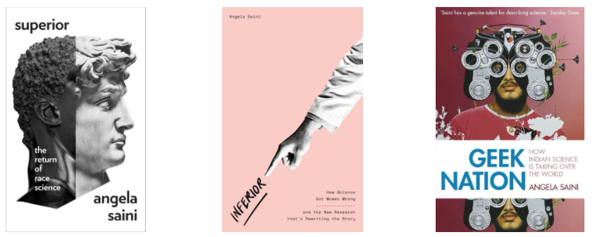






About the author
Angela Saini
Award Winning Science Journalist | Author | Broadcaster
Masters of Engineering – Oxford University
Masters in Science and Security – King's College London, Department of War Studies
Founder of 'Challenging Pseudoscience' at the Royal Institute of Great Britain
Honorary Fellow of the British Science Association
Advisory Board Member of the Manchester Museum of Science and Industry
Sits on the Lancet Covid-19 Commission Task Force on Global Health Diplomacy
Board Member of the Association of British Science Writers
Member of RSAs Disinformation Advisory Group
One of the world's top 50 thinkers – Prospect Magazine, 2020

Slide 27
Thank you!
We are super excited to start this project with you – thank you for being part of it!

