Slide 1

Introduction to the Warwick Chemistry Diversity Book Club
Introduction to Book 2 - Gender

Slide 2



Why we started the Diversity Book Club
To improve diversity in the chemical sciences we must first educate ourselves and be aware of the diversity issues that prevail within our community
The Diversity Book Club provides an opportunity to work together to connect, communicate and reflect on these topics.
STEM & Diversity Group

Slide 3

The diversity themes
Theme | Corresponding Book | Corresponding RSC Report
Race | Superior - Angela Saini | Diversity Landscape of the Chemical Sciences
Gender | Invisible Women - Caroline Criado Perez | Breaking the Barriers
Sexual Orientation | Straight Jacket: How to be gay and happy - Matthew Todd | Exploring the Workplace for LGBT+ Physical Scientists
Unconscious Bias | Sway - Dr Pragya Agarwal | Is publishing in the chemical sciences gender biased

Slide 4



Expectations for Discussion Sessions
In order to get as much out of the Book Club as possible, this is what is expected of each participant:
Read
Each month you will be given a portion to read
Reflect
Answer the questions in the Question Booklet BEFORE the session
Attend
Make sure to come along once a month to your 1-hour Book Club discussion
Want to emphasise: just do what you can!!

Slide 5
Opportunity to contribute EDI initiatives
After each book, there will be an optional brainstorming session on ED&I initiatives in the department, evaluating what exists, what works well and if we can apply our learnings from the book to action within the department.
We’d love you to attend this and help drive for change!
Details of how to report an issue can be found in the Participant Guide
14th of April

Slide 6


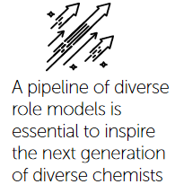
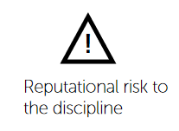
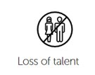
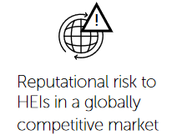

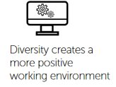
Second diversity theme: GENDER
Gender balance is not a target in and of itself but an outcome of an equitable system. As our survey respondents say, the academic system should be focused on retaining the best talent, 'regardless of gender or any other protected characteristic.’
Key Objectives:
1. To improve our understanding of the barriers to retention and progression of women in academic roles
2. To identify actionable solutions to enable women to meet their full potential in these roles.
3. To begin to investigate issues of retention and progression of women outside academia
Why should we care about equity?

Slide 7
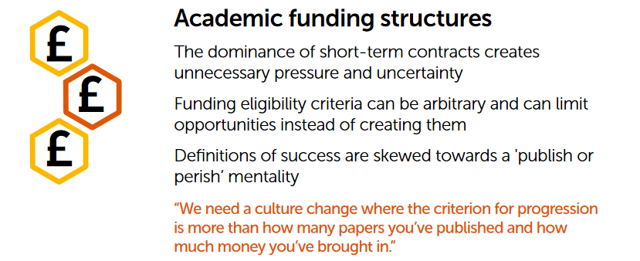
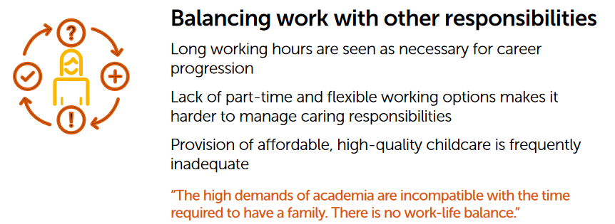
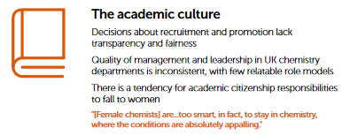
Key themes that affect women in STEM
"All of these factors apply to both men and women, but they disproportionately affect female academics in the chemical sciences."

Slide 8
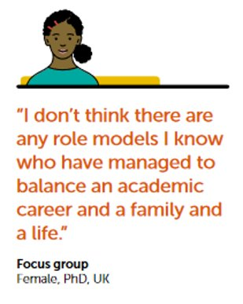
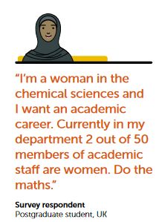
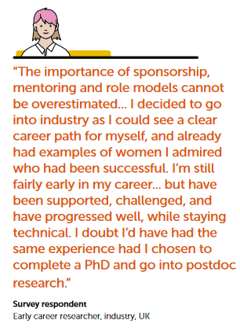
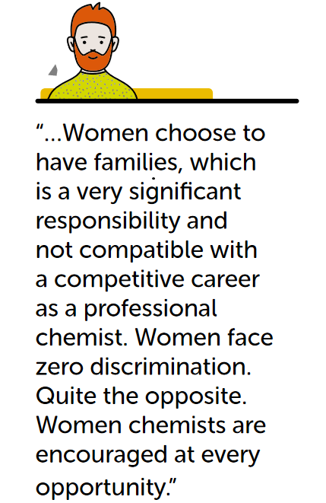
The importance of representation
If women cannot see how they can be successful through role models they are more likely to leave.
Importance of educating ourselves and others on diversity issues is also apparent.

Slide 9
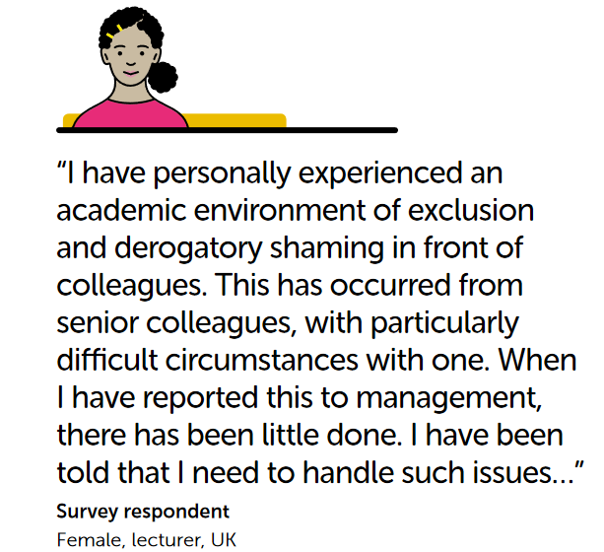
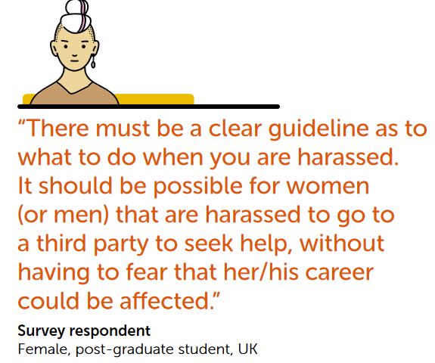
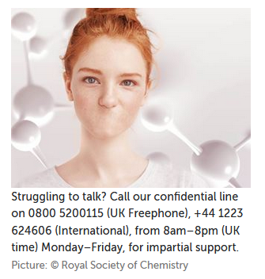
Bullying and harassment
"Our survey includes strong anecdotal evidence of harassment and bullying. Some respondents even described these behaviours as characteristic of academic departments."
Bullying/and or harassment happens disproportionately to women.
Intersectionality also needs to be considered here.

Slide 10
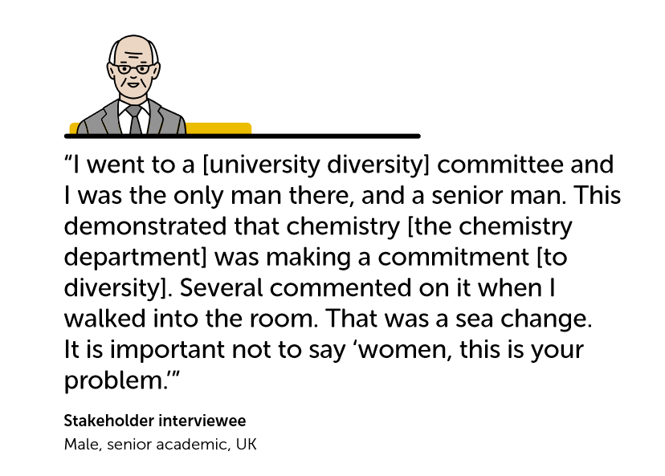
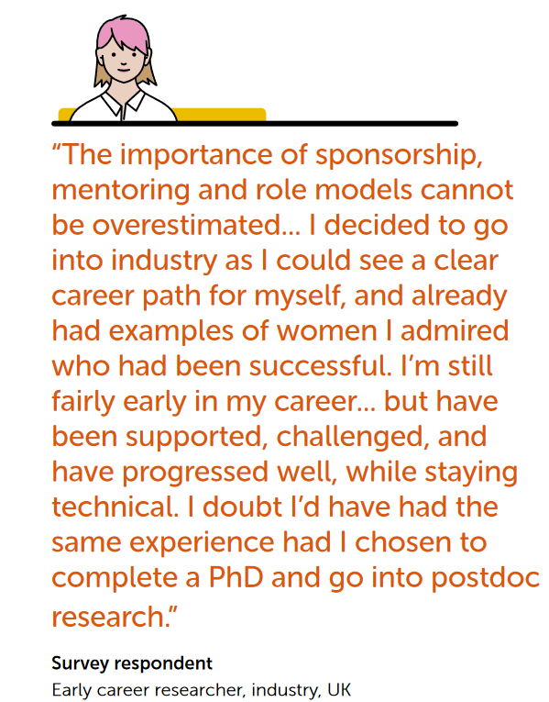
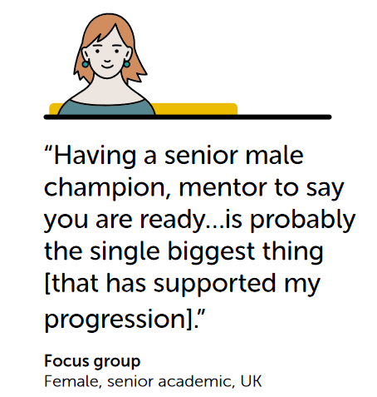
Recognition and allyship
Considerations into how we recognise success need to be given.
Mentorship can be very powerful.

Slide 11
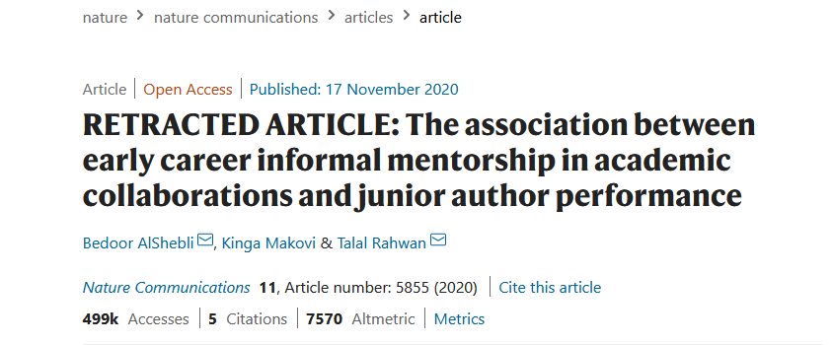
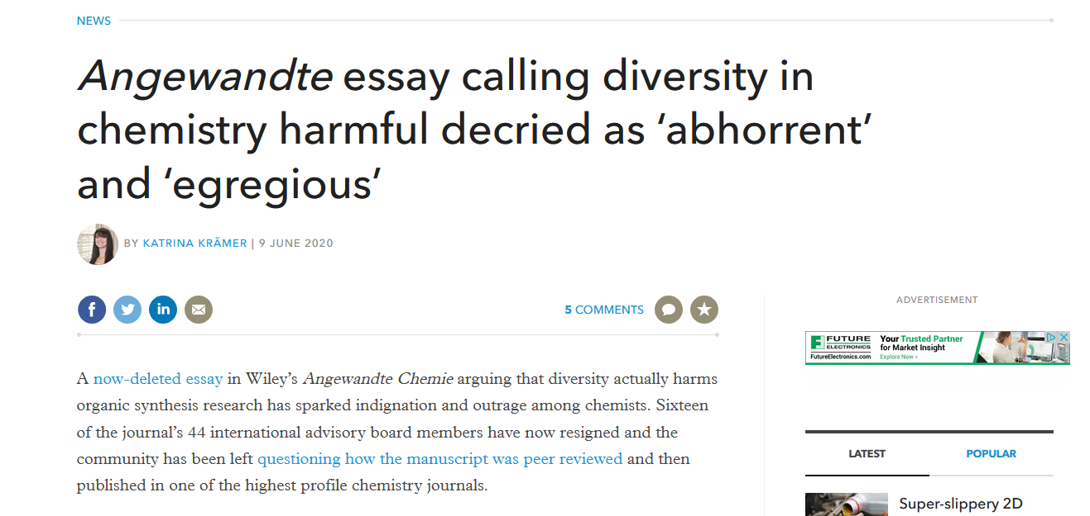
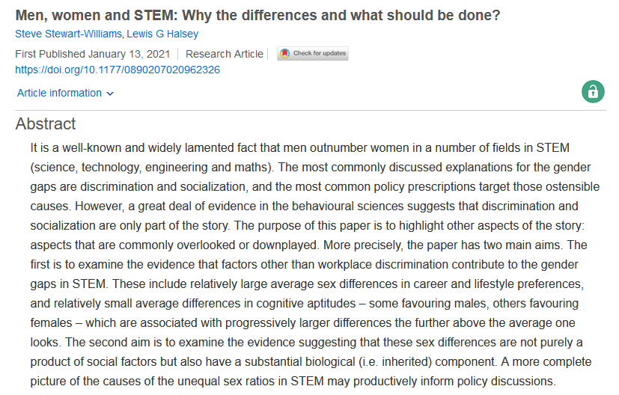
But we got equality, right..?

Slide 12
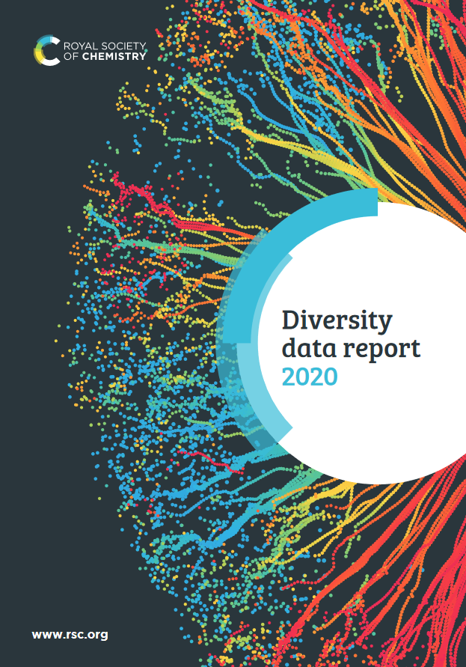

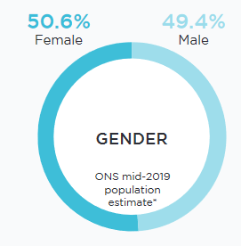
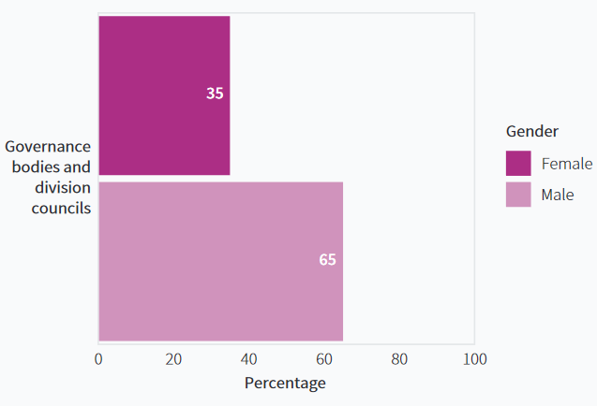
Critically reviewing the RSC
The RSC is making great strides in EDI efforts...reflecting inward is important too
We can use the UK population benchmark as a target for representational diversity
Looking at the Board of Trustees and Division Councils we can see that more representation is needed

Slide 13
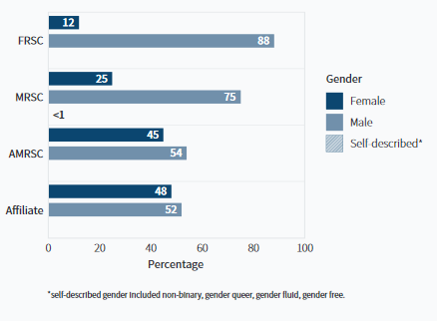
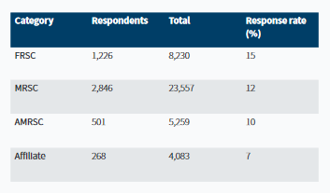
Critically reviewing the RSC
Membership to the RSC goes from Affiliate to AMSRC to MRSC to FRSC as you gain experience
Representation or the "leaky pipeline" drops off after AMRSC
What does this mean for Chemistry?
We also need to be conscious of the fact that if we see gender as binary, we are being accidently exclusionary.

Slide 14
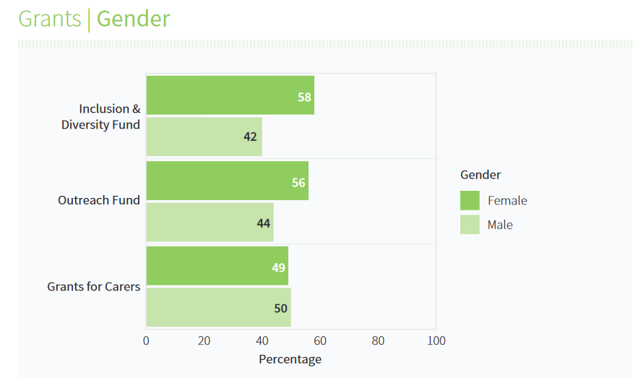
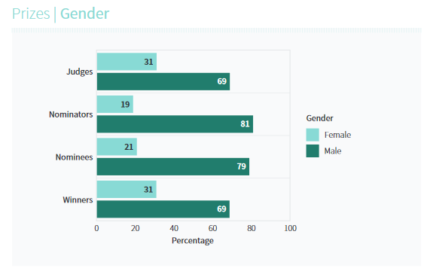
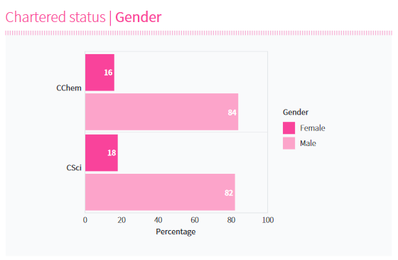
Critically reviewing the RSC
Women more likely to apply for diversity funding and outreach funding
Chartered status only at 16% for women
Prizes much lower than membership for women (at least in early career)

Slide 15
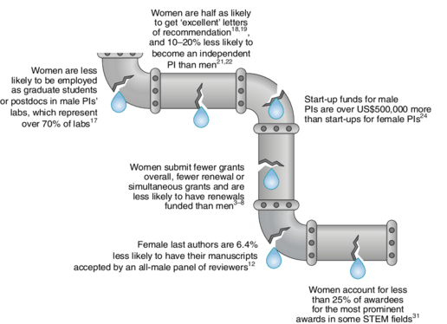
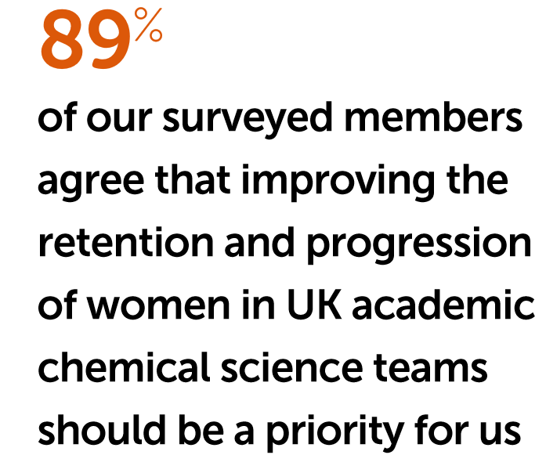
The 'leaky pipeline'
The "leaky pipeline" is a term often used to describe the loss of women throughout career stages
In order to fix this, we need to change the system
How the entire scientific community can confront gender bias in the workplace Nature Ecology & Evolution 3(1) Kathleen Grogan

Slide 16
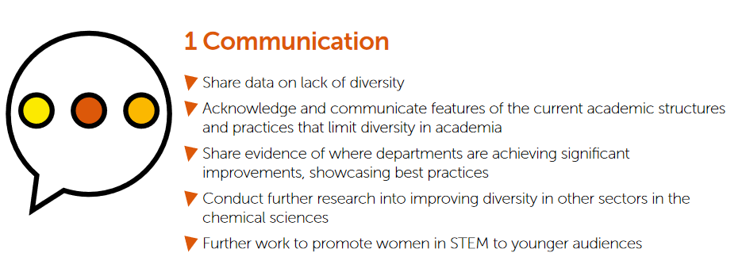
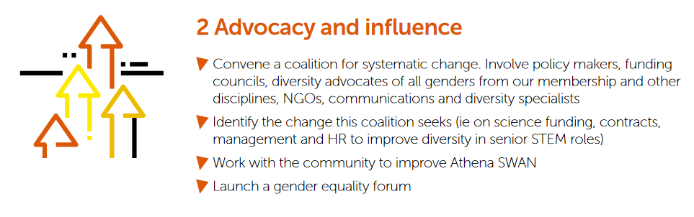
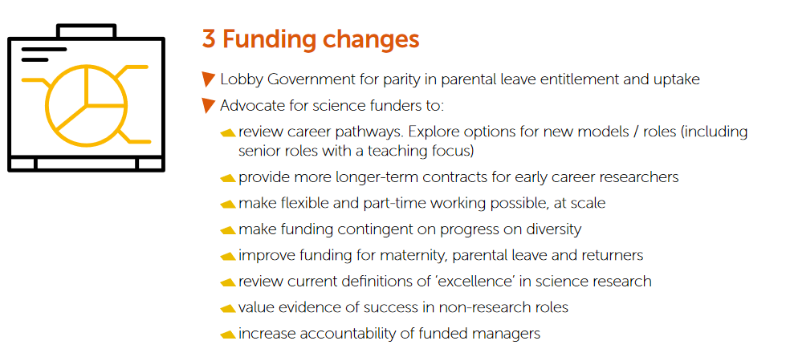
How to improve diversity

Slide 17
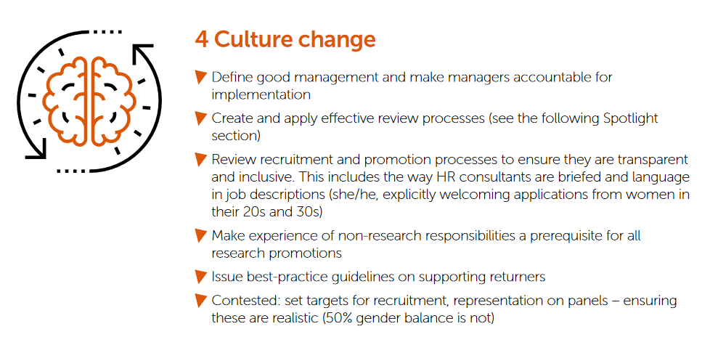
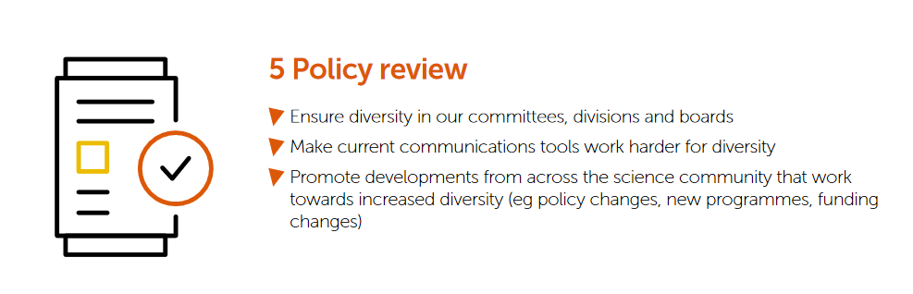
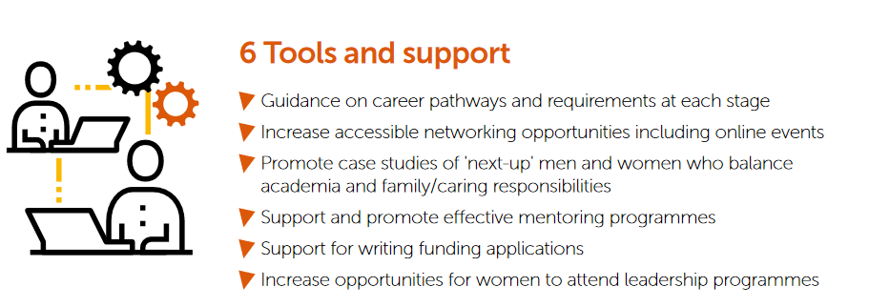
How to improve diversity

Slide 18
So how can we help?

Slide 19




On the Subject of Gender
"Revalatory – It should be required reading for policy and decision makers everywhere"
- Nicola Sturgeon
Published March 2019
Award-winning campaigner and writer Caroline Criado Perez brings together for the first time an impressive range of case studies, stories and new research from across the world that illustrate the hidden ways in which women are excluded from the very building blocks of the world we live in, and the impact this has on their health and wellbeing.
Mailed to every MP and Discussed in Parliament
"A Brilliant Exposé" - The Guardian
Multi Award Winning
Being translated into 24 languages
2019 Insight Investment Science Books Prize & Financial Times Business Book of the Year
Bestseller
"A Book That Changes The Way You See The World"
- The Sunday Times

Slide 20


About the author
Caroline Criado Perez OBE
Feminist Author |Journalist | Activist
English Language & Literature – Oxford University
Behavioural and Feminist Economics – London School of Economics and Political Science
Campaigned for twitter to have a report abuse button on tweets
2013 Recipient of the Liberty Human Rights Campaigner of The Year Award
Campaigned for the first statue of a woman (Millicent Fawcett) in Parliament Square
Campaigned for a female historical figure on british bank notes
2020 Recipient of Finland's Hän Award for Promoting Equality
Named one of the BBCs 100 Women 2013
Campaigned for female representation in the media

Slide 21
Thank you!
We really hope you enjoy Book 2!

