Slide 1

Introduction to the Warwick Chemistry Diversity Book Club
Introduction to Book 3 – Sexual Orientation

Slide 2



Why we started the Diversity Book Club
To improve diversity in the chemical sciences we must first educate ourselves and be aware of the diversity issues that prevail within our community
The Diversity Book Club provides an opportunity to work together to connect, communicate and reflect on these topics.
STEM & Diversity Group

Slide 3

The diversity themes
Theme | Corresponding Book | Corresponding RSC Report
Race | Superior - Angela Saini | Diversity Landscape of the Chemical Sciences
Gender | Invisible Women - Caroline Criado Perez | Breaking the Barriers
Sexual Orientation | Straight Jacket: How to be gay and happy - Matthew Todd | Exploring the Workplace for LGBT+ Physical Scientists
Unconscious Bias | Sway - Dr Pragya Agarwal | Is publishing in the chemical sciences gender biased

Slide 4



Expectations for Discussion Sessions
In order to get as much out of the Book Club as possible, this is what is expected of each participant:
Read
Each month you will be given a portion to read
Reflect
Answer the questions in the Question Booklet BEFORE the session
Attend
Make sure to come along once a month to your 1-hour Book Club discussion
Want to emphasise: just do what you can!!

Slide 5
Opportunity to contribute EDI initiatives
After each book, there will be an optional brainstorming session on ED&I initiatives in the department, evaluating what exists, what works well and if we can apply our learnings from the book to action within the department.
We’d love you to attend this and help drive for change!
Details of how to report an issue can be found in the Participant Guide
14th of July

Slide 6
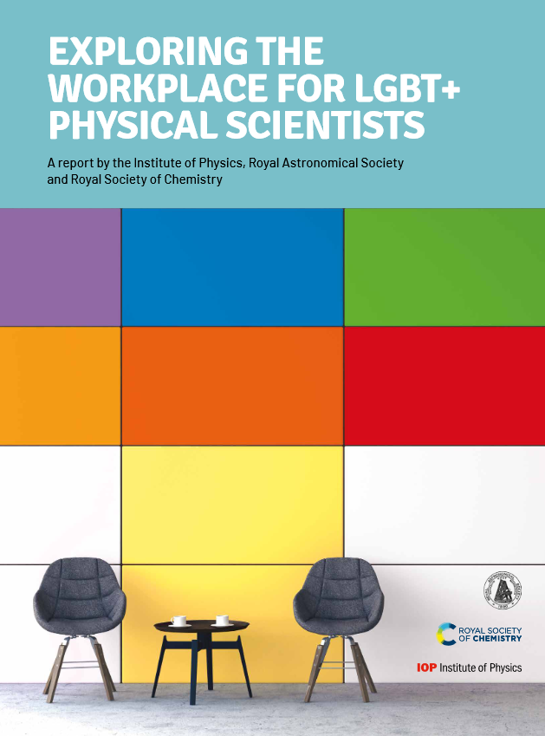
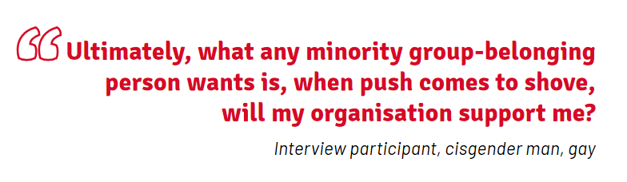
Third diversity theme: SEXUAL ORIENTATION
“Tackling the barriers that LGBT+ physical scientists face can create broader benefits. Encouraging an inclusive culture is not only the right thing to do – it can help actively cultivate a positive climate for diversity and inclusion for all.”
Booklet is collaborative between the RSC and the Institute of Physics
Looks at documenting the experiences of LGBT+ scientists
Explores improvements that can be made at an institutional level

Slide 7
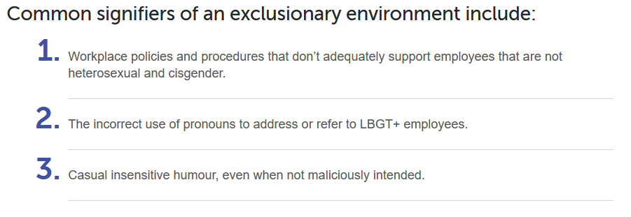
Common indicators of exclusionary environments

Slide 8
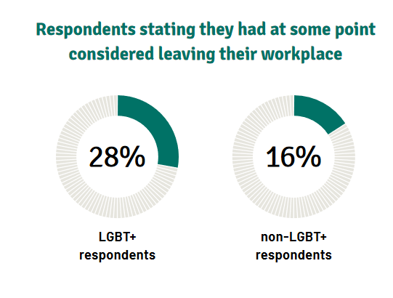
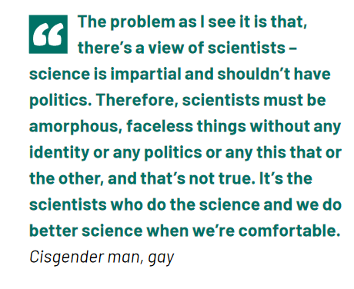
Loss of talent
Diverse workforces have been proven to produce better science.

Slide 9
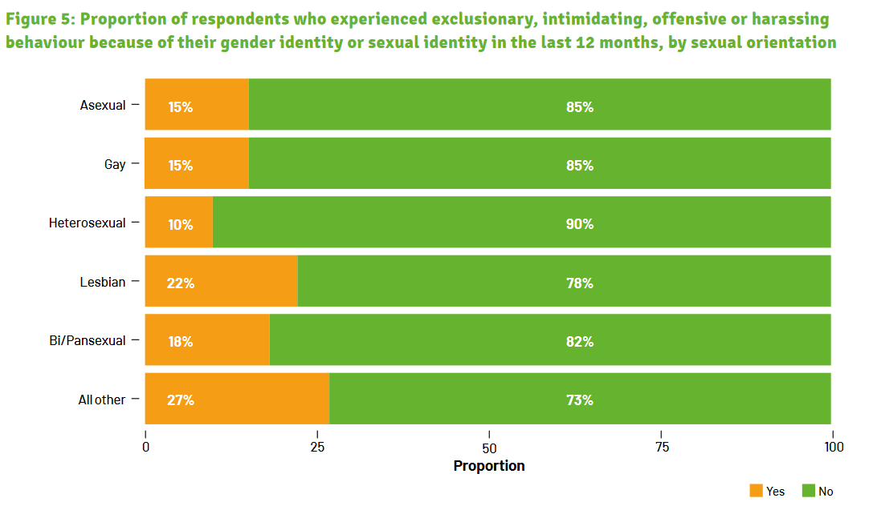
The importance of representation

Slide 10
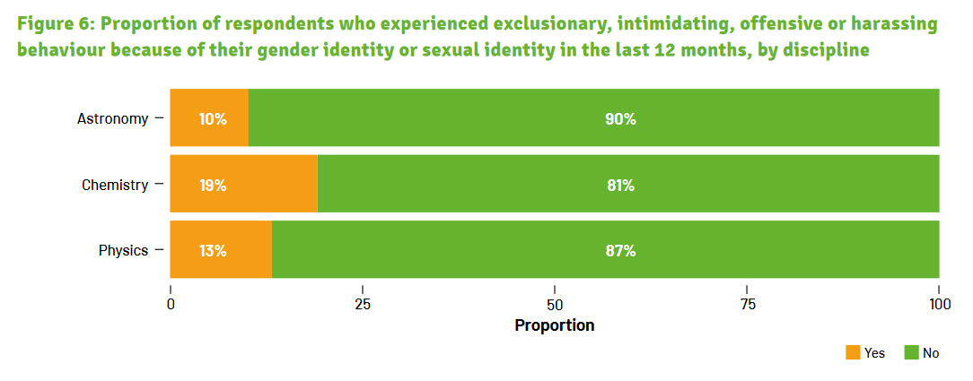
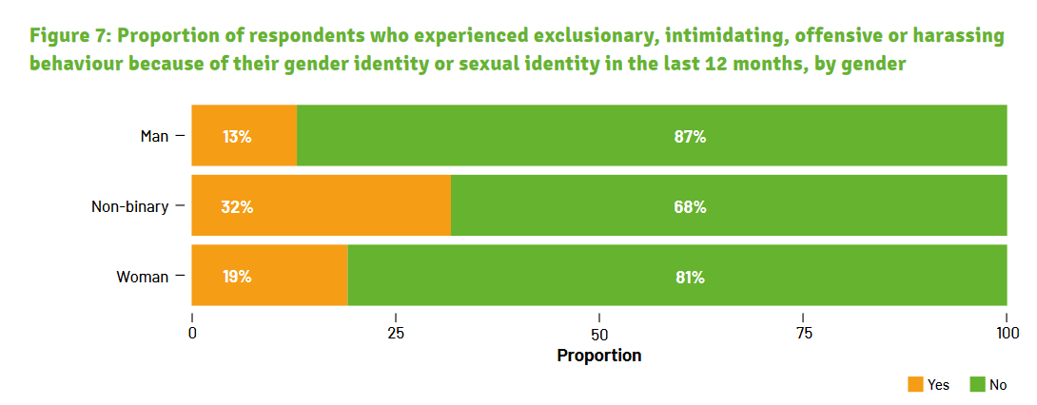
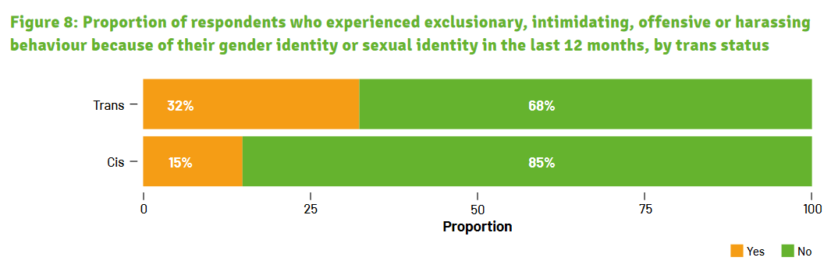
Exclusionary/offensive/harassing behaviours
Non-binary and Trans individuals experience even more discrimination which may be something we don’t often consider

Slide 11



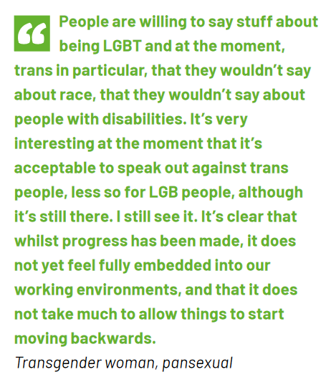
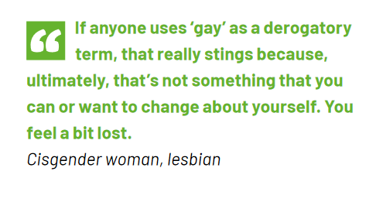
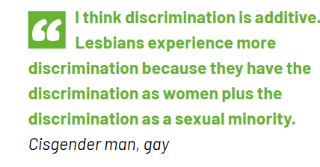
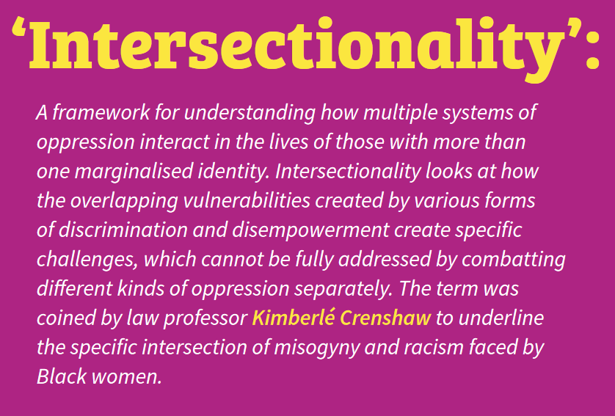
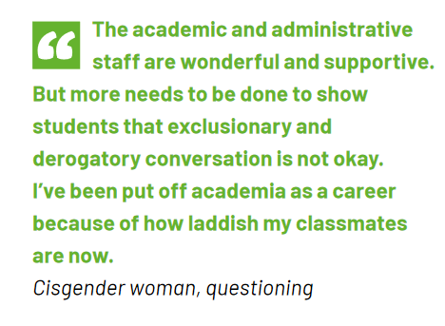
Lived experiences

Slide 12
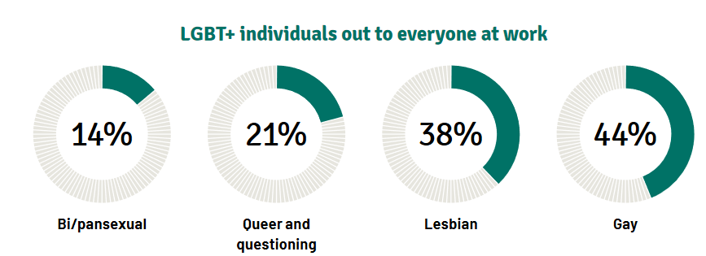
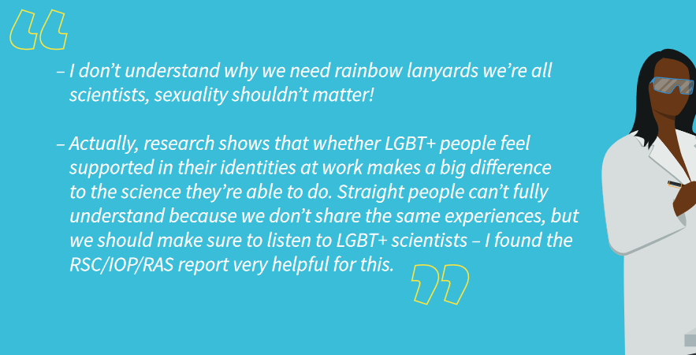
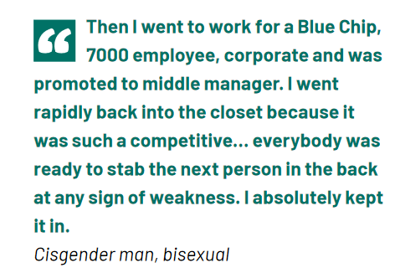
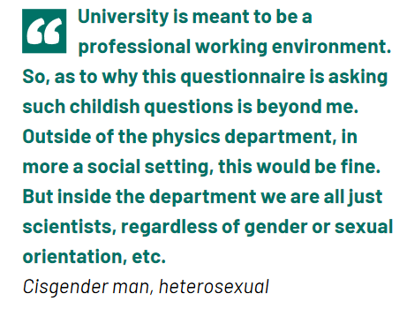
Feeling comfortable at work
Just 9% of non-binary individuals were out to everyone at work, compared to 31% of women and 44% of men.

Slide 13
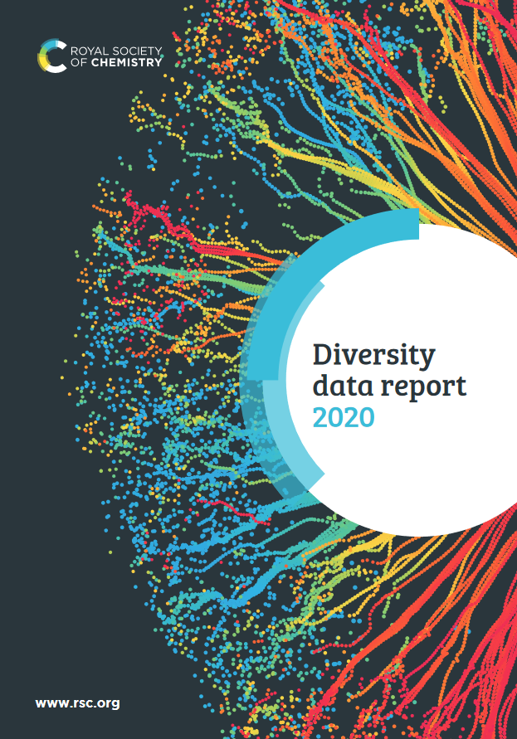

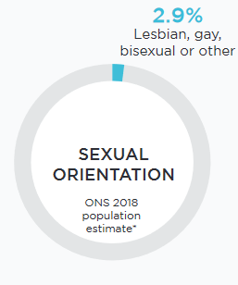
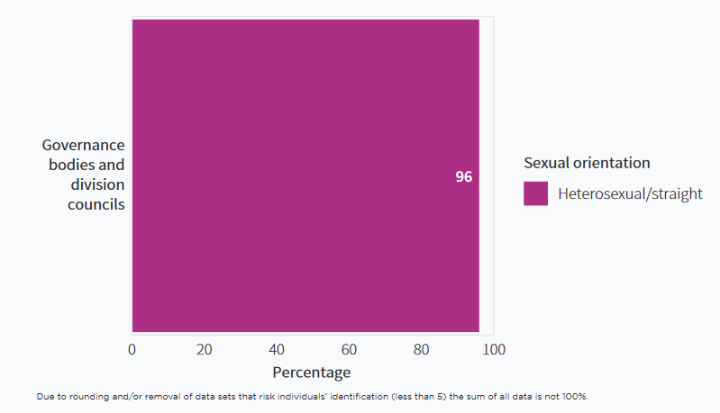
Critically reviewing the RSC
The RSC is making great strides in EDI efforts...reflecting inward is important too
We can use the UK population benchmark as a target for representational diversity
All numbers are small, so data sets have been removed to not risk individuals’ identification

Slide 14

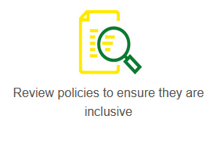
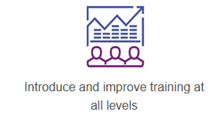
How to improve things?
“No one is definable by a single characteristic – we are all complex individuals subject to a whole host of different influences. But, to create an environment where the best scientists can flourish and the best science can be done, we need to make sure everyone feels comfortable.
If we can do that it won’t just benefit our LGBT+ colleagues, but everyone in our workplaces.
Let’s act now to effect real change.”

Slide 15
So how can we help?

Slide 16

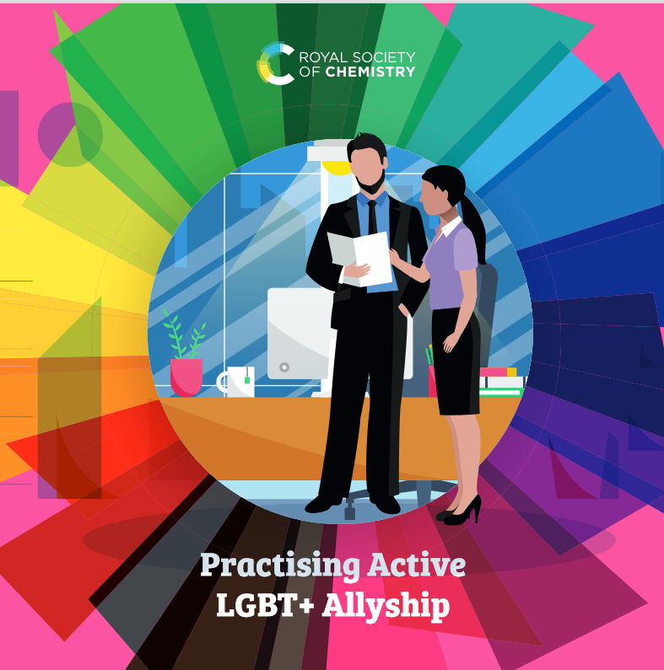
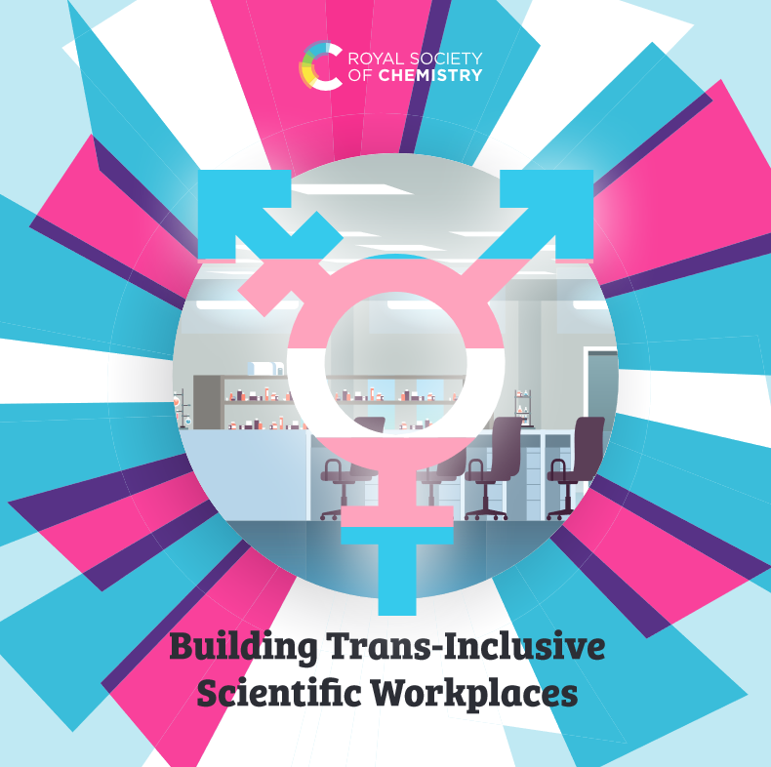
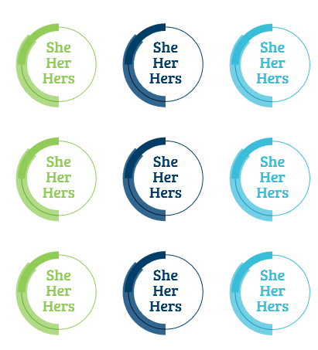
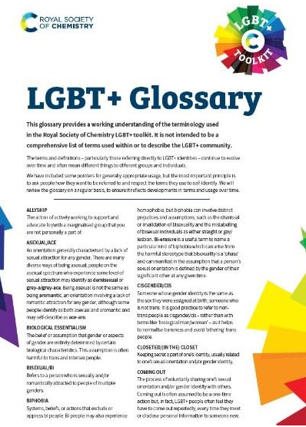
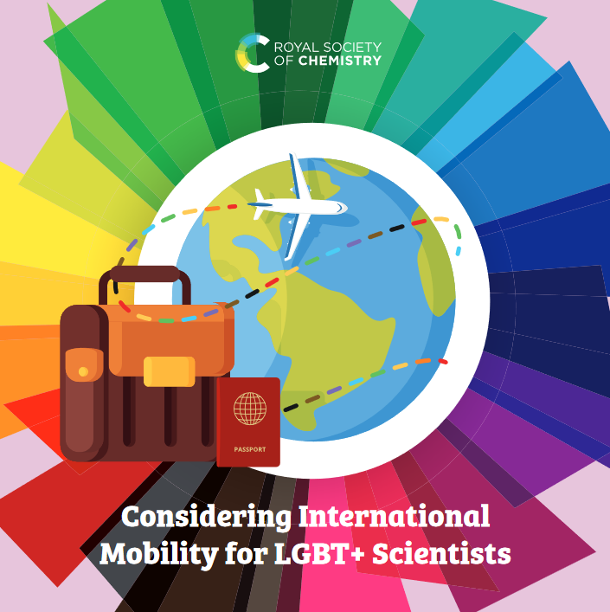
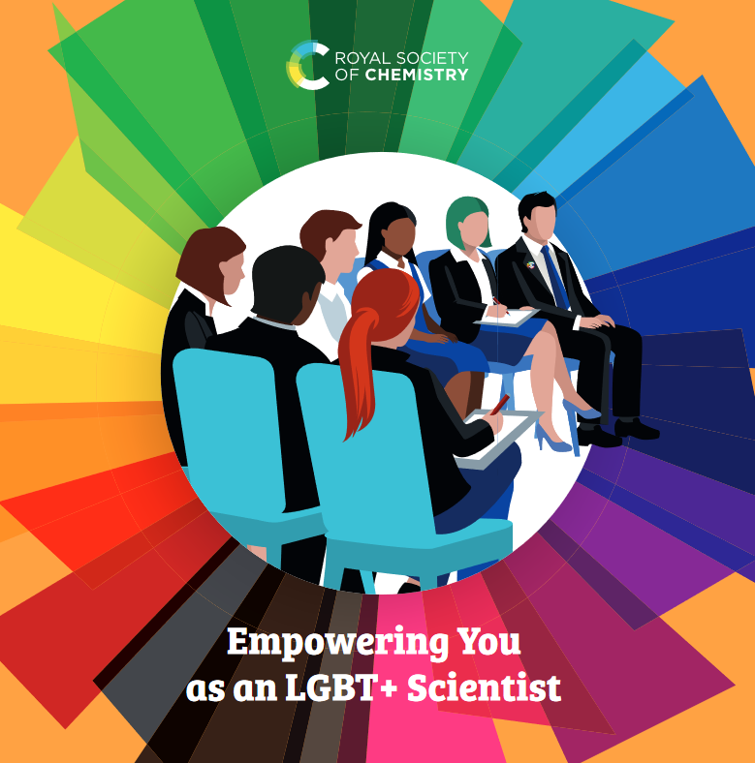
Educating ourselves and others
RSC have full LGBT+ Toolkit available online
Free to download and use
Guides for LGBT+ scientists, How to be an Ally, and how we can make inclusive workplaces

Slide 17

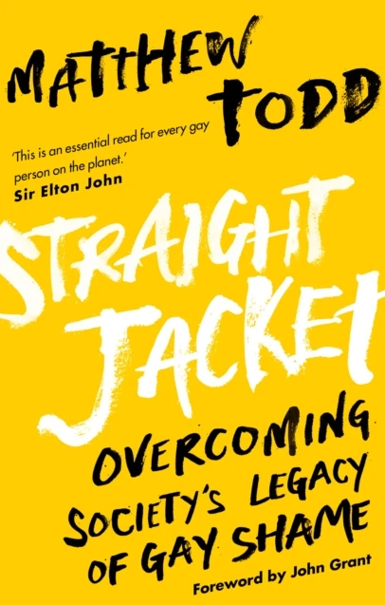
On the Subject of Sexual Orientation
Published March 2018
Straight Jacket is a revolutionary clarion call for gay men, the wider LGBT community, their friends and family. Part memoir, part ground-breaking polemic, it looks beneath the shiny facade of contemporary gay culture and asks if gay people are as happy as they could be - and if not, why not?
"A essential book" - The Observer
'This is an essential read for every gay person on the planet' - Elton John
Winner Boyz Best LGBT Book 2007
Shortlisted for the Polari Book Prize 2017
'Straight Jacket documents Todd's own childhood experiences, and the long-term mental health and addiction issues he has suffered; he is also using it to call for a government inquiry into the experiences of LGBT children at school.' - The Guardian

Slide 18
Trigger Warnings
Substance abuse
Violence
Suicide/Ideation
Sexual relationships

Slide 19
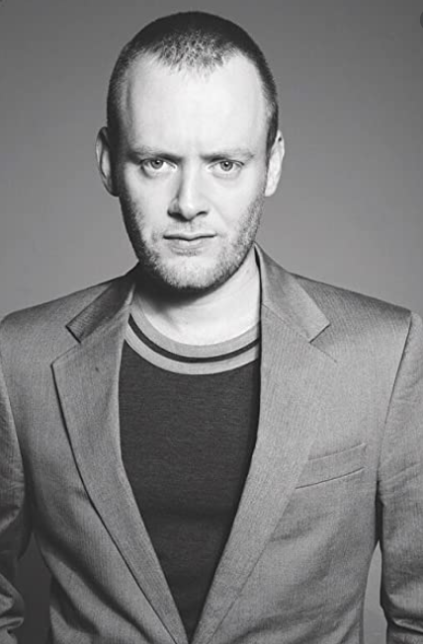
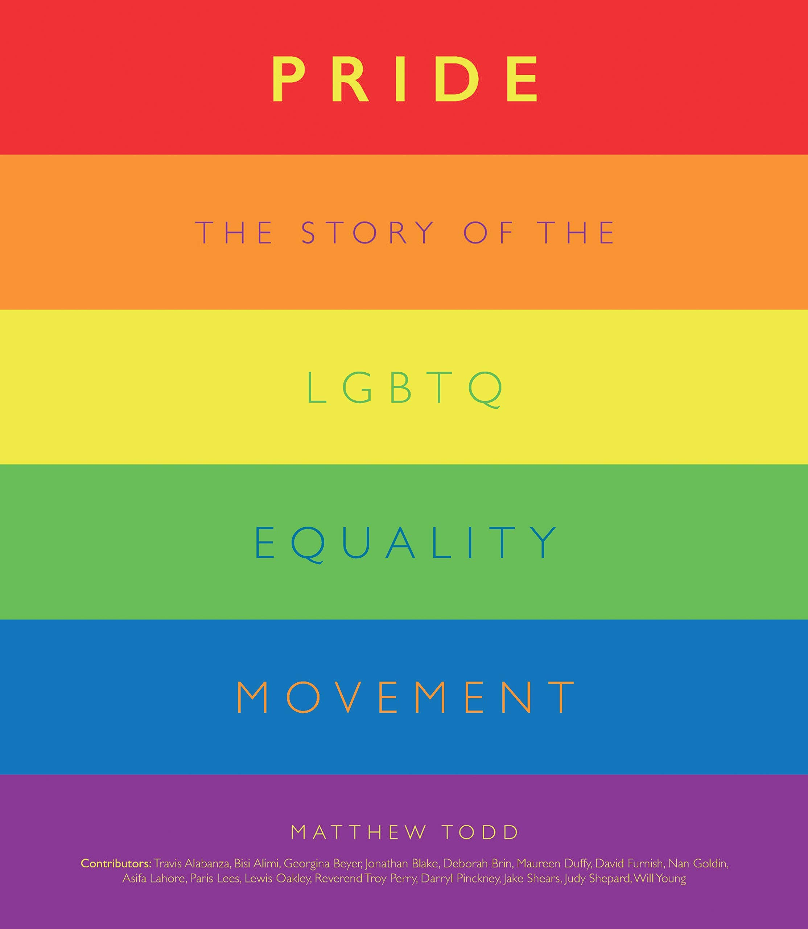
About the author
Matthew Todd
Award winning writer| Journalist | Performer
Worked for gay rights group Stonewall in the early nineties
Ex-Editor of Attitude Magazine
Writes for The Guardian and gives talks around the UK on LGBT and mental health issues
Interviewed countless celebrities including Madonna, Elton John and Lady Gaga
British Society of Magazine Editor's Scoop of the Year 2016 for Prince William appearing on the cover of Attitude.
British Society of Magazine Editor's Men's Magazine Editor of the Year 2011

Slide 20
Thank you!
We really hope you enjoy Book 3!

