Slide 1

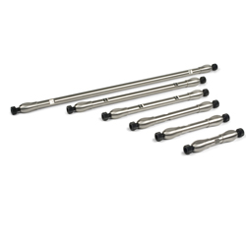
HPLC
Paul Sainsbury

Slide 2
What are your goals!!
What is the purpose of the method?
What is the analyte, and is there more than one?
What is the sample for analysis?
Do you need quantification?
What level of effort is appropriate and what resources are available?
What are the desired method criteria
Minimum resolution, maximum runtime, accuracy and precision

Slide 3
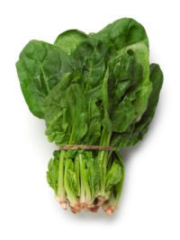
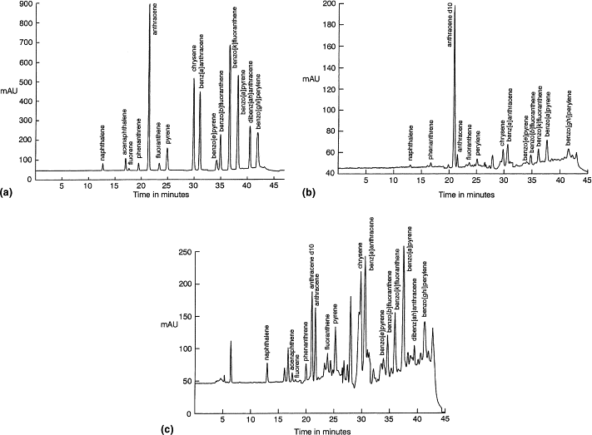
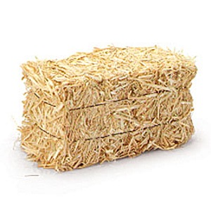
Complex Sample Matrix
Complex Mixture of Analytes
Challenge likely to be related to developing the sample preparation method
Challenge likely to be related to developing the chromatographic method

Slide 4
Types of HPLC
Ionic
Ion Exchange
GFC
Polar non ionic
Normal phase
SEC
Polarity
Partition
Reverse phase
Non-polar
GPC
Adsorption
10¹
10²
10³
10⁴
10⁵
10⁶
10⁷
Molecular weight

Slide 5
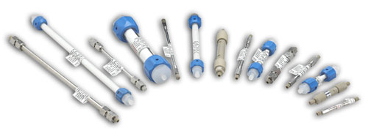
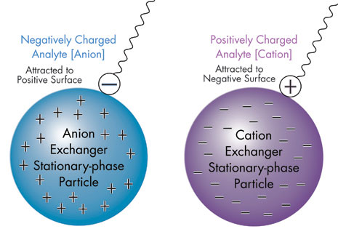
Reverse, Normal, IE and HILIC
LONG???
…or SHORT??

Slide 6
Endcapping
…and Silica A or B????

Slide 7
What Detection Method?
Fluorescence
Diode Array
Refractive Index
Mass Spec
Conductivity
UV
Electrochemical
Evaporative Light Scattering
Charged Aerosol Detection
Notes:
Diode Array – multiple wavelengths Electrochemical – based on things that are oxidised or reduced and measures change in current on the surface of electrodes

Slide 8
Gradient or Isocratic
Isocratic
Can be useful to obtain the best resolution for a critical pair
To separate one peak in a complex sample
Gradient
Separating mixtures which result in peaks bunched together
Speeding up analysis by shortening run times
Flushing off hydrophobic compounds which are not of interest and may take a long time to elute

Slide 9
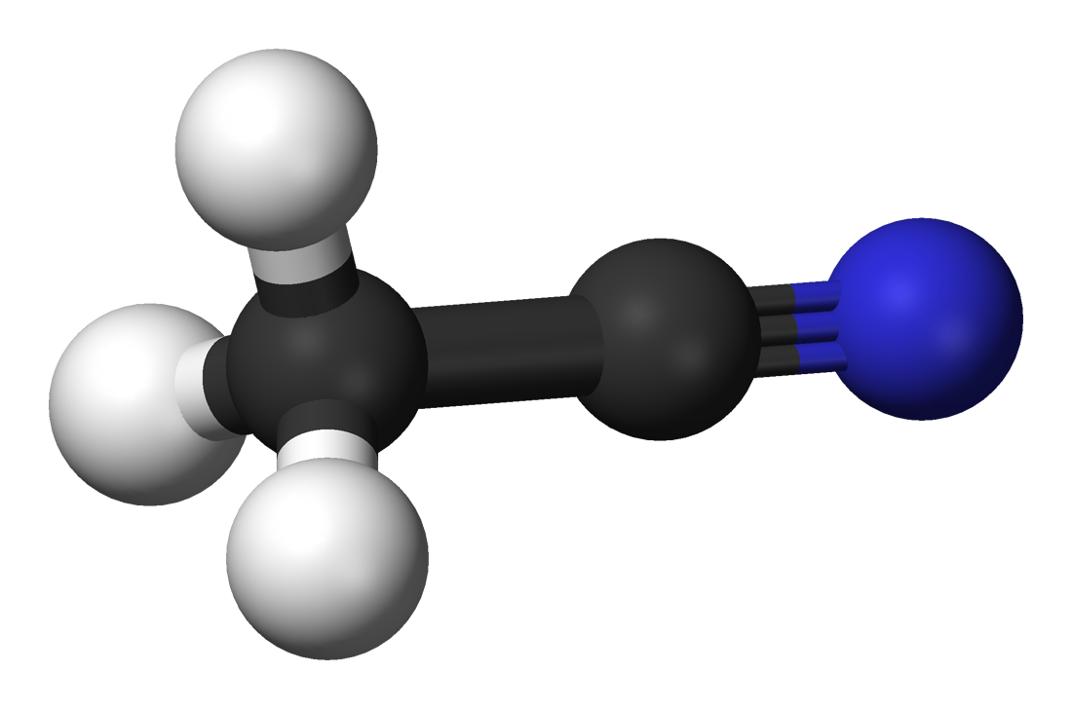
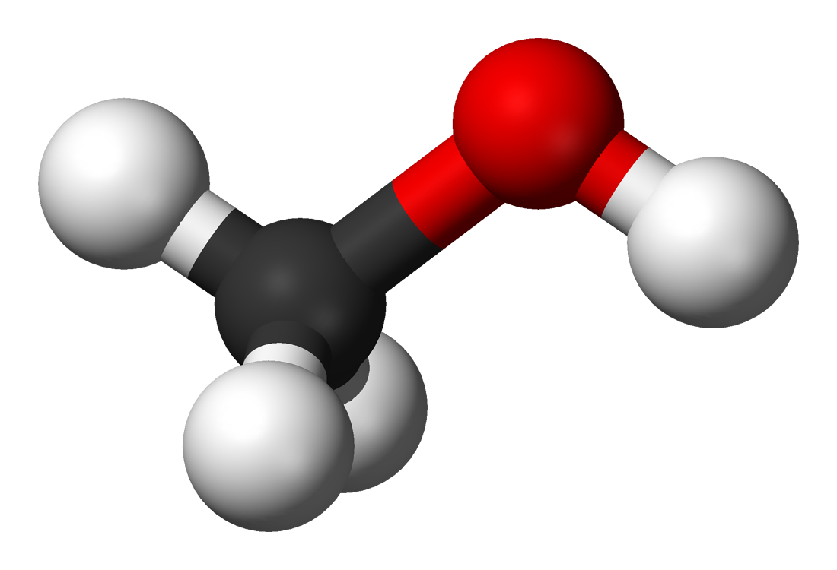
Choosing Solvents
Acetonitrile
  Expensive
  Lower absorbance
    Lower noise
  Less back pressure on column
Methanol
  Higher elution strength at 100%
  Different selectivity and sensitivity
    Sharper peaks with many carboxylic acids

Slide 10
Choosing Buffers
Consider
Detector compatability
Volatile buffers required for MS, ELSD and CAD
Solubility at high amounts of the organic solvent!!!
Phosphate buffer will precipitate in high concentrations of acetonitrile
Common Choices
Low pH
0.1 % Formic Acid
0.1 % Trifluoroacetic acid
Neutral pH
0.1 % Ammonium acetate
High pH
0.1 % ammonium hydroxide
(not good for column longevity)

Slide 11
Suggested Initial Conditions
Column
Type B Silica
C₁₈
Dimensions
Standard HPLC – 10 cm x 4.6 mm ~3 µm
Mobile Phase Conditions
A Solvent Buffer pH 2-8
B Solvent
Acetonitrile
Methanol
Gradient Range
5 to 95 %B
Temperature
40 °C
Time
20 mins
Re-equilibration
8 mins
Wash
Usually only needs 30 column lengths!!!
Injection volume
10 µl
Flow rate
1.5 mL/min
Detector
UV
MS
Notes:
Best to buffer as small change in pH gives large change in retention times

