Slide 1



Circular dichroism comparability study for ARBRE network
Dr Nikola P. Chmel Porto 20 March 2017

Slide 2
Previous study
Four samples:
~0.2 mg/ml solution of lysozyme
~0.6 mM solution of R,R-Na[Co(EDDS)]
~0.6 mM solution of S,S-Na[Co(EDDS)]
Water
Samples send by mail/courier (no chilling)
Minimum set of measurement conditions:
Specified wavelength range
=<1 nm measurement step
After measurements samples returned back to Warwick for stability testing

Slide 3
Results: lysozyme

Slide 4
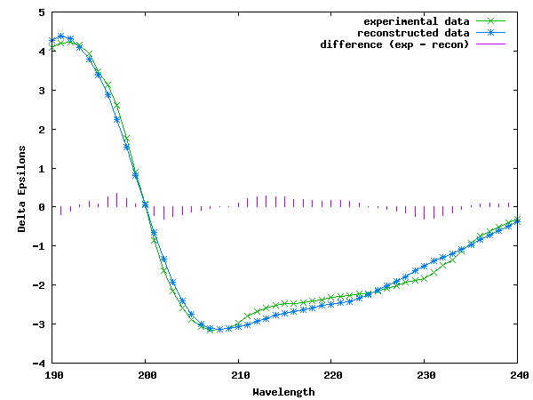

Results: lysozyme
 | Helix | Sheet | Turn | Unord | Total | Difference
1 | 0.298 | 0.213 | 0.215 | 0.275 | 1.001 | 0.044
2 | 0.274 | 0.209 | 0.219 | 0.298 | 1 | 0.089
3 | 0.308 | 0.178 | 0.225 | 0.288 | 0.999 | 0.046
4 | 0.318 | 0.216 | 0.214 | 0.253 | 1.001 | 0.05
5 | 0.395 | 0.14 | 0.213 | 0.252 | 1 | 0.153
6 | 0.322 | 0.186 | 0.224 | 0.268 | 1 | 0.025
7 | 0.282 | 0.199 | 0.227 | 0.293 | 1.001 | 0.074
8 | 0.351 | 0.189 | 0.179 | 0.281 | 1 | 0.075
Average | 0.319 | 0.191 | 0.215 | 0.276 | 1.001 | 0
Contin-LL (Provencher & Glockner)
Reference set 4
Sreerama, N. and Woody, R.W. (2000), Analytical Biochemistry, 287, 252–260 and references therein.

Slide 5
Results: Na[Co(EDDS)]

Slide 6
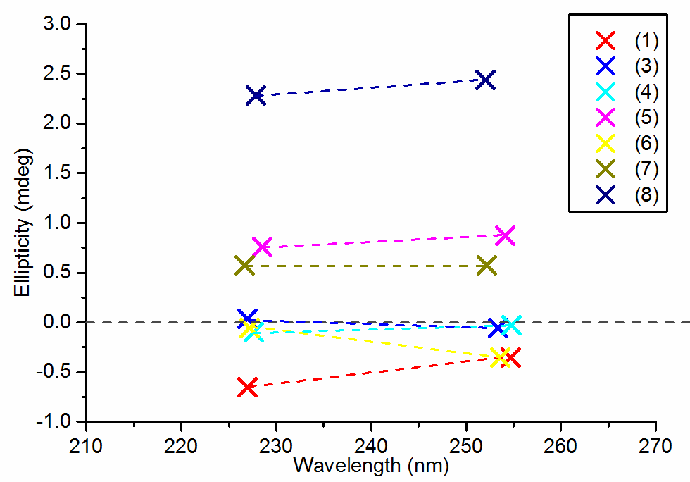
Results: Na[Co(EDDS)] – baseline drift

Slide 7
Summary
It is apparent that even in such a small scale study that there were significant differences in quality of data recorded in different labs.
Various issues were identified (intensity calibration, wavelength calibration, baseline drift).
There is a need for further study across the network in order to:
give better picture of CD data quality across the network,
take steps in order to improve the data quality and standardisation across the network.

Slide 8
Format of the new study
Time frame:
STSM application: March/April 2017
samples distributed end of May 2017
data collection: June – July 2017
samples return and data processing: August 2017
Samples:
~0.1 mg/ml solution of lysozyme
~0.4 mM solution of R,R-Na[Co(EDDS)]
~0.6 mM solution of S,S-Na[Co(EDDS)]
Water
Samples send by mail/courier (no chilling)
After measurements samples returned back to Warwick for stability testing

Slide 9
Format of the new study
Proposition, a two tiered study:
Minimal
4 samples (protein, two standards, baseline)
lysozyme and water samples measured using the lab own SOP
Two standards and water samples measured using the supplied SOP
5 measurements altogether (2 – 4 hours of instrument/staff time)

Slide 10
Format of the new study
Proposition, a two tiered study:
Complete
4 samples (protein, two standards, baseline)
all samples measured using the lab own SOP
all samples measured using the supplied SOP
Calibration data from wavelength (e.g. Ho or ammonia) and intensity (e.g. ACS) calibration performed on the day
Samples re-measured if required after calibration
10-14 measurements altogether (~1 workday of instrument/staff time)

Slide 11


Discussion
Any changes in the proposed format of the survey?
Consistency with other efforts of WG4 and P4EU?
n.chmel@warwick.ac.uk warwick.ac.uk/nikolachmel/cdsurvey

