Slide 1
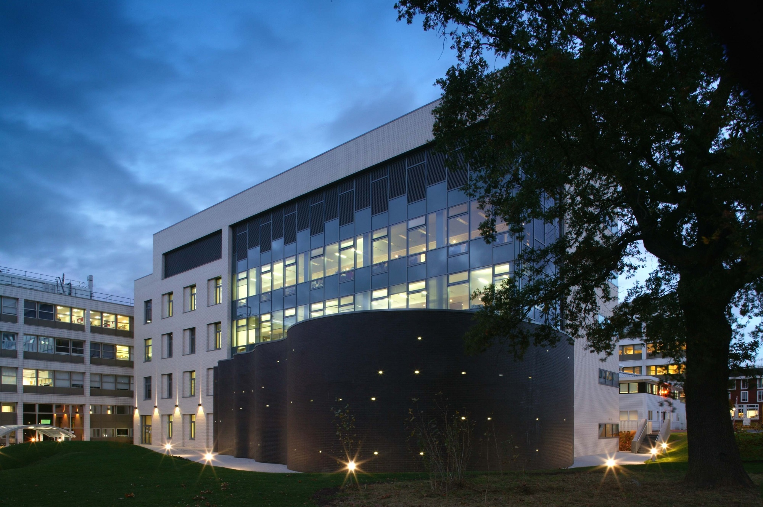
Group Meeting Update
Wednesday 17th October 2018

Slide 2
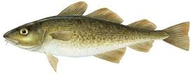
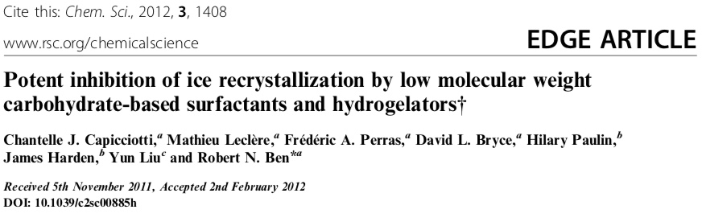
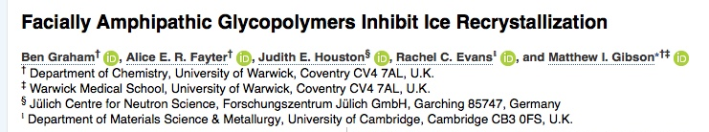
Vinyl Pyrrolidone as an IRI
Does hydrophobicity induce activity?
Hydrophillic, but inactive
LAME – easily copolymerized with VAc

Slide 3
Vinyl Pyrrolidone as an IRI
Why MADIX?
During propagation, the LAM cannot stabilize the polymer radical (K_{p} for VAc is 10x faster than MMA)
Deactivation with a normal RAFT agent, a di- or tri-thiocarbonate generates a more stable material which has no real drive to break –polymerisation stops
Need to use a less stable Z group

Slide 4
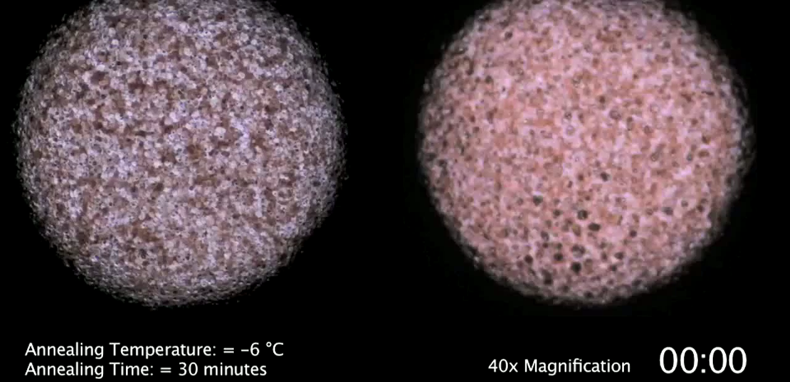
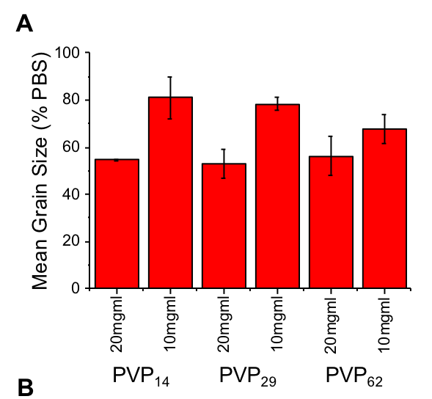
Homopolymer IRI Activity
PEG 20mgml
PEG 10mgml

Slide 5
Increasing Hydrophobicity
20 mg.ml
10 mg.ml
20 mg.ml
10 mg.ml
20 mg.ml
10 mg.ml
PVP₂₄VAc₂
PVP₅₂VAc₃
PVP₁₀₆VAc₅

Slide 6
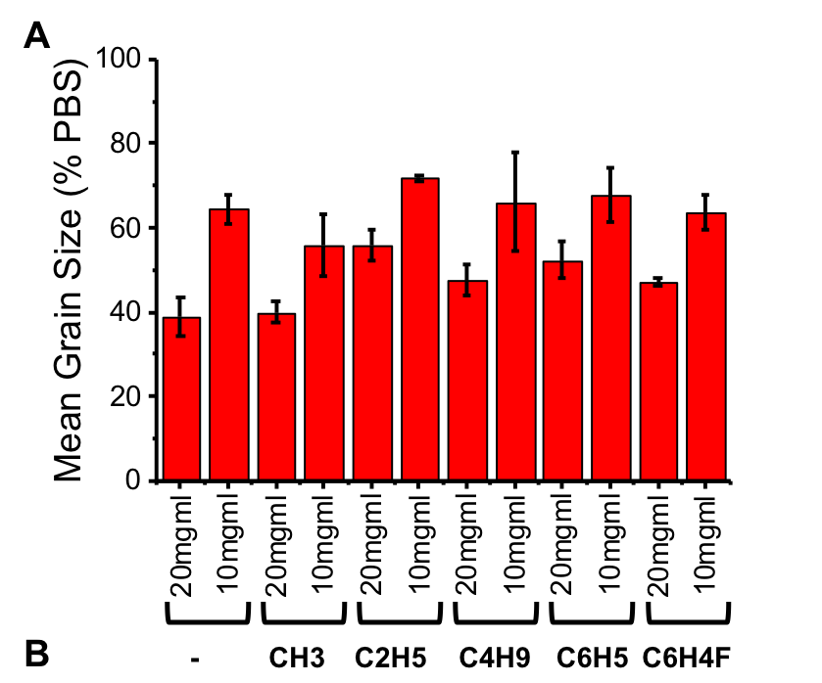
Increasing Hydrophobicity
Cannot induce significant activity in a water soluble polymer by increasing hydrophobicity
Separate domains of hydrophobicity and hydrophilicity are required
OH

Slide 7
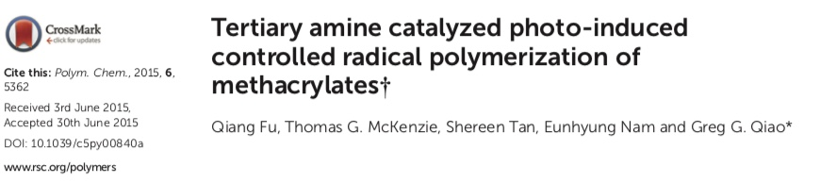
Part 2 – High Throughput Photopolymerisation
No degassing
No thermal/photo initiators
Proposed mechanism uses DMSO and TEOA as scavenger
Toluene control also polymerized – is DMSO necessary?

Slide 8
Monomer and Solvent Versatility
Decided to test multiple solvents and monomers
DMAEMA, HEAm, MA, NIPMAM and Styrene
Dioxane, MEK, MeOH/Toluene, Methanol
Polymers formed in all plates
Targeted one MW

Slide 9
Making Polymers in Volatile Solvents
Polymer | Solvent | Mp | Mn | Mw | PD
DMAEMA | Dioxane | 19625 | 11203 | 17317 | 1.54574667
 |  | 18142 | 10353 | 16875 | 1.62996233
 |  | 18033 | 10605 | 16623 | 1.56746818
 |  | 17817 | 10310 | 16780 | 1.62754607
 |  | 19744 | 11828 | 18482 | 1.56256341
 | MeOH | 18252 | 12444 | 18014 | 1.44760527
 |  | 18033 | 12451 | 17885 | 1.43643081
 |  | 17603 | 11621 | 16968 | 1.46011531
 |  | 17498 | 11672 | 17049 | 1.46067512
 |  | 17925 | 11797 | 17560 | 1.48851403
MA | Dioxane | 3663 | 4279 | 5101 | 1.19210096
 |  | 3686 | 4198 | 4796 | 1.14244879
 |  | 3709 | 4659 | 5564 | 1.19424769
 |  | 3709 | 4662 | 5822 | 1.24882025
 |  | 5156 | 4820 | 5913 | 1.22676349
 | MeOH | 3460 | 3915 | 4353 | 1.11187739
 |  | 3482 | 3889 | 4253 | 1.09359733
 |  | 3549 | 4040 | 4457 | 1.10321782
 |  | 3549 | 4040 | 4457 | 1.10321782
 |  | 4446 | 4154 | 4779 | 1.15045739
HEA | MeOH/Tol | 13277 | 7910 | 12796 | 1.61769912
 |  | 12431 | 7799 | 12374 | 1.58661367
 |  | 12284 | 7275 | 11769 | 1.61773196
 |  | 11433 | 7288 | 11594 | 1.59083425
 |  | 11163 | 6974 | 10834 | 1.55348437
Styrene | MEK | 1785 | 1829 | 1830 | 1.00054675
 |  | 1910 | 1932 | 1936 | 1.00207039
 |  | 2427 | 2525 | 2577 | 1.02059406
 |  | 2443 | 2495 | 2548 | 1.02124248
 |  | 2427 | 2508 | 2561 | 1.02113238
NIPMAM | MeOH | 12732 | 9858 | 12609 | 1.27906269
 |  | 12885 | 9959 | 12810 | 1.28627372
 |  | 12656 | 9771 | 12191 | 1.24767168
 |  | 13198 | 10070 | 12939 | 1.28490566
 |  | 12581 | 9842 | 12718 | 1.29221703
Analysed 5 polymers on normal GPC
Good correlation between our data and Dan’s
Wide variety of monomer classes and solvents can be used
However… no molecular weight control, aiming for DP100 works, anything else still generates the same MW polymer.
Varying Monomer concentration, total volume, headspace etc either give no polymer, or polymer of the same MW

Slide 10
Future Work
VPVAc Paper is in review
Work out how to get molecular weight control
Decide how this compares to the HEPES polymers for making ampholyte libraries
Make ampholyte libraries

Slide 11
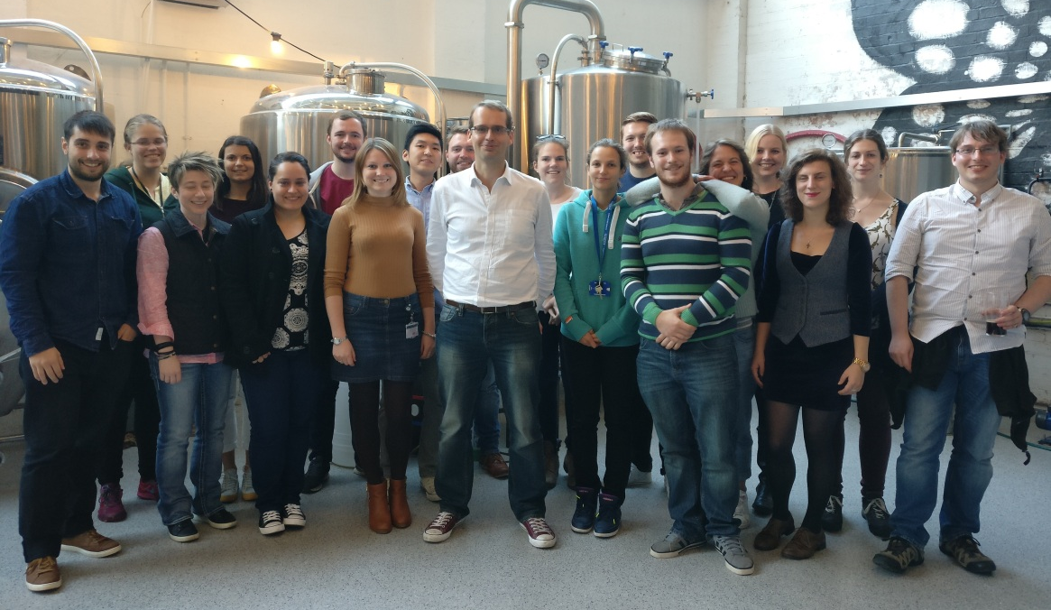










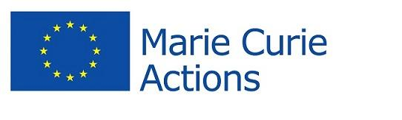

The GibsonGroup 2018
Post-docs
Dr. Sarah-Jane Richards
Dr. Caroline Biggs
Dr Collette Guy
Dr Muhammed Hasan
Dr Antonio Laezza
Dr Thomas Congdon
Kat Murray
Phd Students
Chris Stubbs
Ben Graham
Trisha Bailey
Laura Wilkins
Maria Gyprioti
Vinko Varas
Gabriell Erni-Cassolla
Robyn Wright
Alice Faytor
Iain Galpin
Alex Baker
Rueben Thomas
Ioanna Kontopoulou
Alex Murray
Jessie Davies
MSc Students
Kev Malzkadeh
Jessie Davies
Administrative Coordinator
Angela Hurst
Visitors
Toru Ishibe
Funders £$€
Noreen Murray Philanthropy Award
Friends of the University of Warwick Trust

Slide 12
Group Meeting Update
Wednesday 17th October 2018

