Slide 1


Glycosylated Nanomaterials: Neutralisation and Detection of Bacteria and Toxins
Sarah-Jane Richards &
Matthew I. Gibson
Department of Chemistry, University of Warwick, UK
S-J.Richards@warwick.ac.uk
www.warwick.ac.uk/go/gibsongroup
248th ACS Meeting – 13th August

Slide 2
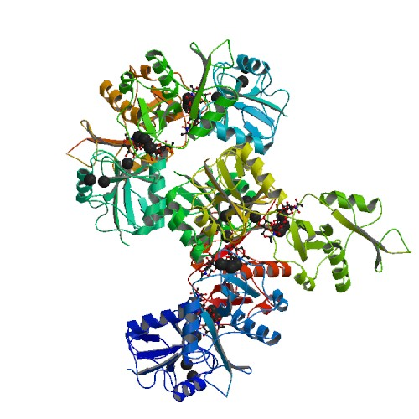
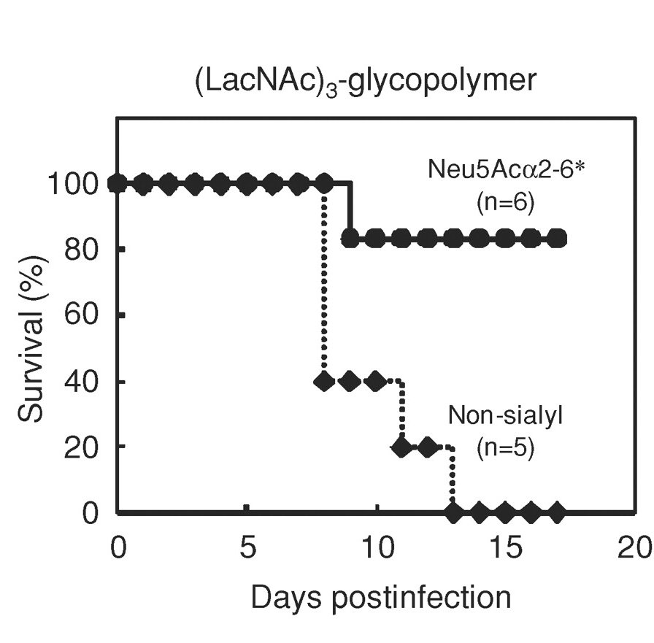
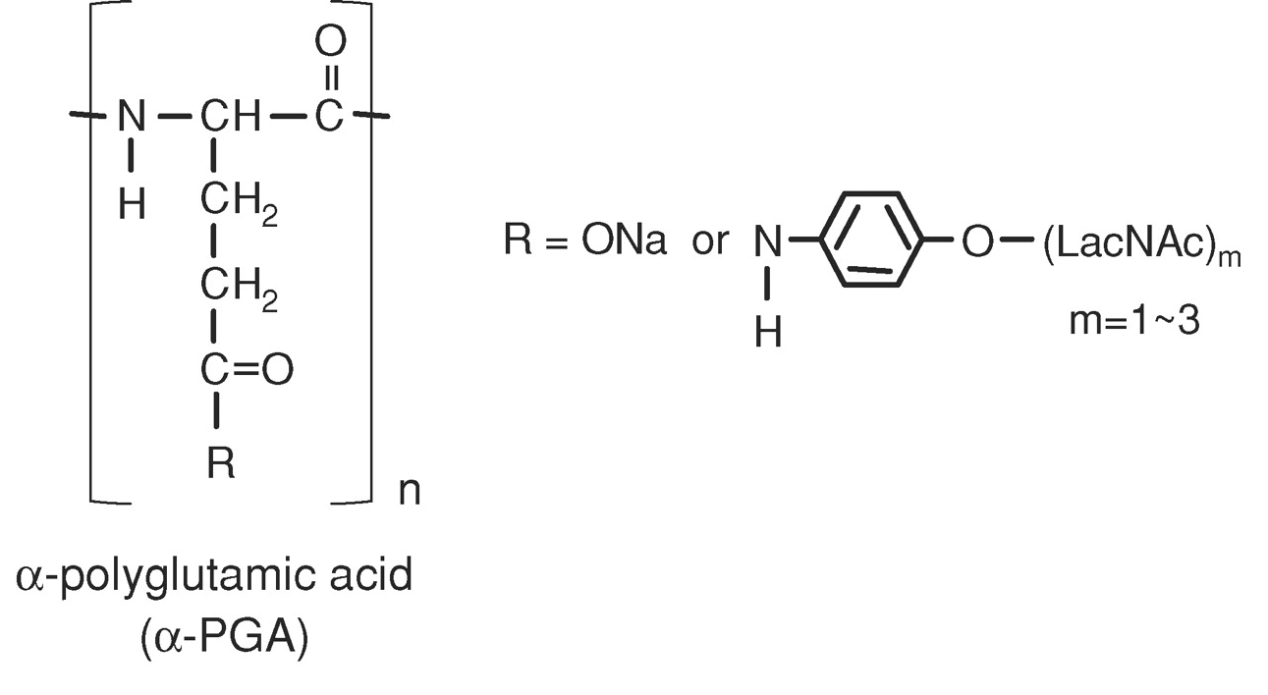
Applications: Anti-adhesion Therapy
Interactions can be inhibited at nM of glycopolymers
Influenza inhibition in mice
Sharon, N. Biochimica et Biophysica Acta, 2006, 527–537
Hidari et al. Glycobiology 2008, 18, 779
Notes:
Change to cholera
Get rid of HIV

Slide 3
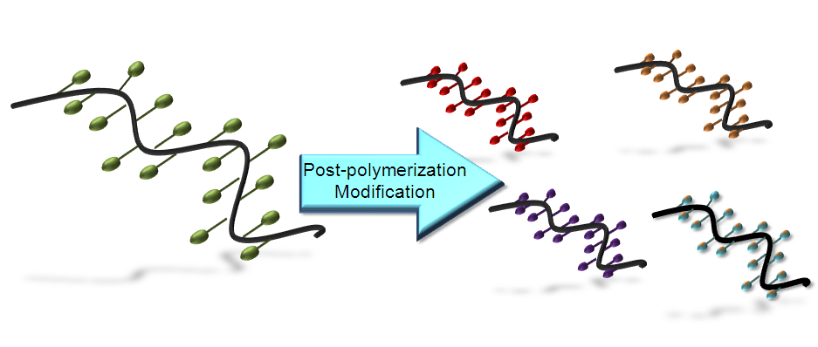
Glycopolymers by Post-Polymerisation Modification
Jones, M. W., Richards, S-J., Haddleton, D. M. Gibson, M. I.; Polym. Chem., 2013,
Richards, S-J., Jones, M. W., Hunabun, M. I., Haddleton, D. M., Gibson, M. I.; Angew. Chem., 2012
Jones, M. W., L. Otten, Richards, S-J., Lowery, R., Phillips, D. J. Haddleton, D. M. Gibson, M. I.; Chem. Sci., 2014
Notes:
Change red pic
Ref at botto,

Slide 4
Easy to make 50 gram scale
1 column/distillation
Compatible with RAFT/ATRP
Quantitative functionalisation with non-hindered amines
Density control
Sequentially
modified
polymer libraries
Theato, P.; J. Pol. Sci. A., 2008, 46, 6677

Slide 5
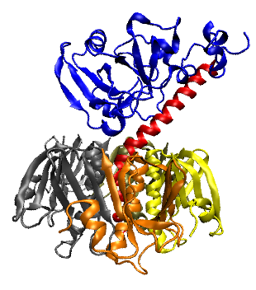
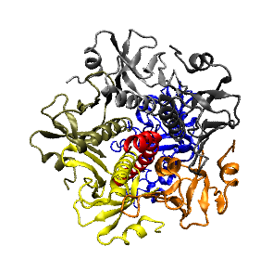
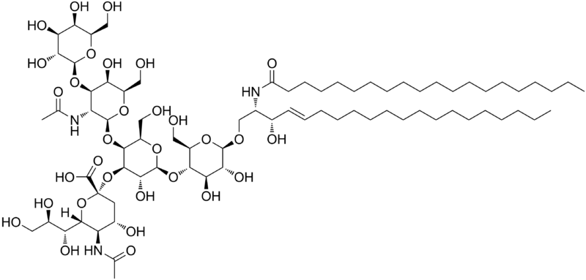
Selective Binding of Cholera-Toxin
Enzymatic domain
Induces toxic effect
Carbohydrate binding domain
Binds to epithelial cells to promote cell uptake
Anti-adhesion therapy does not target bacteria, so less evolutionary stress
Galectins – at least 13
Sigma-Aldrich – 8 Galactose-’specific’ lectins
β-D Galactose
How do we engineer a high-affinity binder for cholera toxin, without total synthesis of complex carbohydrates?
GM-1 ganglioside

Slide 6
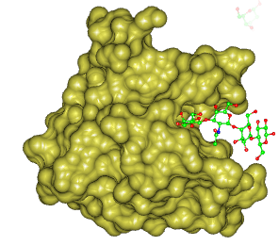
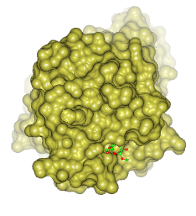
Glycan Accessibility as a Tool for Lectin Specificity
Cholera Toxin
Peanut Agglutinin
16 Å
6.3 Å
Kiick et al.; Macromol. 2007, 40, 7103 and Biomac., 2006, 7 483
Notes:
More reference

Slide 7
Glycopolymer Library
Polymer | DP^{[a]} | Linker^{[b]} | Density^{[c]} | M_{w}/M_{n}^{[d]}
GP1 | 18 | Short | 100 | 1.29
GP2 | 33 | Short | 100 | 1.27
GP3 | 70 | Short | 100 | 1.26
GP4 | 18 | Long | 100 | 1.32
GP5 | 33 | Long | 100 | 1.28
GP6 | 70 | Long | 100 | 1.27
GP7 | 33 | Long | 50 | 1.23
GP8 | 33 | Long | 25 | 1.21
GP9 | 33 | Long | 10 | 1.20

Slide 8
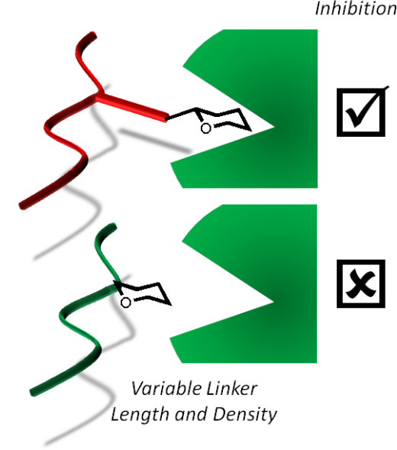
Peanut Agglutinin
Cholera Toxin
Polymer length
Polymer length
Short Linker
Long Linker
Short Linker
Long Linker
Richards, S-J., Jones, M. W., Hunabun, M. I., Haddleton, D. M., Gibson, M. I.; Angew. Chem., 2012, 51, 7812

Slide 9
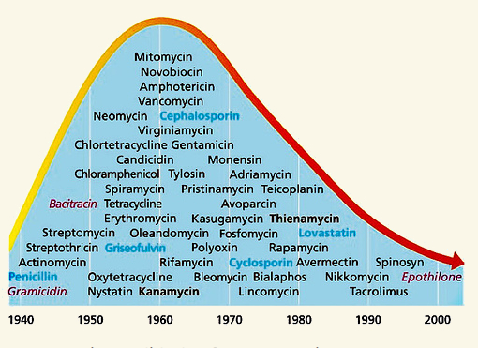
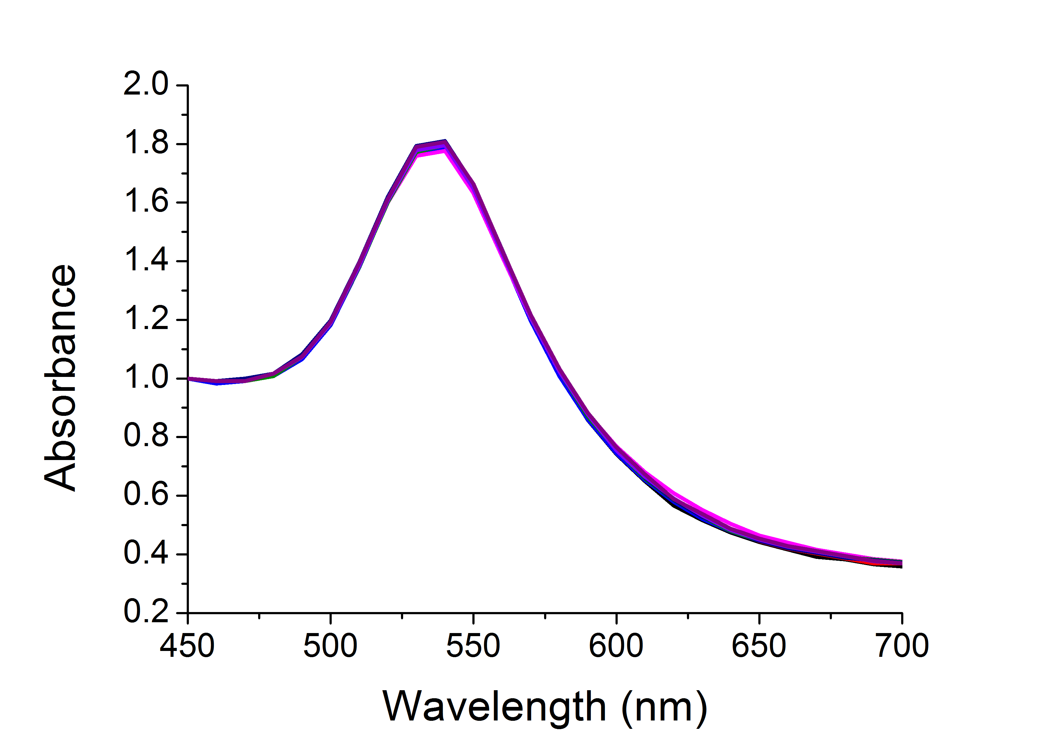
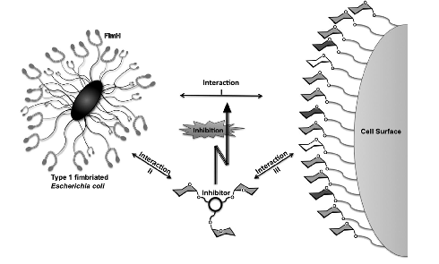
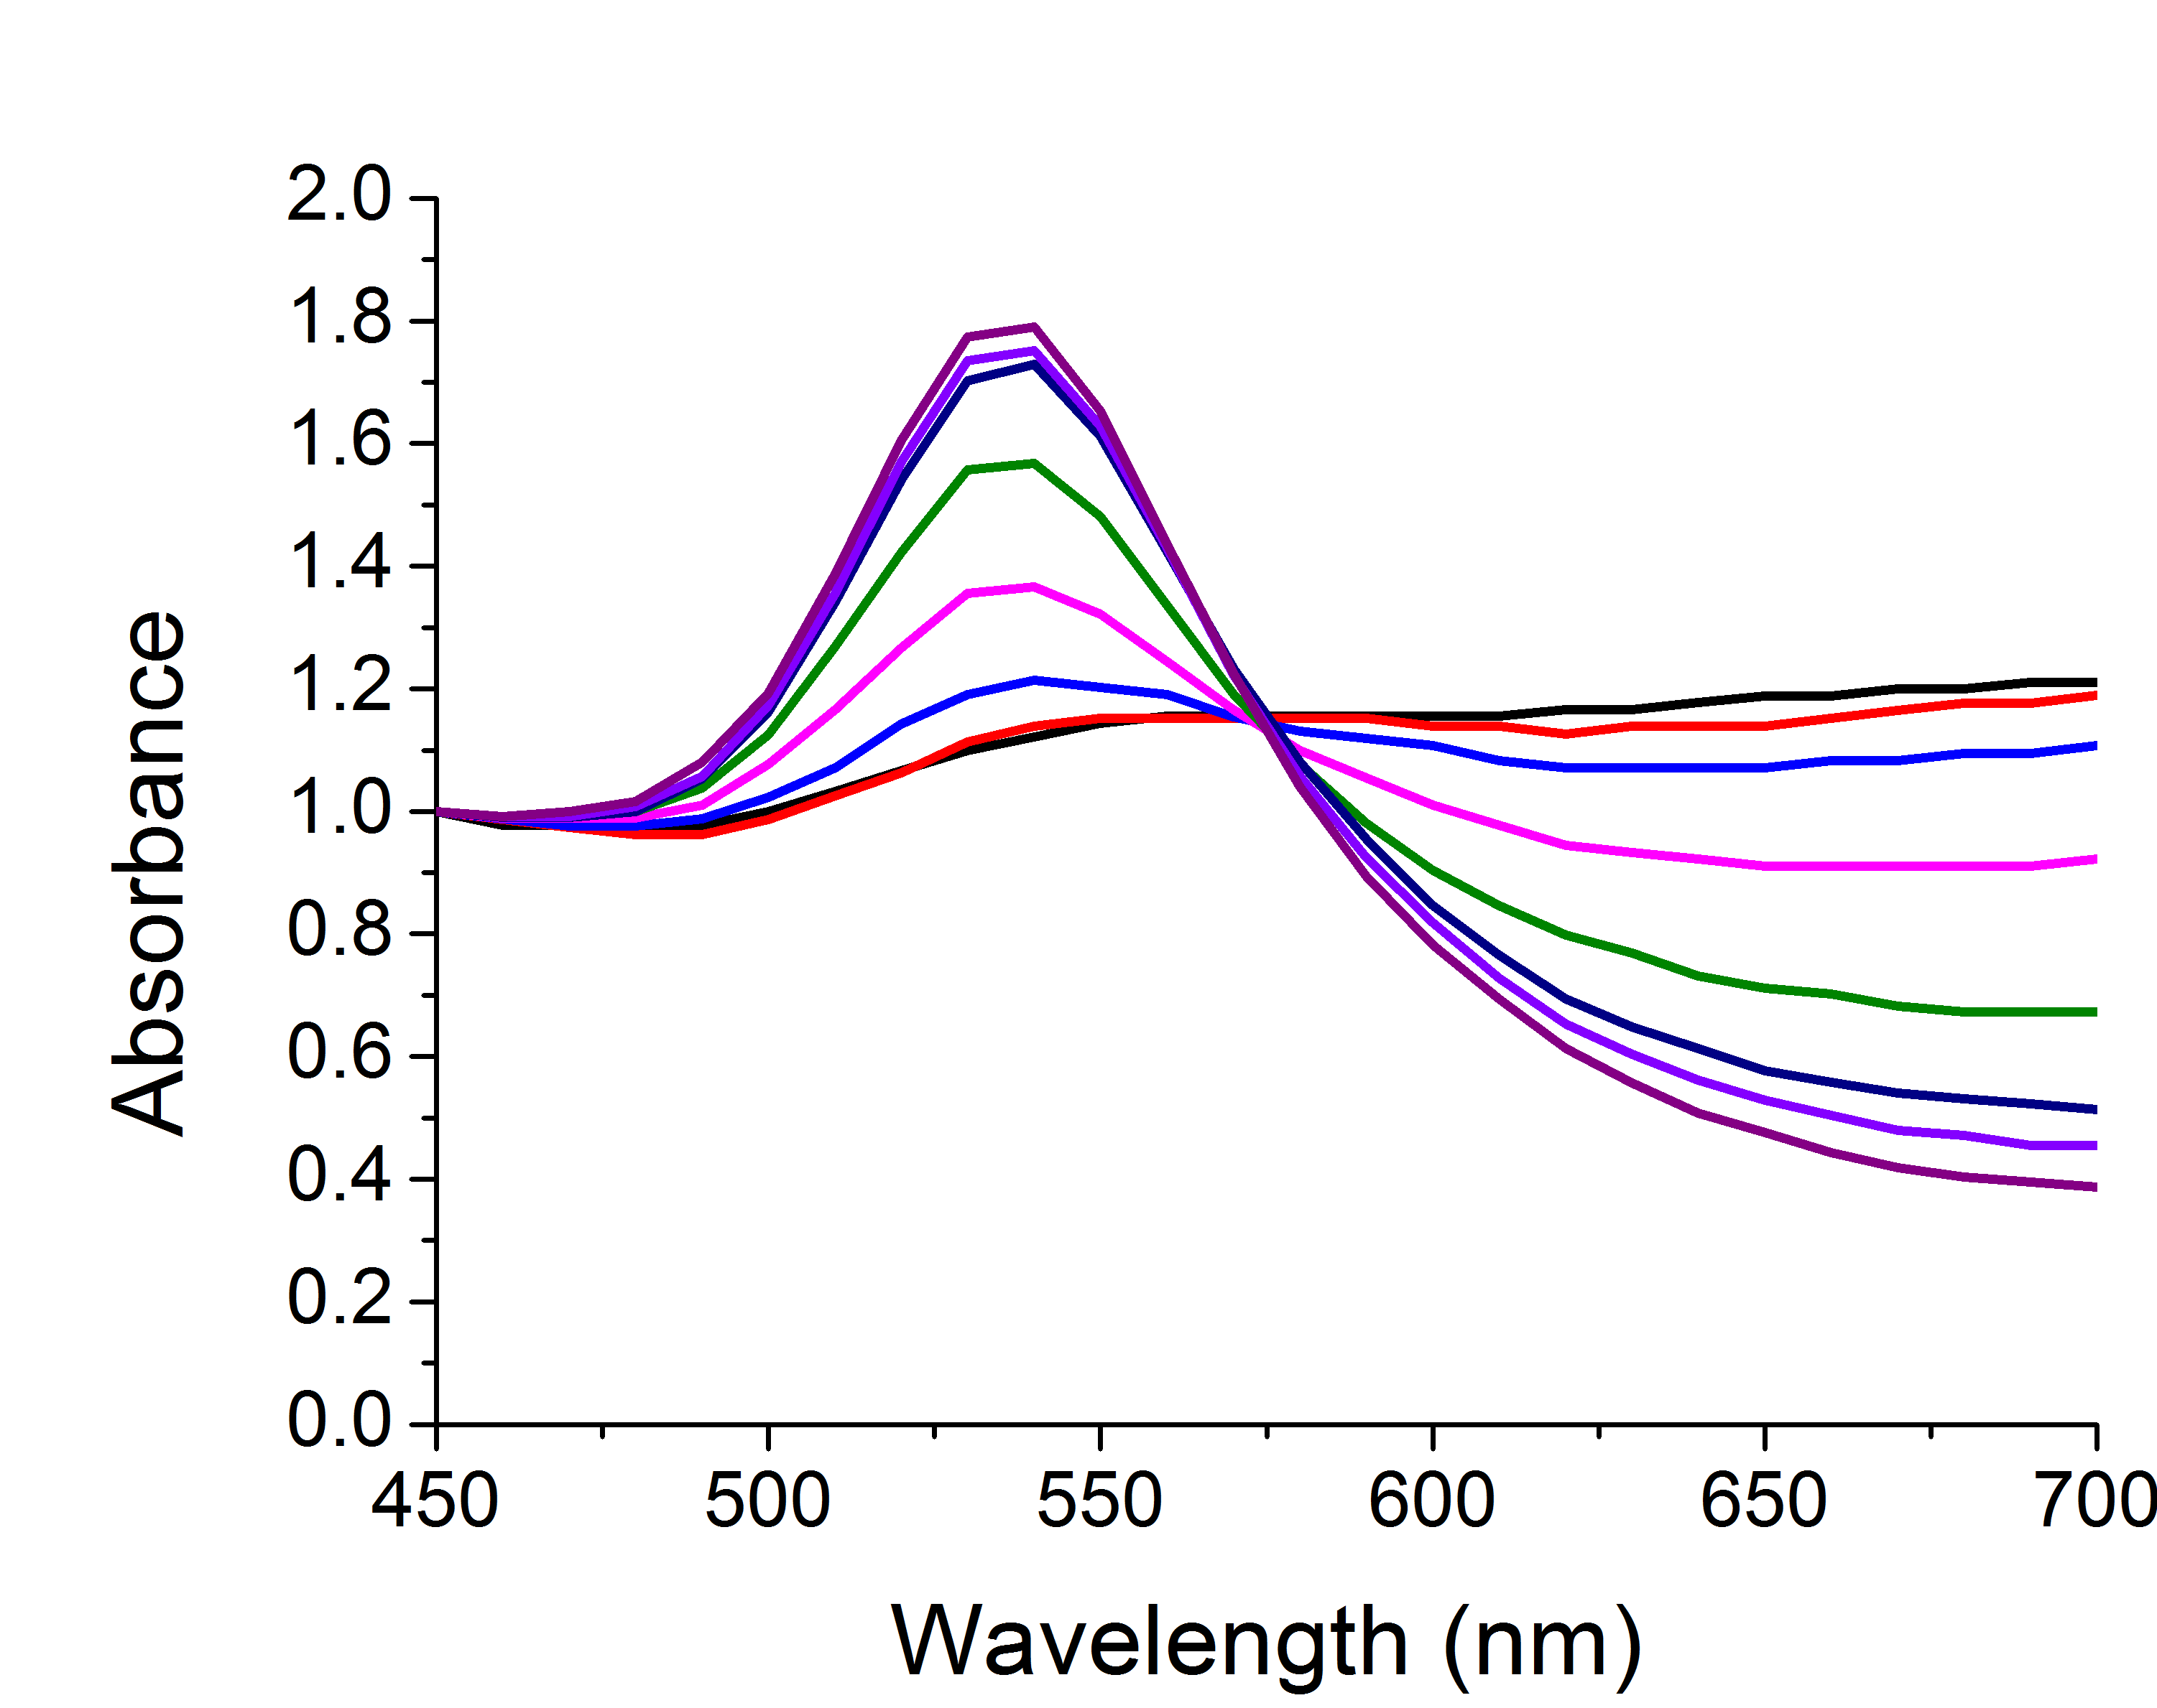
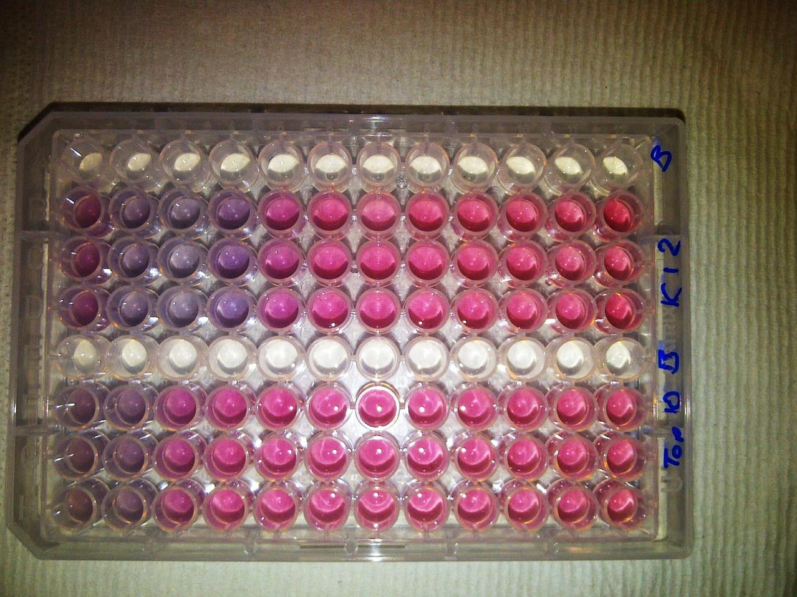
Applications: Detection
Direct
Label-free
Easy
Sensitive
Quantifiable in real-time
Notes:
More reference

Slide 10
Con A induced aggregation
[Con A]
Size dependant aggregation
Kinetics of colour change
Richards, S-J., Fullam, E., Besra, G. S. Gibson, M. I.; J. Mater. Chem. B, 2014, 2, 1490-1498
Notes:
More reference

Slide 11

Bacteria induced aggregation
[FimH+ bacteria]
[FimH- bacteria]
Colour Change ☑
Fast ☑
Specific ☑
Saline Stability ☒
Bacteria induced colour change
K-12
+ FimH
TOP10
- FimH
OD = 0.25
OD 0.005
[Bacteria]
Richards, S-J., Fullam, E., Besra, G. S. Gibson, M. I.; J. Mater. Chem. B, 2014, 2, 1490-1498
Notes:
More reference

Slide 12
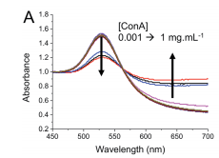
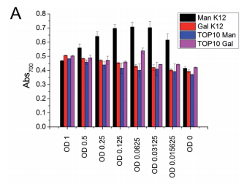
40 nm
n = 68
Colour Change ☒
Fast ☒
Specific ☑
Saline Stability
Con A induced aggregation
Directly functionalised
PEG functionalised
Bacteria induced aggregation
[ConA]
Colour change ☒ Specific ☑ Saline Stable ☑
Richards, S-J., Fullam, E., Besra, G. S. Gibson, M. I.; J. Mater. Chem. B, 2014, 2, 1490-1498
Notes:
More reference

Slide 13
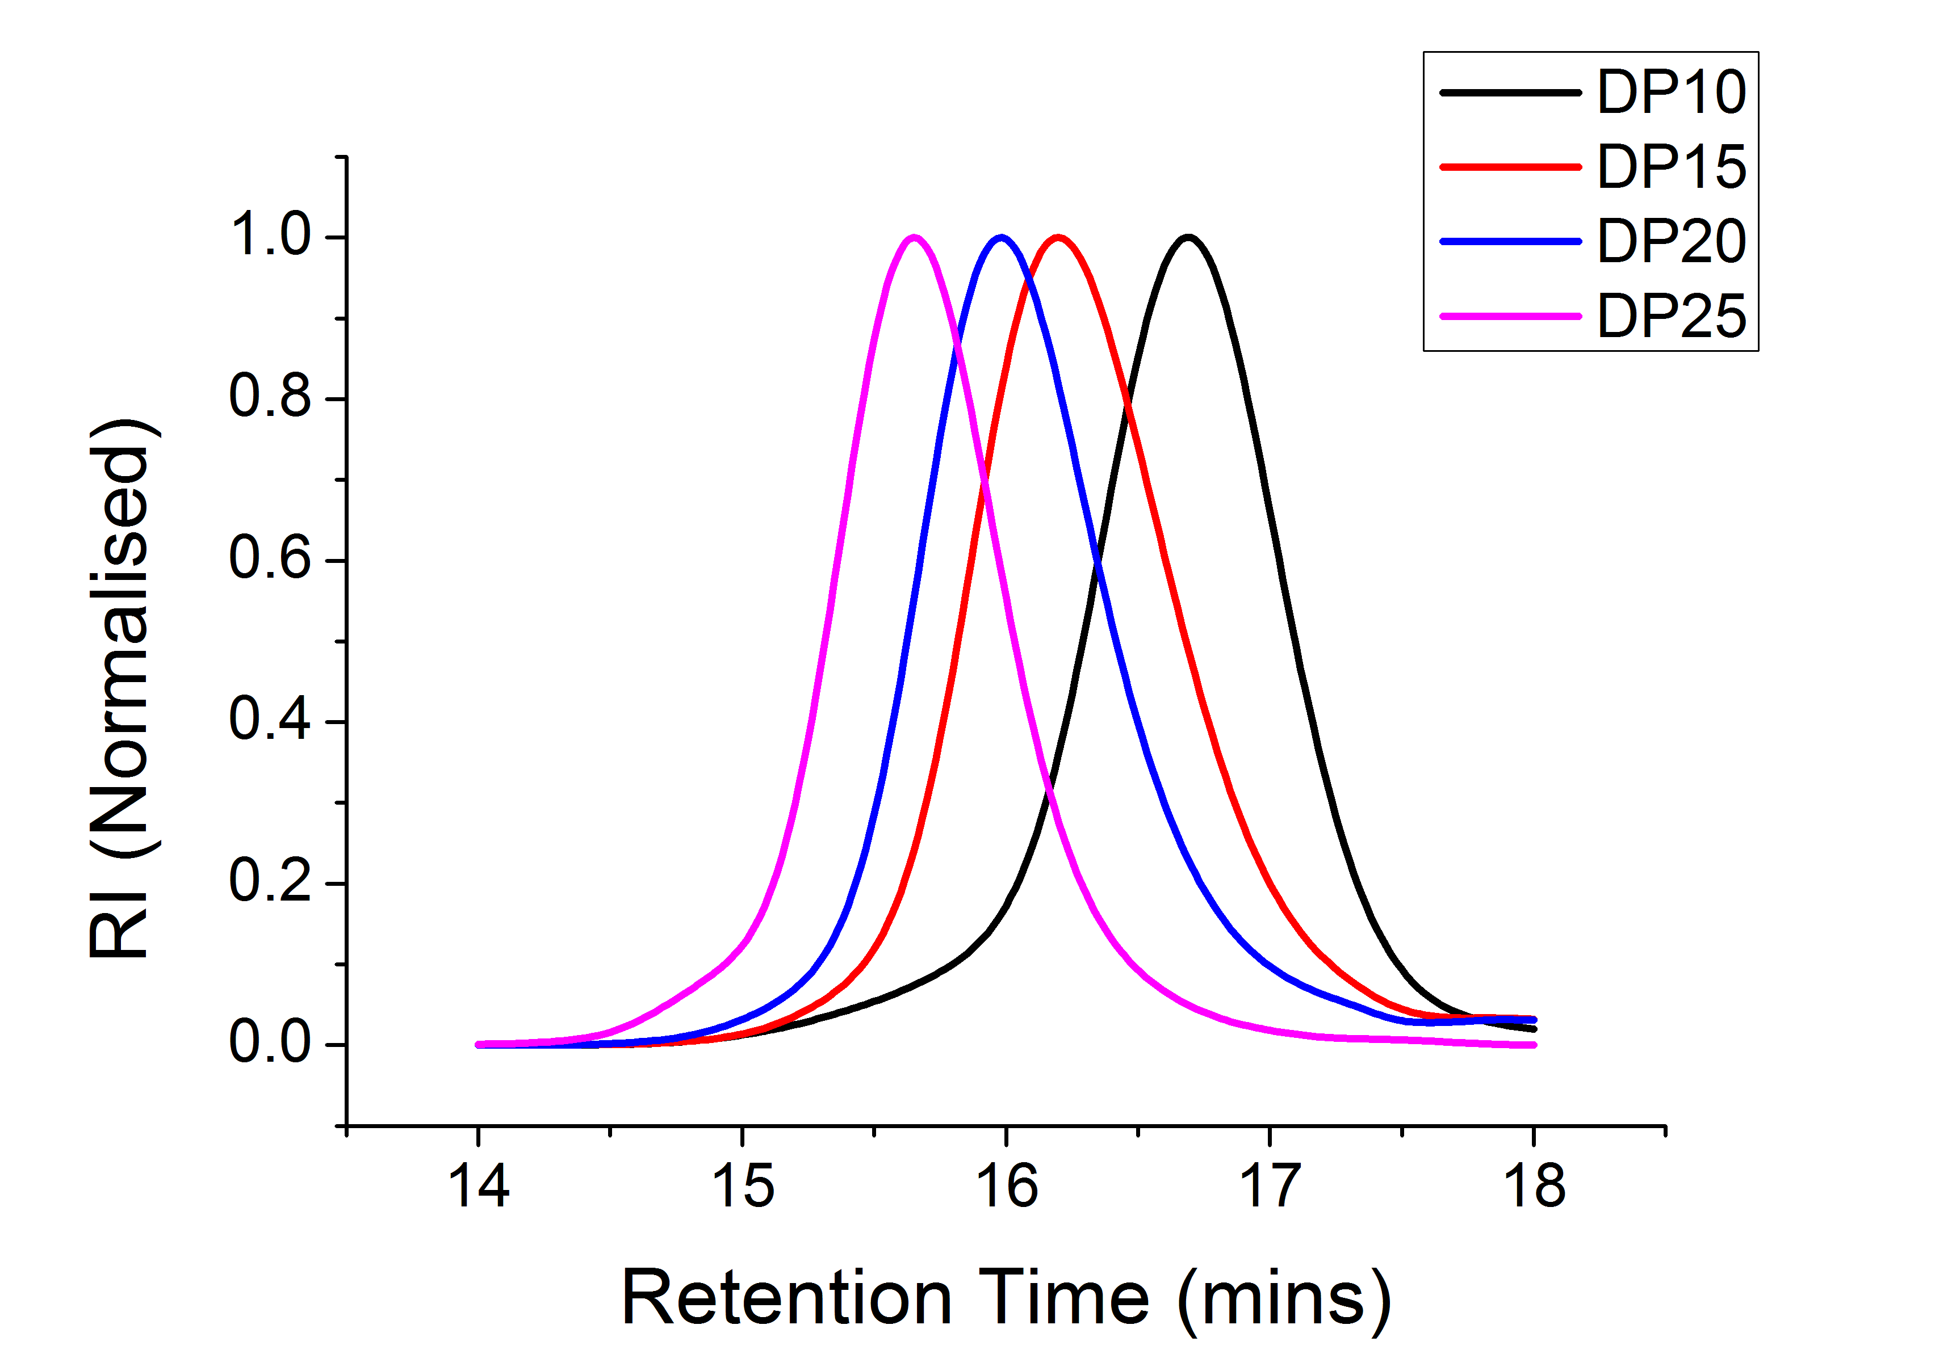
Saline stability
SEC of sizes
Kinetics of colour change
Optimisation of polymer coating
Notes:
More reference

Slide 14
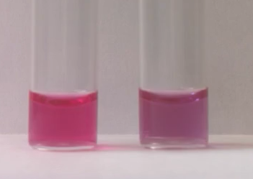
Soy bean agglutinin induced aggregation
Rapid colour change (< 5 mins)
Colour Change ☑
Fast ☑
Specific ☑
Saline Stability ☑
[SBA]
[SBA]
Highly specific change
Aggregation behaviour confirmed by DLS
Richards, S-J., Fullam, E., Besra, G. S. Gibson, M. I., In Preparation
Notes:
More reference

Slide 15
Summary
Tandem Post-Polymerisation Modification
Multivalent inhibitors that have good affinity AND specificity
Glycogoldnanoparticles
Optimised polymer coating for lectin detection

Slide 16
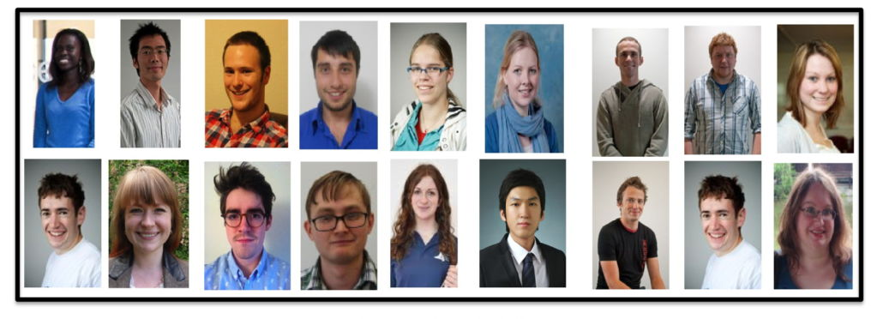




Acknowledgements
Gibson Group Members
Gemma-Louise Davies - Daniel Mitchell
Yunhua Chen - Richard Lowery
Catherine Cooper - Ben Martyn
Robert Deller - Lewis Blackman
Caroline Biggs - Sang-Ho Won
Daniel Phillips - Laura Wilkins
Tom Congdon - Robert Keogh
Lucienne Otten
Matthew Gibson
Dave Haddleton
Del Besra
Elizabeth Fullam
Mathew Jones

Slide 17
Glycosylated Nanomaterials: Detection and Neutralisation of Bacteria and Toxins
Sarah-Jane Richards & Matthew I. Gibson
Department of Chemistry, University of Warwick, UK
S-J.Richards@warwick.ac.uk
www.warwick.ac.uk/go/gibsongroup
248th ACS Meeting – 13th August

Slide 18
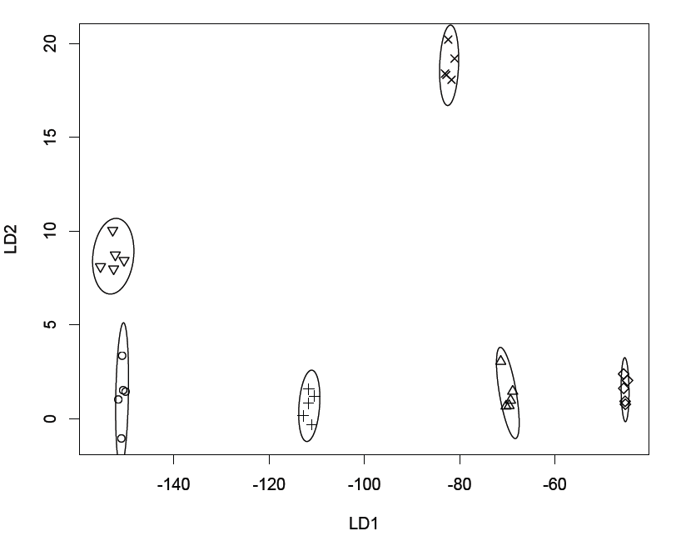
Underivatised reducing sugars
Lectin Screening and Discrimination
Notes:
More reference

