Slide 1
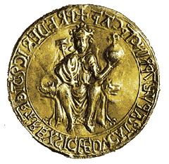
Dr. Antonio Laezza antonio.laezza@unina.it
A semi-synthetic strategy to regioselective modifications of microbial sourced chondroitin polysaccharide
Department of Chemical Sciences, University of Naples Federico II Complesso Universitario Monte S.Angelo, via Cintia 4
I-80126 Napoli, Italy
Notes:
We designed this template so that each member of the project team has a set of slides with its own theme where he/she can present their research. Members, here’s how you add a new slide to just your set:
Mark where you want to add the slide: Select an existing one in the Thumbnails pane, click the New Slide button, then choose a layout.
The new slide gets the same theme as the previous one you selected.
Careful! Don’t annoy your fellow presenters by accidentally changing their themes. That can happen if you choose a theme Variant from the Design tab, which changes all of the slides in your presentation to that look.

Slide 2
Summary
Microbial sourced chondroitin polysaccharide
Regioselective fucosylation and sulfation
Anticoagulant
activity
Conjugation with L-Threonine
Antifreeze activity

Slide 3
Semi-synthesis of fucosylated chondroitin sulfate

Slide 4
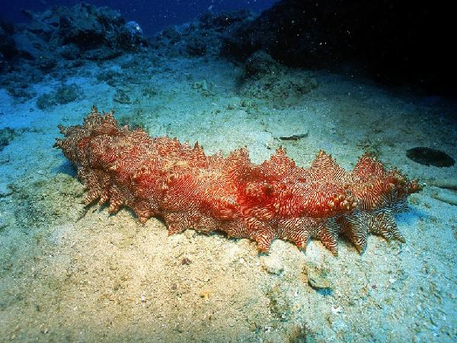
Fucosylated chondroitin sulfate
Fucosylated chondroitin sulfate (fCS) is a glycosaminoglycan (GAG) from sea cucumber^{[1]}
^{[1]} Bedini, E.; Laezza, A.; Iadonisi, A. Eur. J. Org. Chem. 2016, 18, 3018-3042
STRUCTURE:
Sulfated α-fucose branches depends on the species of sea cucumber^{[2][3]}
Trisaccharide repeating unit
^{[2]} Chen, S.; Xue, C.; Yin, L.; et al., Carbohydr. Polym. 2011, 83, 688-696
^{[3]} Myron, P.; Siddiquee, S.; Al Azad, S. Carbohydr. Polym. 2014, 112, 173-178
β-D-glucuronic acid
(GlcA)
N-Acetyl-ß-D-galactosamine
(GalNAc)
α-L-fucose
(Fuc)
Responsible for biological
activities of fCS
Notes:
NON DIRE LINEARE

Slide 5
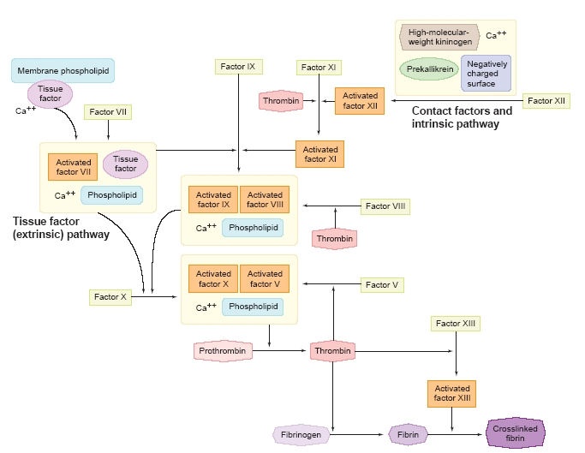
Coagulation
Blood coagulation relies on:
1) Vasoconstriction
2) Platelet plug
3) Clot formation
Serpin-dependent mechanism driven by Antithrombin (AT) and Heparin Cofactor II (HCII)^{[4]}
Serpin-independent mechanism
due to inhibition of Factor Xa
and thrombin generation^{[5]}
^{[4]} Mourão, P.A.S.; Pereira, M.S.; Pav ão, M.S.; et al., J. Biol. Chem. 1996, 271,
23973-23984
^{[5]} Glauser, B.F.; Pereira, M.S.; Monteiro, R.Q.; et al., Thromb. Haemost. 2008, 100,
420-428

Slide 6
Why semi-synthesis of fCS?
In order to obtain low molecular weight fCS several methods were employed
Mild and regioselective depolymerization^{[6][7][8]}
^{[6]} Zhao, L.; Wu, M.; Xiao, C.; et al., Proc. Natl. Acad. Sci. U.S.A. 2015, 112, 8284-8289
^{[7]} Liu, X.; Hao, J.; Shan, X.; et al., Carbohydr. Polym. 2016, 152, 343-350
^{[8]} Li, J.; Li, S.; Zhi, Z.; et al., Mar. Drugs 2016, 14, 170-183
Total synthesis of di- and trisaccharide fragments^{[9][10][11]}
^{[9]} Tamura, J.I.; Tanaka, H.; Nakamura, A.; et al., Tetrahedron Lett. 2013, 54, 3940-3943
^{[10]} Ustyuzhanina, N.E.; Fomitskaya, P.A.; Gerbst, A.G.; et al., Mar. Drugs 2015, 13, 770-787
^{[11]} Vinnitkiy, D.Z.; Ustyuzhanina, N.E.; Dmitrenok, A.S.; et al., Carbohydr. Res. 2017, 438, 9-17
Semi-synthesis of fCS^{[12][13]}
^{[12]}Laezza, A.; Iadonisi, A.; De Castro, C.; et al., Biomacromolecules 2015, 16, 2237-2245
^{[13]} Laezza, A.; Iadonisi, A.; Pirozzi, A.V.A.; et al., Chem. Eur. J. 2016, 50, 18215-18226

Slide 7
Chondroitin derivatization
Escherichia coli
O5:K4:H4
Biotechnological
production
Polysaccharide
purification
Defructosylation
IN COLLABORATION WITH THE RESEARCH GROUP OF PROF. SCHIRALDI AT
THE UNIVERSITY
OF CAMPANIA LUIGI VANVITELLI^{[14]}
chondroitin
purity grade: 89-94%
weight-averaged M_{w}: 45.0 kDa
polydispersity: 1.40
^{[14]} Cimini, D.; Restaino, O.F.; Catapano, A.; et al., Appl. Microbiol. Biotechnol. 2010, 85, 1779-1787

Slide 8
Semi-synthetic strategy
chondroitin
CH₃COCl/CH₃OH 0.58 M
CH₃OH, rt, 2 days
PhCH(OCH₃)₂, CSA
DMF, 80°C, o.n.
Sulfation free -OH
Capping unreacted
–OH as -OAc
^{[12]}
1) SO₃.py DMF
50°C, o.n.
Glycosylation*
Et₃N, Ac₂O
NaBrO₃
Na₂S₂O₄
DMAP, CH₃CN
rt, o.n.
H₂O-AcOEt
rt, o.n.
2) NaOH
pH~ 13
rt, 6h
1
fCS-I,II:R = H or per-O-sulfated-L-Fuc,
(R' = H and R'' = SO₃⁻⁺Na) or
(R' = SO₃⁻⁺Na and R'' = H)
Cleavage Bn and benzylidene groups
*
Global deprotection
2
per-O-benzylated
L-fucose-thioglycoside
^{[12]} Laezza, A.; Iadonisi, A.; De Castro, C.; et al., Biomacromolecules 2015, 16, 2237-2245
fCS | Acceptor | Donor | Yield | Degree of fucosylation | α/β | O-3-linked-: O-2- linked-: (O-4,6)-linked-α-Fuc-ratio
I | 1 | 2 | 98% | 0.77 | 2.9 | 40% : 22% : 38%
II | 1 | 2 | 76% | 0.32 | 2.3 | 38% : 62% : 0%
Glycosylation
conducted at rt
Glycosylation
conducted at -20°C

Slide 9
A library of semi-synthetic fCS with different Fuc branching site and/or sulfation pattern
sulfation site (protected with orthogonal cleavable groups)
2
1
branching site
4
3
5
chondroitin acceptors
Fuc donors
Fuc sulfation / Branching position | O-2 and/or O-3 of GlcA units | O-4 or O-6 of GalNAc units
Fuc 2,3,4 S | ✓ | ✓
Fuc 2,4 S | ✓ | ✓
Fuc 2,3 S | ✓ | ✓
Fuc O S | ✓ | ✓
Notes:
METTI I NUMERI SOTTO LE STRUTTURE

Slide 10
Semi-synthetic strategy
Capping unreacted
–OH as -OAc
Sulfation free -OH
^{[13]}
1) SO₃.py DMF
50°C, o.n.
Et₃N, Ac₂O
NaBrO₃
Na₂S₂O₄
Glycosylation
DMAP, CH₃CN
rt, o.n.
H₂O-AcOEt
rt, o.n.
2) NaOH
pH~ 13
rt, 6h
1
fC-I: R = H or L-Fuc, (R' = R'' = H)
fCS-III: R = H or per-O-sulfated-L-Fuc, (R' = H
and R'' = SO₃⁻⁺Na) or (R' = SO₃⁻⁺Na and R'' = H)
Cleavage Bn and benzylidene groups
Global deprotection
fCS-IV: R = H or 2,3-di-O-sulfated-L-Fuc, (R' = H
and R'' = SO₃⁻⁺Na) or (R' = SO₃⁻⁺Na and R'' = H)
fCS-V: R = H or 2,4-di-O-sulfated-L-Fuc, (R' = H
and R'' = SO₃⁻⁺Na) or (R' = SO₃⁻⁺Na and R'' = H)
Sulfation free -OH
1) SO₃.py DMF
50°C, o.n.
^{[13]}
NaBrO₃
Na₂S₂O₄
Glycosylation
H₂O-AcOEt
rt, o.n.
2) NaOH
pH~ 13
rt, 6h
3
fC-II: (R = H and R’ = H or L-Fuc) or
(R = H or L-Fuc and R’ = H)
fCS-VI: (R = H and R' = SO₃⁻⁺Na or per-O-sulfated-L-Fuc)
or (R = SO₃⁻⁺Na or per-O-sulfated-L-Fuc and R' = H)
Cleavage Bn groups
fCS-VII: (R = H and R' = SO₃⁻⁺Na or 2,3-di-O-sulfated-L-Fuc)
or (R = SO₃⁻⁺Na or 2,3di-O-sulfated-L-Fuc and R' = H)
^{[13]} Laezza, A.; Iadonisi, A.; Pirozzi, A.V.A.; et al., Chem. Eur. J. 2016, 50, 18215-18226
Global deprotection
fCS-VIII: (R = H and R' = SO₃⁻⁺Na or 2,4-di-O-sulfated-L-Fuc)
or (R = SO₃⁻⁺Na or 2,4di-O-sulfated-L-Fuc and R' = H)
Notes:
METTI I NUMERI SOTTO LE STRUTTURE

Slide 11
Semi-synthetic strategy
fC-I: R = H or L-Fuc, (R' = R'' = H)
fC-II: (R = H and R’ = H or L-Fuc) or (R = H or L-Fuc and R’ = H)
fCS-III: R = H or per-O-sulfated-L-Fuc, (R' = H
and R'' = SO₃⁻⁺Na) or (R' = SO₃⁻⁺Na and R'' = H)
fCS-VI: (R = H and R' = SO₃⁻⁺Na or per-O-sulfated-L-Fuc)
or (R = SO₃⁻⁺Na or per-O-sulfated-L-Fuc and R' = H)
fCS-IV: R = H or 2,3-di-O-sulfated-L-Fuc, (R' = H
and R'' = SO₃⁻⁺Na) or (R' = SO₃⁻⁺Na and R'' = H)
fCS-VII: (R = H and R' = SO₃⁻⁺Na or 2,3-di-O-sulfated-L-Fuc)
or (R = SO₃⁻⁺Na or 2,3di-O-sulfated-L-Fuc and R' = H)
fCS-V: R = H or 2,4-di-O-sulfated-L-Fuc, (R' = H
and R'' = SO₃⁻⁺Na) or (R' = SO₃⁻⁺Na and R'' = H)
fCS-VIII: (R = H and R' = SO₃⁻⁺Na or 2,4-di-O-sulfated-L-Fuc)
or (R = SO₃⁻⁺Na or 2,4di-O-sulfated-L-Fuc and R' = H)
 | Acceptor | Donor | Yield | Degree of fucosylation | α/β | Branching site ratio
fC-I | 1 | 2 | 33% | 0.34 | 5.2 | 0.9
fC-II | 3 | 2 | 39% | 0.38 | 3.5 | 0.9
fCS-III | 1 | 2 | 41% | 0.51 | 3.6 | 0.9
fCS-IV | 1 | 4 | 41% | 0.43 | 5.5 | 0.6
fCS-V | 1 | 5 | 17% | 0.44 | 2.8 | 1.1
fCS-VI | 3 | 2 | 47% | 0.45 | 4.3 | 1.3
fCS-VII | 3 | 4 | 38% | 0.43 | 4.0 | 2.1
fCS-VIII | 3 | 5 | 40% | 0.50 | 1.4 | 2.4
Notes:
1) MODIFICA SLIDE TOGLI SPETTRO

Slide 12
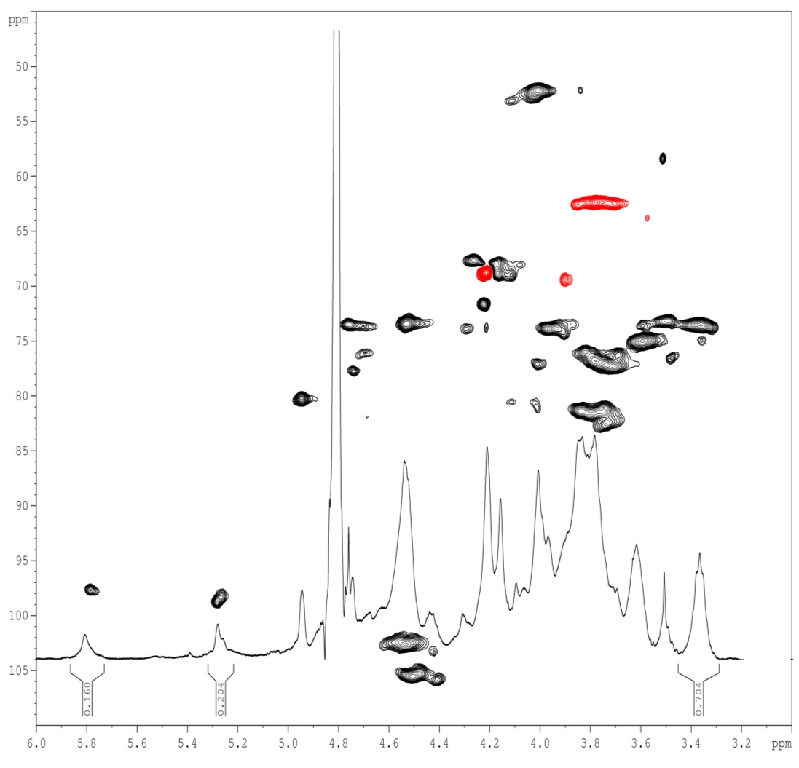
Semi-synthetic strategy
fCS-VI: (R = H and R' = SO₃⁻⁺Na or per-O-sulfated-L-Fuc)
or (R = SO₃⁻⁺Na or per-O-sulfated-L-Fuc and R' = H)
CH₂-6
GalNAc-(6-OH)
CH-4
GalNAc-(4-OH)
CH₂-6
GalNAc6S
CH-4
GalNAc-(4-Fuc)
CH₂-6
GalNAc-(6-Fuc)
CH-4
GalNAc4S
¹H-NMR and HSQC-DEPT spectra of fCS-VI (600 MHz, D₂O, 298 K)

Slide 13

Anticoagulant activity
IN COLLABORATION WITH THE RESEARCH GROUP OF PROF. SCHIRALDI
AT THE UNIVERSITY OF CAMPANIA LUIGI VANVITELLI
AT-dependent activity against factor Xa
 | fC-I | fC-II | fCS-III | fCS-IV | fCS-V | fCS-VI | fCS-VII | fCS-VIII | Heparin
Activity [IU/mg] | 0.20 | 0.25 | 0.18 | 0.27 | n.d. | 0.26 | 0.33 | 0.23 | 198
AT-dependent values similar to low molecular weight fCS^{[4][14]}
^{[4]} Mourão, P.A.S.; Pereira, M.S.; Pavão, M.S.; et al., J. Biol. Chem. 1996, 271, 23974-23984
^{[14]} Wu, M.; Wen, D.; Gao, N.; et al., Eur. J. Med. Chem. 2015, 92, 257-269
HC-II-mediated anti-factor IIa activity
160
140
120
100
HC-II concentration [ng/mL]
80
60
40
20
0
fC-I
fC-II
fCS-III
fCS-IV
fCS-V
fCS-VI
fCS-VII
fCS-VIII
heparin
Notes:
MODIFICA NOMI CAMPIONI NELLE TABELLE

Slide 14
Conclusions
Semi-synthetic strategies from microbial sourced chondroitin to fucosylated chondroitin sulfate
First O-glycosylation of secondary hydroxyls of polysaccharides
Library of different O-glycosylated chondroitin polysaccharides

Slide 15
Synthesis, conformational study and antifreeze activity of threonine decorated microbial sourced chondroitin

Slide 16
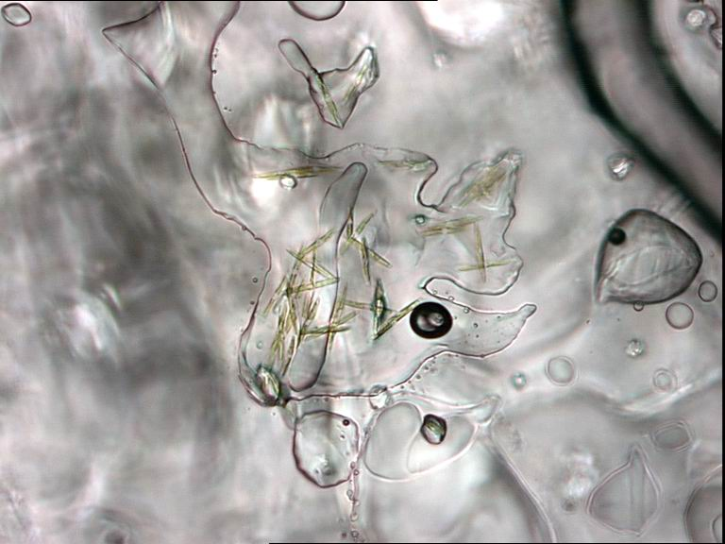
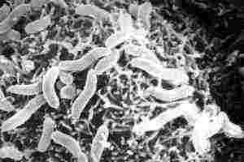
Colwellia psychrerytraea 34H
STRUCTURE:
Tetrasaccharide repeating unit
β-D-Glucuronic Acid
(GlcA)
α-D-Galacturonic Acid
(GalA)
N-Acetyl-β-D-Glucosamine
(GlcNAc)
N-Acetyl-β-D-Galactosamine
(GalNAc)
Isolated in Arctic Sea
Obligate psychrophile
CPS with cryoprotectant function

Slide 17
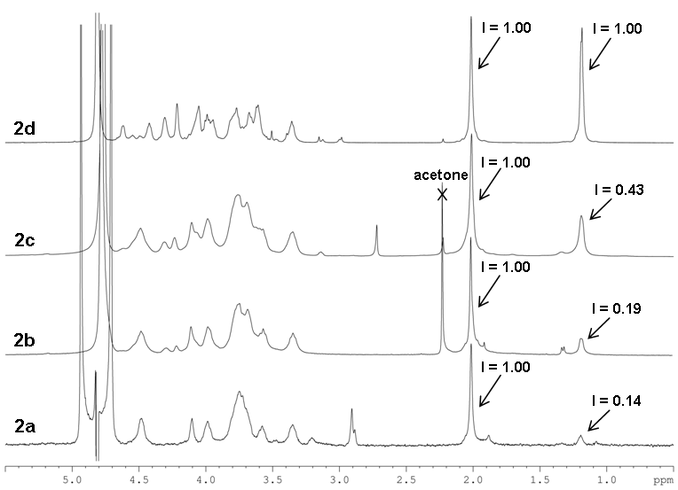
Semi-synthetic strategy
Coupling with Thr-OMe
1) ThrOMe , pyBOP®
HOBt, DIPEA
DMF, rt, o.n.
1) ThrOMe, EDC, NHS
MES, H₂O, rt, o.n.
^{[15]}
2) NaOH, H₂O
pH~ 13 , rt, 6h
Chondroitin: X = COOH
6: X = COO⁻⁺(n-Bu)₄
7a: DS = 0.14 from EDC
Global deprotection
7b: DS = 0.19 from pyBOP
1) ThrOMe , TBTU
2,4,6-collidine
DMF, rt, o.n.
Coupling with
Thr-OMe
2) NaOH, H₂O
pH~ 13 , rt, 6h
Global deprotection
7d
7c
^{[15]}
7b
7c: DS = 0.43 from TBTU
7a
^{[15]} Laezza, A.; Casillo, A.; Cosconati, A.; et al., Biomacromolecules
2017, DOI: 10.1021/acs.biomac.7b00326
¹H-NMR spectra (600 MHz, D₂O, 298K)
of polysaccharides 7a-d (I = Integral area)
Notes:
METTI NUMERO AI CAMPIONI

Slide 18
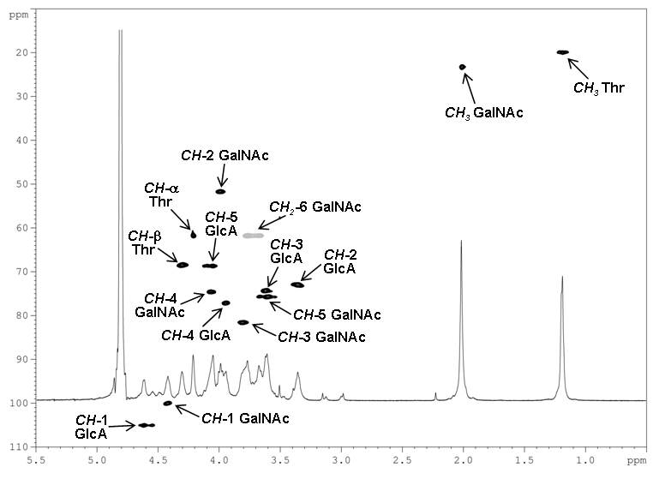
Semi-synthetic strategy
PhCH(OCH₃)₂, CSA
DMF, 80°C, o.n.
Protection of
O-4,6-diol by benzylidene ring
ThrOMe,TBTU,
2,4,6-collidine
DMF, rt, o.n.
Coupling with Thr-OMe
NaBrO₃, Na₂S₂O₄
7:3 v/v H₂O-AcOEt
rt, o.n.
Cleavage benzylidene group
¹H-NMR and HSQC-DEPT spectra of 7d (600 MHz, D₂O, 298 K)
NaOH, H₂O
pH~ 13, rt, 6h
Global deprotection
^{[15]}
7d: DS = 1.00 from TBTU
^{[15]} Laezza, A.; Casillo, A.; Cosconati, A.; et al., Biomacromolecules 2017, DOI: 10.1021/acs.biomac.7b00326

Slide 19

Antifreeze actvity
IN COLLABORATION WITH THE RESEARCH GROUP OF PROF. GIBSON AT THE UNIVERISTY OF WARWICK
There is a trend that as the threonine content increases, the IRI activity is reduced. This could be associated to the slight decrease of the molecular weight ^{[15]}
IRI activity of chondroitin polysaccharide 7a-d
^{[15]} Laezza, A.; Casillo, A.; Cosconati, A.; et al., Biomacromolecules 2017, DOI: 10.1021/acs.biomac.7b00326

Slide 20
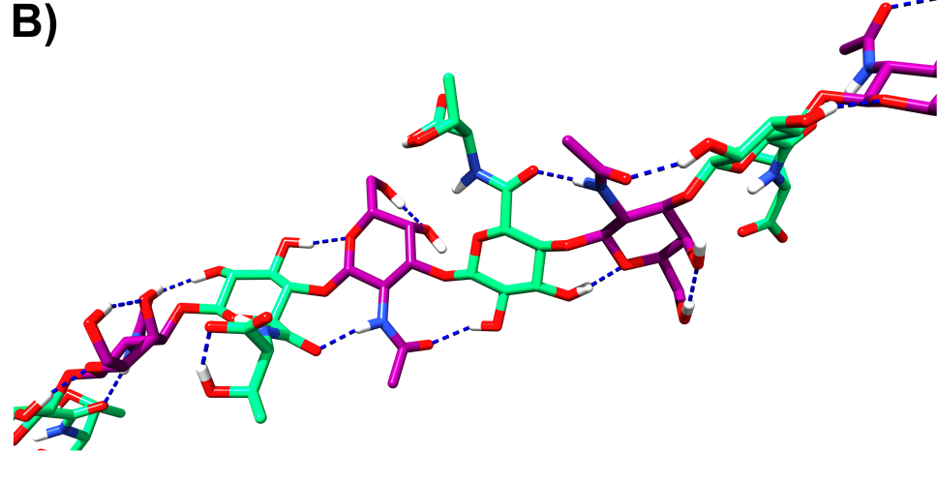
Molecular weight determination and conformational study
IN COLLABORATION WITH THE RESEARCH GROUP OF PROF. PADUANO AT UNIVERSITY OF NAPLES FEDERICO II (M_{w} determination)
M_{w} decreases with the increase of Thr-decoration
IN COLLABORATION WITH THE
RESEARCH GROUP OF PROF. RANDAZZO AT
THE UNIVERSITY OF NAPLES FEDERICO II (Conformational studies)
Semi-synthetic polysaccharide adopts a fairly linear conformation stabilized by inter-residue H-bond interactions
It differs from “zigzag” arrangement of C. psychrerythraea Thr-decorated CPS^{[16]} and from helical arrangement of
C. psychrerythraea EPS^{[17]}
^{[16]} Carillo , S.; Casillo, A.; Pieretti, G.; et al., J. Am. Chem. Soc. 2015, 137, 179-189
^{[17]} Casillo, A.; Parrilli, E.; Sannino, F.; et al., Carbohydr. Polym. 2017, 156, 364-371

Slide 21
Conclusions
Different degree of Thr-decoration of microbial sourced chondroitin
The presence of Thr is not sufficient for IRI activity
This finding will help future investigation towards the development of polymer mimics of antifreeze agents

Slide 22


Acknowledgment
University of Naples Federico II
(SSCN Group)
Dr. Emiliano Bedini
Prof. Michelangelo Parrilli
Prof. Rosa Lanzetta
Prof. Antonio Molinaro
Prof. Cristina De Castro
Prof. Maria Michela Corsaro
Prof. Alfonso Iadonisi
Prof. Alba Silipo
University of Warwick
Prof. Matthew I. Gibson
University of Naples Federico II
Prof. Luigi Paduano
Prof. Antonio Randazzo
University of Campania Luigi Vanvitelli
Prof. Mario De Rosa
Prof. Chiara Schiraldi
L.297 project “Produzione biotecnologica
di condroitina”

Slide 23
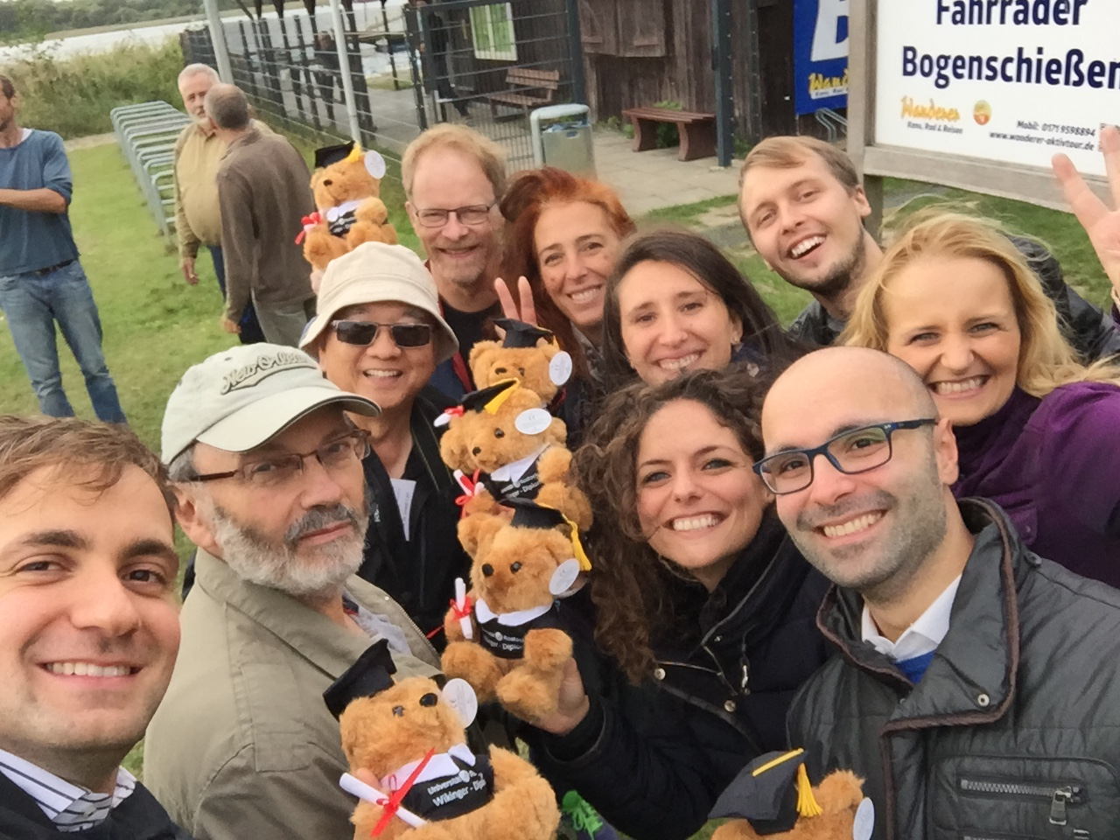
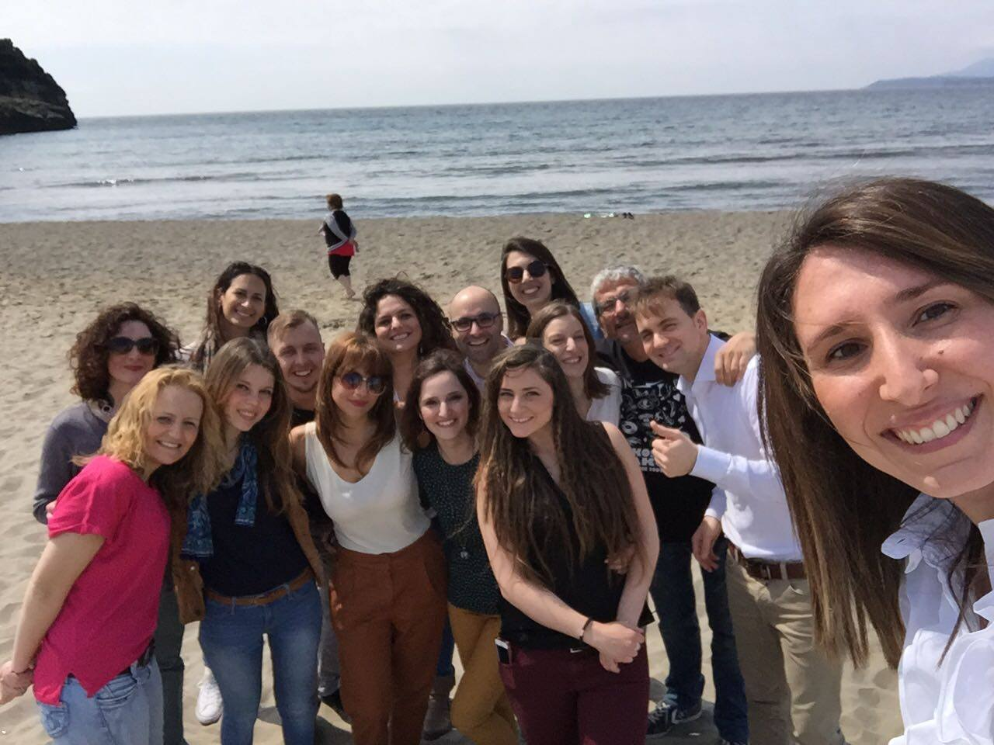
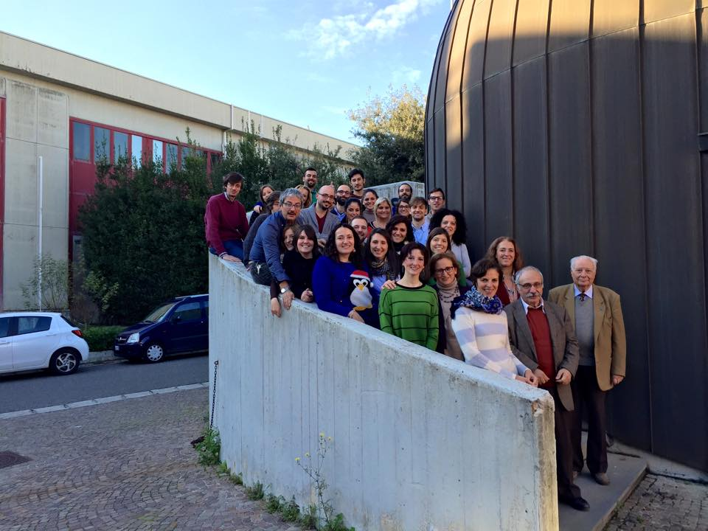
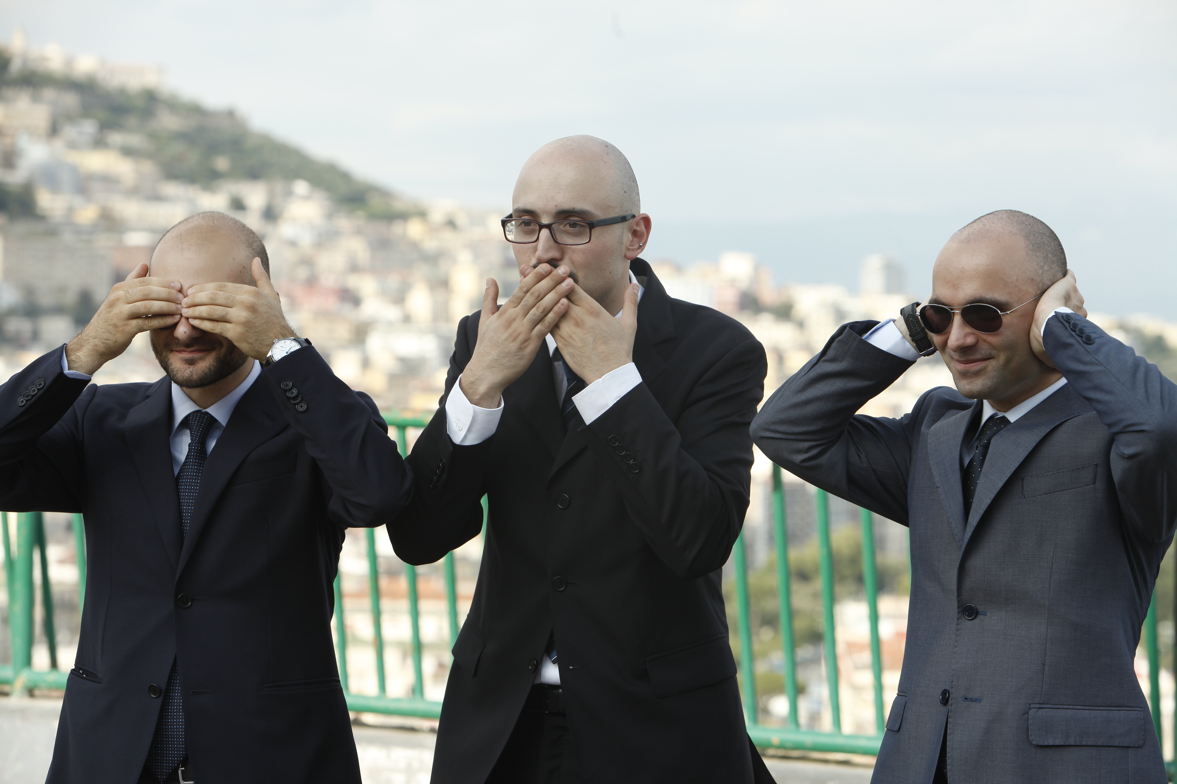

Slide 24
Thank you for your attention

Slide 25


Slide 27
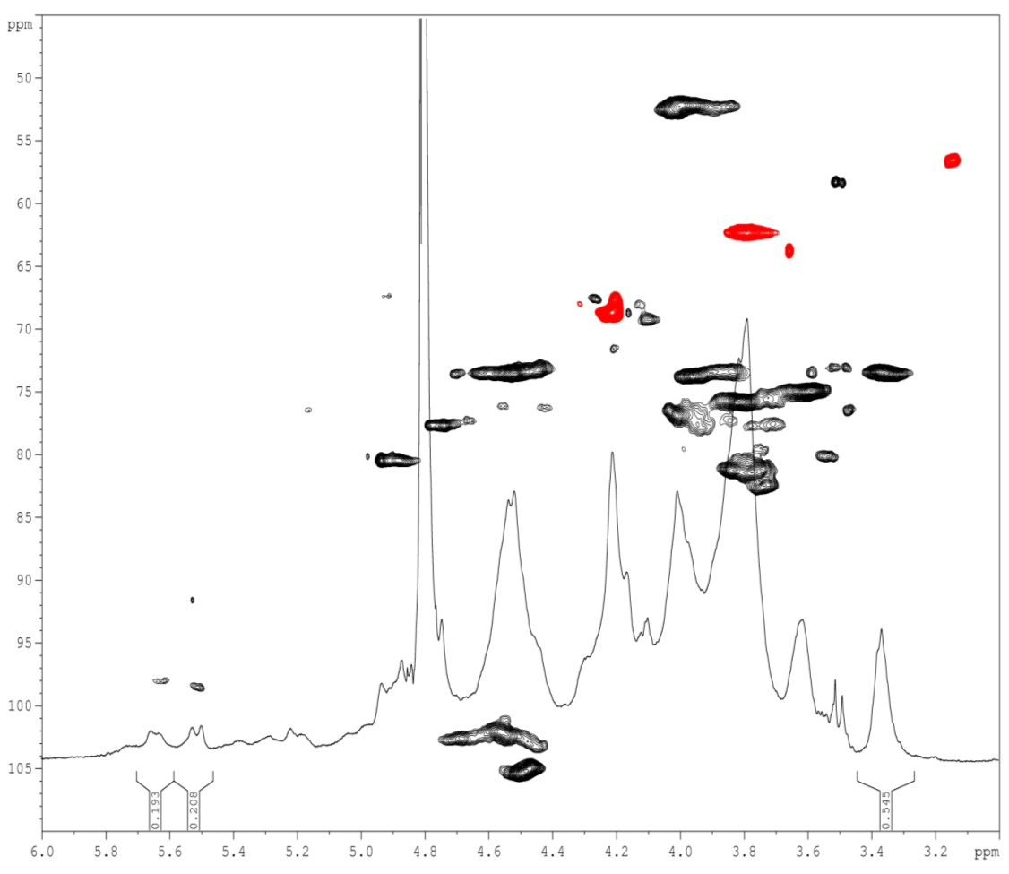
CH-2
GalNAc4S + GalNAc6S
CH₂-6
GalNAc4S
CH-4
GalNAc4S

Slide 28
Regioselective sulfation of microbial sourced chondroitin

Slide 29
Chondroitin sulfate
Chondroitin sulfate is a GAG widely distributed in mammals and invertebrates, as well as in some bacteria^{[1]}
^{[1]} Bedini, E.; Laezza, A.; Iadonisi, A. Eur. J. Org. Chem. 2016, 18, 3018-3042
Natural sulfation patterns
0: GlcA-GalNAc E: GlcA-GalNAc(4,6S)
A: GlcA-GalNAc(4S) K: GlcA(3S)-GalNAc(4S)
B: GlcA(2S)-GalNAc(4S) L: GlcA(3S)-GalNAc(6S)
C: GlcA-GalNAc(6S) M: GlcA(3S)-GalNAc(4,6S)
D: GlcA(2S)-GalNAc(6S) R: GlcA(2,3S)-GalNAc
STRUCTURE:
Disaccharide repeating unit
β-D-glucuronic acid
(GlcA)
N-Acetyl-ß-D-galactosamine
(GalNAc)
→ 4)-ß-D-GlcA-(1→3)-ß-D-GalNAc-(1 →
polysaccharide with a variable sulfation pattern

Slide 30
Chondroitin sulfate
Important in osteoarthritis and osteoarthrosis treatment^{[22]}
[22] Bishnoi, M.; Jain, A.; Hurkat, P.; et al., Glycoconj. J. 2016, 33, 693-705
Depending on sulfation pattern further employments have been proposed^{[23] [24]}
Natural sulfation patterns
0: GlcA-GalNAc E: GlcA-GalNAc(4,6S)
A: GlcA-GalNAc(4S) K: GlcA(3S)-GalNAc(4S)
B: GlcA(2S)-GalNAc(4S) L: GlcA(3S)-GalNAc(6S)
C: GlcA-GalNAc(6S) M: GlcA(3S)-GalNAc(4,6S)
D: GlcA(2S)-GalNAc(6S) R: GlcA(2,3S)-GalNAc
[23] Yamada, S.; Sugahara, K. Curr. Drug Discovery Technol.
2008, 5, 289-301
[24] Schiraldi, C.; Cimini, D.; De Rosa, M. Appl. Microbiol. Biotechnol. 2010, 87, 1209-1220
Interest to develop chemical and chemoenzymatic^{[25][26]} fine modification of sulfation pattern
[25] Bedini, E.; Parrilli, M. in Chondroitin sulfate: Structure, use and health implications, (Ed. Pomin, V.H.), Nova Science Publishers Inc. New York, (NY) 2013, 1-27
[26] Scott,R.A.; Panitch, A. Wiley Interdiscip. Rev. Nanomed. Nanobiotechnol. 2013, 5, 388-398

Slide 31
Semi-synthetic strategy
Orthoester route
chondroitin
Benzylidene route
CH₃C(OCH₃)₂, CSA
DMF, 80°C, o.n.
PhCH(OCH₃)₂, CSA
DMF, 80°C, o.n.
precipitation
AC₂O, Et₃N, DMAP
CH₃CN, rt, o.n.
AC₂O, Et₃N, DMAP
CH₃CN, rt, o.n.
Capping unreacted
–OH as -OAc
AC₂O, Et₃N, DMAP
DMF, rt, o.n.
one-pot
Cleavage
orthoester
group
4:1 v/v ACOH-H₂O, rt
dialysis
NaBrO₃, Na₂SO₄
H₂O-EtOAc, rt, o.n.
Cleavage benzylidene group
Sulfation
free -OH
1) SO₃.py DMF
50°C, o.n.
2) NaOH
pH~ 13
rt, 6h
Global deprotection
Sulfation
free -OH
1) SO₃.py DMF
50°C, o.n.
2) NaOH
pH~ 13
rt, 6h
Global deprotection
^{[27]}
CS-A,C,K,L: (R = SO₃⁻⁺Na, R’ = H) or (R = H, R’ = SO₃⁻⁺Na); R’’ = SO₃⁻⁺Na or H
CS-A,C: (R = SO₃⁻⁺Na, R’ = H) or (R = H, R’ = SO₃⁻⁺Na)
CS-A,C,K,L: (R = SO₃⁻⁺Na, R’ = H) or (R = H, R’ = SO₃⁻⁺Na);
R’’ = SO₃⁻⁺Na or H
[27] Bedini, E.; De Castro, C.; De Rosa, M.; et al., Chem. Eur. J. 2012, 18, 2123-2130
Notes:
Idrolisi con AcOH 90’
METTI NUMERI ALLE STRUTTURE
METTI CITAZIONE

Slide 32
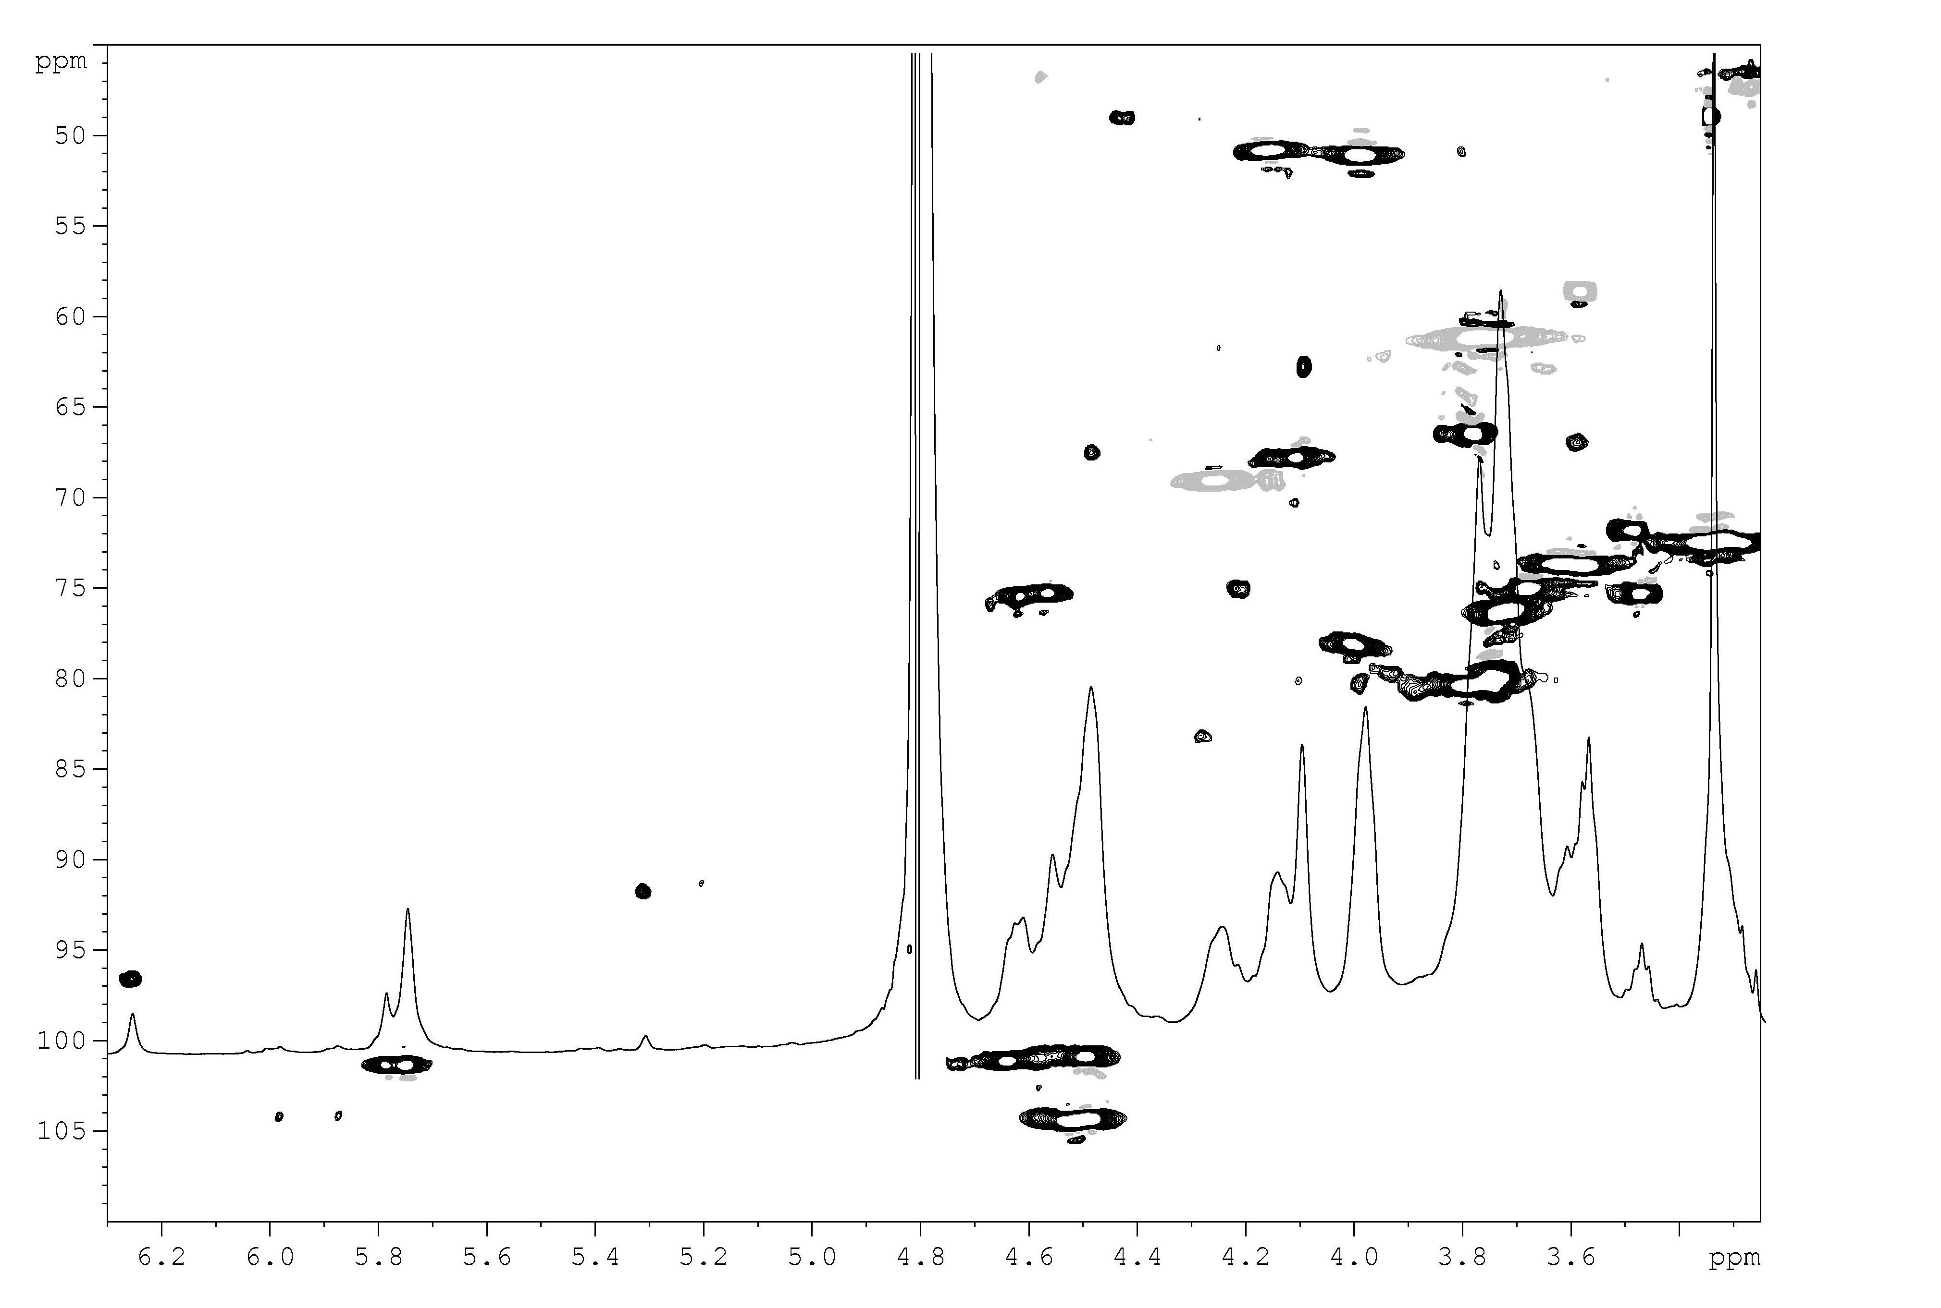
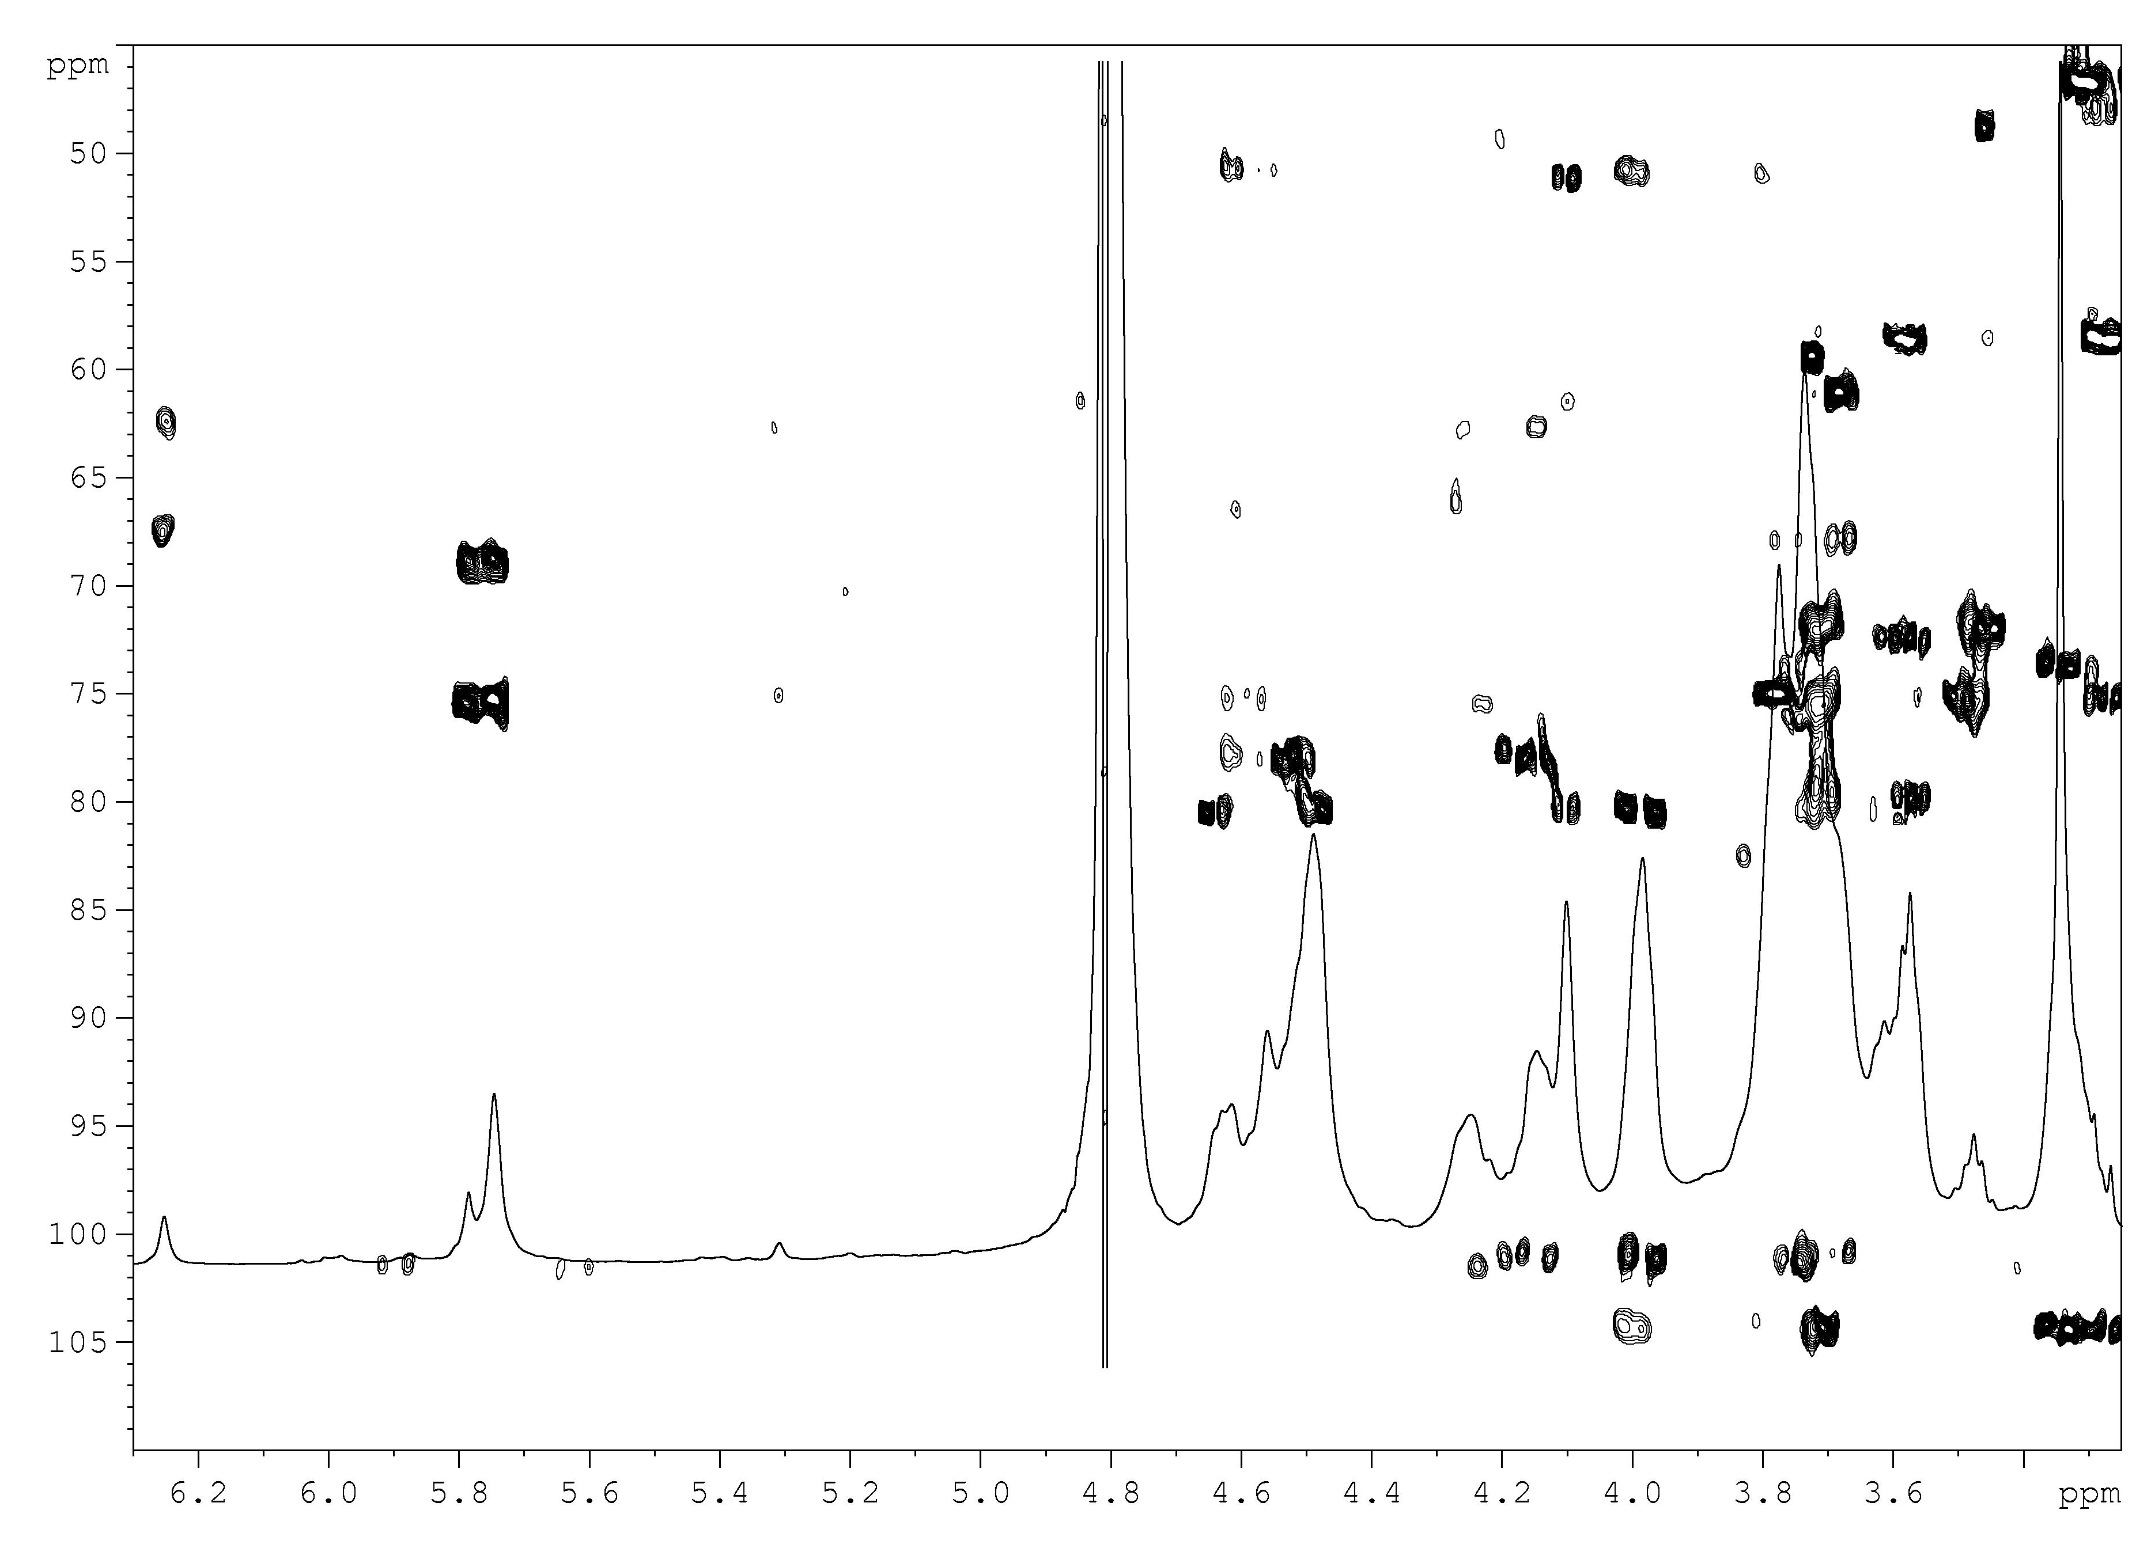
Labile acetals formation
T [°C] | GlcA-3S/GlcA | GalNAc/GalNAc-4 or 6S | GalNAc-4S/GalNAc-6S
80 | 0.29 | ~0 | 0.34
50 | 0.27 | ~0 | 0.46
rt | 0.50 | 2.04 | ~0
rt | 0.50 | ~0 | 0.59
Benzylidenation
Orthoesterification
CH₂-6
GalNAc
CH₂-6
GalNAc
CH-4
GalNAc
Benzylidene
methine signals
CH-4
GalNAc
CH-3
GlcA
Zoom of ¹H and HSQC-DEPT spectra of acetalated intermediate (600 MHZ, 4 mM in D₂O, 298K)
Zoom of ¹H and HMBC spectra of acetalated intermediate (600 MHZ, 4 mM in D₂O, 298K)

Slide 33
Proposed mechanism
chondroitin
PhCH(OCH₃)₂, CSA
DMF, rt, o.n.
- CH₃OH
Intraglycosidic
benzylidene
Interglycosidic
benzylidene
^{[28]}
- CH₃OH
- CH₃OH
^{or}
Transacetalation at high
temperature
[28] Laezza, A.; De Castro, C.; Parrilli, M.; et al., Carbohydr. Polym. 2014, 112, 546-555

Slide 34
Semi-synthesis of fucosylated chondroitin sulfate

Slide 35
Fucosyl donors
Ac₂O
I_{2,} Et₃SiH
Py, rt
CH₂Cl₂, 50°C
reflux
Quant.
(NH₂)₂CS
CH₃CN, 60°C
2) Et₃N
EtI, RT
BnBr
Na(s)
DMF, rt
MeOH, rt
75%
83%
53%
Over two steps
Ethyl 2,3,4-tri-O-benzyl-β-
L-fucopyranosyl thioglycoside
CF₃(NPh)Cl
NaH, CH₂Cl₂, 0°C
per-O-benzylated-L-Fucose
57%
2,3,4-tri-O-benzyl-L-fucopyranosyl-
N-phenyl-trifluoroacetimidate

Slide 36
Fucosyl donors
(CH₃)₂C(OCH₃)₂
BnBr
CSA, rt
NaH, DMF, rt
98%
90%
THF/H₂O
4:1(v/v)
RT
(Bu)₂SnO
C₆H₆/MeOH, 60°C
BzBr
Py, CH₂Cl₂, rt
BnBr
Bu₄NI, 60°C
82%
95%
98%
Ethyl 2,3-di-O-benzyl-4-O-benzoyl-
β-L-fucopyranosyl thioglycoside

Slide 37
Fucosyl donors
TBDMSCl
BnBr
ImH, DMF, rt
NaH, DMF, rt
77%
93%
TBAF
THF, MeOH, RT
BzBr
Py, CH₂Cl₂, rt
73%
95%
Ethyl 2,4-di-O-benzyl-3-O-benzoyl-
β-L-fucopyranosyl thioglycoside

Slide 38
Conclusions
Semi-synthesis of fucosylated chondroitin sulfate
Semi-synthetic strategies from microbial sourced chondroitin to fucosylated chondroitin sulfate
First O-glycosylation of secondary hydroxyls of polysaccharides
Library of different O-glycosylated chondroitin polysaccharides
Depolymerization of semi-synthetic fCS and interaction with selectins
STD-NMR studies revealed a slightly minor affinity of semi-synthetic dfCS with respect to that obtained from natural one
Preliminary strategy for non-degradative β-eliminative depolymerization on semi-synthetic fucosylated chondroitin sulfate
The high heterogeneity of semi-synthetic derivative did not allow an exact evaluation of ligand binding
Further docking and molecular dynamics experiments to evaluate the binding site

Slide 39
Conclusions
Synthesis, confromational study and antifreeze activity of threonine decorated microbial sourced chondroitin
Different degree of Thr-decoration of micrcobial sourced chondroitin
The presence of Thr is not sufficient for IRI activity
This finding will help future investigation towards the development of polymer mimics of antifreeze agents
Study of regioselective sulfation of polymannuronic acid polysaccharide
Key reaction is the diol protection
Further optimization on benzylidene protecting group will be then applied for a quantitative and regioselective sulfation of polymannuronic acid

Slide 40
Study of regioselective sulfation of polymannuronic acid polysaccharide

