Slide 1


Glycosylated gold nanoparticle biosensors:
Label-free and high-throughput evaluation of glycan-lectin interactions
Dr Sarah-Jane Richards and Prof. Matthew I. Gibson
Department of Chemistry, University of Warwick, UK
@LabGibson
@RichardsSJ
www.warwick.ac.uk/sarahjane_richards
Brightsparks Symposium 12/09/16
University of Warwick
s.richards.1@warwick.ac.uk

Slide 2
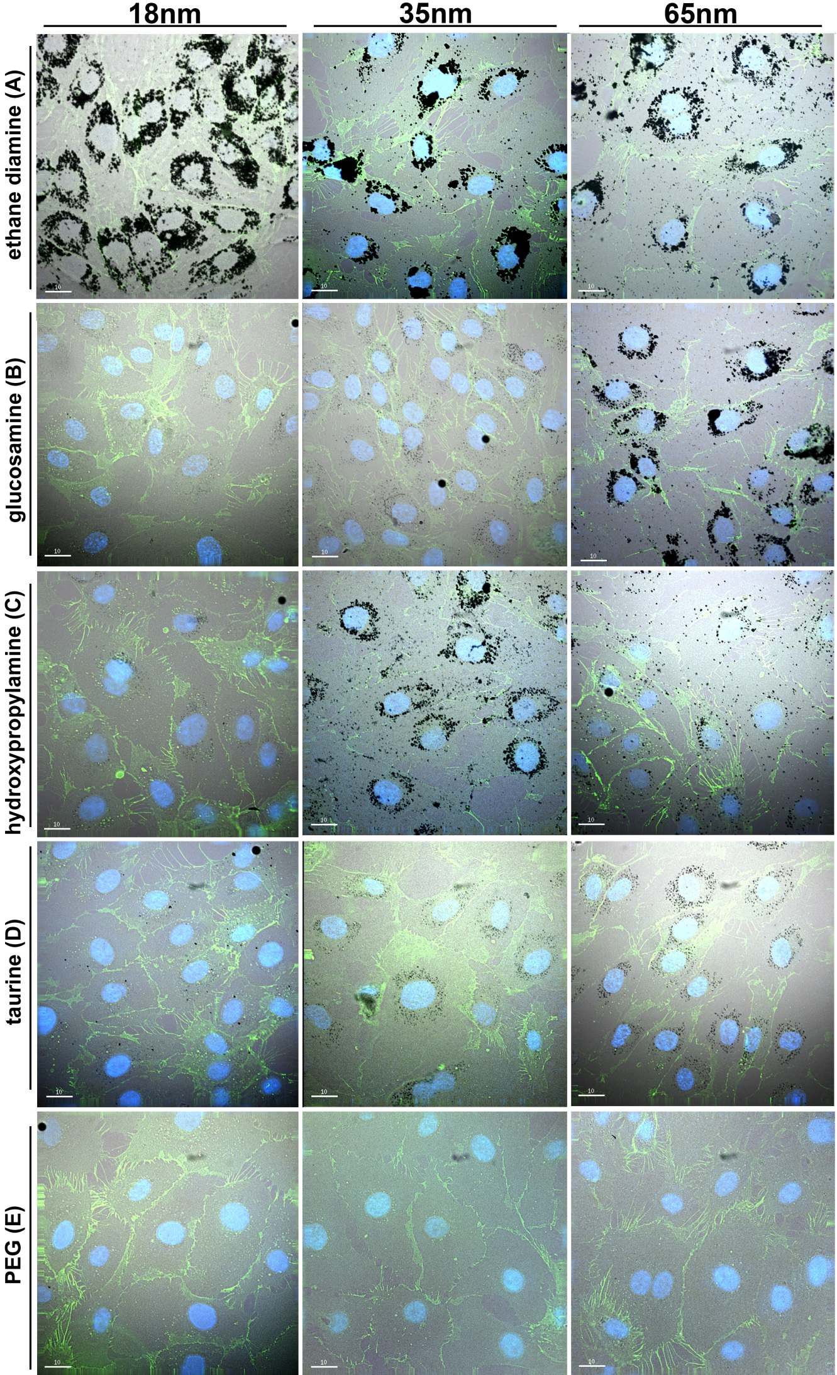
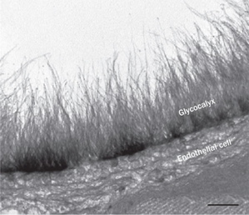
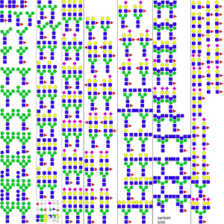
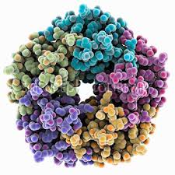
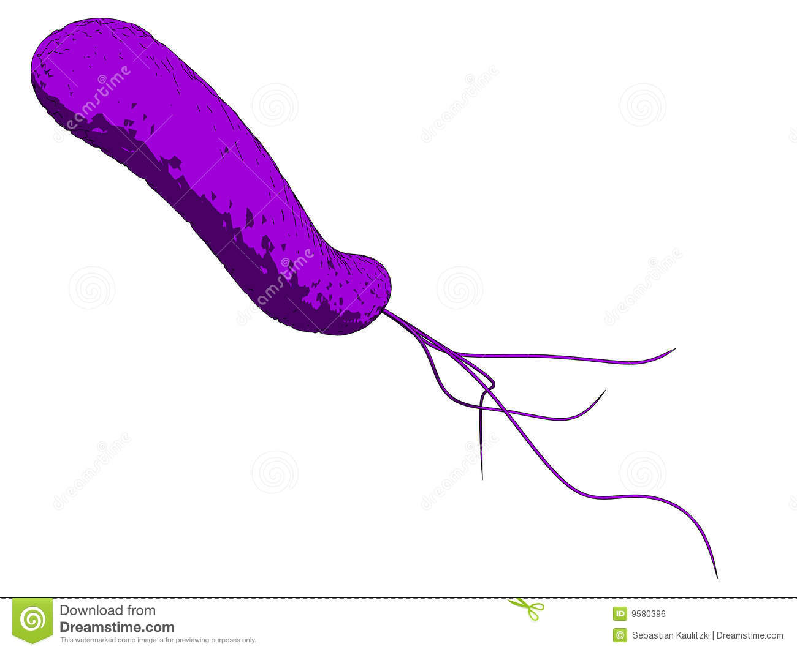
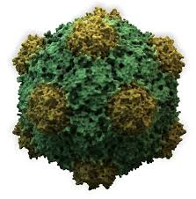
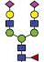

Glycans are Crucial Biomarkers
Selection of N-linked mammalian glycans d/load from P Stanley Lab
Cholera
Ricin
Influenza
Ebola
Shiga Toxins
HIV
Non antibiotic solutions to resistance
Treatment
Diagnosis
Understanding

Slide 3
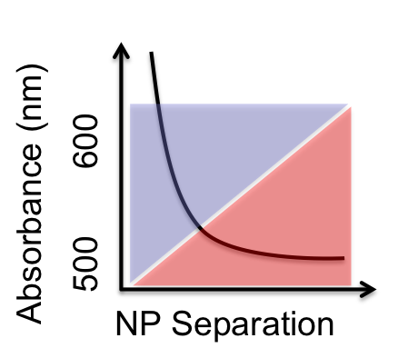
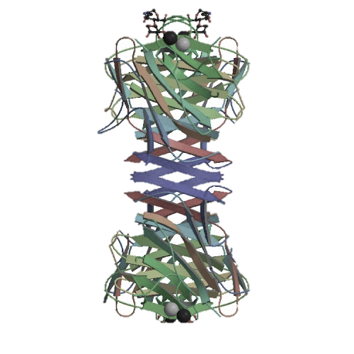
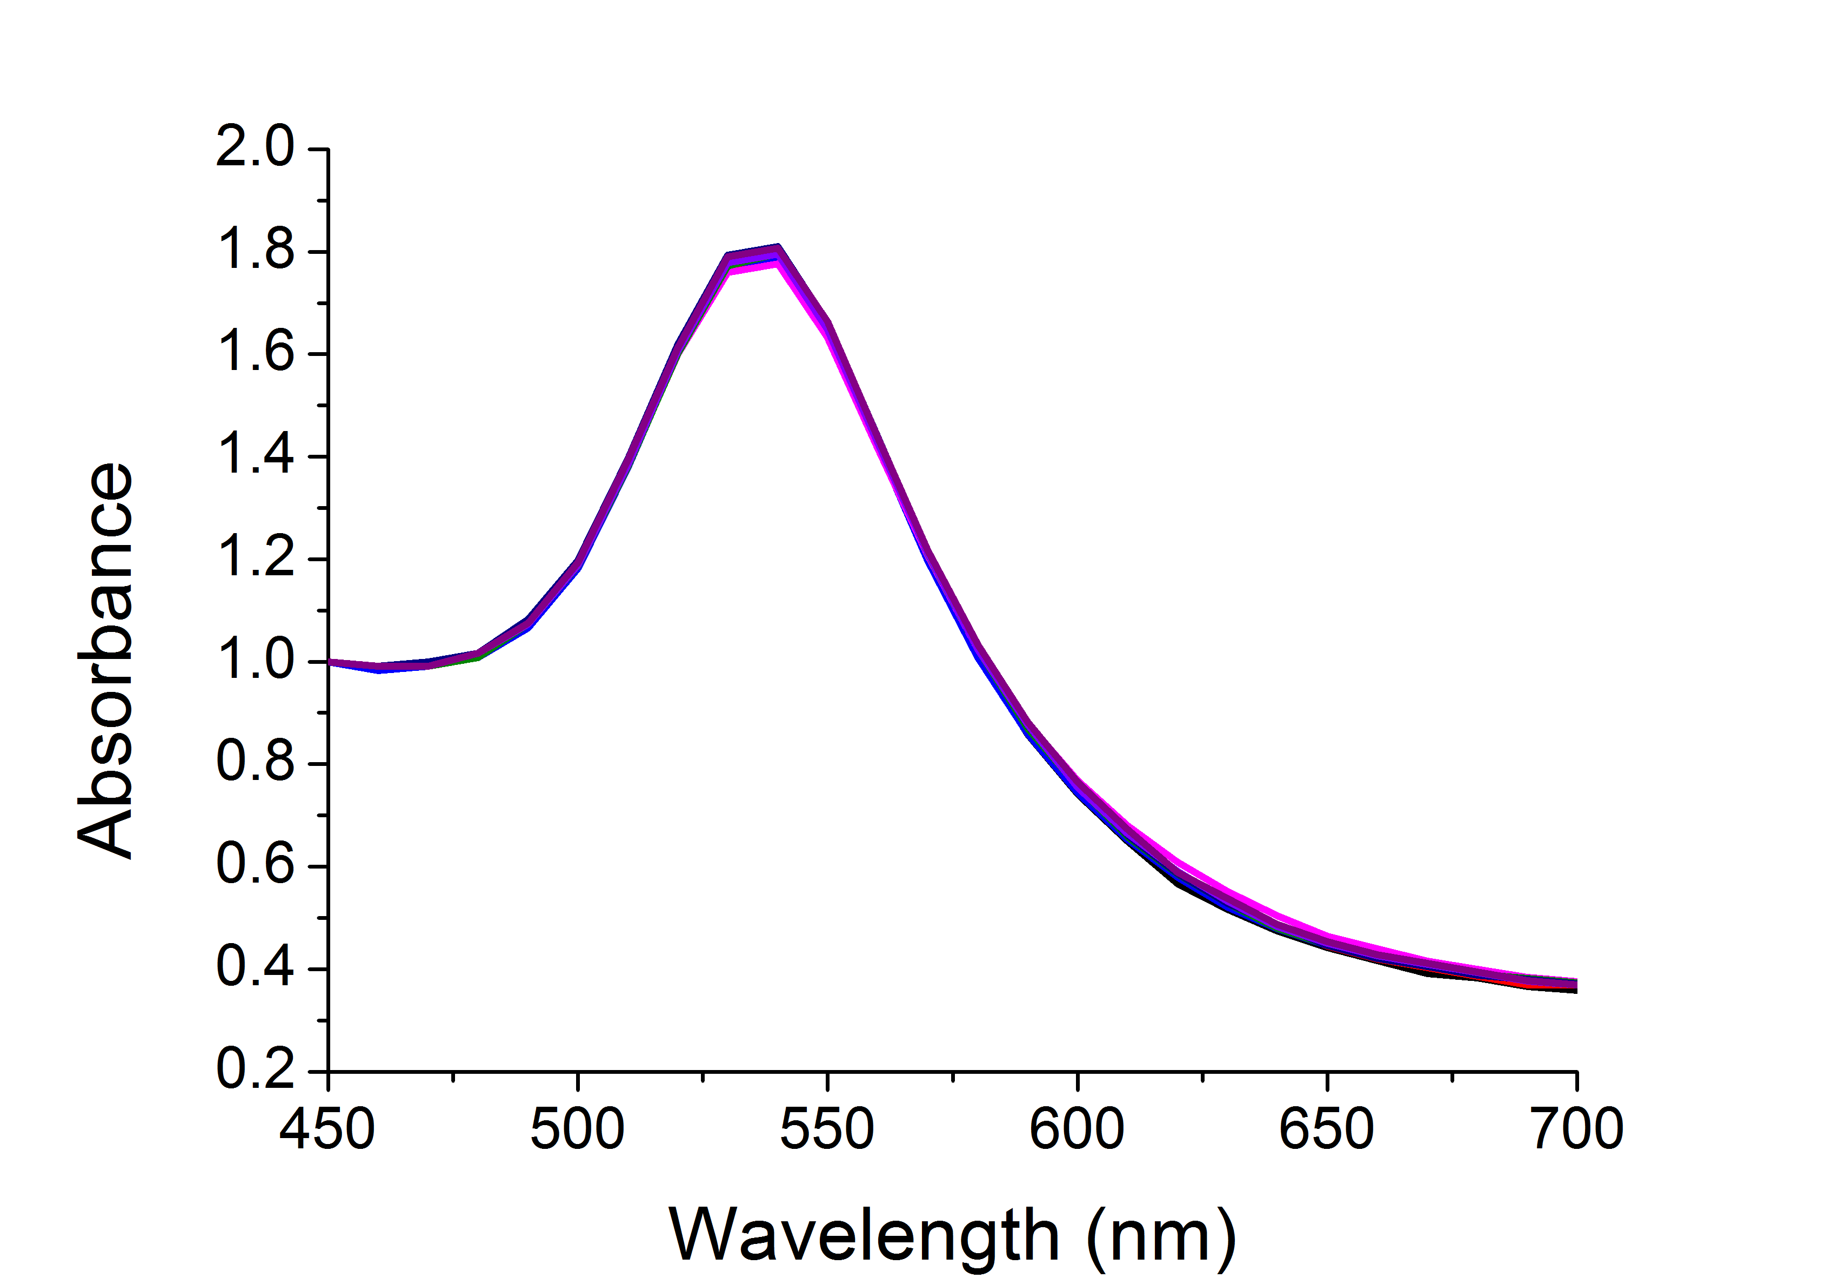
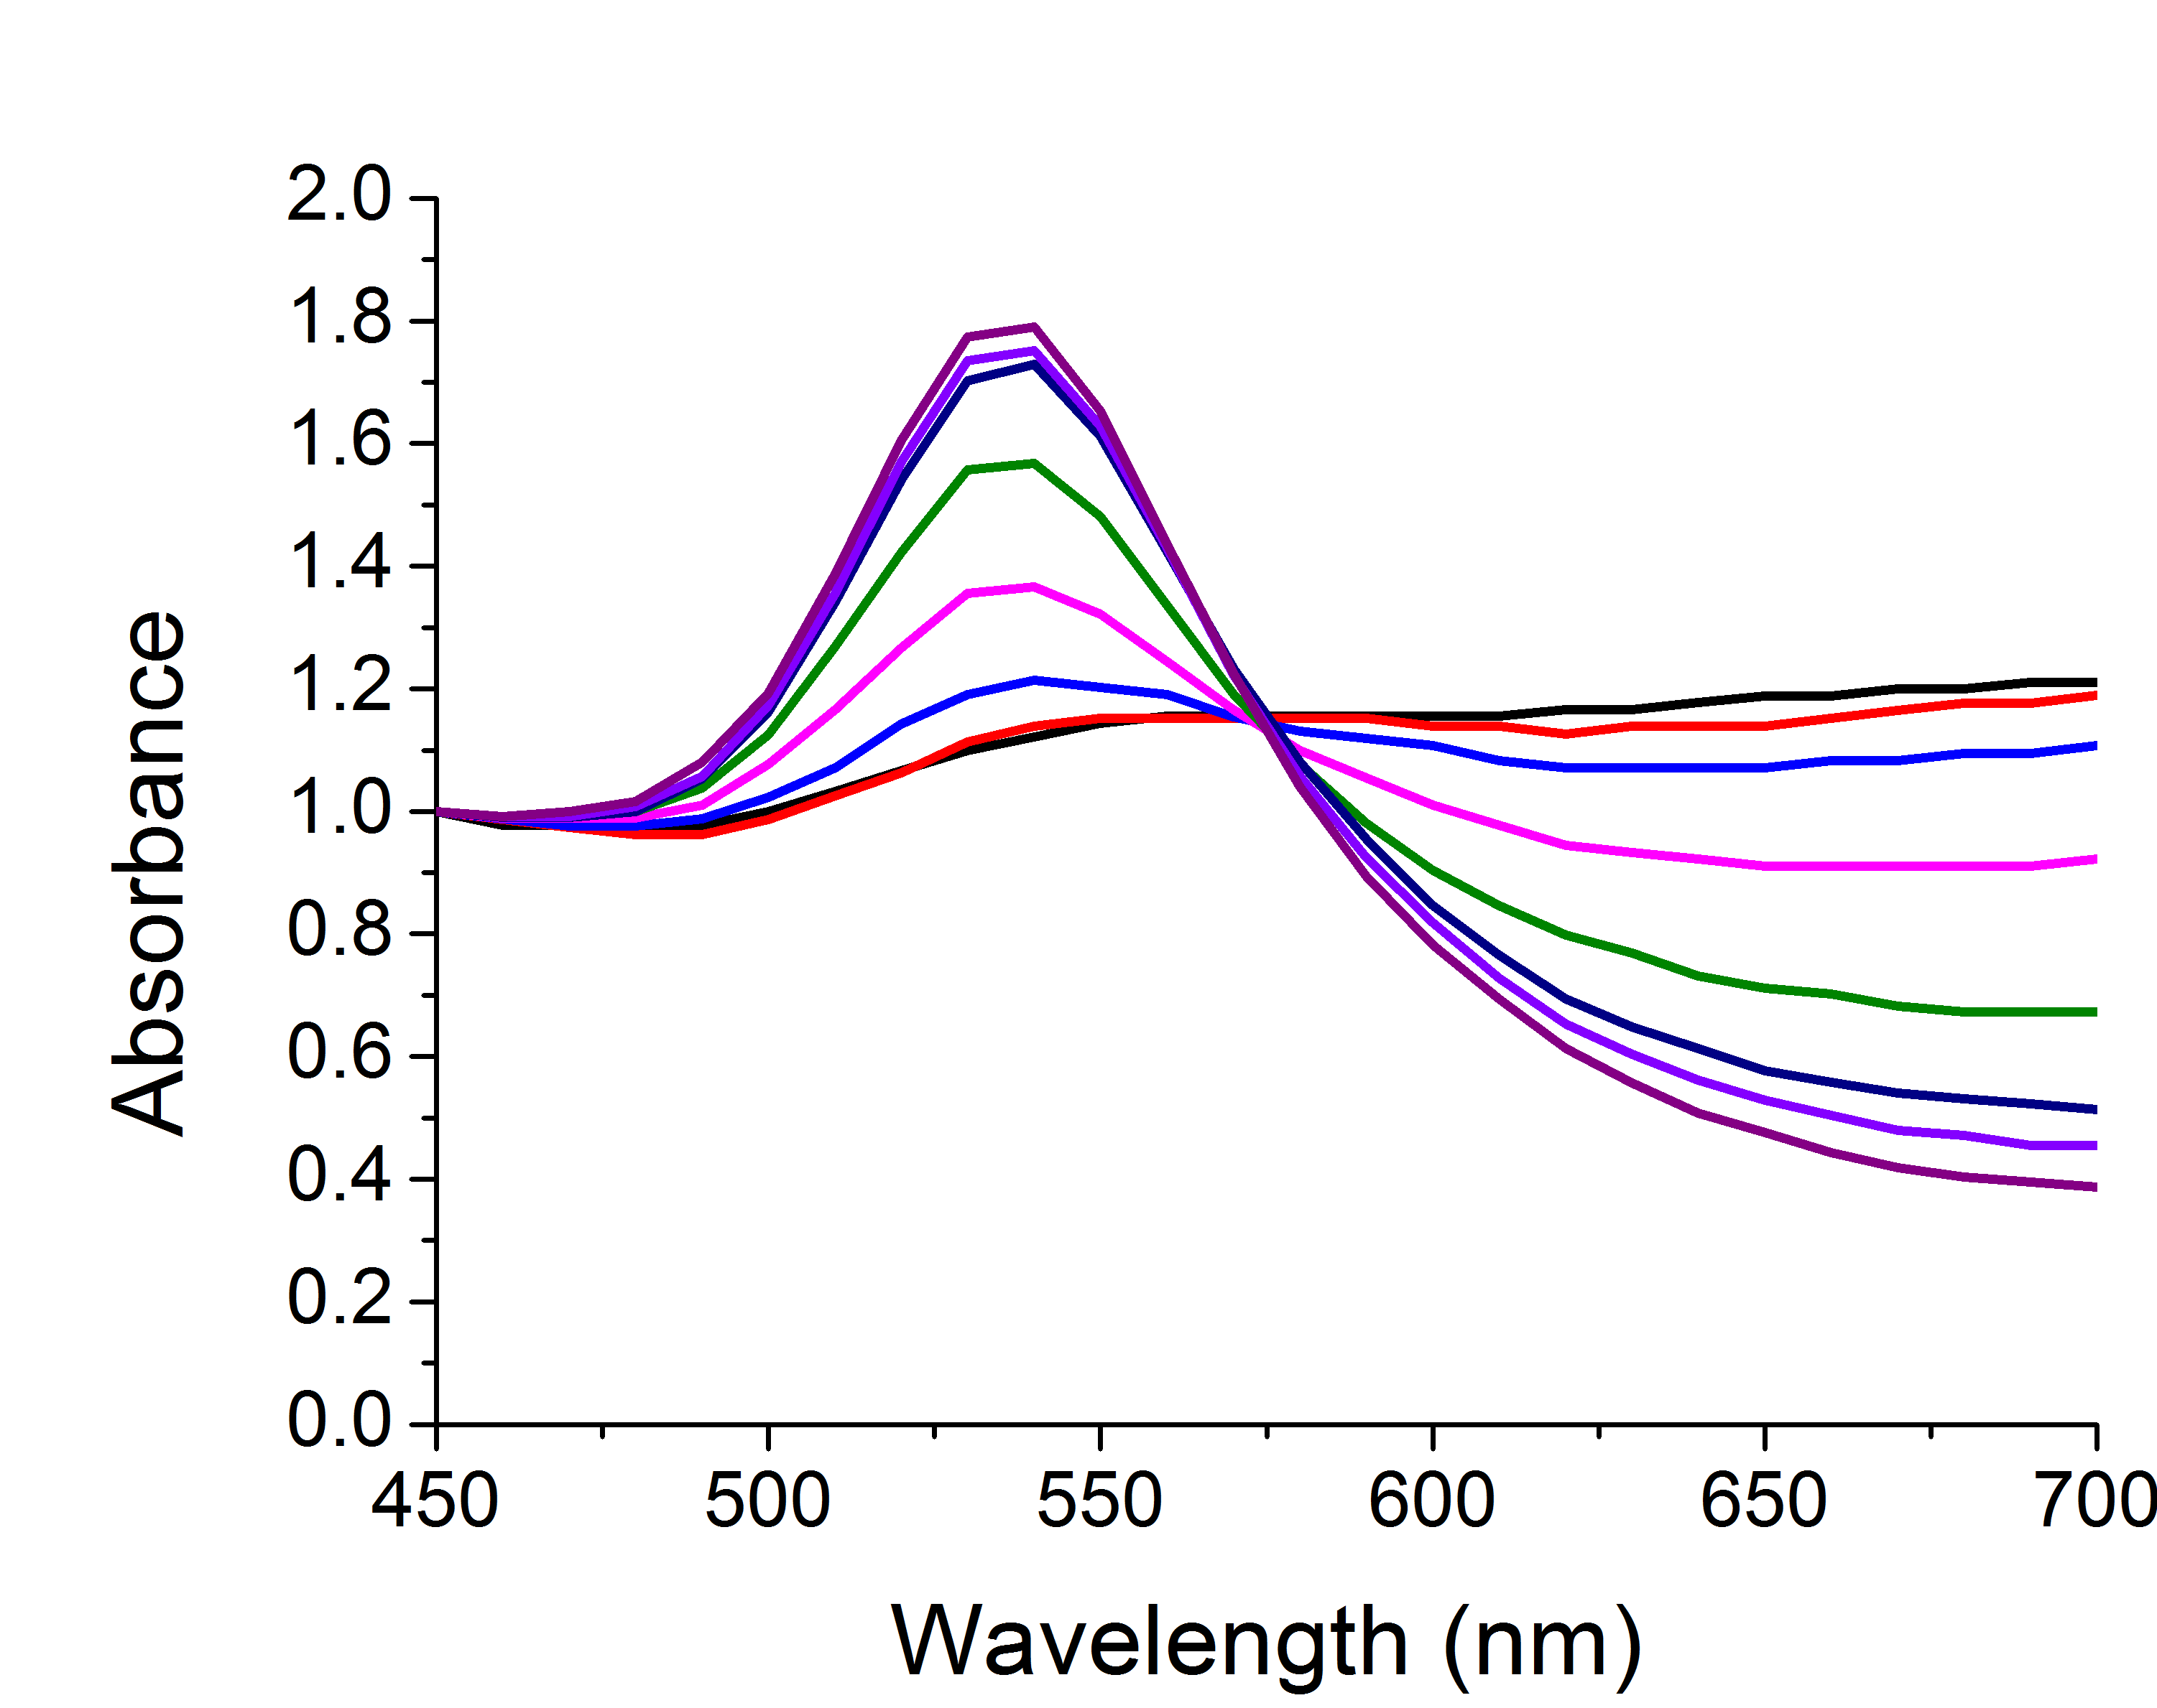
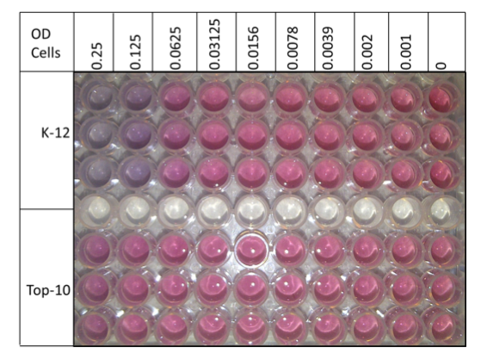
Label-Free Biosensing

Slide 4
Glycosylated Gold Nanoparticles
[ConA]
Colour Change ☑
Fast ☑
Specific ☑
Saline Stability ☒
Richards, S-J., Fullam, E., Besra, G. S. Gibson, M. I.; J. Mater. Chem. B, 2014, 2, 1490-1498

Slide 5
PEG-Stabilized AuNPs
40 nm
Colour Change ☒
Fast ☒
Specific ☑
Saline Stability ☑
n = 68
Con A induced aggregation
Directly functionalised
PEG functionalised
[ConA]
Richards, S-J., Fullam, E., Besra, G. S. Gibson, M. I.; J. Mater. Chem. B, 2014, 2, 1490-1498

Slide 6
Optimisation of polymer coating
Masked thiol for immobilization on to AuNP
Thiol for immobilization on to AuNP
Sugar conjugation site
Sugar for lectin recognition
Richards, S-J., Biggs, C. I, Gibson, M. I., Methods in Molecular Biology; Macro-Glycoligands, 2016, Series Vol 1367

Slide 7
Optimisation of polymer coating
‘Goldilocks’ Particle
Richards, S-J., Biggs, C. I, Gibson, M. I., Methods in Molecular Biology; Macro-Glycoligands, 2016, Series Vol 1367

Slide 8
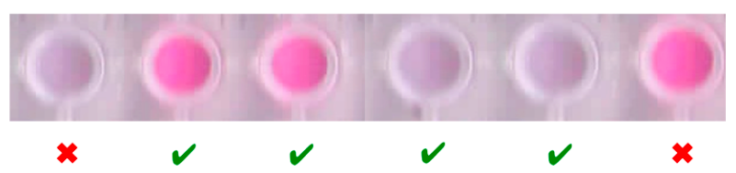
Optimisation of Polymer Coating
Saline stability
DP10
DP20
DP75
Colour Change ☑
Fast ☑
Specific ☑
Saline Stability ☑
Speed of colour change
Too short
‘Just right’
Too long
Richards, S-J and Gibson, M. I.; Macro Lett., 2014, 2, 1490-1498, 1, 1004-1008

Slide 9
Polymer coating characterisation
XPS
1:19 ratio
Otten, L., D. Vlachou, Richards, S-J.* Gibson, M. I.; Analyst., 2016, 141, 4305-4312
Notes:
Change structure!!

Slide 10
Optimisation Summary
Soy bean agglutinin induced aggregation
Rapid colour change (< 5 mins)
[SBA]
[SBA]
Colour Change ☑
Fast ☑
Specific ☑
Saline Stability ☑
Highly specific change
Aggregation behaviour confirmed by DLS
Richards, S-J., Gibson, M. I. ACS Macro Lett.., 2014, 3, 1004-1008

Slide 11
Improving identification power
Toxin 1
Toxin 2
Can ‘never’ have a perfect, single channel glyco-sensor

Slide 12
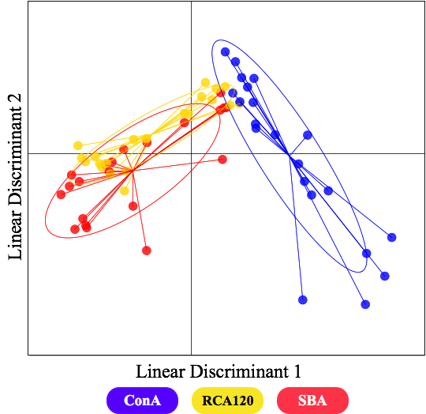
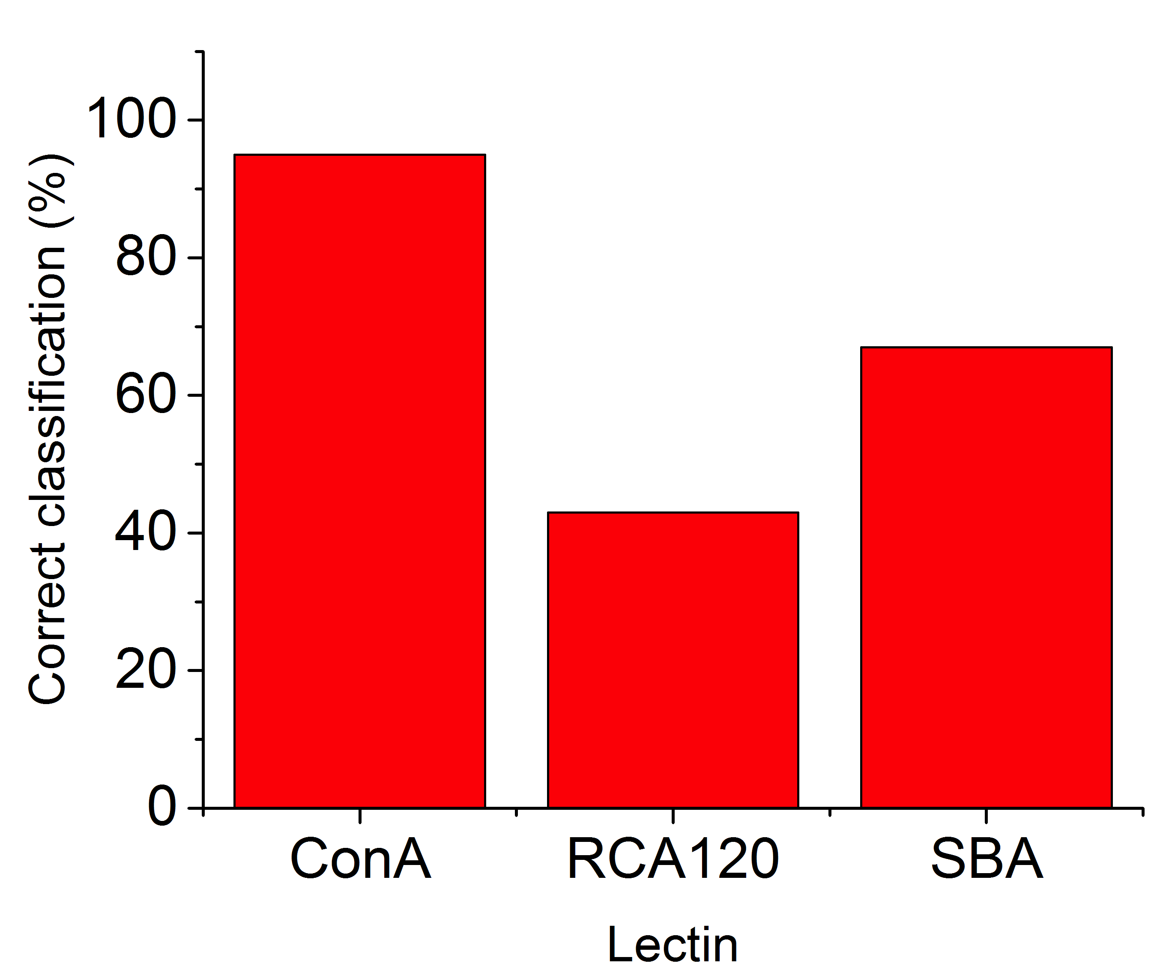
Protein identification
Man
Gal
Otten, L., D. Vlachou, Richards, S-J.* Gibson, M. I.; Analyst., 2016, 141, 4305-4312

Slide 13
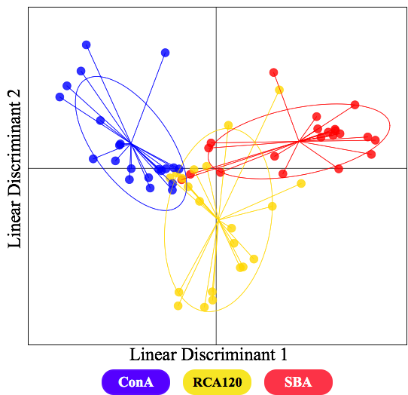
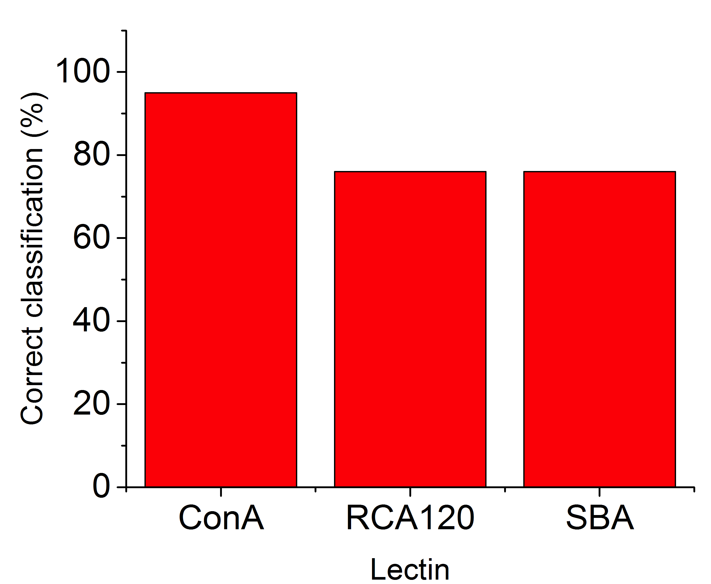
Increasing identification using heterogeneity
10%
90%
20%
80%
30%
70%
40%
60%
50%
50%
60%
40%
70%
30%
80%
20%
90%
10%
Gal
Man
Otten, L., D. Vlachou, Richards, S-J.* Gibson, M. I.; Analyst., 2016, 141, 4305-4312

Slide 14
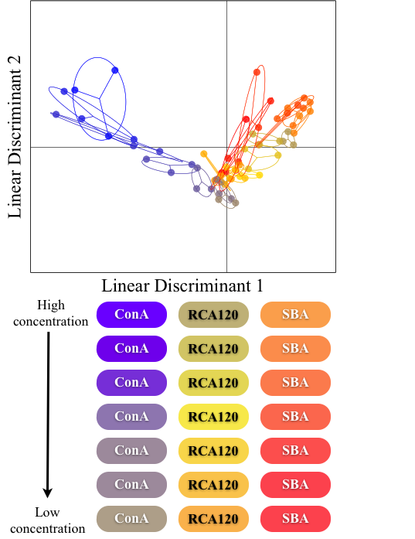
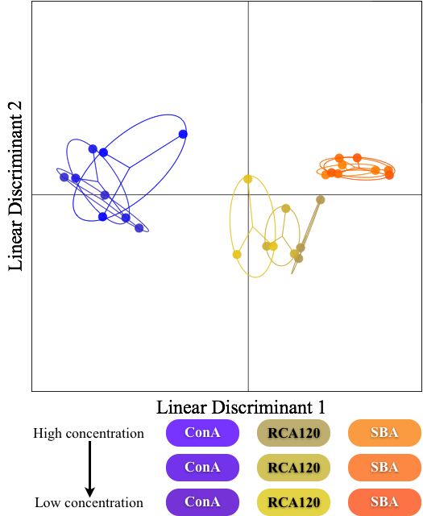
Concentration effects on identification
10%
90%
20%
80%
30%
70%
40%
60%
50%
50%
60%
40%
70%
30%
80%
20%
90%
10%
Man
Gal
Otten, L., D. Vlachou, Gibson, M. I.; Richards, S-J.* Analyst., 2016, 141, 4305-4312

Slide 15
Towards High-throughput screening
Underivatised reducing sugars
Richards, S-J., Otten, L., Gibson, M. I.; J. Mater Chem. B., 2016, 4, 3046-3053

Slide 16
High-throughput data collection
Richards, S-J., Otten, L., Gibson, M. I.; J. Mater Chem. B., 2015, DOI: 10.1039/C5TB01994J

Slide 17
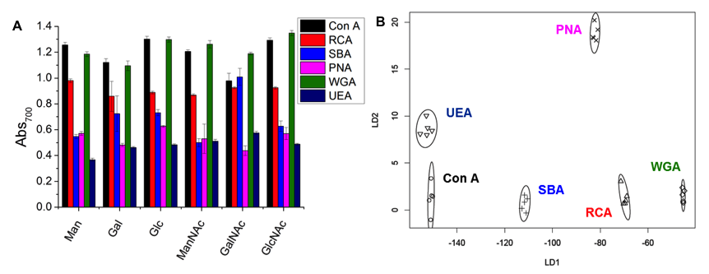
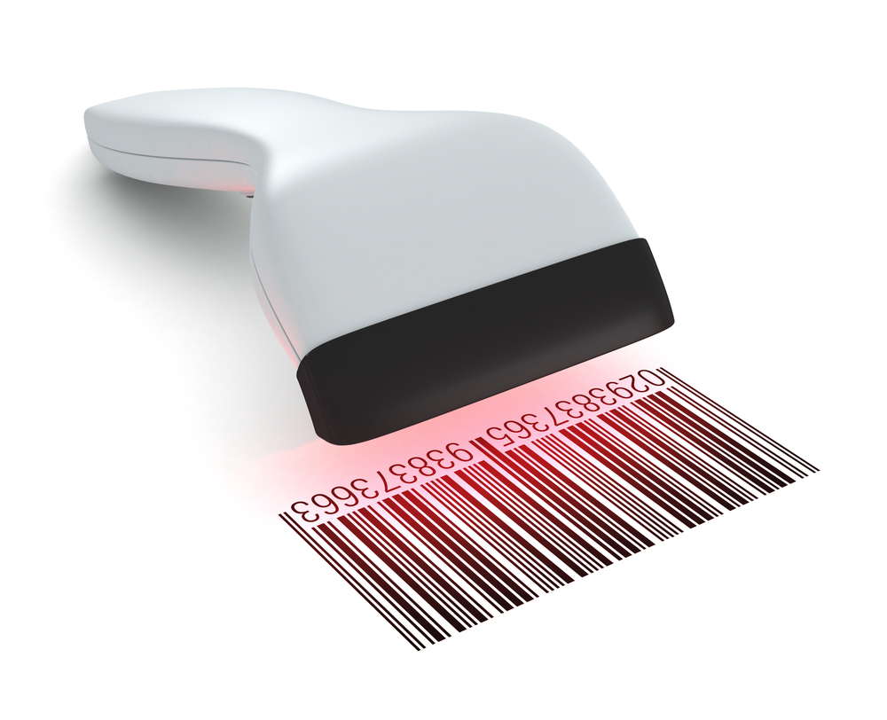
Protein identification
Lectin Screening and Discrimination
Otten, L. O. and Gibson, M. I. RSC Adv., 2015,5, 53911-53914
Richards, S-J., Otten, L., Gibson, M. I.; J. Mater Chem. B., 2016, 4, 3046-3053

Slide 18
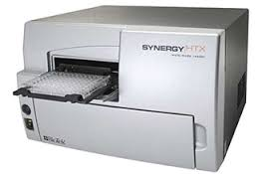
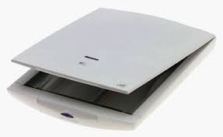
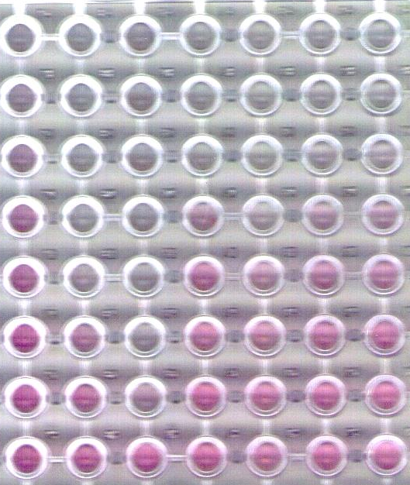
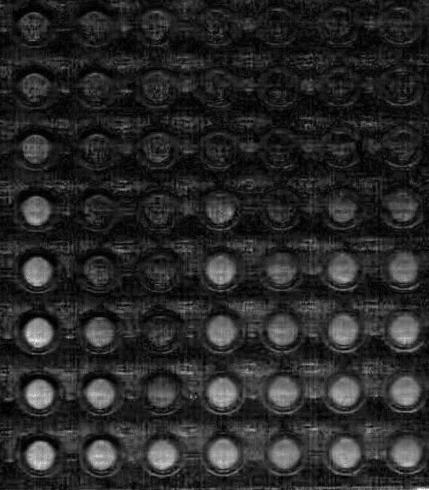
Low cost, low resource detection
vs
£10,000
£50
Richards, S-J., Otten, L. O., Gibson, M. I.; J. Mater Chem. B., 2016, 4, 3046-3053

Slide 19
Summary
Polymer coating essential for saline stability and optical readout
Simple protein detection and identification
High-throughput and low resource detection possible

Slide 20
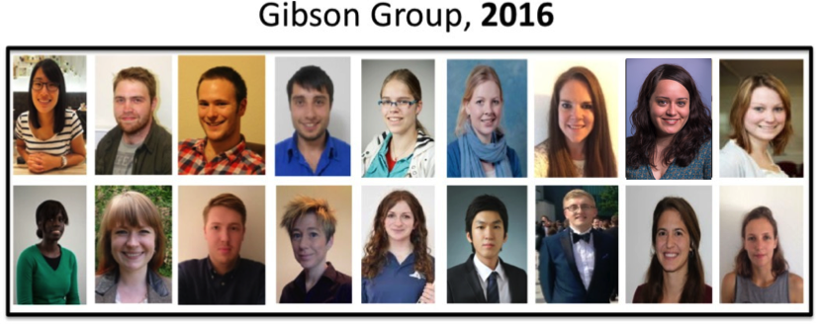
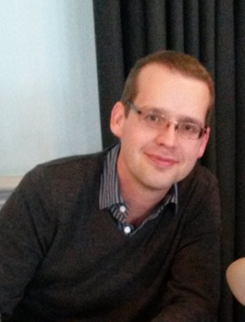








Acknowledgements
Post-docs
Dr. Sarah-Jane Richards
Dr. Caroline Biggs
Dr Collette Guy
Eva Caamano-Gutierrez
Dr Lucienne Otten
Phd Students
Alaina Emmanuella
Sang Ho Won
Lewis Blackman
Benjamin Martyn
Joseph Healey
Nick Alcaraz
Julia Lipecki
Chris Stubbs
Ben Graham
Trishia Bailey
Laura Wilkins
Maria Gyprioti
Vinko Varas
Gabriell Erni-Cassolla
Undergrad Students
Lizzie Eyre
Josh Parkin
Funders £$€
Noreen Murray Philanthropy Award
www.warwick.ac.uk/go/gibsongroup
@LabGibson

Slide 21
Glycosylated gold nanoparticle biosensors:
Label-free and high-throughput evaluation of glycan-lectin interactions
Dr Sarah-Jane Richards and Prof. Matthew I. Gibson
Department of Chemistry, University of Warwick, UK
@LabGibson
@RichardsSJ
www.warwick.ac.uk/sarahjane_richards
Brightsparks Symposium 12/09/16
University of Warwick
s.richards.1@warwick.ac.uk

