Slide 1


Glycosylated gold nanoparticle biosensors:
Label-free and high-throughput evaluation of glycan-lectin interactions
Sarah-Jane Richards and Matthew I. Gibson
Department of Chemistry, University of Warwick, UK
www.warwick.ac.uk/sarahjane_richards
@LabGibson
250th ACS Meeting 16/08/15
Boston, MA
s-j.richards@warwick.ac.uk

Slide 2
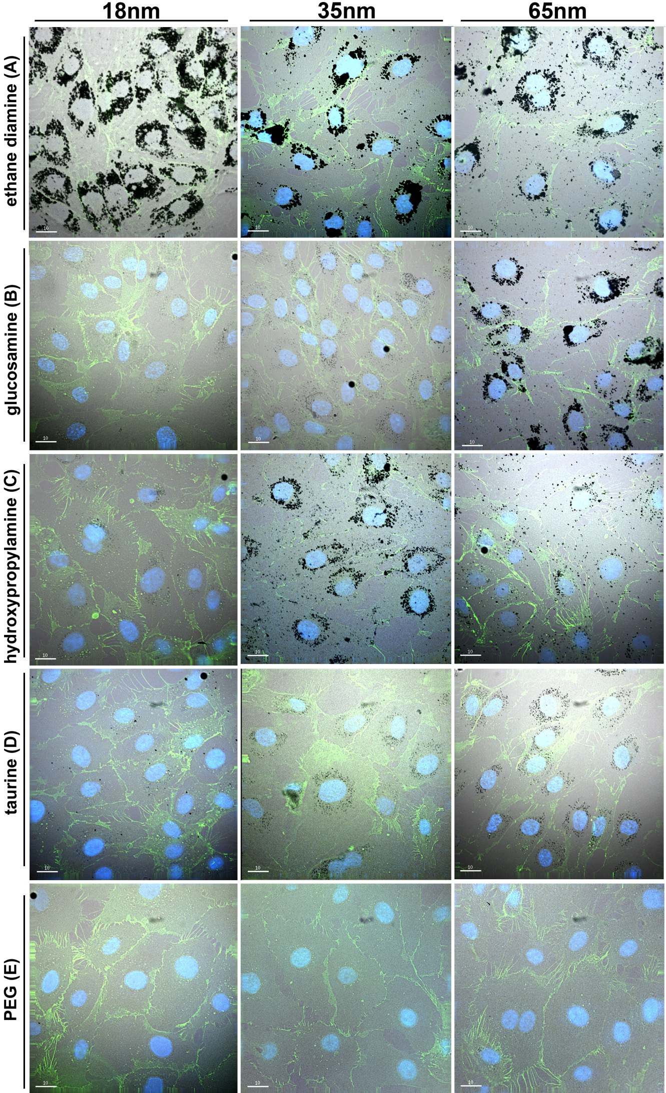
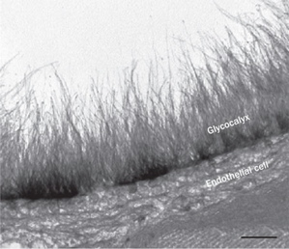
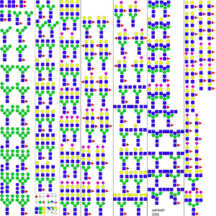
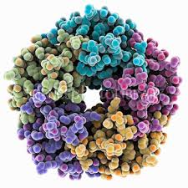
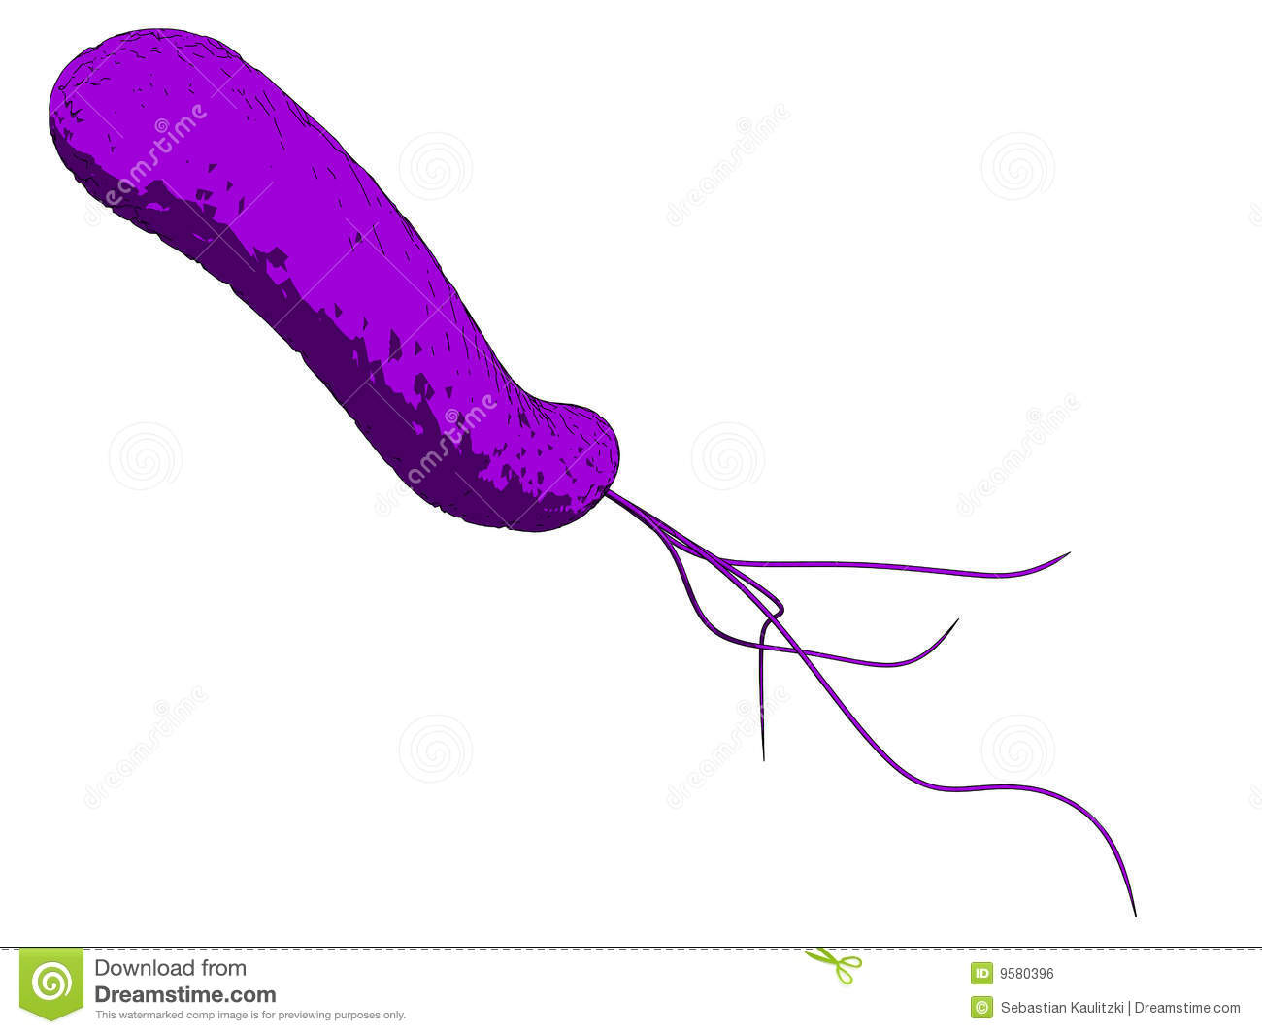
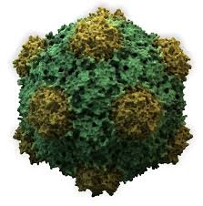
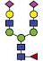

Glycans are Crucial Biomarkers
Selection of N-linked mammalian glycans d/load from P Stanley Lab
Cholera
Ricin
Influenza
Ebola
Shiga Toxins
HIV
Non antibiotic solutions to resistance
Treatment
Diagnosis
Understanding

Slide 3
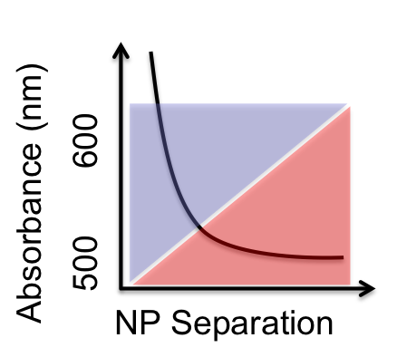
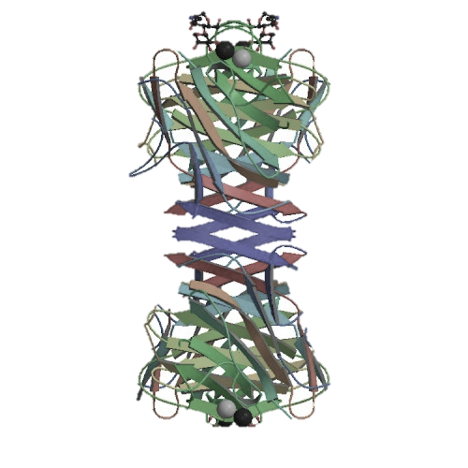
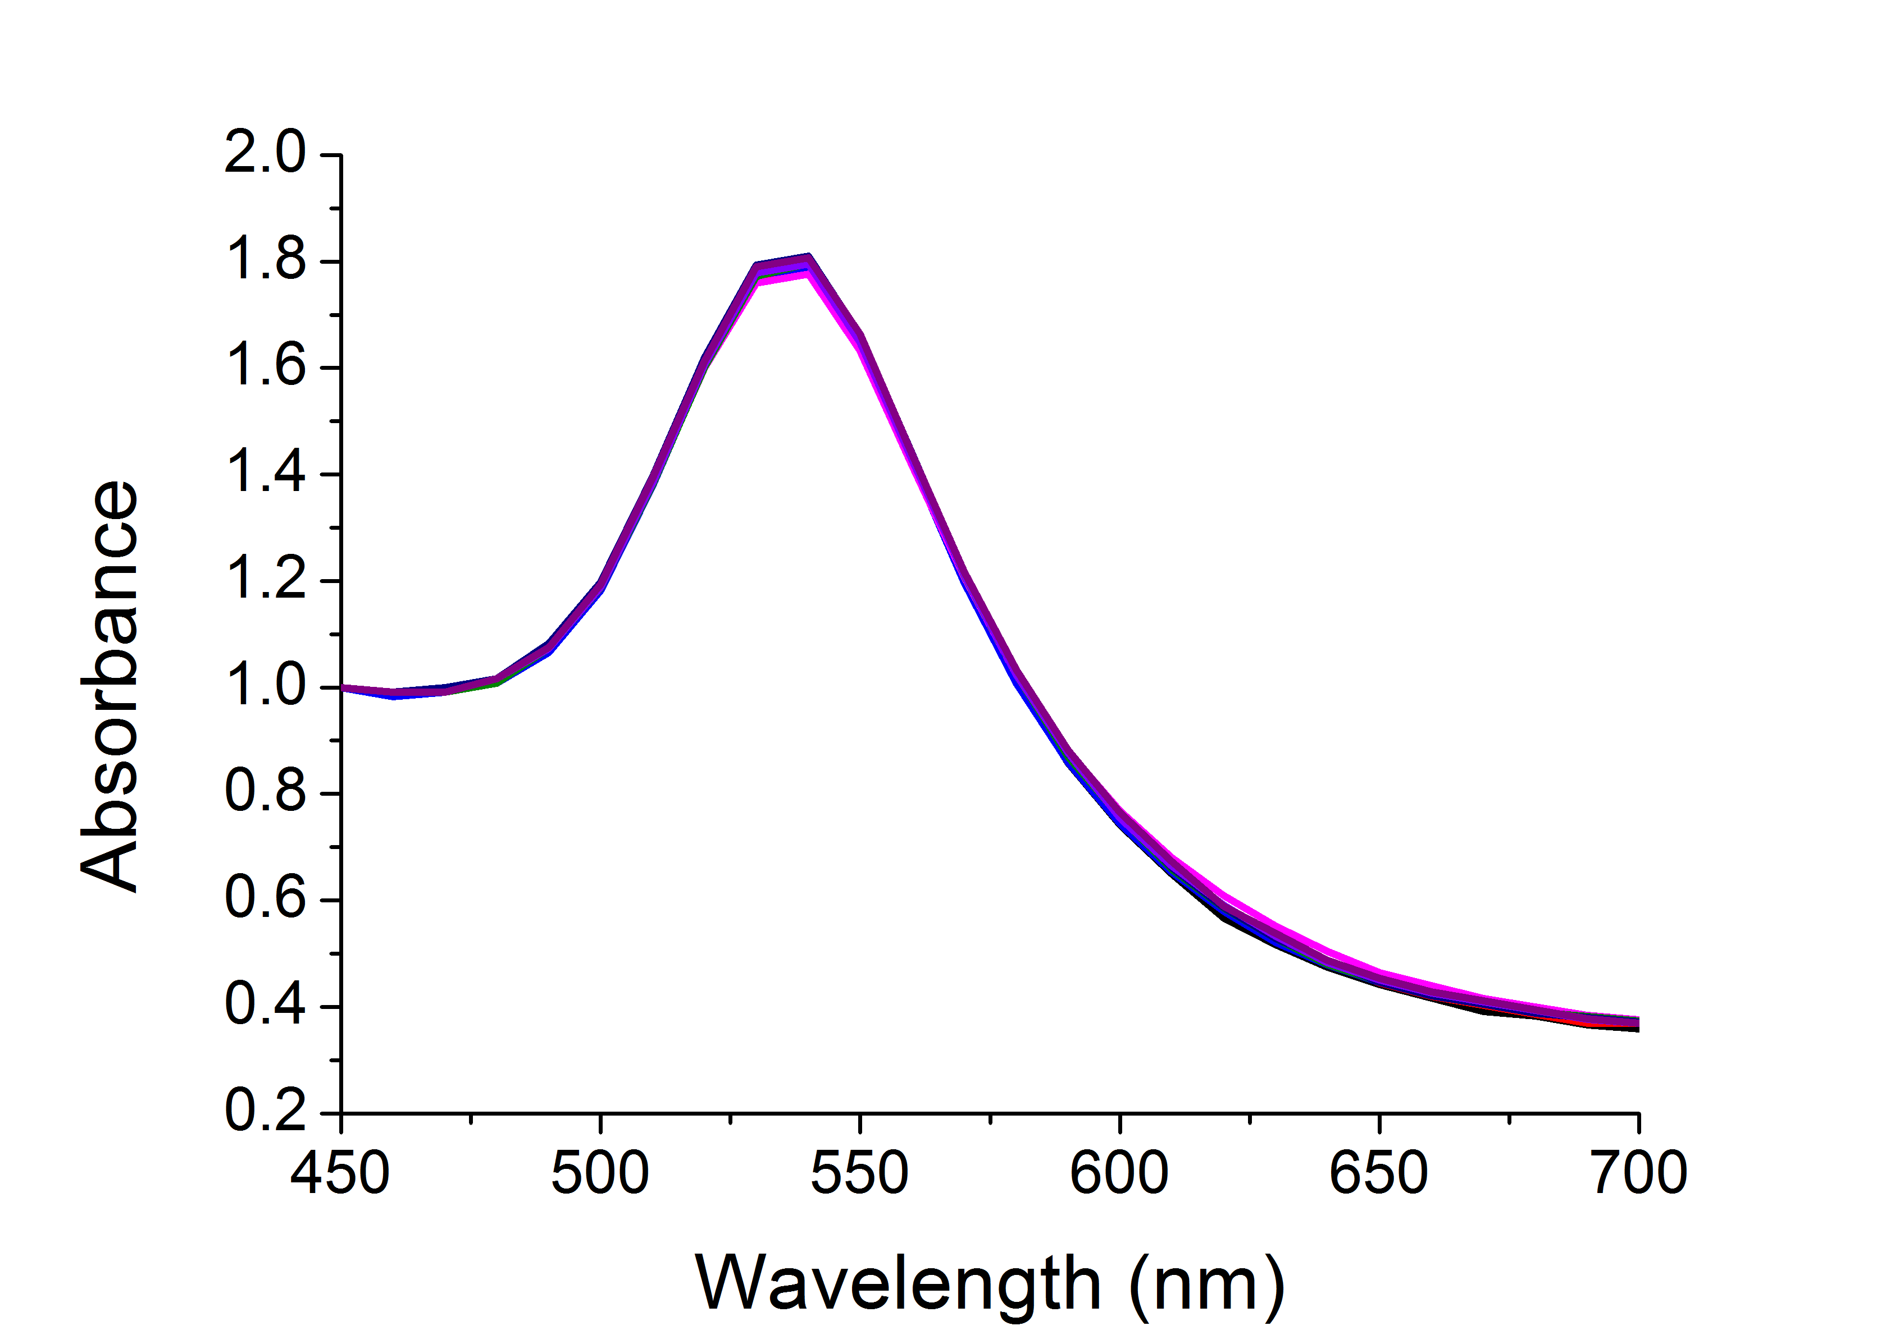
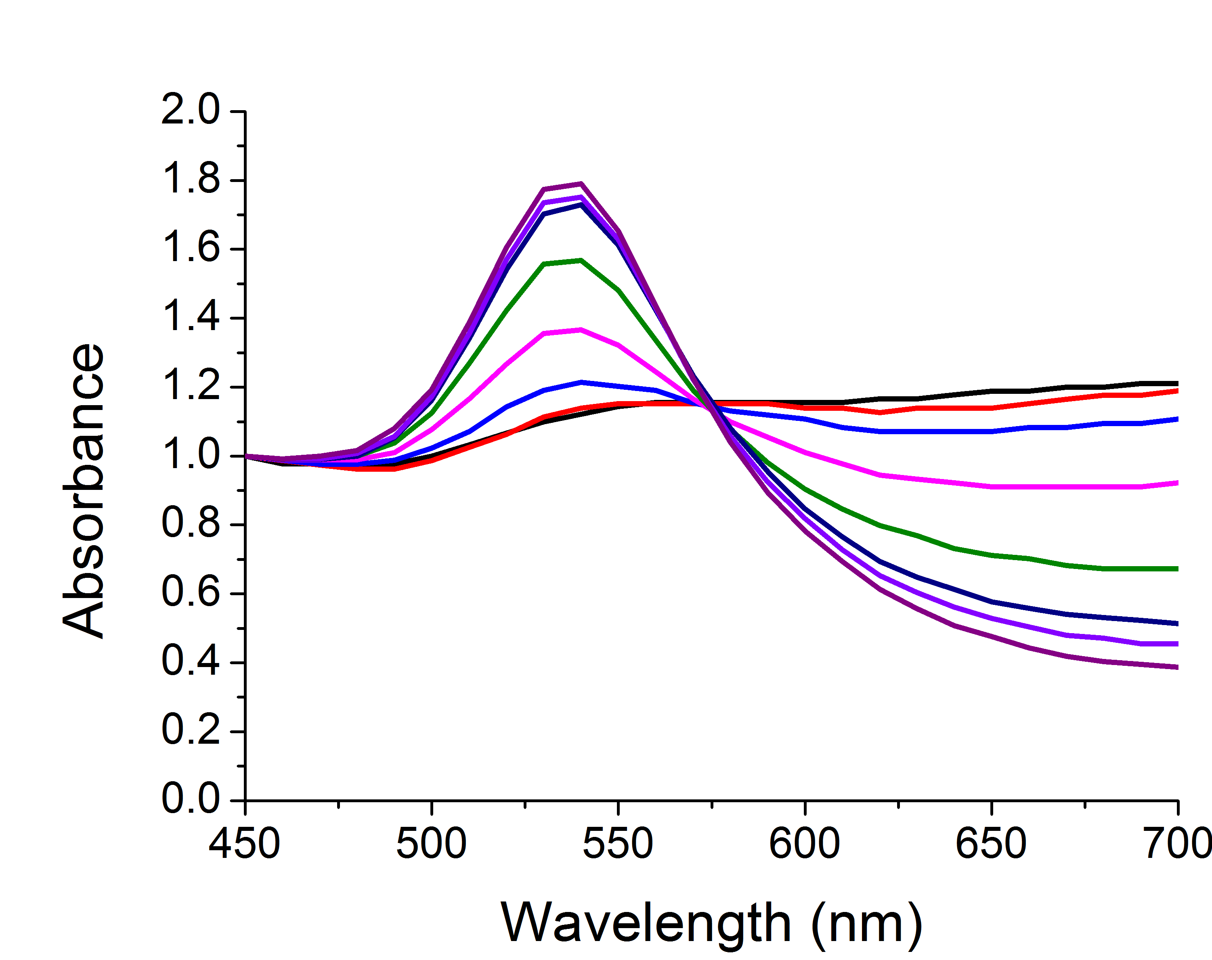
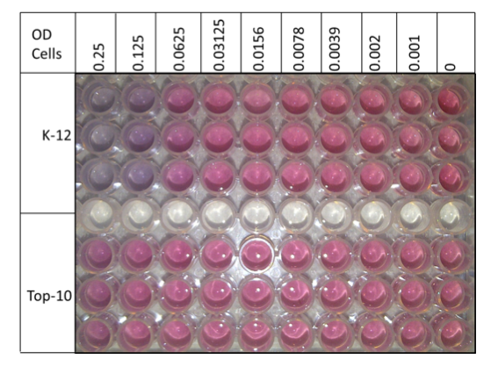
Label-Free Biosensing

Slide 4
Glycosylated Gold Nanoparticles
[ConA]
Colour Change ☑
Fast ☑
Specific ☑
Saline Stability ☒
Richards, S-J., Fullam, E., Besra, G. S. Gibson, M. I.; J. Mater. Chem. B, 2014, 2, 1490-1498

Slide 5
PEG-Stabilized AuNPs
40 nm
Colour Change ☒
Fast ☒
Specific ☑
Saline Stability ☑
n = 68
Con A induced aggregation
Directly functionalised
PEG functionalised
[ConA]
Richards, S-J., Fullam, E., Besra, G. S. Gibson, M. I.; J. Mater. Chem. B, 2014, 2, 1490-1498

Slide 6
Optimization of polymer coating
Masked thiol for immobilization on to AuNP
Thiol for immobilization on to AuNP
Sugar conjugation site
Sugar for lectin recognition
Richards, S-J., Biggs, C. I.., Gibson, M. I.; Book Chapter, Accepted

Slide 7
Conjugation Versatility
Richards, S-J., Biggs, C. I.., Gibson, M. I.; Book Chapter, Accepted

Slide 8
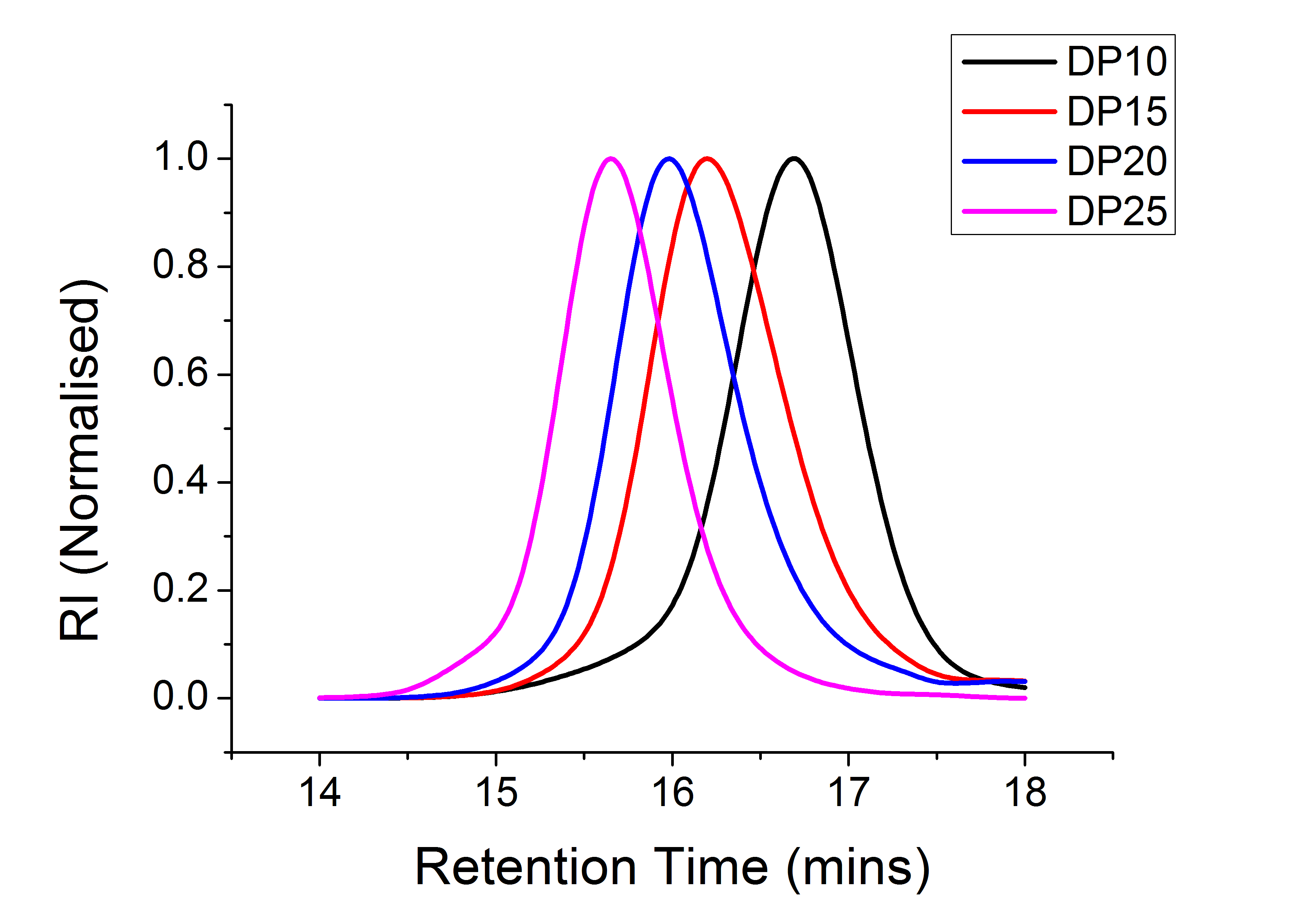
Optimization of Polymer Coating
SEC of sizes
Saline stability
Kinetics of colour change
Richards, S-J and Gibson, M. I.; Macro Lett., 2014, 2, 1490-1498, 1, 1004-1008

Slide 9
Lectin Specificity and Speed of Readout
Soy bean agglutinin induced aggregation
Rapid colour change (< 5 mins)
[SBA]
[SBA]
Colour Change ☑
Fast ☑
Specific ☑
Saline Stability ☑
Highly specific change
Aggregation behaviour confirmed by DLS
Richards, S-J and Gibson, M. I.; Macro Lett., 2014, 2, 1490-1498, 1, 1004-1008

Slide 10
Underivatised reducing sugars
Richards, S-J., Otten, L. O., Gibson, M. I.; Submitted

Slide 11
Polymer coating characterisation
A
B
C
C
Richards, S-J., Otten, L. O., Gibson, M. I.; Submitted

Slide 12
High-throughput data collection
Richards, S-J., Otten, L. O., Gibson, M. I.; Submitted

Slide 13
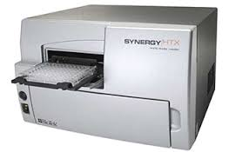
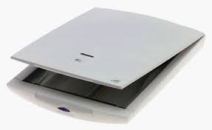
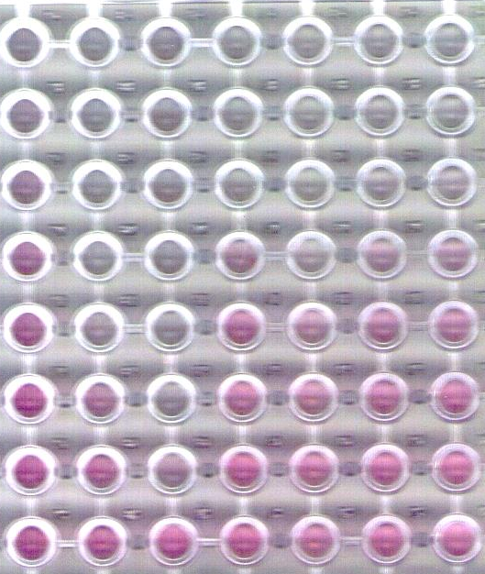
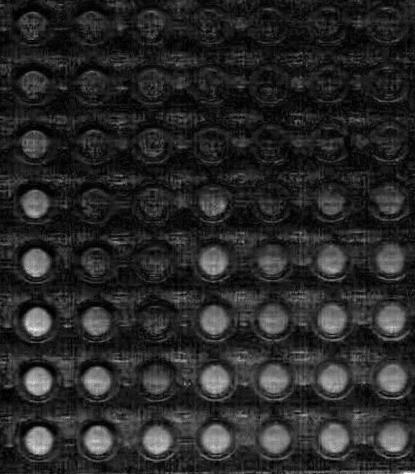
Low-Cost, Low-Resource Detection
vs
£10,000
£50
Richards, S-J., Otten, L. O., Gibson, M. I.; Submitted

Slide 14
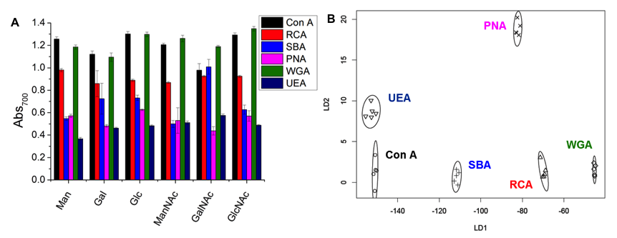
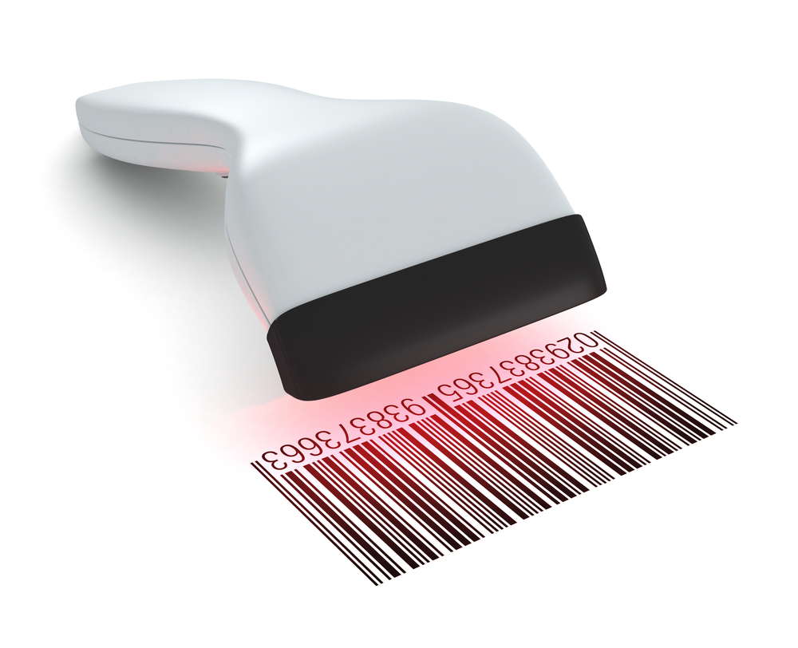
Lectin Screening and Discrimination
Otten, L. O. and Gibson, M. I. RSC Adv., 2015,5, 53911-53914
Richards, S-J., Otten, L. O., Gibson, M. I.; Submitted

Slide 15
Summary
Polymer coating essential for saline stability and optical readout
Vast conjugation space
High-throughput and low resource detection possible

Slide 16
POLY 448: Tandem post-polymerization modification: Routes to effective glycopolymer inhibitors of bacterial toxins.
Grand Ballroom C – Westin Boston Waterfront Hotel
Thursday 10:45 – 11:10
Treatment
Diagnosis
Understanding

Slide 17
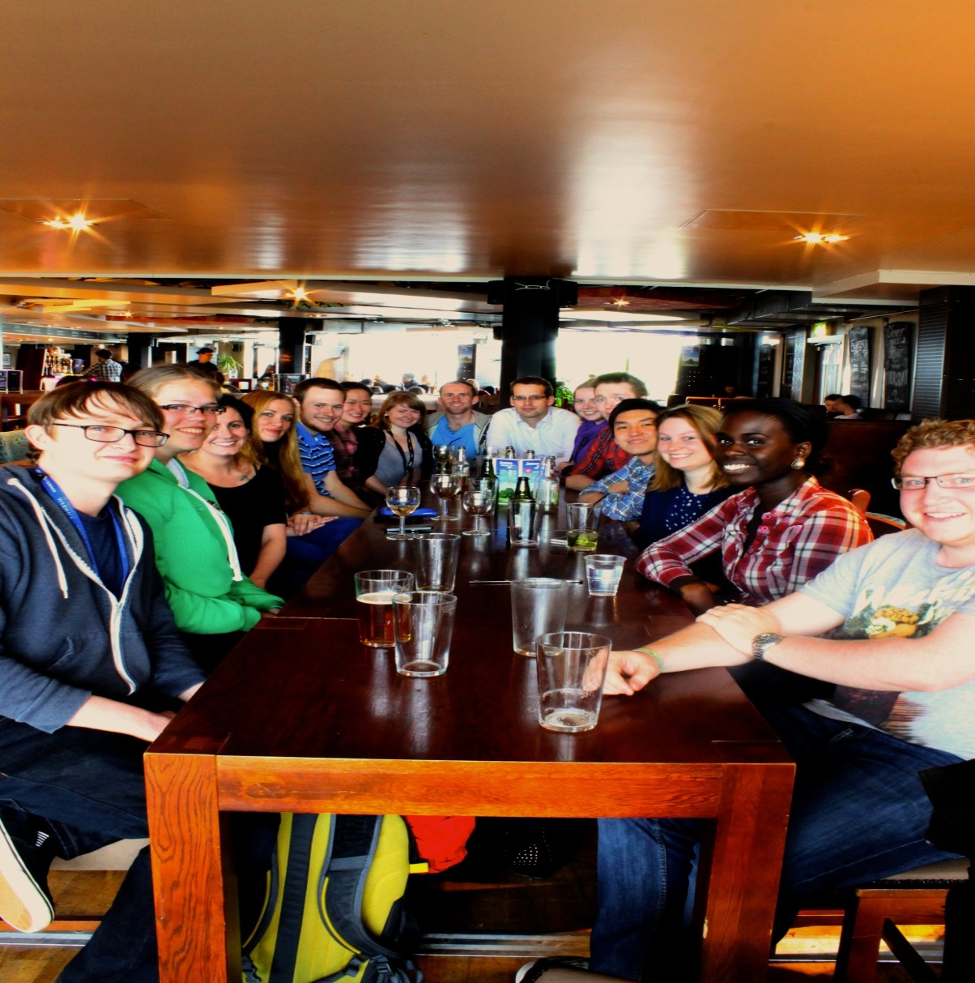




Acknowledgements
Current Gibson Group Members
Dr Gemma-Louise Davies - Daniel Mitchell
Dr Daniel Phillips - Ben Martyn
Dr Tom Congdon - Lewis Blackman
Caroline Biggs - Sang-Ho Won
Lucienne Otten - Laura Wilkins
Dr Matthew Gibson
Prof. Gurdyal Besra
Dr Elizabeth Fullam

Slide 18
Glycosylated gold nanoparticle biosensors: Label-free and high-throughput evaluation of glycan-lectin interactions
Sarah-Jane Richards and Matthew I. Gibson
Department of Chemistry, University of Warwick, UK
s-j.richards@warwick.ac.uk
www.warwick.ac.uk/sarahjane_richards
@LabGibson
250th ACS Meeting 16/08/15
Boston, MA

