Slide 1

Bio-Orthogonal Reactions for Metabolic labelling
Christmas day of science 2014
Ben Martyn

Slide 2
Bio-Orthogonal Reactions for Metabolic labelling
What is Metabolic Labelling?
What is bio-orthogonal chemistry?
Staudinger Ligation
Azide Alkyne Coupling
Inverse Electron Demand Diels Alder
Problems
Looking ahead
Notes:
16700 Students
Includes visiting and exchange students (heads) and HEFP students in local colleges. Excludes students taught overseas and on external programmes.
3800 Staff
3000 full and part time, 800 casua, 96% non-academic staff live in Coventry. 3rd largest employer in Coventry area
£174.5 m turnover
For year ended July 2001, projected to rise to £222 m by 2004/05
Arts Centre
250,000 visits each year, 70% of audience from Coventry/Warwickshire, 67% self-generated income. £580,000 University subsidy to Arts Centre each year (not all grant)

Slide 3
Metabolic Labelling
Metabolic labelling: Using internal cell processes to incorporate labels into biomolecules.

Slide 4
Metabolic Labelling
1
Incorporated Label
Label
Into Cell
2
Incorporated Label
Label reacts with “tag”
Label
Into Cell

Slide 5
What sort of labels?
Isotope Labelling – Requires careful experiment planning and complex analysis.
Green Fluorescent Protein – May perturb the system.
“Tagging” – Requires Bio-orthogonal chemistry
1) R. J. Beynon and J. M. Pratt, Mol. Cell. Proteomics, 2005, 4, 857–72.
Notes:
Isotope labelling: complex and sometimes expensive reagents, Confounding issues include the metabolic lability of the amino acid precursor, incomplete labeling, and the role of protein turnover in labeling kinetics.
GFP: Very powerful tool for proteins but no good for sugars lipids and other secondary metabolites
Bio-Orthogonal Reagents: Demanding requirements but many options now available.

Slide 6
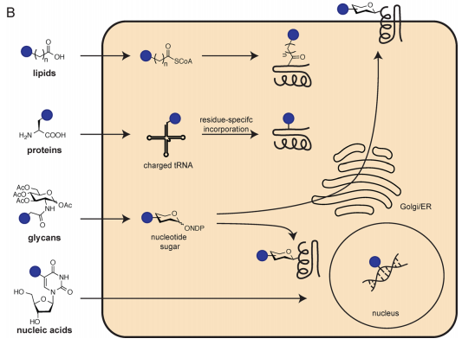
What can we label?
Proteins
Sugars
Lipids
Nucleic acids
Figure from: D. M. Patterson, L. A. Nazarova, and J. A. Prescher, ACS Chem. Biol., 2014, 9, 592–605.

Slide 7
Bio-Orthogonality
What is a bio-orthogonal reaction?
“Click chemistry in a biological setting”
  Selective
  Biologically inert
  Chemically inert
  Kinetics
  Accessible engineering
Notes:
Accessible engineering: Compatible with the cell metabolic pathway.

Slide 8
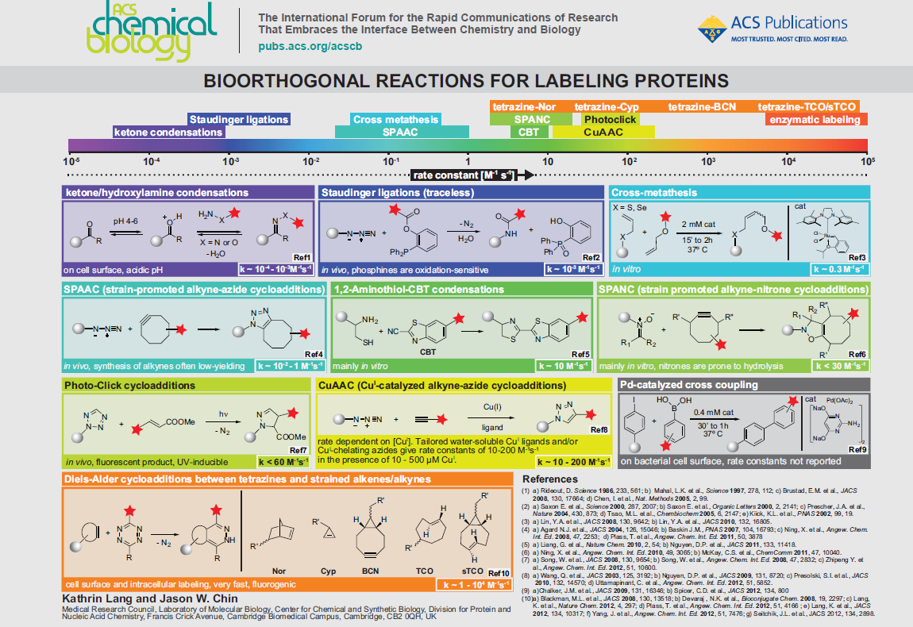
Bio-orthogonal reactions

Slide 9
Staudinger Reaction

Slide 10
Staudinger Ligation

Slide 11
Staudinger Ligation (traceless)
1)Saxon E. et al., Science 2000, 287, 2007 2) Saxon E. et al., Organic Letters 2000, 2, 2141
3)Prescher, J.A. et al., Nature 2004, 430, 873 4) Tsao, M.L. et al. chembiochem 2005, 6, 2147
5) Kiick, K. L. et al., PNAS 2002, 99, 19.
Notes:
Prof. Raines, at Uni of wisconsin also developed a “traceless staudinger ligation” using a thioester, for peptide coupling. Increased complexity as reagent is more susceptable to air.

Slide 12
Staudinger Ligation
Advantages and Limitations:
Low toxicity
Slow Kinetics (k = 10^{‑3}M⁻¹s⁻¹)
Needs high concentrations
Phosphines are oxidation sensitive
Notes:
Attempts to increase the nucelopphlicity of the phosphine results in increased susceptability to oxidation.

Slide 13
Cu^{I} Catalysed azide-alkyne cycloaddition (CuAAC)
Advantages and Limitations:
Very fast kinetics (k = 10 – 200M⁻¹S⁻¹)
“Tricomponent” mechanism
Cu^{I} toxicicity

Slide 14
Cu^{I} Catalysed azide-alkyne cycloaddition (CuAAC)
Picolyl Azide:
Pre-organises the Cu^{I} allowing much lower concentrations to be used
C. Uttamapinant, M. I. Sanchez, D. S. Liu, J. Z. Yao, and A. Y. Ting, Nat. Protoc., 2013, 8, 1620–34.

Slide 15
Strain Promoted Alkyne Azide Coupling (SPAAC)
Advantages and Limitations
Fast Kinetics (relatively!) k = 10⁻² – 1M⁻¹S⁻¹
Low toxicity
Synthetically challenging to make cyclooctynes.

Slide 16
Cyclooctynes
Notes:
Fluorine Lowers the LUMO of the alkyne

Slide 17
Cyclooctynes

Slide 18
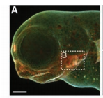
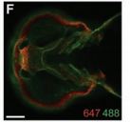
Zebra fish development monitored by SPAAC
Multiple labelling experiments showed development of different cell types and different rates of internalisation between cell types.
Notes:
Mouth devloped later than the fins and olfactory organs
Eye and dorsal epithelium had slow internalisation
Pectoral fins showed fast internalisation.

Slide 19
Inverse Electron Demand – Diels Alder
Increasing rate of reaction

Slide 20
Inverse Electron Demand – Diels Alder
Advantages and limitations:
Very fast Kinetics (k = 1-10⁴ M⁻¹s⁻¹)
TCO is fastest but isomerises to un-reactive cis-isomer.
Tetrazenes EWG makes them susceptible to hydrolysis and thiols.

Slide 21
Problems in the field
No standardised comparisons
Few places with collated strengths and weaknesses
Solubilities and stabilities often not stated

Slide 22
Looking forward
New bio-orthogonal reactions
Tuning of current reagents: Photoactivated reagents
Pro-fluorescence
Mutually orthogonal reactions

Slide 23
Thanks for listening!
Further Reading:
D. M. Patterson et al, ACS Chem. Biol., 2014, 9, 592–605.
E. M. Sletten and C. R. Bertozzi, Angew. Chem. Int. Ed. Engl., 2009, 48, 6974–98.
M. D. Best, Biochemistry, 2009, 48, 6571–84.

