Slide 1

Section Title
Christmas Tutorial on Surface Characterisation Techniques
                DSA
                Ellipsometry
                QCM
                XPS
Surface Characterisation Techniques
Caroline Biggs

Slide 2
For Each technique I will cover
What is it and what is it used for?
How can I get access and/ or training?
What sort of data can I expect?
Recommended further reading/ references

Slide 3

go.warwick.ac.uk/am2

Slide 4
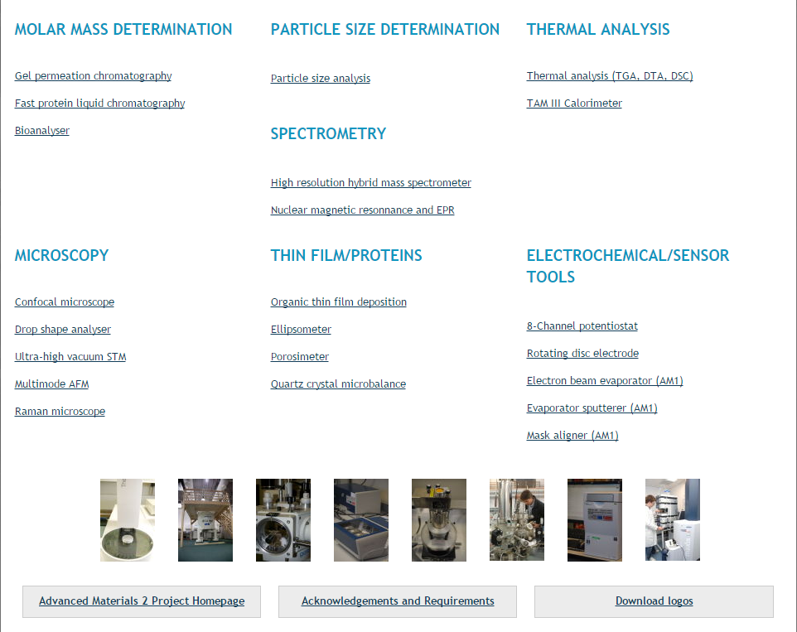

Slide 5
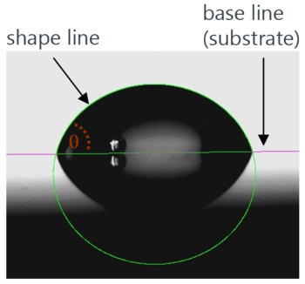
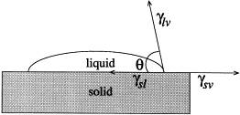
Drop Shape Analysis
What is it and what is it used for?
Determine contact angle made by a liquid on a almost any surface
Measure surface tension/ interfacial tension
Sensile drop → metered onto surface
Pendant drop → allowed to hang from needle
Contour of drop recognised
Geometric model fitted
Angle defined by mechanical equilibrium of drop under 3 interfacial tensions, can be calculated
Roughness = larger than expected angles

Slide 6
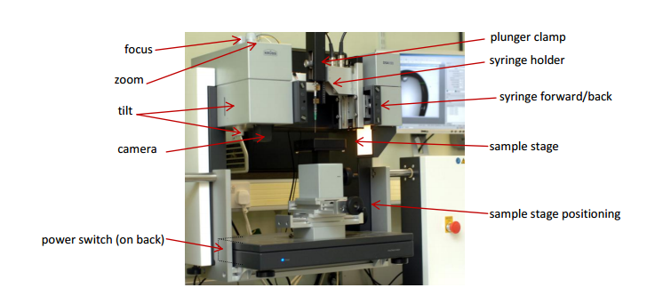
Drop Shape Analysis
2. How can I get access and training?
Krüss drop shape analysis system DSA100 with tilting table
Location: C314
Booked via AM2 page

Slide 7
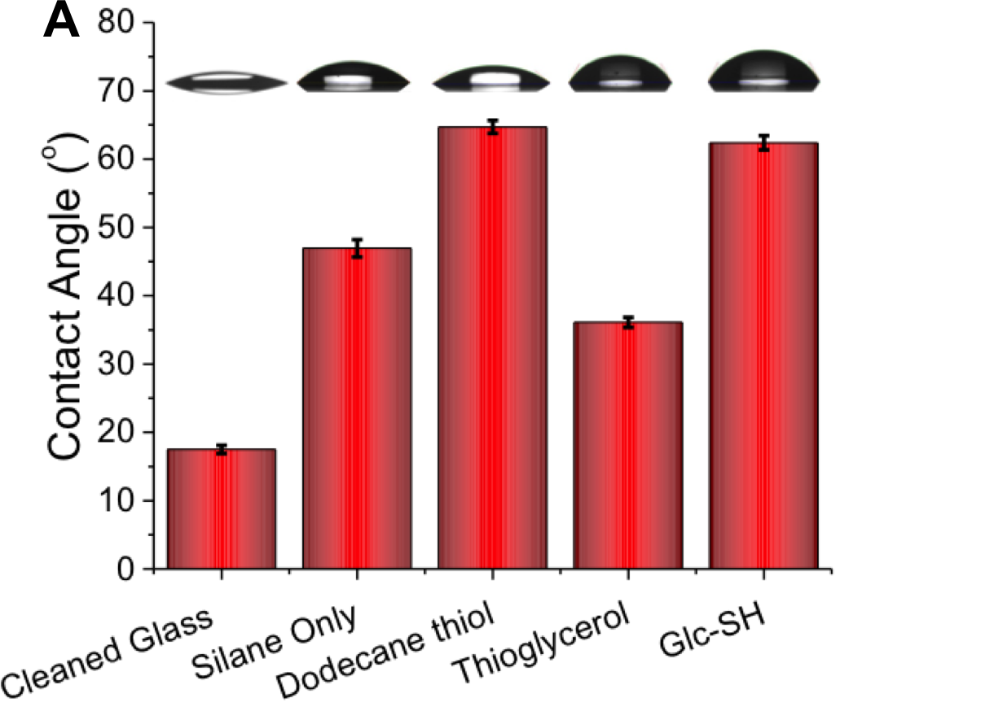
Drop Shape Analysis
3. What sort of data can I expect?
Contact angles
Select sessile drop and appropriate computational method (I recommend Young-Laplace, unless your angles are <10˚).
Use a drop between 1 and 10 nm¹
Obtain angle for left and right side of image (hopefully the same), write them down
Copy image from screen into paint and save
Make yourself a nice figure
b. Surface tension
Surface must be totally smooth and homogenous
Select pendant drop and Young-Laplace
You must use an known amount of water
1. Effect of Drop Volume on Static Contact Angles, Kruss Technical Note, Available at http://www2.warwick.ac.uk/fac/cross_fac/sciencecity/programmes/internal/themes/am2/booking/dropshapeanalyser/effect_of_drop_volume_on_static_contact_angles.pdf

Slide 8
Drop Shape Analysis
4. Recommended references and further reading
User guide (made by Ben)
http://www2.warwick.ac.uk/fac/cross_fac/sciencecity/programmes/internal/themes/am2/booking/dropshapeanalyser/instructions_for_drop_size_analyser_v5.pdf
User guide (from the manufacturer)
http://www2.warwick.ac.uk/fac/cross_fac/sciencecity/programmes/internal/themes/am2/booking/dropshapeanalyser/kruss_manual-dsa100.pdf
Journals
D. Y. Kwok and A. W. Neumann, Advances in Colloid and Interface Science, 1999, 81, 167-249.
K. Grundke, T. Bogumil, T. Gietzelt, H. J. Jacobasch, D. Y. Kwok and A. W. Neumann, Interfaces, Surfactants and Colloids in Engineering, 1996, 101, 58-68.

Slide 9
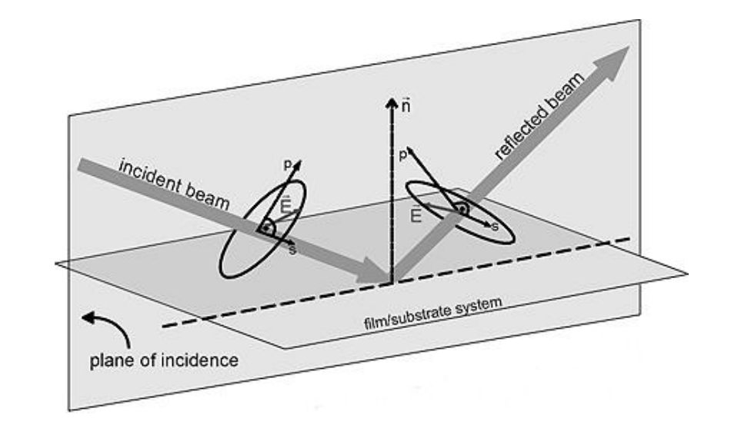
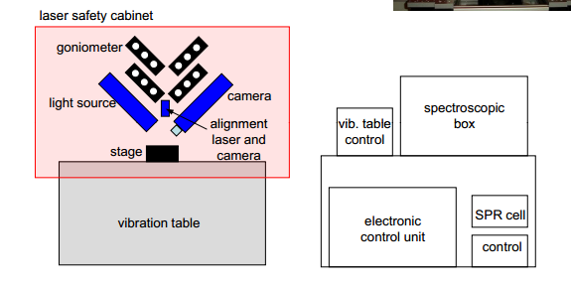
Ellipsometry
What is it and what is it used for?
Optical technique to investigate this roughness, thickness and composition of thin films
Incident radiation (laser source) is reflected or absorbed by the sample
The change in polarisation of the radiation source is measured
Given as two parameters, psi (amplitude component) and delta (phase difference)
Combine with wavelength of the incident light to calculate layer thickness, error and confidence interval
Advantage: Non-destructive and contactless
Sub-nanometer resolution
Disadvantage: Modelling. Lots and lots of modelling
Must know the optical constants for your system

Slide 10
Ellipsometry
2. How can I get access and training?
Nanofilm imaging spectroscopic ellipsometer
EP4Model software installed
Recommend using WVase (can have your own copy too)
Location: C103a
Booked via AM2 page

Slide 11
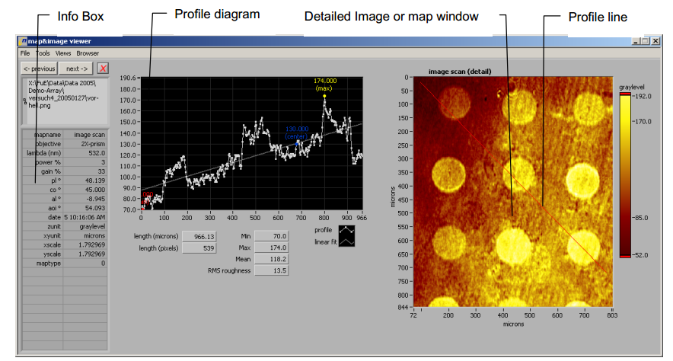
Ellipsometry
3. What sort of data can I expect?
Silicon, germanium, titanium or gold surfaces are best
Sequential film thickness measurements
Or calculate other film parameters from a known thickness

Slide 12
Ellipsometry
4. Recommended references and further reading
Handbook of Ellipsometry’, H. G. Tompkins and E. A. Irene Eds.
Available in the library or borrow a copy from Ben Douglas
Principles of Ellipsometery by Accurion
http://www2.warwick.ac.uk/fac/cross_fac/sciencecity/programmes/internal/themes/am2/booking/ellipsometer/compendium_-_principles_-_i.pdf

Slide 13
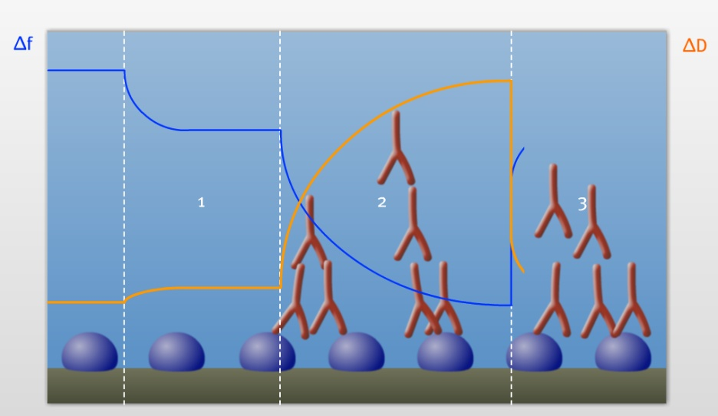
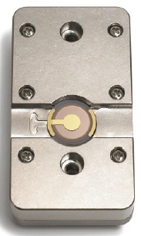
Quartz-Crystal Microbalance with Dissipation
1. What is it and what is it used for?
Measure change in frequency upon addition of mass to a surface
Monitors frequency and energy dissipation response
Kinetics of both structural changes and mass changes are obtained simultaneously
QC chips are thin quartz discs between 2 electrodes
Excite crystal to oscillation by applying AC voltage

Slide 14
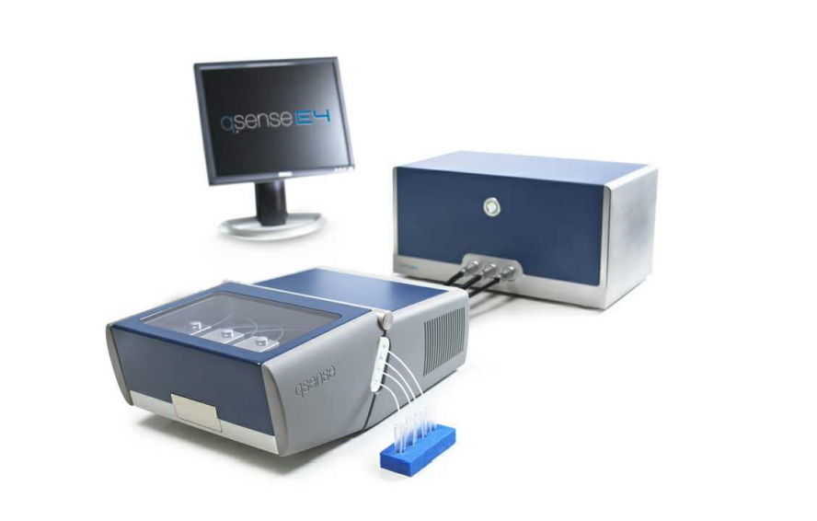
Quartz-Crystal Microbalance with Dissipation
2. How can I get access and training?
Q-Sense E4 System with QSoft 401 software
Also E1 System in Electrochemistry, compatible with organic solvents
Location: C206
Booked via AM2 page

Slide 15
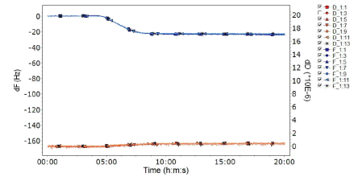
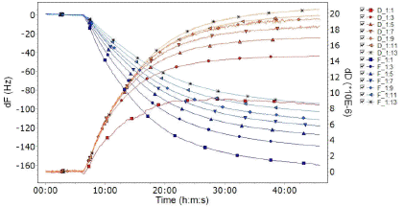
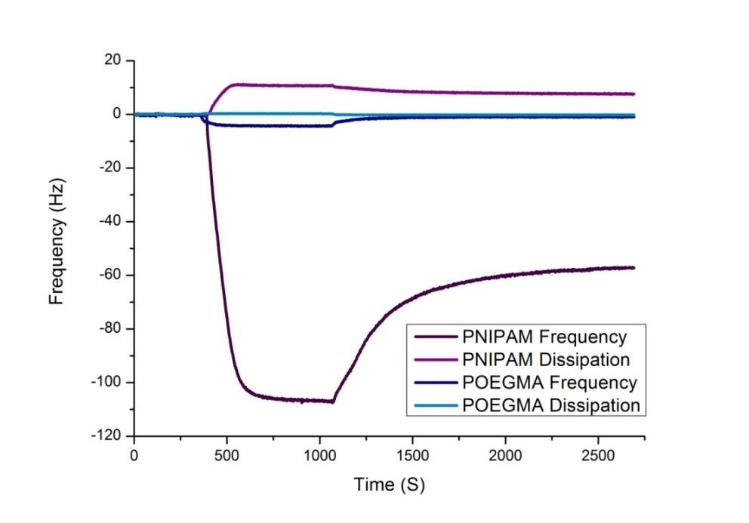
Quartz-Crystal Microbalance with Dissipation
3. What sort of data can I expect?
Qualitative:
Raw data plot (ΔD/ Δf against time)
Quantitative (rigid film):
Sauerbrey equation
Δm = (C/n) Δf n = harmonic number
        c = (crystal thickness x crystal density) / fundamental frequency
        Gives areal mass in ng/ cm²
Quantitative (soft and laterally homogenous film):
Viscoelastic modeling of ΔD and Δf

Slide 16
Quartz-Crystal Microbalance with Dissipation
4. Recommended reading and references
Biolin Scientific Website, lots of training resources, videos and webinars
http://www.biolinscientific.com/q-sense/?training Q-Sense E4 System with QSoft 401 software
E4 User manual
http://www2.warwick.ac.uk/fac/cross_fac/sciencecity/programmes/internal/themes/am2/booking/qcm/e4_operator_manual_-_download_version.pdf
Journals
Zhang, G.; Wu, C., Quartz Crystal Microbalance Studies on Conformational Change of Polymer Chains at Interface. Macromolecular Rapid Communications 2009, 30 (4-5), 328-335
G. Z., Study on conformation change of thermally sensitive linear grafted poly(N-isopropylacrylamide) chains by quartz crystal microbalance. Macromolecules 2004, 37 (17), 6553-6557
O'Sullivan, C. K.; Guilbault, G. G., Commercial quartz crystal microbalances - theory and applications. Biosensors & Bioelectronics 1999, 14 (8-9), 663-670

Slide 17
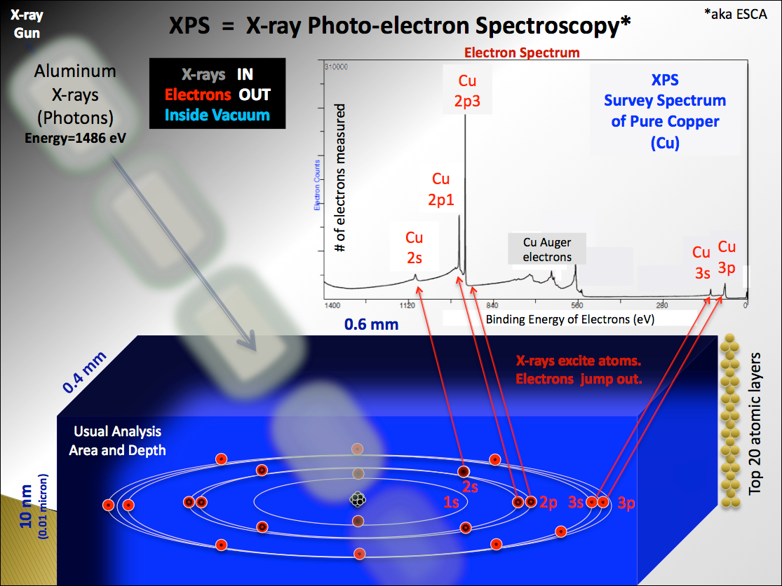
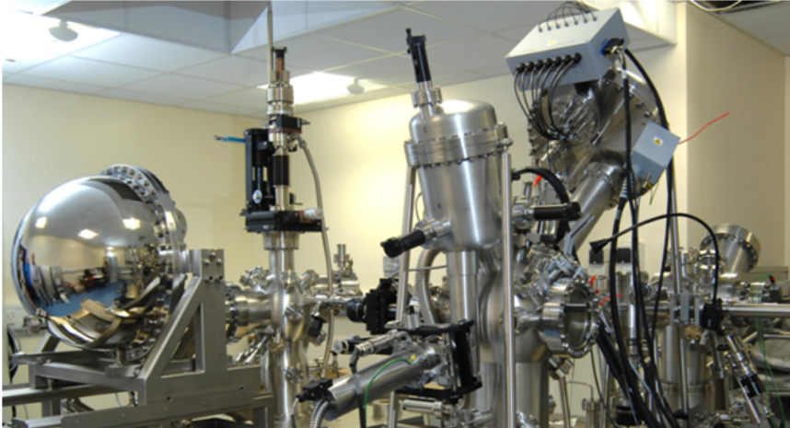
X-Ray Photoelectron Spectroscopy
What is it and what is it used for?
Spectroscopic technique to measure the elemental composition of a surface
Irradiate with a bean of X-rays and measure the kinetic energy and number of electrons released from the top 10 nm
Cannot detect hydrogen or lithium

Slide 18
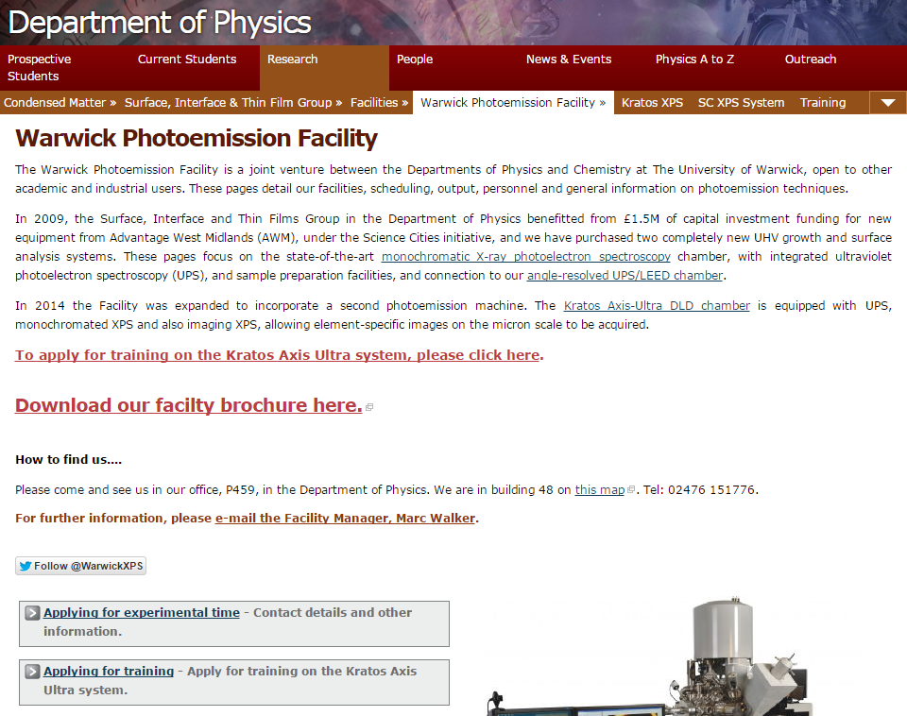
X-Ray Photoelectron Spectroscopy
2. How can I get access and training?
go.warwick.ac.uk/xps
Two machines available (Science city Monochromated Al K_{α} X-ray and Krtos Axis Ultra, which is new and has an autosampler)
Three options for obtaining XPS data:
a. Submit your samples and leave un them
b. Stay and learn how they are run
c. Get trained on the machine
(must prove you are an extensive user)
Maximum sample dimensions (l x w x h) are 12 mm x 12 mm x 4 mm
Can test anything coated with silicon
Including gold nanoparticles, if supported on Si wafters

Slide 19
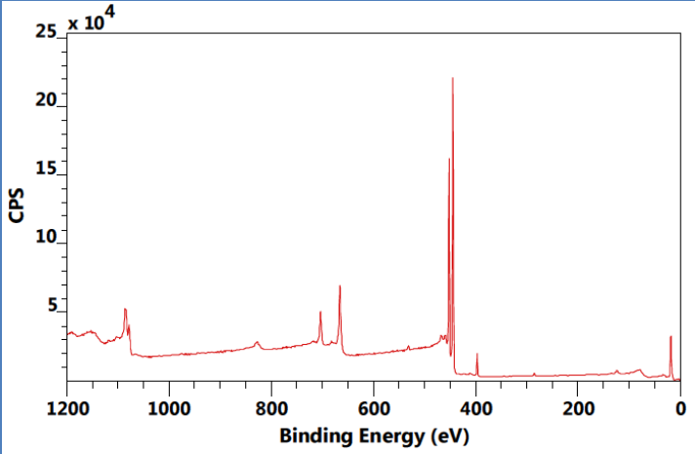
X-Ray Photoelectron Spectroscopy
3. What sort of data can you expect?
Analysis of films on silicon or gold
Si surfaces are harder, due to loss peaks, need longer acquisition times and therefore more expensive
Sulphur is very hard to detect, S 2p peak is under the Si loss peaks
AuNPs- surface composition (outer 10 nm) and relative grafting density
If you see calcium it means you need to work on your handling procedures!
Representative high-resolution XPS spectrum of C 1s region before and after addition of thio-galactose with amine catalyst.

Slide 20
X-Ray Photoelectron Spectroscopy
4. Recommended reading and references
An overview of XPS made by the Physics department
http://www2.warwick.ac.uk/fac/sci/physics/research/condensedmatt/surface/exp/xps/xps_flipbook.pdf
Casa XPS (How to analyse the data)
http://www.casaxps.com/help_manual/
NIST Database (How to reference you data and assign peaks)
http://srdata.nist.gov/xps/Default.aspx

Slide 21
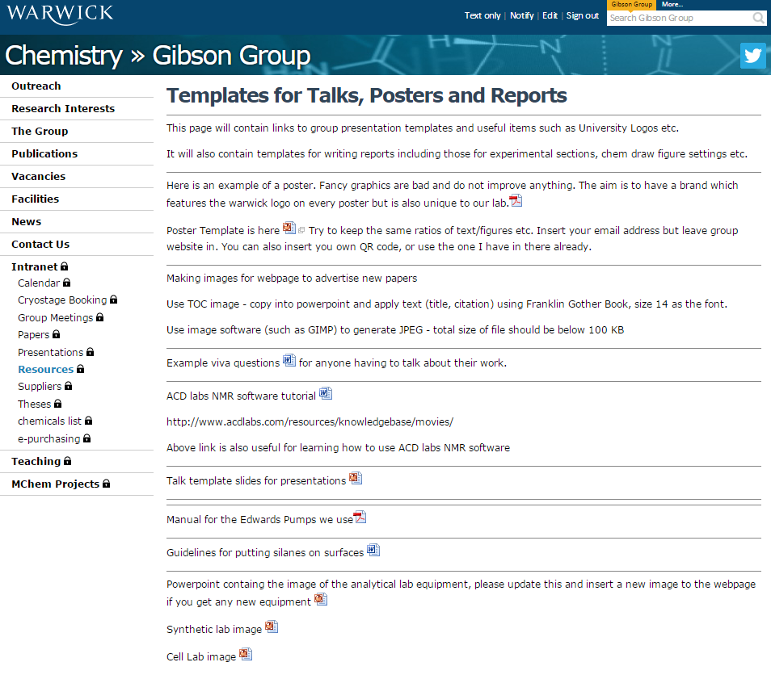
I found this talk really useful and interesting, I think I’d like to read through the information again...

Slide 22
Section Title
Christmas Tutorial on Surface Characterisation Techniques
                DSA
                Ellipsometry
                QCM
                XPS
Surface Characterisation Techniques
Caroline Biggs

