Slide 1


Novel Cryoprotectants and Extremophile Biology
Daniel E. Mitchell
daniel.mitchell@warwick.ac.uk

Slide 2
Introduction
Evolution of Antifreeze (glyco) proteins (AF(G)Ps) enabling life in freezing conditions.
Can we mimic an AF(G)P synthetically?
What applications might this have?
2

Slide 3
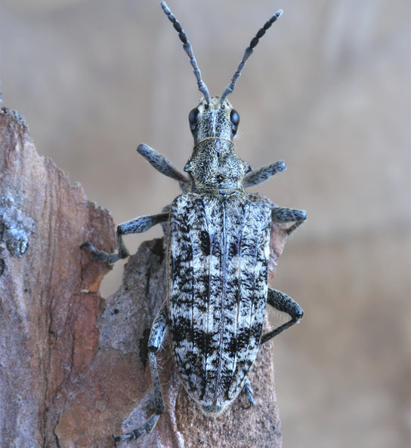
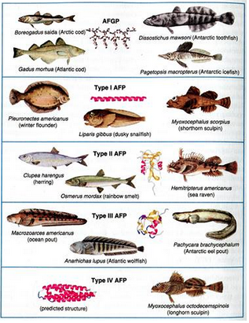
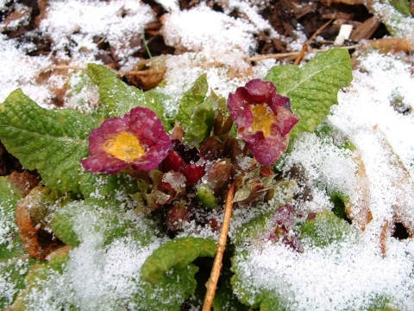
Antifreeze (Glyco)proteins
Wide Variety of different proteins, found in range of organisms that have to survive the cold…
3
Notes:
Siberian longhorn beetle, primrose

Slide 4
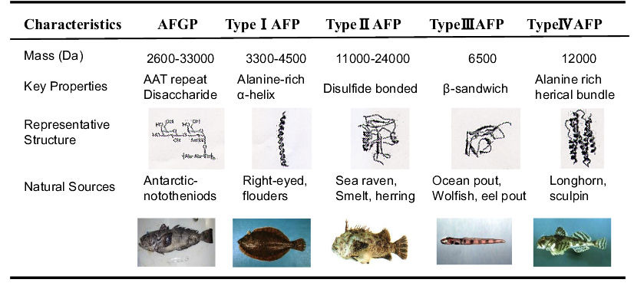
Antifreeze (Glyco)proteins
Wide Variety of different proteins, found in range of organisms that have to survive the cold…
4
Hidehisa Kawahara (2013). Characterizations of Functions of Biological Materials Having Controlling-Ability Against Ice Crystal Growth, Advanced Topics on Crystal Growth, ISBN: 978-953-51-1010-1,

Slide 5
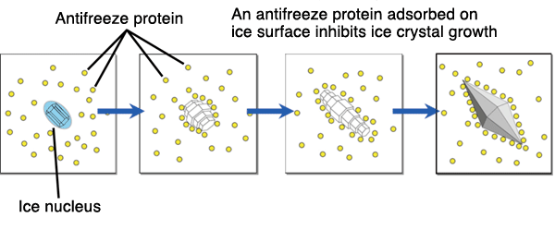
Antifreeze (Glyco)proteins
5

Slide 6
Evolutionary Basis
Interesting Receptor - ligand interaction.
Focus on type 2 antifreeze protein:
    Calcium Dependence
    Defined Binding Pockets
    Looks like a C-type lectin

Slide 7
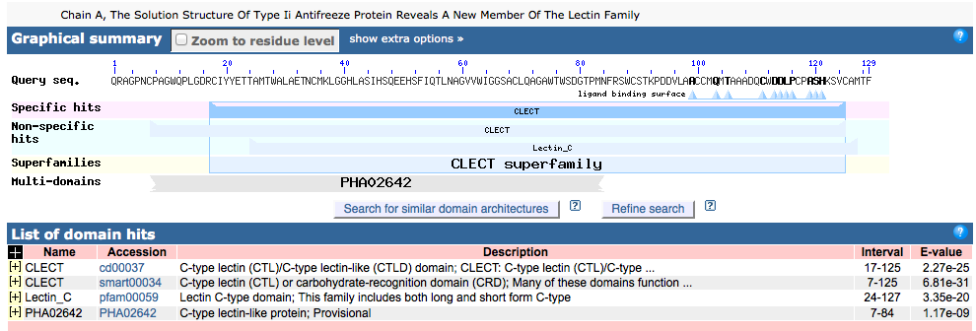
Evolutionary Basis
Compare type 2 AFP to other proteins using online database
7
Altschul, S.F. et al. (1990) J. Mol. Biol. 215:403-410

Slide 8
Evolutionary Basis
Similar to:
Human lectins e.g DC-SignR, Langerin and Lithostathine
Snake venom C-type lectin
Rat Mannose Binding protein
8
Altschul, S.F. et al. (1990) J. Mol. Biol. 215:403-410

Slide 9
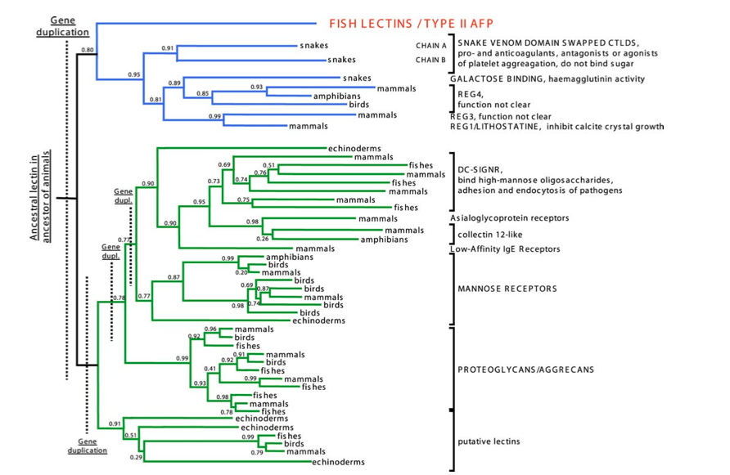
Evolutionary Basis
9
Liu et al. Plos One. 2007,6, 548-559

Slide 10
Do C-type Lectins Stop Ice crystal growth
10

Slide 11
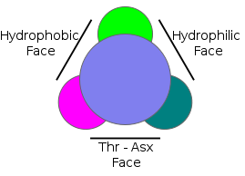
Might other proteins work like an AFP?
Want something that binds to ice, either through biding pocket (lectin like) or through some other method.
Simplified model of a Type 1 AFP
11

Slide 12
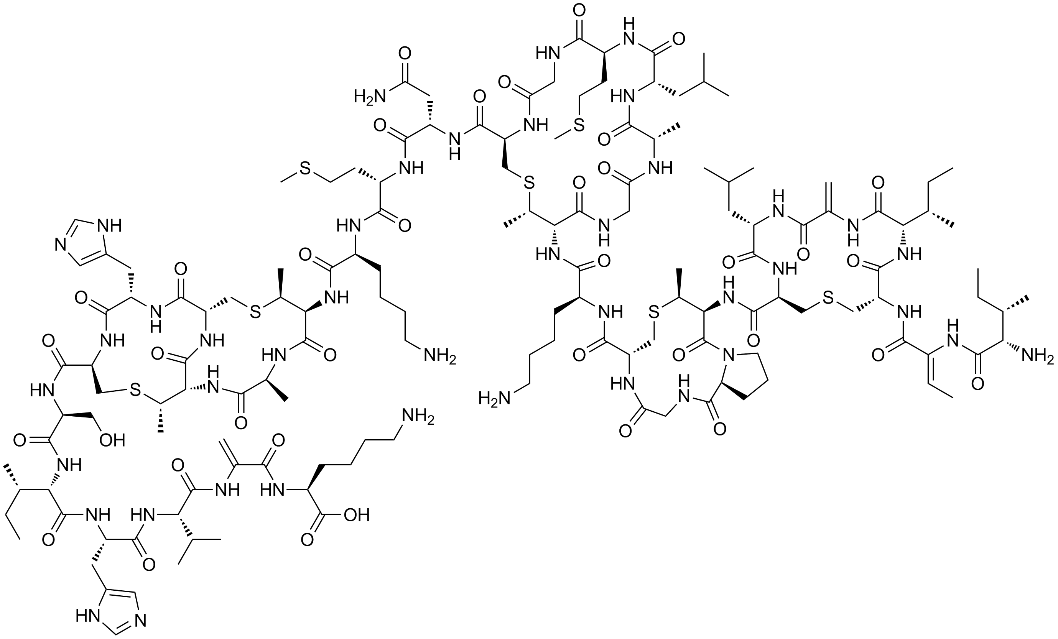
Might other proteins work like an AFP?
Antimicrobial proteins- often have charged surface to bind to bacterial membrane and hydrophobic surface to disrupt the membrane
Nisin
12

Slide 13
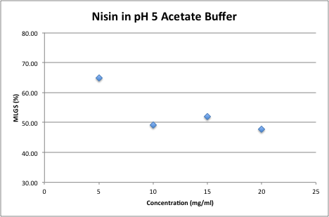
Might other proteins work like an AFP?
Nisin- Ice crystal growth:
13

Slide 14
Might other proteins work like an AFP?
Nisin- Ice crystal growth
Other Ideas???
14

Slide 15
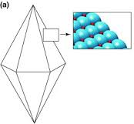
Synthetic Mimics
Why??
Cheaper/ Scalable
no issues with cytotoxicity
Reduce Ice shaping
15

Slide 16
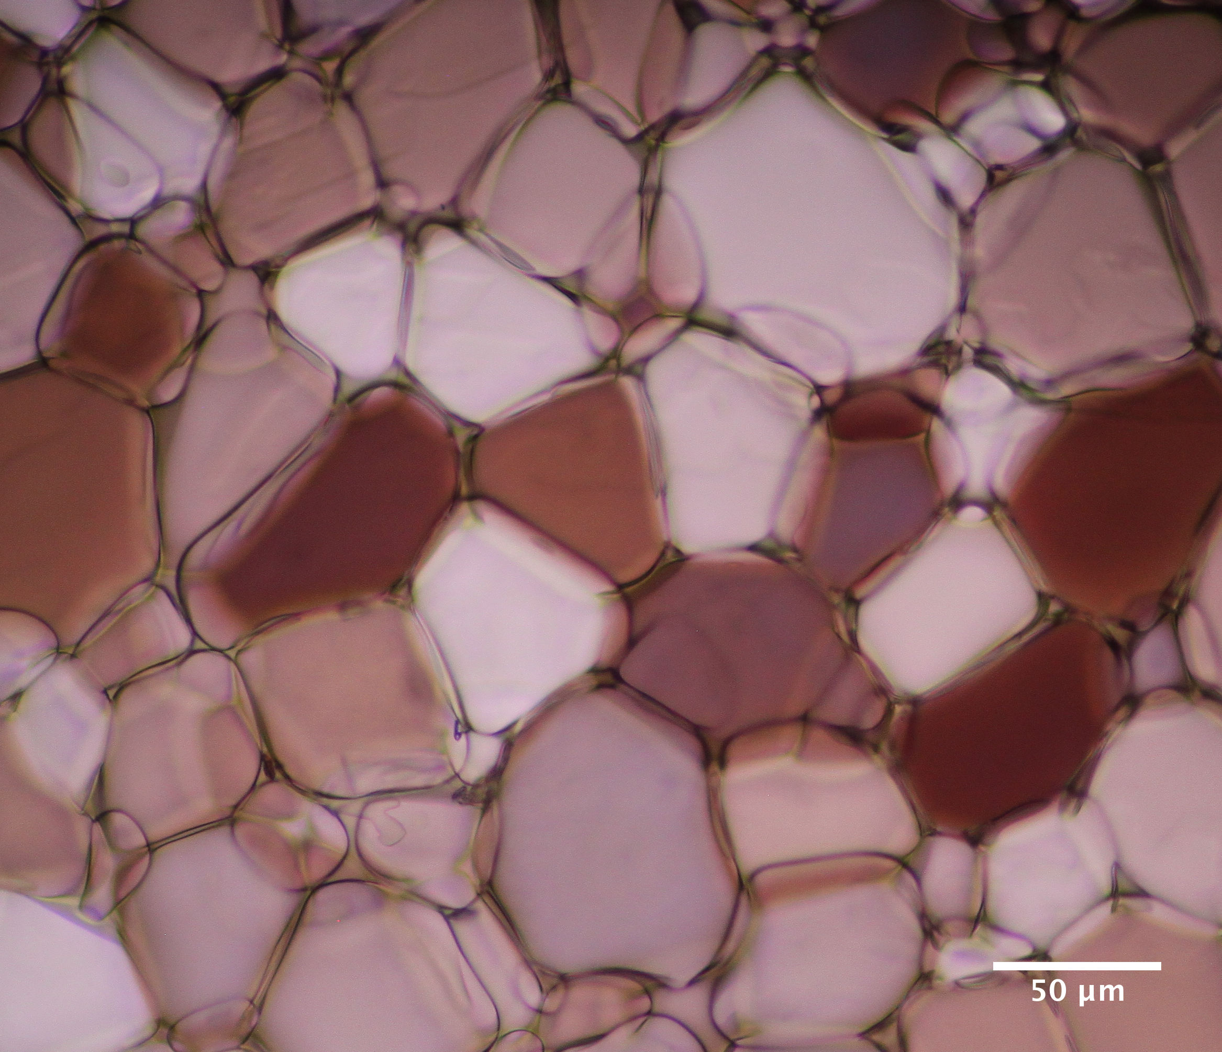
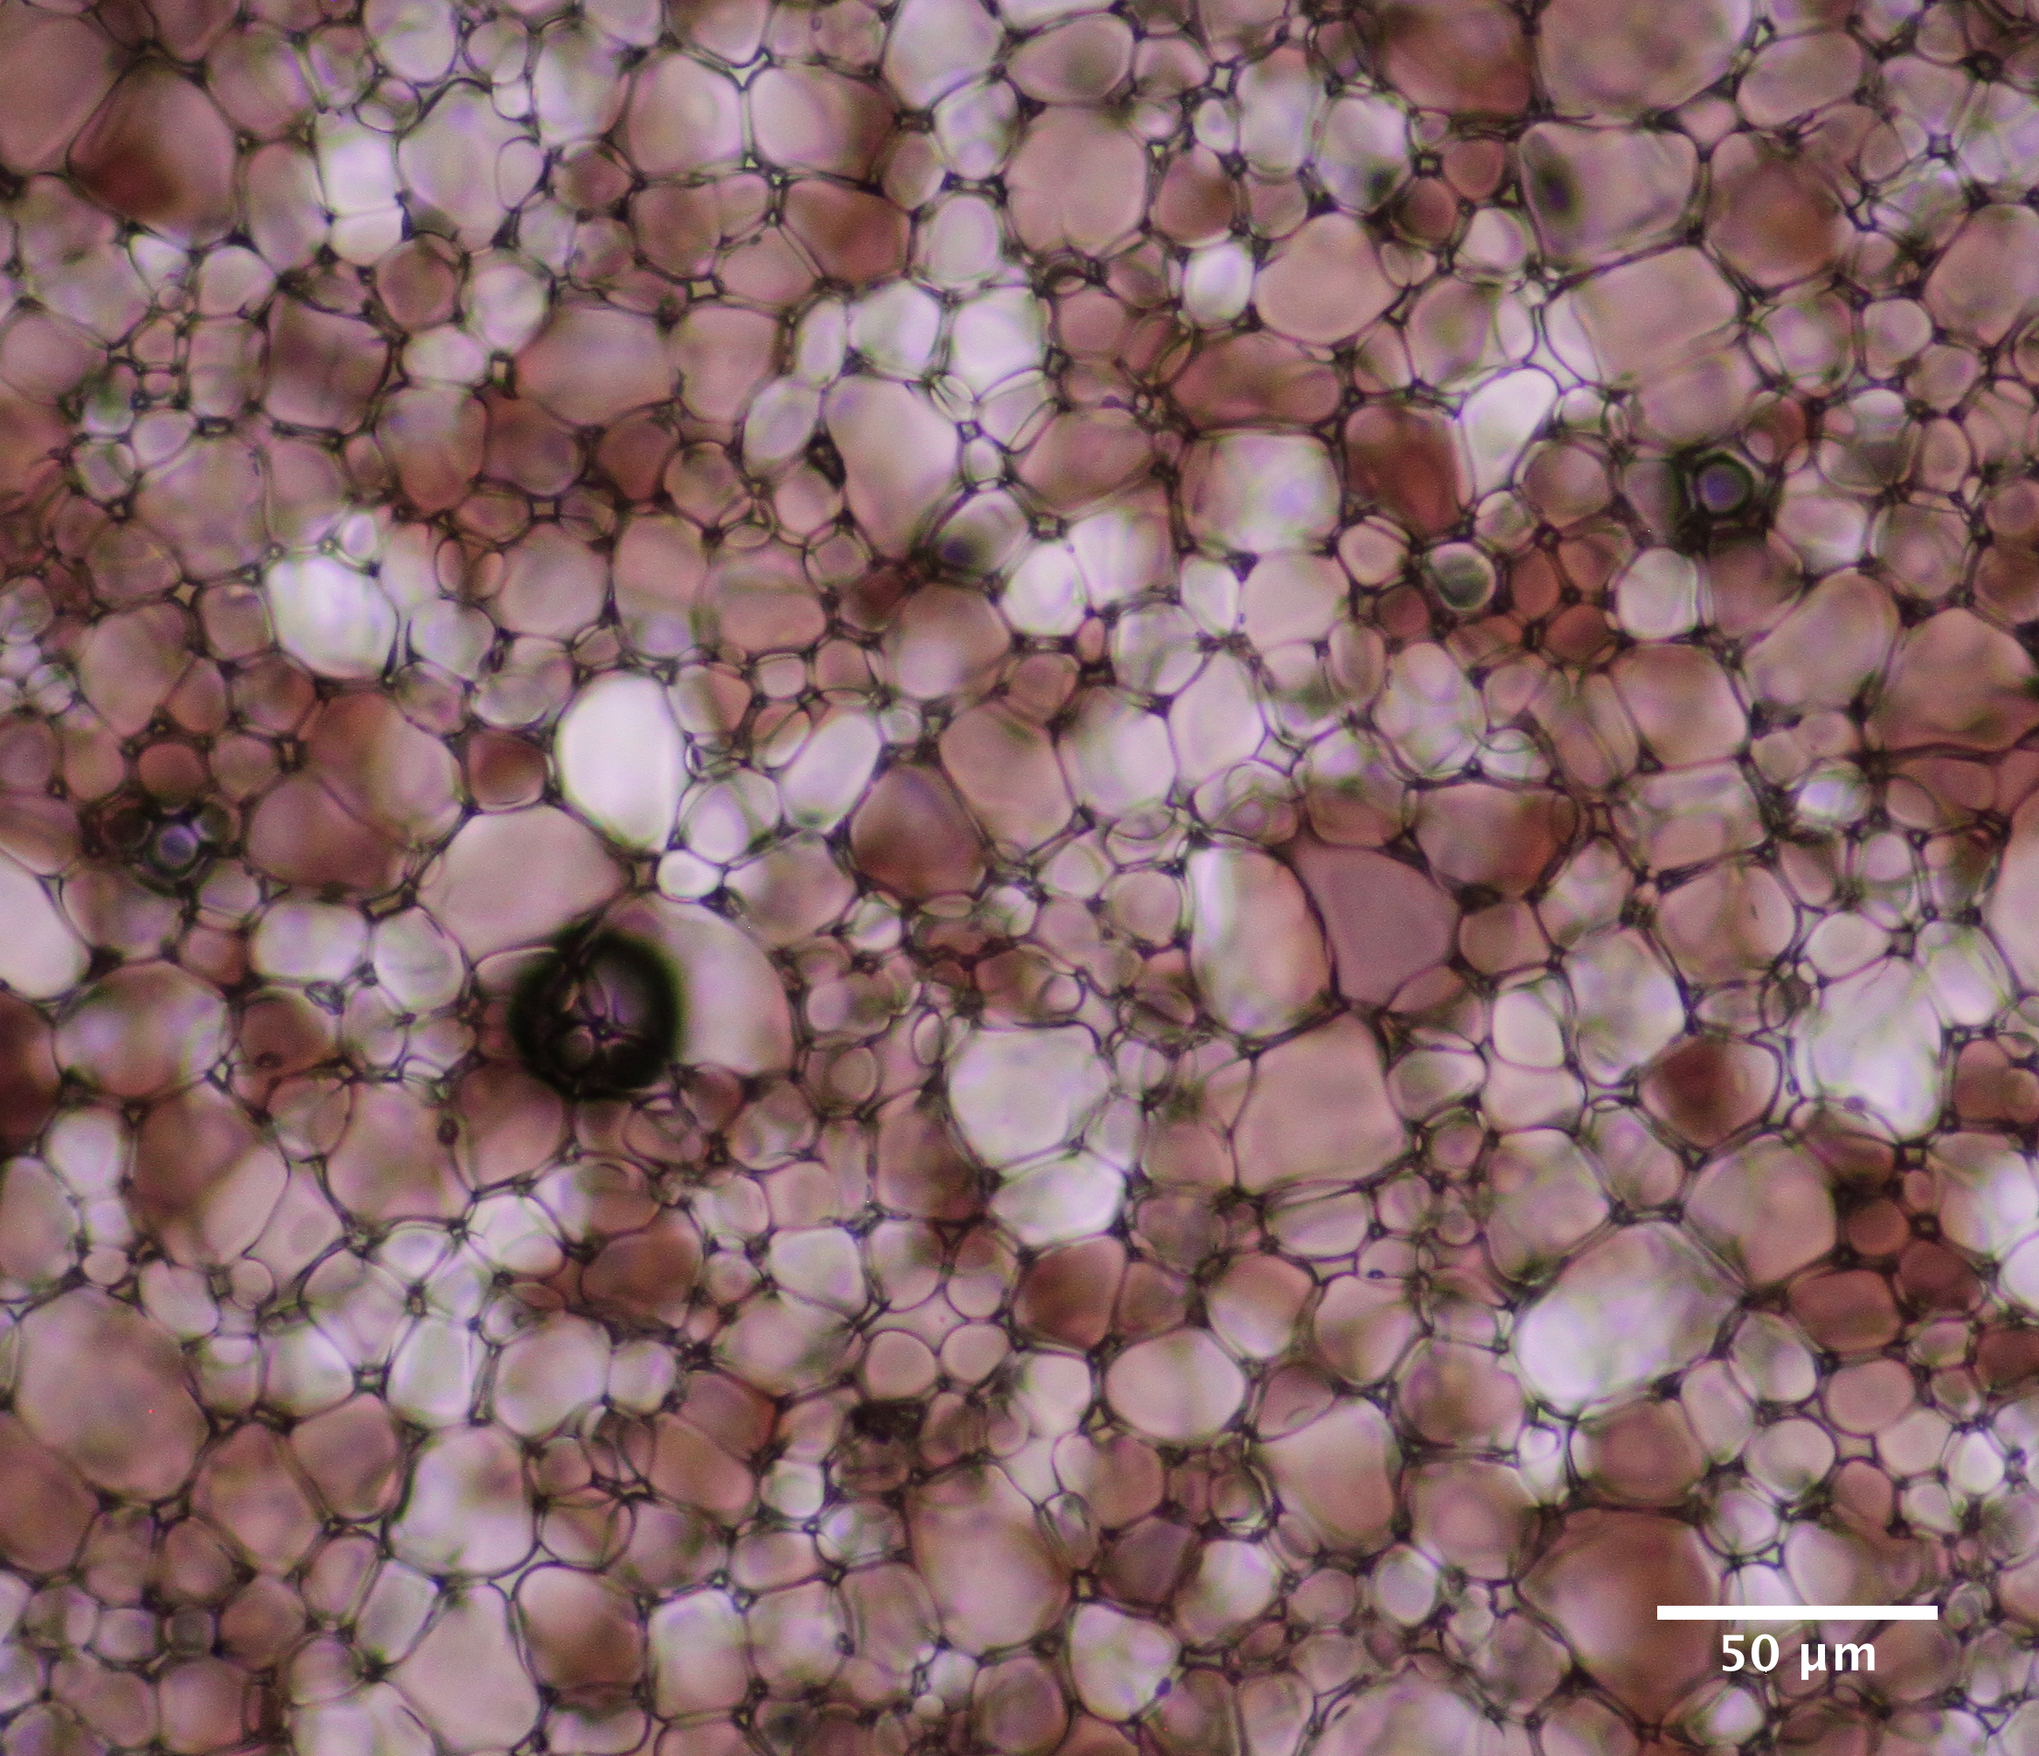
Polymers- polyampholytes
Poly(aminoethyl methacrylate) (PAEMA) functionalized with ~ 50% COOH groups
Poly(methyl vinyl ether-alt-maleic anhydride) functionalized with (boc protected) ethanol amine
PBS Blank
pAEMA (50% COOH)
16
Mitchell et al. Biomaterials Science. 2014, 2(12) 1787-1796.

Slide 17
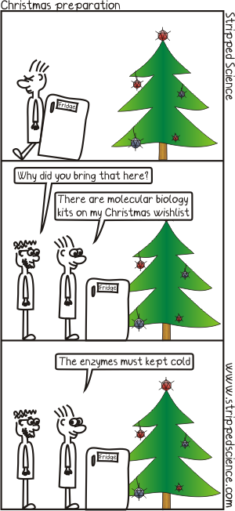
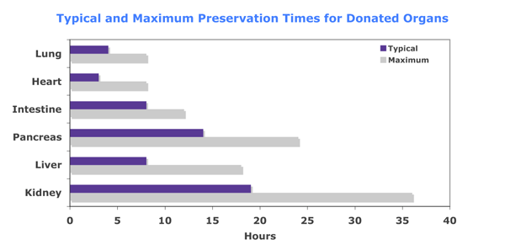
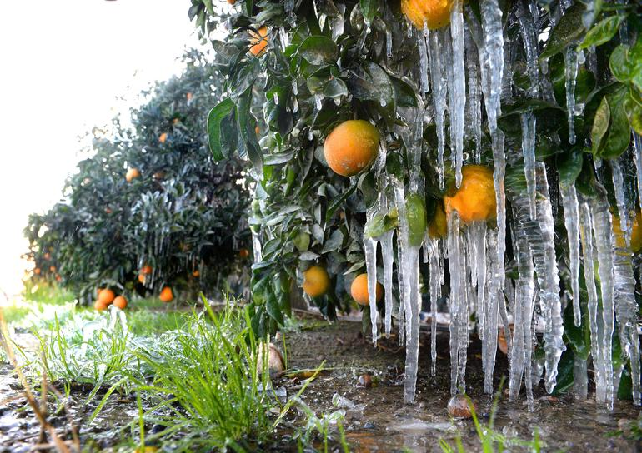
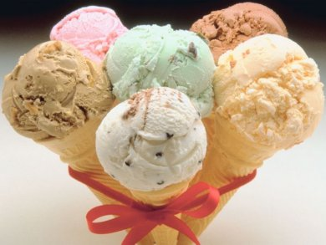
Uses of Cryoprotectants
17

Slide 18
Protein Preservation
Beta-Galactosidase:
18

Slide 19
Protein Preservation
Taq Polymerase – number of cycles required to reach a “threshold level”.
Smaller number of cycles the better the taq.
19

Slide 20
What Next…
Can we engineer a small synthetic protein that exhibits IRI activity?
-less likely to be cytotoxic.
-Can add it as a tag in expression of other proteins.
-Can already be present inside the cell via expression.
-Use polyampholyte or hydrophobic/ hydrophilic faces as a starting point.
20

Slide 21
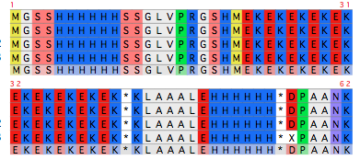
What Next…
Alternating lysine (+, K) and glutamic acid residues (-, E).
… Very hard to express.
21

Slide 22
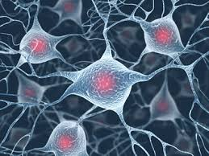
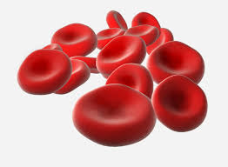
What Next…
Mammalian Cell Cryopreservation
22

Slide 23
Conclusion
Some structural similarity between C-type lectins and type 2 AFPs, C-type lectins have some ice binding ability.
Can mimic an AFP with a polyampholyte polymer.
Proteins can be frozen with a PEG/PVA mix and maintain activity.
Attempts to create a non-cytotoxic synthetic AFP ongoing…
23

Slide 24

Questions???

