Slide 1



Exploiting Novel Natural
‘Nano-syringes’
Joe Healey
MOAC DTC

Slide 2
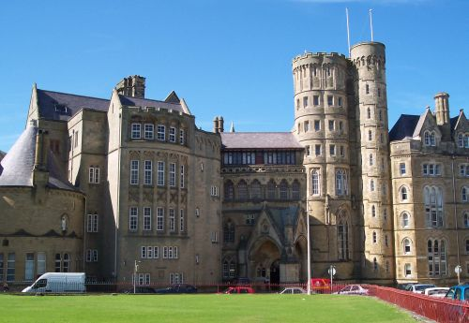
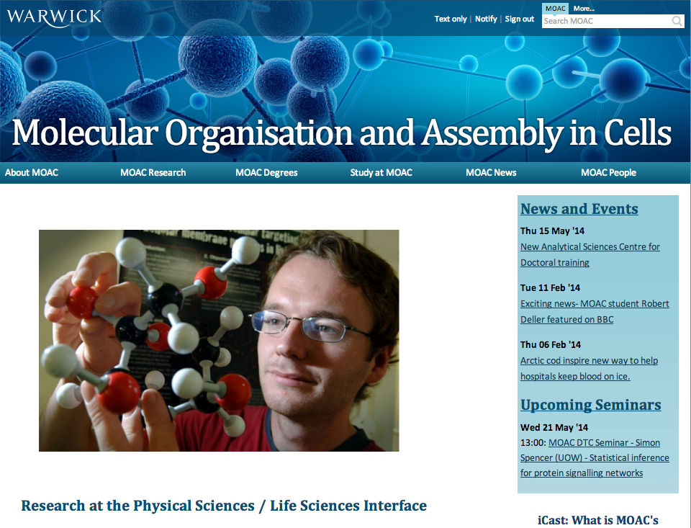
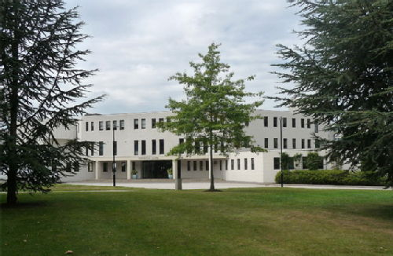
A little about me…
Biology graduate – Aberystwyth University.
Now first year MOAC PhD.
PhD is a collaborative effort between Gibson lab and WMS Microbiology and Infection Unit.
Cosupervised by Matt, and Nick Waterfield.

Slide 3
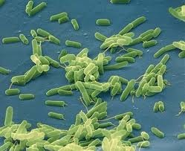
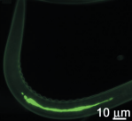
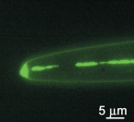
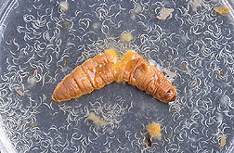
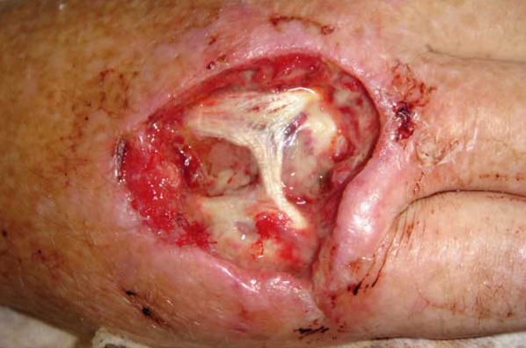
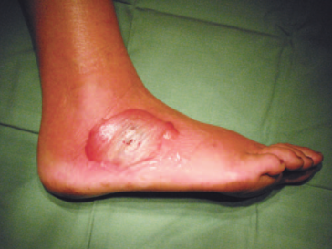
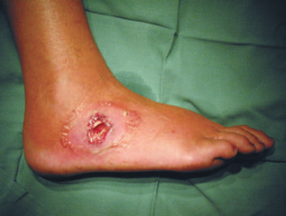
A little background on our bug…
Photorhabdus
Gram negative, bioluminescent bacillus.
Symbiont of nematodes, insect pathogen.
Opportunist human pathogen (certain strains).
  Capable of causing necrotic ulcers, bacteraemia, malaise.
Many other weird and wonderful biological tricks!
Notes:
Gram negative
Entomopathogen
Discuss unique characteristics – lux, toxins etc etc. Things that make it an interesting model other than for human pathogenicity (introduce this idea on the next slide – talk about unique plasmid)
Human pathogenic (pictures)
Facultative intracellular
Symptoms?

Slide 4
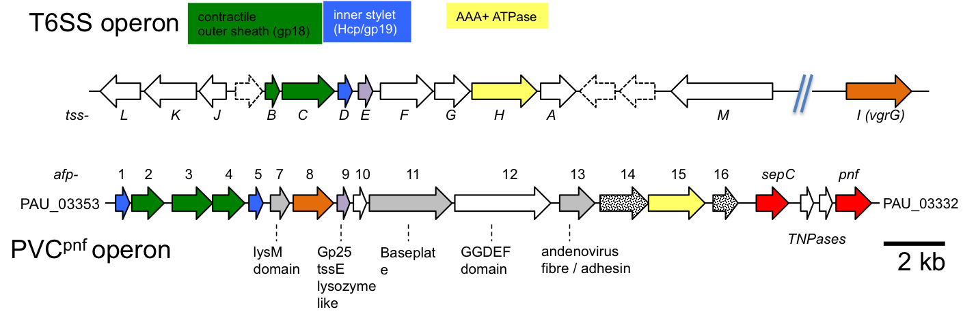
The PhD Project itself...
Photorhabdus makes secretion structures – Photorhabdus Virulence Cassettes.
We think we can exploit these.
The PVCs are homologous to, but different from, a number of known structures:
  R-type pyocins
  Bacteriophage tails
  Type 6 Secretion Systems
  Antifeeding Prophages
Notes:
Discuss similarities between ATCC and JUN, yet JUN cannot cause disease in humans (not an exhaustive phylogeny)
Growth restriction
UNIQUE PLASMID

Slide 5
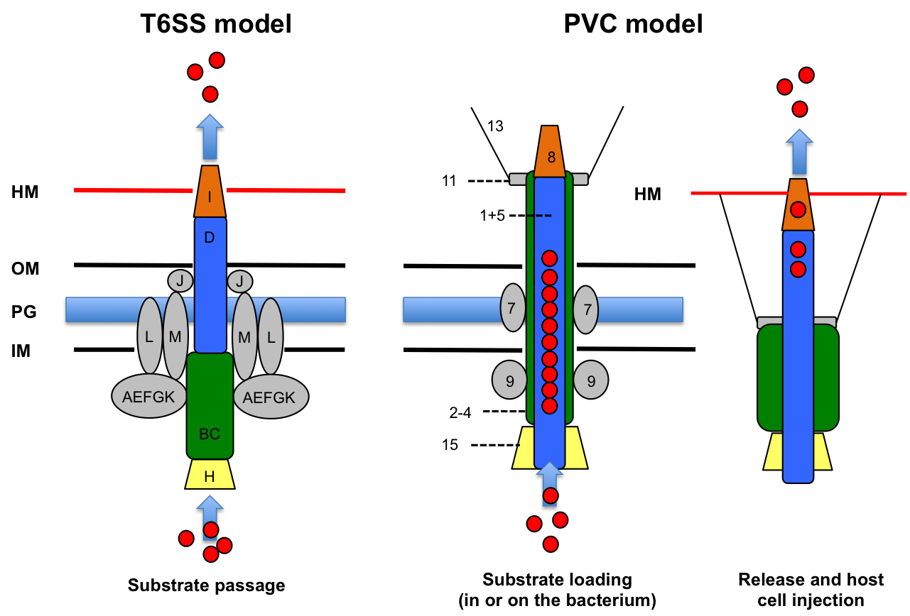
Extremely potent toxin delivery structures! (lethal within 15 minutes in some cases)

Slide 6
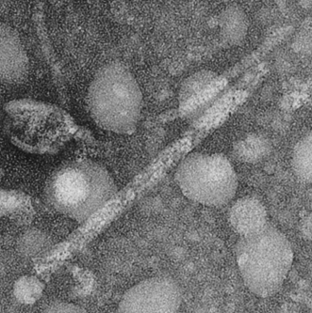
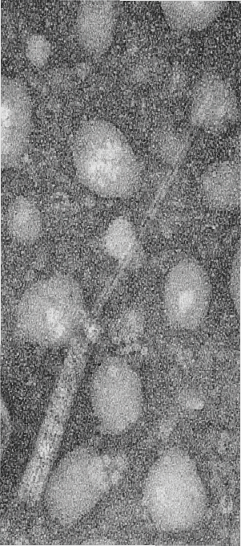
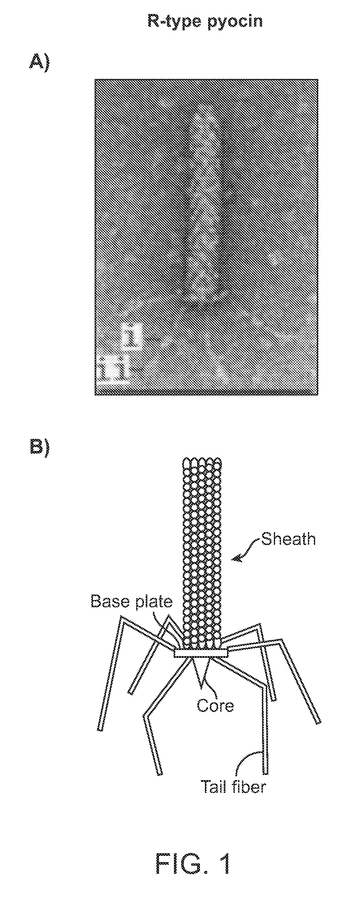

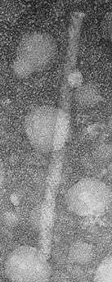
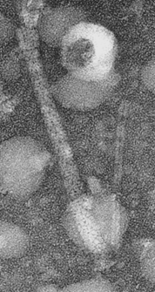
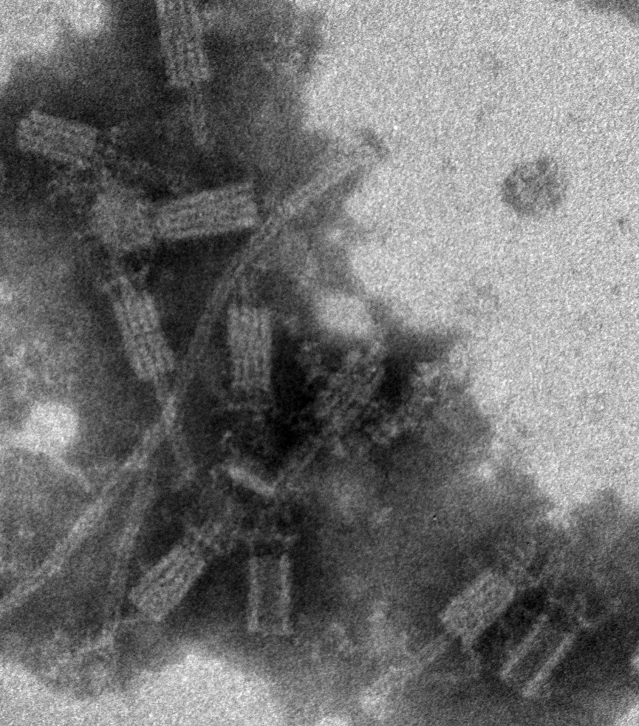

Slide 7
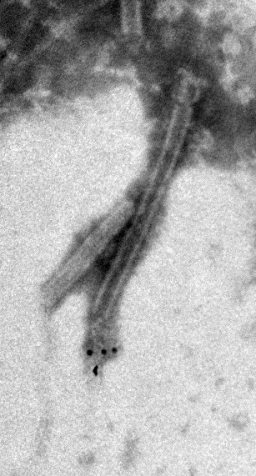
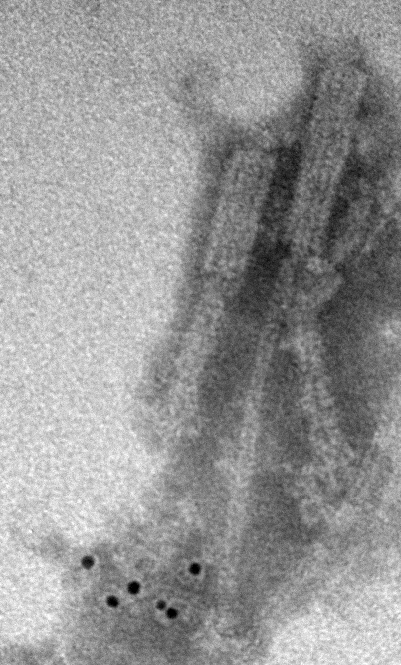
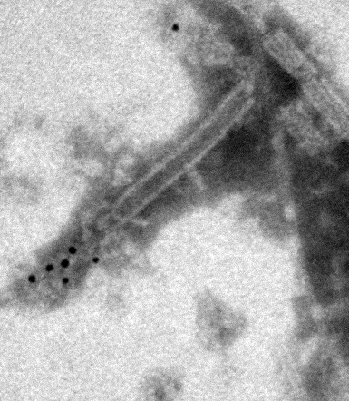
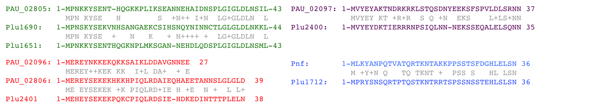
Immunogold labelling shows payloads with conserved N-termini delivered by the syringes.

Slide 8
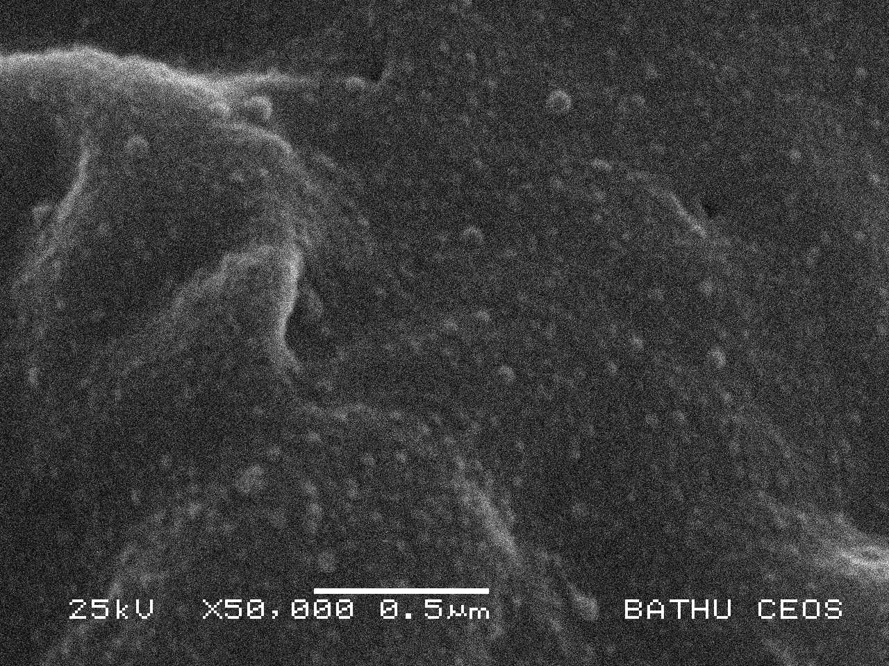
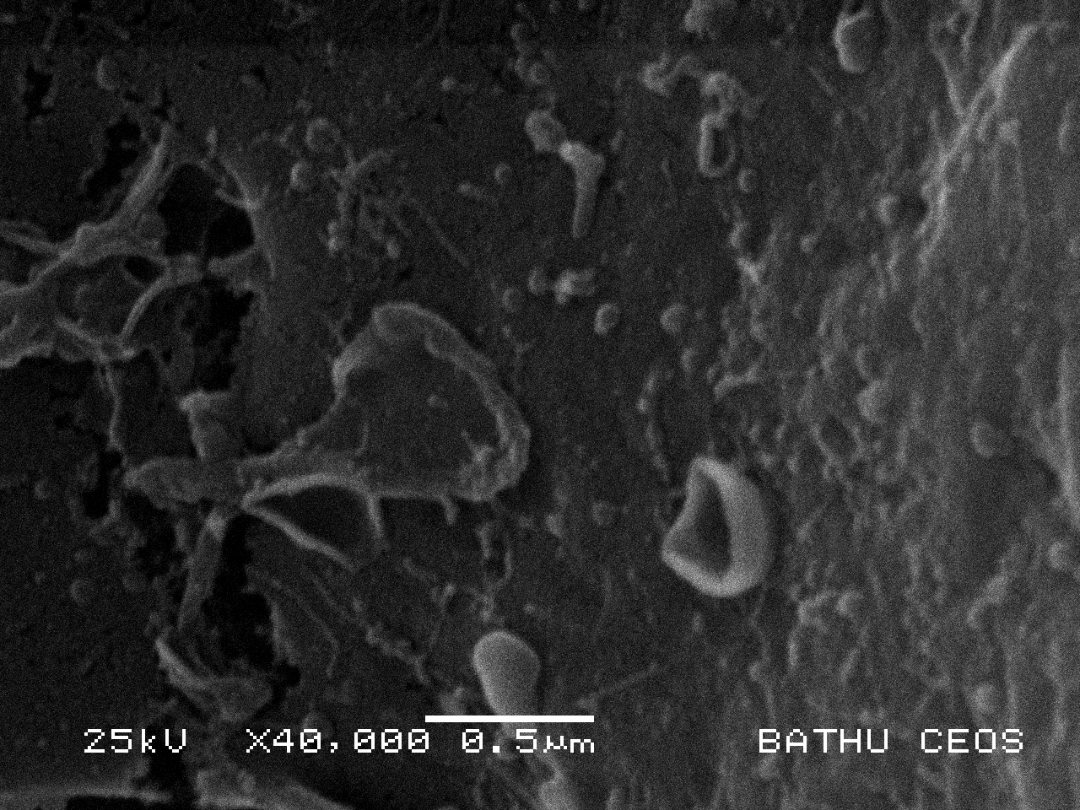
Insect hemocytes challenged with PVC^{pnf} needles

Slide 9
So what’s the plan…?
We will attempt to functionalise these needles as biotech tools using synthetic biology and recombineering. This will involve:
  Making controllable, clean expression systems.
  Changing payloads.
  Changing cell specificity (Adenovirus tail fiber modifications)
2-4
1+5
15
11
13
Payload protein
8
Variants
pvc-
1
2
3
4
5
7
8
9
11
16
pnf
10
12
13
14
15
Contractile device
Membrane
penetration
Host cell targeting
Loading pump
Payload

Slide 10
So what’s the plan…in chemistry?
The project is synthetic biology based to start with.
What ideas have we got for chemistry?
  More imaging is always useful (e.g. discharging needle)
  Loading interesting payloads (cell differentiation via growth factors?)
  Testing avoidance of immunogenicity.
  Measurements of payload dosage.
No doubt plenty more I haven’t mentioned as I am not really a chemist!
Ideas welcome!

Slide 11
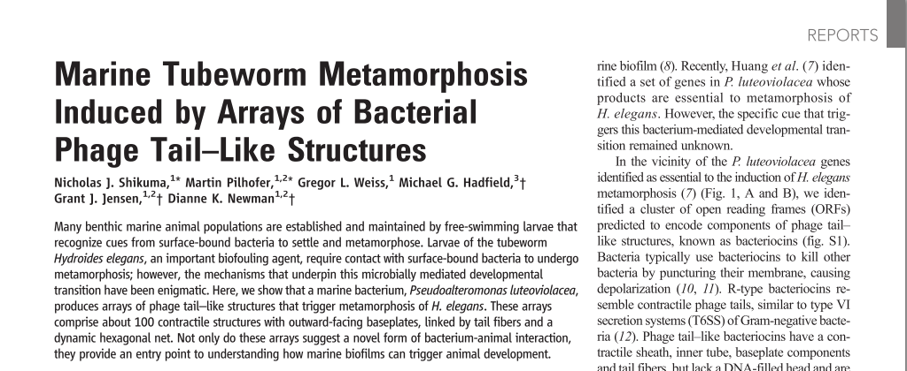
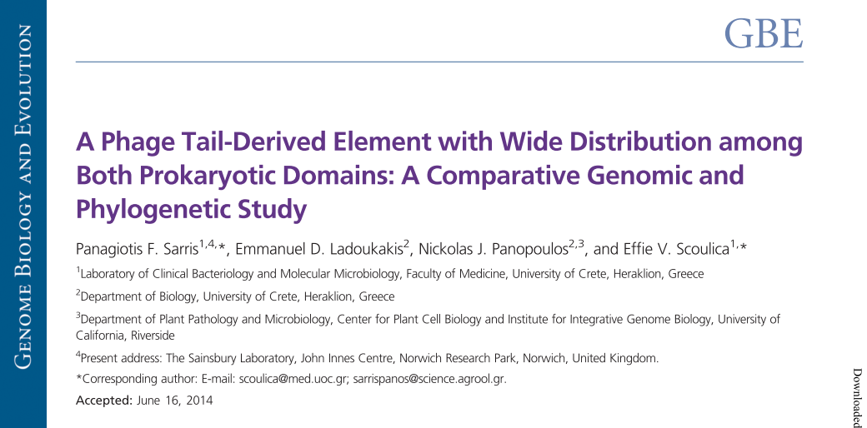
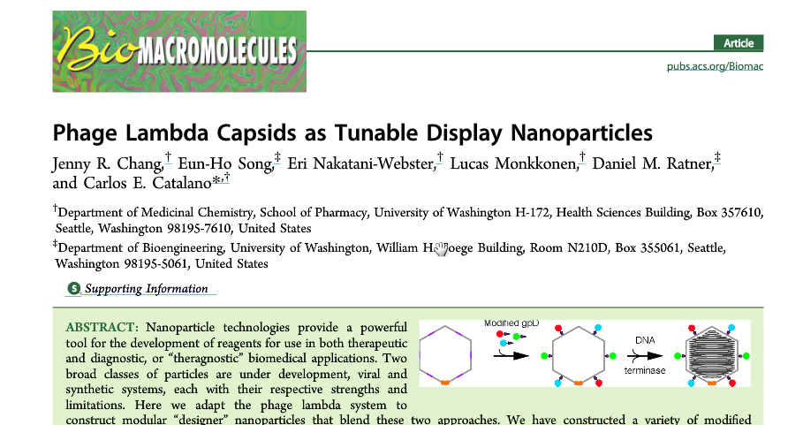
Potential impact…
A good amount of existing literature points to the ubiquity and potential applications of these structures:

Slide 12


‘Acknowledgements’
Dr. Nick Waterfield for taking me on as a PhD student.
Dr. Matt Gibson, for likewise getting on board when I appeared looking for a co-supervisor.

