Slide 1
Light Scattering:
Probing the Effect of Chain Confinement on Thermoresponsive Behaviour
Lewis Blackman
10/12/2014

Slide 2
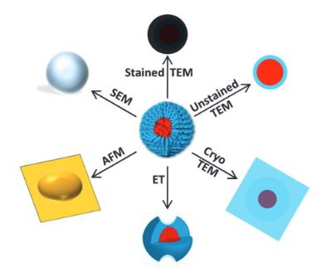
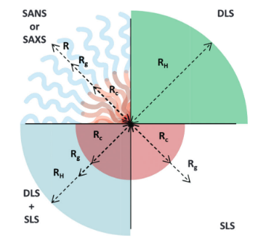
Analysis of Polymeric Self-Assemblies
Microscopy
Light Scattering

Slide 3
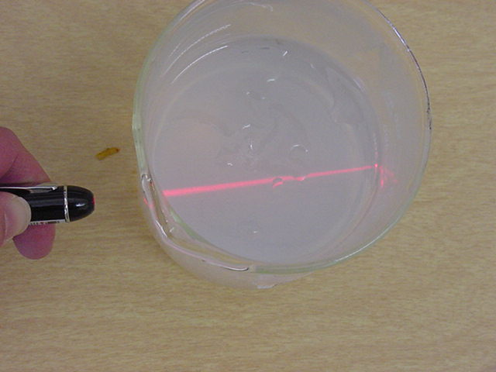
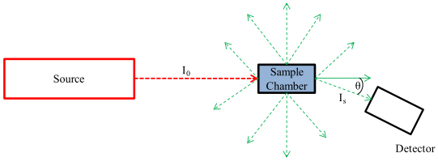
Light Scattering
λ
+ Good statistics compared with microscopy (measuring >10⁹ particles at once)
+ Analysis can be conducted in solution with minimal effect on the sample.
Data is fit to a model (multiple structures or completely unknown structures can be very problematic)

Slide 4
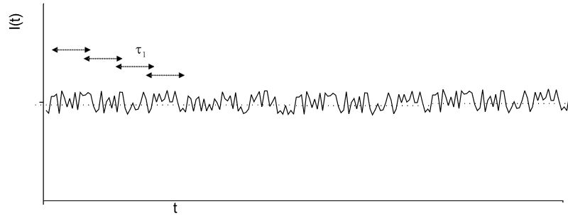
DLS vs SLS
DLS
SLS
Fluctuations in intensity with time due to Brownian Motion

Slide 5
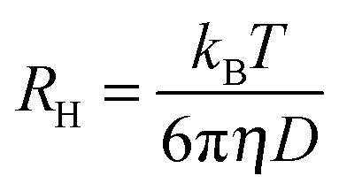
Dynamic Light Scattering
  Measure changes in scattering intensity over short (e.g. millisecond) timescale
  Changes are related to the speed at which particles move
  This can then be related to the hydrodynamic radius, R_{H}
Stokes-Einstein equation

Slide 6



Dynamic Light Scattering at Multiple Angles
Measure I(t) at multiple angles (q) and concs (c)
Each measurement gives you a correlation function g₂(q,t)
Fit correlation func. to get relaxation time
Single angle measurements do not confirm a spherical morphology, or that sample is under Brownian motion
$$g_{2}\left(q,t\right)∝e^{−\frac{t}{τ}}$$

Slide 7
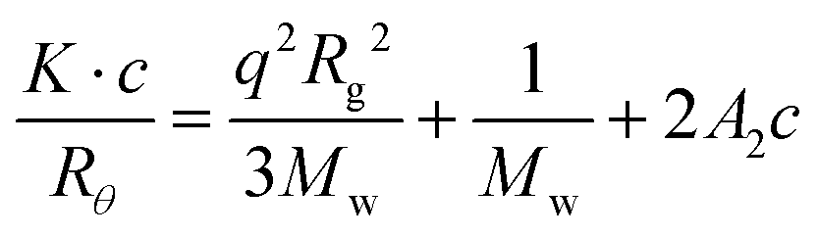
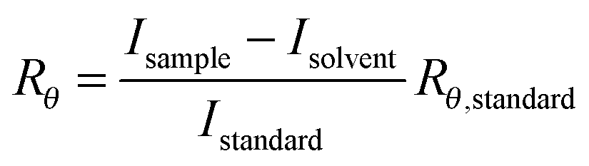
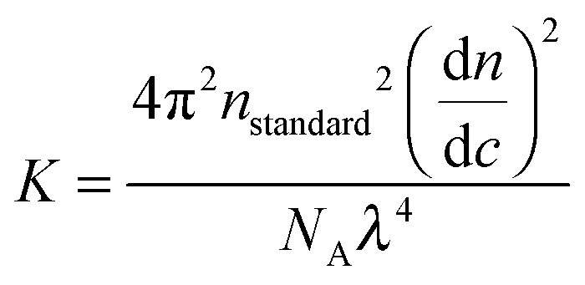
Static Light Scattering at Multiple Angles
Static light scattering (SLS)
  Measure scattering intensity over long timescales (e.g. 1000τ) and average
R_{g} from gradient
Zimm equation
Rayleigh ratio
M_{w} from intercept
Optical Constant
Zero q:
Kc/R_{θ,0} from intercept
- Only valid in the Zimm region (qR_{g} < 1)
O'Reilly, R. K. Chem. Soc. Rev. 2014, 43, 2412.

Slide 8
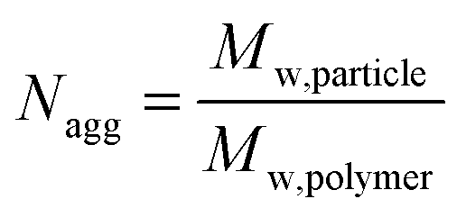
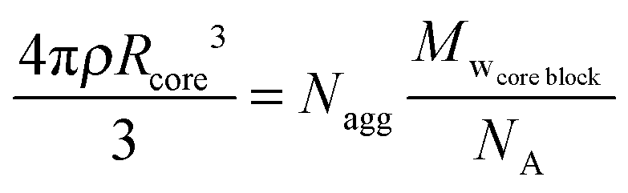
Static Light Scattering: Zimm Plot Obtains Absolute Values
Cannot be performed if R_{g}<20 nm
_{No significant gradient}
Zero q, zero c:
A₂ from gradient
M_{w} from intercept
O'Reilly, R. K. Chem. Soc. Rev. 2014, 43, 2412.

Slide 9
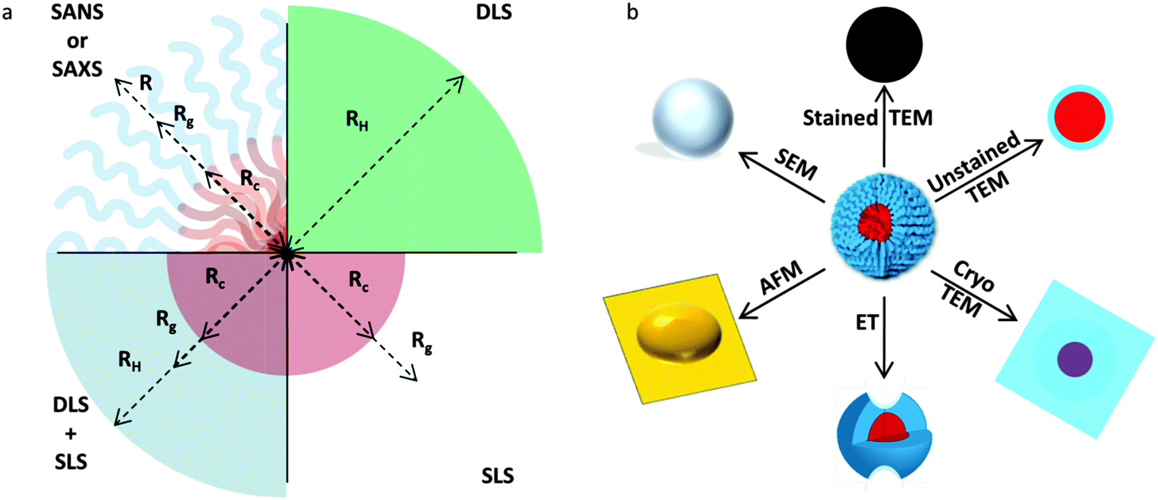

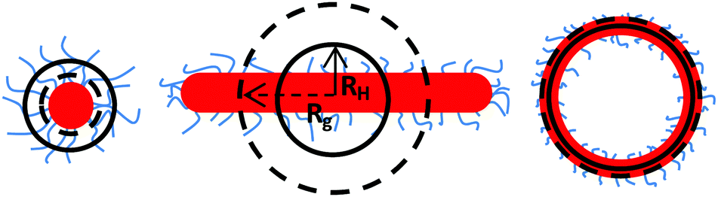
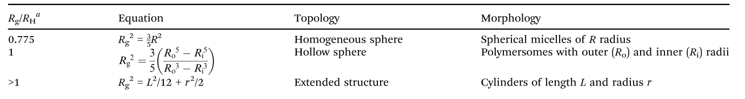
Combining SLS and DLS Data
O'Reilly, R. K. Chem. Soc. Rev. 2014, 43, 2412.

Slide 10
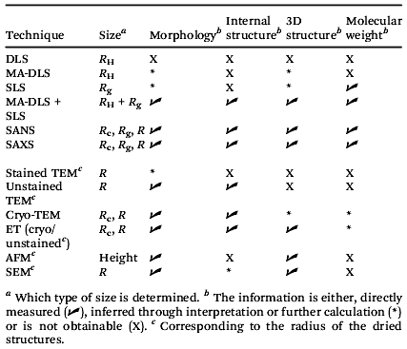
Complimentary Analysis
Covered in this talk
Light Scattering Techniques
Microscopy
O'Reilly, R. K. Chem. Soc. Rev. 2014, 43, 2412.

Slide 11
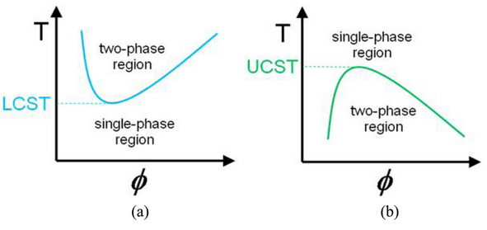
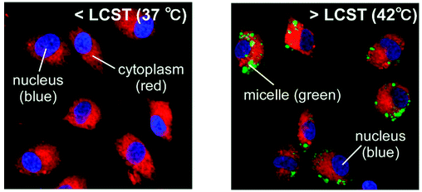
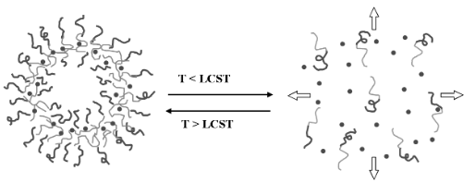
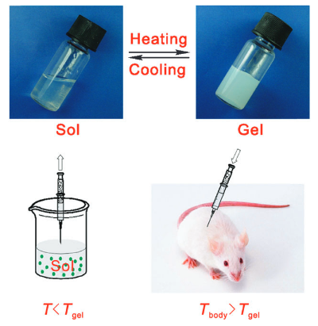
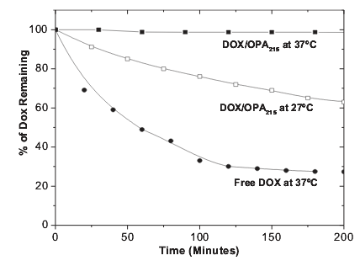
Thermoresponsive Polymers
Cellular Uptake
Controlled Drug Release
Tissue Engineering
Georgiou, T. K. Polymers 2011, 3, 1215.
Okano, T. Biomacromolecules 2009, 10, 1331.
Yang, S. Adv. Mater. 2006, 18, 2905.
Ding, J. Chem. Soc. Rev. 2008, 37, 1473.

Slide 12
Assessing the Effect of Chain Confinement on Thermoresponsive Behaviour
Hydrophilic Block
Statistical Hydrophilic/ Hydrophobic Block
Increasing hydrophobicity in core
Increasing N_{agg} but same R_{h}
O'Reilly, R. K.; Gibson, M. I. Chem. Commun. 2011, 47, 11627.

Slide 13
Controlling Chain Confinement with N_{agg}
What is the effect of confinement of chains on thermoresponsive behaviour?
Cloud Point ≠ Cloud Point?
Corona chains are thermoresponsive:
Core is not thermoresponsive:

Slide 14
Synthesis of Thermoresponsive Amphiphilic Diblock Copolymers
DP_{NIPAAm} | DP_{nBA} | DP_{DMA} | % hydrophobic in core
75 | 40 | 0 | 100%
75 | 36 | 4 | 90%
75 | 32 | 8 | 80%
75 | 28 | 12 | 70%
75 | 20 | 20 | 50%
100% nBA
90% nBA
50% nBA
70% nBA
80% nBA

Slide 15
Cloud Point Trends
Hysteresis

Slide 16
Cloud Point Trends
Highly confined chains have to overcome the effects of crowding and entanglement before dissolution is possible
Low N_{agg}
Coronal chains free to macroscopically dissolve/precipitate rapidly
High N_{agg}
Coronal chains sterically hindered so respond slowly to temperature changes
Measured
Temperature
Macroscopic
Aggregation
and Precipitation
Increasing Temperature

Slide 17
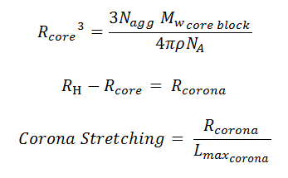
Probing LCST with light scattering: Corona Stretching
Variable Temperature DLS/SLS at Multiple Angles
Onset of true thermoresponsive behaviour
R_{H} = 18.6 nm
Data shown for
90% nBA micelles
Data shown for
90% nBA micelles

Slide 18
Probing LCST with light scattering: Corona Stretching
70% nBA micelles

Slide 19
Conclusions
Conclusions
Hysteresis of the cloud point in thermoresponsive self-assemblies may be able to be explained by kinetic and steric arguments
The onset of true molecular thermoresponsive behaviour on the nanoscale occurs at much lower temperatures than the cloud point (a macroscopic property)
The rate of corona stretching seems to be independent of N_{agg} at this chain density

Slide 20
Acknowledgements
Dan Wright
Dr. Mathew Robin
Dr. Helen Willcock
Prof. Rachel O’Reilly
Dr. Matthew Gibson
O’Reilly and Gibson Groups

