Slide 1
Simple Lectin Identification Using a ‘Chemical Tongue’
Lucienne Otten
Supervised by: Dr. Matthew Gibson

Slide 2
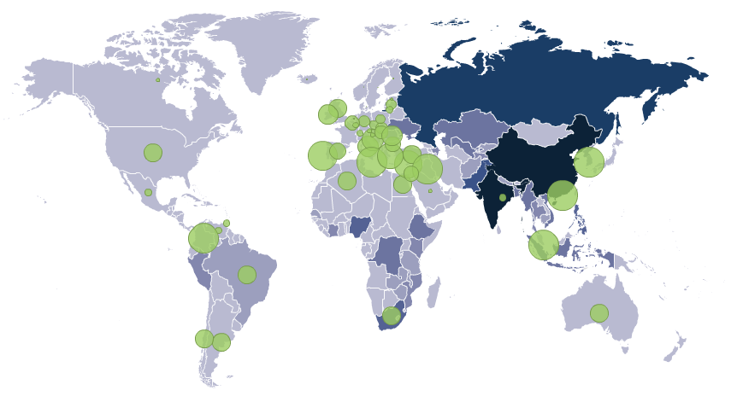


Antibiotic resistance
% of S. aureus individuals
carrying resistant strains
No. of cases of MDR-TB in thousands
CDC
Notes:
Antibiotic resistant bacteria are becoming increasingly common and result in thousands of deaths every year. The green circles on this map indicate the percentage of staphylococcus aureus infections that are resistant to antibiotics. The blue colour of each country indicates the number of multi drug resistant cases of tuberculosis, extensively and totally drug resistant forms of tuberculosis now also exist and it is thought that TB results in approximately 1.3 million deaths every year. A common problem with treatment of bacterial infections is that species identification techniques are time consuming and can be inaccurate for many bacteria responsible for hospital acquired infections which often enter viable but not culturable phases making identification based on culturing challenging. Genomic identification of species and detection of antibiotic resistant strains is also challenging and expensive especially for bacteria such as Mtb- identification of resistance of Mtb through genomic identification can indicate a strain as being susceptible to an antibiotic it then turns out to be resistant to. As such there is increasing interest in the discovery of new, facile and rapid techniques for point-of-care bacterial detection.

Slide 3
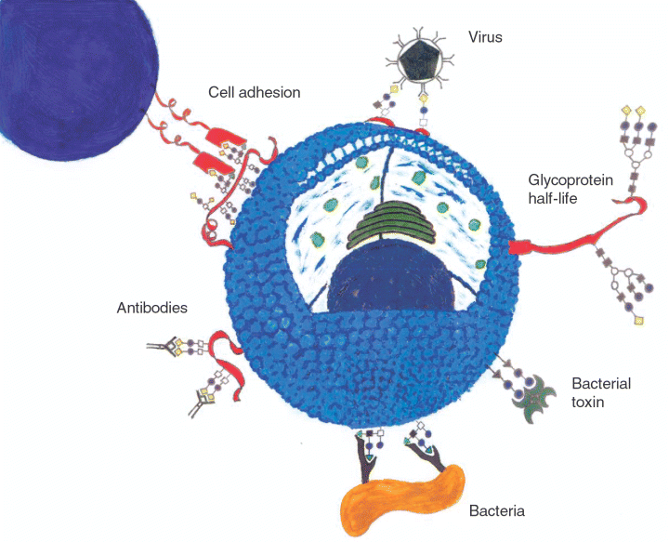
Protein-Carbohydrate Interactions
Holgersson et al. Immunol Cell Biol (2005)
Notes:
Protein Carbohydrate interactions are essential for many biological processes including cell-cell communication, fertilisation and immune system processes. Their prevalence in Nature mean they are often exploited by pathogenic organisms both through initial adhesion phases for bacteria, bacterial toxins and viruses but also as a form of mimicry to avoid the immune system. The role these interactions play in the bacterial adhesion phase make them a target for bacteria species identification as the carbohydrate specificity of bacteria can be used to identify pathogenicity of likely sites in the body where the bacteria may target.

Slide 4

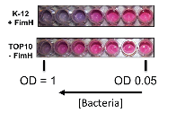
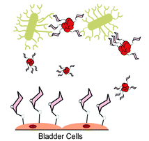
Otten, L. et al. J. Mater. Chem. B (2013)
Richards, S-.J. et al. J. Mater. Chem. B (2014)
Jones, M.W. and Otten L. et al. Chem. Sci. (2014)
Barras, A. et al. Nanoscale (2013)
Notes:
Protein Carbohydrate interactions offer an attractive target for toxin identification and examples in the literature include cholera toxin detection using gold nanoparticles, detection of FimH positive E. coli among many others. Identification and understanding of carbohydrate binding can also aid in the production of anti-adhesion therapies for both bacteria and their toxins.

Slide 5
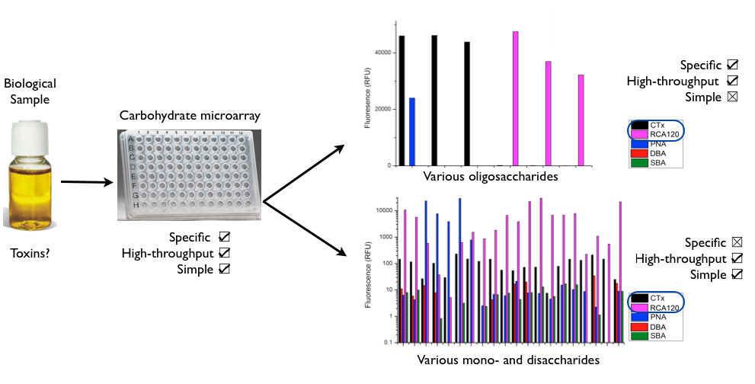
Point of care diagnostics
CFG database
Notes:
Improving point of care diagnostics of bacteria causing an infection will help to reduce the spread of antibiotic resistance by ensuring that infections are treated with the appropriate antibiotics. Using protein-carbohydrate interactions to identify bacterial species could allow a rapid method of screening to identify sources of infection. However identification of pathogenic bacteria or their toxins in biological samples can be challenging due to impurities within the sample that may also bind to carbohydrates.

Slide 6
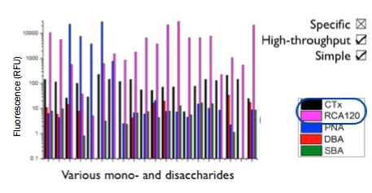
Mono-/di-saccharides
CFG database
Notes:
For example if we consider the binding profiles of 2 toxins and 3 other lectins of similar binding specificity to a variety of mono and di-saccharides it can be seen that all of these lectins bind a multitude of different surfaces with different specificities and identification of a single lectin based on its binding profile would be challenging. Whilst functionalisation of surfaces with mono and di saccharides would be cheap and high-throughput it doesn’t offer good lectin specificity and thus would offer poor resolution in identification.

Slide 7
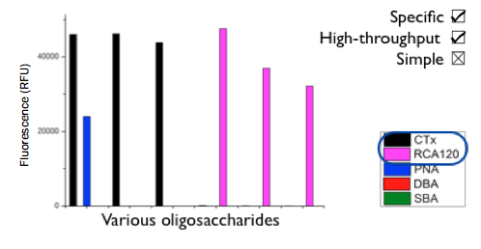
Oligosaccharides
CFG database
Notes:
In contrast to this, functionalisation with oligosaccharides can offer excellent specificity- here you can see identification of the 2 toxins (CTx and RCA120) from the other lectins. However, these compounds are often expensive due to challenging extraction, synthesis and purification methods. So the ideal technique for identification would use cheap readily available monosaccharides but with the resolution of an oligosaccharide array.

Slide 8
Surface Functionalisation
Godula, K. and Bertozzi, C.R. J. Am. Chem. Soc. (2010)
Notes:
As such commercially available hydrazide functionalised 96-well plates were further functionalised with various monosaccharides at 50 degrees for 12 hours in the presence of an aniline catalyst.

Slide 9
Binding profiles
Notes:
The surfaces chosen were glucose, galactose, mannose and a mixed surface functionalised with 50% galactose and 50% mannose. These surfaces were then incubated with 4 lectins and the unbound lectin was removed by washing. The results confirmed what was seen in the earlier CFG data- it would be challenging to identify a single lectin based on its binding profile from these results. As such a statistical technique called linear discriminant analysis was employed. This technique has been used by various research groups in classification of samples and has had success in identifying proteins even when the changes in binding seen were very small.

Slide 10
Linear Discriminant Analysis
Notes:
So before I go further into my results I will explain how LDA works by using an example data set, there are clearly two distinct classes here (click). So lets say we want to use this model to classify an unknown sample (click), if we consider the x co-ordinate (click) of this sample it could belong to either class and if we consider the y co-ordinate (click) then again it could belong to either class. The problem with this data set is that whilst it is well seperated into two groups, the groups over lap so it is hard to classify a point that falls just outside these categories (click). LDA takes this initial data set and transforms the x and y co-ordinates of every point.

Slide 11
Linear Discriminant 2
Linear Discriminant 1
Notes:
To produce a model in which your initial data is classed into groups. The difference between these groups is that any over lap in the x and the y plane is minimised as much as possible to aid in the classification of an unknown sample. So if we consider our unknown sample (click), if you consider the x position of it (click) it can clearly only belong to the green group and if you consider the y position (click) again it can clearly only belong to the green group and thus you can say with much higher confidence that the unknown point belongs to the green group. This example is an idealised example and such good seperation is uncommon in real data sets but it gives an example as to why LDA is a powerful tool in classification.

Slide 12
Binding profiles
Otten, L and Gibson, MI. Manuscript in preparation
Notes:
So if we now consider the initial binding profiles again, this would be our initial data set that is used as a training matrix to produce the linear discriminant model.

Slide 13
Linear Discriminant Analysis
DBA
PNA
RCA120
Linear Discriminant 2
SBA
Linear Discriminant 1
Otten, L and Gibson, MI. Manuscript in preparation
Notes:
The linear discriminant model produced for this data shows good resolution for all of the lectins assessed. All are well grouped and there is no overlap between the groups.

Slide 14
Identification of blind samples
Otten, L and Gibson, MI. Manuscript in preparation
Notes:
So if we now consider the binding profiles of 4 blind samples (one for each lectin), we can use the LDA model shown on the previous slide to identify the lectin responsible for the binding profiles of each of the blind samples.

Slide 15
Identification of blind samples
Sample | Predicted | Actual
U1 | RCA120 | RCA120
U2 | PNA | PNA
U3 | SBA | SBA
U4 | DBA | DBA
U4
Linear Discriminant 2
U1
U3
U2
Linear Discriminant 1
Otten, L and Gibson, MI. Manuscript in preparation
Notes:
All 4 blind samples were correctly identified using the linear discriminant model and whilst the exact points fall out of the groups on 2 occasions it should be noted that this is a 2 dimensional representation of a model with more than 2 dimensions. The fit of the model could also be improved by analysis of a larger initial sample set or by analysis of more carbohydrate surfaces. This work is only really an initial study to show validity of the technique. However the aim of this technique was to improve point of diagnostics identification of bacterial species and as such the applicability of this technique to bacterial species has to be assessed.

Slide 16
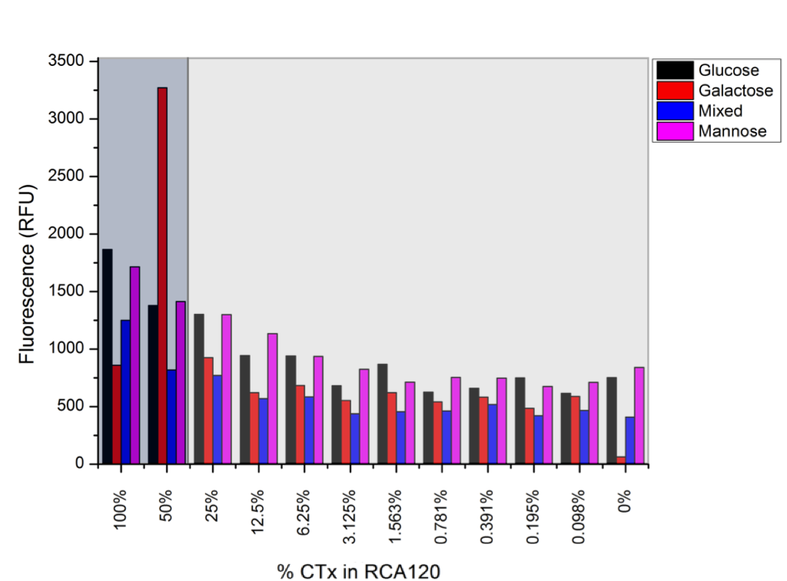
Detection of mixed samples
Otten, L and Gibson, MI. Manuscript in preparation
Notes:
This technique was further expanded to the detection of one lectin in the presence of another one as biological samples will often contain biological contaminants that may also bind the carbohydrate surface. The model generated by linear discriminant analysis was able to identify which lectin comprised the majority of the samples used. So if the sample was more than half RCA120 then the model identified RCA120 as the lectin predominantly responsible for the binding profile.

Slide 17



Bacterial labelling
R= biotin
Notes:
As such, bacterial cells of 2 strains of E. coli and a strain of M. smegmatis were labelled by addition of biotin conjugated to an NHS ester. This then reacts with primary amines found in proteins in the bacterial cell wall. Further reaction of the biotin labelled bacterial cells with avidin conjugated to FITC results in fluorescently labelled cells.

Slide 18
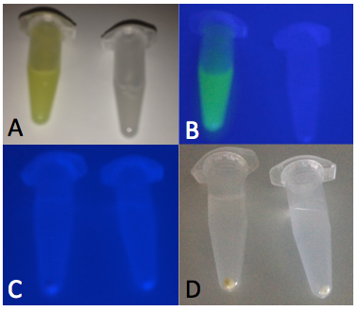
Bacterial labelling
Notes:
Normally under UV light FITC fluoresces as can be seen in the left of image B. Disappointingly this was not seen with the fluorescently labelled cells. However after the cells were spun down they were found to be visibly yellow compared to unlabelled cells and samples of fluorescently labeled cells were found to have a significantly higher fluorescence reading when compared to unlabelled samples thus indicating the success of the labelling step.

Slide 19
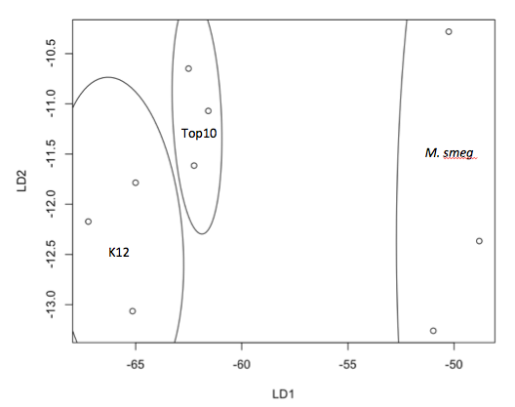
Bacterial LDA model
Top10
M. smegmatis
K12
Notes:
Addition of labelled bacterial cells to 11 different sugar surfaces was used to produce a training data set for LDA. An additional programme was used to look at all possible combinations of these sugar surfaces and it was found that all bacterial species could be correctly identified using only the fluorescence data from just 3 sugar surfaces. The displayed LDA model was produced using the binding of the bacterial cells to arabinose, dextran and galactosamine.

Slide 20
LDA Predictions
Sample | Predicted | Actual
U1 | M. smegmatis | M. smegmatis
U2 | M. smegmatis | M. smegmatis
U3 | M. smegmatis | M. smegmatis
U4 | M. smegmatis | M. smegmatis
U5 | Top10 | Top10
U6 | Top10 | Top10
U7 | Top10 | Top10
U8 | Top10 | Top10
U9 | K12 | K12
U10 | K12 | K12
U11 | K12 | K12
U12 | K12 | K12
Notes:
The LDA model produced was then used to identify the bacterial species present in unknown samples. 12 independent samples of bacteria were produced (4 replicates of each species) and the model correctly predicted the bacterial species present in each sample after analysis of binding to arabinose, dextran and galactosamine. Further analysis of the model revealed that it was capable of detecting the presence of bacteria down to an OD of 0.02 and was able to distinguish the difference between Top10 and K12 down to an OD of 0.5.
The results I have shown so far highlight the validity of the model in identification of both lectins and bacterial species in terms of their protein carbohydrate interactions. However the examples have only been on a small scale with discrimination of only 4 lectins and 3 bacterial species. As such the validity of this modelling technique for larger data sets had to be tested.

Slide 21
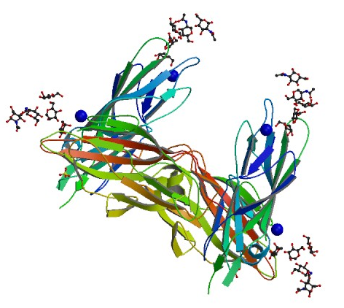
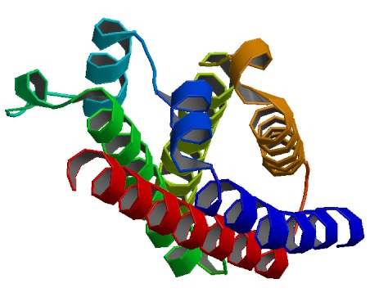
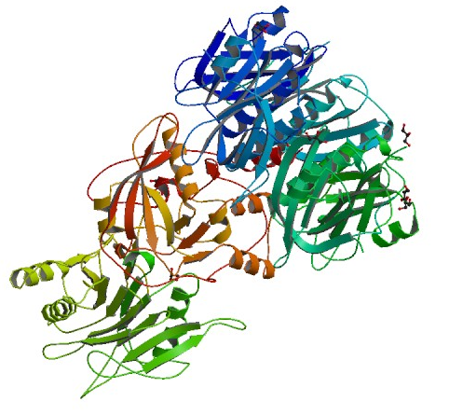
CFG data
FimH
FliD
Typhoid toxin
CFG database
Notes:
Data sets of lectin binding are freely available to be downloaded. The consortium for functional glycomics have published the results of hundreds of different lectins bound to hundreds of different carbohydrate surfaces. As such they are a perfect source to get larger numbers of data sets to trial LDA as a predictive tool on a larger scale. Binding data for 21 different bacterial lectins was downloaded from the CFG database. The selected lectins included everything from well characterised surface proteins to putative carbohydrate binding toxins from a variety of species including E. coli, C. difficile, M. tuberculosis and Salmonella typhi (the bacteria responsible for typhoid).
Initially I used just 5 monosaccharides to generate an LDA model, unsurprisingly this yielded a very poor identification rate of 50%. As such I increased the number to include all of the monosaccharides in the CFG database.

Slide 22
So why not use more sugars?
α-glucose, α-galactosamine, α-mannose, fucose, β-galactose, β-glucose and β-galactosamine
CFG database
Notes:
Including binding to more sugar surfaces does increase the predictive power of the LDA model but only up to a certain point, beyond which there is no improvement and generally the predictive power of the model actually gets worse. In the case of the 21 bacterial lectins I examined- the optimum number of monosaccharides required to achieve the best predictive power of the model was found to be 7, addition of more sugars after this point just decreased the predictive power. The 7 monosaccharides required had to be 7 specific monosaccharides in this case these ones. For every set of lectins you decide to discriminate the model you produce has to be tailored to discriminate between them, just adding more and more sugars might improve the predictive power of the model but the overall efficiency of the system is being reduced- for every set of lectins there is an optimum set of sugars- binding to which will allow the best discrimination between the lectins.

Slide 23
Conclusions
Linear discriminant analysis has been shown to aid in the identification of blind lectin samples
It has also shown to be applicable to identification of bacterial species
Analysis of larger data sets highlighted the need for identifying ‘optimum surfaces’.
Notes:
Statistical technique was utilised to separate binding profiles and identify lectins responsible for binding in blind samples and even in mixed samples of lectins. This technique used only monosaccharides to produce binding profiles and achieved an excellent resolution between lectins.

Slide 24
Future work
Extend the bacterial LDA analysis to more species of bacteria
Extend the LDA analysis of the CFG database to beyond monosaccharides.

Slide 25






Acknowledgements
Gibson Group Members
Gemma-Louise Davies - Daniel Mitchell
Yunhua Chen - Richard Lowery
Catherine Cooper - Ben Martyn
Robert Deller - Lewis Blackman
Caroline Biggs - Sang-Ho Won
Daniel Phillips - Laura Wilkins
Tom Congdon - Robert Keogh
Sarah-Jane Richards
Matthew Gibson

