Slide 1
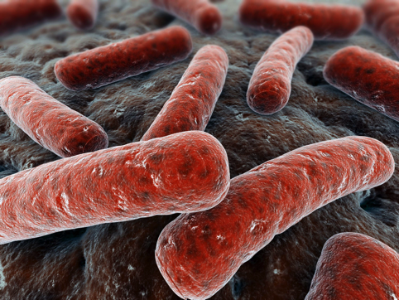
Label-Free Uptake: Keeping an Ion Carbohydrates in Mycobacteria
Richard Lowery
Supervisor: Dr Elizabeth Fullam
Co-Supervisor: Dr Matthew Gibson

Slide 2
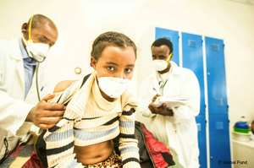



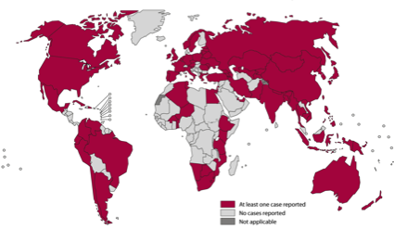

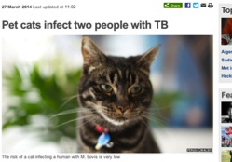
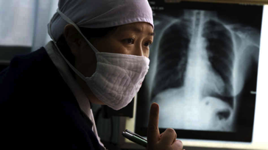
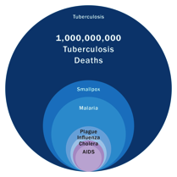
Understanding Nutrient Uptake in Mycobacteria
Notes:
Bullet points for this slide are along the lines of
TB global health problem
TB nasty disease – airborne infection so difficult to prevent spread
One third of world’s population infected
9 million new cases each year – 2 million deaths.
TB bigger killer than almost anything else
Drugs available but 6-9 months therapy – nasty side effects – patients stop taking drugs so now have MDR, XDR and TDR – very difficult and costly to treat – in some cases no drugs at all left so can’t be treated
TB difficult to treat complex, waxy cell wall.
TB survives intracellularly – but nutrients it uses to survive largely unknown. We want to figure out the nutrients it uses to survive and develop probes and tools for analysing this.

Slide 3

The tuberculosis timebomb
Estimated up to ⅓ of the worlds population infected with M. tuberculosis
Pulmonary TB treatment - four antibiotics pyrazinamide, ethambutol, isoniazid and rifampicin – every day for two months, continue isoniazid and rifampicin for a further two months
Prolonged treatment have lead to rise of MDR, XDR and TDR strains
[1] WHO -http://www.who.int/mediacentre/factsheets/fs107/en/index.html
Notes:
BCG – live attenuated bovine TB
ADD IN FACTS FROM EMAILS

Slide 4
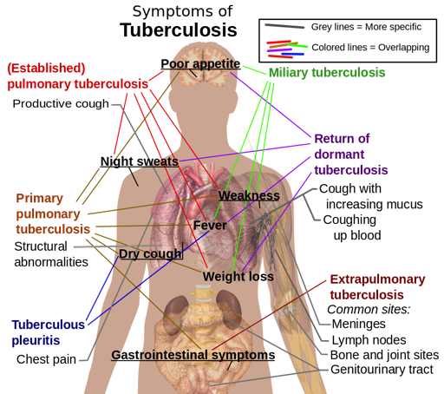
Tuberculosis
Mycobacterium tuberculosis is the causative agent of the disease Tuberculosis (TB)
Invade and replicate within endosomes of alveolar macrophages
Symptoms develop slowly and can manifest for decades as latent TB
Aim: To develop effective techniques for tracking carbohydrate uptake and metabolism to try and identify new drug targets
[1] WHO -http://www.who.int/mediacentre/factsheets/fs107/en/index.html
Notes:
TB infection begins when the mycobacteria reach the pulmonary alveoli, where they invade and replicate within endosomes of alveolar macrophages.[1][47] The primary site of infection in the lungs, Symptoms depend on where the infection occurs/spreads - two main classes PULMONARY and EXTRAPULMONARY (people with weak immune systems e.g. HIV, usually from latent TB) - Lymph nodes, bones/joints, gastrointestinal, genitourinary or cns.
Most people can fight this infection but can develop…TB is a granulomatous inflammatory disease (i.e granulomas form allowing lymphocytes to ....the infected macrophages) - --> latent TB
Tissue damage in equilibrium with healing - if breaks down - active TB, granulomas break down and are now infectious
Very little is know about the nutrient uptake of tuberculosis in this intracellular environment (carbs know as main carbon source at initial stages of infection)
1% of population infected each year (going to grow)
chance of developing cronic tb from latent - 10% over a lifetime
with HIV this is a chance of 10% a year
emergence of multi-drug-resistant (MDR), extensively drug-resistant (XDR) and totally drug resistant strains (TDR)
✔

Slide 5
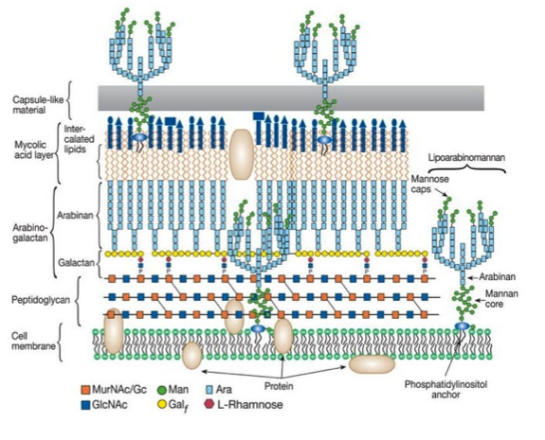
Mycobacteria
Mycobacterium are a genus of Actinobacteria that include a number of known pathogenic species including M. leprae (Leprosy) and M. tuberculosis (tuberculosis)
Complex access to nutrients because of highly selective transport of solutes
Mycolic acid-arabinogalactan-peptidoglycan complex
Notes:
The cell envelope of Myco is waxy and hydrophobic and made up of three major components: a plasma membrane, a covalently linked mycolic acid, arabinogalactan and peptidoglycan complex (MAPc), and a polysaccharide-rich capsule-like material.
The presence of an outer membrane (OM) and a secondary lipid inner membrane (IM) barrier in mycobacteria, with a complex array of transporters allow the genus to selectively limit transport of solutes from the extracellular environment to the cytoplasm ².This barrier makes understanding its nutrient uptake complex and contributes to the lengthy treatment required to eliminate the pathogen as drug uptake is difficult.
✔
M. tuberculosis has a complex, unique cell wall that is rich is diverse carbohydrates and lipids that protects the bacterium from environmental stresses and chemotherapeutic agents. Despite the global threat of TB there are limited studies to investigate the nutrient requirements of this organism.

Slide 6
Notes:
How do nutrients get taken up by Mtb and how does Mtb transport them – what are these nutrients as macrophages environment nutrient source limited

Slide 7
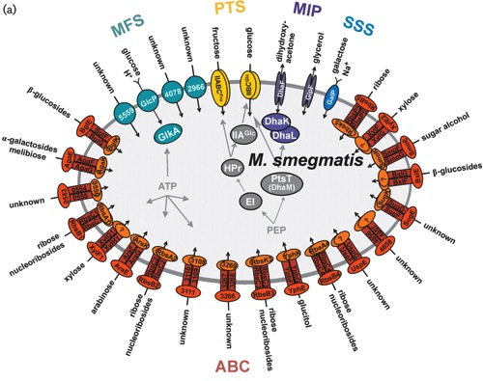
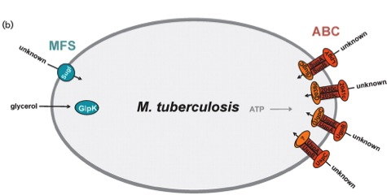


Transporters for uptake of carbohydrates across the inner membrane of (a) M. smegmatis and (b) M. tuberculosis.
Trehalose
GPC
Nutrient acquisition by mycobacteria. Microbiology. 2008 Mar ;154(Pt 3):679-92. doi: 10.1099/mic.0.2007/012872-0.
Notes:
Detecting carbohydrates, which lack detectable moieties (e.g. chromophores or fluorophores) is a challenge
For our experiments we use the model organism M.smeg, because it fast growing, non-pathogenic (has a doubling time of 2-3 hours while M.tub has a doubling time of 24hrs), its genome is similar (how?) and is a good basis for developing techniques in a class 1 environment before taking it into a class 2/3
Titgemeyer et al through bioinformatics analysis of both organisms⁵. This analysis found in M. smegmatis 28 putative carbohydrate transport proteins in its IM have been proposed consisting of several permeases belong to the sodium solute superfamily, major intrinsic protein family, major facilitator superfamily and phosphotransferase system transporters
Though ABC transporters between the species shared 62% of their amino acid sequence with one another, the systems displayed low homology (<25%) with transporters outside of the genus making prediction of substrates unobtainable⁶
recently Kalscheuer et al 2010 demonstrated the specificity of the LpqY-SugA-SugB-SugC ABC transporter for the non-mammalian dissacharide trehalose
Recent studies have implicated a role for putative sugar-transporters in M. tuberculosis to have an essential role during intracellular infection.^{[2]} Despite the obvious importance in gaining a detailed understanding of how M. tuberculosis processes carbohydrates, there exist very few detailed studies. This is due to the inherent lack of chromophore/fluorophore moieties on the sugars that significantly limits the analytic tools available to probe these essential biological processes in vitro and in vivo.
Glycero-
phosphocholine

Slide 8
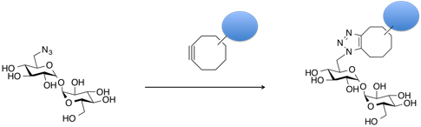
Probing Carbohydrate Uptake
Fluorescent labelled – complex synthesis, large size
Radiolabelled – expensive / not widely available (commercially)
Azido-modified carbohydrates
Notes:
FLUORESCENT (NEXT SLIDE)
Label-free
PAPER
Probes for such studies to date have been limited to radiolabelled,^{[2]} fluorescently modified,^{[3]} or azido-modified carbohydrates.^{[4]} Radiolabelled ¹⁴C/³H carbohydrates are expensive and non-standard carbohydrates are not readily available from commercial sources nor easy to synthesise. Fluorescently labelled carbohydrates have been used for such studies.^{[3]} However, their synthesis is often non-trivial and, more importantly, the large size of the fluorophores gives significant changes to the molecule
Extrapolating the function of the native carbohydrate from such derivatives is challenging, and non-specific uptake due to the lipophilic character of most dyes cannot be ruled out. The use of azido-sugars to metabolically label cells followed by Cu-free click,^{[5]} or Staudinger-ligation^{[6]} chemistry has been successfully undertaken.^{[7]} However, this method requires chemical synthesis of the desired azido-sugar, and pre-requisite knowledge about the intracellular processing of the sugar to ensure the structural modification will not influence its metabolism, relative to the native carbohydrate.^{[8]}

Slide 9
Probing Carbohydrate Uptake
Notes:
However, their synthesis is often non-trivial and, more importantly, the large size of the fluorophores gives significant changes to the molecule
fluorescent probes is structurally unsound due to the low molecular weight of carbohydrates and can cause nonselective oxidation of carbohydrates and peripherally associated glycolipids¹⁹ affecting investigated attributes
Extrapolating the function of the native carbohydrate from such derivatives is challenging
Detecting carbohydrates, which lack detectable moieties (e.g. chromophores or fluorophores) is a challenge. The use of fluorescent probes is structurally unsound due to the low molecular weight of carbohydrates and can cause nonselective oxidation of carbohydrates and peripherally associated glycolipids¹⁹ affecting investigated attributes.
Carbohydrates lack detectable moieties
Fluorescent probes structurally unsound
¹⁴C is the gold standard technique
Fluoresent probes may sterically hinder the tagged molecules(carbs) ALSO cause nonselective oxidation of the original species
No decay (lifetime)
We want to investigate a range of carbohydrates, some of which may need to be repeated...

Slide 10
Probing Carbohydrate Uptake
Fluorescent labelled – complex synthesis, large size
Radiolabelled – expensive / not widely available
Azido-modified carbohydrates
Notes:
RADIO - NOT Commercially AVALIBLE
AZIDO (metabolically label cells followed by Cu-free click,^{[5]} or Staudinger-ligation) - pre-requisite knowledge about the intracellular processing of the sugar to ensure the structural modification will not influence its metabolism, relative to the native carbohydrat
alternative biochemically passive labelling strategies are required.
Label-free - alternative biochemically passive labelling strategies are required
PAPER
Probes for such studies to date have been limited to radiolabelled,^{[2]} fluorescently modified,^{[3]} or azido-modified carbohydrates.^{[4]} Radiolabelled ¹⁴C/³H carbohydrates are expensive and non-standard carbohydrates are not readily available from commercial sources nor easy to synthesise. Fluorescently labelled carbohydrates have been used for such studies.^{[3]} However, their synthesis is often non-trivial and, more importantly, the large size of the fluorophores gives significant changes to the molecule
Extrapolating the function of the native carbohydrate from such derivatives is challenging, and non-specific uptake due to the lipophilic character of most dyes cannot be ruled out. The use of azido-sugars to metabolically label cells followed by Cu-free click,^{[5]} or Staudinger-ligation^{[6]} chemistry has been successfully undertaken.^{[7]} However, this method requires chemical synthesis of the desired azido-sugar, and pre-requisite knowledge about the intracellular processing of the sugar to ensure the structural modification will not influence its metabolism, relative to the native carbohydrate.^{[8]}

Slide 11
Deuterium labeled carbohydrates
Deuterium (D or ²H) stable isotope of hydrogen (one proton and one neutron)
Change in mass (Mass spectrometry)
Carbohydrate uptake in mycobacteria
Carbohydrate | Structure | M (g/mol) | Uptake in M.smegmatis
Trehalose | Disaccharide | 342.3 | +ve
Glucose | Monosaccharide | 180.2 | +ve
Mannose | Monosaccharide | 180.2 | +ve
Galactose | Monosaccharide | 180.1 | ?
Arabinose | Monosaccharide | 150.1 | +ve
Notes:
Deuterium is a stable, safe and readily available isotope of hydrogen that has near identical chemical reactivity, and has a
Its low natural abundance in water of < 0.02%, essential for any analytical method

Slide 12
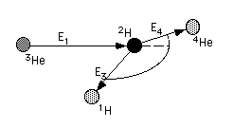
Ion Beam Analysis
An incoming ion beam enters through the surface of the sample and loses energy while penetrating. In a certain depth the incoming particle can undergo a nuclear reaction with atoms of the sample. The energy of the reaction products is a function of the energy of the incoming ions.
Notes:
probe the composition and obtain elemental depth profiles
(mega-electron volt) MeV ion beam analysis techniques
NUCLEAR REACTION ANALYSIS
Ion beam that interacts with particles in the sample and the energy detected is a function this interaction
Produces a nucleus in an excited state which immediately decays, emitting ionizing radiation which can be detected
So the ion beam analysis allows us to detect differences in ion content of a sample, so we can determine the content of deuterium to the hydrogen content
We therefore reasoned that ³He Nuclear Reaction Analysis (NRA), which is uniquely sensitive towards the detection of deuterium could be employed to monitor the uptake of deuterated nutrients into bacteria.^{[9]}. NRA is one of a family of MeV ion beam analysis techniques often used for quantitative materials analysis and depth profiling^{[10-11]}. The ²H(³He,p)a nuclear reaction is well established in materials analysis to quantify variation in ²H content with depth.^{[12-13]} This method is also appealing as data acquisition is rapid (typically less than 10 minutes) and does not rely on external calibration.

Slide 13
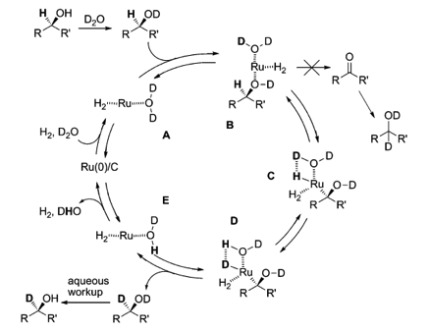
Method for regio-, chemo- and stereoselective deuterium labeling
of sugars based on ruthenium-catalyzed C-H bond activation, Sawama et al 2010
Notes:
To obtain deuterated carbohydrates, the regio-selective method of Sawama et al. was employed.
Was necessary to use their anomeric methyl ethers, since previous studies have shown that non-methylated protected sugars undergo decomposition under these reaction conditions with Ru/C-catalysed hydrogenation
METHOD ONLY DEUTERATED THOSE H ADJACENT FROM THE HYDROXYL GROUP
The ruthinuium catalyst acts as a platform for the H-D exchange
hydroxyl groups act as a directing group (B)
this allows an oxidative addition at the CH bond adjacent to these directing groups(C)
thus allowing H-D exchange, reductive elimination to form the C-D bond required, (D)
this is followed by aqueos workup that removes the acidic deuterium (Aqu)
possibly due to the hemi-acetal moiety of non-reduced sugars (makes them quite unstable)
The ruthinuium catalyst acts as a platform for the H-D exchnage, hydroxyl groups act as a directing group (B) , this allows an oxidative addition at the CH bond adjacent to these (C)directing groups, D+ → thus allowing H-D exchange, reductive elimination to form the C-D bond required, this is followed by aqueos workup that removes the acidic deuterium
(deuterated sugars preferential because CD bonds are more thermodynamically stable due to the H-D isotope effect, and D2O excess enhances this exchange reaction) - Isotopic rate changes are most pronounced when the relative mass change is greatest, since the effect is related to vibrational frequencies of the affected bonds. For instance, changing a hydrogen atom (H) to its isotope deuterium (D) represents a 100% increase in mass, whereas in replacing carbon-12 with carbon-13, the mass increases by only 8 percent. The rate of a reaction involving a C–H bond is typically 6–10 times faster than the corresponding C–D bond, whereas a 12C reaction is only 4 percent faster than the corresponding 13C reaction (even though, in both cases, the isotope is one atomic mass unit heavier).
However, the a-d-glucose was completely
decomposed presumably due to the hydrolysis of the
hemi-acetal moiety of glucose and the subsequent Ru/C-catalyzed
hydrogenation.
Meanwhile, a-d-methylglucoside (1a) bearing an acetal
moiety, which should be more stable towards the hydrolysis,
underwent the H–D exchange reaction

Slide 14
Characterisation
Notes:
Estimate degree of deuteration
Change in Spin quantum number, I. ¹H,I=1/2 while ²H, I=1 (NMR)

Slide 16

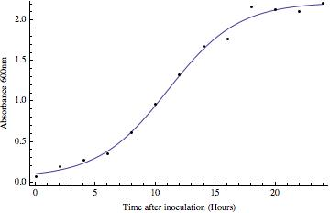
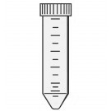



Grow M. smegmatis to mid-exponential phase in TSB (+0.05% tween), OD₆₀₀ = 1 (1.23 x 10⁸ cfu)
Centrifuge and wash with PBS
Re-suspend in sterile PBS
Aliquot
950ul cell suspension + 50ul (1M) carbohydrate (PBS) at given times
3hr
3hr
3hr
3hr
Shaken at 800rpm at 37ºC, then washed twice with sterile PBS
Freeze dried for Analysis

Slide 17
¹H⁺
¹H⁺
¹H⁺
³He⁺
⁴He
Notes:
Samples were irradiated with the ³He⁺ ion beam and protons resulting from the nuclear reaction were detected at 170°.
The low natural abundance of ²H, along with the high energy of the detection of the emitted protons meant that this gave extremely good signal to noise ratio, and is ideal to detect low levels of deuterated carbohydrates.
Encouragingly, the ion beam analysis detected the deuterium signal of the ²H labelled M. smegmatis heat-killed cells, compared to zero signal for cell-only M. smegmatis control.
This method is also appealing as data acquisition is rapid (typically less than 10 minutes) and does not rely on external calibration.

Slide 18
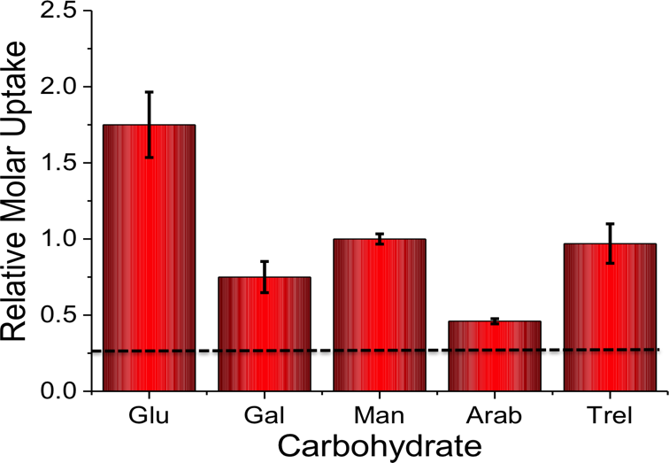
Notes:
acquisition using NRA and analysis of the data WE WERE ABLE TO CALCULATE THE RELATIVE MOLAR UPTAKE OF EACH ²H-CARBOHYDRATE as shown in Figure 3. THIS CALCULATION INCLUDED A CORRECTION FOR THE TOTAL LEVEL OF DEUTERATION PER-SUGAR (DETERMINED FROM TABLE 1) TO ENSURE THAT A DIRECT COMPARISON OF UPTAKE OF EACH ²H CARBOHYDRATE CAN BE MADE.
In M. smegmatis there are a number of known uptake mechanisms for glucose
Mannose and trehalose have both been shown to act as a sole carbon source for mycobacteria.
The uptake of galactose has been shown in M. smegmatis but cannot serve as a sole carbon source.
D-arabinose is known to be a major sugar in the cell wall polysaccharides of mycobacterial species⁶¹. D-arabinose is not synthesised by mammalian cells and is thought to be synthesised in M. smegmatis from D-ribose. However, Arabinose has been predicted to be transported in M. smegmatis by an ABC permease, but has yet to be shown to be demonstrated by the cyanobacteria
Detail – see report
(say will differ)

Slide 19
Relative Uptake in Mycobacteria
Comparable to those utilising either ¹⁴C carbohydrates, fluorescently labelled carbohydrates or azido-modified carbohydrates
Results agree with previous studies where mycobacteria were grown on carbohydrates as the sole carbon source
Care must be taken; uptake of carbohydrates is not always correlated with metabolic activity
Notes:
The results obtained from the NRA ²H-carbohydrate uptake assay are COMPARABLE TO THOSE UTILISING EITHER ¹⁴C CARBOHYDRATES, FLUORESCENTLY LABELLED CARBOHYDRATES OR AZIDO-MODIFIED CARBOHYDRATES.^{[2-4]} Additionly our results agree with previous studies where mycobacteria were grown on carbohydrates as the sole carbon source.^{[15-16]}
That been said, it has been demonstrated that uptake varies depending on the precise experimental conditions and uptake of carbohydrates is not always correlated with metabolic activity

Slide 20
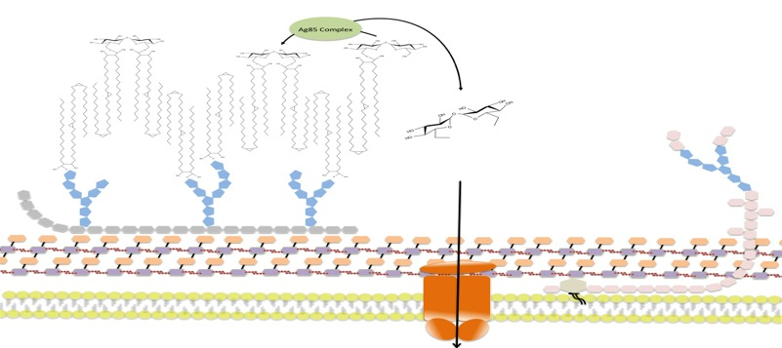
Trehalose
Capsule
TDM
TMM
Trehalose
TMM
Arabino-galactan
Peptidoglycan
?
Cell
Membrane
To the
capsule
GlgB
LpqY-SugABC
TreXYZ pathway
TMM
Trehalose
α-1,4-Glucan
GlgE
TreS
UDP-glucose
Pep2
Maltose-1-Phosphate
Maltose
Glucose 6-phosphate
Notes:
REQUIRED FOR CELL STABILITY AND VIRULENCE (shown in transporter in mice-knock out)
UNIQUE SYNTHESIS
RECYCLING FROM CELL WALL etc (ABC transporter)
Trehalose forms part of the mycobacterial outer cell wall as mono-(TMM -trehalosemonomycolate ) or di- (TDM) mycolates and has been shown to contribute to the stability of the OM⁹. The action of the extracellular proteins Ag85A, Ag85B and Ag85C, synthesizes these glycolipids¹⁰ TDM also know as the cord factor has been shown to act as the main virulence factor in Mtb infection.^{11,12} Trehalose therefore has become a key focus of carbohydrate biochemistry in Mtb as a potential for identification of new drug targets.
Recently, it has been shown that trehalose is recycled from the cell wall of M. tuberculosis and is taken up by an ABC-transporter that is essential for the virulence of this pathogen.^{[2]} In vitro studies have demonstrated that trehalose can serve as a sole carbon source for mycobacteria and that it is an essential precursor for cell wall metabolites.^{[17]} Intriguingly, trehalose uptake has been shown to be tolerant to a range of chemically altered trehalose analogues indicating its potential role as a new drug and biosensing target.^{[3]} Given the important role of trehalose in mycobacteria we sampled uptake of ²H trehalose by M. smegmatis from 0-60 mins.

Slide 21

Grow M. smegmatis to mid-exponential phase in TSB (+0.05% tween), OD₆₀₀ = 1 (1.23 x 10⁸ cfu)
Centrifuge and wash with PBS
Re-suspend in sterile PBS
Aliquot
950ul cell suspension + 50ul (1M) carbohydrate (PBS) at given times
5min
10min
30min
60min
180min
Shaken at 800rpm at 37ºC, then washed twice with sterile PBS
Freeze dried for Analysis
Notes:
OVER TIME

Slide 22
Ion beam results
Notes:
Crucially, these results demonstrate that this NRA method CAN BE USED FOR MONITORING DYNAMIC UPTAKE PROCESSES, especially with relatively slow growing organisms such as mycobacteria. A key feature to emphasise is the novel use of ion-beam analysis to evaluate biological uptake processes utilising deuterated probes that are structurally more analogous to the ‘native’ sugars, than chemically modified probes, such as FITC-modified-, azido-modified-sugars and are easier and cheaper to handle than radio-labelled carbohydrates

Slide 23
Conclusions
Utalising Sawama et al method for deuteration, we created a range of ²H-carbohydrates can be generated in a scalable low cost manner
To our knowledge this is the first use of such analysis in the discovery of small molecule uptake in bacteria and is comparable to data obtained by other methods
Unusual uptake of trehalose into mycobacteria was observed, which is of particularly importance in the development of new treatments and diagnostics for pathogenic M. Tuberculosis
Cytosolic and cell wall distrabution
Notes:
In summary, we have taken advantage of the ability to deuterate carbohydrates in a facile, regio-selective scalable manner enabling rapid access to a wide-range of carbohydrates that has allowed us to determine the relative uptake of a panel of ²H-carbohydrates by M. smegmatis. This ²H-carbohydrate uptake was probed experimentally and analysed by making use of the ³He nuclear reaction analysis using an ion-beam. To our knowledge this is the first use of such analysis in the discovery of small molecule uptake in bacteria and is comparable to data obtained by other methods. Using this method, the unusual uptake of trehalose into mycobacteria is observed, which is of particularly importance in the development of new treatments and diagnostics for pathogenic mycobacteria such as M. tuberculosis and for probing carbohydrate uptake into a range of biotechnologically, and medically, relevant organisms

Slide 24



Acknowledgements
Thank you all for listening!
Supervisors:
Elizabeth Fullam
Matthew Gibson
Collaborators:
Adrian Chaplin (Warwick)
Ivan Prokes (Warwick)
Richard Thompson (Durham)
Gibson group

