Slide 1


Glycosylated Nanomaterials: Detection of Bacteria and Toxins
Sarah-Jane Richards &
Matthew I. Gibson
Department of Chemistry, University of Warwick, UK
S-J.Richards@warwick.ac.uk
www.warwick.ac.uk/go/gibsongroup
COST IBCARB Spring Training School – Friday 10th April

Slide 2
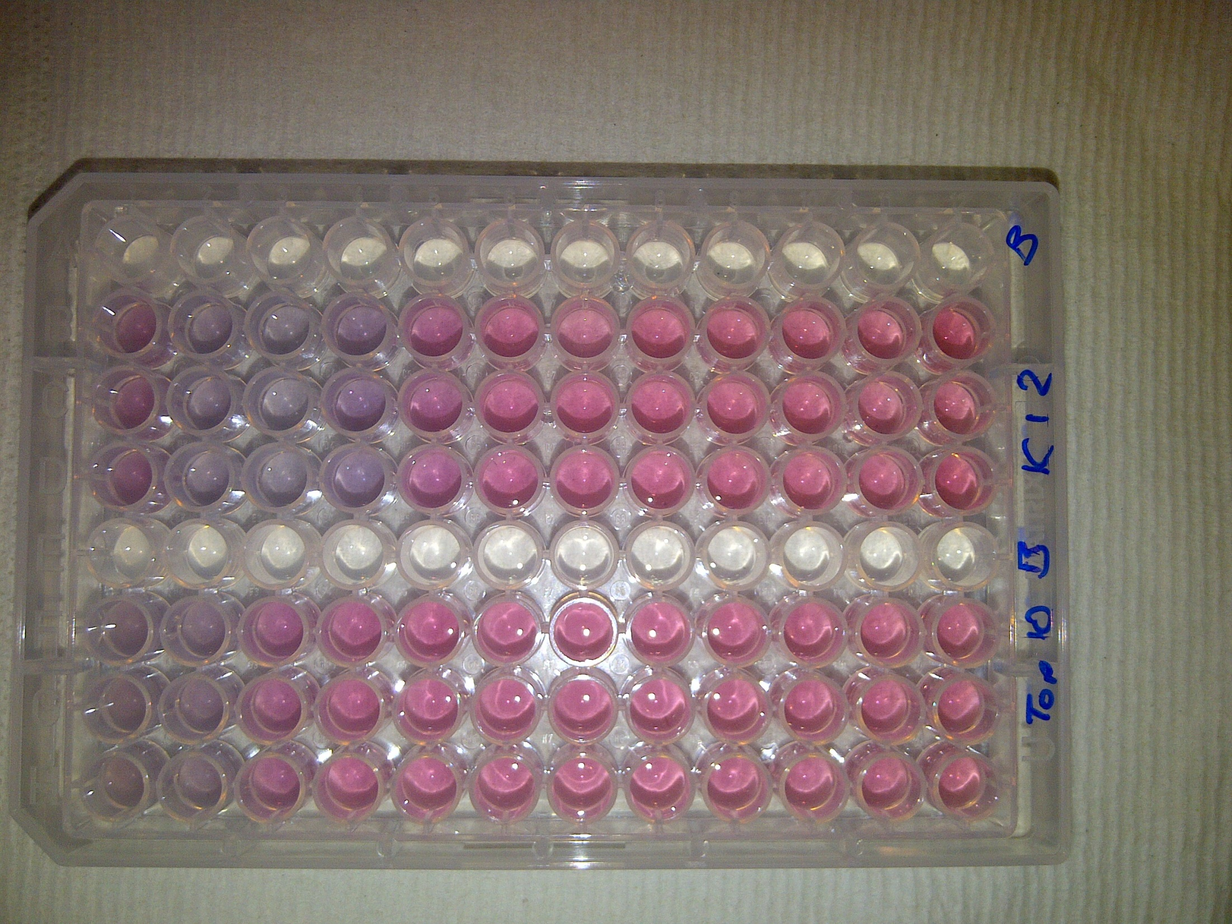
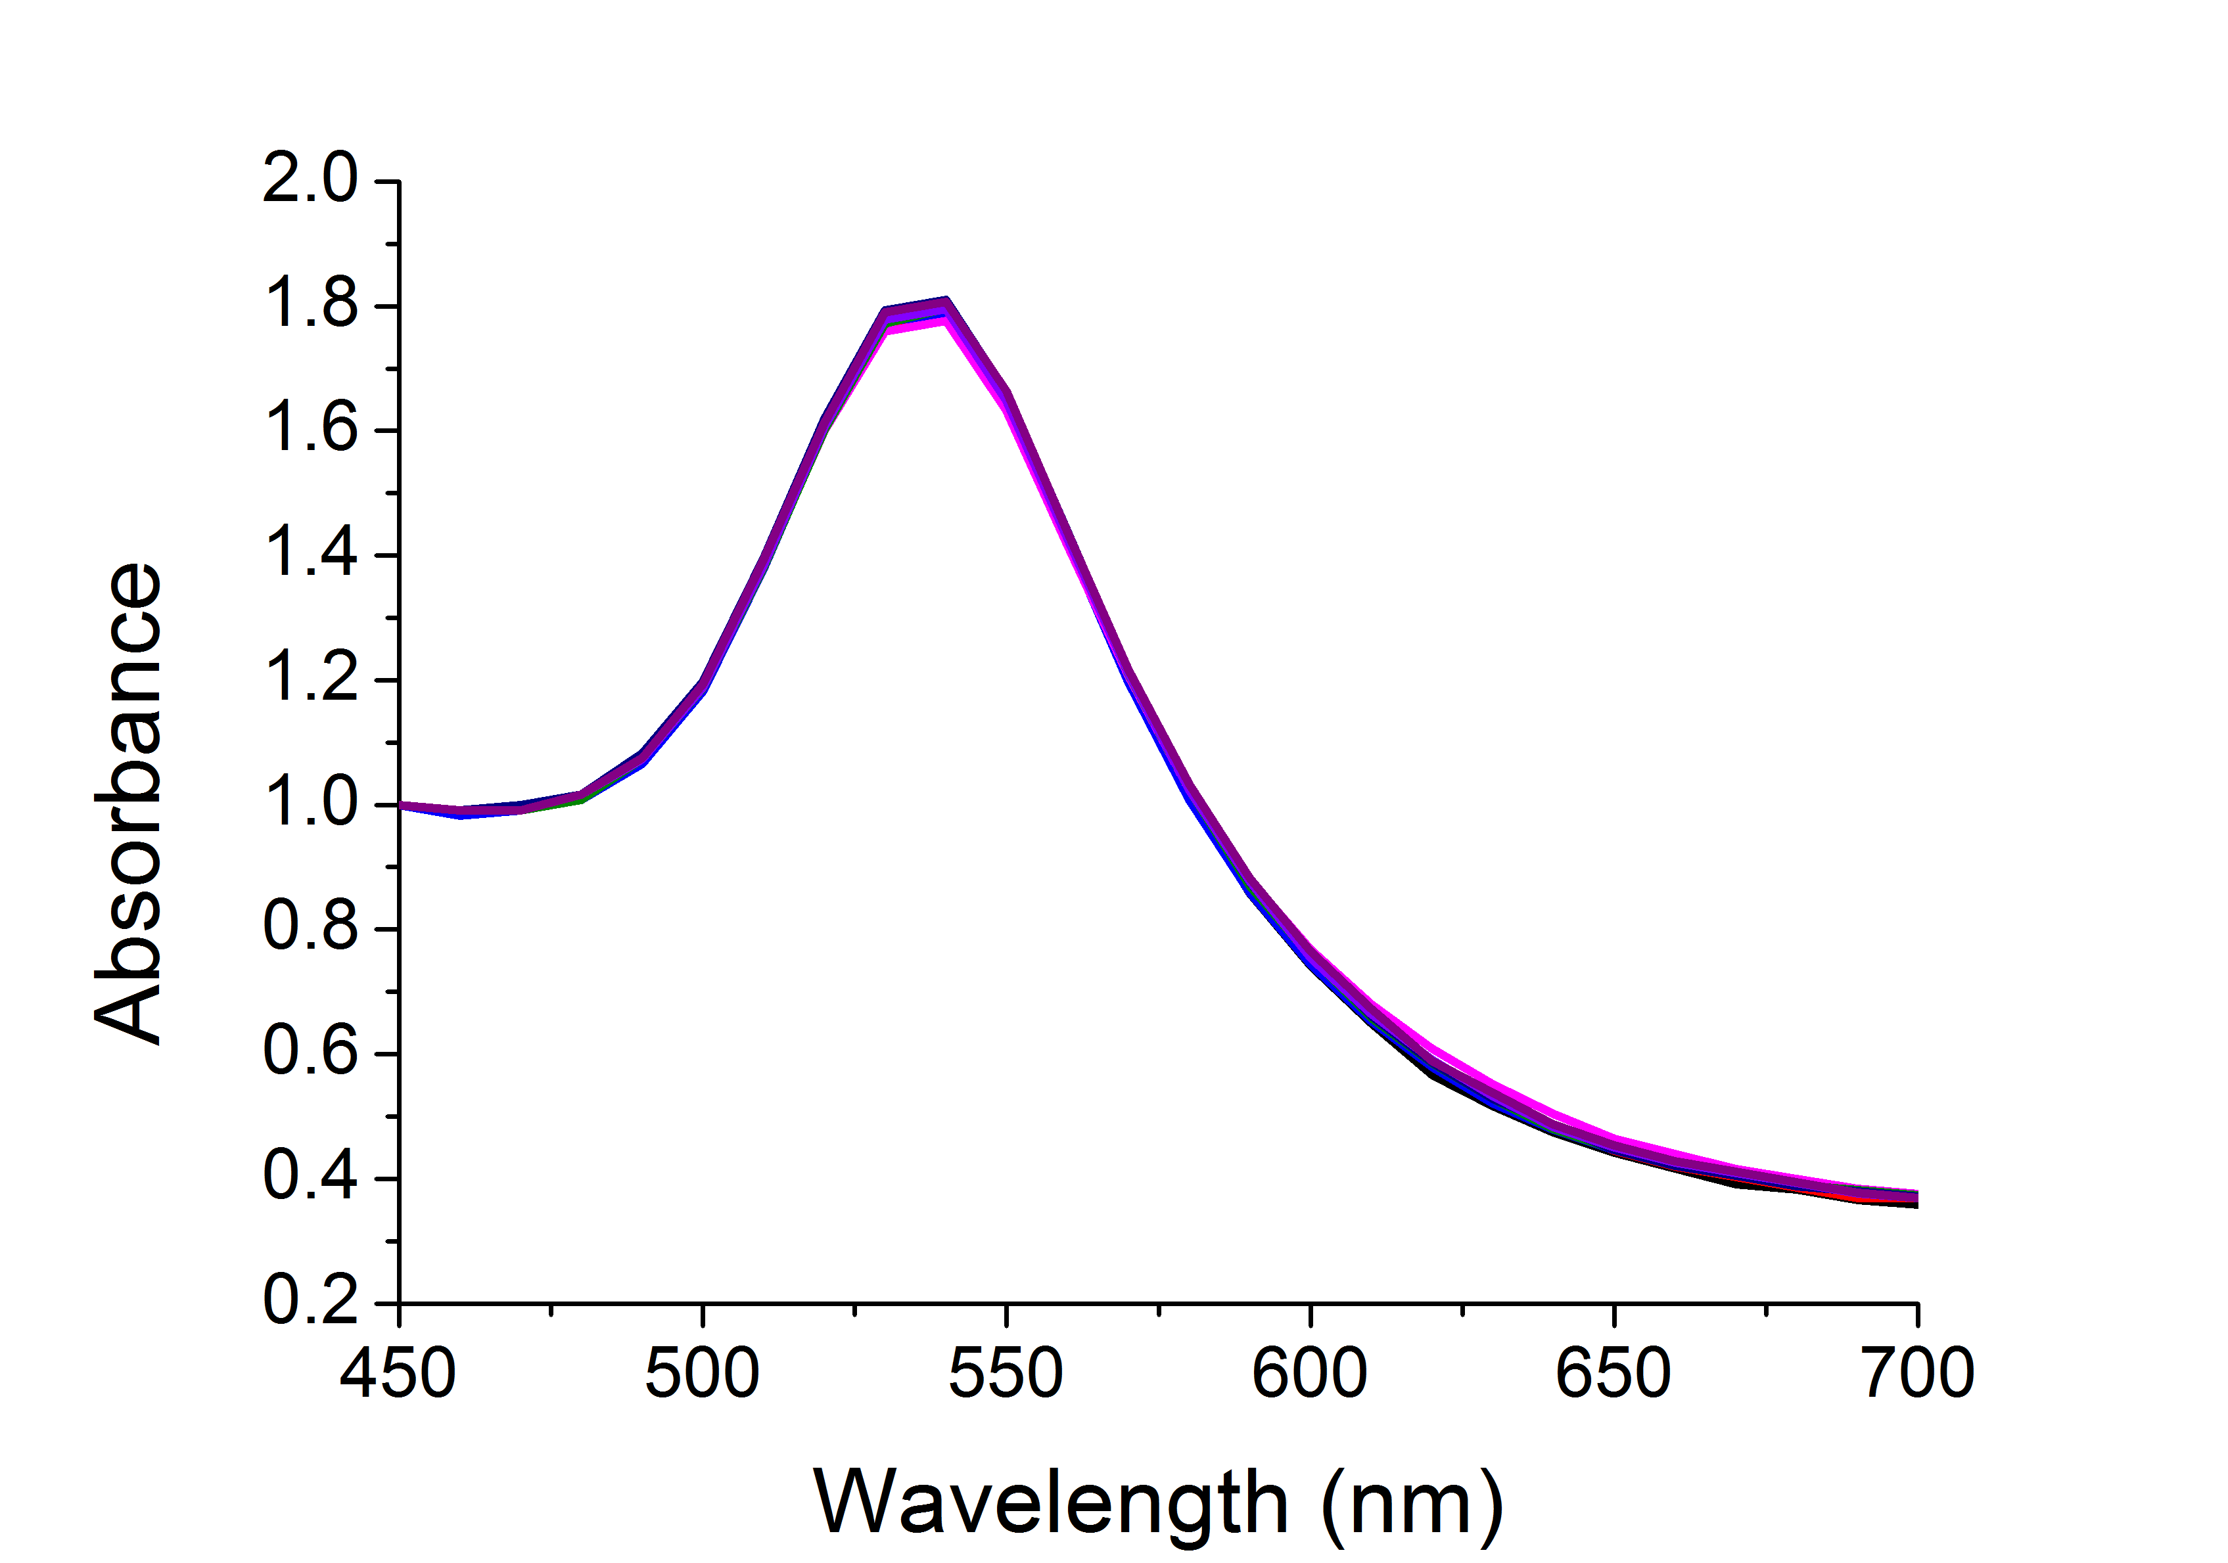
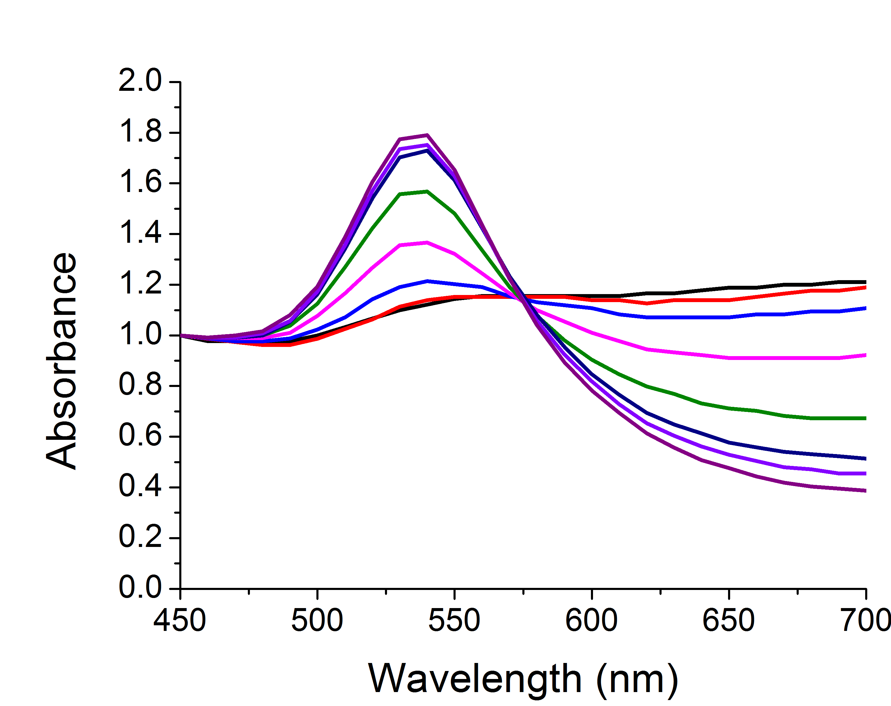
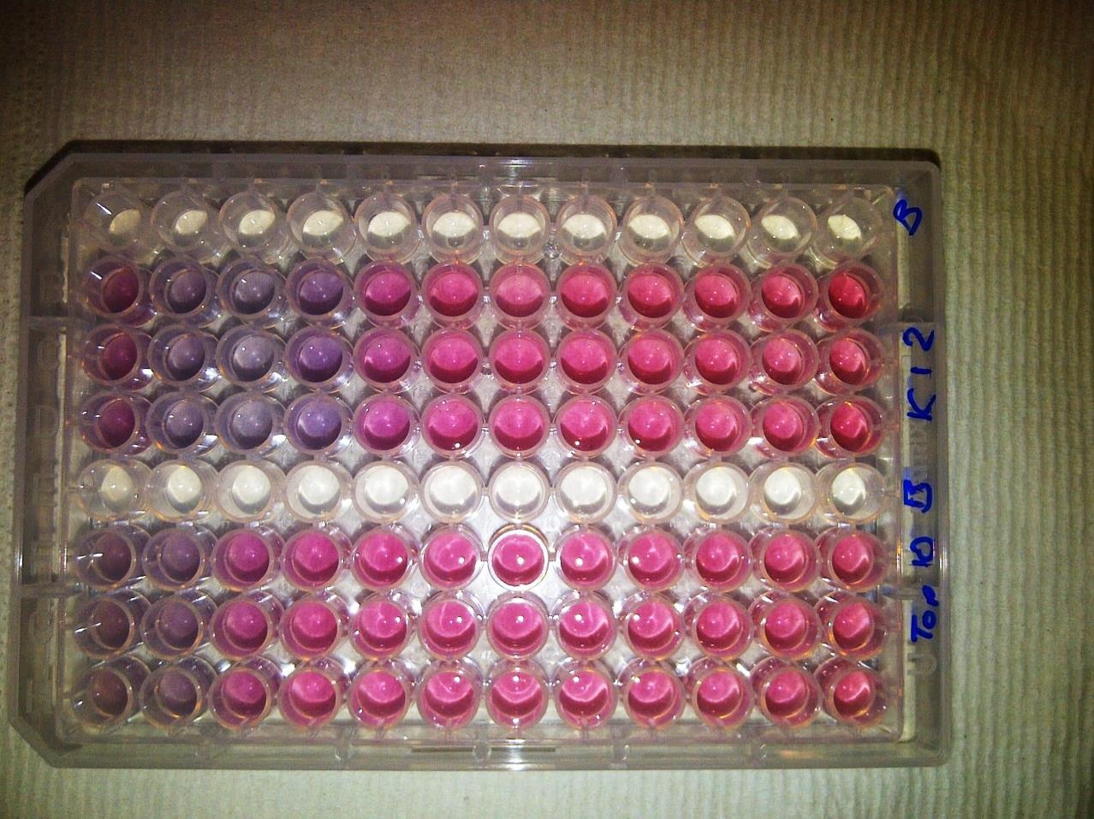
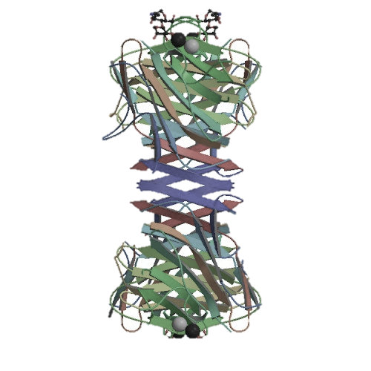
Glycosylated gold nanoparticles for detection
Incorrect glycan = no interaction
Correct glycan = interaction
Notes:
More reference

Slide 3
Con A induced aggregation
[Con A]
Size dependant aggregation
Kinetics of colour change
Richards, S-J., Fullam, E., Besra, G. S. Gibson, M. I.; J. Mater. Chem. B, 2014, 2, 1490-1498
Notes:
More reference

Slide 4

Bacteria induced aggregation
[FimH+ bacteria]
[FimH- bacteria]
Colour Change ☑
Fast ☑
Specific ☑
Saline Stability ☒
Bacteria induced colour change
K-12
+ FimH
TOP10
- FimH
OD = 0.25
OD 0.005
[Bacteria]
Richards, S-J., Fullam, E., Besra, G. S. Gibson, M. I.; J. Mater. Chem. B, 2014, 2, 1490-1498
Notes:
More reference

Slide 5
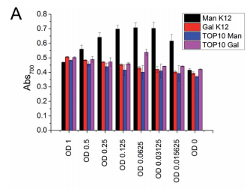
40 nm
n = 68
Colour Change ☒
Fast ☒
Specific ☑
Saline Stability ☑
Con A induced aggregation
Directly functionalised
PEG functionalised
Bacteria induced aggregation
[ConA]
Richards, S-J., Fullam, E., Besra, G. S. Gibson, M. I.; J. Mater. Chem. B, 2014, 2, 1490-1498
Notes:
More reference

Slide 6
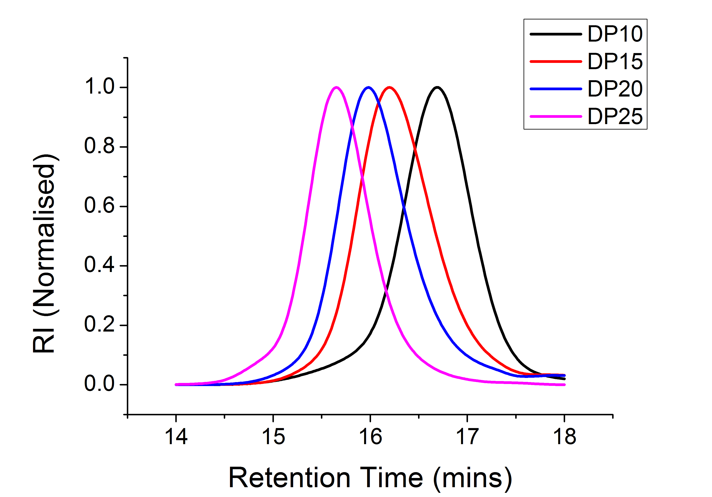
Saline stability
SEC of sizes
Kinetics of colour change
Optimisation of polymer coating
Richards, S-J. and Gibson, M. I., ACS Macro Lett. 2013, 1, 1002-1008
Notes:
More reference

Slide 7
Soy bean agglutinin induced aggregation
Rapid colour change (< 5 mins)
[SBA]
[SBA]
Colour Change ☑
Fast ☑
Specific ☑
Saline Stability ☑
Highly specific change
Aggregation behaviour confirmed by DLS
Richards, S-J. and Gibson, M. I., ACS Macro Lett. 2013, 1, 1002-1008
Notes:
More reference

Slide 8
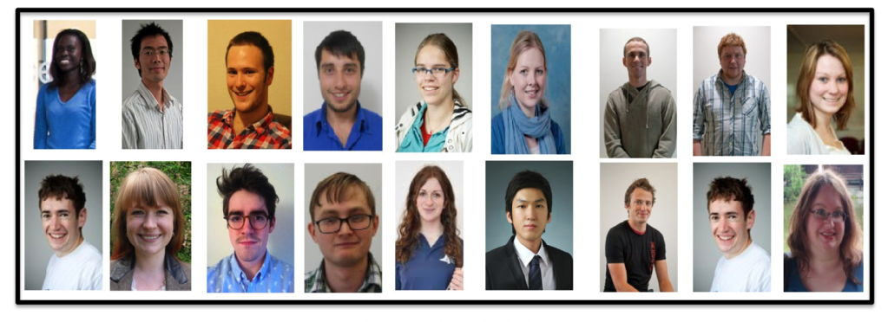

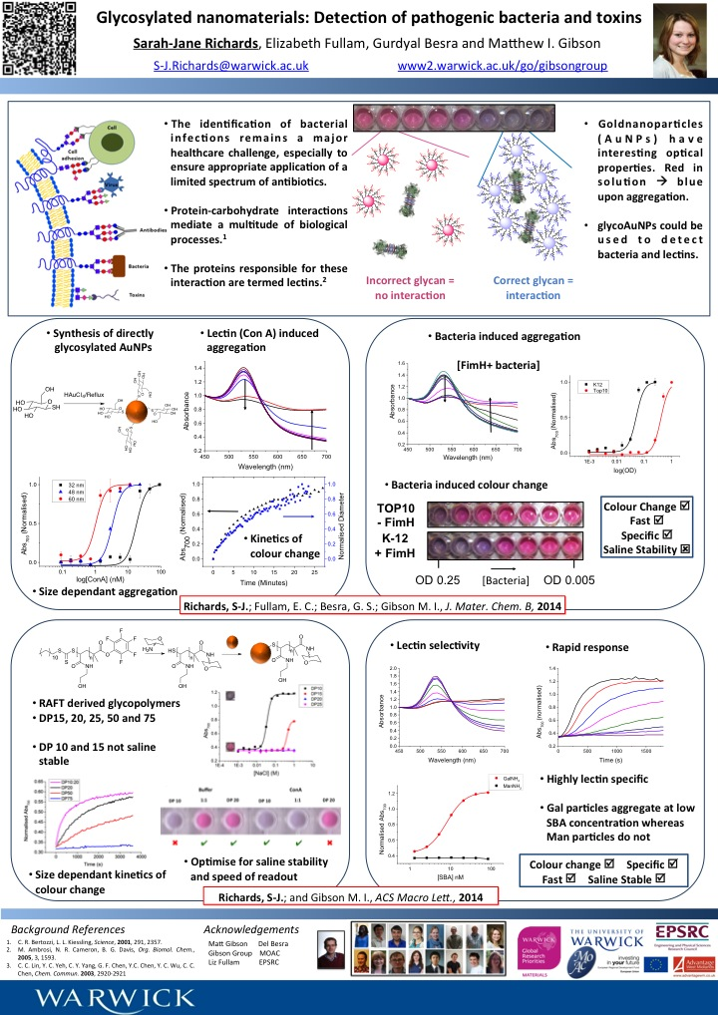




Acknowledgements
Matthew Gibson
Del Besra
Elizabeth Fullam
Gibson Group

