Slide 1


Glycosylated gold nanoparticle biosensors:
Label-free and high-throughput evaluation of glycan-lectin interactions
Sarah-Jane Richards and Matthew I. Gibson
Department of Chemistry, University of Warwick, UK
www.warwick.ac.uk/sarahjane_richards
@LabGibson
MultiGlycoNano 2015 29/10/15
Antalya, Turkey
s-j.richards@warwick.ac.uk

Slide 2
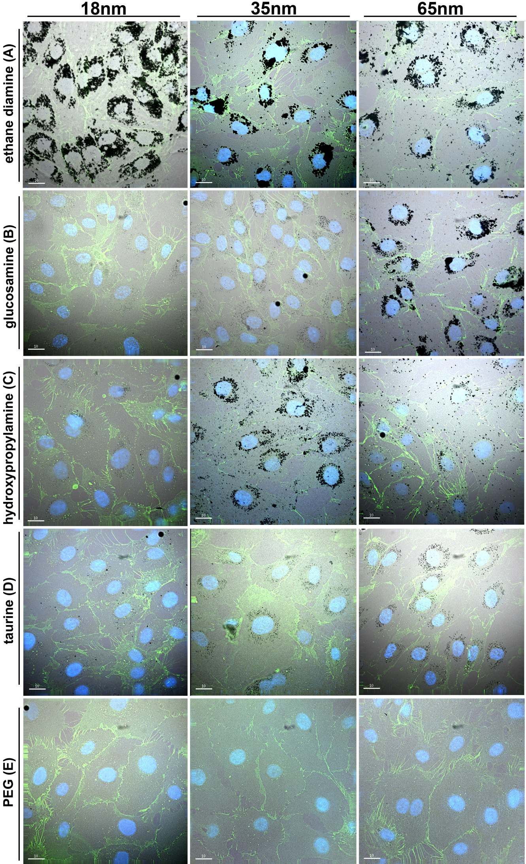
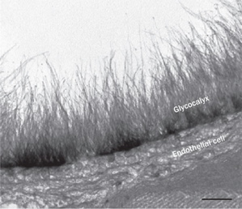
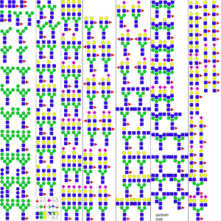
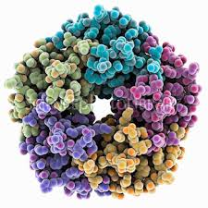
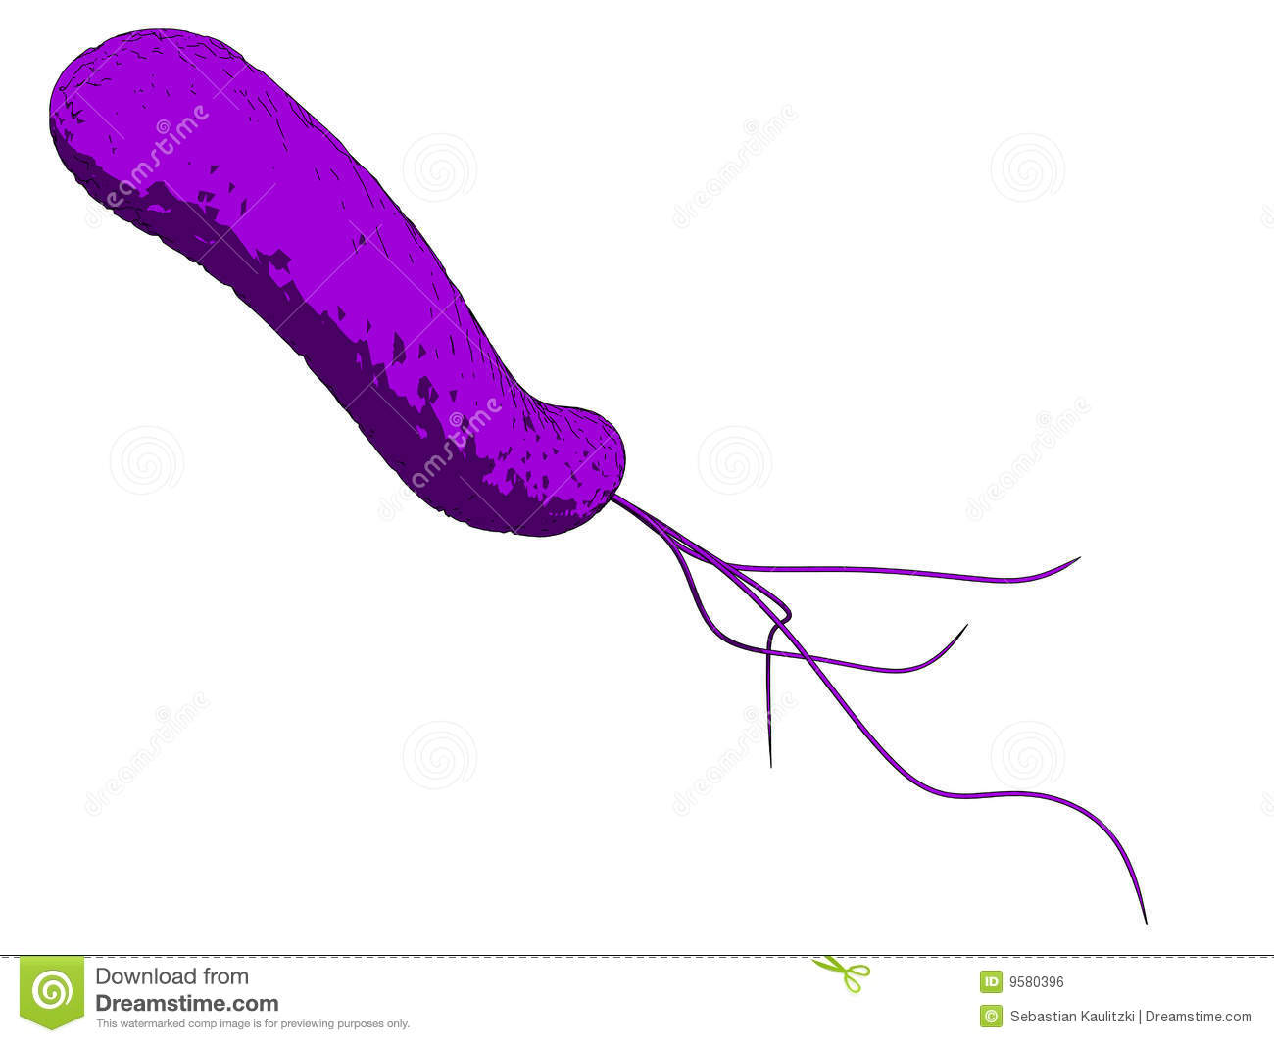
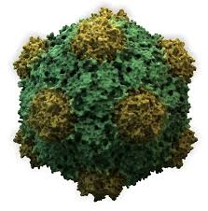
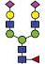

Glycans are Crucial Biomarkers
Selection of N-linked mammalian glycans d/load from P Stanley Lab
Cholera
Ricin
Influenza
Ebola
Shiga Toxins
HIV
Non antibiotic solutions to resistance
Treatment
Diagnosis
Understanding

Slide 3
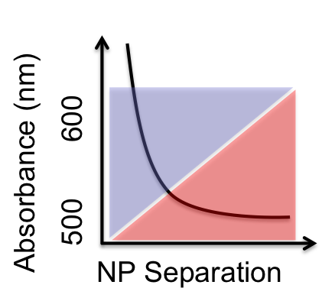
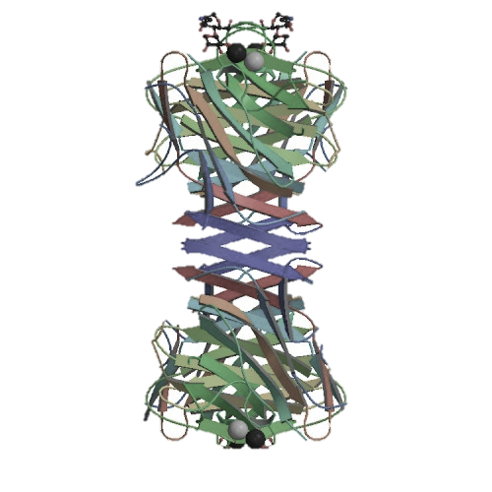
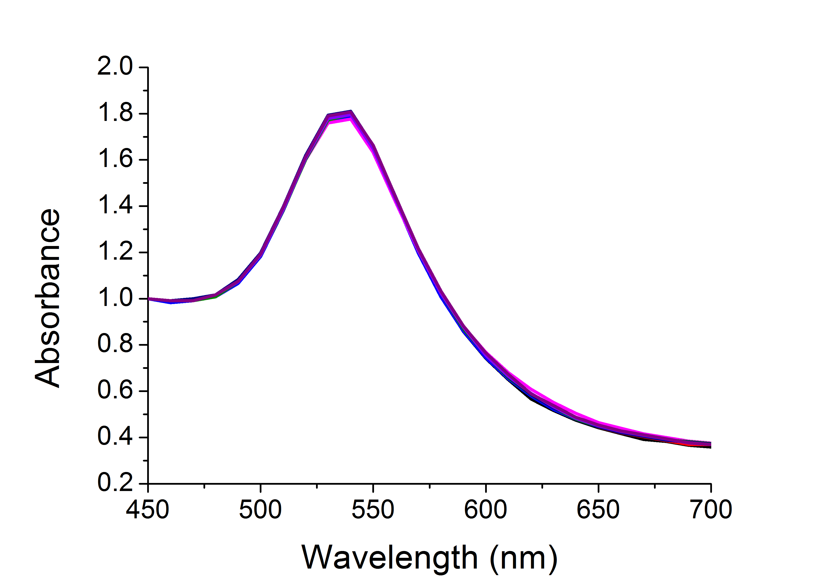
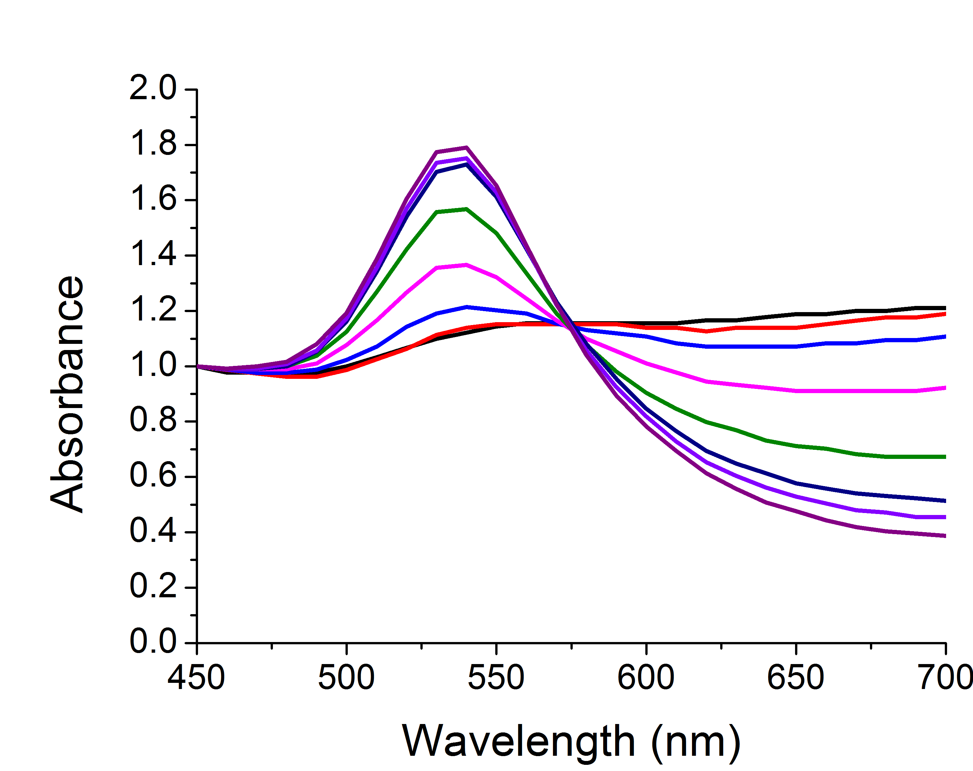
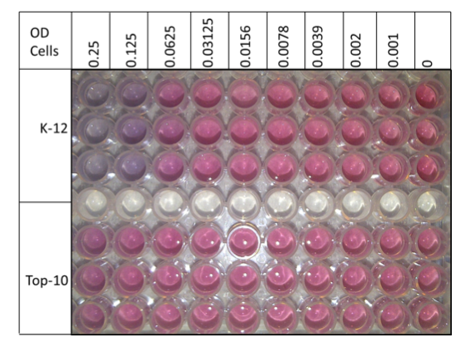
Label-Free Biosensing

Slide 4
Glycosylated Gold Nanoparticles
[ConA]
Colour Change ☑
Fast ☑
Specific ☑
Saline Stability ☒
Richards, S-J., Fullam, E., Besra, G. S. Gibson, M. I.; J. Mater. Chem. B, 2014, 2, 1490-1498

Slide 5
PEG-Stabilized AuNPs
40 nm
Colour Change ☒
Fast ☒
Specific ☑
Saline Stability ☑
n = 68
Con A induced aggregation
Directly functionalised
PEG functionalised
[ConA]
Richards, S-J., Fullam, E., Besra, G. S. Gibson, M. I.; J. Mater. Chem. B, 2014, 2, 1490-1498

Slide 6
Optimisation of polymer coating
Masked thiol for immobilization on to AuNP
Thiol for immobilization on to AuNP
Sugar conjugation site
Sugar for lectin recognition
Richards, S-J., Biggs, C. I, Gibson, M. I., Methods in Molecular Biology; Macro-Glycoligands, 2016, Series Vol 1367

Slide 7
Conjugation Versatility
Richards, S-J., Biggs, C. I, Gibson, M. I., Methods in Molecular Biology; Macro-Glycoligands, 2016, Series Vol 1367
S-J. Richards, C. I. Biggs, M. I, Gibson, Methods in Molecular Biology; Macro-Glycoligands, 2016, Series Vol 1367

Slide 8
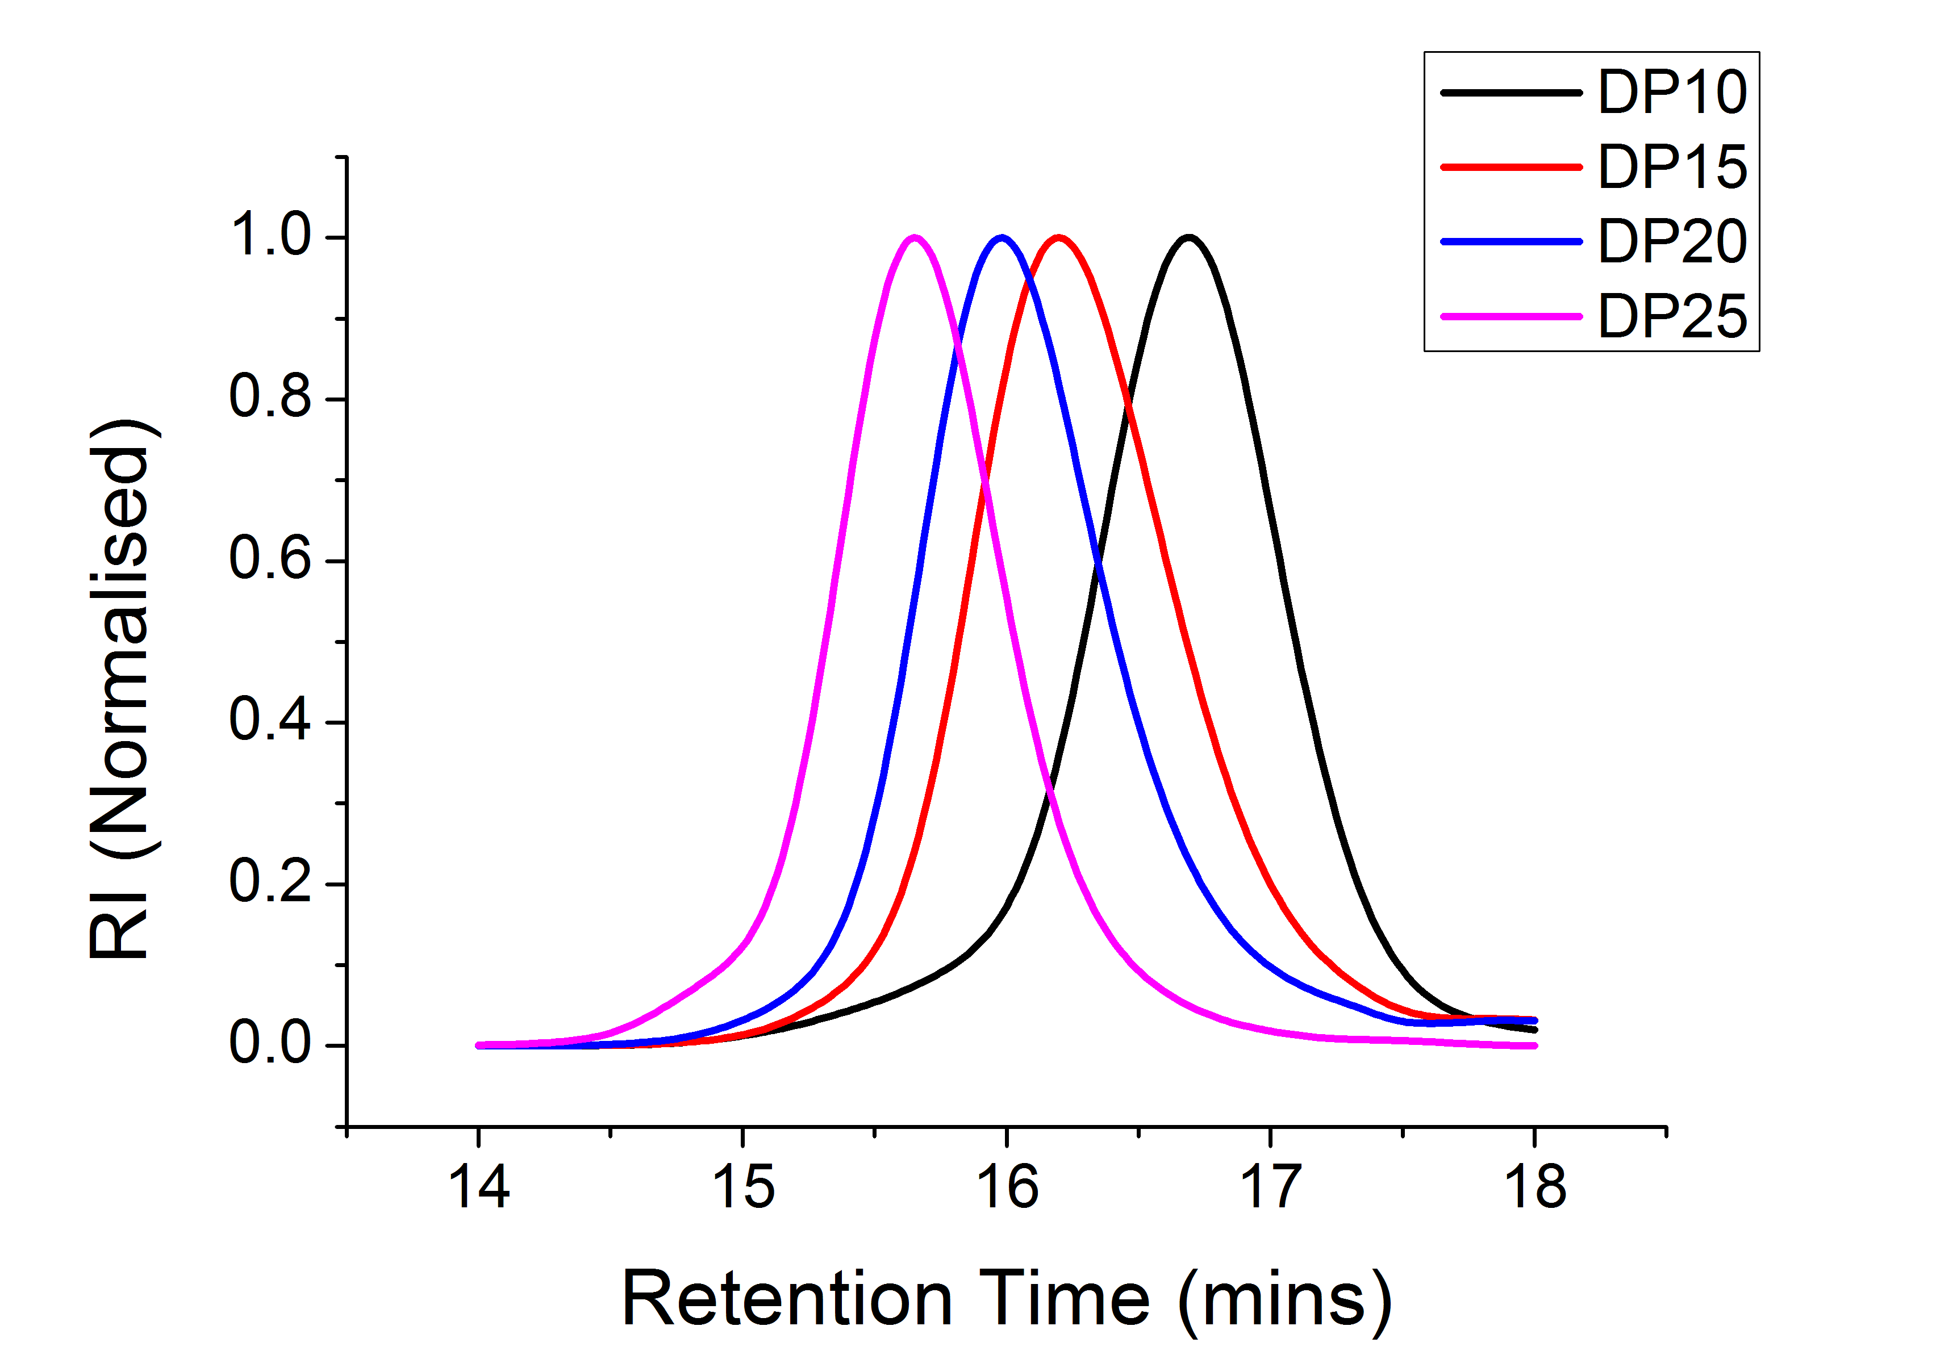
Optimisation of Polymer Coating
SEC of sizes
Saline stability
Kinetics of colour change
Richards, S-J., Otten, L. O., Gibson, M. I.; J. Mater Chem. B., 2015, DOI: 10.1039/C5TB01994J

Slide 9
Lectin Specificity and Speed of Readout
Soy bean agglutinin induced aggregation
Rapid colour change (< 5 mins)
[SBA]
[SBA]
Colour Change ☑
Fast ☑
Specific ☑
Saline Stability ☑
Highly specific change
Aggregation behaviour confirmed by DLS
Richards, S-J., Otten, L. O., Gibson, M. I.; J. Mater Chem. B., 2015, DOI: 10.1039/C5TB01994J

Slide 10
Underivatised reducing sugars
Richards, S-J., Otten, L. O., Gibson, M. I.; J. Mater Chem. B., 2015, DOI: 10.1039/C5TB01994J

Slide 11
Polymer coating characterisation
A
B
C
C
Richards, S-J., Otten, L. O., Gibson, M. I.; J. Mater Chem. B., 2015, DOI: 10.1039/C5TB01994J

Slide 12
High-throughput data collection
Richards, S-J., Otten, L. O., Gibson, M. I.; J. Mater Chem. B., 2015, DOI: 10.1039/C5TB01994J

Slide 13
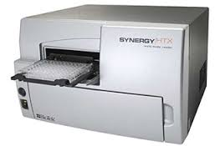
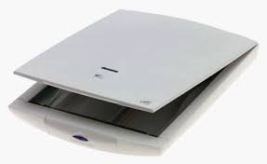
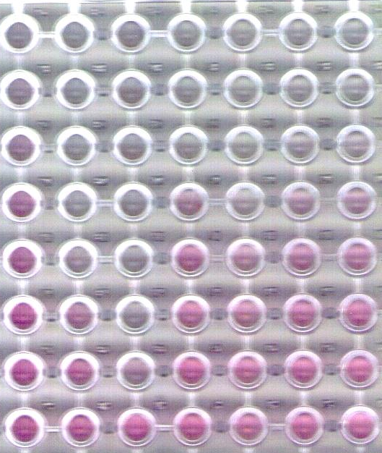
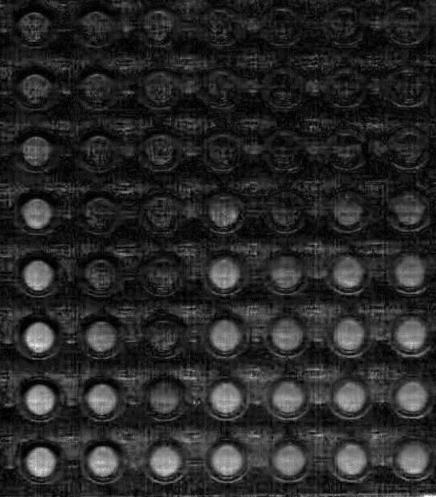
Low-Cost, Low-Resource Detection
vs
£10,000
£50
Richards, S-J., Otten, L. O., Gibson, M. I.; J. Mater Chem. B., 2015, DOI: 10.1039/C5TB01994J

Slide 14
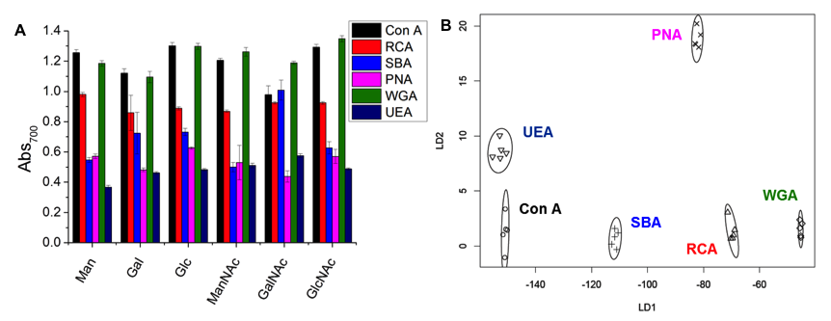
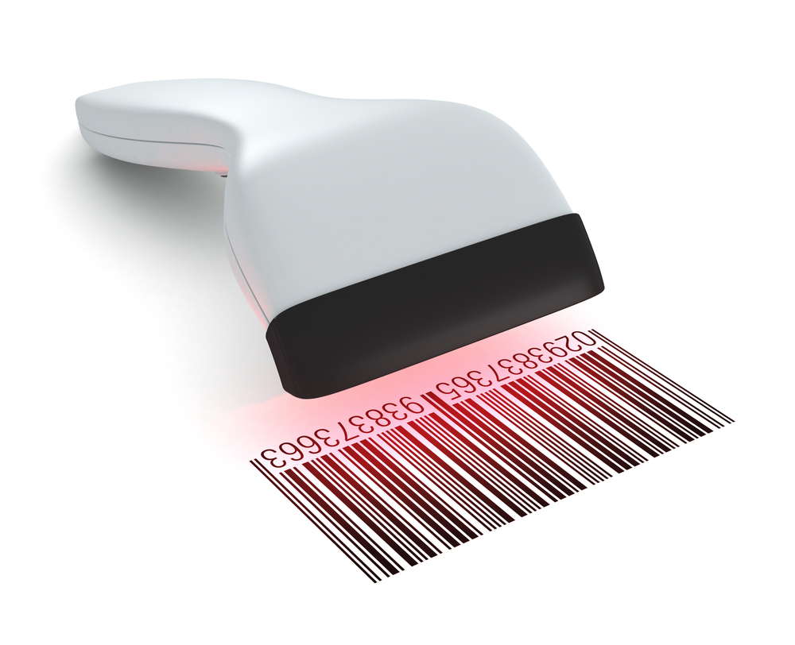
Lectin Screening and Discrimination
Otten, L. O. and Gibson, M. I. RSC Adv., 2015,5, 53911-53914
Richards, S-J., Otten, L. O., Gibson, M. I.; J. Mater Chem. B., 2015, DOI: 10.1039/C5TB01994J

Slide 15
Summary
Polymer coating essential for saline stability and optical readout
Vast conjugation space
High-throughput and low resource detection possible

Slide 16
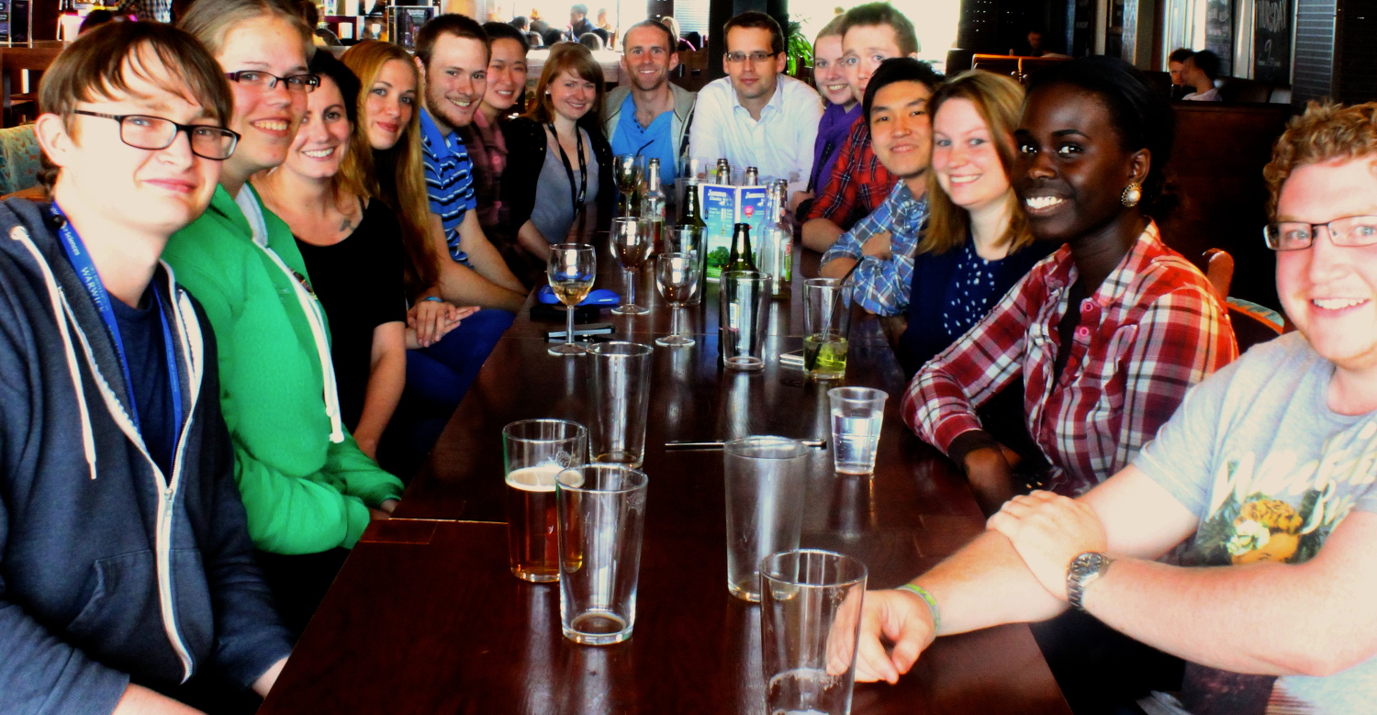



Acknowledgements
Post-docs
Dr. Caroline Biggs
Dr Collette Guy
Phd Students
Alaina Emmanuel
Lucienne Otten
Daniel Mitchell
Sang Ho Won
Lewis Blackman
Benjamin Martyn
Joseph Healey
Julia Lipecki
Chris Stubbs
Ben Graham
Trisha Bailey
Laura Wilkins
Maria Grypioti
Research Fellow
Dr Gemma-Louise Davies
Masters Students
Josh Garcia-Hall
Shin Yiing Lim
Chris Packer
Recent Alumni
Dr Thomas Congdon
Dr Daniel Phillips
Dr. Robert Deller
Dr Cathy Cooper
Dr Yunhua Chen
Dr Matthew Gibson
Prof. Gurdyal Besra
Dr Elizabeth Fullam
www.warwick.ac.uk/go/gibsongroup
@LabGibson

Slide 17
Glycosylated gold nanoparticle biosensors:
Label-free and high-throughput evaluation of glycan-lectin interactions
Sarah-Jane Richards and Matthew I. Gibson
Department of Chemistry, University of Warwick, UK
www.warwick.ac.uk/sarahjane_richards
@LabGibson
MultiGlycoNano 2015 29/10/15
Antalya, Turkey
s-j.richards@warwick.ac.uk

