Slide 1


Identification of resistant microorganisms via carbohydrate binding profiles
Eva Caamaño Gutiérrez^{1,3},Giancarlo Biagini³, Matthew I. Gibson^{1,2}
¹Department of Chemistry, University of Warwick, UK
²Medical School, University of Warwick, UK
³Liverpool School of Tropical Medicine, Liverpool, UK
e.caamano@warwick.ac.uk
www.warwick.ac.uk/go/gibsongroup
@LabGibson @Eva_Caamano
EPSRC AMR “Bridging the Gaps”. 29th June 2016
University of Warwick

Slide 2
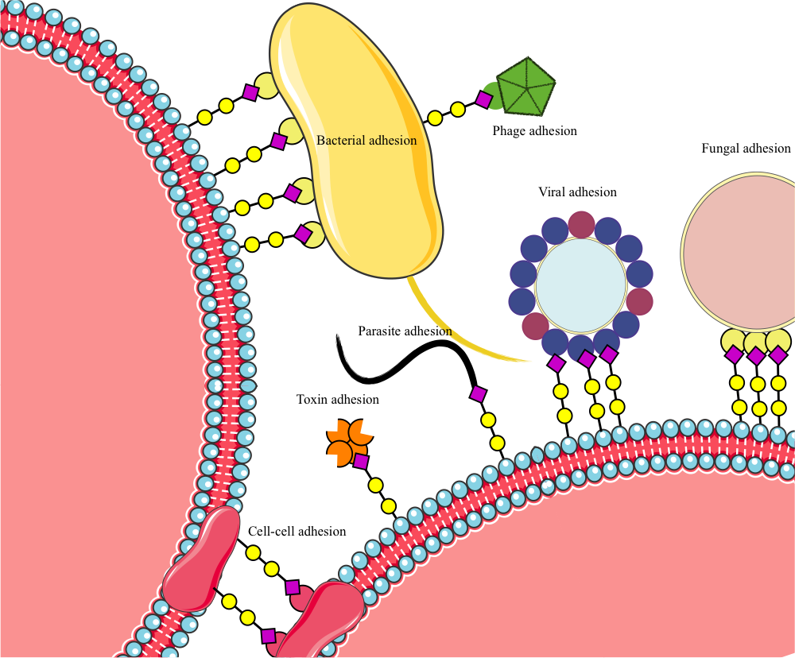
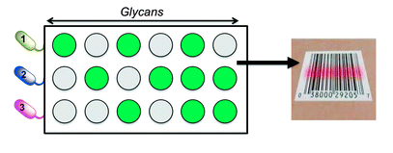
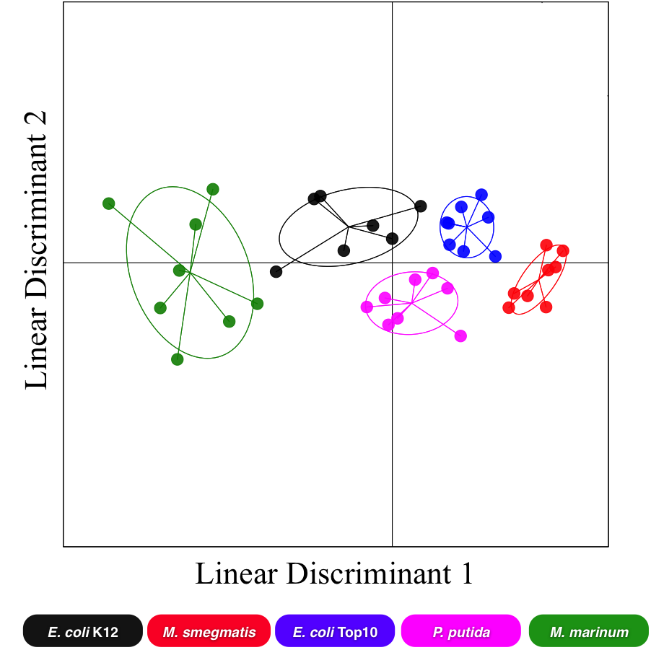

Exploiting pathogen’s glycan adhesion for detection
Carbohydrates play a crucial role in infection
Carbohydrate microarrays coupled with statistical modeling has been used to discriminate between bacteria strains
Carbohydrate modifications have been linked to resistant phenotypes in several diseases.
Otten, L., Fullam, E., Gibson, M.I. Mol. Biosyst. (2016)
Notes:
Here just remind about the background of the project and carbohydrate binding profiles has been already used for strain discrimination

Slide 3
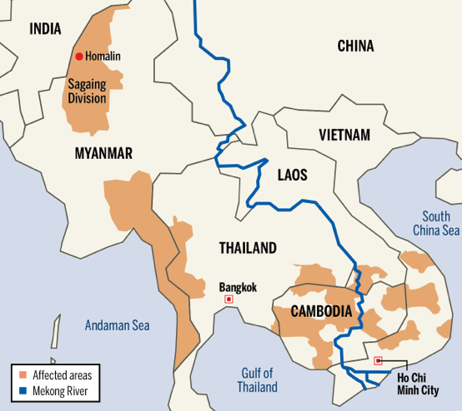
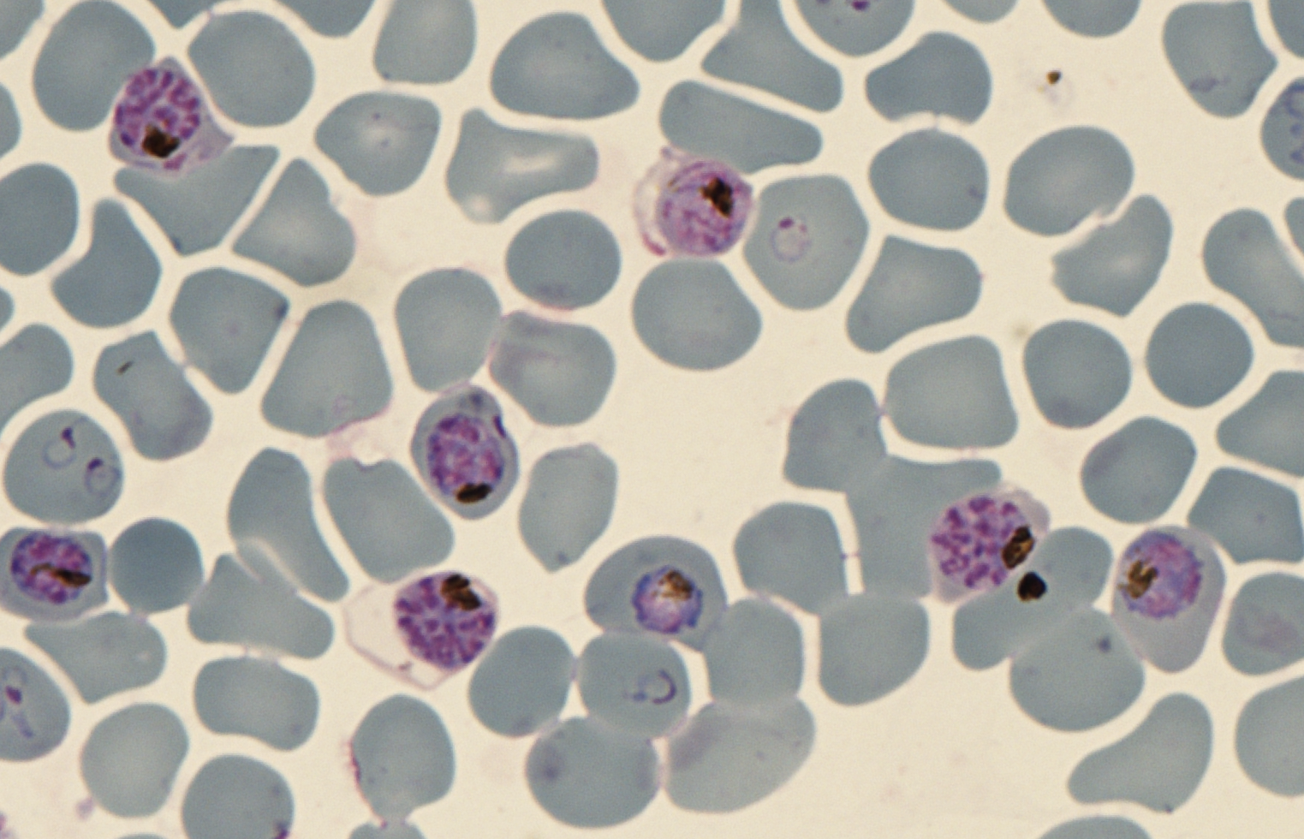
Can we use carbohydrate binding profiles to discriminate between resistant strains of Plasmodium falciparum?
Strain | Artemisinin-resistance related gene
3D7 | WT
TH004-004 | WT
TH004-023 | Mutation
TH004-036 | Mutation
TH004-64 | Mutation
Confidential
Notes:
Introduce the biological problem: we have resistant and susceptible strains of Plasmodium and we want to see if we can use the carbohydrate binding profiles to discriminate them

Slide 4
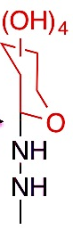
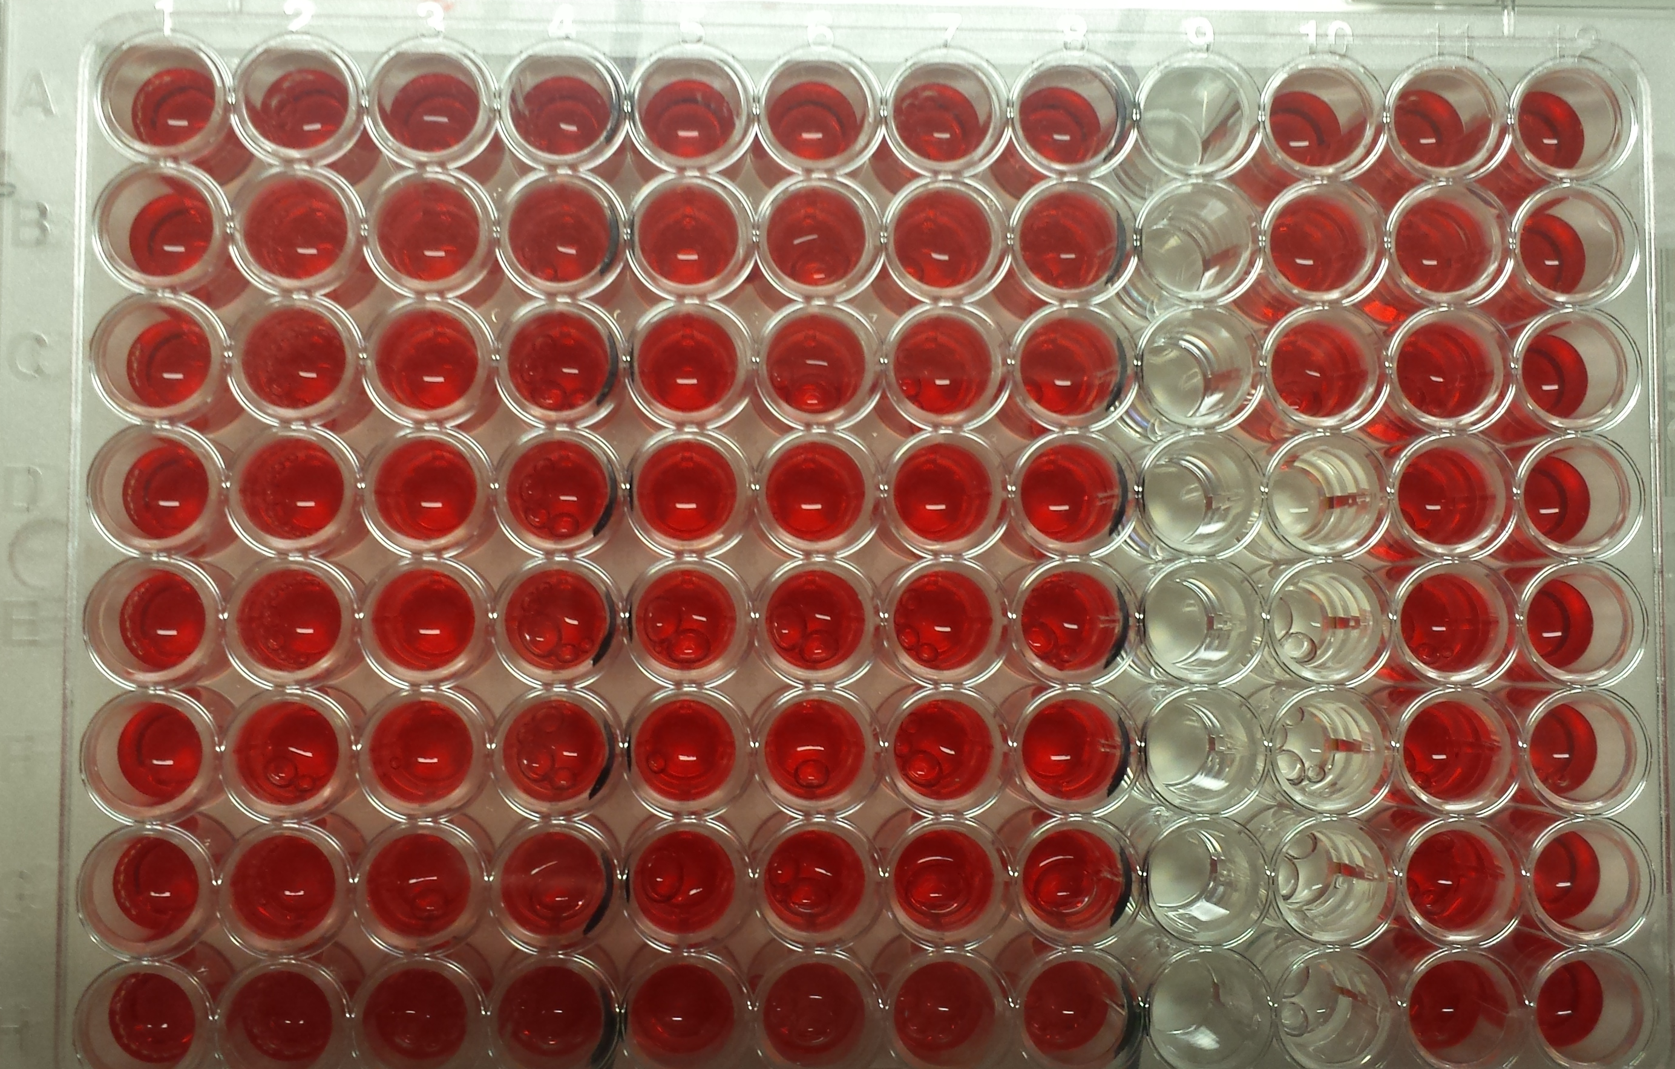
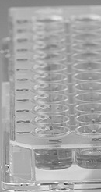
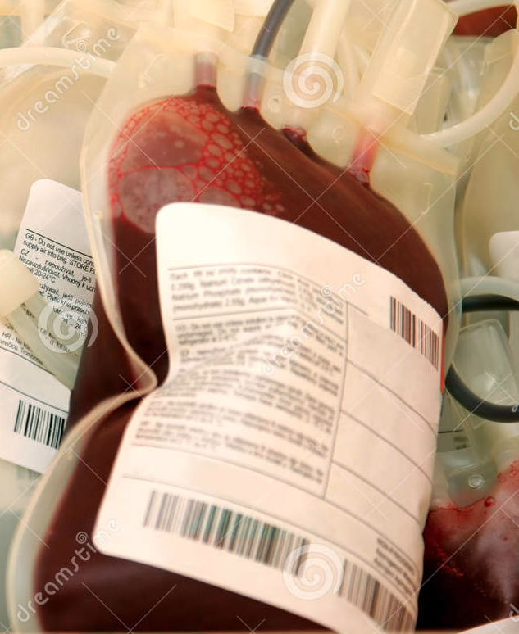
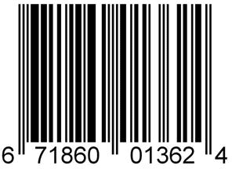
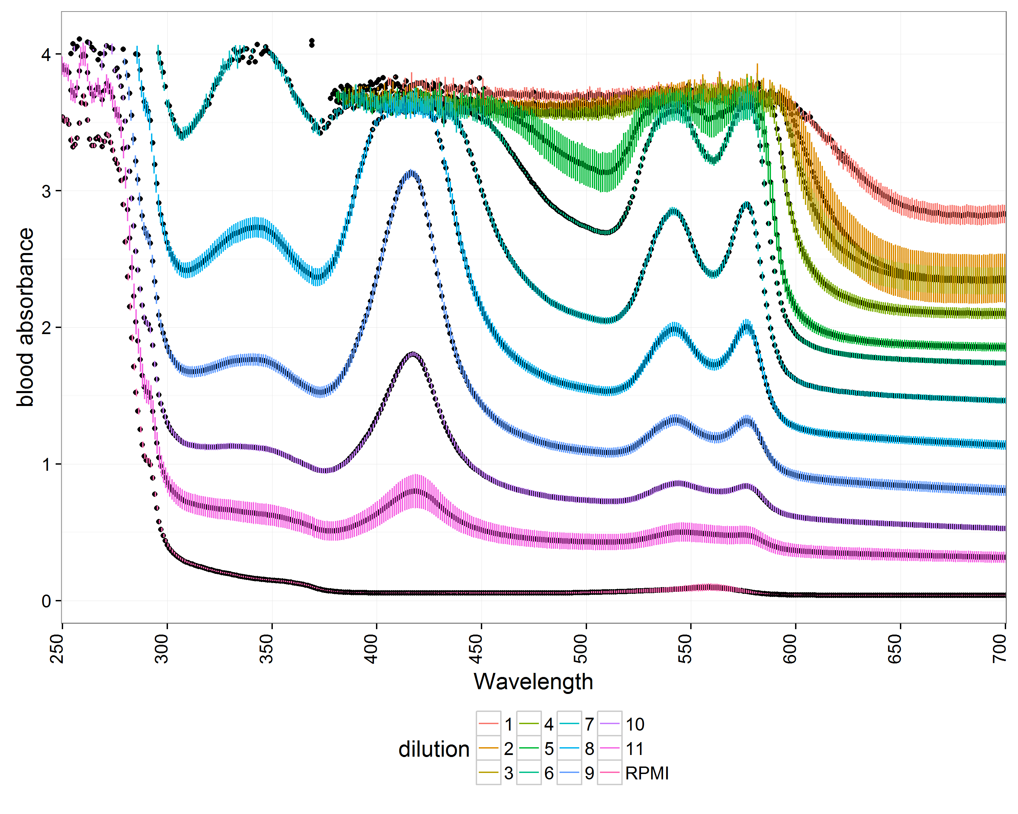
How can we measure carbohydrate binding profiles?
A) Discrimination between microbial resistant strains using fluorescently labeled cells.
B) Developing label-free techniques.
Great in uncolored solutions but how to detect it in blood?
Otten, L.,Gibson, M.I., RSC Adv. (2015); Richards, S-J. et al., ACS Macro Letters (2014)
Notes:
Mention that the aim of our study is to (a)try to discriminate between microbial resistant strains using labeled cells and parallel (b) develop label free techniques (show why this might pose a challenge with an already coloured fluid)

Slide 5
A) Discrimination between microbial resistant strains using fluorescently labeled cells.
Notes:
Progress on project A

Slide 6
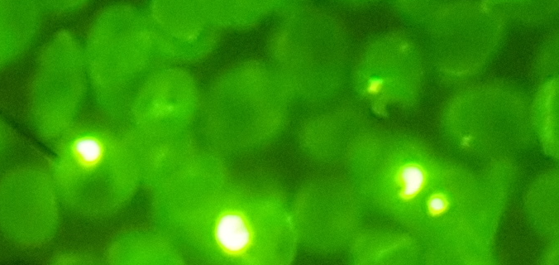
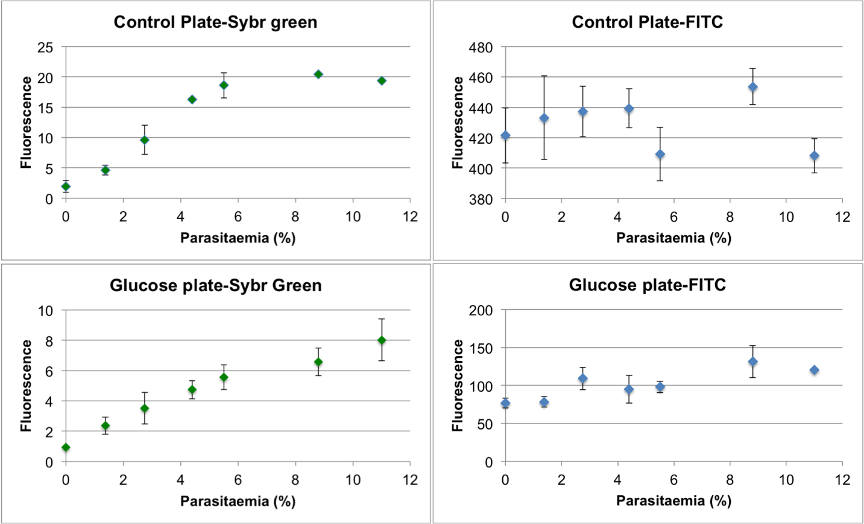
(A)
Exploring robust ways to detect sugar-carbohydrate interactions
Using informative fluorophores
Adequate controls in place
Outlier removal
Blanks to account for unspecific binding
Controls to account for parasitaemia oscillations
Modelling
Confidential
Notes:
We identified a better fluorophore that takes into account parasitaemia oscillations and we came up with the steps to minimize random effects.

Slide 7
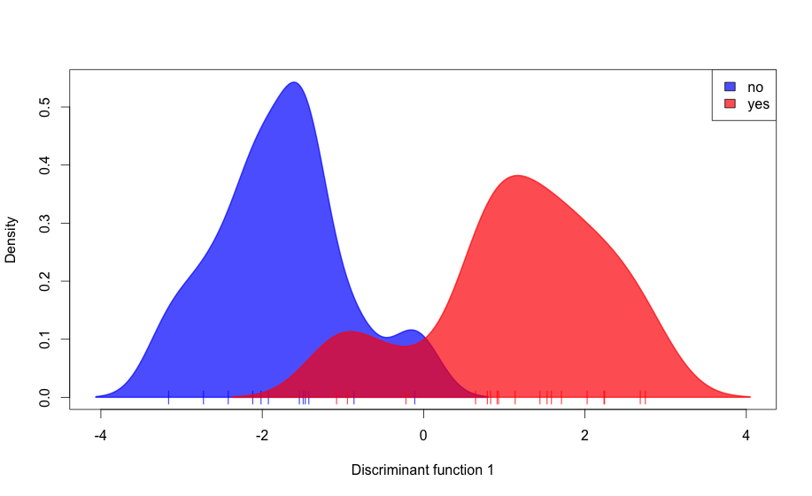
(A)
Malaria infected samples with resistant strains have been discriminated from susceptible.
With 80% of the strain-stages screened, we can discriminate resistance in the mature stages with 90% accuracy.
Next stage: Once all data is acquired→Validating the model with new data
Confidential
Notes:
Mention the preliminar success but also emphasize that this is not valid until we validate it

Slide 8
B) Developing label-free techniques.
Notes:
Brief progress on project 2

Slide 9
B)
Blood absorbance spectra masks the AuNPs interactions
This is how the interaction is detected prior blood addition
But blood masks the signal we are interested in
Confidential
Notes:
Given gold nanoparticles bound to a sugar that is known to interact with a protein and other that is not we can detect their differences in absorbance but when we add blood their spectra are indistinguishable, how do we overcome this?

Slide 10
B)
By scaling, normalising and removing the blood-only background we manage to discriminate samples
Confidential
Notes:
We do some scaling and normalisation steps followed by background signal removal and voila!

Slide 11
B)
We can use these data to build a model to predict other samples
But the model does not predict very well very high concentrations of blood
Confidential
Notes:
We do some scaling and normalisation steps followed by background signal removal and voila!

Slide 12
Other biofluids: Surine
But we still can discriminate between samples with as little as 0.00625 mg mL⁻¹ SBA
Confidential
Notes:
This slide is just for the lab meeting

Slide 13
Surine interact with our probes
Surine seems to interact with the sugars with a preference for mannose
Confidential
Notes:
This slide is just for the lab meeting

Slide 14
Future work
A) Discrimination between microbial resistant strains using fluorescently labeled cells.
B) Developing label-free techniques.
Finishing collecting data and build the final model
Prepare more Carbo-bind plates to acquire the validation dataset.
Acquire the validation dataset and test the model with it
Determine limits of detection for all biofluids.
Can we build a model to predict binding vs not binding?
Publication
Publication
Confidential
Notes:
Brief mention on future work

Slide 15
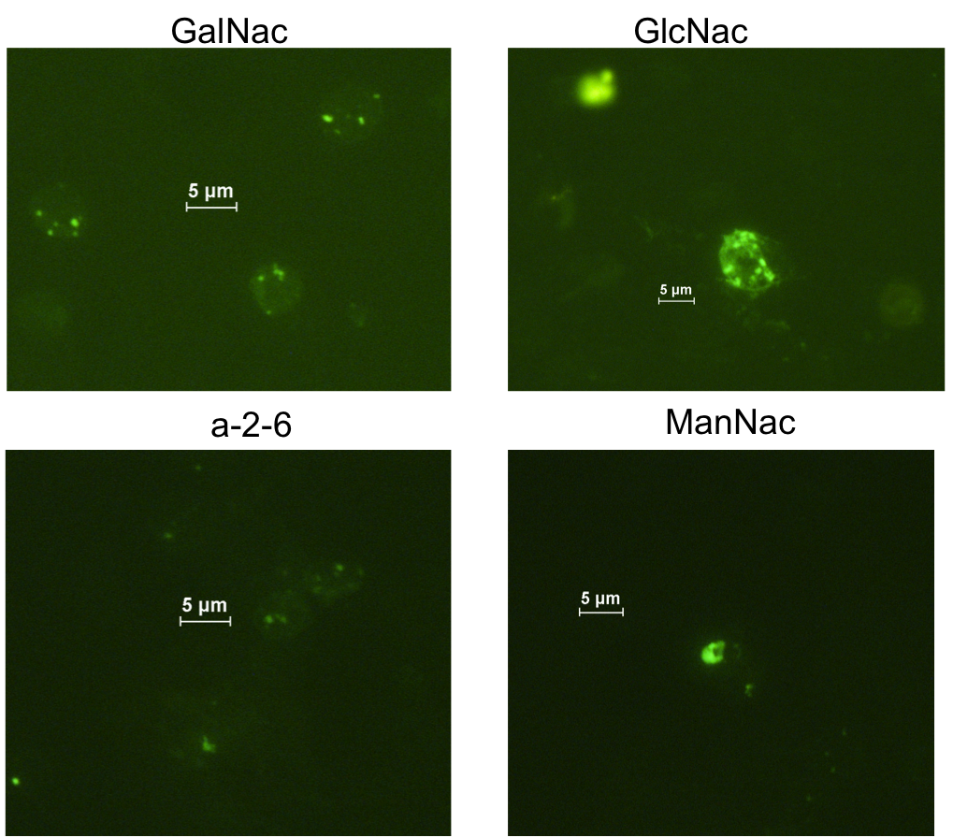
Other things of interest
Sugar functionalised glass slides were not good for alive cell binding.
Confidential
Notes:
This slide is just for the lab meeting

Slide 16
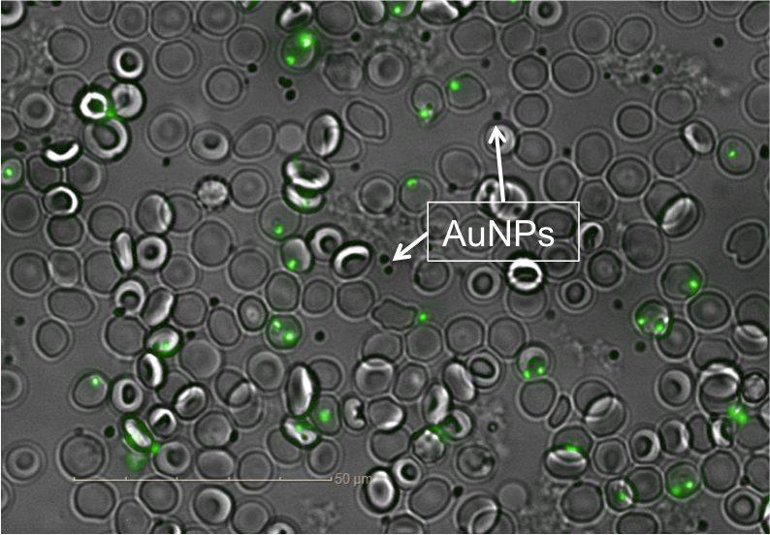
Other things of interest
AuNPs aggregates can be detected by microscopy
Confidential
Notes:
This slide is just for the lab meeting

Slide 17
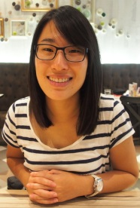
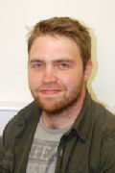
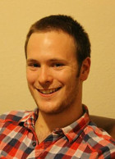
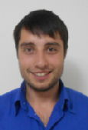
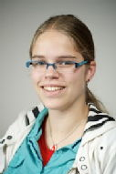
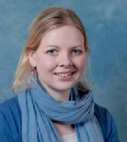
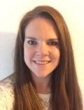
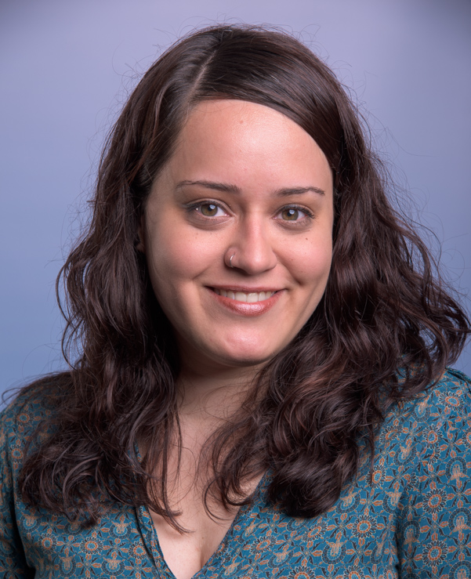

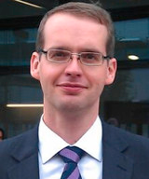
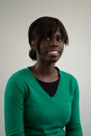
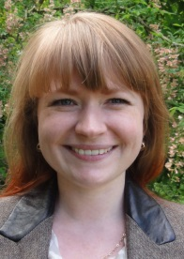
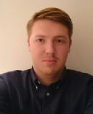
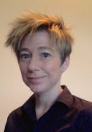
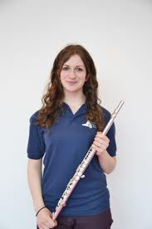
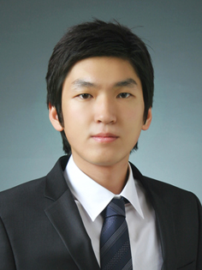
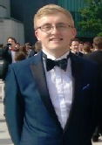
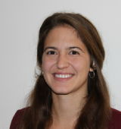
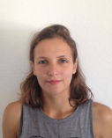





Acknowledgements
Prof. Matthew I. Gibson
Dr. Lucienne Otten
Dr. Sarah-Jane Richards
Benjamin Martyn
Prof. Giancarlo Biagini
Matthew Phanchana

