Slide 1

Responsive Assemblies for Biological Applications
Lewis D. Blackman,* Daniel B. Wright, Mathew P. Robin, Matthew I. Gibson and Rachel K. O’Reilly
University of Warwick, Gibbet Hill Road, Coventry, CV4 7AL, UK
@RORgroup @LabGibson

Slide 2
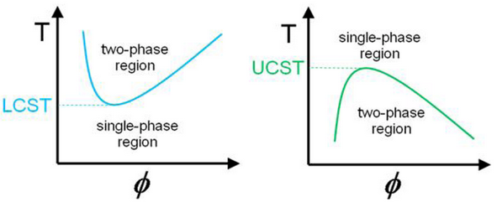
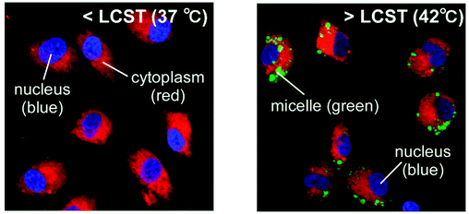
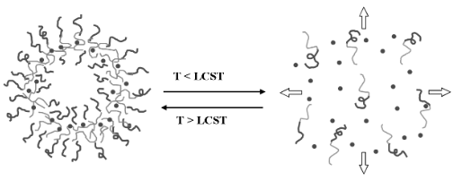
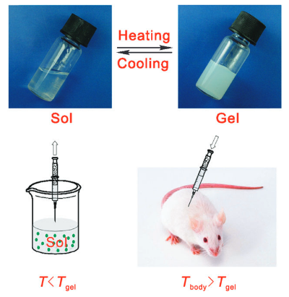
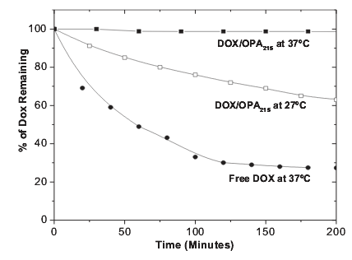
Thermoresponsive Polymers
Cellular Uptake
Controlled Drug Release
Tissue Engineering
Ward, M. A. Polymers 2011, 3, 1215.
Okano, T. Biomacromolecules 2009, 10, 1331.
Yang, S. Adv. Mater. 2006, 18, 2905.
Ding, J. Chem. Soc. Rev. 2008, 37, 1473.
2

Slide 3
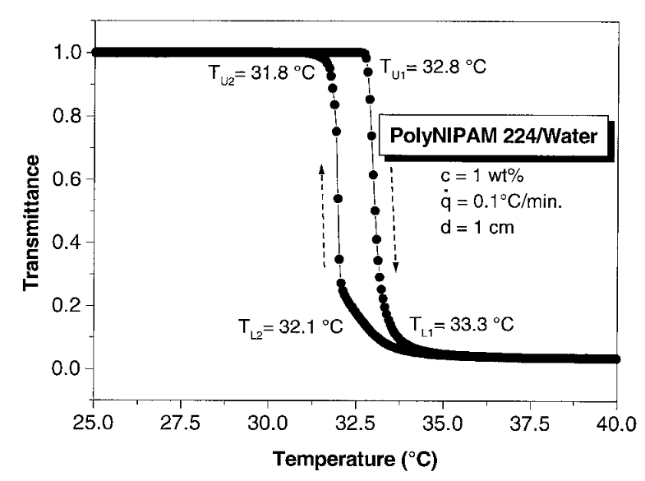
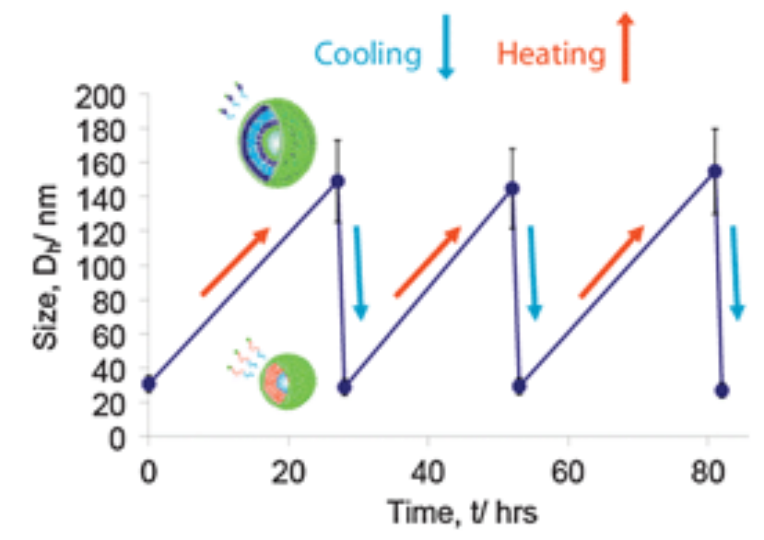
Thermoresponsive Polymers: pNIPAM
Exhibits sharp transition close to body temperature
Insensitive to other environmental conditions
Slow reversibility in certain systems
pNIPAM
Cooling
Heating
Djokpé, E. Macromol. Chem. Phys. 2001, 202, 750.
O'Reilly, R. K. Chem. Commun. 2011, 47, 355.
3

Slide 4
Tunable N_{agg} Micelles
Statistical Hydrophilic/ Responsive Core-Forming Block
Hydrophilic
Corona-Forming Block
What is the effect of N_{agg} on the thermoresponsive behaviour of a corona block?
p(DMAEMA-co-DEAEMA)-b-DMAEMA
O'Reilly, R. K. Polym. Chem. 2015, DOI: 10.1039/C4PY01782J.
4

Slide 5
Diblock Copolymer Design
Statistical Hydrophilic/ Hydrophobic Core-Forming Block
Responsive
Corona-Forming Block
p(DMA-co-nBA)-b-NIPAM
5

Slide 6
Diblock Copolymer Synthesis
Polymer | nBA:DMA Feed Ratio | DP nBA | DP DMA | Mol % nBA | Ð
MCTA | N/A | N/A | N/A | N/A | 1.07
1 | 1:1 | 20 | 17 | 54 | 1.10
2 | 7:3 | 26 | 11 | 70 | 1.11
3 | 4:1 | 27 | 7 | 79 | 1.10
4 | 9:1 | 37 | 4 | 90 | 1.11
5 | 1:0 | 40 | N/A | 100 | 1.11
6

Slide 7

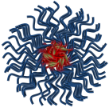



Micelle Preparation and Characterisation
R_{H}
R_{core}
R_{corona}
N_{agg}
Multiple angle DLS and SLS
7

Slide 8
Probing Thermoresponsive Behaviour: Turbidimetry and Microcalorimetry
Macroscopic Precipitation
T_{p}
Two Phase System
Cloud Point
One Phase System
8

Slide 9
Probing Thermoresponsive Behaviour: Turbidimetry and Microcalorimetry
T_{p}
Cloud point
Hysteresis
Transition temperature does not change with N_{agg}
Degree of hysteresis increases with increasing nBA composition in core forming block
9

Slide 10
Origin of Hysteresis in Highly Aggregated Micelles
Known to be a kinetic effect
Two Possible Conclusions:
Differences in intraparticle chain entanglement
Differences in core hydration
Heated to 40°C
Cooled and held at 30°C
10

Slide 11

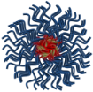
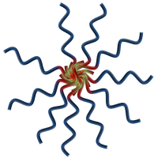
Probing Thermoresponsive Behaviour: Variable Temperature Light Scattering
Heat
L_{max,} _{corona}
R_{H}
Coronal Chain Collapse
R_{core}
R_{corona}
11

Slide 12
Probing Thermoresponsive Behaviour: Turbidimetry and Microcalorimetry
Macroscopic Precipitation
T_{p}
Coronal Chain Collapse
Two Phase System
Cloud Point
One Phase System
12

Slide 13

Conclusions
Well-defined polymers were synthesised by RAFT polymerisation
LLS determined the resultant micelles had tunable N_{agg}
The pNIPAM coronal chains were shown to collapse at temperatures lower than the normal transition temperature observed for unimers
The chain collapse and transition temperatures were found to be independent of N_{agg}
The degree of hysteresis was found to increase as a function of N_{agg}
Interchain entanglement at high N_{agg}
Low rate of water penetration at high nBA content
Coronal Chain Collapse
13

Slide 14

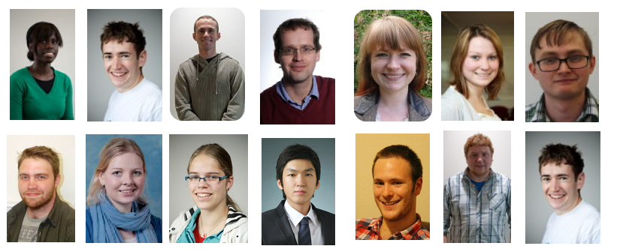



Acknowledgements
Malvern Instruments Ltd.
Dr. Daniel Wright
Dr. Mathew Robin
Prof. Rachel O’Reilly
Dr. Matthew Gibson
O’Reilly Group
Gibson Group
Funding Sources:
EPSRC
BP
ERC
IAS
Thank you!
@RORgroup @LabGibson
14

Slide 15
Responsive Assemblies for Biological Applications
Lewis D. Blackman,* Daniel B. Wright, Mathew P. Robin, Matthew I. Gibson and Rachel K. O’Reilly
University of Warwick, Gibbet Hill Road, Coventry, CV4 7AL, UK
@RORgroup @LabGibson

