Slide 1


An Introduction to Light Scattering Techniques for Characterisation of Self-Assemblies in Solution
Lewis Blackman
Department of Chemistry, University of Warwick, UK
L.D.Blackman@warwick.ac.uk
www.warwick.ac.uk/go/gibsongroup
@LabGibson @RORgroup
Midlands Young Researcher Meeting on Nanomaterials. 17/12/2015
University of Warwick

Slide 2
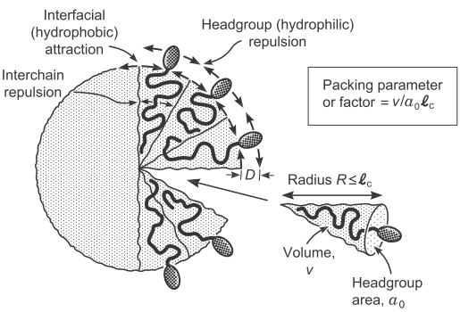
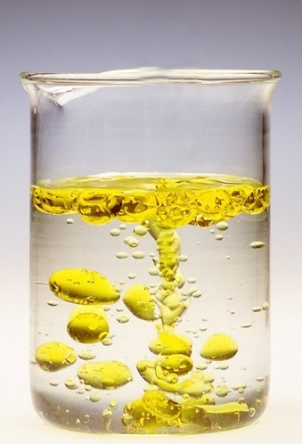
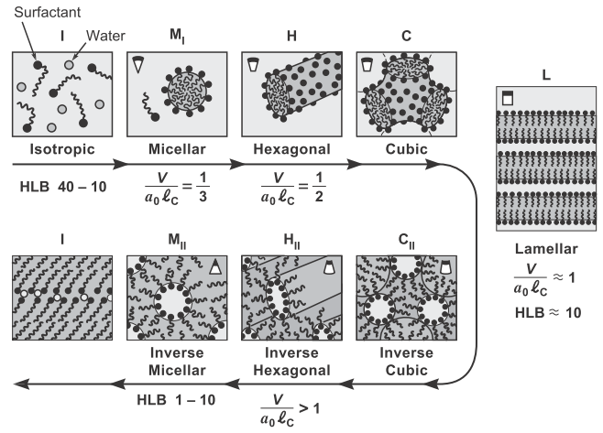

Introduction to Self-Assembly
Hydrophilic/ Lipophilic mixture
e.g. oil and water
Surfactants
Microphase Separation
Self-Assembly
Single surfactant molecule
a₀
Phase Separation
V
l_{c}
Israelachvili, J. N. Intermolecular and Surface Forces (Third Edition); Academic Press: San Diego, 2011

Slide 3
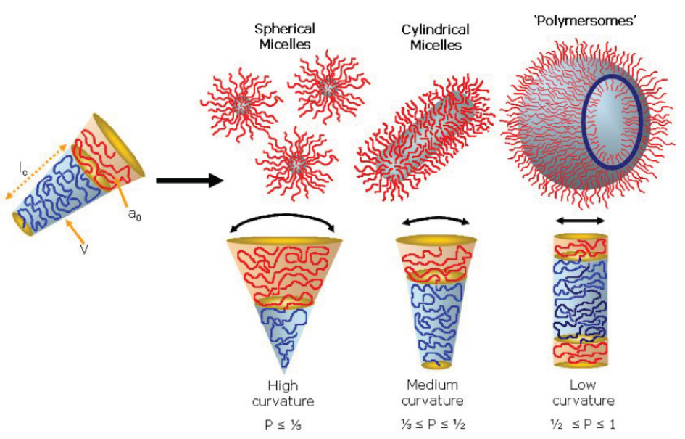
Block Copolymer Self-Assembly
Surfactant
Block Copolymer
a₀, l_{c} and V still important but difficult to calculate.
Inverted structures are typically not found (in solution)
No unimer exchange possible – frozen structures formed!
Ryan, A. J. et al. Macromol. Rapid Commun. 2009, 30, 267.

Slide 4
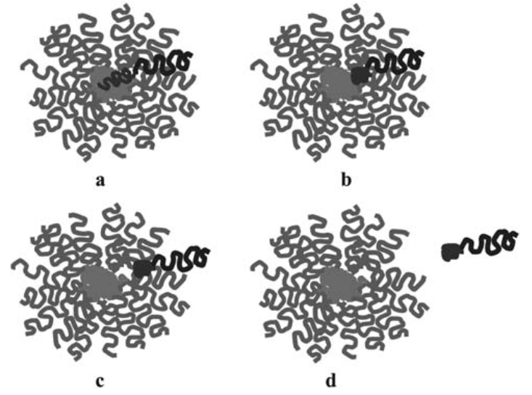
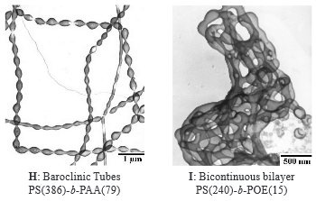
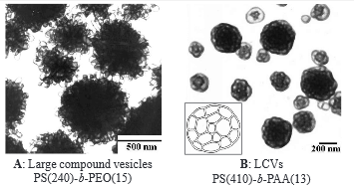
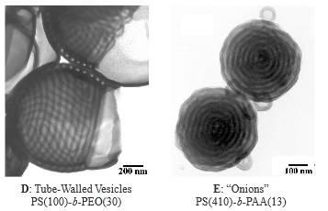
Block Copolymer Self-Assembly
Non-Ergodic Systems
Unimer Exchange Requires
Extraction of hydrophobic block from core
Interfacing with the polar solvent
Diffusion through the incompatible corona
All very high energy processes
Final Morphology Depends on Preparation Pathway
Eisenberg, A. et al. Can. J. Chem. 1999, 77, 1311.

Slide 5
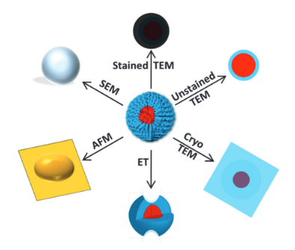
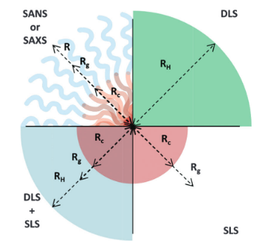
Analysis of Polymer Self-Assemblies
Microscopy
Light Scattering
O'Reilly, R. K. et al. Chem. Soc. Rev. 2014, 43, 2412.

Slide 6
Why Light Scattering?
+ Good statistics (measuring >10⁹ particles at once)
+ Analysis can be conducted in solution with minimal effect on the sample.
- Data is fit to a model (multiple structures or completely unknown structures can be very problematic)

Slide 7
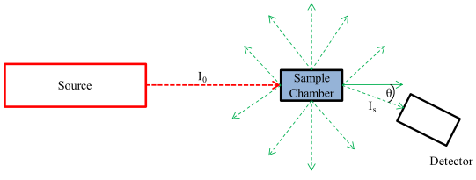
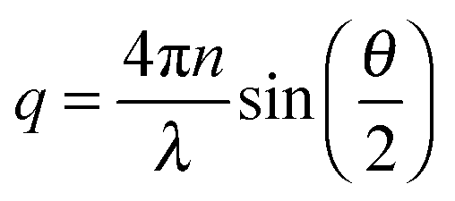
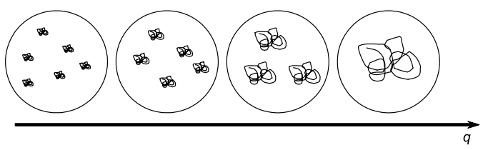
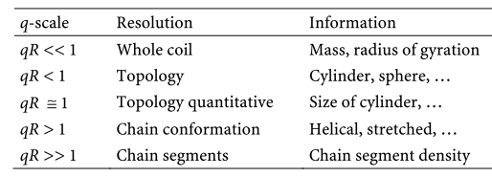
Light Scattering
All about q (scattering wave vector)
λ
Units: Reciprocal length
Schärtl, W. Light Scattering from Polymer Solutions and Nanoparticle Dispersions; Springer, 2007.

Slide 8
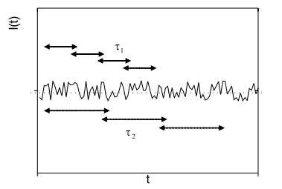
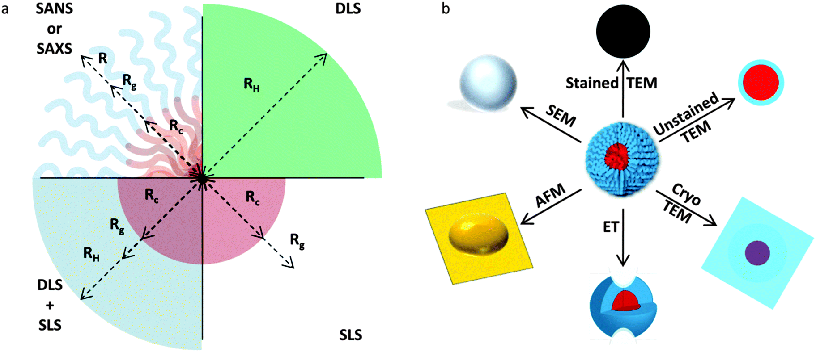
Dynamic vs. Static Light Scattering
Dynamic
Static
Schärtl, W. Light Scattering from Polymer Solutions and Nanoparticle Dispersions; Springer, 2007.

Slide 9
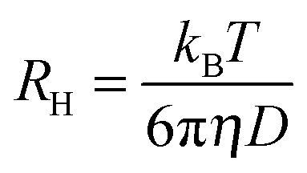
Dynamic Light Scattering
Measure changes in scattering intensity over short (e.g. millisecond) timescale
Changes are related to the speed at which particles move
This can then be related to the hydrodynamic radius, R_{H}
Stokes-Einstein equation

Slide 10

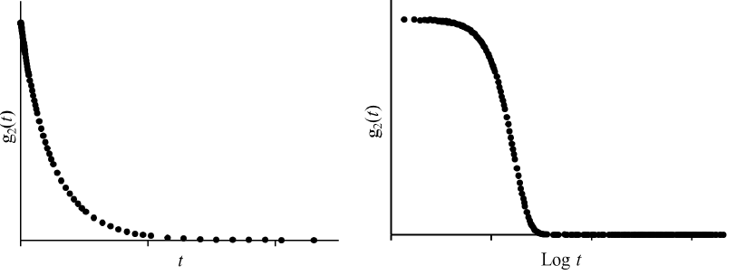

Dynamic Light Scattering
t=0
Detector
Increasing time
Detector
Detector
Wright, D. B. Thesis, University of Warwick, UK, 2015.

Slide 11



Dynamic Light Scattering
Measure I(t) at multiple angles (q) and concs (c)
Each measurement gives you a correlation function g₂(q,t)
Fit correlation function to get relaxation time
Single angle measurements do not confirm that sample is under Brownian motion or that the data is fit to correct mode of interest.
Robin, M. P. Thesis, University of Warwick, UK, 2014.

Slide 12
DLS – Limitations
Cannot measure the size of turbid solutions.
Cannot measure the size of aggregating or sedimenting particles.
Polyelectrolyte materials are difficult to analyse and require salt additives.
Surfactant-like molecules that promote the formation of bubbles can be problematic.

Slide 13
Static Light Scattering
Static light scattering (SLS)
Measure scattering intensity over long timescales (e.g. 1000τ) and average
Provides information on the mass, size, and viral coefficients of a system.
I = KCM_{w}S(q)
K = contrast factor (constant)
C = Concentration
Mw= Molecular weight
S(q) = structure factor
Schärtl, W. Light Scattering from Polymer Solutions and Nanoparticle Dispersions; Springer, 2007.

Slide 14
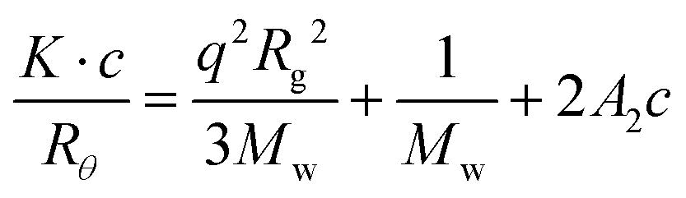
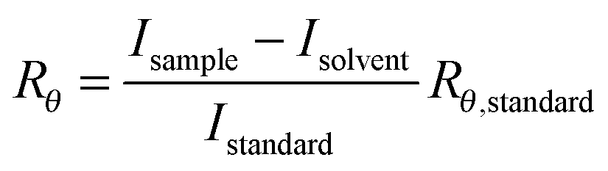
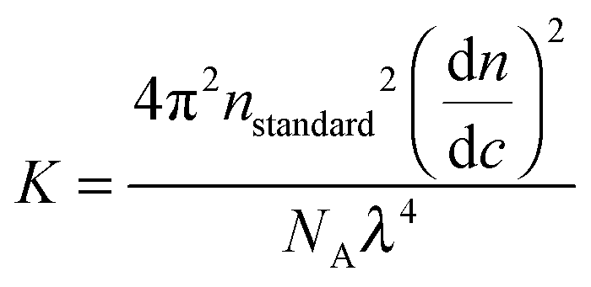
SLS – Zimm Equation
Zimm Approximation – qR_{g} < 1
I_{sample} is independent of S(q)
R_{g} from gradient
Rayleigh ratio
Optical Constant
M_{w} from intercept
dn/dc value is the source of most of the error.
Obtained using a refractometer or using literature values.
Typically a 10% error in Kc/R_{θ} is applied.
Zero q:
Kc/R_{θ,0} from intercept
Schärtl, W. Light Scattering from Polymer Solutions and Nanoparticle Dispersions; Springer, 2007.

Slide 15
SLS – Extrapolation to zero c
Absolute M_{w} from intercept
A₂ from slope
Why is this necessary?
To remove non-ideal interactions from calculation of M_{w}
To obtain second virial coefficient
Wright, D. B. Thesis, University of Warwick, UK, 2015.

Slide 16
SLS – Extrapolation to zero c
A₂ > 0
A₂ = 0
A₂ < 0
Slope = A₂
A₂ >0 particles like solvent more than itself
A₂<0 particle likes itself more than solvent, tend to aggregate
A₂=0 particle-solvent interactions equivalent to particle-particle interactions
Wright, D. B. Thesis, University of Warwick, UK, 2015.

Slide 17
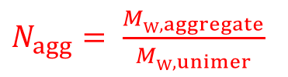
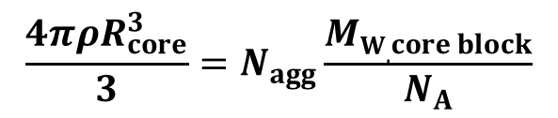
SLS – Additional Information
N_{agg}
Aggregation Number
Core Radius
O'Reilly, R. K. et al. Chem. Soc. Rev. 2014, 43, 2412.

Slide 18

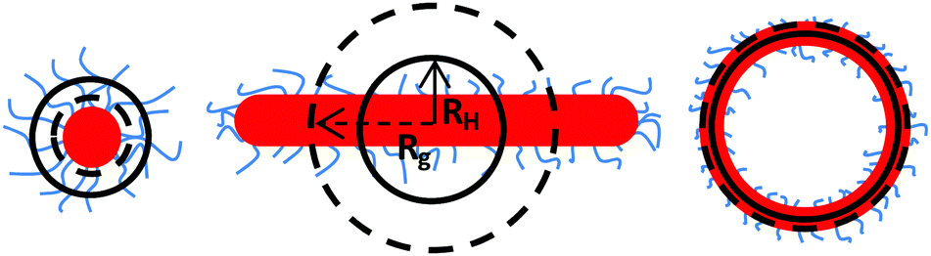
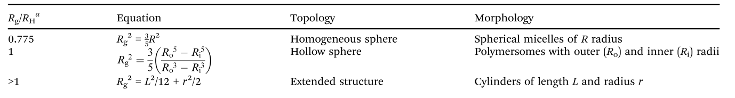
Combining SLS and DLS
O'Reilly, R. K. et al. Chem. Soc. Rev. 2014, 43, 2412.

Slide 19
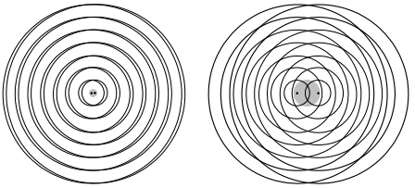
Light Scattering from Complicated Systems
Small particles
Scattering centres in close proximity
Minimal interference
Weak angular dependence
Large particles
Scattering centres further away
Interference is not negligible
Angular dependent scattering
Large particles scatter less light at higher angles
Schärtl, W. Light Scattering from Polymer Solutions and Nanoparticle Dispersions; Springer, 2007.

Slide 20
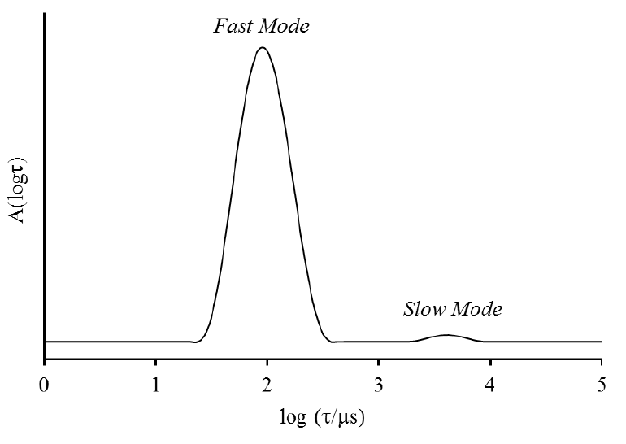
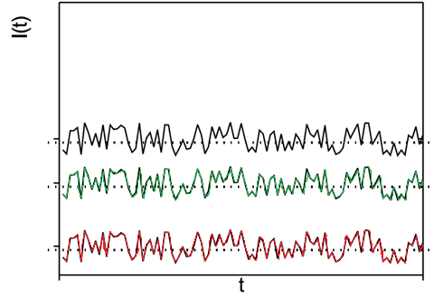
Light Scattering from Complicated Systems
DLS data at one angle
Angular independent
Angular dependent
Scattering at multiple angles
SLS data at multiple angles
50°
90°
130°
Wright, D. B. Thesis, University of Warwick, UK, 2015.

Slide 21
Light Scattering from Complicated Systems
A_{fast}
I_{fast} = A_{fast}I_{sample}
Kc/R_{θ, fast}
Using an inverse Laplace transformation, we can deconvolute the DLS fit if two or more modes are present
τ value for that mode obtains D and R_{H}.
Using the relative amplitudes of the modes, we can obtain the scattering contribution from the mode of interest.
We can then apply this to the SLS data in order to study one mode in isolation.
Wright, D. B. Thesis, University of Warwick, UK, 2015.

Slide 22
Conclusions
Light scattering is a non-destructive technique that can yield information on:
Particle hydrodynamic, core and corona radii and the radius of gyration
Morphology (R_{g}/R_{H})
The chain density within the particle (N_{agg})
Virial coefficients and particle-particle interactions (k_{D} and A₂)
Multiple angle DLS and SLS allows one to analyse complicated systems in situ
Can be used to compliment other analysis techniques such as microscopy and SANS/SAXS

Slide 23













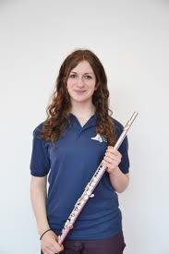
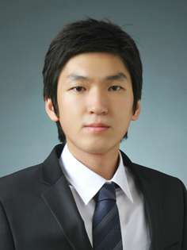





Acknowledgements
Dr. Mathew Robin
Dr. Daniel Wright
Dr. Matthew Gibson
Prof. Rachel O’Reilly

Slide 24
An Introduction to Light Scattering Techniques for Characterisation of Self-Assemblies in Solution
Lewis Blackman
Department of Chemistry, University of Warwick, UK
L.D.Blackman@warwick.ac.uk
www.warwick.ac.uk/go/gibsongroup
@LabGibson @RORgroup
Midlands Young Researcher Meeting on Nanomaterials. 17/12/2015
University of Warwick

