Slide 1


The Effect of Thermoresponsive Micellar Structure on Thermal Hysteresis
Lewis D. Blackman, Daniel B. Wright, Mathew P. Robin, Matthew I. Gibson and Rachel K. O’Reilly
Department of Chemistry, University of Warwick, UK
L.D.Blackman@warwick.ac.uk
www.warwick.ac.uk/gibsongroup
www.warwick.ac.uk/ror
@LabGibson @RORgroup
Macrogroup UK Young Researcher’s Meeting. 06/04/2016
University of Liverpool

Slide 2
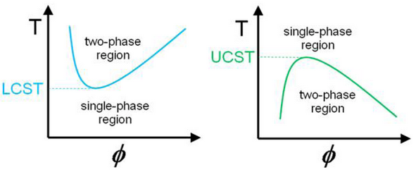
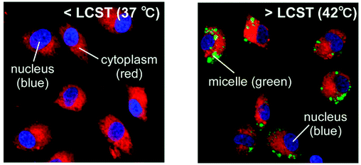
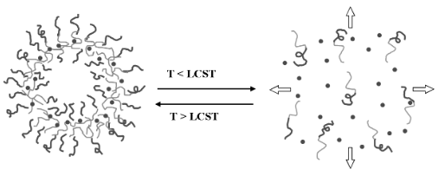
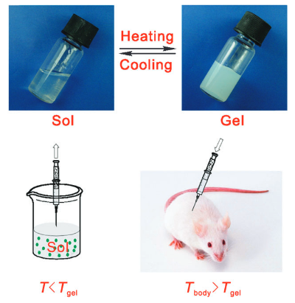
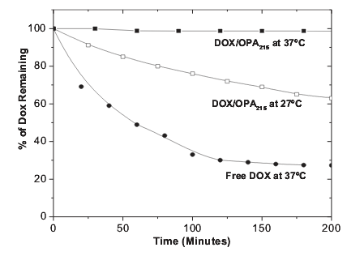

Thermoresponsive Polymers
Cellular Uptake
Controlled Drug Release
Tissue Engineering
Georgiou, T. K. Polymers 2011, 3, 1215. Okano, T. Biomacromolecules 2009, 10, 1331.
Yang, S. Adv. Mater. 2006, 18, 2905. Ding, J. Chem. Soc. Rev. 2008, 37, 1473.
2

Slide 3
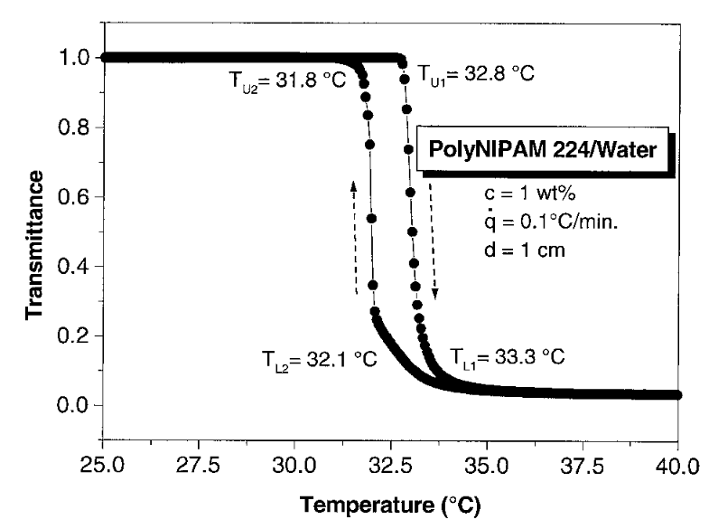
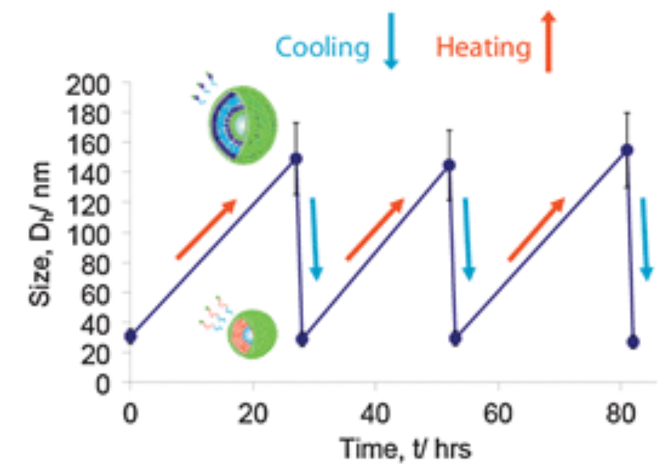
Thermoresponsive Polymers: pNIPAM
Exhibits sharp transition close to body temperature
Insensitive to other environmental conditions
Slow reversibility in certain systems
pNIPAM
Cooling
Heating
Djokpé, E.; Vogt, W. Macromol. Chem. Phys. 2001, 202, 750.
3
Moughton, A. O.; Patterson, J. P.; O'Reilly, R. K. Chem. Commun. 2011, 47, 355.

Slide 4
Tunable N_{agg} Micelles
Statistical Hydrophilic/ Responsive Core-Forming Block
Hydrophilic
Corona-Forming Block
What is the effect of N_{agg} on the thermoresponsive behaviour of a corona block?
p(DMAEMA-co-DEAEMA)-b-DMAEMA
Wright, D. B.; Patterson, J. P.; Pitto-Barry, A.; Cotanda, P.; Chassenieux, C.; Colombani, O.; O'Reilly, R. K. Polym. Chem. 2015, 6, 2761.
4

Slide 5





Diblock Copolymer Design and Micelle Preparation
Statistical Hydrophilic/ Hydrophobic Core-Forming Block
Responsive
Corona-Forming Block
p(DMA-co-nBA)₄₀-b-NIPAM₇₅
Blackman, L. D.; Wright, D. B.; Robin, M. P.; Gibson, M. I.; O’Reilly, R. K. ACS Macro Letters 2015, 1210.
5

Slide 6
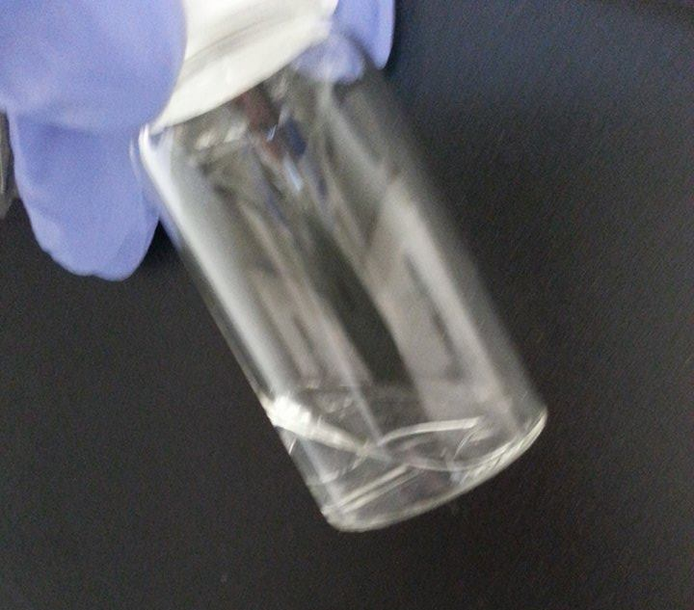


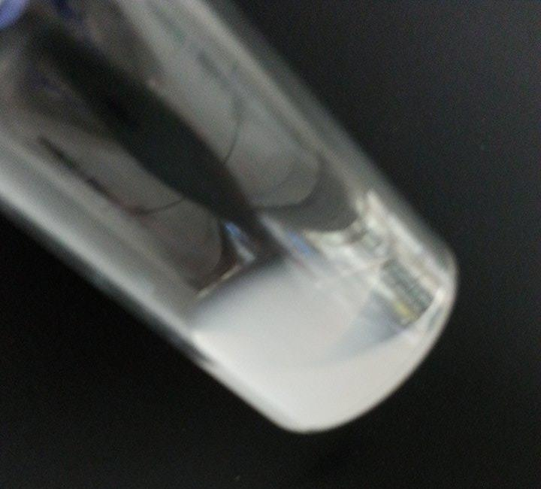
Probing Thermoresponsive Behaviour
Macroscopic Precipitation
T_{p}
Two Phase System
Cloud Point
One Phase System
Blackman, L. D.; Wright, D. B.; Robin, M. P.; Gibson, M. I.; O’Reilly, R. K. ACS Macro Letters 2015, 1210.
6

Slide 7
Probing Thermoresponsive Behaviour
T_{p}
Cloud point
Hysteresis
Transition temperature does not change with N_{agg}
Degree of hysteresis increases with increasing nBA composition in core forming block
Blackman, L. D.; Wright, D. B.; Robin, M. P.; Gibson, M. I.; O’Reilly, R. K. ACS Macro Letters 2015, 1210.
7

Slide 8
Origin of Hysteresis in Highly Aggregated Micelles
Known to be a kinetic effect
Two Possible Conclusions:
  Differences in intraparticle chain entanglement
  Differences in core hydration
Heated to 40 °C
Cooled and held at 30 °C
Blackman, L. D.; Wright, D. B.; Robin, M. P.; Gibson, M. I.; O’Reilly, R. K. ACS Macro Letters 2015, 1210.
8

Slide 9



Origin of Hysteresis in Highly Aggregated Micelles
pNIPAM₃₀₀
pNIPAM₃₀₀-b-nBA₂₈
pNIPAM₇₅-b-nBA₄₀
Degree of hysteresis is reduced by increasing weight fraction of the corona
  Differences in core hydration, as opposed to corona entanglement, lead to differences in hysteresis
Blackman, L. D.; Wright, D. B.; Robin, M. P.; Gibson, M. I.; O’Reilly, R. K. ACS Macro Letters 2015, 1210.
9

Slide 10
Investigating Hysteresis Using Other Thermoresponsive Coronas
pDEAm
pNIPAM
pDEGMA
x = 0.50
x = 0.54
x = 0.46
x = 0.69
x = 0.70
x = 0.68
x = 0.76
x = 0.79
x = 0.82
x = 0.88
x = 0.90
x = 0.88
x = 1.00
x = 1.00
x = 1.00
Polymer
Type
T_{g}
H bond donor?
1-5
Linear
High
No
6-10
Linear
High
Yes
11-15
Brush-like
Low
No
10

Slide 11
Investigating Hysteresis Using Other Thermoresponsive Coronas
pDEAm
pNIPAM
pDEGMA
11

Slide 12
Investigating Hysteresis Using Other Thermoresponsive Coronas
Nearly identical corona blocks with almost identical cloud points
pDEAm
pNIPAM
Hydrogen bonding ability plays major role in determining hysteresis
But…
Hysteresis can be introduced by hydrophobic core
12

Slide 13
Investigating Hysteresis Using Other Thermoresponsive Coronas
Similar corona blocks but with different cloud points and side-chain lengths
pDEGMA
pOEGMA
Corona | mol% nBA | Cloud Point/ °C | Hysteresis/ °C
pDEGMA | 45 | 20.3 | 0.4
pDEGMA | 69 | 21.0 | 0.5
pDEGMA | 77 | 19.8 | 0.1
pDEGMA | 87 | 20.5 | Irreversible
pDEGMA | 100 | 22.1 | Irreversible
Heating
Cooling
Heating
Cooling
13

Slide 14
Conclusions
Well defined responsive amphiphilic block copolymers were synthesised by RAFT polymerisation.
Multi-angle DLS and SLS revealed the resulting micelles had a tuneable N_{agg}.
The cloud point transition temperatures were found to be independent of N_{agg}.
The degree of hysteresis was shown to be dependent on the core block hydrophobicity.
Differences in the hysteresis was a result of differences in micellar core hydration.
Both hydrogen bonding ability and core composition played a role in determining hysteresis.
Coronas with a brush-like architecture showed irreversible phase transitions at high N_{agg}.
pNIPAM₃₀₀
pNIPAM₃₀₀-b-nBA₂₈
pNIPAM₇₅-b-nBA₄₀
pDEAm vs. pNIPAM
pDEGMA
pOEGMA
Blackman, L. D.; Wright, D. B.; Robin, M. P.; Gibson, M. I.; O’Reilly, R. K. ACS Macro Letters 2015, 1210.
14

Slide 15
























Acknowledgements
Malvern Instruments Ltd.
Dr. Daniel Wright
Dr. Mathew Robin
Prof. Rachel O’Reilly
Dr. Matthew Gibson
O’Reilly Group
Gibson Group
15

Slide 16
The Effect of Thermoresponsive Micellar Structure on Thermal Hysteresis
Lewis D. Blackman, Daniel B. Wright, Mathew P. Robin, Matthew I. Gibson and Rachel K. O’Reilly
Department of Chemistry, University of Warwick, UK
L.D.Blackman@warwick.ac.uk
www.warwick.ac.uk/gibsongroup
www.warwick.ac.uk/ror
@LabGibson @RORgroup
Macrogroup UK Young Researcher’s Meeting. 06/04/2016
University of Liverpool

