Slide 1


Glycosylated nanomaterials: Neutralisation and Detection of Bacteria and Toxins
Sarah-Jane Richards and Matthew I. Gibson
Department of Chemistry, University of Warwick, UK
s-j.richards@warwick.ac.uk
www.warwick.ac.uk/go/gibsongroup
www.warwick.ac.uk/sarahjane_richards
@LabGibson
MC12 20/07/15
York, UK

Slide 2
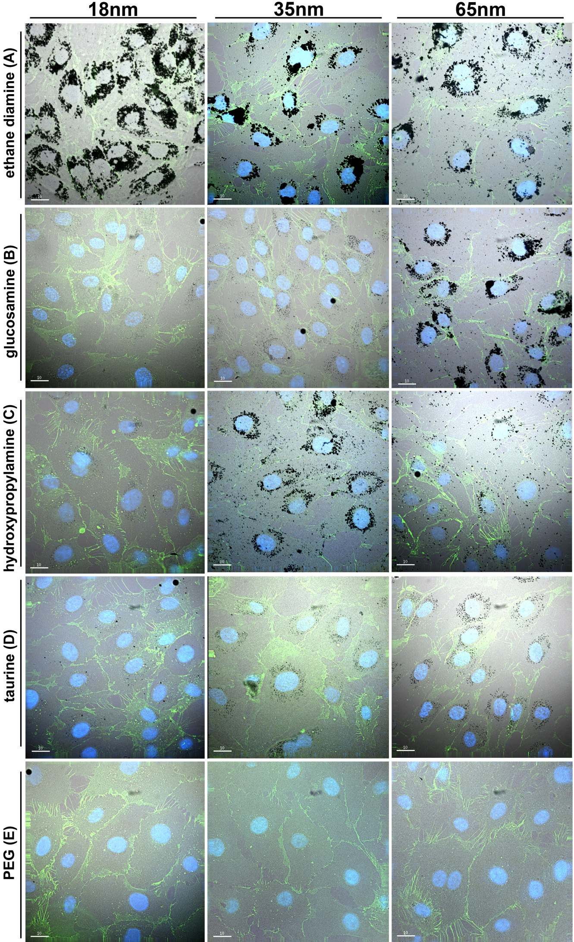
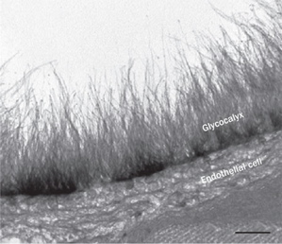
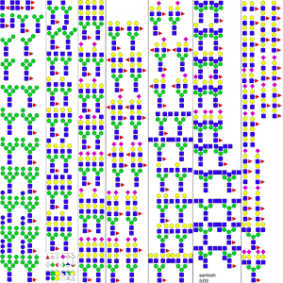
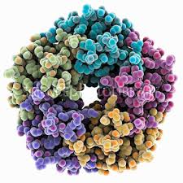
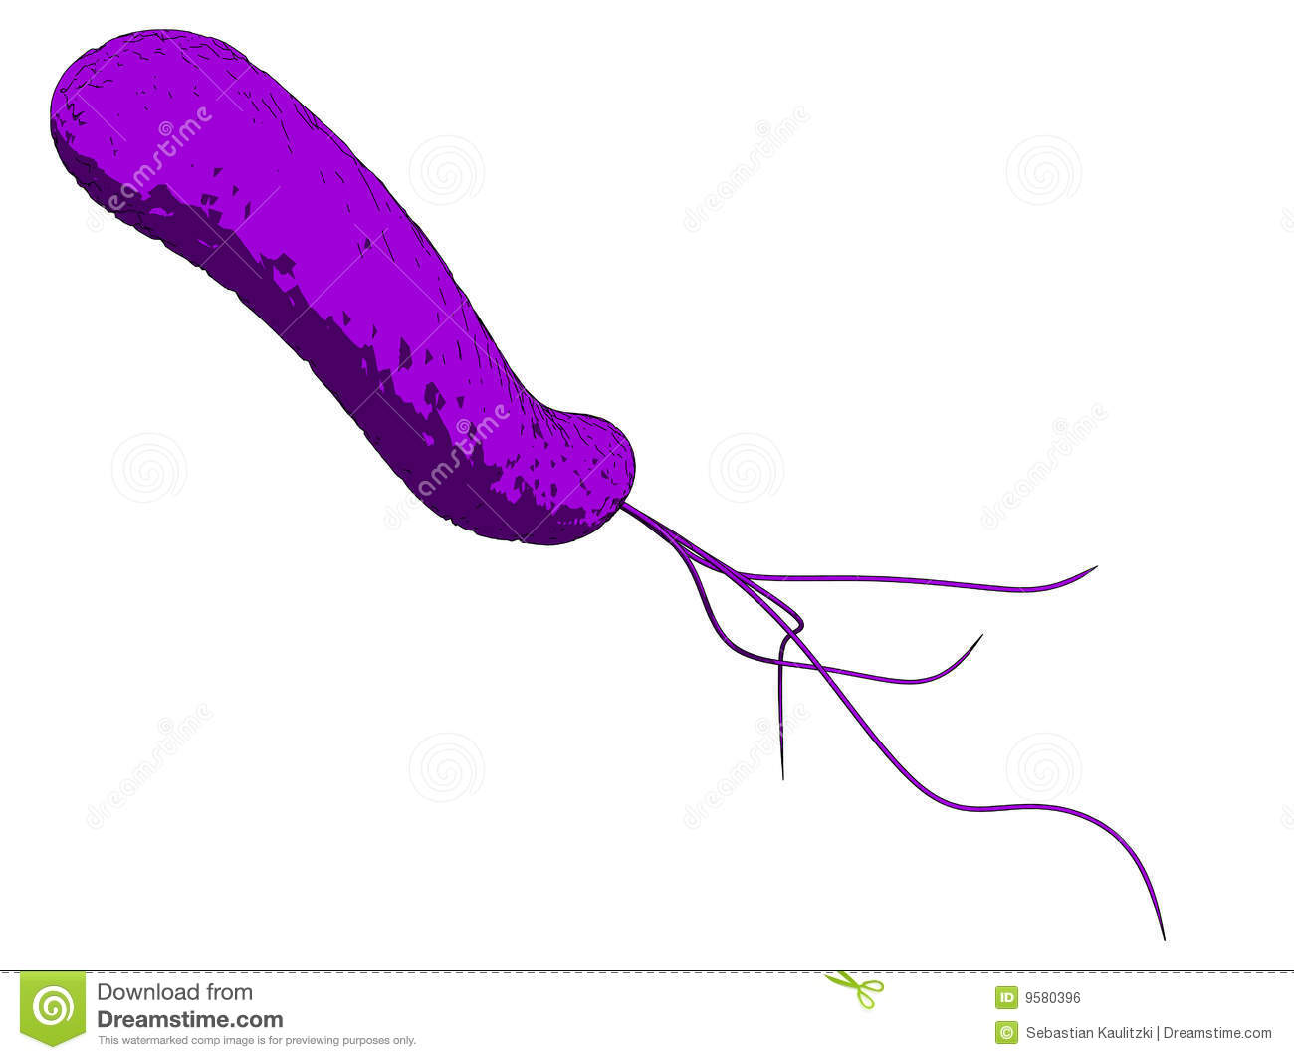
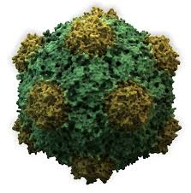
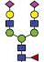

Glycans are Crucial Biomarkers
Selection of N-linked mammalian glycans d/load from P Stanley Lab
Cholera
Ricin
Influenza
Ebola
Shiga Toxins
HIV
Non antibiotic solutions to resistance
Treatment
Diagnosis
Understanding

Slide 3
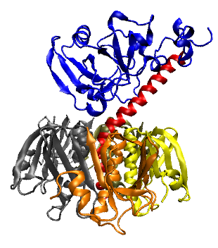
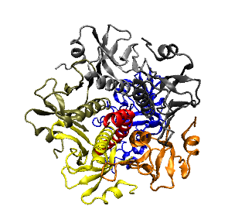
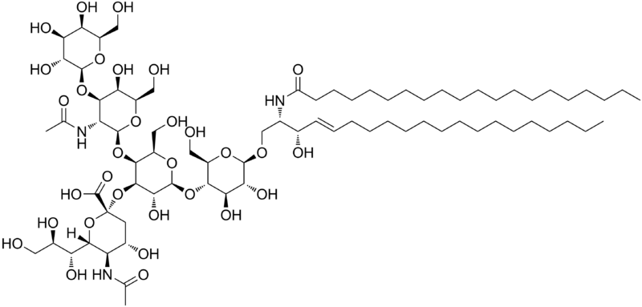
Selective Binding of Cholera-Toxin
Enzymatic domain
Induces toxic effect
Carbohydrate binding domain
Binds to epithelial cells to promote cell uptake
Anti-adhesion therapy does not target bacteria, so less evolutionary stress
Galectins – at least 13
Sigma-Aldrich – 8 Galactose-’specific’ lectins
β-D Galactose
How do we engineer a high-affinity binder for cholera toxin, without total synthesis of complex carbohydrates?
GM-1 ganglioside

Slide 4
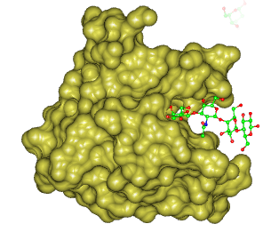
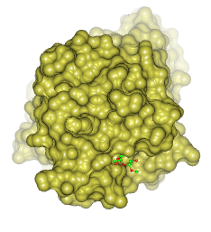
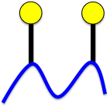
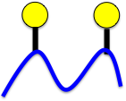
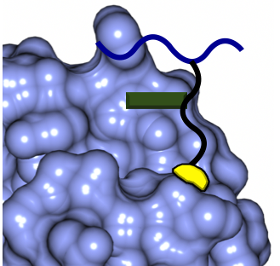
Structural Biology Guided Design
Binding Site Accessibility
Cholera Inhibition Activity
<<<
Angew. Chem. Int. Ed., 2012, 51, 7812
Allosteric Interactions
Chem. Sci., 2014, 5, 1611

Slide 5
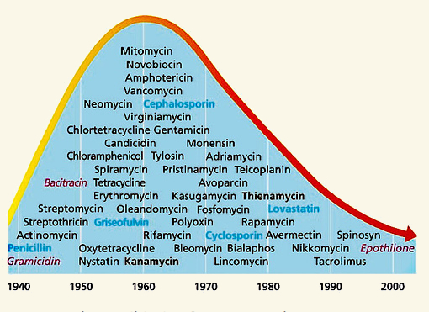
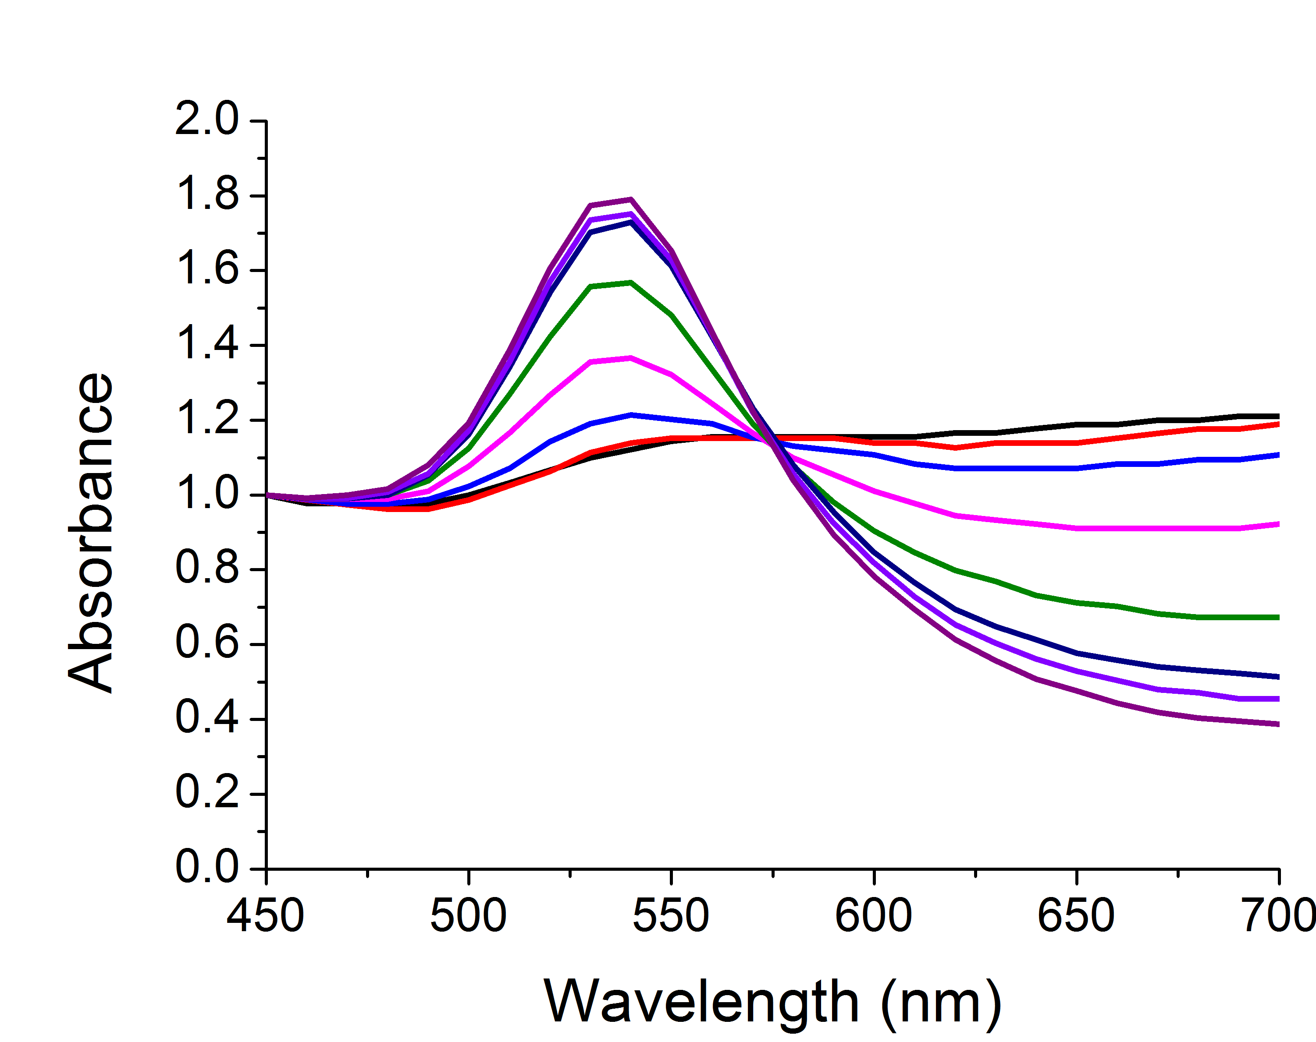
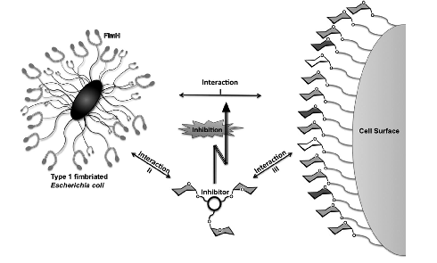
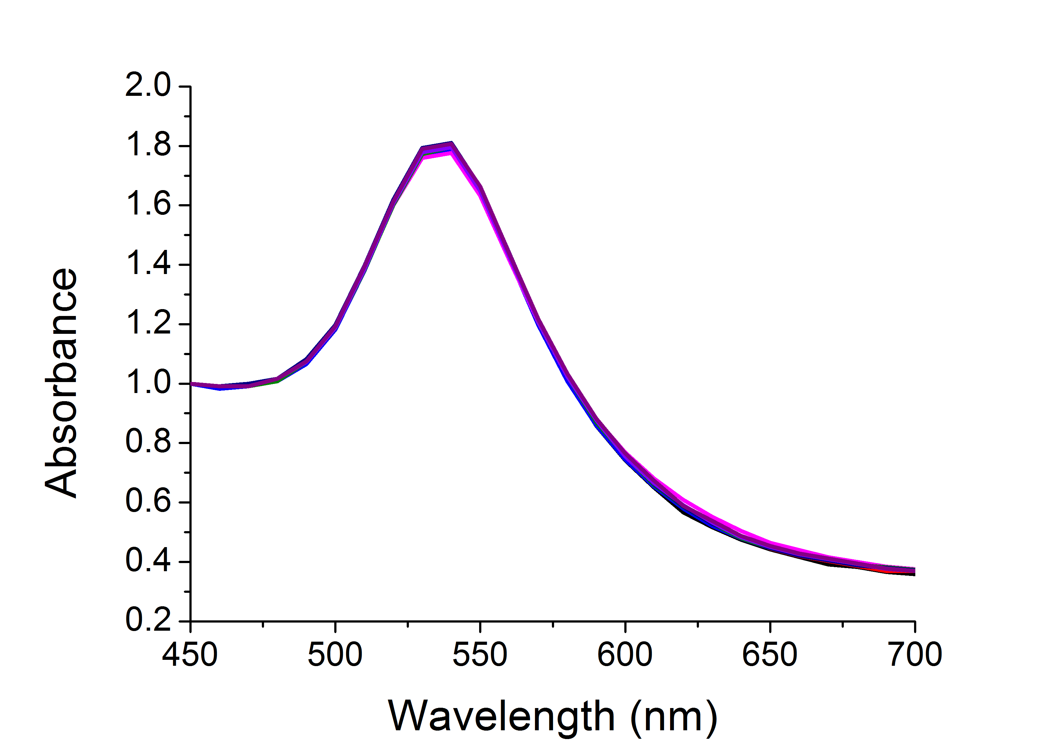
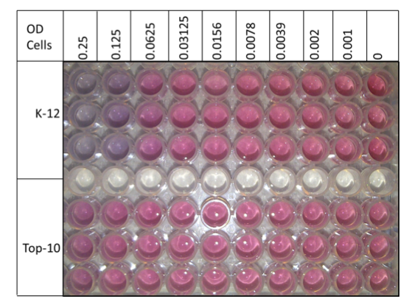
Direct
Label-free
Easy
Sensitive
Quantifiable in real-time

Slide 6
[ConA]
Richards, S-J., Fullam, E., Besra, G. S. Gibson, M. I.; J. Mater. Chem. B, 2014, 2, 1490-1498

Slide 7
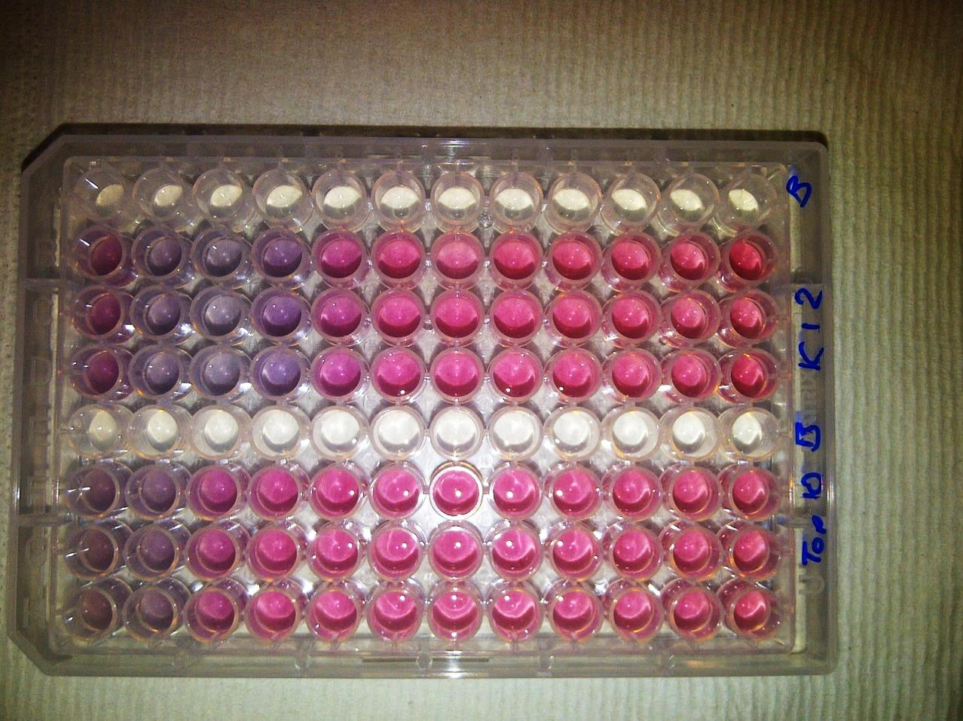

Bacteria induced aggregation
[FimH+ bacteria]
[FimH- bacteria]
Colour Change ☑
Fast ☑
Specific ☑
Saline Stability ☒
Bacteria induced colour change
K-12
+ FimH
TOP10
- FimH
OD = 0.25
OD 0.005
[Bacteria]
Richards, S-J., Fullam, E., Besra, G. S. Gibson, M. I.; J. Mater. Chem. B, 2014, 2, 1490-1498

Slide 8
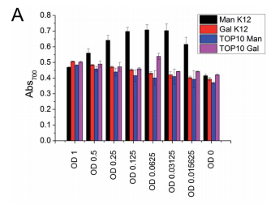
40 nm
n = 68
Colour Change ☒
Fast ☒
Specific ☑
Saline Stability ☑
Con A induced aggregation
Directly functionalised
PEG functionalised
Bacteria induced aggregation
[ConA]
Richards, S-J., Fullam, E., Besra, G. S. Gibson, M. I.; J. Mater. Chem. B, 2014, 2, 1490-1498

Slide 9
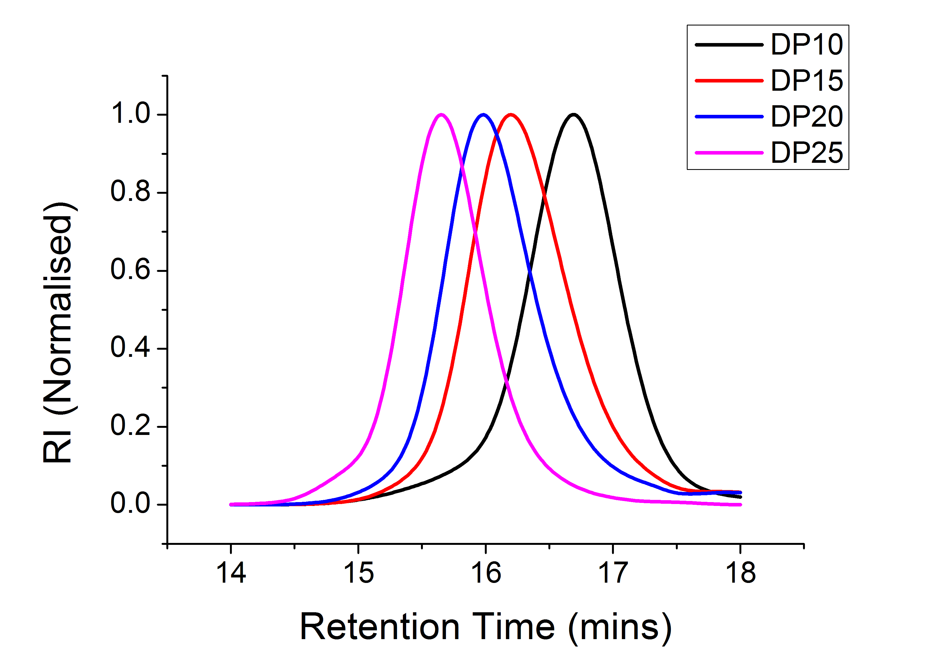
SEC of sizes
Kinetics of colour change
Optimisation of polymer coating
Richards, S-J and Gibson, M. I.; Macro Lett., 2014, 2, 1490-1498, 1, 1004-1008

Slide 10
Soy bean agglutinin induced aggregation
Rapid colour change (< 5 mins)
[SBA]
[SBA]
Colour Change ☑
Fast ☑
Specific ☑
Saline Stability ☑
Highly specific change
Aggregation behaviour confirmed by DLS
Richards, S-J and Gibson, M. I.; Macro Lett., 2014, 2, 1490-1498, 1, 1004-1008

Slide 11
Underivatised reducing sugars
Richards, S-J., Otten, L. O., Gibson, M. I.; Submitted

Slide 12
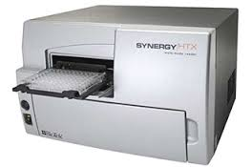
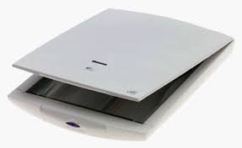
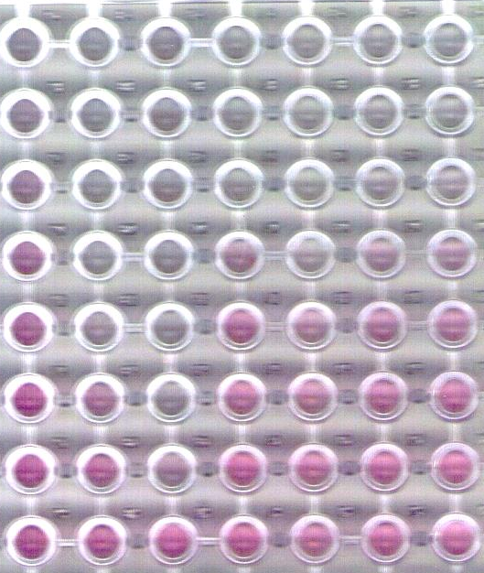
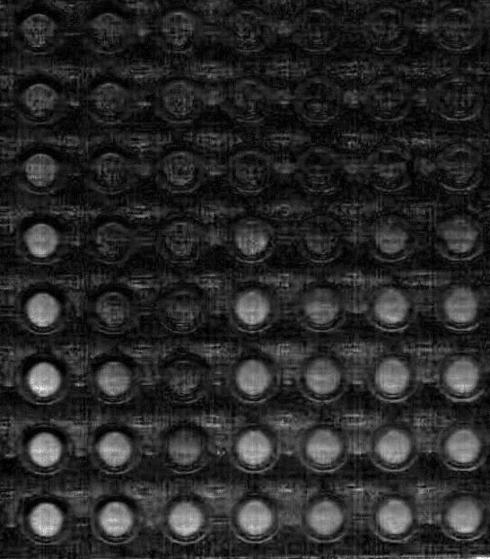
Low-cost, low resource detection
vs
£10,000
£50
Richards, S-J., Otten, L. O., Gibson, M. I.; Submitted

Slide 13
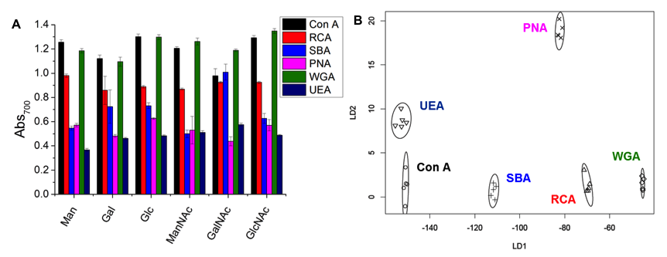
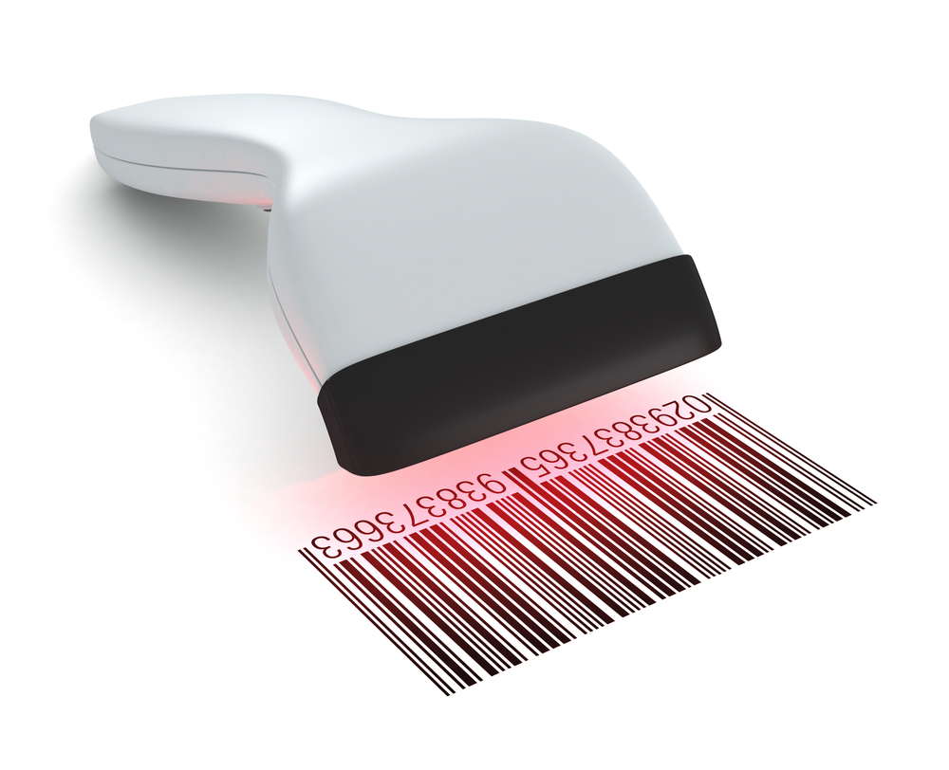
Lectin Screening and Discrimination
Otten, L. O. and Gibson, M. I. RSC Adv., 2015,5, 53911-53914
Richards, S-J., Otten, L. O., Gibson, M. I.; Submitted

Slide 14
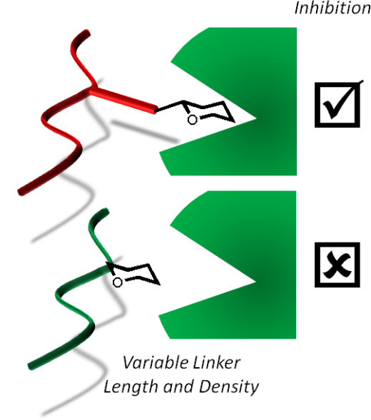
Summary
Tandem Post-Polymerisation Modification
Multivalent inhibitors that have good affinity AND specificity
Glycogoldnanoparticles
Optimised polymer coating for lectin detection and discrimination
Towards low-cost, low-resource diagnostics

Slide 15
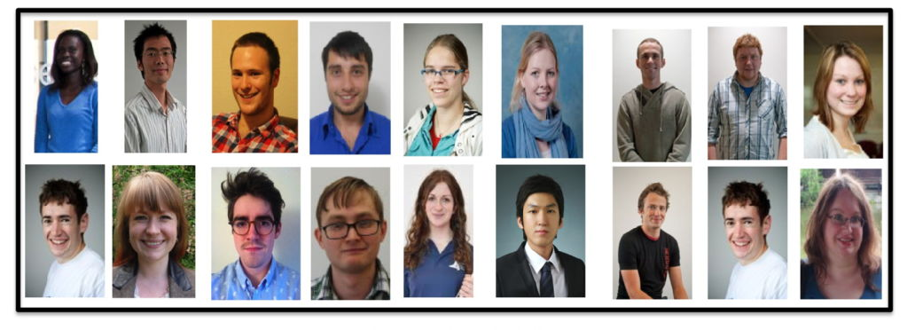





Acknowledgements
P178
P026
P001
P021
Gibson Group Members
Dr Gemma-Louise Davies - Daniel Mitchell
Dr Yunhua Chen - Richard Lowery
Dr Catherine Cooper - Ben Martyn
Dr Robert Deller - Lewis Blackman
Dr Daniel Phillips - Sang-Ho Won
Tom Congdon - Laura Wilkins
Caroline Biggs - Jamie Kasperczak-Wright
Lucienne Otten - Matt Probert
Dr Matthew Gibson
Prof. David Haddleton
Prof. Gurdyal Besra
Dr Elizabeth Fullam
Dr Mathew Jones

Slide 16
Glycosylated nanomaterials: Neutralisation and Detection of Bacteria and Toxins
Sarah-Jane Richards and Matthew I. Gibson
Department of Chemistry, University of Warwick, UK
s-j.richards@warwick.ac.uk
www.warwick.ac.uk/go/gibsongroup
www.warwick.ac.uk/sarahjane_richards
@LabGibson
MC12 20/07/15
York, UK

Slide 17
Glycopolymers by Post-Polymerisation Modification
Jones, M. W., Richards, S-J., Haddleton, D. M. Gibson, M. I.; Polym. Chem., 2013,
Richards, S-J., Jones, M. W., Hunabun, M. I., Haddleton, D. M., Gibson, M. I.; Angew. Chem., 2012
Jones, M. W., L. Otten, Richards, S-J., Lowery, R., Phillips, D. J. Haddleton, D. M. Gibson, M. I.; Chem. Sci., 2014

