Slide 1


Glycosylated gold nanoparticle biosensors:
Label-free and high-throughput evaluation of glycan-lectin interactions
Sarah-Jane Richards and Matthew I. Gibson
Department of Chemistry, University of Warwick, UK
@LabGibson
@RichardsSJ
www.warwick.ac.uk/sarahjane_richards
ICS 2016 18/07/16
New Orleans, LA, USA
s-j.richards@warwick.ac.uk

Slide 2
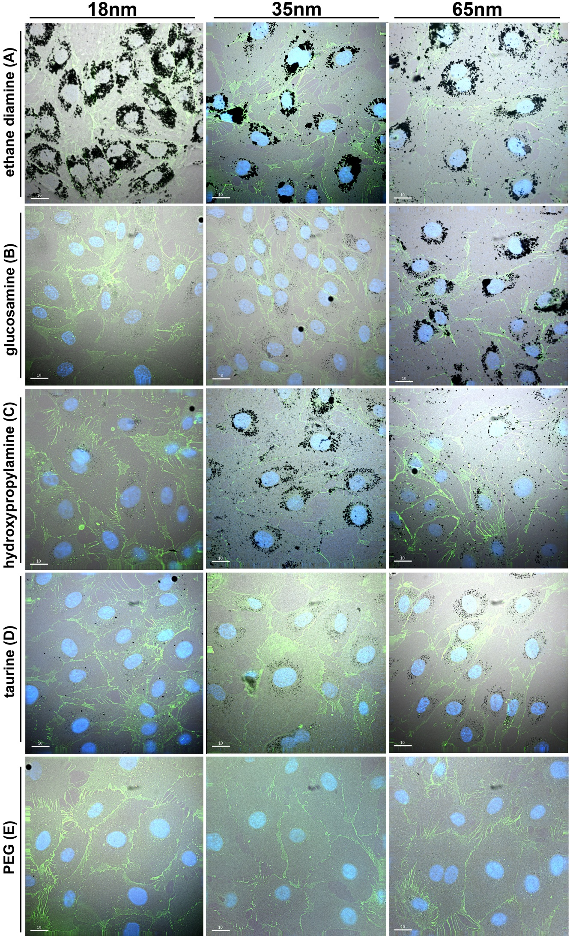
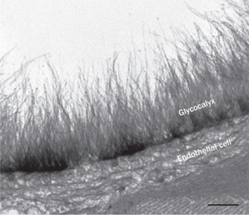
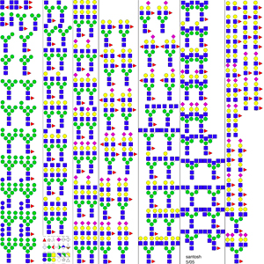
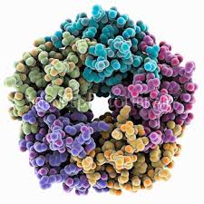
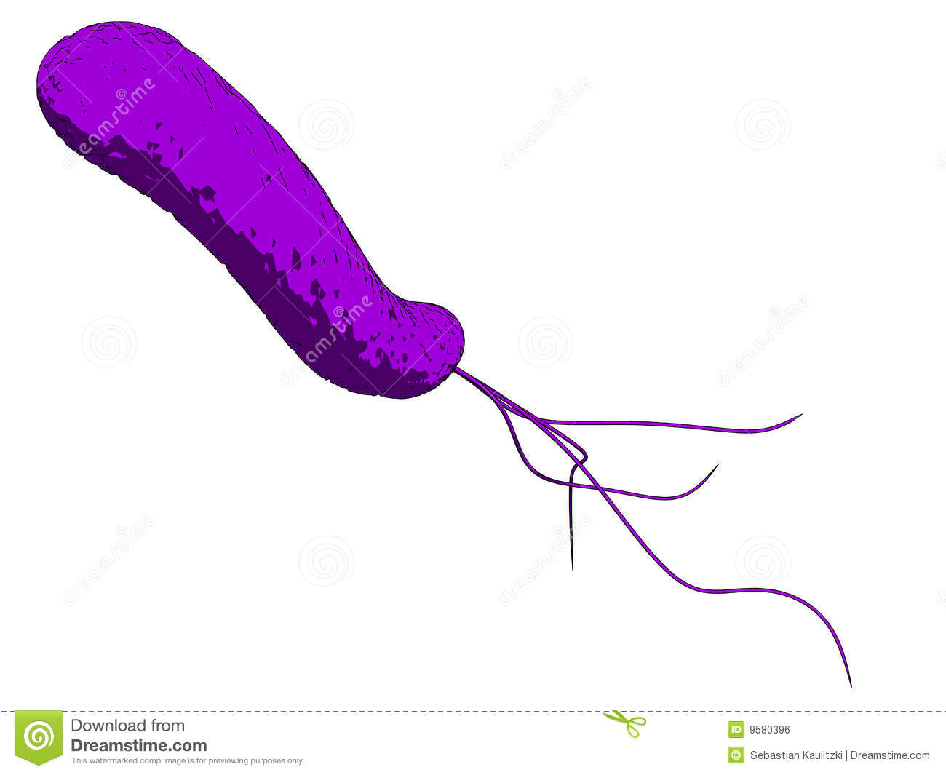
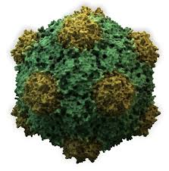
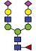

Glycans are Crucial Biomarkers
Selection of N-linked mammalian glycans d/load from P Stanley Lab
Cholera
Ricin
Influenza
Ebola
Shiga Toxins
HIV
Non antibiotic solutions to resistance
Treatment
Diagnosis
Understanding

Slide 3
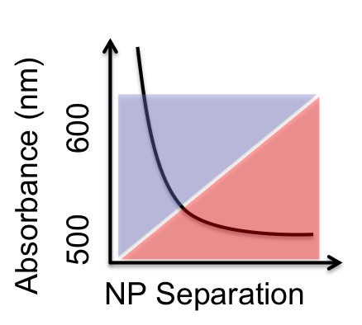
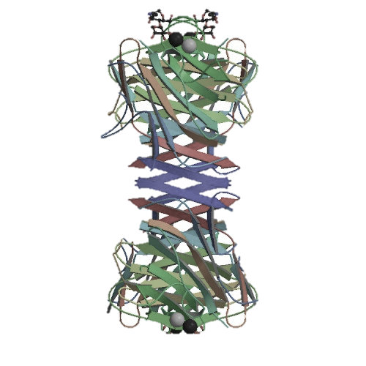
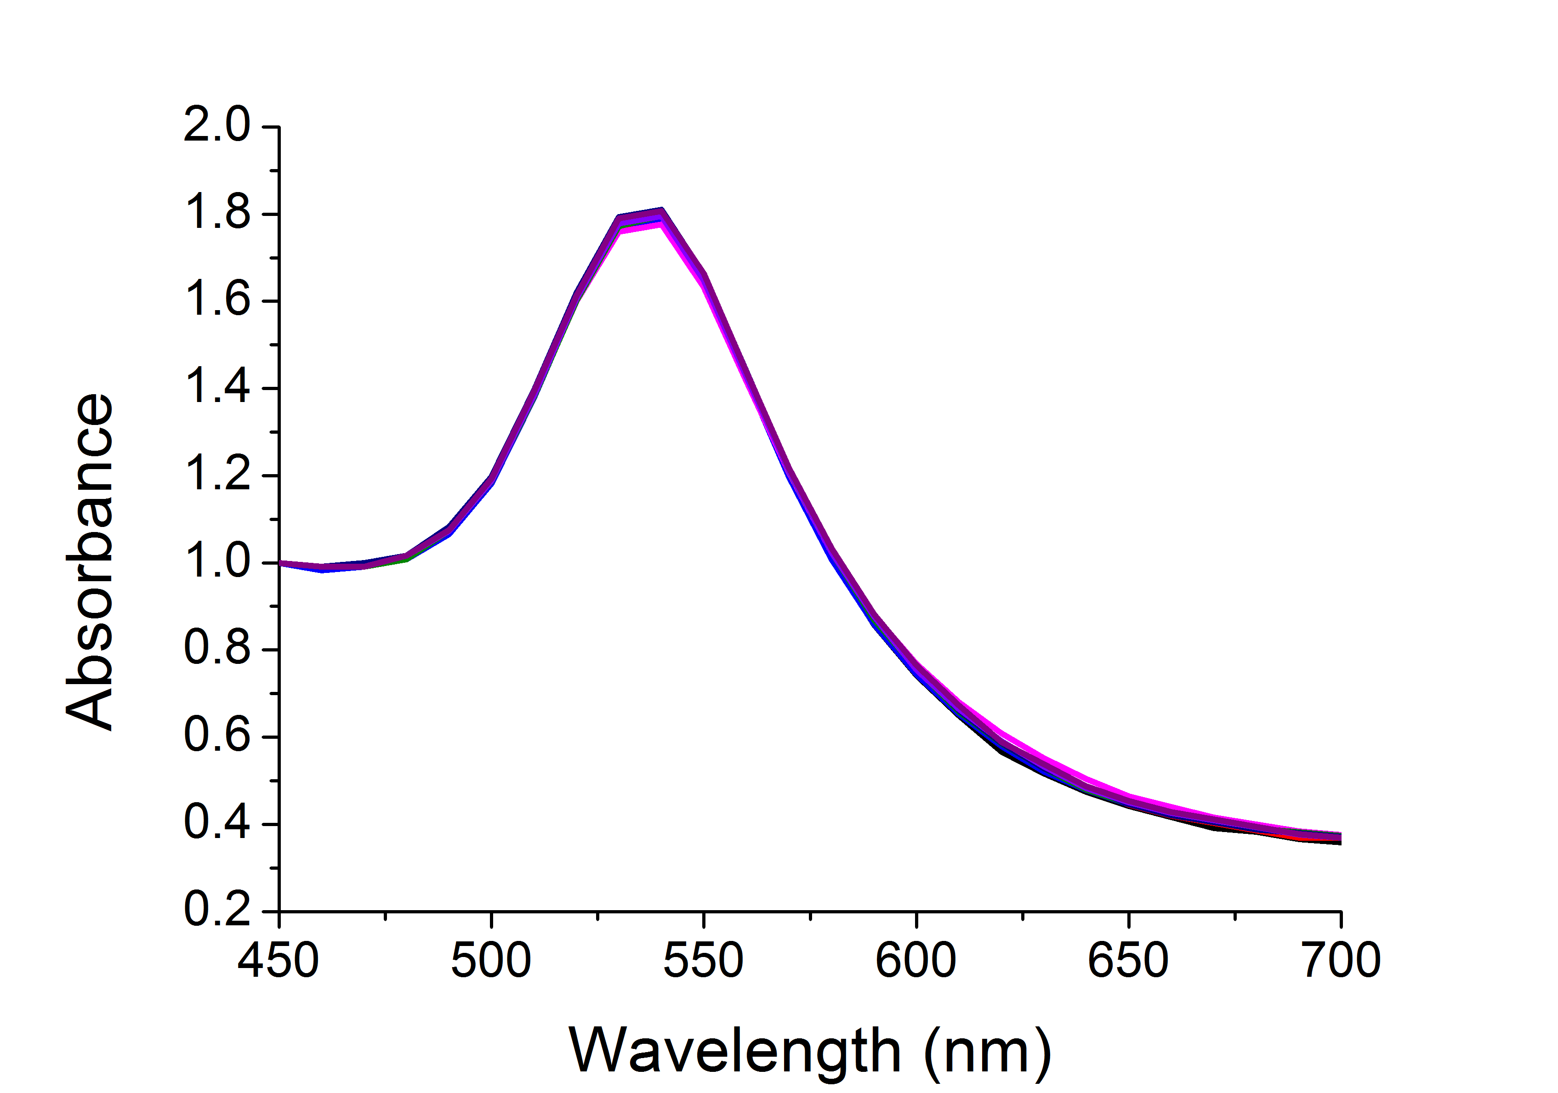
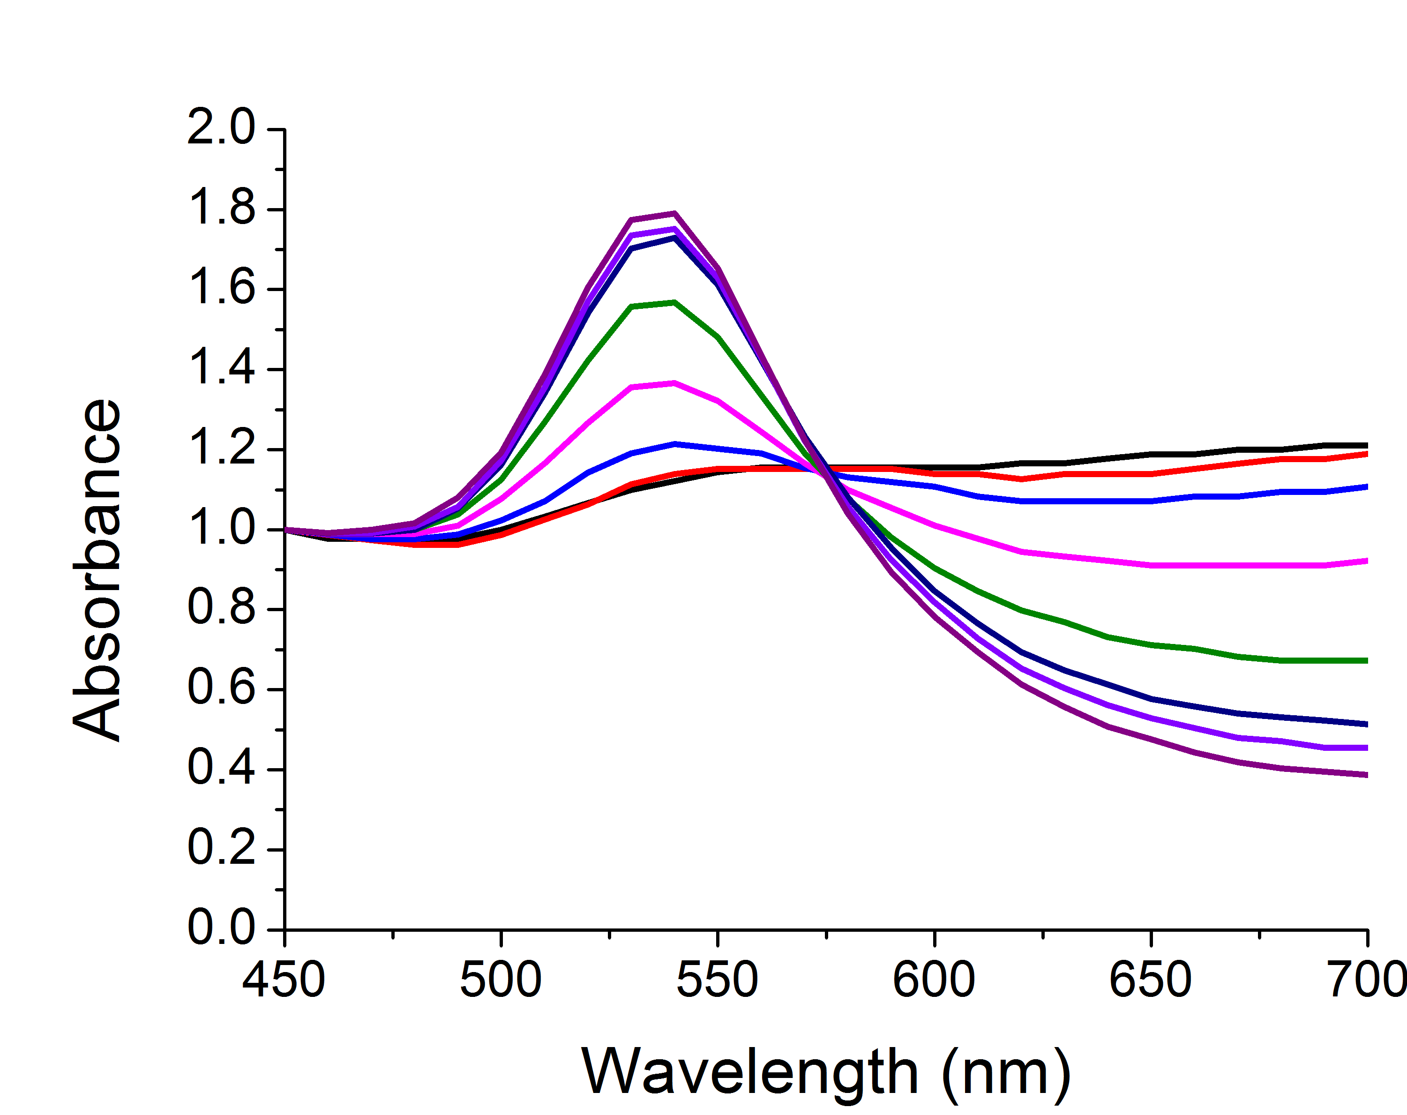
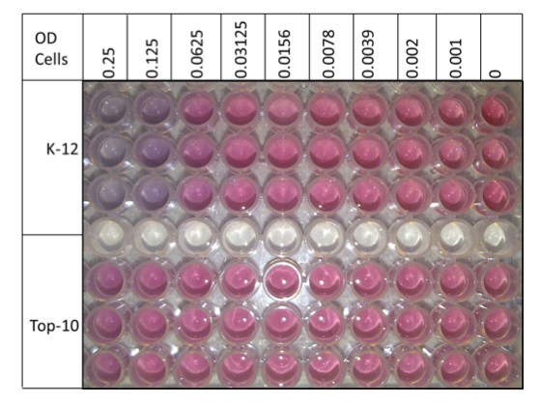
Label-Free Biosensing

Slide 4
Glycosylated Gold Nanoparticles
[ConA]
Colour Change ☑
Fast ☑
Specific ☑
Saline Stability ☒
Richards, S-J., Fullam, E., Besra, G. S. Gibson, M. I.; J. Mater. Chem. B, 2014, 2, 1490-1498

Slide 5
PEG-Stabilized AuNPs
40 nm
Colour Change ☒
Fast ☒
Specific ☑
Saline Stability ☑
n = 68
Con A induced aggregation
Directly functionalised
PEG functionalised
[ConA]
Richards, S-J., Fullam, E., Besra, G. S. Gibson, M. I.; J. Mater. Chem. B, 2014, 2, 1490-1498

Slide 6
Optimisation of polymer coating
Masked thiol for immobilization on to AuNP
Thiol for immobilization on to AuNP
Sugar conjugation site
Sugar for lectin recognition
Richards, S-J., Biggs, C. I, Gibson, M. I., Methods in Molecular Biology; Macro-Glycoligands, 2016, Series Vol 1367

Slide 7
Conjugation Versatility
Richards, S-J., Biggs, C. I, Gibson, M. I., Methods in Molecular Biology; Macro-Glycoligands, 2016, Series Vol 1367
S-J. Richards, C. I. Biggs, M. I, Gibson, Methods in Molecular Biology; Macro-Glycoligands, 2016, Series Vol 1367

Slide 8
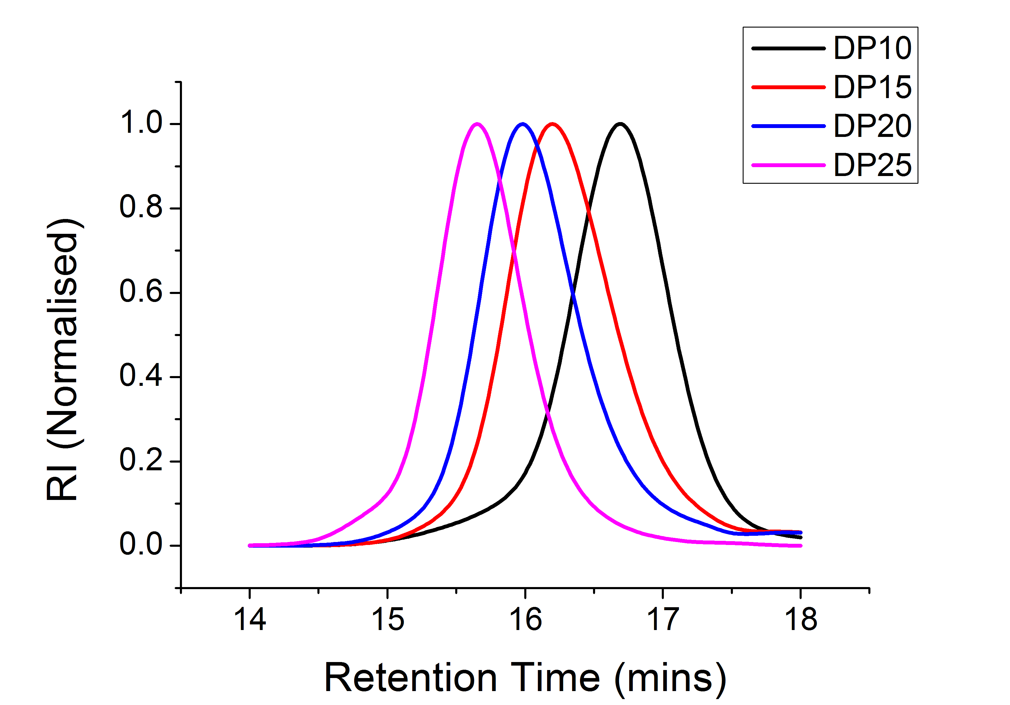
Optimisation of Polymer Coating
60 nm
Size Exclusion Chromatographs
Saline stability
Kinetics of colour change
Richards, S-J., Gibson, M. I. ACS Macro Lett., 2014, 3, 1004-1008

Slide 9
Lectin Specificity and Speed of Readout
Soy bean agglutinin induced aggregation
Rapid colour change (< 5 mins)
[SBA]
[SBA]
Colour Change ☑
Fast ☑
Specific ☑
Saline Stability ☑
Highly specific change
Aggregation behaviour confirmed by DLS
Richards, S-J., Gibson, M. I. ACS Macro Lett.., 2014, 3, 1004-1008

Slide 10
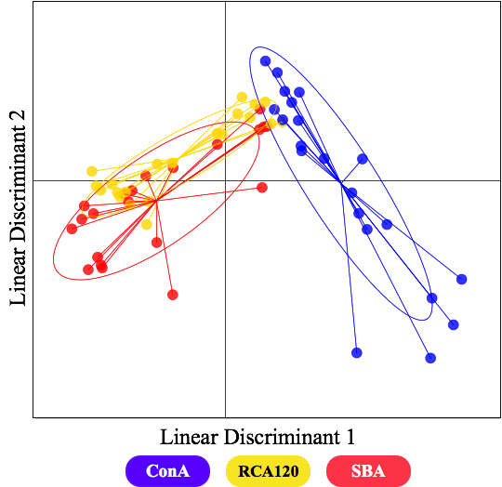
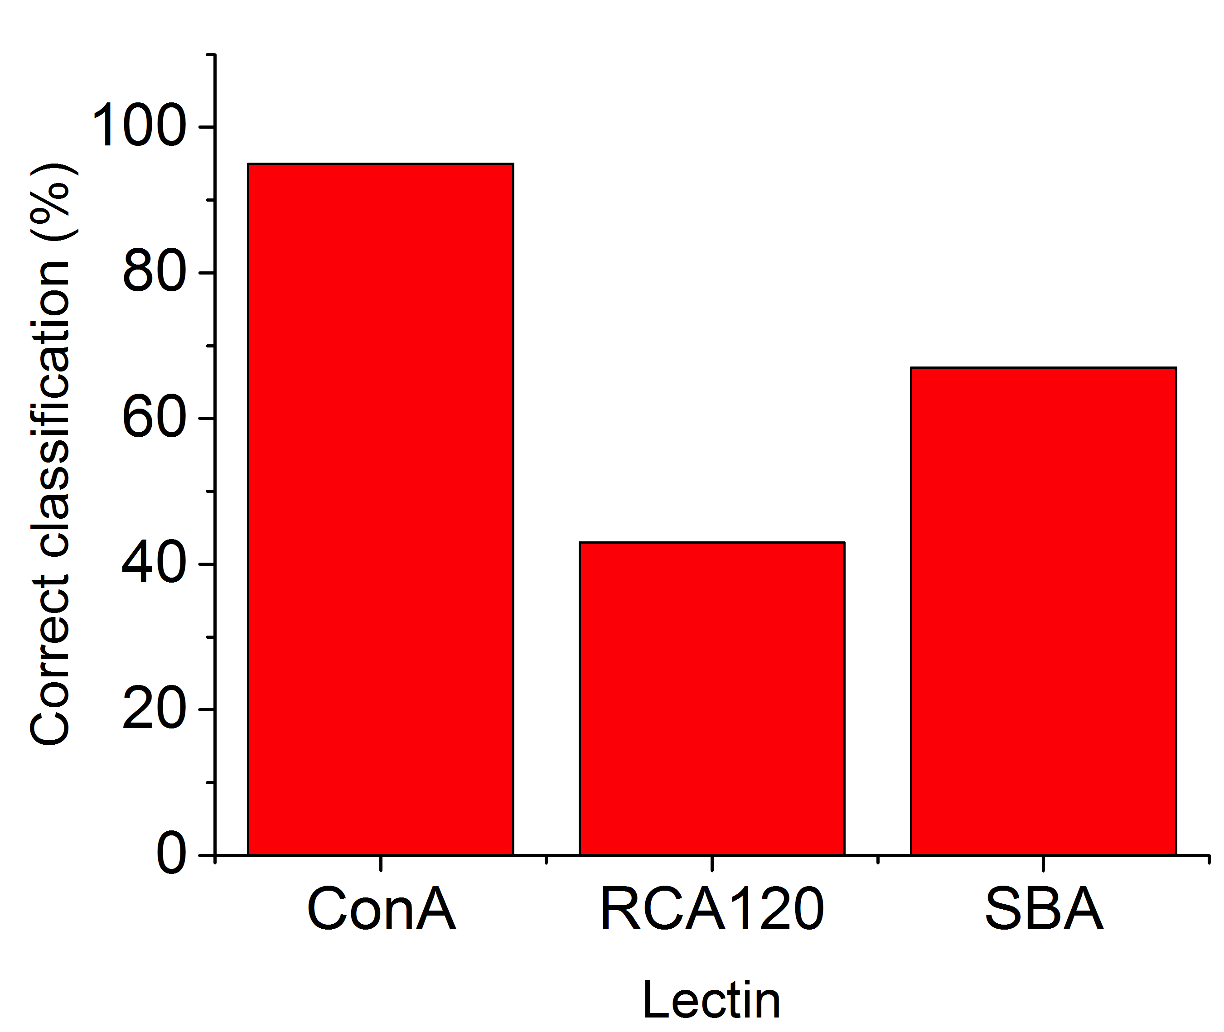
Lectin Discrimination
Man
Gal
Otten, L., Vlachou, D, Richards, S-J.*, Gibson, M. I.; Analyst., 2016, 141, 4305-4312

Slide 11
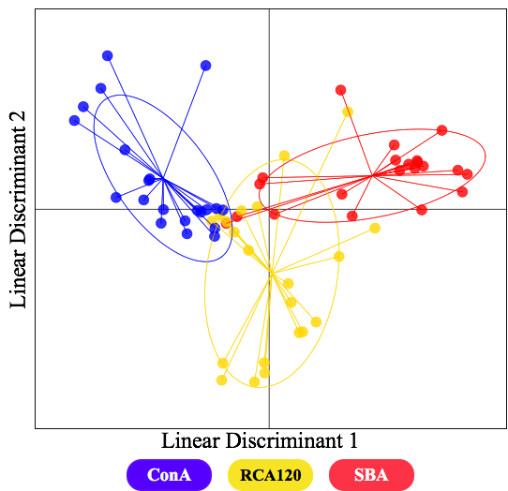
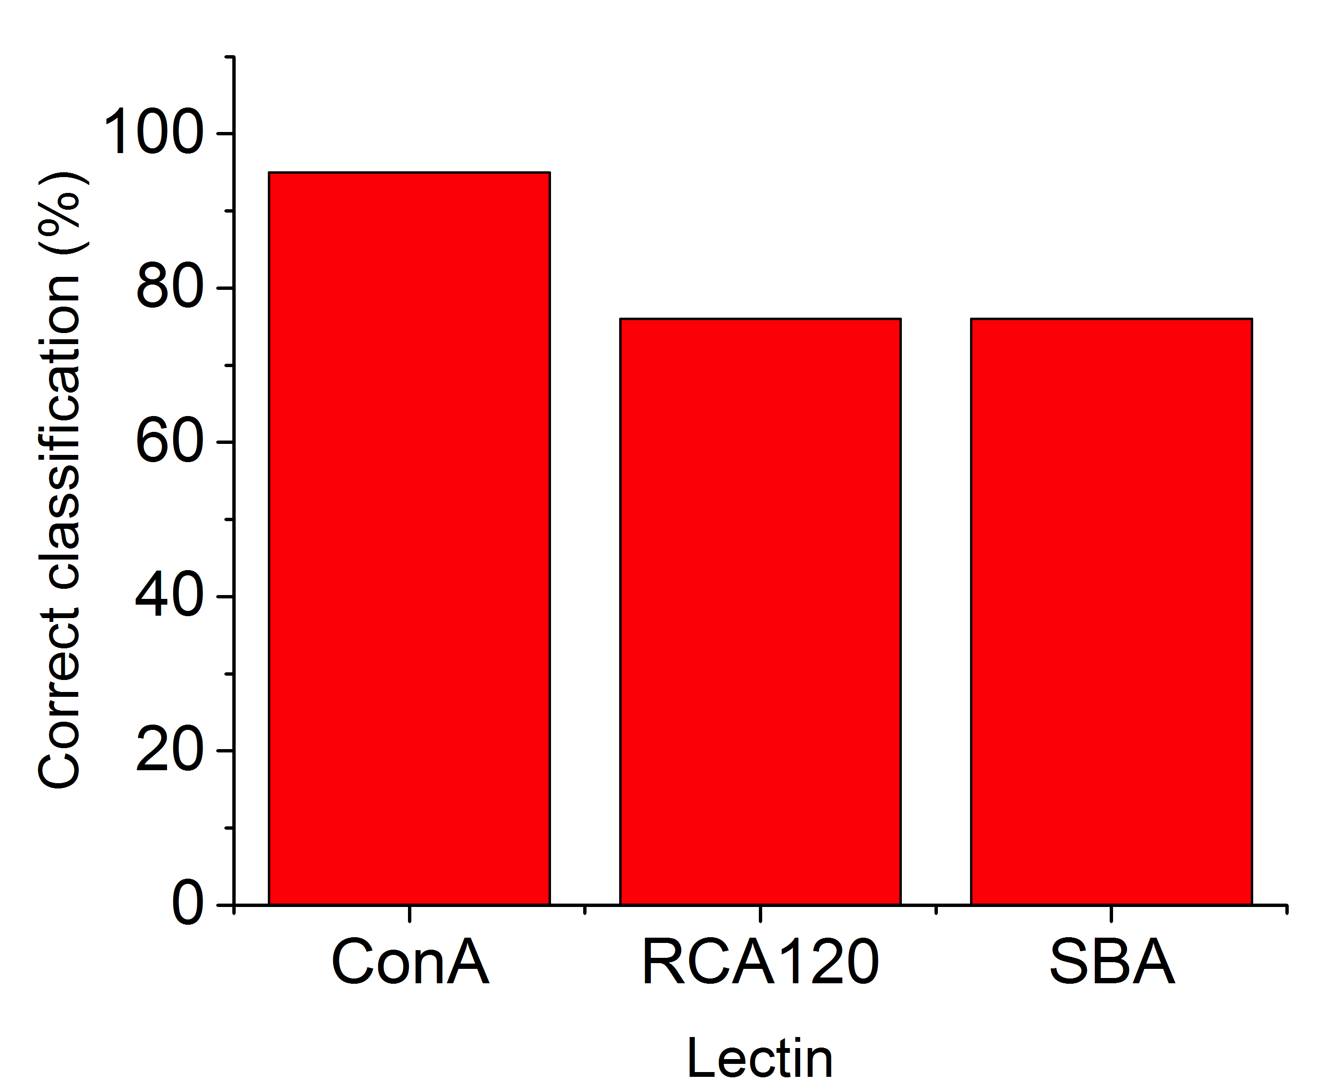
Increased Discriminatory Power using Heterogeneity
10%
90%
20%
80%
30%
70%
40%
60%
50%
50%
60%
40%
70%
30%
80%
20%
90%
10%
Man
Gal
Otten, L., Vlachou, D, Richards, S-J.*, Gibson, M. I.; Analyst., 2016, 141, 4305-4312

Slide 12
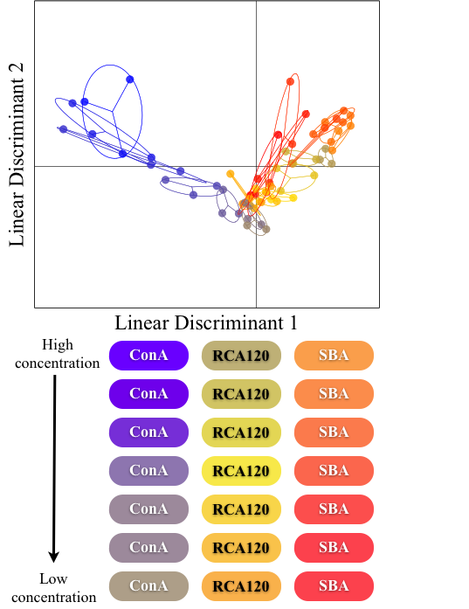
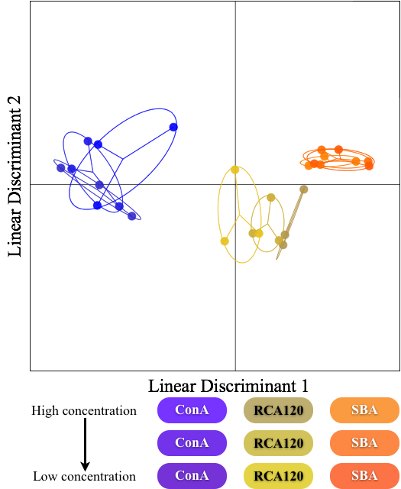
Lectin Concentration and Discrimination
10%
90%
20%
80%
30%
70%
40%
60%
50%
50%
60%
40%
70%
30%
80%
20%
90%
10%
Man
Gal
Otten, L., Vlachou, D, Richards, S-J.*, Gibson, M. I.; Analyst., 2016, 141, 4305-4312

Slide 13
‘In plate’ polymerization
‘In plate’ polymer modification
‘In plate’ AuNP functionalization
Towards High-Throughput Sensing
Richards, S-J., Biggs, C. I, Gibson, M. I., Methods in Molecular Biology; Macro-Glycoligands, 2016, Series Vol 1367

Slide 14
High-throughput data collection
Richards, S-J., Otten, L. O., Gibson, M. I.; J. Mater Chem. B., 2015, DOI: 10.1039/C5TB01994J

Slide 15
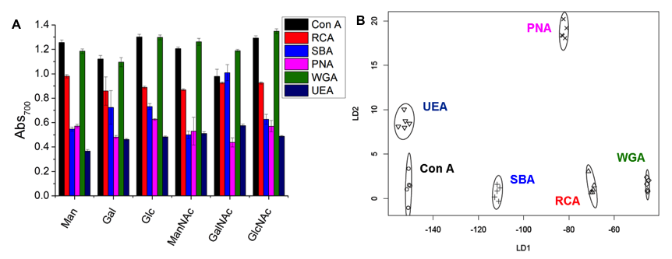
Lectin Discrimination
Otten, L. and Gibson, M. I. RSC Adv., 2015, 5, 53911-53914
Richards, S-J., Otten, L., Gibson, M. I.; J. Mater Chem. B., 2016, 4, 3046-3053

Slide 16
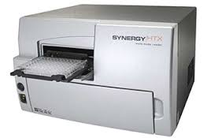
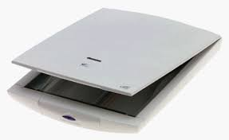
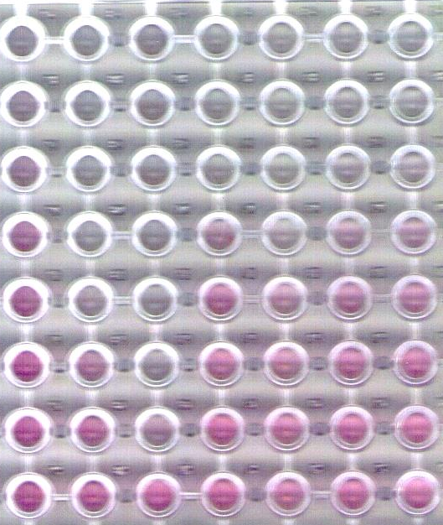
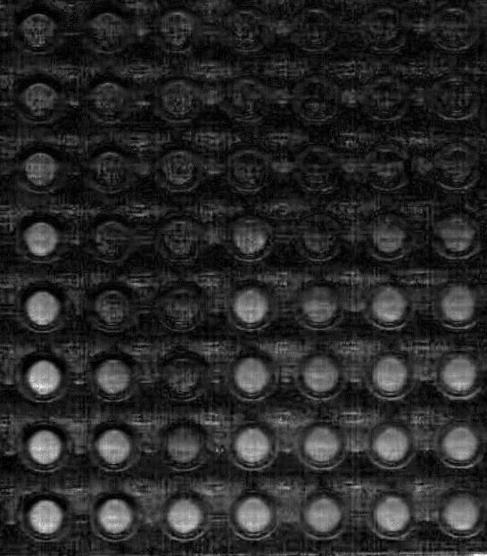
Low-cost, Low-resource Detection
vs
£10,000
£50
Richards, S-J., Otten, L. O., Gibson, M. I.; J. Mater Chem. B., 2016, 4, 3046-3053

Slide 17


Summary
Polymer coating essential for saline stability and optical readout
Vast conjugation space
High-throughput and low resource detection possible

Slide 18

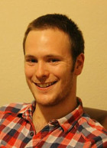

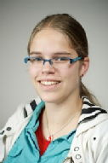
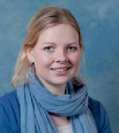

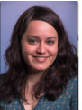

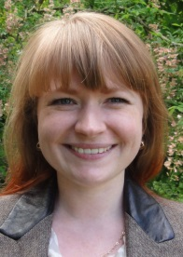
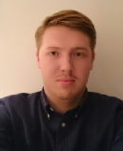
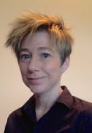

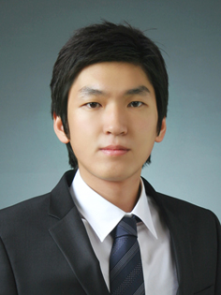
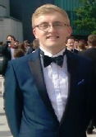
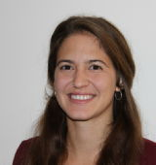

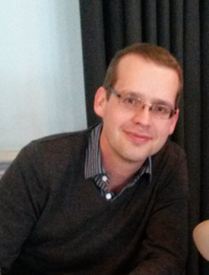








Acknowledgements
Gibson Group, 2016
Post-docs
Dr Caroline Biggs
Dr Collette Guy
Eva Caamano-Gutierrez
Dr Lucienne Otten
PhD Students
Sang Ho Won
Lewis Blackman
Benjamin Martyn
Joseph Healey
Nick Alcaraz
Julia Lipecki
Chris Stubbs
Ben Graham
Trishia Bailey
Laura Wilkins
Maria Gyprioti
Vinko Varas
Gabriell Erni-Cassolla
Undergrad Students
Lizzie Eyre
Josh Parkin
Prof. Matthew Gibson
Collaborators
Dr Liz Fuilam
Prof. Del Besra (uni B’ham)
Funders £$€
Noreen Murray Philanthropy Award
www.warwick.ac.uk/go/gibsongroup
@LabGibson

Slide 19
Glycosylated gold nanoparticle biosensors:
Label-free and high-throughput evaluation of glycan-lectin interactions
Sarah-Jane Richards and Matthew I. Gibson
Department of Chemistry, University of Warwick, UK
@LabGibson
@RichardsSJ
www.warwick.ac.uk/sarahjane_richards
ICS 2016 18/07/16
New Orleans, LA, USA
s-j.richards@warwick.ac.uk

