Slide 1


Novel detection methods for carbohydrate-protein interactions in biofluids
Eva Caamaño Gutiérrez^{1,3},Lucienne Otten¹,Giancarlo Biagini³, Matthew I. Gibson^{1,2}
¹Department of Chemistry, University of Warwick, UK
²Medical School, University of Warwick, UK
³Liverpool School of Tropical Medicine, Liverpool, UK
e.caamano@warwick.ac.uk
www.warwick.ac.uk/go/gibsongroup
@LabGibson @Eva_Caamano
Parasitology journal club. 7th July 2016
Liverpool School of Tropical Medicine

Slide 2
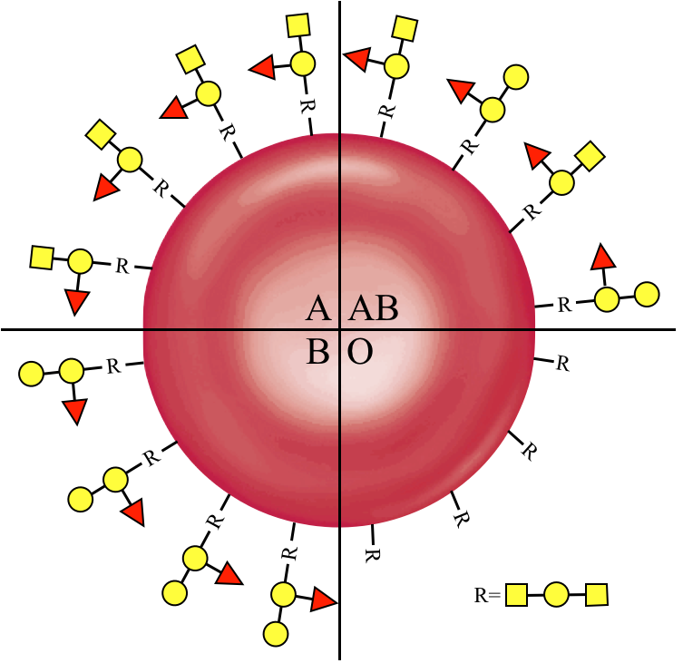
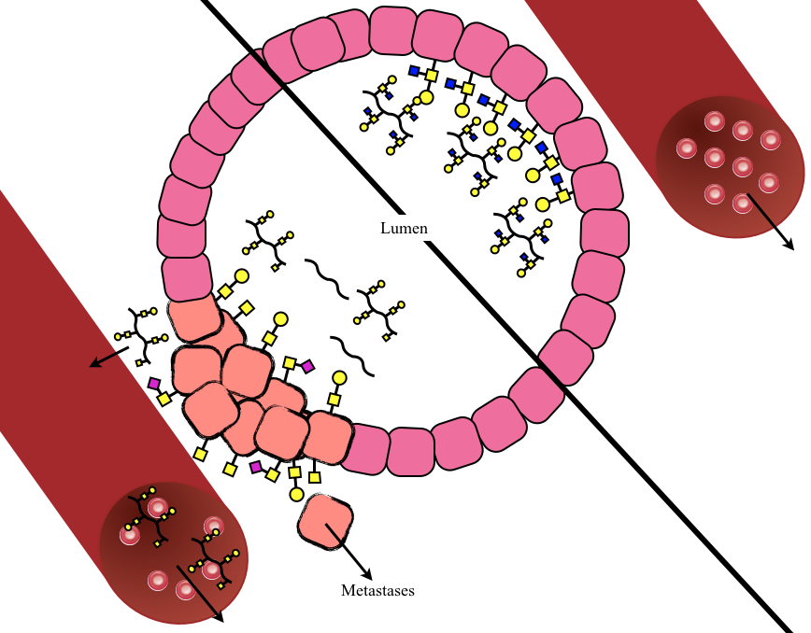

Protein Carbohydrate interactions
Notes:
All mammalian cells are surrounded by a cell membrane which are decorated with long chains of carbohydrates. These carbohydrates interact with carbohydrate binding proteins known as lectins and these interactions play an essential role in cell-cell signaling, fertilisation and both passive and innate immunity. The carbohydrates on the cell surface determine everything from blood group to disease susceptibility and changes in glycosylation of cells can represent disease states such as cancer.
Involve prot-CHO→microarray, prot-CHO important nature, exploited by pathogens, needs to be specific
As both toxins work through an initial protein-carbohydrate interaction phase this offers an attractive option for a cheap microarray based detection method.
However protein carbohydrate interactions are crucial in many other biological processes including cell-cell communication, fertilisation and the immune system to name but a few.
Their prevalence in nature means they are also readily exploited by other pathogens and mediate the initial adhesion phases for many bacterial strains and viruses.
As such, care must be taken to ensure that any sensor is specific for toxins and not influenced by other environmental contaminants which may have similar binding specificities to the toxins.

Slide 3
Carbohydrate-protein interactions are exploited by pathogens
Notes:
Their prevalance in nature means that these interactions are readily exploited by pathogens. They form the initial binding step before colonisation for bacteria and play an important role in the binding of toxins, viruses and parasites prior to cell internalisation. As they are crucial for many pathogens they form an attractive target for detection. Indeed carbohydrate microarrays have been used to detect bacteria in blood samples, pathogens in food and for the detection and discrimination of human and avian influenza strains. However as many non pathogenic lectins also interact through these adhesion pathways it is crucial that any detection system is specific to the pathogen of interest and not affected by contaminating lectins in biological samples.

Slide 4
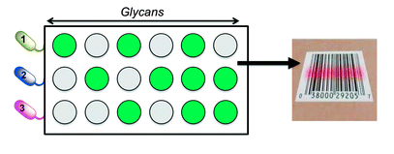
We want to exploit pathogen’s glycan adhesion for their detection using a high-throughput, cheap and facile method
Carbohydrate microarrays coupled with statistical modeling has been used to discriminate between bacteria strains
Otten, L., Fullam, E., Gibson, M.I. Mol. Biosyst. (2016)
Notes:
Here just remind about the background of the project and carbohydrate binding profiles has been already used for strain discrimination

Slide 5
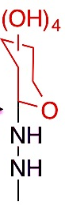
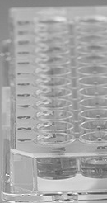
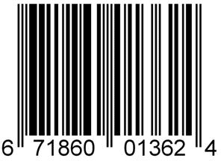
How can we measure carbohydrate binding profiles?
A) Discrimination between microbial resistant strains using fluorescently labeled cells.
Incubation+
Washes
B) Developing label-free techniques.
Otten, L.,Gibson, M.I., RSC Adv. (2015); Richards, S-J. et al., ACS Macro Letters (2014)
Notes:
Mention that the aim of our study is to (a)try to discriminate between microbial resistant strains using labeled cells and parallel (b) develop label free techniques (show why this might pose a challenge with an already coloured fluid)

Slide 6
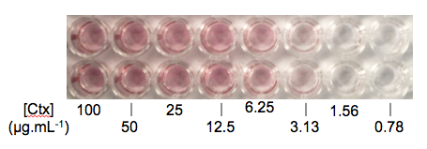
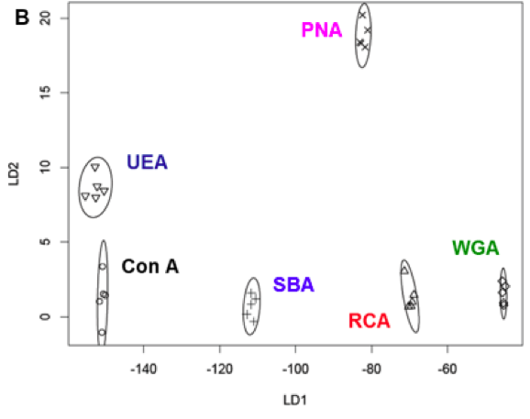
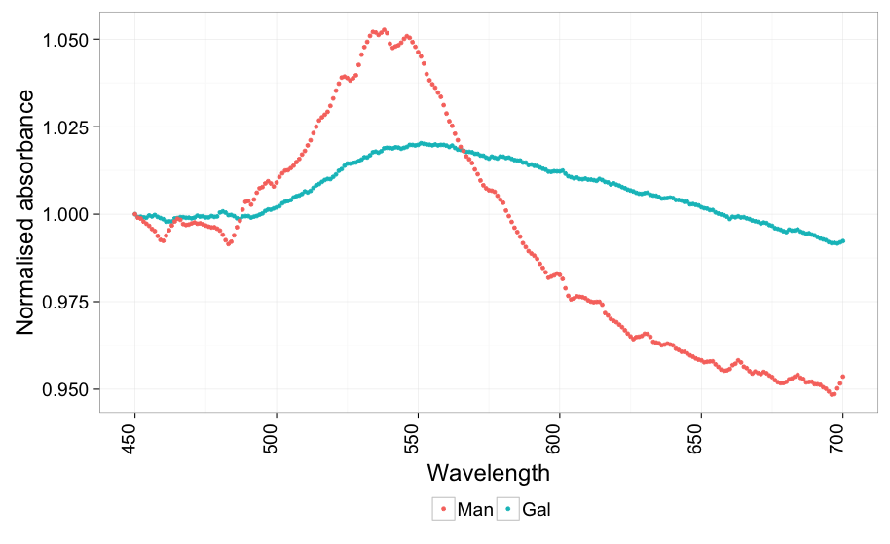
B)
Label free techniques: AuNPs
Otten, L. et al. J. Mater. Chem. B (2013)
Yes interaction
No interaction
Richards, S-J., Otten, L., Gibson, M.I., J. Mater. Chem. B (2016)
Richards, S-J. et al., ACS Macro Letters (2014)
Notes:
Whilst the method described uses fluorescently labelled lectins which wouldn’t be available in real world situations. Label free methods of detection of lectin binding to carbohydrate surfaces has been previously shown.
I have previously shown the selective binding of gold nanoparticles to proteins bound to a carbohydrate surface leading to a colourimetric assay where high protein binding is characterised by a pink colour on the surface
Another member of the lab has used carbohydrate functionalised gold nanoparticles for a colourimetic assay in solution where addition of the lectin to the solution brings the particles closer together resulting in a colour change from pink to purple and a characteristic shift in absorbance of the particles.
The latter has recently been combined with LDA to discriminate between 6 different lectins based on monosaccharide particle binding with excellent distinction between the groups in the LDA model.

Slide 7
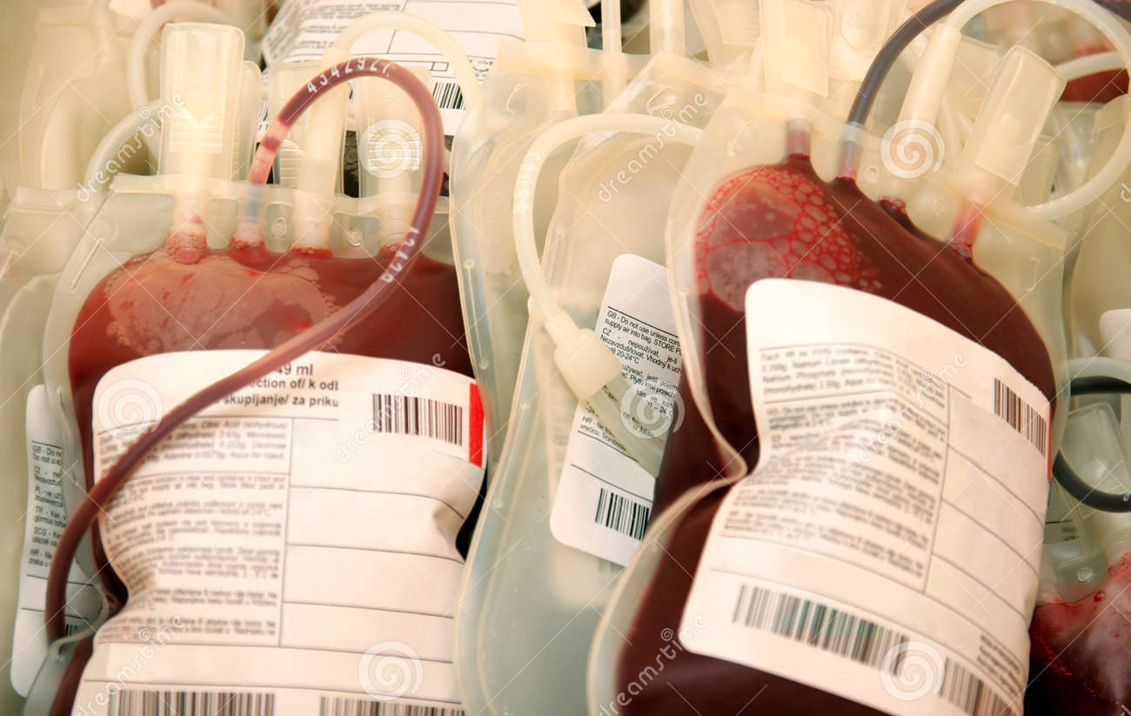
B)
Label free techniques: AuNPs
Otten, L. et al. J. Mater. Chem. B (2013)
Great in uncolored solutions but how to detect it in blood?
Richards, S-J. et al., ACS Macro Letters (2014)
Notes:
Whilst the method described uses fluorescently labelled lectins which wouldn’t be available in real world situations. Label free methods of detection of lectin binding to carbohydrate surfaces has been previously shown.
I have previously shown the selective binding of gold nanoparticles to proteins bound to a carbohydrate surface leading to a colourimetric assay where high protein binding is characterised by a pink colour on the surface
Another member of the lab has used carbohydrate functionalised gold nanoparticles for a colourimetic assay in solution where addition of the lectin to the solution brings the particles closer together resulting in a colour change from pink to purple and a characteristic shift in absorbance of the particles.
The latter has recently been combined with LDA to discriminate between 6 different lectins based on monosaccharide particle binding with excellent distinction between the groups in the LDA model.

Slide 8
B)
Blood masks the AuNPs interactions
Spectra prior blood addition
Yes interaction
Spectra post blood addition
Yes interaction
No interaction
Only blood
No interaction
Blood masks the signal
we are interested in
Confidential
Notes:
Given gold nanoparticles bound to a sugar that is known to interact with a protein and other that is not we can detect their differences in absorbance but when we add blood their spectra are indistinguishable, how do we overcome this?

Slide 9
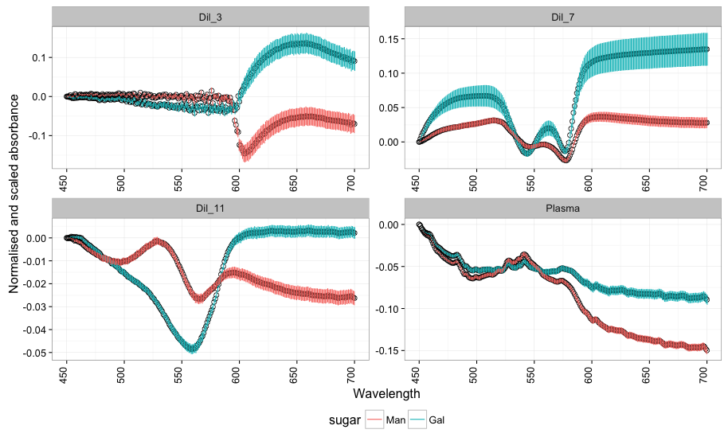
B)
By scaling, normalising and removing the blood-only background we manage to discriminate samples
Confidential
Notes:
We do some scaling and normalisation steps followed by background signal removal and voila!

Slide 10
B)
We can use these data to build a model to predict other samples
Confidential
Notes:
We do some scaling and normalisation steps followed by background signal removal and voila!

Slide 11
Other biofluids: Surine
We can discriminate interactions with good limits of detection (0.00625 mg mL⁻¹⁾
Confidential
Notes:
This slide is just for the lab meeting

Slide 12
























Acknowledgements
Prof. Matthew I. Gibson
Dr. Lucienne Otten
Dr. Sarah-Jane Richards
Benjamin Martyn
Prof. Giancarlo Biagini
Matthew Phanchana

Slide 13
Thank you!

Slide 14
Surine interact with our probes
Surine seems to interact with the sugars with a preference for mannose
Confidential
Notes:
This slide is just for the lab meeting

