Slide 1


Identification of resistant microorganisms via carbohydrate binding profiles
Eva Caamaño Gutiérrez^{1,3},Giancarlo Biagini³, Matthew I. Gibson^{1,2}
¹Department of Chemistry, University of Warwick, UK
²Medical School, University of Warwick, UK
³Liverpool School of Tropical Medicine, Liverpool, UK
e.caamano@warwick.ac.uk
www.warwick.ac.uk/go/gibsongroup
@LabGibson @Eva_Caamano
15th September 2016
Liverpool School of Tropical Medicine

Slide 2
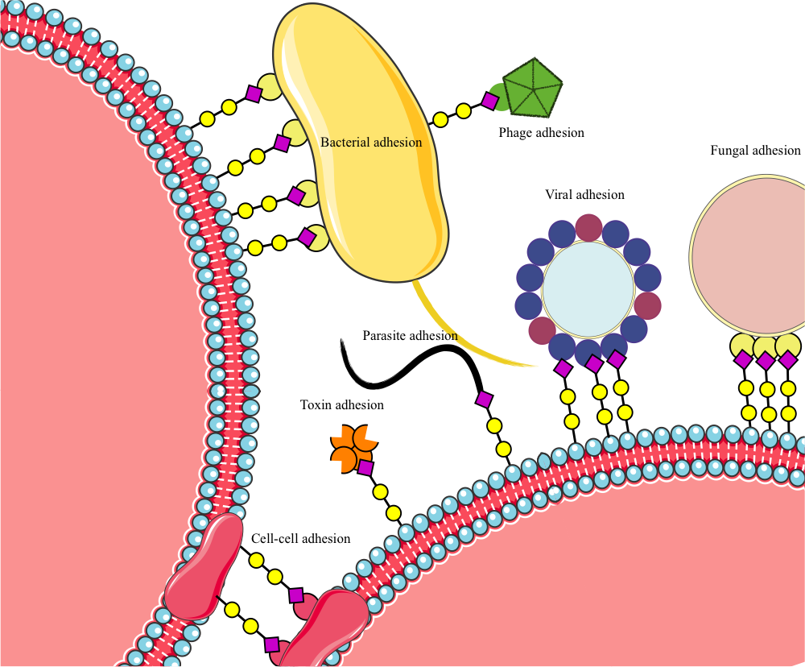
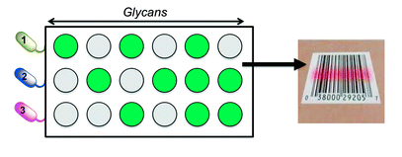
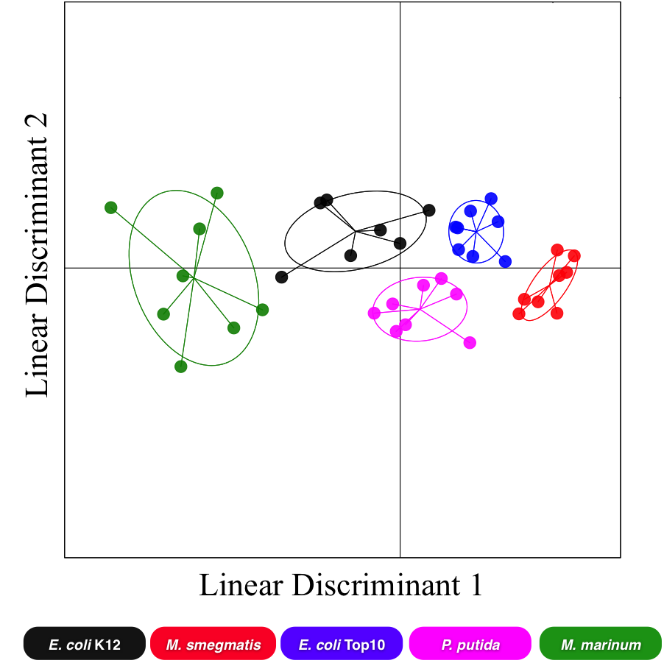

Exploiting pathogen’s glycan adhesion for detection
Carbohydrates play a crucial role in infection
Carbohydrate microarrays coupled with statistical modeling has been used to discriminate between bacteria strains
Carbohydrate modifications have been linked to resistant phenotypes in several diseases.
Otten, L., Fullam, E., Gibson, M.I. Mol. Biosyst. (2016)
Notes:
Here just remind about the background of the project and carbohydrate binding profiles has been already used for strain discrimination

Slide 3
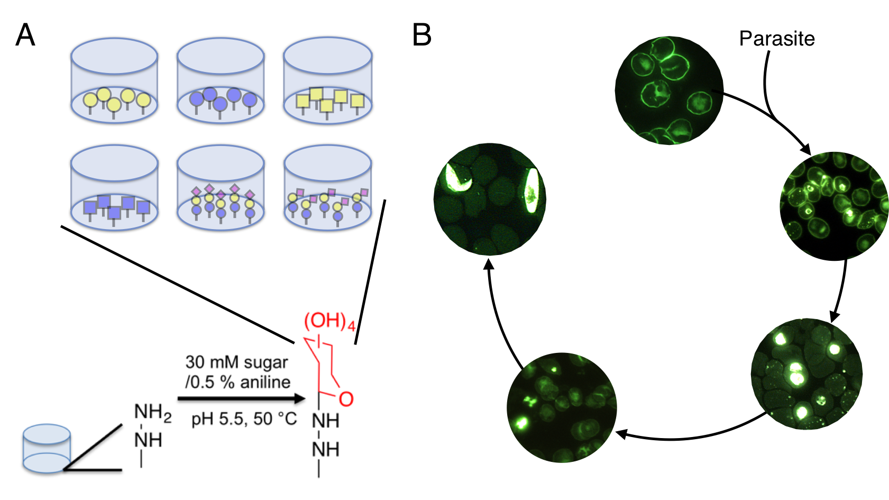




Experimental set-up
Build model
Predict unknowns
Labeled sample is incubated with the sugar coated plates. Then wells are washed and plates are read.
Need further optimization of labeling techniques and quality controls
?
Notes:
Introduce the biological problem: we have resistant and susceptible strains of Plasmodium and we want to see if we can use the carbohydrate binding profiles to discriminate them

Slide 4
We had used carbohydrate binding profiles to discriminate between infected and non-infected samples of Plasmodium falciparum and predicted unknowns
FITC-labeled cells
Confidential
Notes:
Introduce the biological problem: we have resistant and susceptible strains of Plasmodium and we want to see if we can use the carbohydrate binding profiles to discriminate them

Slide 5
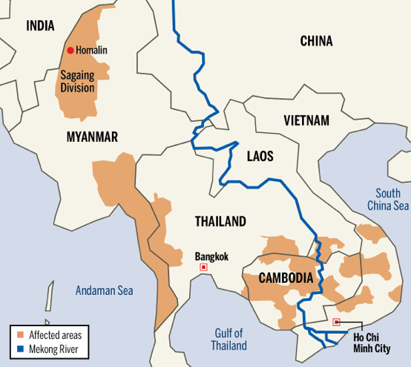
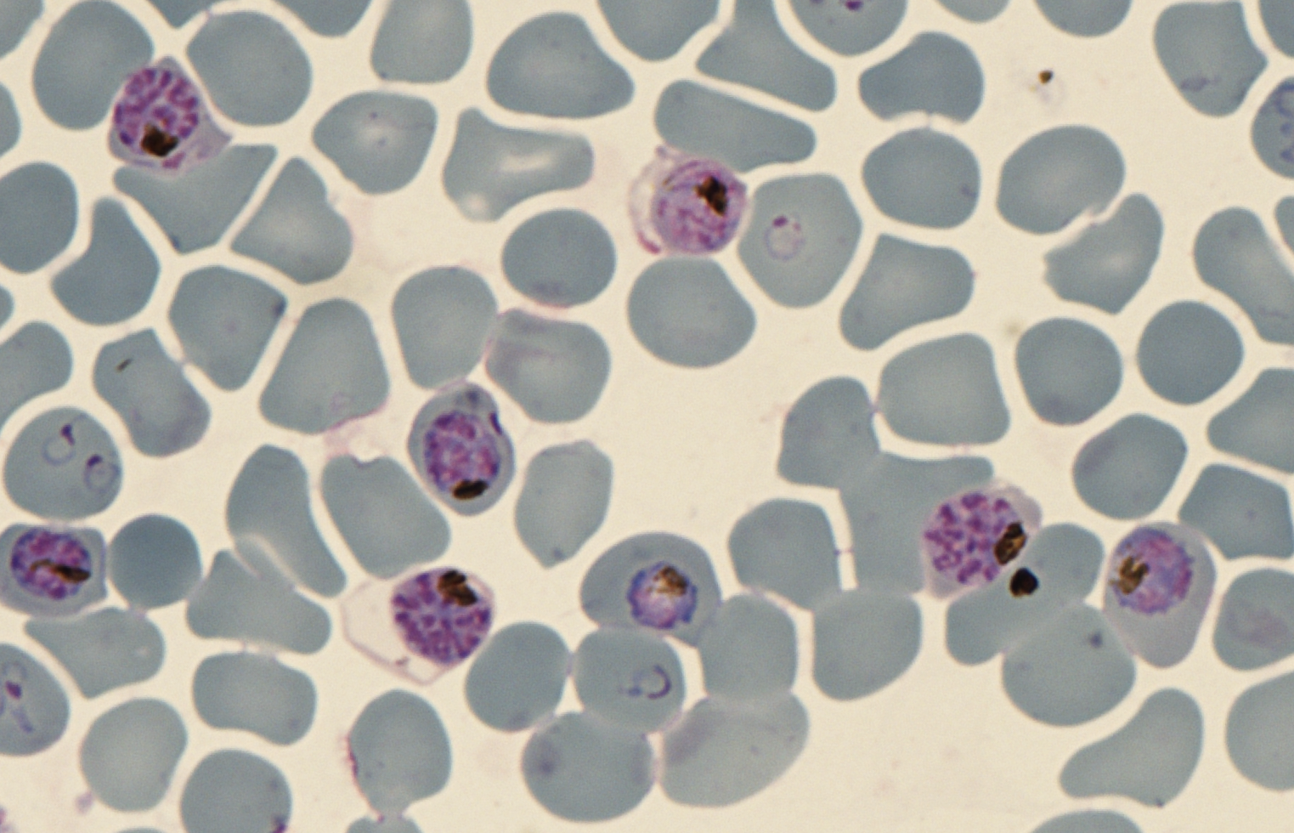
Can we use carbohydrate binding profiles to discriminate between resistant strains of Plasmodium falciparum?
Strain | Artemisinin-resistance related gene
3D7 | WT
TH004-004 | WT
TH004-023 | Mutation
TH004-036 | Mutation
TH004-64 | Mutation
Notes:
Introduce the biological problem: we have resistant and susceptible strains of Plasmodium and we want to see if we can use the carbohydrate binding profiles to discriminate them

Slide 6
Initial results pointed towards a very good separation between strains, specially at the trophozoite stage
100% accuracy
83% accuracy
How can we know this is not product of random differences such as small oscillations of parasitaemia?
Confidential

Slide 7
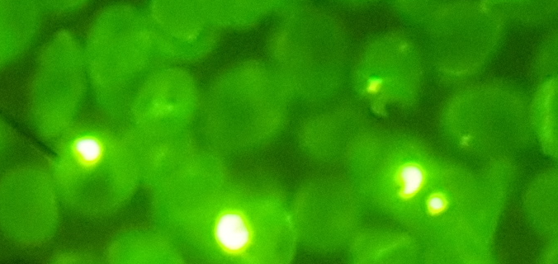
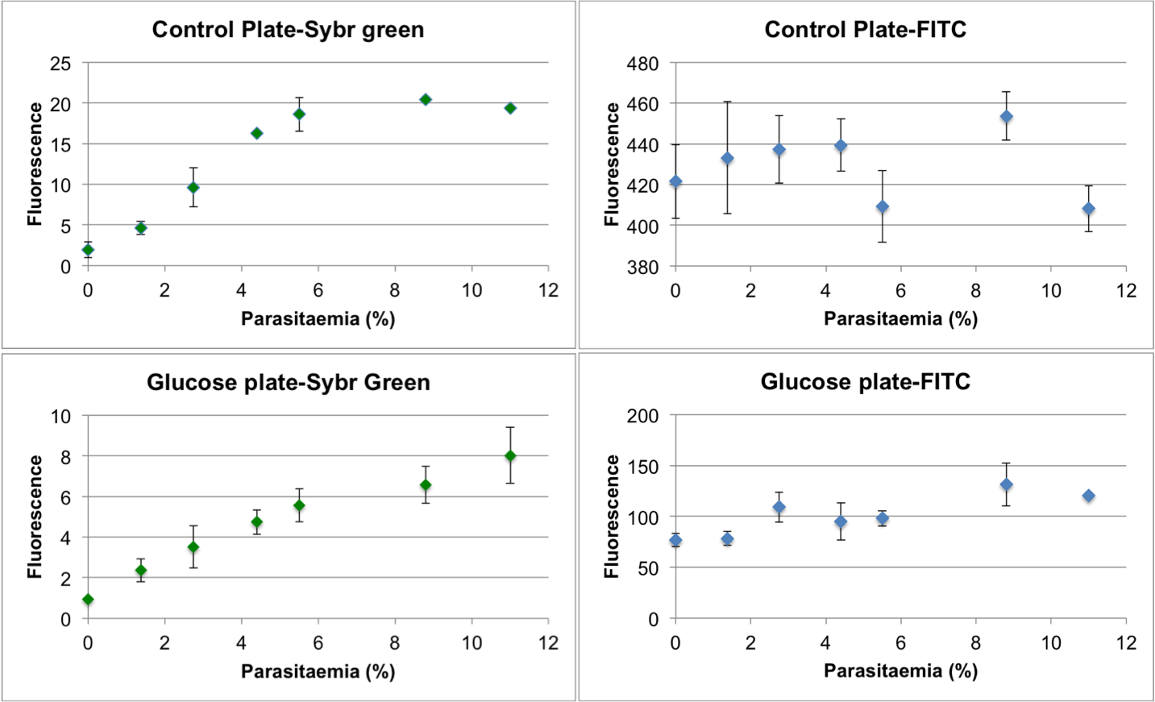
Optimising the labelling method we obtained information about parasitaemia levels that can be used to correct differences between batches
Confidential
Notes:
We identified a better fluorophore that takes into account parasitaemia oscillations and we came up with the steps to minimize random effects.

Slide 8
Next step in method optimisation involved the implementation of controls to correct for experimental variation
Outlier removal
Blanks to account for unspecific binding
Controls to account for parasitaemia oscillations
Modelling
Confidential
Notes:
We identified a better fluorophore that takes into account parasitaemia oscillations and we came up with the steps to minimize random effects.

Slide 9
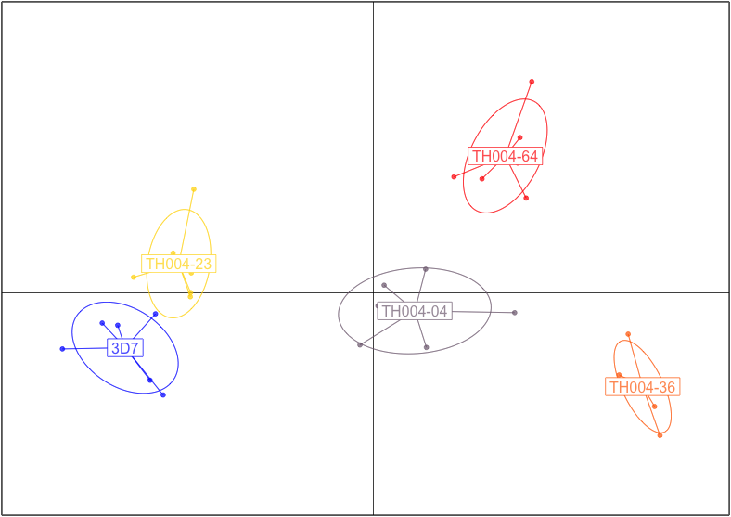
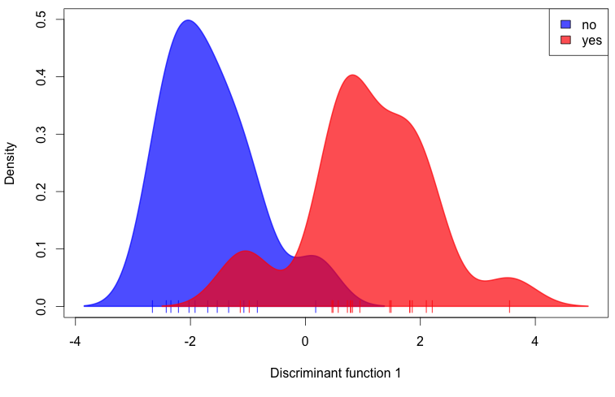
We can reproduce previous results and discriminate between resistant and not resistant strains
Strain reclassification can be achieved at 100%
Resistance phenotype can be discriminated with 85% accuracy
What happens when we introduce more variation? Can we reproduce the results?
Confidential
Notes:
We identified a better fluorophore that takes into account parasitaemia oscillations and we came up with the steps to minimize random effects.

Slide 10
Independent replicates increase variance but discrimination is still possible
Resistance phenotype can be discriminated with 73% accuracy
Strain reclassification can be achieved at 70%
With only 10 simple mono and disaccharides we are able to gain some insight into the nature of the strains
Confidential
Notes:
We identified a better fluorophore that takes into account parasitaemia oscillations and we came up with the steps to minimize random effects.

Slide 11
Future work
Model improvement
Test other methods of normalization to control batch effect
Model validation
Acquire an independent dataset for each strain that would serve to predict its identity with the model
Publication?
Manuscript preparation
Notes:
Brief mention on future work

Slide 12
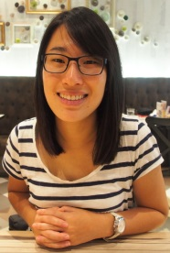



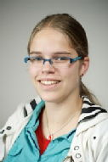
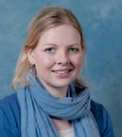

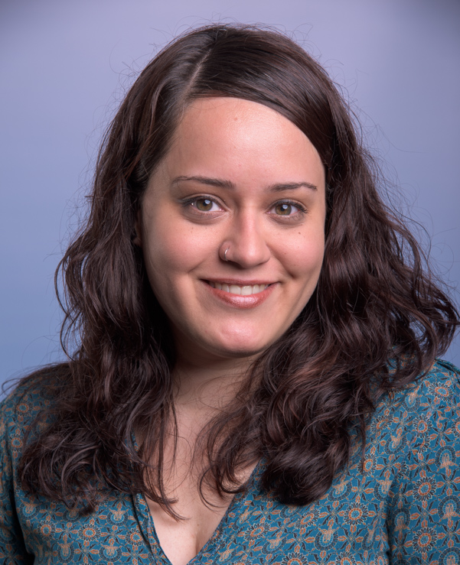


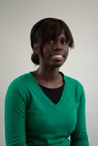
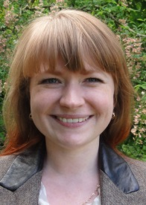


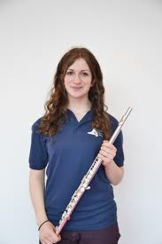
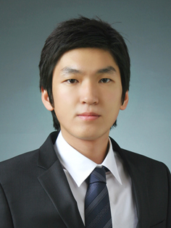

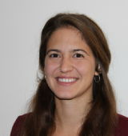






Acknowledgements
Prof. Matthew I. Gibson
Dr. Lucienne Otten
Dr. Sarah-Jane Richards
Benjamin Martyn
Prof. Giancarlo Biagini
Matthew Phanchana

