Slide 1


Tandem post-polymerization modification:
Routes to effective glycopolymer inhibitors of bacterial toxins
Sarah-Jane Richards and Matthew I. Gibson
Department of Chemistry, University of Warwick, UK
www.warwick.ac.uk/sarahjane_richards
@LabGibson
250th ACS Meeting 16/08/15
Boston, MA
s-j.richards@warwick.ac.uk

Slide 2
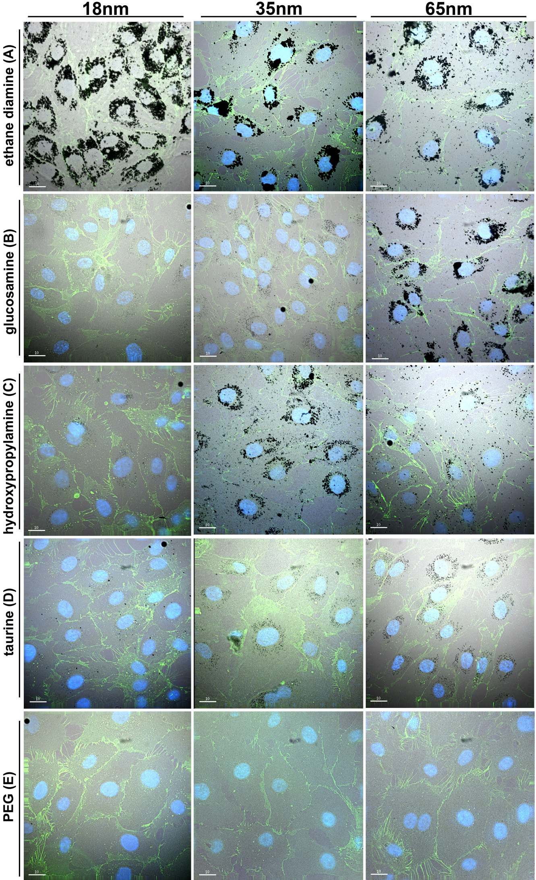
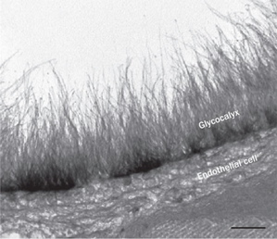
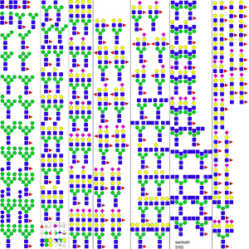
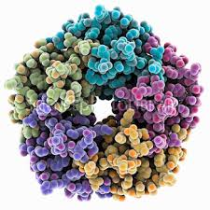
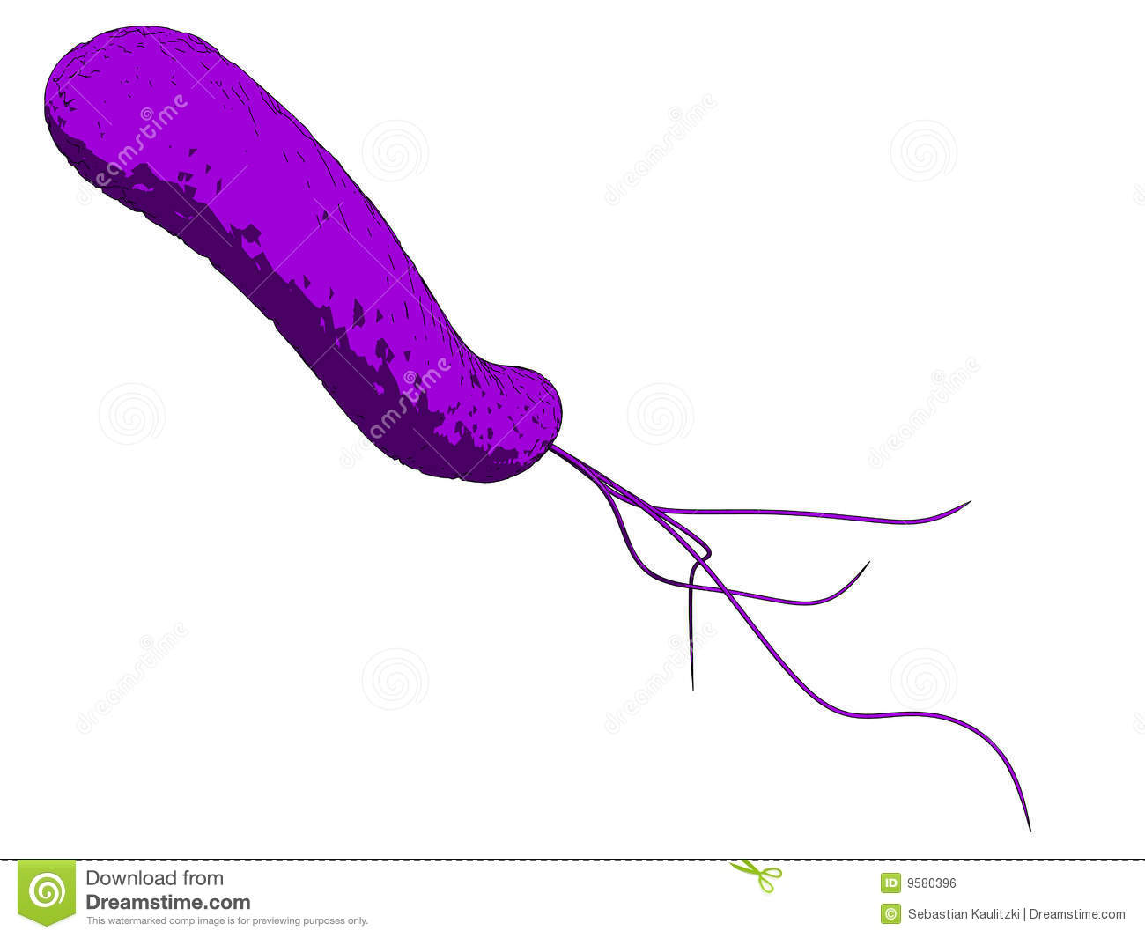
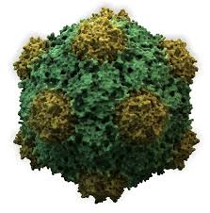
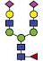

Glycans are Crucial Biomarkers
Selection of N-linked mammalian glycans d/load from P Stanley Lab
Cholera
Ricin
Influenza
Ebola
Shiga Toxins
HIV
Non antibiotic solutions to resistance
Treatment
Diagnosis
Understanding

Slide 3
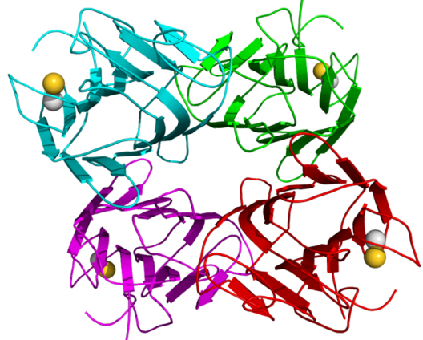
Post-Polymerisation Modification
Predicted linear response
Structural Biology – Organic Synthesis
Cell Surface Glycans – Materials Science/multivalency
J. Pol. Sci. A., 2007, 45, 2059/ Angew. Chem. 2009, 48, 48

Slide 4
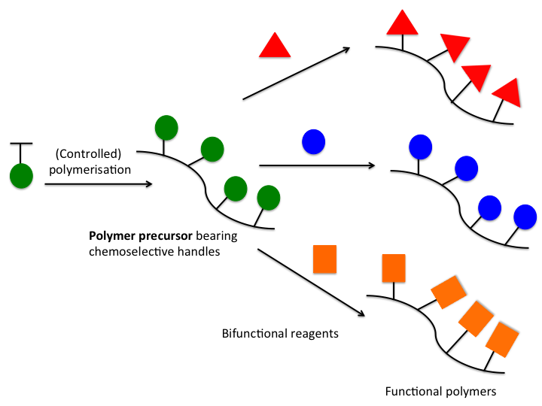
Post-Polymerisation Modification
J. Pol. Sci. A., 2007, 45, 2059/ Angew. Chem. 2009, 48, 48

Slide 5
Glycopolymers by Post-Polymerisation Modification
Jones, M. W., Richards, S-J., Haddleton, D. M. Gibson, M. I.; Polym. Chem., 2013,
Richards, S-J., Jones, M. W., Hunabun, M. I., Haddleton, D. M., Gibson, M. I.; Angew. Chem., 2012
Jones, M. W., L. Otten, Richards, S-J., Lowery, R., Phillips, D. J. Haddleton, D. M. Gibson, M. I.; Chem. Sci., 2014

Slide 6
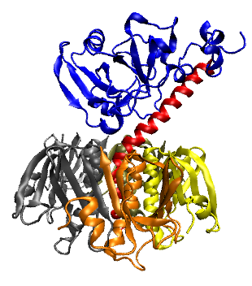
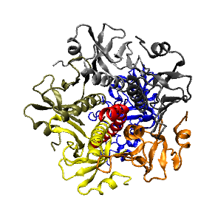
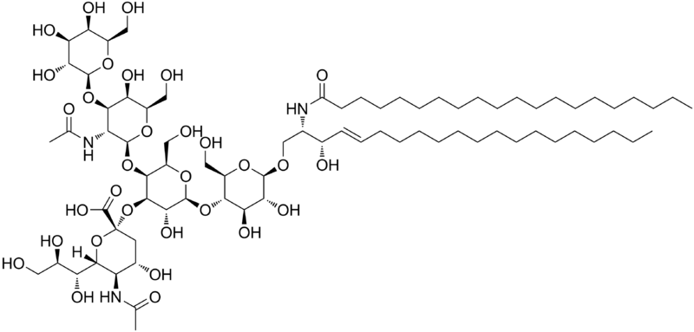
Selective Binding of Cholera-Toxin
Enzymatic domain
Induces toxic effect
Carbohydrate binding domain
Binds to epithelial cells to promote cell uptake
Anti-adhesion therapy does not target bacteria, so less evolutionary stress
Galectins – at least 13
Sigma-Aldrich – 8 Galactose-’specific’ lectins
β-D Galactose
How do we engineer a high-affinity binder for cholera toxin, without total synthesis of complex carbohydrates?
GM-1 ganglioside

Slide 7
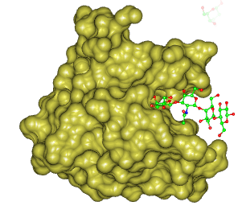
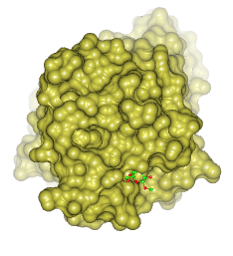
Glycan Accessibility as a Tool for Lectin Specificity
Cholera Toxin
Peanut Agglutinin
16 Å
6.3 Å
Kiick et al.; Macromol. 2007, 40, 7103 and Biomac., 2006, 7 483
Notes:
More reference

Slide 8
Easy to make 50 gram scale
1 column/distillation
Compatible with RAFT/ATRP
Quantitative functionalisation with non-hindered amines
Density control
Sequentially
modified
polymer libraries
Theato, P.; J. Pol. Sci. A., 2008, 46, 6677

Slide 9
Glycopolymer Library
Polymer | DP^{[a]} | Linker^{[b]} | Density^{[c]} | M_{w}/M_{n}^{[d]}
GP1 | 18 | Short | 100 | 1.29
GP2 | 33 | Short | 100 | 1.27
GP3 | 70 | Short | 100 | 1.26
GP4 | 18 | Long | 100 | 1.32
GP5 | 33 | Long | 100 | 1.28
GP6 | 70 | Long | 100 | 1.27
GP7 | 33 | Long | 50 | 1.23
GP8 | 33 | Long | 25 | 1.21
GP9 | 33 | Long | 10 | 1.20

Slide 10
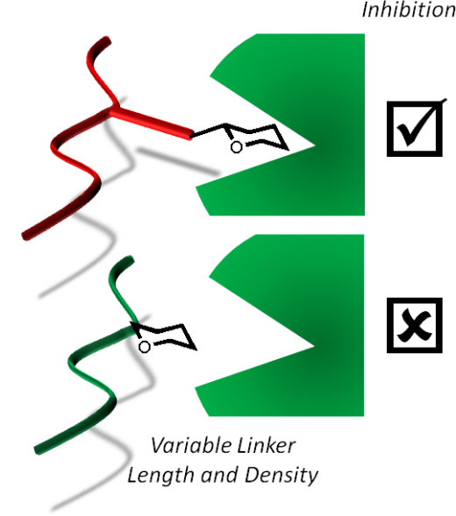
Peanut Agglutinin
Cholera Toxin
Polymer length
Polymer length
Short Linker
Long Linker
Short Linker
Long Linker

Slide 11
Improved Synthesis with Poly(azlactones)
100 % Atom efficient
Quantitative conversion with unhindered amines
Scalable synthesis of monomer
One-pot, two step synthesis/post-
polymerisation modification possible
Jones, M. W., Richards, S-J., Haddelton, D. M., Gibson, M. I.; Polym. Chem., 2013
M.E Buck & D. M Lynn, Polym. Chem., 2012, 3, 66

Slide 12
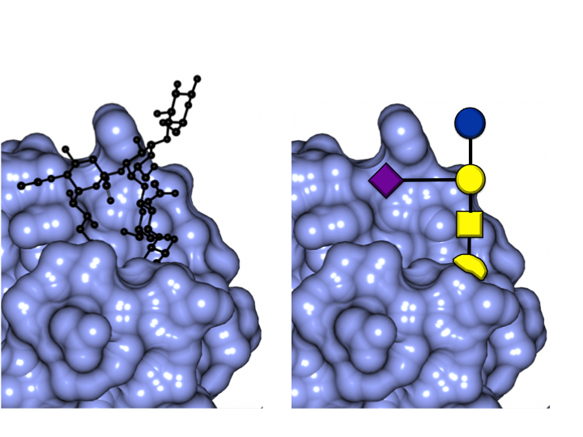
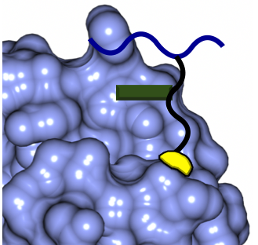
Bio-Inspired Glycan-Mimetic, Selective GlycoPolymers
Ctx with GM-1
Crystal Structure
Polymer Design Concept
Tran et al., OBC, 2011, 9, 3658

Slide 13

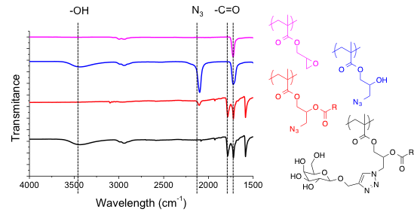
Tandem Post-Polymerization³ Modification Strategy
Carbohydrate
Variable 2º binding motif
Optimised
Linkage Length
Fixed multivalent Scaffold

Slide 14
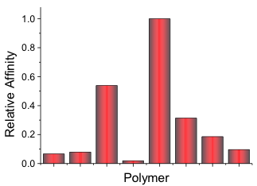
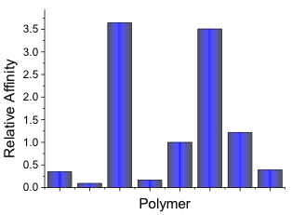
Influence of Secondary Binding Motifs
Cholera Toxin
Peanut Agglutinin

Slide 15
Identification of a Cholera Selective Glycopolymer
CTx Selective Glycopolymer
Non-Selective Glycopolymer

Slide 16


Summary
Binding Site Accessibility
Cholera Inhibition Activity
<<<
Angew. Chem. Int. Ed., 2012, 51, 7812
Allosteric Interactions
Chem. Sci., 2014, 5, 1611

Slide 17
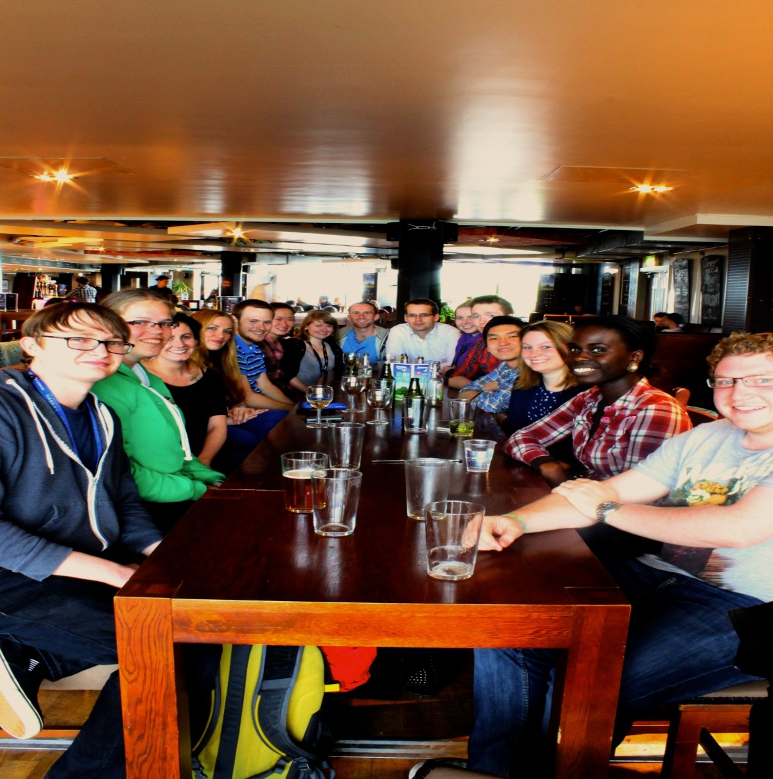



Acknowledgements
Current Gibson Group Members
Dr Gemma-Louise Davies - Daniel Mitchell
Dr Daniel Phillips - Ben Martyn
Dr Tom Congdon - Lewis Blackman
Caroline Biggs - Sang-Ho Won
Lucienne Otten - Laura Wilkins
Dr Matthew Gibson
Prof. Dave Haddleton
Dr Mathew Jones

Slide 18
Tandem post-polymerization modification:
Routes to effective glycopolymer inhibitors of bacterial toxins
Sarah-Jane Richards and Matthew I. Gibson
Department of Chemistry, University of Warwick, UK
www.warwick.ac.uk/sarahjane_richards
@LabGibson
250th ACS Meeting 16/08/15
Boston, MA
s-j.richards@warwick.ac.uk

