Slide 1


Thermal Hysteresis in Thermoresponsive Polymers is Not Related to Thermal Hysteresis in Thermoresponsive Polymer Micelles
Lewis D. Blackman,
Matthew I. Gibson and Rachel K. O’Reilly
Department of Chemistry, University of Warwick, UK
L.D.Blackman@warwick.ac.uk
www.warwick.ac.uk/gibsongroup
www.warwick.ac.uk/ror
@LabGibson @RORgroup
Postgraduate Symposium. 01/06/2016
University of Warwick

Slide 2

PhD Project Overview
2

Slide 3
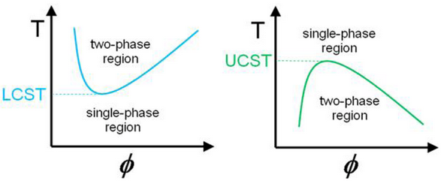
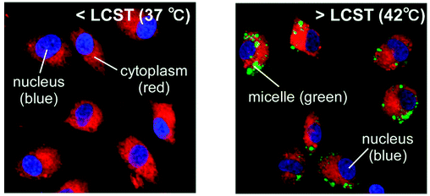
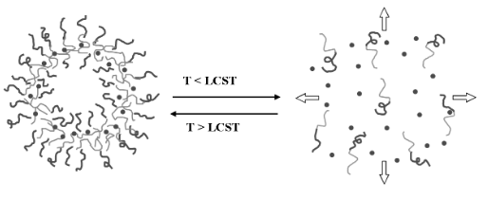
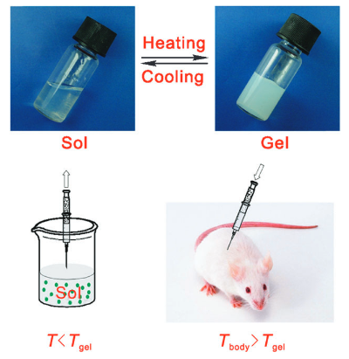
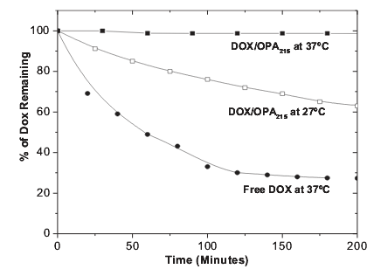
Thermoresponsive Polymers
Cellular Uptake
Controlled Drug Release
Tissue Engineering
Georgiou, T. K. Polymers 2011, 3, 1215. Okano, T. Biomacromolecules 2009, 10, 1331.
Yang, S. Adv. Mater. 2006, 18, 2905. Ding, J. Chem. Soc. Rev. 2008, 37, 1473.
3

Slide 4
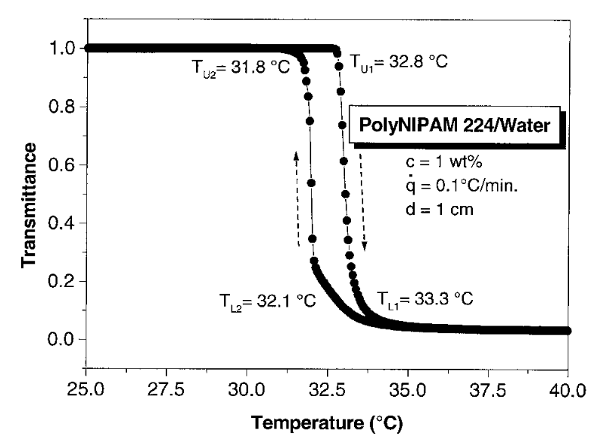
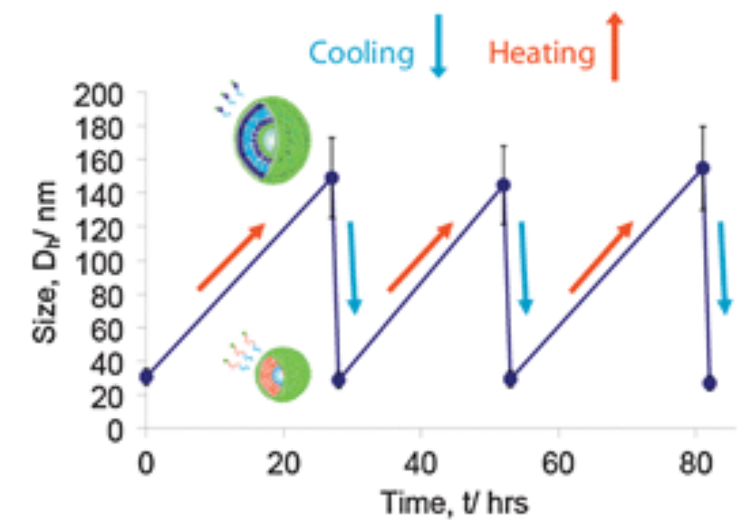
Thermoresponsive Polymers: pNIPAM
Exhibits tuneable, sharp transition in a range close to 37 °C
Insensitive to other environmental conditions
Slow reversibility in certain systems
pNIPAM
Cooling
Heating
Djokpé, E.; Vogt, W. Macromol. Chem. Phys. 2001, 202, 750.
4
Moughton, A. O.; Patterson, J. P.; O'Reilly, R. K. Chem. Commun. 2011, 47, 355.

Slide 5
Low Hysteresis Thermoresponsive Polymers
pDEAm
pOEGMA
Cloud Point ≈ 32 °C
x = 2 - 9
Cloud Point
≈ 20 - 95 °C
pMPA
Cloud Point
≈ 50 °C
Polyacetals
Cloud Point ≈ 6 - 80 °C
Poly(2-oxazoline)s
Low hysteresis results from:
Lack of polymer-polymer hydrogen bonding ability
Low glass transition temperatures
Cloud Point ≈ 25 - 100 °C
Wu, C.; Phys. Chem. Chem. Phys., 2010, 12, 3188. Lutz, J.-F.; J. Polym. Sci., Part A: Polym. Chem., 2008, 46, 3459.
Tanaka, M.; Polymer, 2002, 43, 3825. Koberstein, J. T.; Macromolecules, 2016, 49, 1858. Schubert, U. S.; Chem. Commun., 2008, 5758.
5

Slide 6
Tuneable N_{agg} Micelles
Statistical Hydrophilic/ Responsive Core-Forming Block
Hydrophilic
Corona-Forming Block
What is the effect of N_{agg} on the thermoresponsive behaviour of a corona block?
p(DMAEMA-co-DEAEMA)-b-DMAEMA
Wright, D. B.; Patterson, J. P.; Pitto-Barry, A.; Cotanda, P.; Chassenieux, C.; Colombani, O.; O'Reilly, R. K. Polym. Chem. 2015, 6, 2761.
6

Slide 7
Diblock Copolymer Synthesis
Responsive
Corona-Forming Block
Statistical Hydrophilic/ Hydrophobic Core-Forming Block
p(DMA-co-nBA)₄₀-b-NIPAM₇₅
Polymer | nBA:DMA Feed Ratio | DP nBA | DP DMA | Mol % nBA | Ð
MCTA | N/A | N/A | N/A | N/A | 1.07
1 | 1:1 | 20 | 17 | 54 | 1.10
2 | 7:3 | 26 | 11 | 70 | 1.11
3 | 4:1 | 27 | 7 | 79 | 1.10
4 | 9:1 | 37 | 4 | 90 | 1.11
5 | 1:0 | 40 | N/A | 100 | 1.11
Blackman, L. D.; Wright, D. B.; Robin, M. P.; Gibson, M. I.; O’Reilly, R. K. ACS Macro Lett. 2015, 4,1210.
7

Slide 8





Tunable N_{agg} Micelle Preparation
Multiple Angle DLS and SLS
R_{H}
R_{core}
R_{corona}
N_{agg}
Blackman, L. D.; Wright, D. B.; Robin, M. P.; Gibson, M. I.; O’Reilly, R. K. ACS Macro Lett. 2015, 4,1210.
8

Slide 9
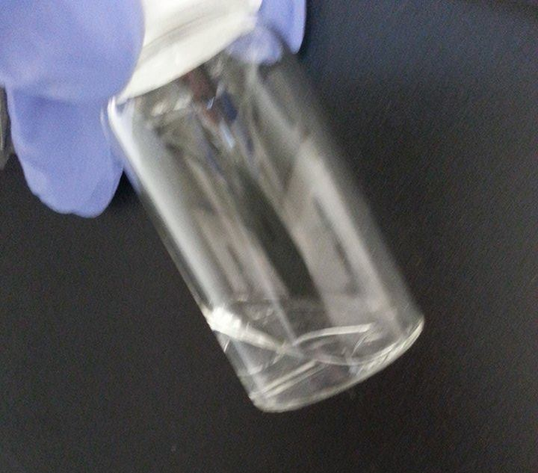


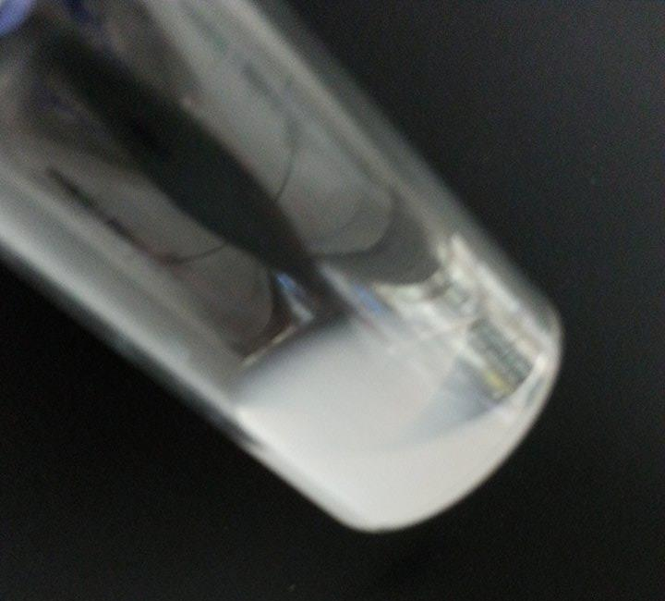
Probing Thermoresponsive Behaviour
Macroscopic Precipitation
T_{p}
Two Phase System
Cloud Point
One Phase System
Blackman, L. D.; Wright, D. B.; Robin, M. P.; Gibson, M. I.; O’Reilly, R. K. ACS Macro Lett. 2015, 4,1210.
9

Slide 10
Probing Thermoresponsive Behaviour
T_{p}
Cloud point
Hysteresis
Transition temperature does not change with N_{agg}
Degree of hysteresis increases with increasing nBA composition in core forming block
Blackman, L. D.; Wright, D. B.; Robin, M. P.; Gibson, M. I.; O’Reilly, R. K. ACS Macro Lett. 2015, 4,1210.
10

Slide 11
Origin of Hysteresis in Highly Aggregated Micelles
Known to be a kinetic effect
Two Possible Conclusions:
  Differences in intraparticle chain entanglement
  Differences in core hydration
Heated to 40 °C
Cooled and held at 30 °C
Blackman, L. D.; Wright, D. B.; Robin, M. P.; Gibson, M. I.; O’Reilly, R. K. ACS Macro Lett. 2015, 4,1210.
11

Slide 12



Origin of Hysteresis in Highly Aggregated Micelles
pNIPAM₃₀₀
pNIPAM₃₀₀-b-nBA₃₂
pNIPAM₇₅-b-nBA₄₀
Degree of hysteresis is reduced by increasing weight fraction of the corona
  Differences in core hydration, as opposed to corona entanglement, lead to differences in hysteresis
Blackman, L. D.; Wright, D. B.; Robin, M. P.; Gibson, M. I.; O’Reilly, R. K. ACS Macro Lett. 2015, 4,1210.
12

Slide 13
Investigating Hysteresis Using Other Thermoresponsive Coronas
pDEAm
pNIPAM
pDEGMA
x = 0.50
x = 0.54
x = 0.46
x = 0.69
x = 0.70
x = 0.68
x = 0.76
x = 0.79
x = 0.82
x = 0.88
x = 0.90
x = 0.88
x = 1.00
x = 1.00
x = 1.00
Polymer
Type
T_{g}
H bond donor?
1-5
Linear
High
No
6-10
Linear
High
Yes
11-15
Brush-like
Low
No
Blackman, L. D.; Gibson, M. I.; O’Reilly, R. K. Manuscript in preparation.
13

Slide 14
Investigating Hysteresis Using Other Thermoresponsive Coronas
pDEAm
pNIPAM
pDEGMA
Blackman, L. D.; Gibson, M. I.; O’Reilly, R. K. Manuscript in preparation.
14

Slide 15
Investigating Hysteresis Using Other Thermoresponsive Coronas
Nearly identical corona blocks with almost identical cloud points
pDEAm
pNIPAM
But…
Hysteresis can be introduced by the presence of a hydrophobic core
Hydrogen bonding ability plays major role in determining hysteresis
Blackman, L. D.; Gibson, M. I.; O’Reilly, R. K. Manuscript in preparation.
15

Slide 16
Investigating Hysteresis Using Other Thermoresponsive Coronas
Similar corona blocks but with different cloud points and side-chain lengths
pDEGMA
pOEGMA
Corona | mol% nBA | Cloud Point/ °C | Hysteresis/ °C
pDEGMA | 45 | 20.3 | 0.4
pDEGMA | 69 | 21.0 | 0.5
pDEGMA | 77 | 19.8 | 0.1
pDEGMA | 87 | 20.5 | Irreversible
pDEGMA | 100 | 22.1 | Irreversible
Heating
Cooling
Heating
Cooling
Blackman, L. D.; Gibson, M. I.; O’Reilly, R. K. Manuscript in preparation.
16

Slide 17
Conclusions
Well defined responsive amphiphilic block copolymers were synthesised by RAFT polymerisation.
Multi-angle DLS and SLS revealed the resulting micelles had a tuneable N_{agg}.
The cloud point transition temperatures were found to be independent of N_{agg}.
The degree of hysteresis was shown to be dependent on the core block hydrophobicity.
Differences in the hysteresis were a result of differences in micellar core hydration.
Both hydrogen bonding ability and core composition played a role in determining hysteresis.
Coronas with a brush-like architecture showed irreversible phase transitions at high N_{agg}.
pNIPAM₃₀₀
pNIPAM₃₀₀-b-nBA₂₈
pNIPAM₇₅-b-nBA₄₀
pDEAm vs. pNIPAM
pDEGMA
pOEGMA
Blackman, L. D.; Wright, D. B.; Robin, M. P.; Gibson, M. I.; O’Reilly, R. K. ACS Macro Lett. 2015, 4,1210.
17

Slide 18













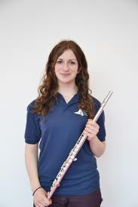




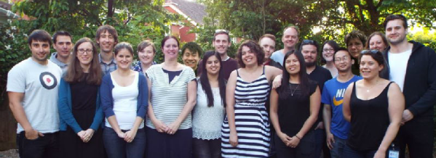





Acknowledgements
University of Warwick
Dr. Daniel Wright
Dr. Mathew Robin
Dr. Helen Willcock
Dr. Craig Bell
Mr. Rod Wesson
Prof. Rachel O’Reilly
Prof. Matthew Gibson
O’Reilly Group
Gibson Group
Dove Group
Davies Group
King’s College London
Dr. Heather Findlay
Prof. Paula Booth
Malvern Instruments Ltd.
18

Slide 19
Thermal Hysteresis in Thermoresponsive Polymers is Not Related to Thermal Hysteresis in Thermoresponsive Polymer Micelles
Lewis D. Blackman,
Matthew I. Gibson and Rachel K. O’Reilly
Department of Chemistry, University of Warwick, UK
L.D.Blackman@warwick.ac.uk
www.warwick.ac.uk/gibsongroup
www.warwick.ac.uk/ror
@LabGibson @RORgroup
Postgraduate Symposium. 01/06/2016
University of Warwick

