Slide 1


Investigating Hysteresis in Thermoresponsive Assemblies
Lewis D. Blackman, Matthew I. Gibson and Rachel K. O’Reilly
Department of Chemistry, University of Warwick, UK
L.D.Blackman@warwick.ac.uk
www.warwick.ac.uk/go/gibsongroup
www2.warwick.ac.uk/fac/sci/chemistry/research/oreilly/oreillygroup/
@LabGibson @RORgroup
RSC Biomaterials Chemistry Meeting. 08/01/2016
University of Birmingham

Slide 2
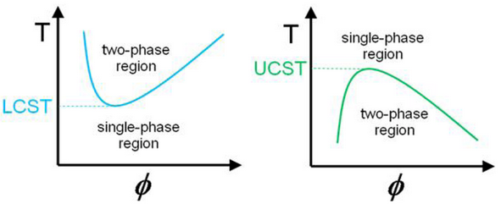
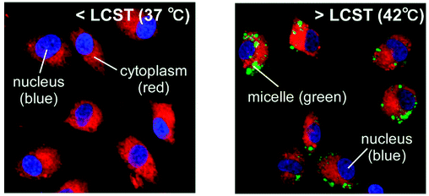
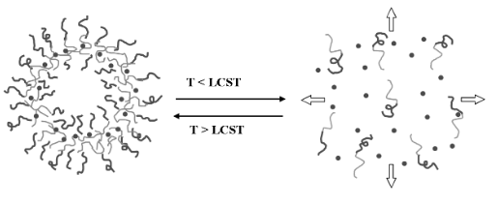
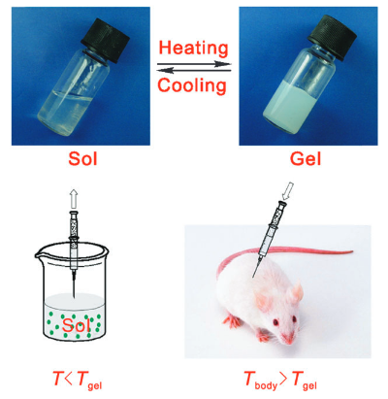
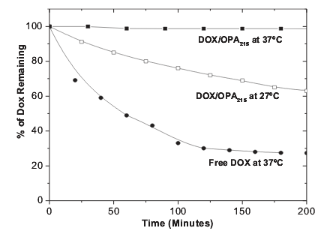

Thermoresponsive Polymers
Cellular Uptake
Controlled Drug Release
Tissue Engineering
Georgiou, T. K. Polymers 2011, 3, 1215. Okano, T. Biomacromolecules 2009, 10, 1331.
Yang, S. Adv. Mater. 2006, 18, 2905. Ding, J. Chem. Soc. Rev. 2008, 37, 1473.

Slide 3
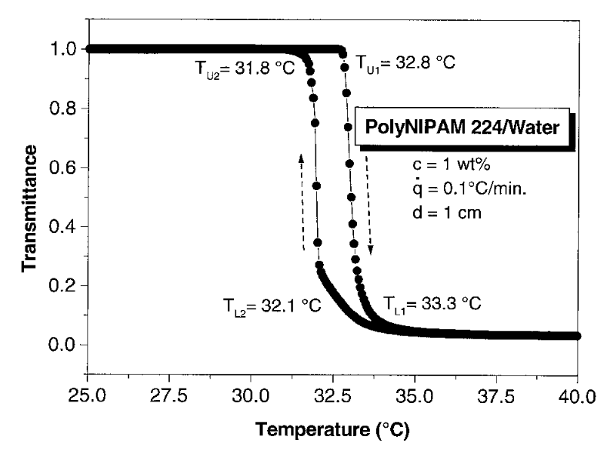
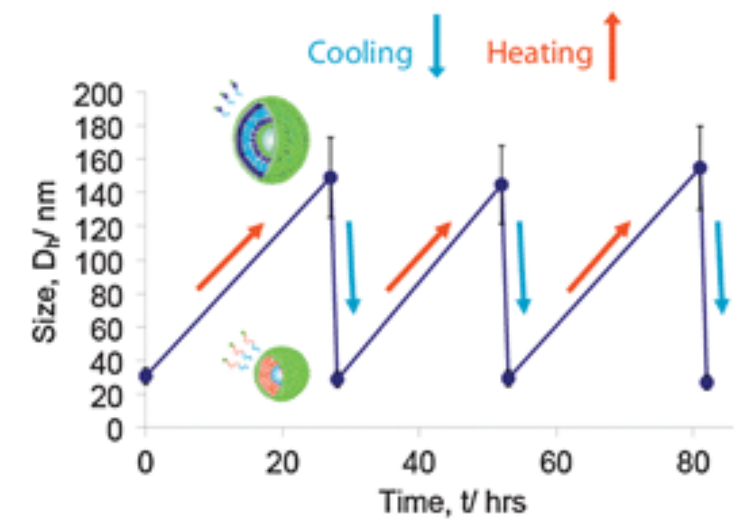
Thermoresponsive Polymers: pNIPAM
Exhibits sharp transition close to body temperature
Insensitive to other environmental conditions
Slow reversibility in certain systems
pNIPAM
Cooling
Heating
Djokpé, E.; Vogt, W. Macromol. Chem. Phys. 2001, 202, 750.
Moughton, A. O.; Patterson, J. P.; O'Reilly, R. K. Chem. Commun. 2011, 47, 355.

Slide 4
Tunable N_{agg} Micelles
Statistical Hydrophilic/ Responsive Core-Forming Block
Hydrophilic
Corona-Forming Block
What is the effect of N_{agg} on the thermoresponsive behaviour of a corona block?
p(DMAEMA-co-DEAEMA)-b-DMAEMA
Wright, D. B.; Patterson, J. P.; Pitto-Barry, A.; Cotanda, P.; Chassenieux, C.; Colombani, O.; O'Reilly, R. K. Polym. Chem. 2015, 6, 2761.

Slide 5





Diblock Copolymer Design and Micelle Preparation
Statistical Hydrophilic/ Hydrophobic Core-Forming Block
Responsive
Corona-Forming Block
p(DMA-co-nBA)₄₀-b-NIPAM₇₅

Slide 6


Probing Thermoresponsive Behaviour
Macroscopic Precipitation
T_{p}
Two Phase System
Cloud Point
One Phase System

Slide 7
Probing Thermoresponsive Behaviour
T_{p}
Cloud point
Hysteresis
Transition temperature does not change with N_{agg}
Degree of hysteresis increases with increasing nBA composition in core forming block

Slide 8


Origin of Hysteresis in Highly Aggregated Micelles
Known to be a kinetic effect
Two Possible Conclusions:
  Differences in intraparticle chain entanglement
  Differences in core hydration
Heated to 40°C
Cooled and held at 30°C

Slide 9
Investigating Hysteresis Using Other Thermoresponsive Coronas
pDEAm
pDEGMA
pOEGMA
pNIPAM
x = 0.50
x = 0.54
x = 0.46
x = 0.50
x = 0.69
x = 0.70
x = 0.68
x = 0.70
x = 0.76
x = 0.79
x = 0.82
x = 0.80
x = 0.88
x = 0.90
x = 0.88
x = 0.90
x = 1.00
x = 1.00
x = 1.00
x = 1.00
Polymer
Type
T_{g}
H bond donor?
1-5
Linear
High
No
6-10
Linear
High
Yes
11-15
Brush-like (short side arm)
Low
No
15-20
Brush-like (long side arm)
Low
No

Slide 10
Investigating Hysteresis Using Other Thermoresponsive Coronas
Nearly identical corona blocks with almost identical cloud points
pDEAm
pNIPAM
Hydrogen bonding ability plays major role in determining hysteresis
But…
Hysteresis can be introduced by hydrophobic core

Slide 11
Investigating Hysteresis Using Other Thermoresponsive Coronas
Similar corona blocks but with different cloud points and side-chain lengths
pDEGMA
pOEGMA
Corona | mol% nBA | Cloud Point/ °C | Hysteresis/ °C
pDEGMA | 45 | 20.3 | 0.4
pDEGMA | 69 | 21.0 | 0.5
pDEGMA | 77 | 19.8 | 0.1
pDEGMA | 87 | 20.5 | Irreversible
pDEGMA | 100 | 22.1 | Irreversible
pOEGMA | 50 | ~72 | ?
pOEGMA | 70 | ~72 | ?
pOEGMA | 80 | ~72 | ?
pOEGMA | 90 | ~72 | ?
pOEGMA | 100 | ~72 | ?

Slide 12
Conclusions
Well-defined polymers were synthesised by RAFT polymerisation.
LLS determined the resultant micelles had tunable N_{agg} by tuning the core composition.
The transition temperatures were found to be independent of N_{agg} or core hydrophobicity.
The degree of hysteresis increased as a function of core hydrophobicity.
The hydrogen bonding character of the corona played a role in determining the reversibility of the transition.
Brush-like pDEGMA coronas with highly hydrophobic cores showed irreversible phase behaviour
Interchain entanglement?
Moderate hydrophilicity of pDEGMA?

Slide 13
























Acknowledgements
Malvern Instruments Ltd.
Dr. Daniel Wright
Dr. Mathew Robin
Prof. Rachel O’Reilly
Dr. Matthew Gibson
O’Reilly Group
Gibson Group

Slide 14
Investigating Hysteresis in Thermoresponsive Assemblies
Lewis D. Blackman, Matthew I. Gibson and Rachel K. O’Reilly
Department of Chemistry, University of Warwick, UK
L.D.Blackman@warwick.ac.uk
www.warwick.ac.uk/go/gibsongroup
www2.warwick.ac.uk/fac/sci/chemistry/research/oreilly/oreillygroup/
@LabGibson @RORgroup
RSC Biomaterials Chemistry Meeting. 08/01/2016
University of Birmingham

Slide 15

Origin of Hysteresis in Highly Aggregated Micelles
pNIPAM₃₀₀
pNIPAM₃₀₀-b-nBA₂₈
pNIPAM₇₅-b-nBA₄₀
Degree of hysteresis is reduced by increasing weight fraction of the corona
  Differences in core hydration, as opposed to corona entanglement, lead to differences in hysteresis

Slide 16



Coronal Chain Collapse in the Single Phase Region
Heat
L_{max,} _{corona}
R_{H}
Coronal Chain Collapse
R_{core}
R_{corona}

