Slide 1


Glycosylated gold nanoparticle biosensors
Dr Sarah-Jane Richards and Prof. Matthew I. Gibson
Department of Chemistry, University of Warwick, UK
@LabGibson
@RichardsSJ
www.warwick.ac.uk/sarahjane_richards
NanoSymposium 13/12/16
University of Birmingham
s.richards.1@warwick.ac.uk

Slide 2
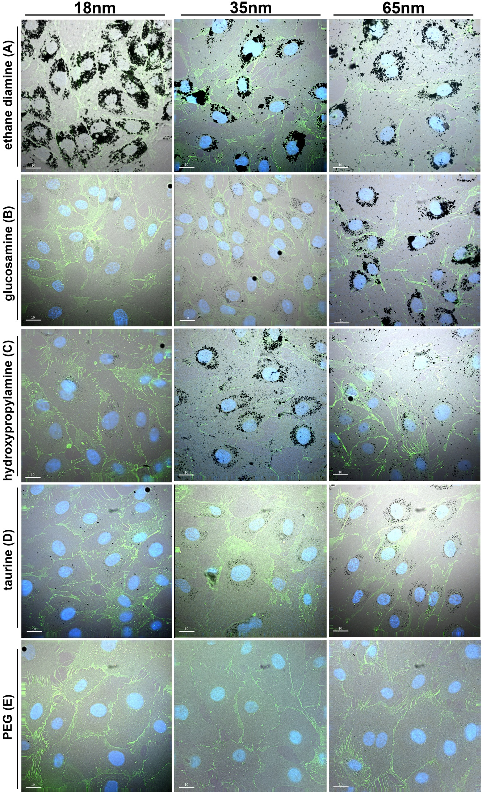
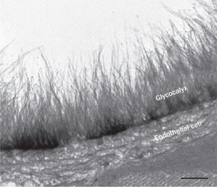
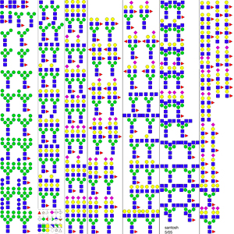
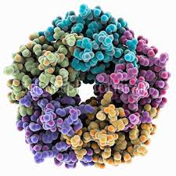
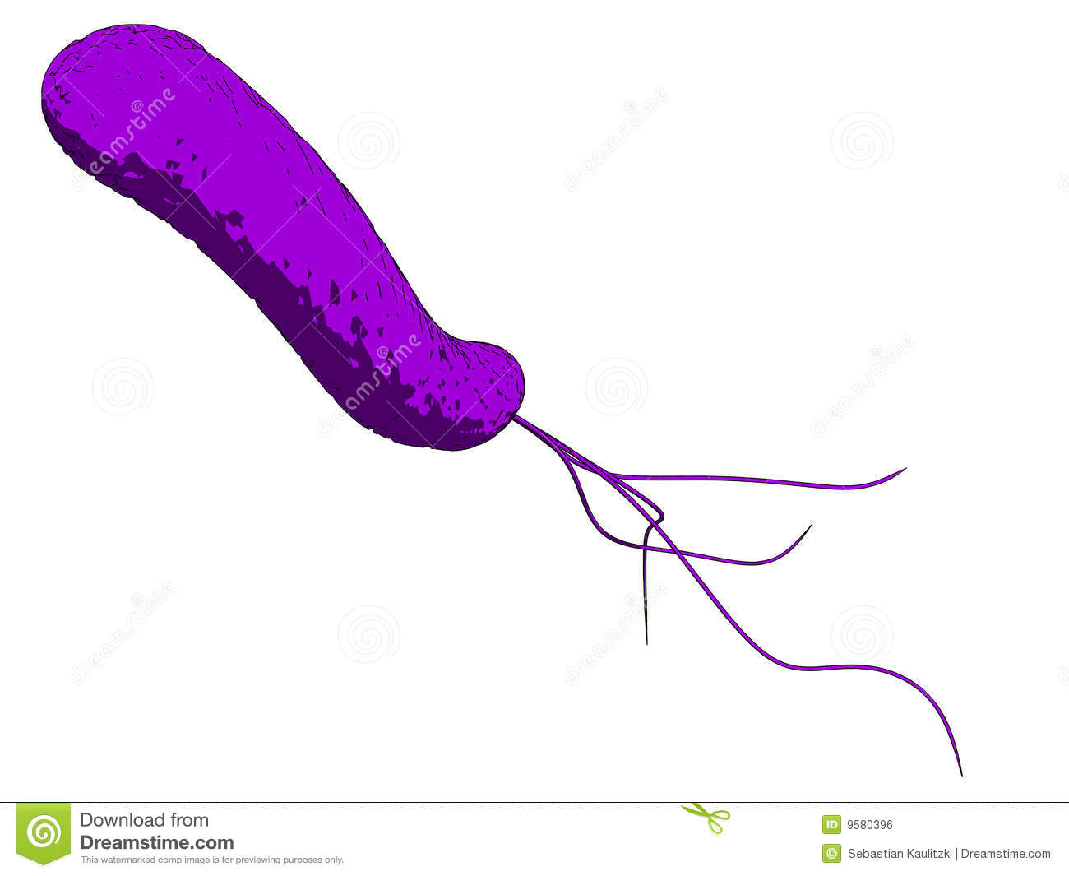
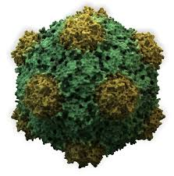
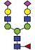

Glycans are Crucial Biomarkers
Selection of N-linked mammalian glycans d/load from P Stanley Lab
Cholera
Ricin
Influenza
Ebola
Shiga Toxins
HIV
Treatment
Diagnosis
Understanding

Slide 3
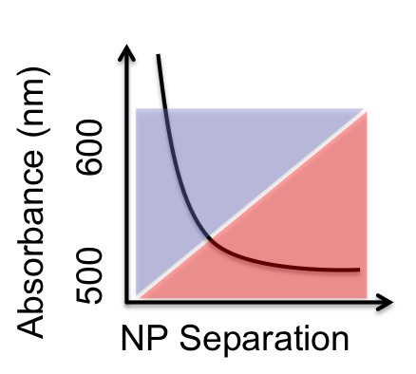
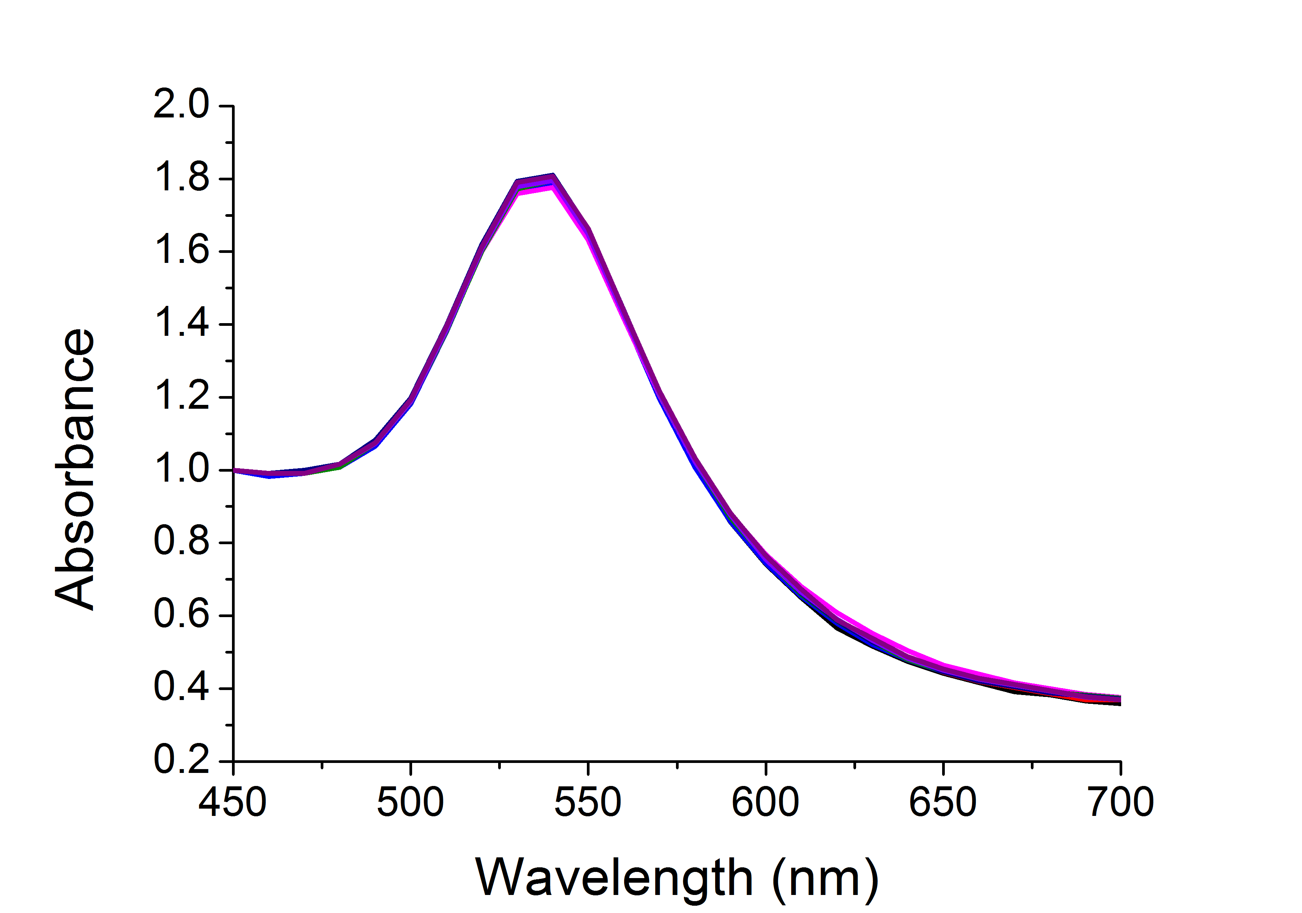
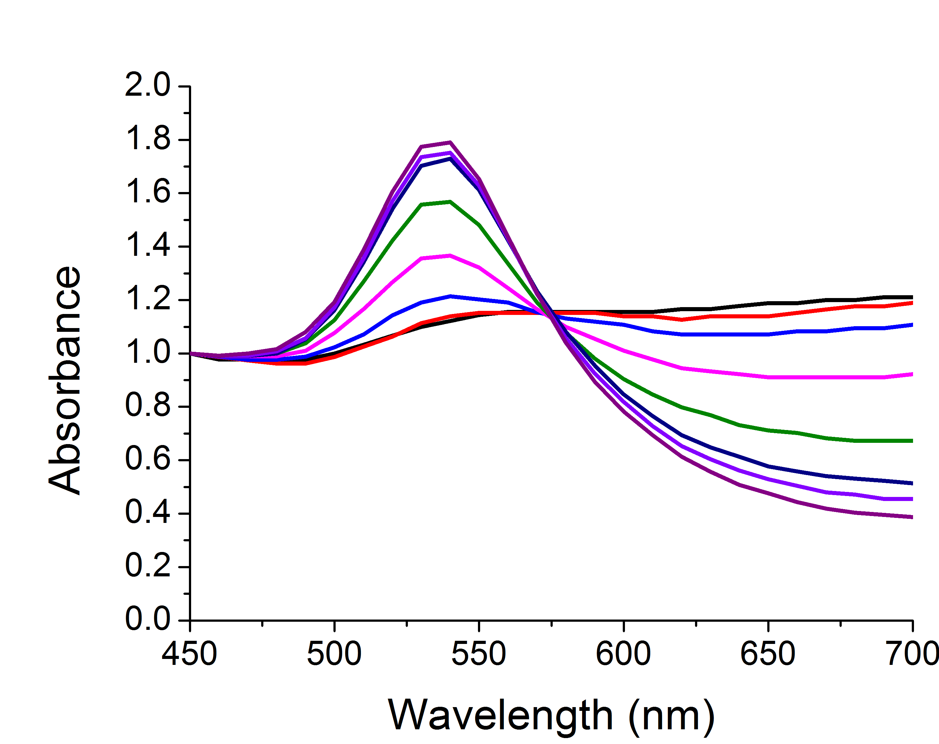
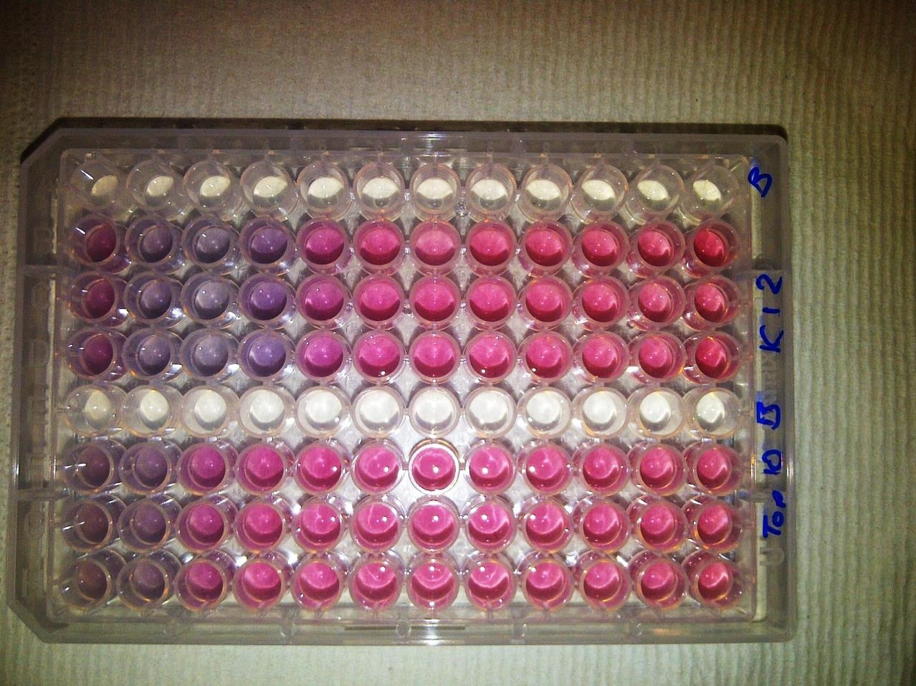
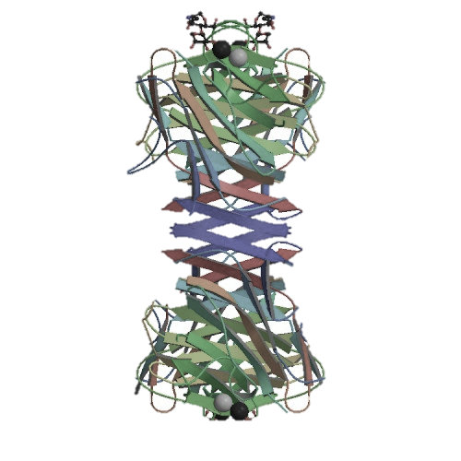
Label-Free Biosensing

Slide 4
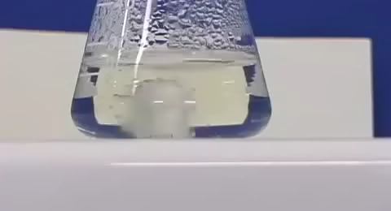
Glycosylated Gold Nanoparticles
[Con A]
Colour Change ☑
Fast ☑
Specific ☑
Saline Stability ☒
Richards, S-J., Fullam, E., Besra, G. S. Gibson, M. I.; J. Mater. Chem. B, 2014, 2, 1490-1498

Slide 5
PEG-Stabilised AuNPs
40 nm
Colour Change ☑
Fast ☒
Specific ☑
Saline Stability ☑
n = 68
Con A induced aggregation
Directly functionalised
PEG functionalised
[ConA]
Richards, S-J., Fullam, E., Besra, G. S. Gibson, M. I.; J. Mater. Chem. B, 2014, 2, 1490-1498

Slide 6
Optimisation of polymer coating
Thiol for immobilisation on to AuNP
Masked thiol for immobilisation on to AuNP
Sugar conjugation site
Sugar for lectin recognition
Richards, S-J., Biggs, C. I, Gibson, M. I., Methods in Molecular Biology; Macro-Glycoligands, 2016, Series Vol 1367

Slide 7
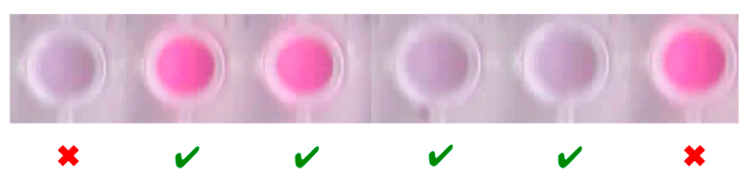
Finding the ‘Goldilocks’ Zone for Optimised Responses
Saline stability
DP10
DP20
DP75
Colour Change ☑
Fast ☑
Specific ☑
Saline Stability ☑
Speed of colour change
Too short
‘Just right’
Too long
Richards, S-J and Gibson, M. I.; Macro Lett., 2014, 2, 1490-1498, 1, 1004-1008

Slide 8
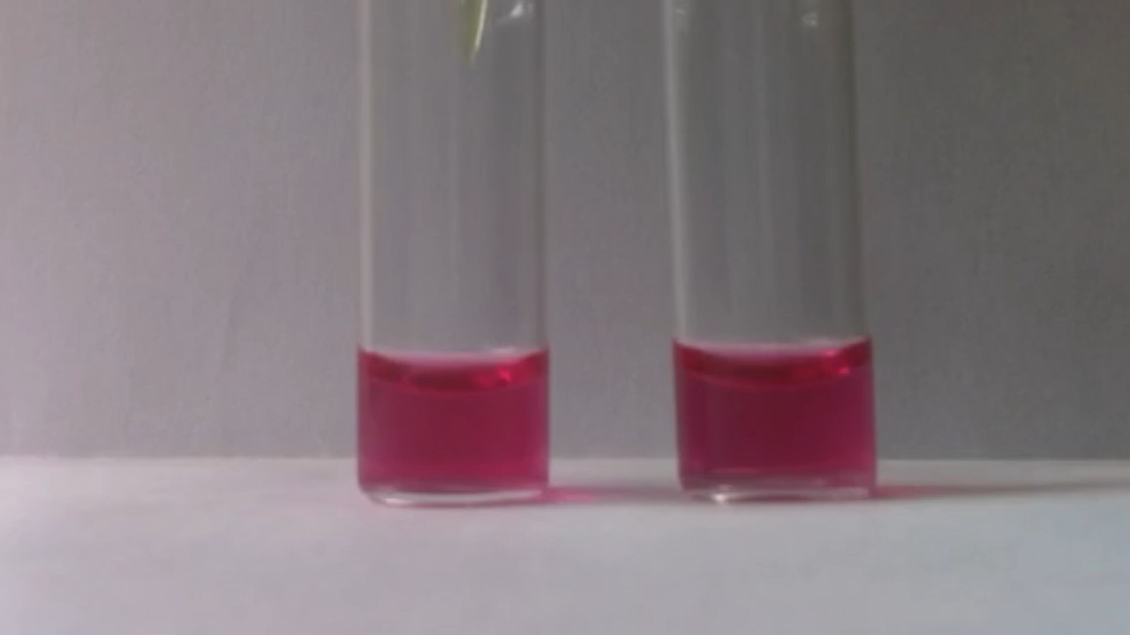
Demonstration of Improved Performance
[SBA]
[SBA]
UV-Vis Titration
Kinetics
Dynamic Light Scattering
Specificity test
Richards, S-J., Gibson, M. I. ACS Macro Lett.., 2014, 3, 1004-1008

Slide 9
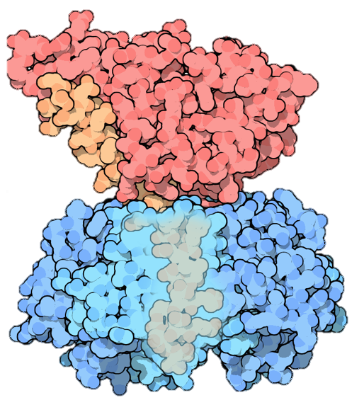
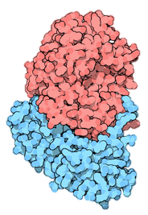
Towards a ‘Real’ Colourimetric Sensor
Cholera Toxin
Ricin
Enzymatic domain
Carbohydrate binding domain
3-5 million cases a year
100-120,000 deaths
~1.8 mg to kill 1 person
Vomiting
Diarrhea
Dehydration
Drop in blood pressure
Clinical shock
Stomach cramps
Death
Vomiting
Diarrhea
Dehydration
Drop in blood pressure
Clinical shock
Seizures
Hematuria
Multiple organ failure
Death

Slide 10
Single vs Multi Channel Sensors
Cholera
Ricin
Can ‘never’ have a perfect, single channel glyco-sensor

Slide 11
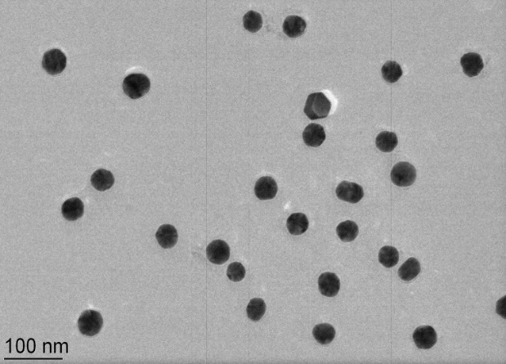
Combinatorial Glyco-AuNP Polymer Libraries
N₂H₄
Reducing sugar capture
Transmission Electron Microscopy
Dynamic Light Scattering
X-Ray Photo-electron Spectroscopy

Slide 12
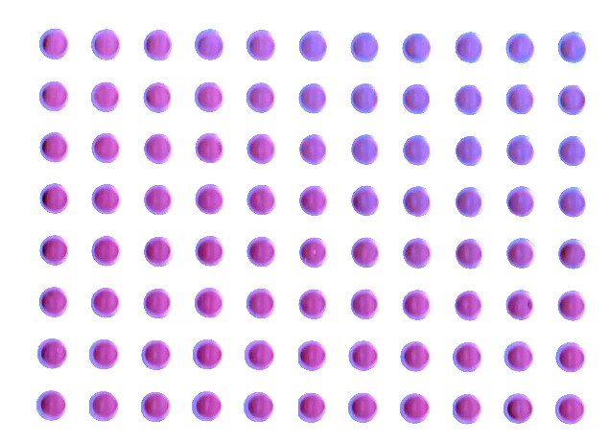
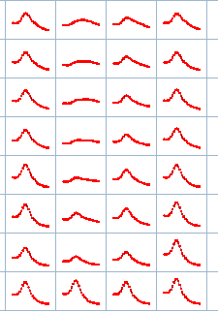
Combinatorial Glyco-AuNP Polymer Libraries
1
2
2
3
3
4
4
1
Plate-Reader
UV-Vis Traces
Dose-response curve
Richards, S-J., Otten, L., Gibson, M. I.; J. Mater Chem. B., 2016, 4, 3046-3053

Slide 13
Decoding the Barcode to Identify Toxins
Linear Discriminant Analysis
6 channels to distinguish between 6 lectin inputs
Richards, S-J., Otten, L., Gibson, M. I.; J. Mater Chem. B., 2016, 4, 3046-3053
Notes:
Second is bacteria identification

Slide 14
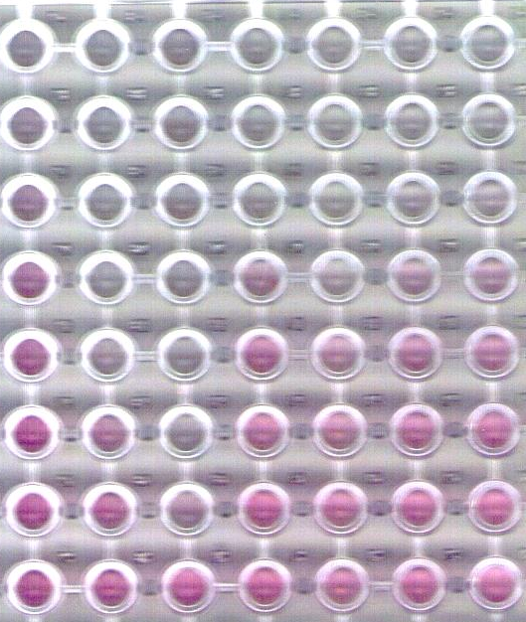
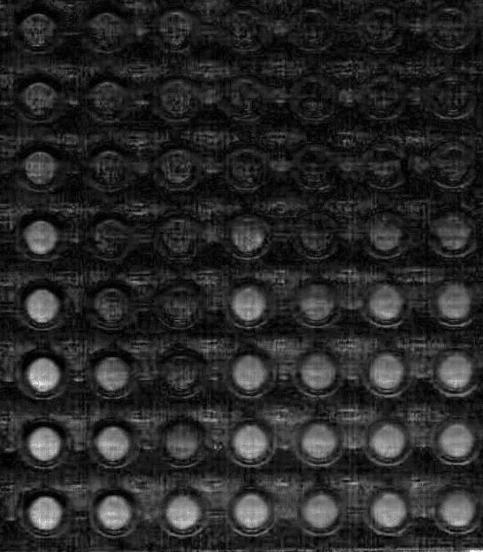
Low Cost Approach using a Mobile Phone?
Mobile Phone Image
Red/Blue Channel separation
Comparison verses UV/Vis
Richards, S-J., Otten, L., Gibson, M. I.; J. Mater Chem. B., 2016, 4, 3046-3053

Slide 15
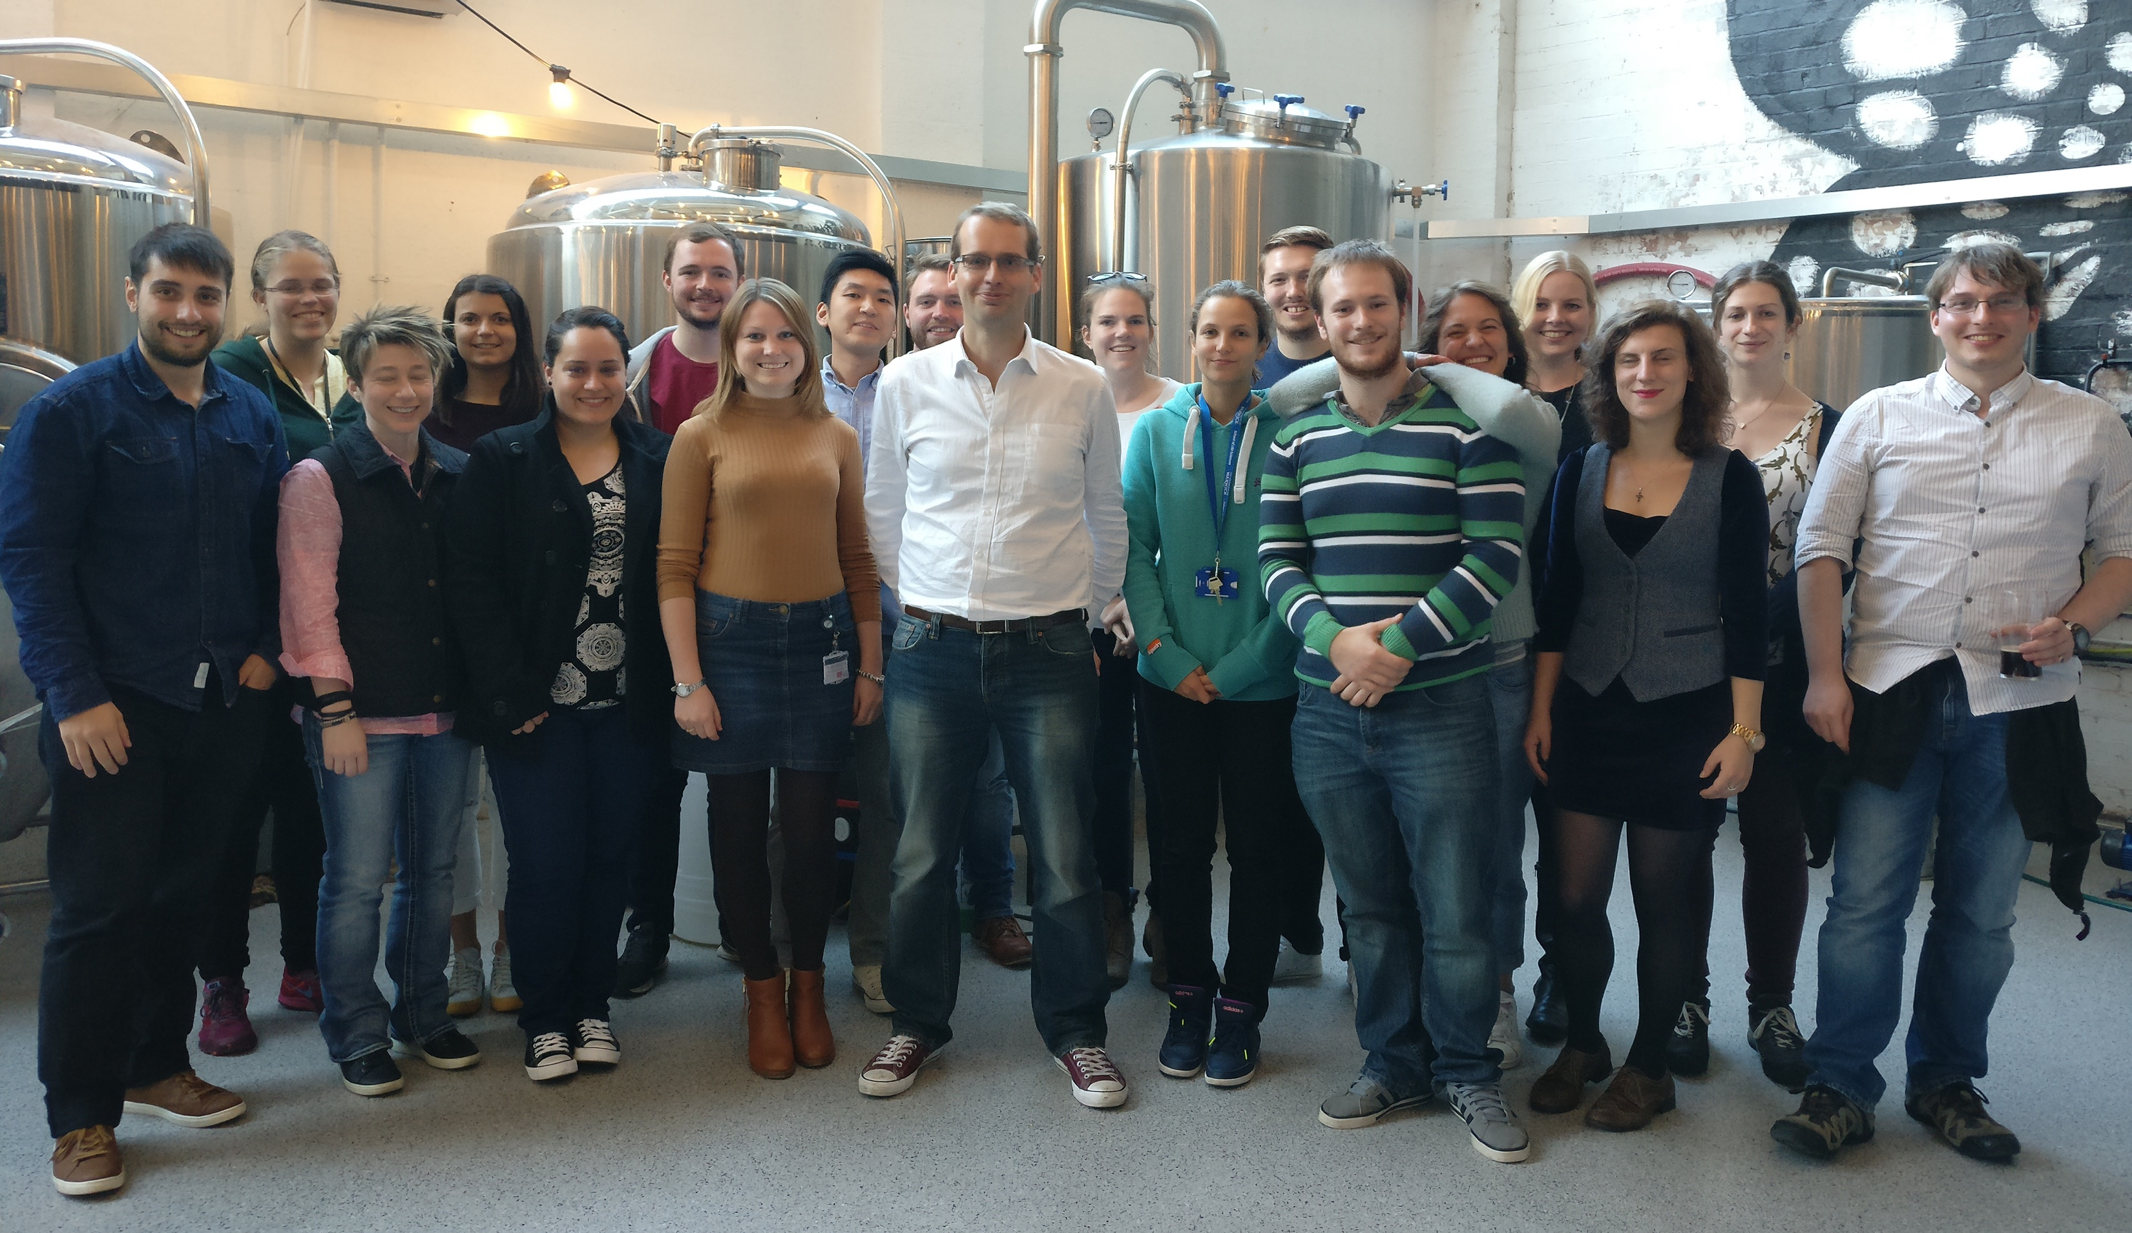







Acknowledgements
Post-docs
Dr Caroline Biggs
Dr Collette Guy
Dr Lucienne Otten
Dr Muhammad Hasan
Dr Kathryn Styles
PhD Students
Sang Ho Won
Lewis Blackman
Benjamin Martyn
Joseph Healey
Nick Alcaraz
Julia Lipecki
Chris Stubbs
Ben Graham
Trisha Bailey
Laura Wilkins
Maria Gyprioti
Vinko Varas
Gabriell Erni-Cassolla
Robyn Wright
Iain Galpin
Masters Students
Nick Vail
Peiwen Seng
Noreen Murray Philanthropy Award
www.warwick.ac.uk/go/gibsongroup
@LabGibson

Slide 16
Glycosylated gold nanoparticle biosensors
Dr Sarah-Jane Richards and Prof. Matthew I. Gibson
Department of Chemistry, University of Warwick, UK
@LabGibson
@RichardsSJ
www.warwick.ac.uk/sarahjane_richards
NanoSymposium 13/12/16
University of Birmingham
s.richards.1@warwick.ac.uk

Slide 17
One more thing… Measurement in (‘real’) Complex Media
‘Binding’ AuNP
‘Non-binding’AuNP
Positive
Negative
Background removal
Unpublished results

