Slide 1

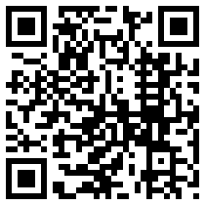
Glycosylated Nanomaterials: Neutralisation and Detection of Bacteria and Toxins
Sarah-Jane Richards &
Matthew I. Gibson
Department of Chemistry, University of Warwick, UK
S-J.Richards@warwick.ac.uk
www.warwick.ac.uk/go/gibsongroup
RSC YMS 2014 Birmingham – 24th June

Slide 2
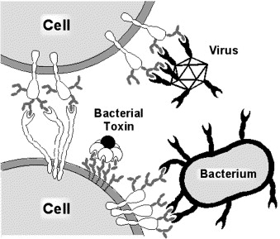
Protein-Carbohydrate Interactions
Blood Groups
Cell signalling
Cellular adhesion of
Viruses
Bacteria
Bacterial toxins
Cancerous cells
Fertilisation
Inflammation
You Houng, Nat. Mater., 2010, 9, 485 Gamblin, Chem. Rev, 2009, 109, 131
Miura, JPOLA, 2007, 45, 5031 Imberty, Chem. Eur. J., 2008, 14, 7490
Spain, Polym. Chem., 2011, 2, 60 Turnbull, B., Rev. Mol. Biotech., 2002, 90, 231
Notes:
Change this slide

Slide 3
Why Materials?
Predicted linear response
Kiessling, Angew, Chem., 2006, 45, 22348 Alexander et al, JACS, 2007, 129, 11014 Mammam, J. Med. Chem., 1995, 38, 4179
Spain et al. Polym. Chem., 2011, 2, 60

Slide 4
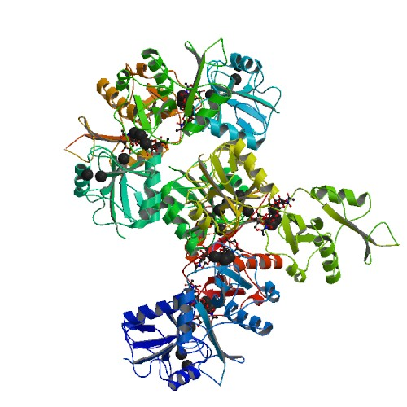
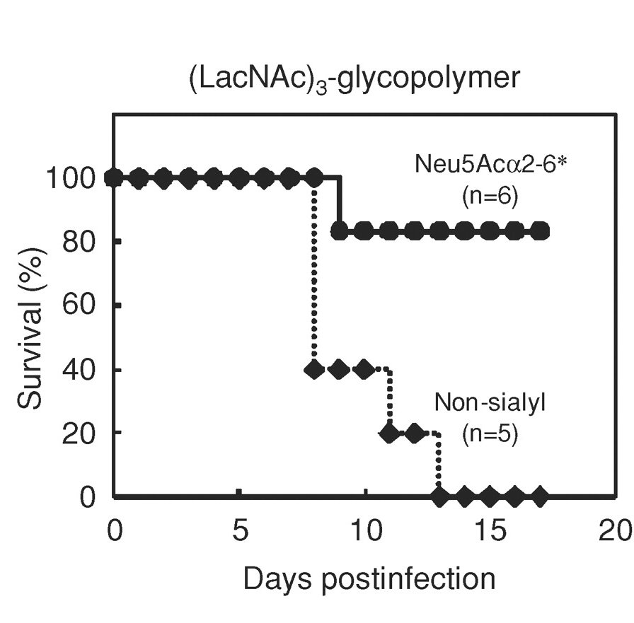
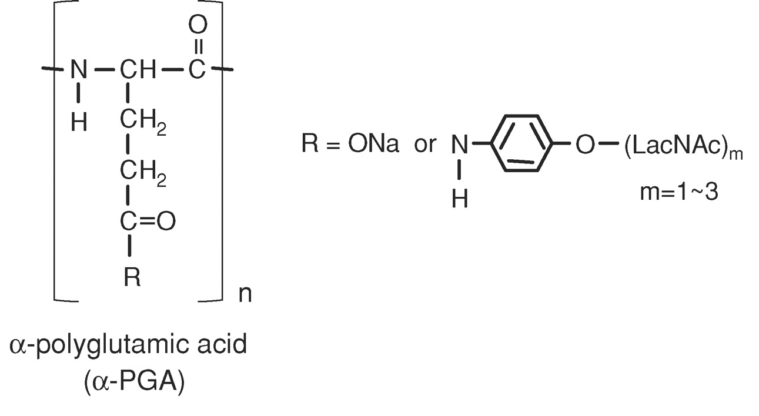
Applications: Anti-adhesion Therapy
Interactions can be inhibited at nM of glycopolymers
Influenza inhibition in mice
Sharon, N. Biochimica et Biophysica Acta, 2006, 527–537
Hidari et al. Glycobiology 2008, 18, 779
Notes:
Change to cholera
Get rid of HIV

Slide 5
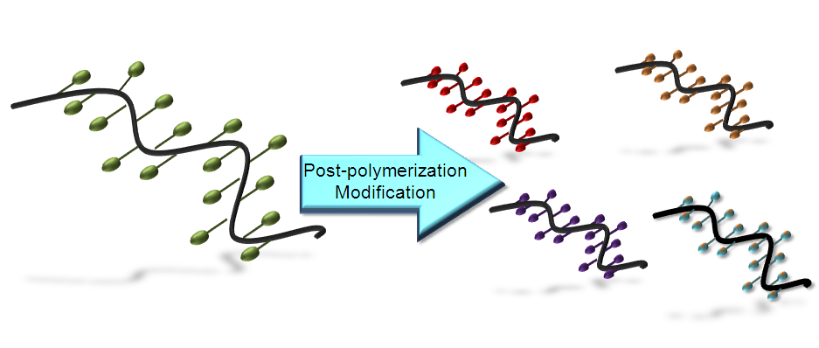
Glycopolymers by Post-Polymerisation Modification
Jones, M. W., Richards, S-J., Haddleton, D. M. Gibson, M. I.; Polym. Chem., 2013,
Richards, S-J., Jones, M. W., Hunabun, M. I., Haddleton, D. M., Gibson, M. I.; Angew. Chem., 2012
Jones, M. W., L. Otten, Richards, S-J., Lowery, R., Phillips, D. J. Haddleton, D. M. Gibson, M. I.; Chem. Sci., 2014
Notes:
Change red pic
Ref at botto,

Slide 6
Easy to make 50 gram scale
1 column/distillation
Compatible with RAFT/ATRP
Quantitative functionalisation with non-hindered amines
Density control
Sequentially
modified
polymer libraries
Theato, P.; J. Pol. Sci. A., 2008, 46, 6677

Slide 7
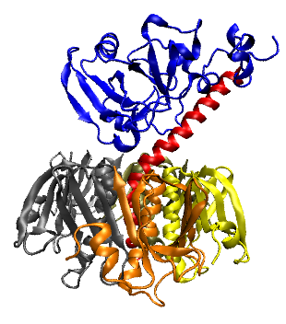
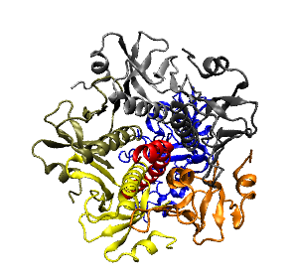
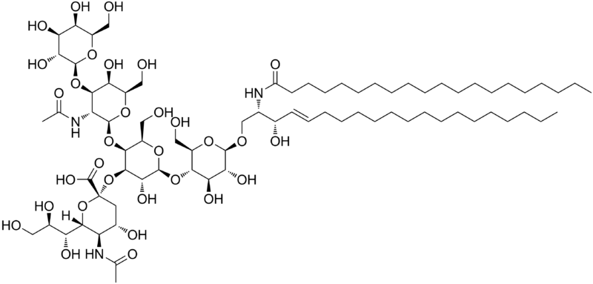
Selective Binding of Cholera-Toxin
Enzymatic domain
Induces toxic effect
Carbohydrate binding domain
Binds to epithelial cells to promote cell uptake
Anti-adhesion therapy does not target bacteria, so less evolutionary stress
Galectins – at least 13
Sigma-Aldrich – 8 Galactose-’specific’ lectins
β-D Galactose
How do we engineer a high-affinity binder for cholera toxin, without total synthesis of complex carbohydrates?
GM-1 ganglioside

Slide 8
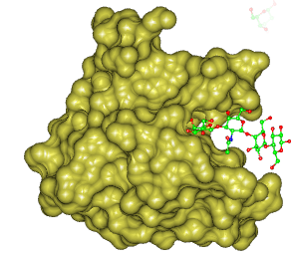
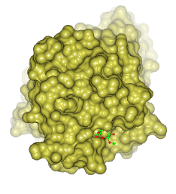
Glycan Accessibility as a Tool for Lectin Specificity
Cholera Toxin
Peanut Agglutinin
16 Å
6.3 Å
Kiick et al.; Macromol. 2007, 40, 7103 and Biomac., 2006, 7 483
Notes:
More reference

Slide 9
Glycopolymer Library
Polymer | DP^{[a]} | Linker^{[b]} | Density^{[c]} | M_{w}/M_{n}^{[d]}
GP1 | 18 | Short | 100 | 1.29
GP2 | 33 | Short | 100 | 1.27
GP3 | 70 | Short | 100 | 1.26
GP4 | 18 | Long | 100 | 1.32
GP5 | 33 | Long | 100 | 1.28
GP6 | 70 | Long | 100 | 1.27
GP7 | 33 | Long | 50 | 1.23
GP8 | 33 | Long | 25 | 1.21
GP9 | 33 | Long | 10 | 1.20

Slide 10
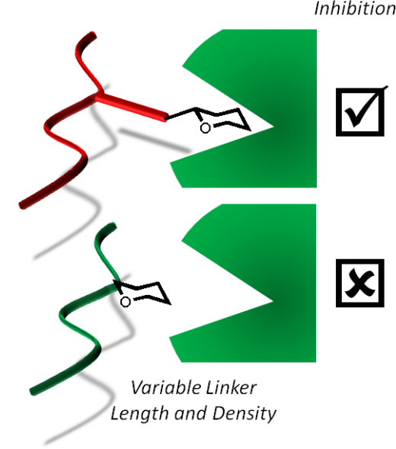
Peanut Agglutinin
Cholera Toxin
Polymer length
Polymer length
Short Linker
Long Linker
Short Linker
Long Linker
Richards, S-J., Jones, M. W., Hunabun, M. I., Haddleton, D. M., Gibson, M. I.; Angew. Chem., 2012, 51, 7812

Slide 11
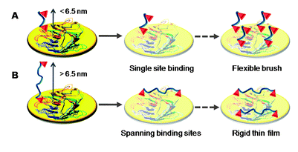
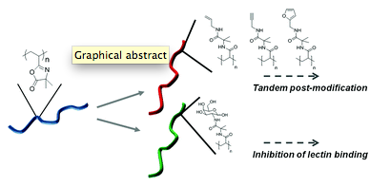
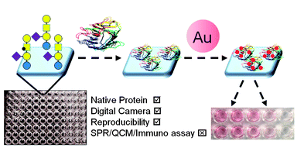
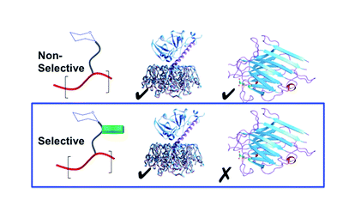
Blood Groups
Cancerous cells
Gou, Y., Richards, S-J., Haddleton, D. M. Gibson, M. I.; Polym. Chem., 2012, 3, 1634-1640
Jones, M. W., Richards, S-J., Haddleton, D. M. Gibson, M. I.; Polym. Chem., 2013, 4, 717-723
Otten, L., Richards, S-J., Fullam, E., Besra, G. S. Gibson, M. I.; J. Mater. Chem. B, 2013, 1, 2665-2672
Jones, M. W., L. Otten, Richards, S-J., Lowery, R., Phillips, D. J. Haddleton, D. M. Gibson, M. I.; Chem. Sci., 2014, 5, 1611-1616
Notes:
Change this slide

Slide 12
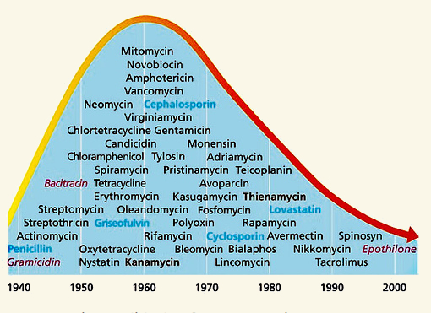
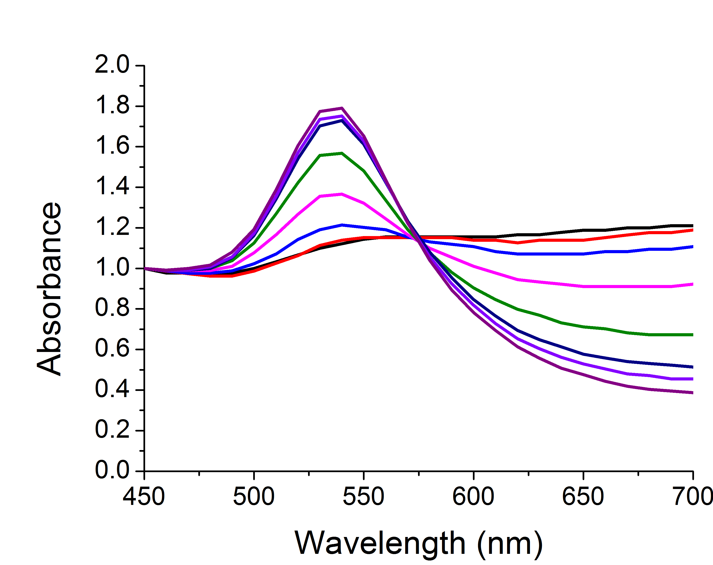
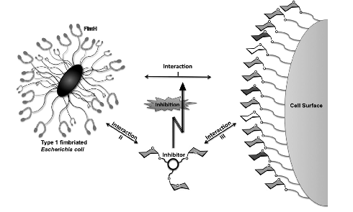
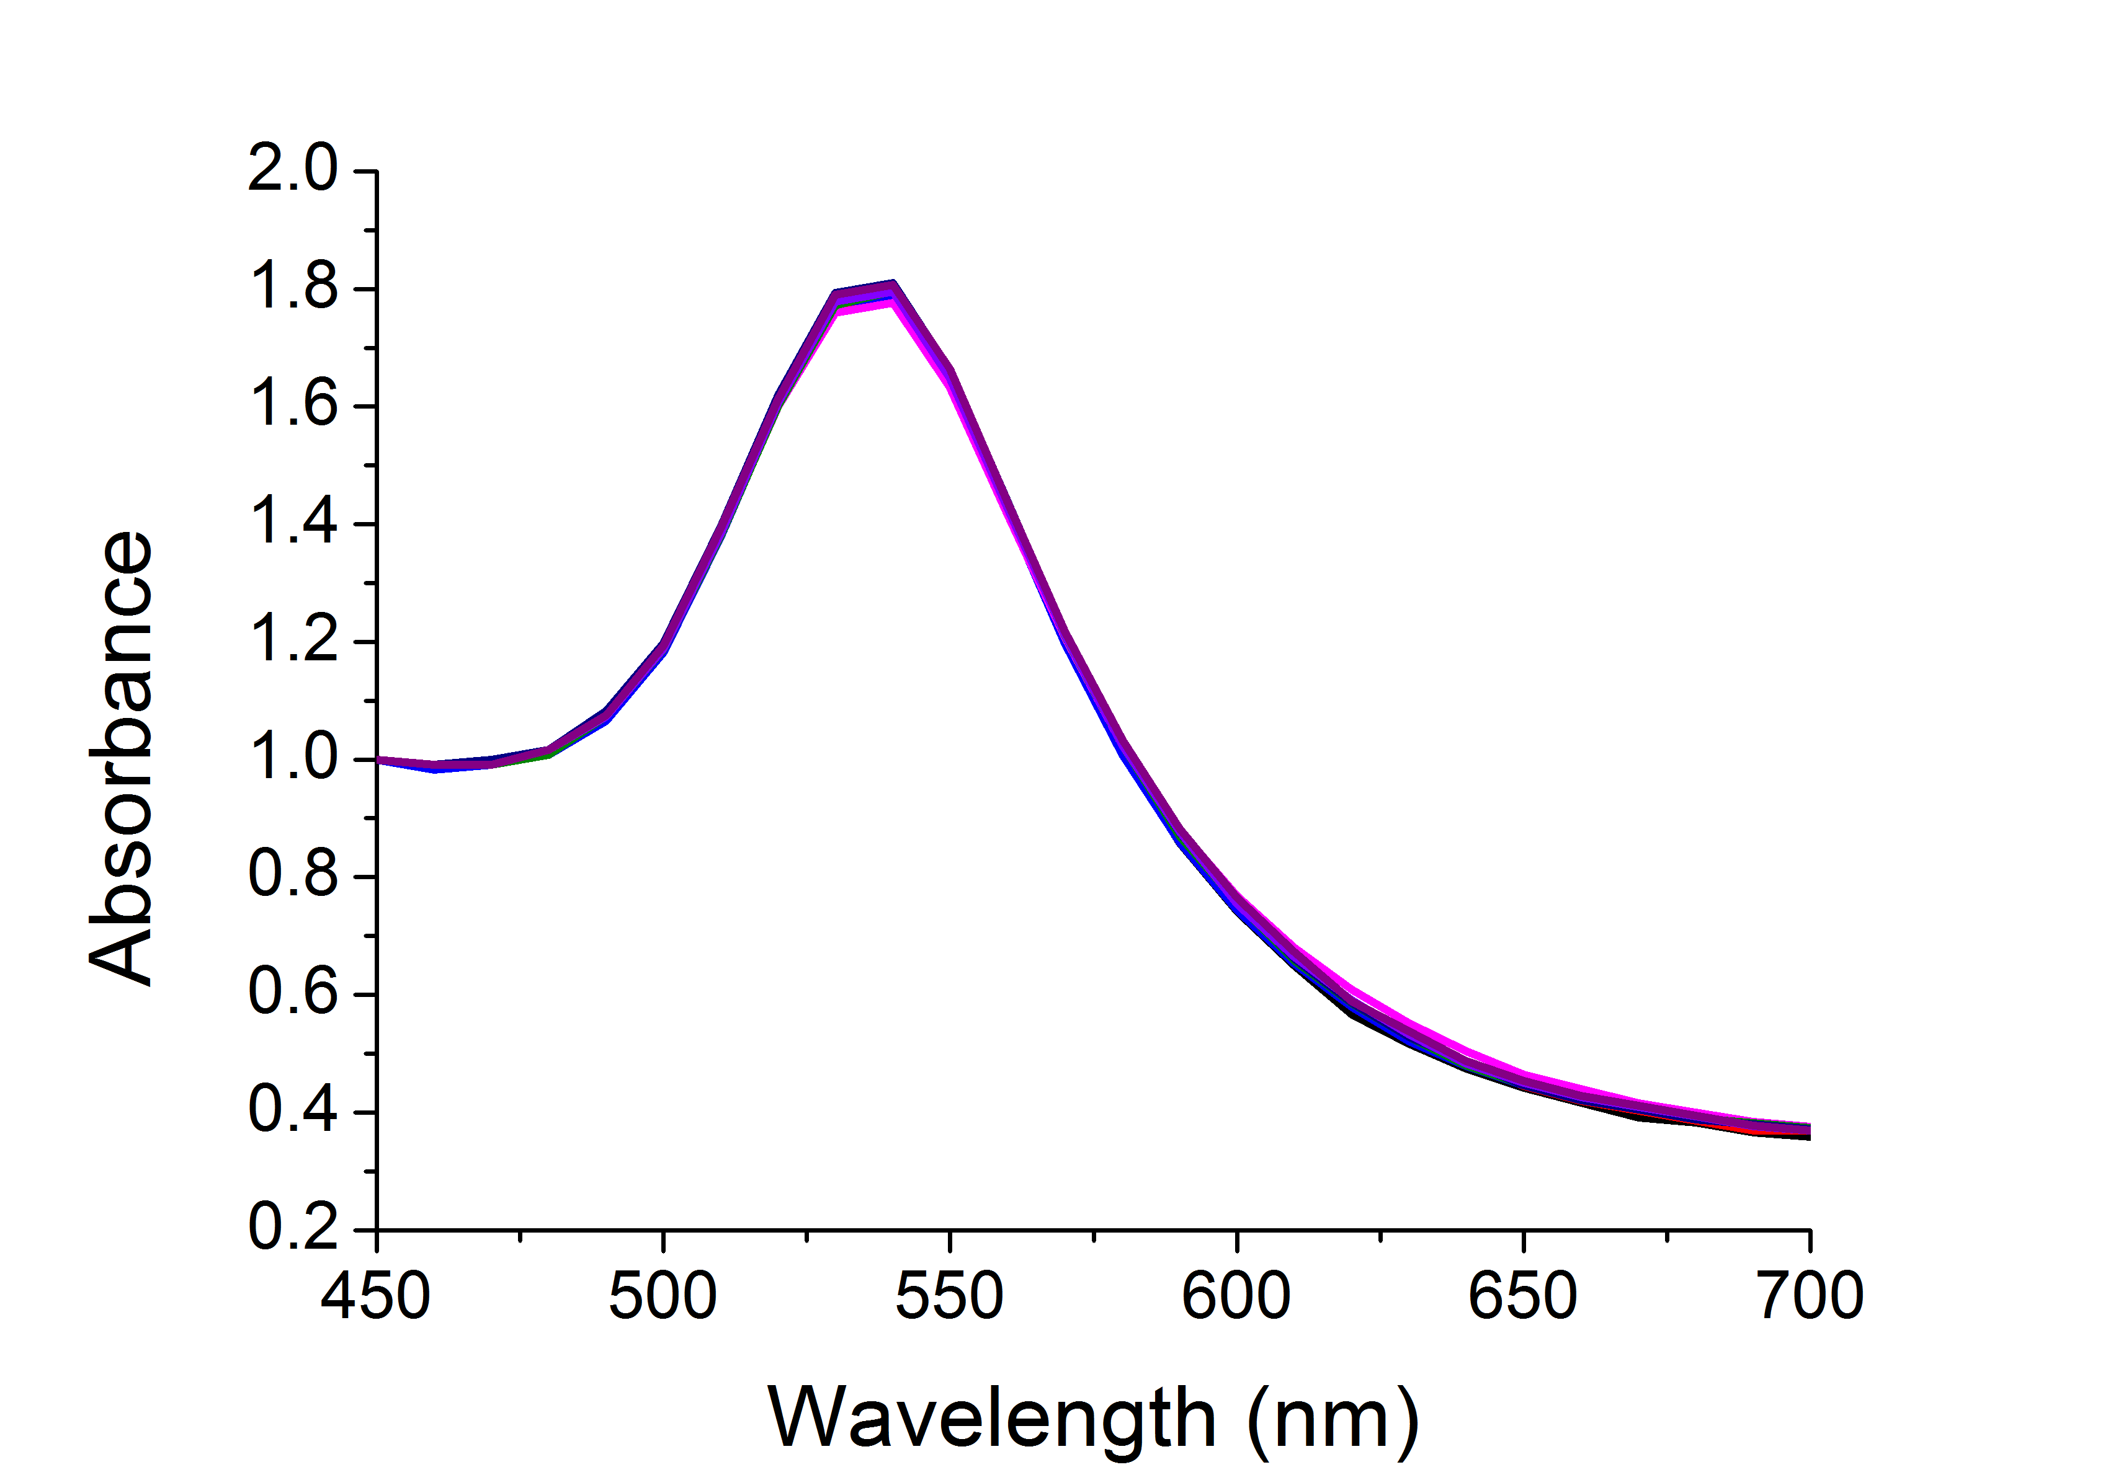
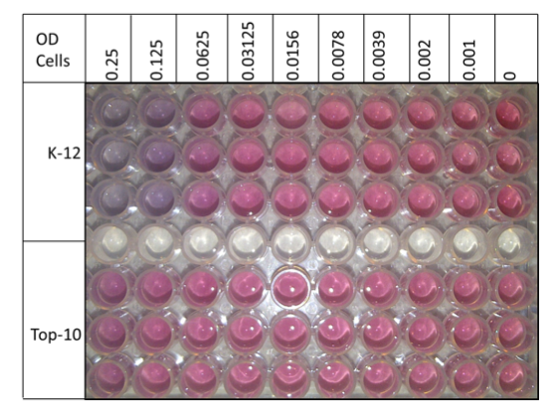
Applications: Detection
Direct
Label-free
Easy
Sensitive
Quantifiable in real-time
Notes:
More reference

Slide 13
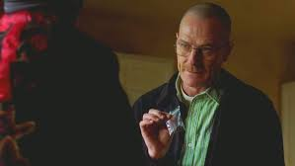
Potential Sensor for Ricin
Notes:
More reference

Slide 14
[ConA]
Richards, S-J., Fullam, E., Besra, G. S. Gibson, M. I.; J. Mater. Chem. B, 2014, 2, 1490-1498
Notes:
More reference

Slide 15
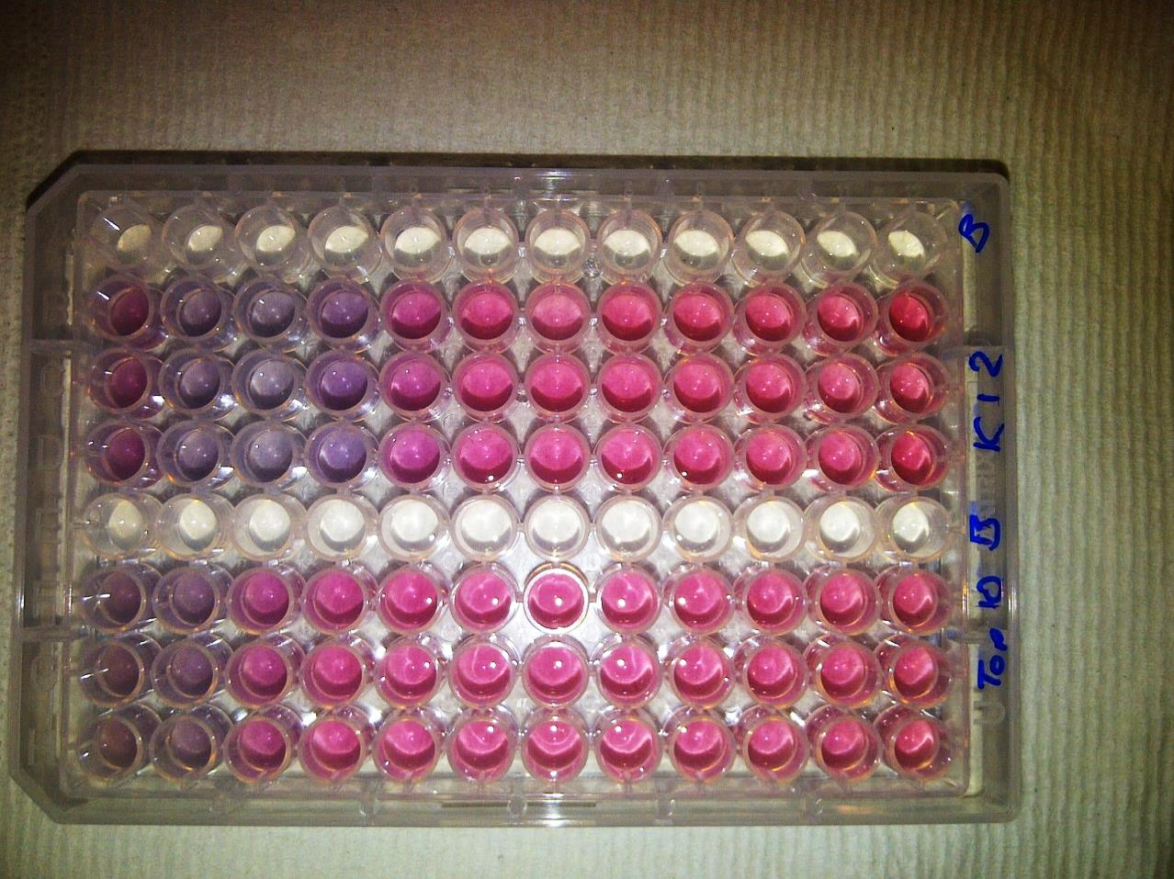

[FimH+ bacteria]
[FimH- bacteria]
Colour Change ☑
Fast ☑
Specific ☑
Saline Stability ☒
K-12
+ FimH
TOP10
- FimH
OD = 0.25
OD 0.005
[Bacteria]
Richards, S-J., Fullam, E., Besra, G. S. Gibson, M. I.; J. Mater. Chem. B, 2014, 2, 1490-1498
Notes:
More reference

Slide 16
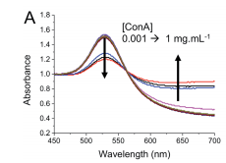
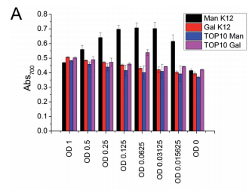
40 nm
Colour Change ☒
Fast ☒
Specific ☑
Saline Stability
PEG functionalised
[ConA]
Colour change ☒ Specific ☑ Saline Stable ☑
Richards, S-J., Fullam, E., Besra, G. S. Gibson, M. I.; J. Mater. Chem. B, 2014, 2, 1490-1498
Notes:
More reference

Slide 17
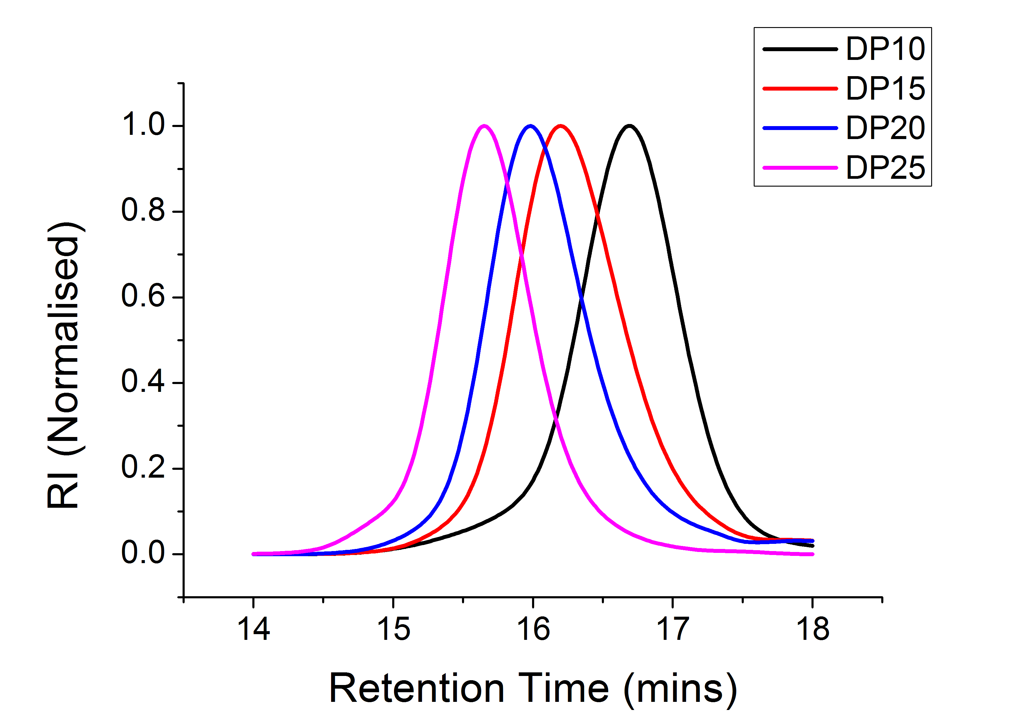
Notes:
More reference

Slide 18
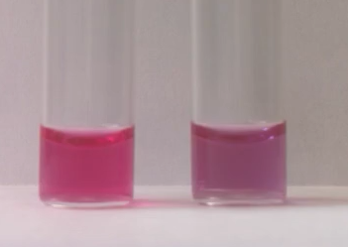
Colour Change ☑
Fast ☑
Specific ☑
Saline Stability ☑
Richards, S-J., Fullam, E., Besra, G. S. Gibson, M. I., In Preparation
Notes:
More reference

Slide 19
Summary
Tandem Post-Polymerisation Modification
Multivalent inhibitors that have good affinity AND specificity
Glycogoldnanoparticles
Optimised polymer coating for lectin detection

Slide 20
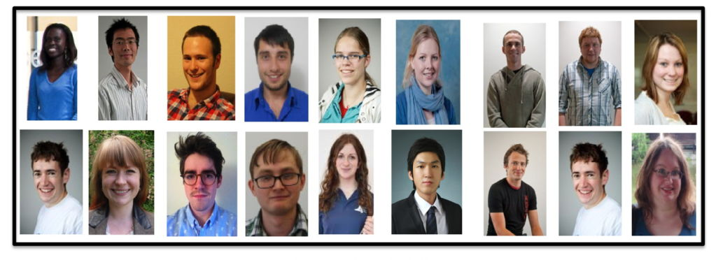




Acknowledgements
Gibson Group Members
Gemma-Louise Davies - Daniel Mitchell
Yunhua Chen - Richard Lowery
Catherine Cooper - Ben Martyn
Robert Deller - Lewis Blackman
Caroline Biggs - Sang-Ho Won
Daniel Phillips - Laura Wilkins
Tom Congdon - Robert Keogh
Lucienne Otten
Matthew Gibson
Dave Haddleton
Del Besra
Elizabeth Fullam
Mathew Jones

Slide 21
Glycosylated Nanomaterials: Detection and Neutralisation of Bacteria and Toxins
Sarah-Jane Richards & Matthew I. Gibson
Department of Chemistry, University of Warwick, UK
S-J.Richards@warwick.ac.uk
www.warwick.ac.uk/go/gibsongroup
RSC YMS 2014 Birmingham – 24th June

