Slide 1
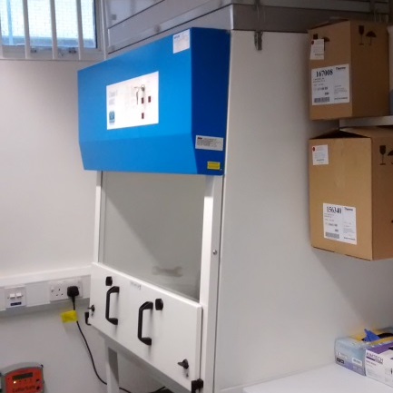
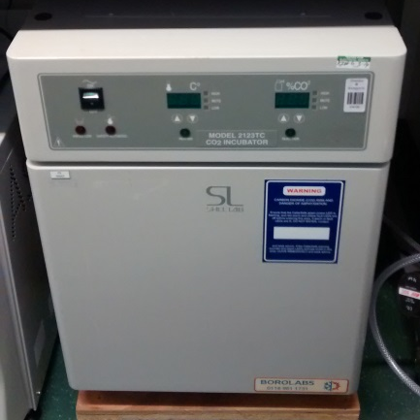
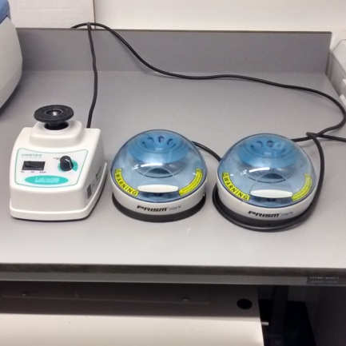
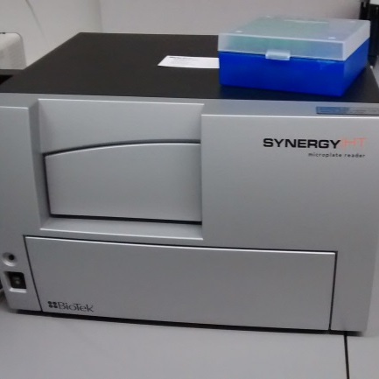
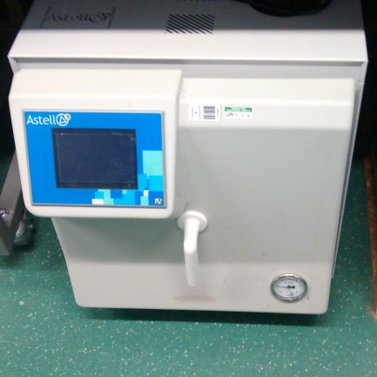
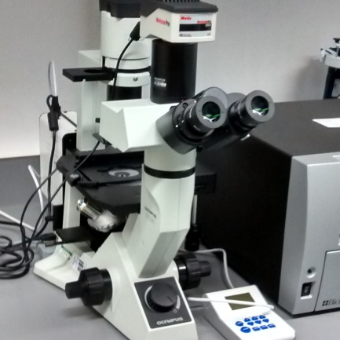
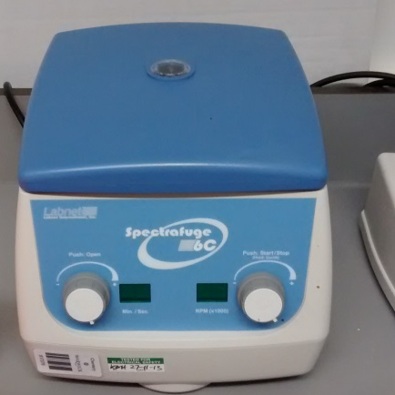
Safety hood | Shel Lab CO₂ Incubator | Labnet Vortex Mixer and 2 Labnet Prism Mini Centrifuges | BioTek Synergy HT VT Microplate Reader Fluorescence & absorbance Wavelengths 200-999 nm Excitation 360, 485, 539, 590 Emission 460, 528, 590, 645
Astell Autoclave | Olympus CKX41 Microscope fitted with MoticamPro | Labnet Spectrafuge 6C

