Slide 1


Title of the Presentation
Matthew I. Gibson
Department of Chemistry, University of Warwick, UK
m.i.gibson@warwick.ac.uk
www.warwick.ac.uk/go/gibsongroup
@LabGibson
Conference. Date
Location

Slide 2

Headings Size 32 MAX, ARIAL FONT
Text, size 20 arial. Only added text for labels.
DO NOT READ OFF SLIDES
REFERENCES IF NEEDED GO HERE. Size 14/16, ARIAL

Slide 3
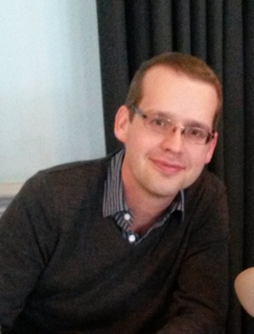
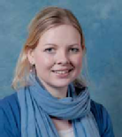


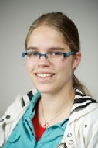
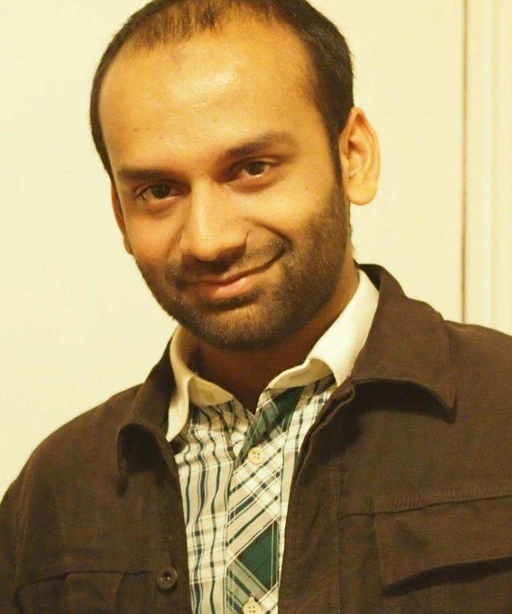
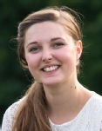
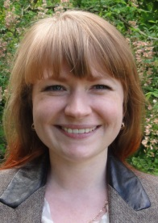
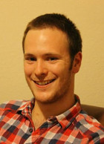
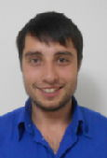
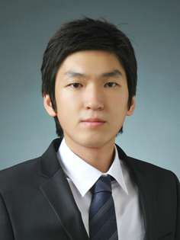
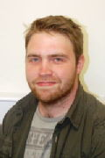

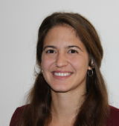
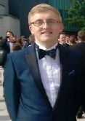
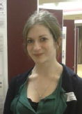
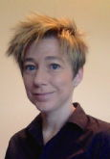
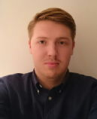

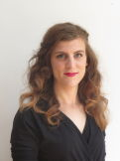
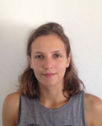
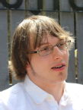








Acknowledgements
Gibson Group, 2017
Post-docs
Dr. Sarah-Jane Richards
Dr. Caroline Biggs
Dr Collette Guy
Dr Lucienne Otten
Kathryn Styles
Dr Muhammad Hasan
Phd Students
Sang-Ho Won
Lewis Blackman
Benjamin Martyn
Joseph Healey
Julia Lipecki
Chris Stubbs
Ben Graham
Trisha Bailey
Laura Wilkins
Marie Gyprioti
Vinko Varas
Gabriel Erni-Cassolla
Alice Fayter
Iain Galpin
Robyn Wright
Undergrad Students
Nick Vail
Funders £$€
Noreen Murray Philanthropy Award
www.warwick.ac.uk/go/gibsongroup
@LabGibson

Slide 4
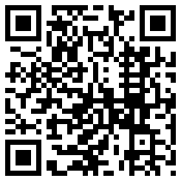
Matthew I. Gibson
Department of Chemistry, University of Warwick, UK
m.i.gibson@warwick.ac.uk
www.warwick.ac.uk/go/gibsongroup
@LabGibson
Conference. Date
Location

Slide 5
Extra bits in case you need them.

