Slide 1



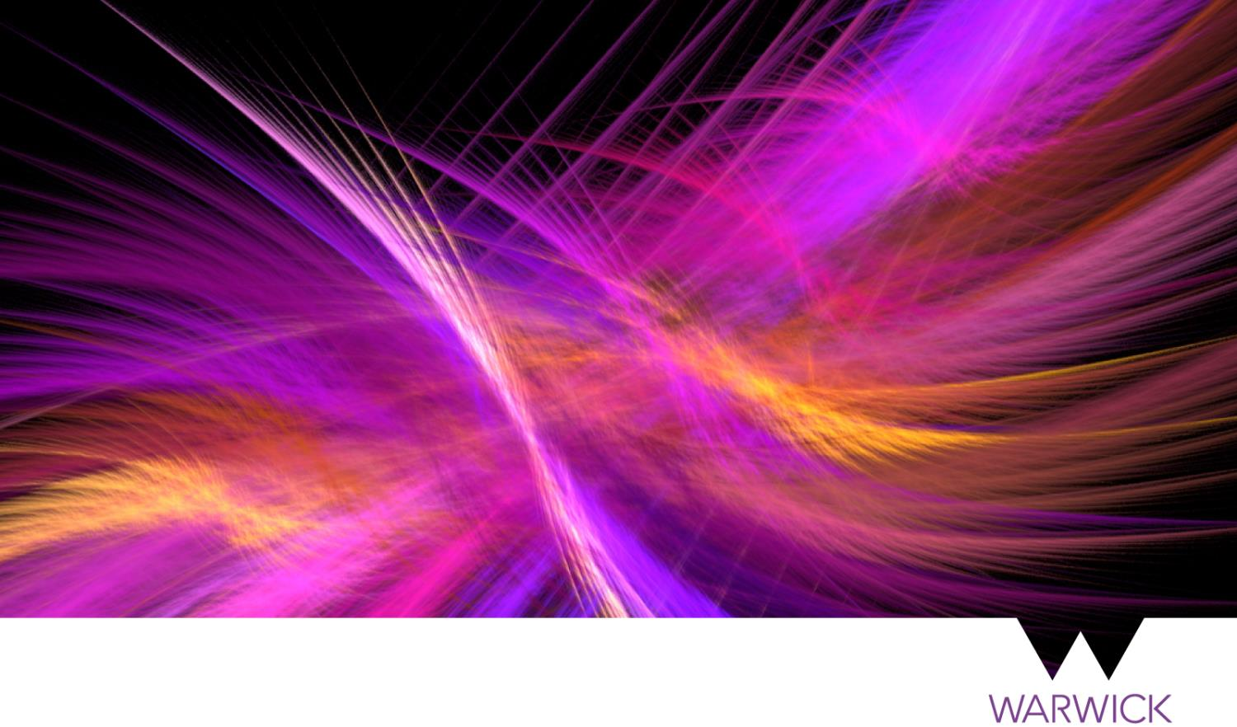
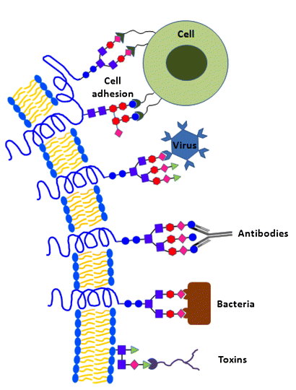
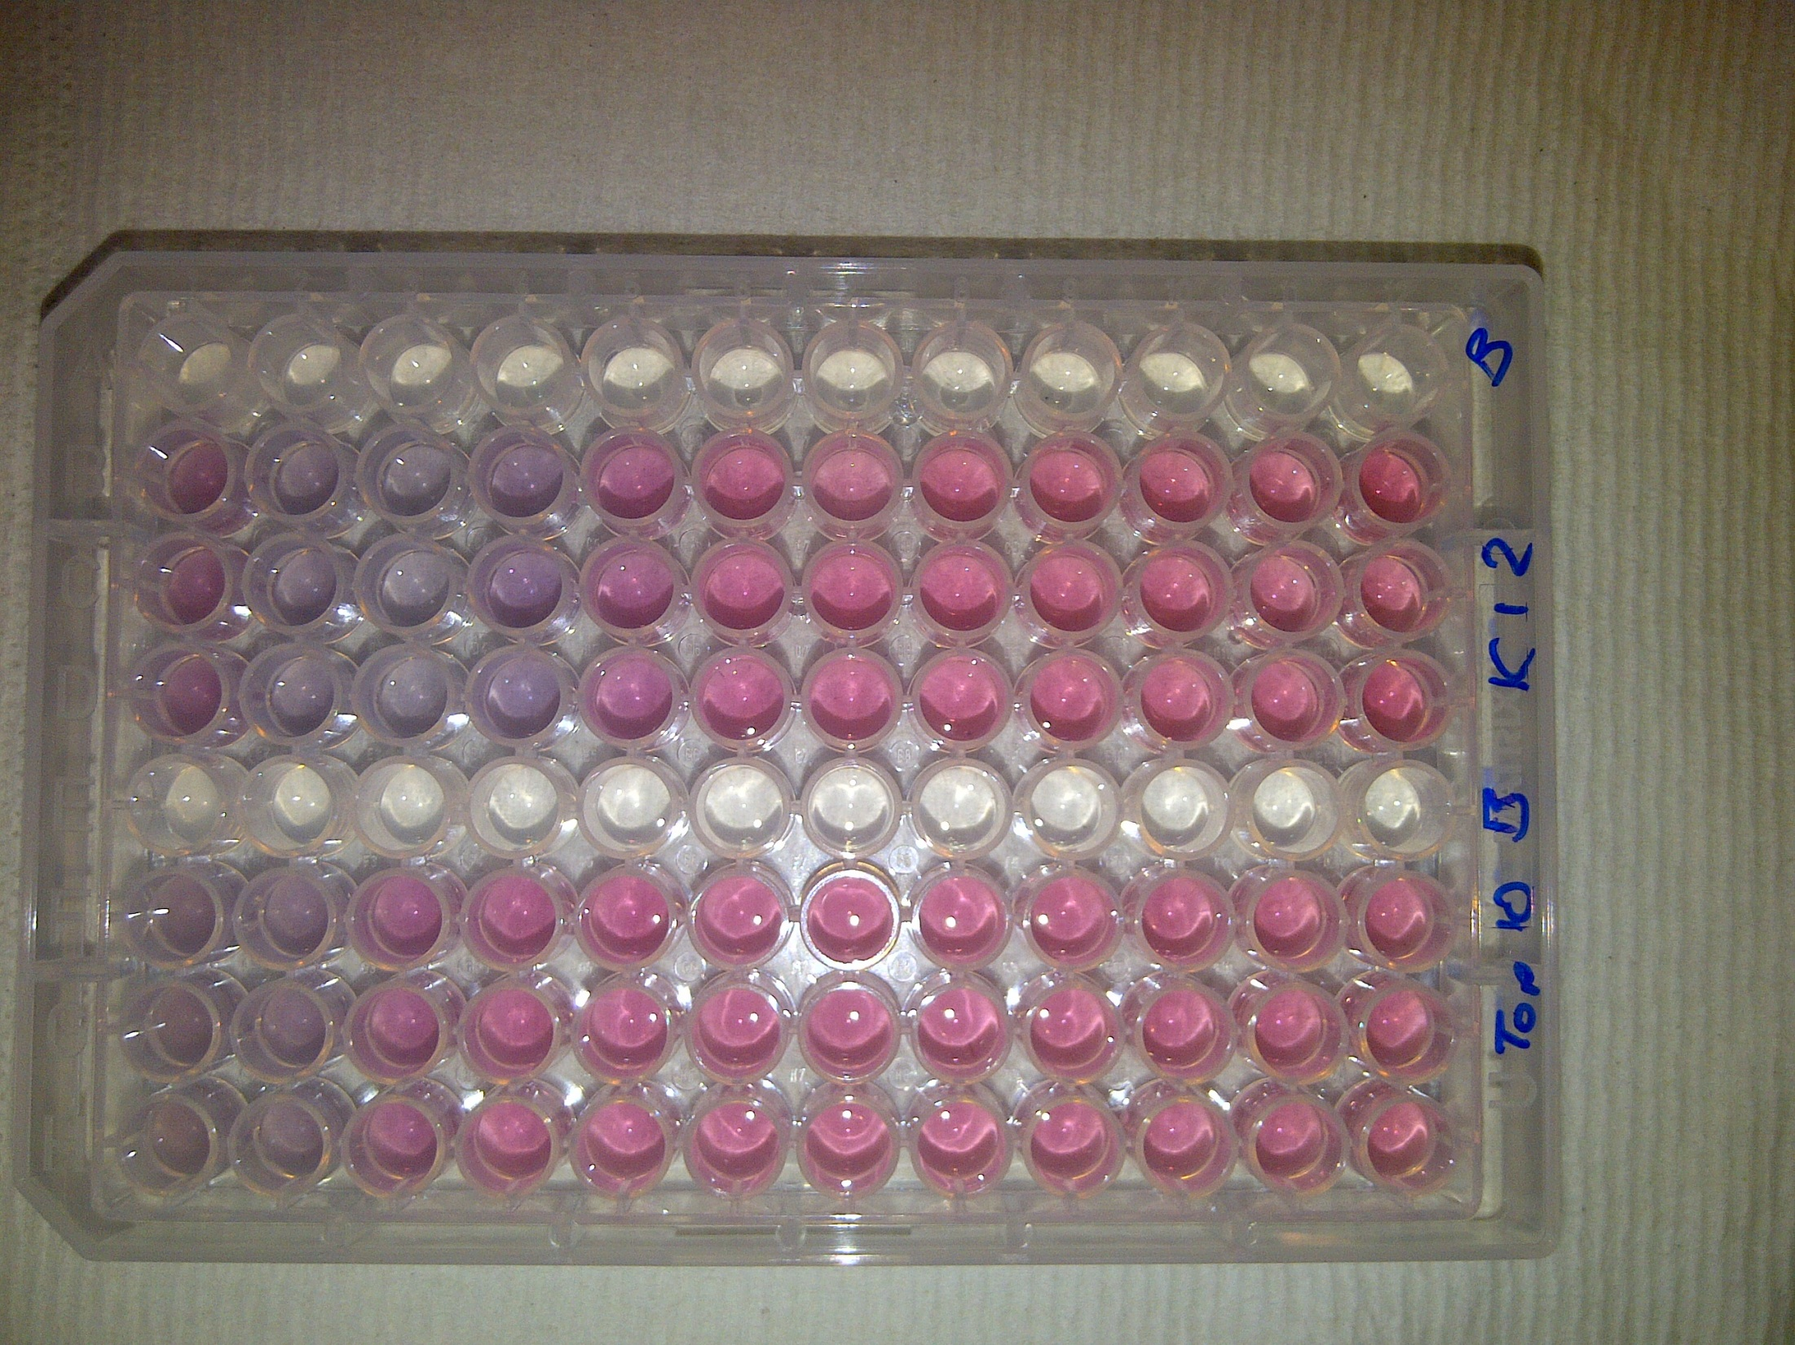
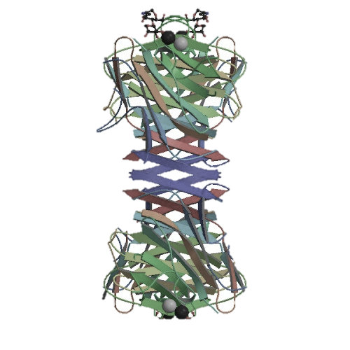
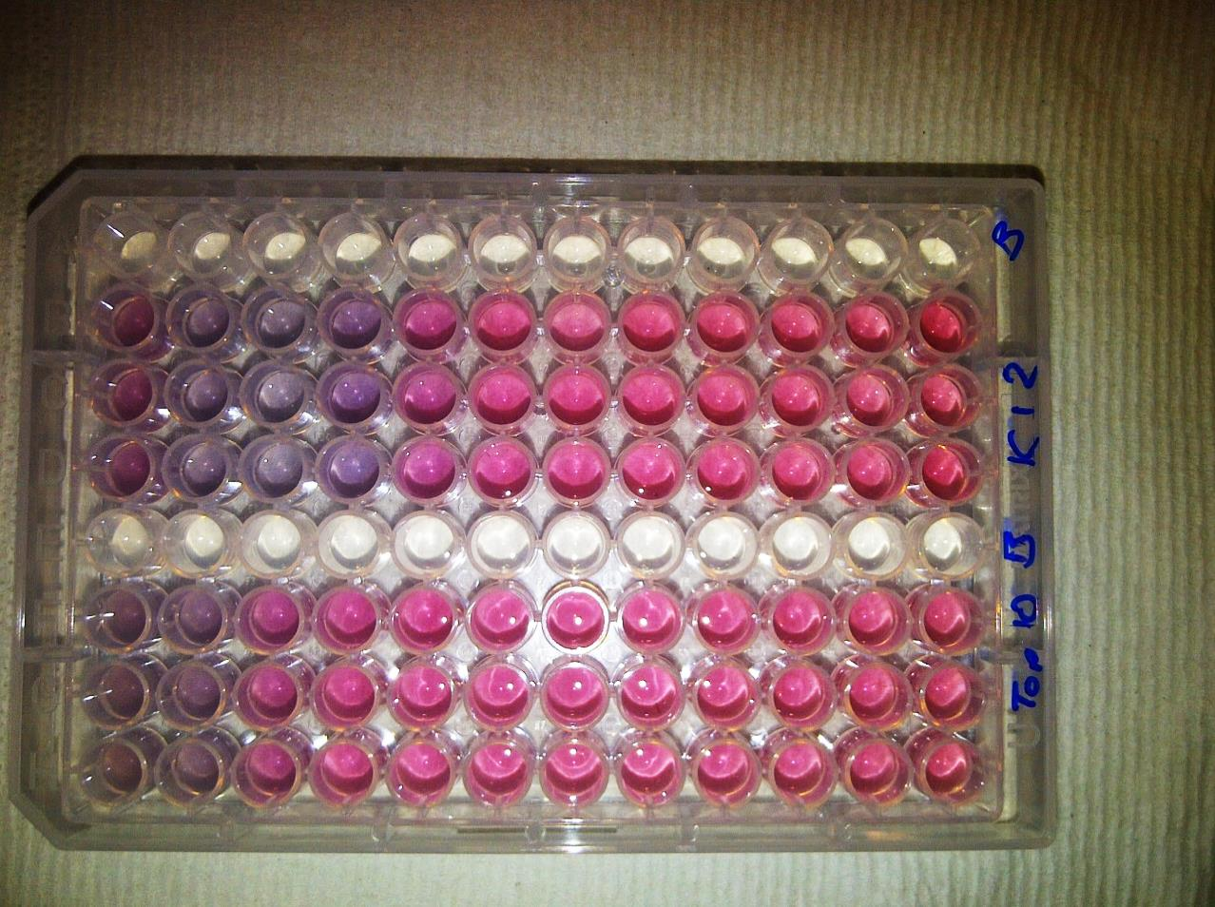








Glycosylated nanomaterials: Detection of pathogenic bacteria and toxins
Sarah-Jane Richards, Elizabeth Fullam, Gurdyal Besra and Matthew I. Gibson
S-J.Richards@warwick.ac.uk
@RichardsSJ
www2.warwick.ac.uk/go/gibsongroup
@LabGibson
The identiﬁcation of bacterial infections remains a major healthcare challenge, especially to ensure appropriate application of a limited spectrum of antibiotics.
Protein-carbohydrate interactions mediate a multitude of biological processes.
The proteins responsible for these interactions are termed lectins
Goldnanoparticles (AuNPs) have interesting optical properties. Red in solution → blue upon aggregation.
Glycosylated AuNPs (glycoAuNPs) could be used to detect bacteria and lectins.
Incorrect glycan = no interaction
Correct glycan = interaction
Synthesis of Directly glycosylated
Lectin (Con A) induced aggregation
Bacteria induced aggregation
[FimH+ bacteria]
Bacteria induced colour change
TOP10
- FimH
Colour Change ☑
Fast ☑
Specific ☑
Saline Stability ☒
Kinetics of colour change
K-12
+ FimH
Size dependant aggregation
OD 0.25
[Bacteria]
OD 0.005
Richards, S-J.; Fullam, L. C.; Besra, G. S.; Gibson M. I., J. Mater. Chem., 2014
Lectin Selectivity
Ultra-fast kinetics
RAFT derived glycopolymers
DP15, 20, 25, 50 and 75
DP 10 and 15 not saline stable
Highly lectin specific
Gal particles aggregate at low SBA concentration whereas Man particles do not
Size dependant kinetics of colour change
Optimised for saline stability and speed of readout
Colour change ☑ Specific ☑
Fast ☑ Saline Stable ☑
Richards, S-J.; and Gibson M. I., ACS Macro Lett., 2014
Background References
Acknowledgements
C. R. Bertozzi, L. L. Kiessling, Science, 2001, 291, 2357
M. Ambrosi, N. R. Cameron, B. G. Davis, Org. Biomol. Chem., 2005, 3, 1593
C. C. Lin, Y. C. Chen, C. Y. Yang, G. F. Chen, Y. C. Chen, Y. C. Wu, C. C. Chen, Chem, Commun, 2003, 2920.
Dr Matthew Gibson
Gibson Group
Prof. Gurdyal Besra (B’ham)
Dr Elizabeth Fullam

