Slide 1
GCSE Computing
University of Warwick
19 April 2012
Notes:
Please ensure the course title is shown on this slide

Slide 2
GCSE Computing
first teaching began September 2010
Sean O’Byrne – Chief Examiner and Principal Moderator for A452
Karen Reid – Qualifications Manager

Slide 3
Where it came from
Idea floated in 2005
Increasing concern about lack of opportunities for programming
ICT losing problem solving aspects
Many teachers asking for computing
Now, it’s suddenly centre stage

Slide 4
CAS
Further momentum from CAS
Royal Society report
Becoming clear that there is a demand
Increasing awareness of difference between ICT / IT and computing

Slide 5
OCR GCSE Computing
The first awarding organisation to have GCSE Computing accredited
Already up and running
Other exam organisations are now following

Slide 6
Introduction
GCSE Computing is a unique, OCR specification developed in response to customer feedback and need.
Technical computing and programming skills are in short supply in the UK.
There are a significant number of students whose skills and interests differ from those included in ICT courses.

Slide 7
Introduction
The qualification forms part of a rich GCSE and GCE suite of ICT and Computing qualifications
OCR’s new ICT GCSE includes a Computing unit as an option
The qualification is designed to provide clear progression to OCR’s GCE Computing

Slide 8
Michael Gove
the UK had been let down by an ICT curriculum that neglects the rigorous computer science and programming skills which high-tech industries need
And one area exemplifies, more than any other, the perils of the centre seeking to capture in leaden prose the restless spirit of technological innovation.
I refer, of course, to the current ICT curriculum.

Slide 9
Michael Gove
Schools, teachers and industry leaders have all told us that the current curriculum is too off-putting, too demotivating, too dull.

Slide 10
Michael Gove
Submissions to the National Curriculum Review Call for Evidence from organisations including the British Computer Society, Computing at School, eSkills UK, Naace and the Royal Society, all called the current National Curriculum for ICT unsatisfactory.
They’re worried that it doesn’t stretch pupils enough or allow enough opportunities for innovation and experimentation – and they’re telling me the curriculum has to change radically.

Slide 11
Michael Gove
Technology in schools will no longer be micromanaged by Whitehall. By withdrawing the Programme of Study, we’re giving schools and teachers freedom over what and how to teach; revolutionising ICT as we know it.
Let me stress - ICT will remain compulsory at all key stages, and will still be taught at every stage of the curriculum. The existing Programme of Study will remain on the web for reference.

Slide 12
Michael Gove
The new Computer Science courses will reflect what you all know: that Computer Science is a rigorous, fascinating and intellectually challenging subject.

Slide 13
Michael Gove
I am pleased that OCR is pioneering work in this field

Slide 14
Early days of OCR GCSE
Dates from about 2005
Meeting of interested parties
Ideas for a specification
Followed by involvement of others
Industry
Academia
Teachers
Examiners

Slide 15
The specification
Computational thinking at its core
Plus technical background
Strong links to the real world
Flexibility built in through A452/3
Practical angle
Programming – language not specified
Problem decomposition
Controlled assessment
assessment is different approach from previous specifications

Slide 16
The philosophy - specification
computational thinking
based on fundamental principles that have been around since the 40s and 50s
connected to contemporary computing
programming
problem solving
fun

Slide 17
The philosophy - specification
algorithms
machines
real life

Slide 18
The philosophy - assessment
NOT box ticking
NOT marking by weight
reward creativity
originality
problem solving
knowledge
communication skills
cleverness

Slide 19
Three complementary units
A451
Computer Systems and Programming
A453
Programming Tasks
A452
Practical Investigation
Notes:
Emphasise that this is not really a “modular” course in the sense that each module has its own content, but that the different skills, knowledge and understanding of the same content is assessed in different ways.

Slide 20
Unit A451
Computer Systems and Programming
Notes:
Please ensure the course title is shown on this slide

Slide 21
Unit A451 - Overview
Assesses the fundamental concepts that candidates need to know, understand and apply
90 minute exam worth 80 marks. (40% of the qualification)
Available in January and June (linear from 2014)
Notes:
You may wish to cover venue housekeeping (where the toilets are, where lunch will be served etc) and trainer introduction/s on this slide

Slide 22
A451 - Content
Computer systems
Computing hardware
Software
Data representation
Databases
Networks
Programming
These form the basis or starting point for the practical investigation in A452.
Learnt alongside A453
Notes:
Show how units are related. A452 helps bring some of A451 to life as well as equipping students with practical skills. A453 contains some content (esp. Knowledge) which is best tested in exam conditions.

Slide 23
Fundamentals of computer systems
Programming
Algorithms
Understand them
produce them
Programming Languages
High and Low
translators
Assemblers, compilers and interpreters
Common tools and facilities
Control flow:
Sequence
Selection
Iteration
Handling data
Variables and constant
Major data types
Arrays (1 D)
Testing
Types of error
Select and justify test data
Define a computer system
Describe the importance of computer systems in the modern world
Explain the need for reliability in computer systems
Explain the need for adherence to suitable professional standards in the development, use and maintenance of computer systems
Explain the importance of ethical, environmental and legal considerations when creating computer systems .
CPU:
Purpose and function, Fetch Execute
Characteristics, clock speed, cache, number of cores
Binary Logic:
Why data is in binary
Simple logic diagrams (AND, NOT and OR)
Truth tables
Memory:
RAM and ROM
Virtual Memory
Cache, Flash and changes in the technology
Computing Hardware
Networks:
Advantages of stand alone
Hardware
Roles in client server and peer to peer
Ring, Bus and Star
LAN / WAN
Addressing (MAC and IP / packets and protocols)
Use of network policies eg failover, security etc
The Internet
Hardware
IP addressing, DNS
HTML and standard file formats such as JPG, MP3 etc
Compression, lossy and lossless
Units: (bit, nibble, byte, kilobyte etc)
Number (8bit binary integers / convert to denary, hex etc)
Character (binary codes used to represent characters)
Images (images as pixels in binary, metadata, colour depth and resolution)
Sound (digital sampling, and effect of sample rates)
Instructions (Instructions coded as bit patterns and how the computer can distinguish)
Software
Operating System:
User Interface
memory and peripheral management
Multi-tasking
Security
Common utility programs
Security
Disk organisation
System maintenance
Custom,, off the shelf, open source and proprietary
Representation of data
in computer systems
Describe a database and the use of databases
Data base Management systems
Relational features
Entities and tables
Components such as tables, forms, queries etc
Use of logical operators in queries
key fields to connect tables
Databases
Communications and networking

Slide 24
Computer Systems
General introduction to the concept of a computer system
Goes beyond the standard personal computer (e.g. mobile phones, satellite set-top boxes)
Includes ethical considerations when creating systems and the need for standards

Slide 25
Level of response questions
A large company with 200 employees uses a local area network (LAN) which includes all the computers in its head office.
Describe the security measures and network policies which can be used to safeguard the security and privacy of the company’s data on the network.
The quality of written communication will be assessed in the answer to this question.

Slide 26
Computer hardware
The CPU – function and main characteristics
Binary logic and why it is relevant to the CPU
Memory – different types used in computers
Input and output devices
Secondary storage

Slide 27
Example from January 2011
(a) State what is meant by a storage device, an input device and an output device in a computer system.
(b) Complete the table below to show whether magnetic, optical or solid state storage is most appropriate for each of the following uses.
Storing pictures in a digital camera
Handheld device used by students for field work
Storage drives on the school’s main file server
Videos of the school production to be given to parents

Slide 28
Level of response questions
The secondary school wants the computer systems to be more accessible to students with disabilities.
Describe, with examples, input and output devices which are available for students with disabilities.
The quality of written communication will be assessed in the answer to this question.

Slide 29
Software
Operating system – the main functions
Utilities for security, disk organisation and system maintenance
Understanding issues with producing software
Custom written vs. off-the-shelf software
Open source vs. proprietary software

Slide 30
Example from January 2011
Describe the following types of common utility programs.
Antivirus
Disk defragmenter

Slide 31
Representation of data
Units used – bytes, kilobytes etc
Representation of whole numbers
Representation of characters
Representation of images
Representation of sound
Instructions and the distinction between instructions and data

Slide 32
Example from January 2011
Convert the hexadecimal number 6A to binary.
Convert the binary number 00111101 to hexadecimal.
Explain why hexadecimal numbers are often used to represent binary numbers.

Slide 33
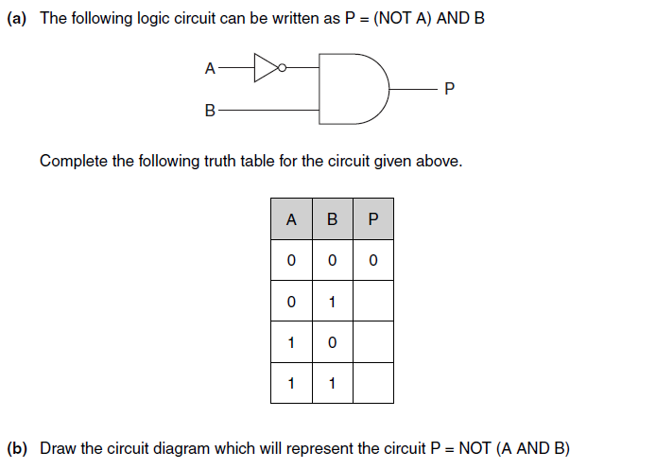

Slide 34
Databases
Concept of a database
DBMS – features and uses
Relational database concepts – entities, relationships, key fields
Queries

Slide 35
Example from January 2011
Explain what is meant by a DBMS.
The database uses forms and reports.
Describe each of these and give one example of how it would be used in the shop’s database.

Slide 36
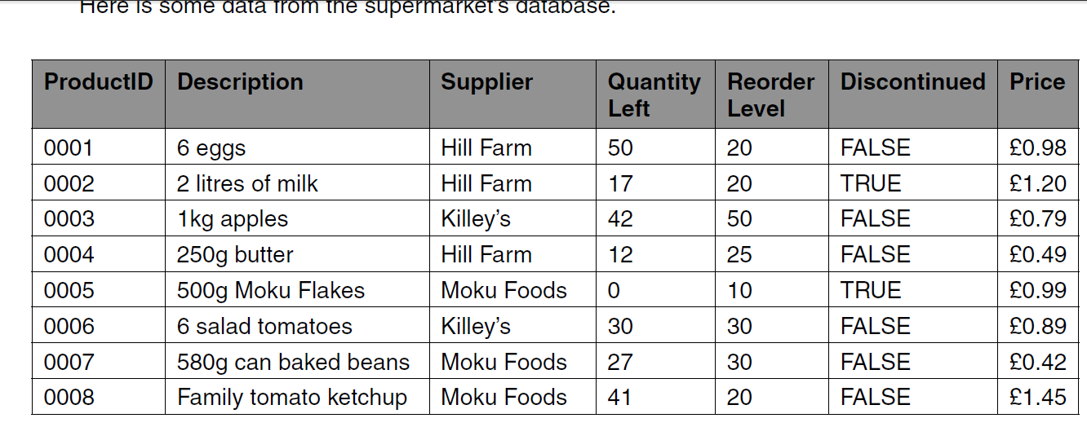
State the ProductID of the products in the above sample which fit the following criteria.
Supplier = Killey’s
Price > £1.00 OR Supplier = Hill Farm
Write the criteria which can be used to select all products which are not discontinued and where the QuantityLeft is lower than the ReorderLevel.

Slide 37
Networks and the Internet
Networking concepts – topologies, LAN/WAN, IP addressing, protocols
Networking hardware
Network management – security, policies
Internet concepts – DNS
Internet standards – HTML, standard file formats, compression

Slide 38
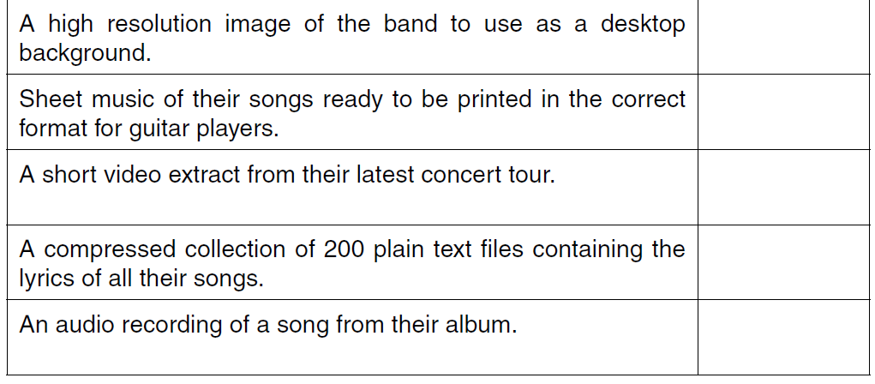
Example from January 2011
Describe HTML.
Explain the importance of HTML in the creation of web pages.
A list of file extensions for common file standards used on the internet is : JPG PDF MP3 MPEG ZIP
Complete the table below to show which file format from the list given above may be used for each of the following files.

Slide 39
Some of the file formats use compression.
Explain the importance of compressing files when transmitting them via the internet.
Describe the difference between lossy and lossless compression and give an example where each would be used.

Slide 40
Programming
Programming language concepts – high level, assembly, machine code, IDE, translation
Programming skill – understand and produce algorithms, understand
Handling data – variables, constants, data types, arrays
Testing – types of errors, selecting test data

Slide 41
Programming – more details
Candidates will be expected to be familiar with imperative code, but not required to know a specific language
Code examples will be given in generic pseudocode. Candidate’s answers can be in pseudocode, a language or flow charts
Links closely with A453.

Slide 42
Example from January 2011
A program contains the following code to calculate the circumference of a bicycle wheel, using the
wheel size (diameter).
BEGIN
CONSTANT Pi = 3.14
INPUT WheelSize
Circumference = Pi * WheelSize
OUTPUT Circumference
END
(a) The code uses one constant and two variables.
(i) State the names of the constant and the variables.

Slide 43
A dog that is 5 years old is equivalent to a 42 year old human. Ashok is writing a program which converts the age of a dog to the equivalent age for a human.
The program uses the following method:
• The user inputs age of the dog in years
• If the age is 2 or less, the human equivalent is 12 times the age
• If the age is more than 2, the human equivalent is 24 for the first 2 years, plus 6 for every additional year.
Write an algorithm to calculate and output the human equivalent of the age of a dog using the method described.

Slide 44
Controlled Assessment
Practical Investigation
Notes:
44
Please ensure the course title is shown on this slide

Slide 45
Controlled Assessment is a new form of internal assessment. Following a coursework review by QCA, Controlled Assessment has been introduced as part of nearly all new GCSEs, to replace coursework.
High, medium or low control levels are set for each of the Controlled Assessment processes: task setting, task taking and task marking.
For each stage, the level of control will ensure reliability and authenticity, and make assessments more manageable for teachers and learners.
Further information is available in the ‘Guide to Controlled Assessment’ enclosed with your training pack.

Slide 46
What do the controlled assessment conditions mean ?
The task setting is high level control
This means OCR set the tasks, centres are not allowed to make up their own tasks !
The Task taking is medium level control
This means the work must be carried out under informal supervision to ensure there is no plagiarism
Research is under low level control
This means research need no be formally supervised, BUT work carried out as part of this research cannot be directly credited as part of the candidate’s assessment

Slide 47
Some useful strategies
The controlled assessment conditions put the responsibility of ensuring no plagiarism on the supervising teacher.
There are various approaches that can help with this including new log ins, secure storage of data on removable devices, use of secure web based portfolio areas etc
BUT what we require is that:
The teacher should is confident that the work submitted is the unaided work of the candidate.
The teacher is required to sign a declaration that this is the case.
Notes:
Time for discussion! Refer to guide to controlled assessment in the pack.
Strategies for delivery:
Research in groups of 3 or 4
Task taking individually, no guidance, no templates.
Evidence: list expected evidence.

Slide 48
Controlled assessment is very similar in many ways to traditional coursework.
Candidates produce a solution to a problem along with a write up which follows the system lifecycle, but work is completed under supervision to prevent the plagiarism sometimes evident in work which is completed outside of class.
Candidates often spent too long on coursework and to this end a recommended time frame is suggested to centres.
Centres should try to remain within this.

Slide 49
Unit A452
This is a controlled assessment unit so must be completed under controlled conditions.
The unit is based around a brief scenario which students will need to research and then carry out practical exercises.
There will be a choice of tasks available and these tasks will remain available for several sessions, (tasks will be added and removed periodically).
Notes:
49
You may wish to cover venue housekeeping (where the toilets are, where lunch will be served etc) and trainer introduction/s on this slide

Slide 50
Unit A452
Purpose of the unit
To provide an opportunity to have hands-on experience of something beyond the basic syllabus
This unit is mostly practical
It covers material beyond A451
Some background work will be necessary
Some teacher guidance is expected to help students get started on the task.
Notes:
50
You may wish to cover venue housekeeping (where the toilets are, where lunch will be served etc) and trainer introduction/s on this slide

Slide 51
Unit A452
The task:
An investigation into a scenario
Requires practical activity
Requires a report to be produced
Requires some evaluation

Slide 52
Unit A452
Tasks set so far:
LMC
JavaScript – validating web forms
Encryption using a spreadsheet
A shopping cart
Watch this space!

Slide 53
Unit A452
The sample task – Little Man Computer
What is expected?
Candidates will need to become familiar with the LMC.
Preliminary investigations are necessary.
The structure of the simulation needs to be understood.

Slide 54
Unit A452
The LMC
This will require understanding of
Memory
The processor
Registers
The instruction set
Loops
How to multiply by repeated addition

Slide 55
Unit A452
These concepts will need to be developed beyond the basic specification coverage as preparation for completing this task.
This process will include:
Teacher input
Collaborative research
Practice

Slide 56
Unit A452
Collaborative research into the chosen topic is permissible but report is candidate's own and they will need to:
Analyse any findings
Complete further individual research and report on the findings.
Include in the report hard evidence from the research/practical work to support any comments or conclusions.

Slide 57
The marking criteria
This unit is assessed by a best fit approach using the marking guidance provided in the specification.
It is not a box-ticking exercise. Deficiencies in one area may be compensated for in others.
The bands are decided upon with reference to the entire report/documentation.

Slide 58
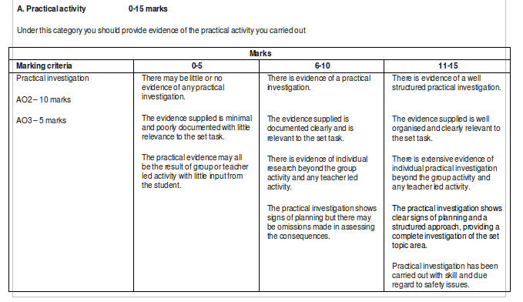
Example Assessment Grid

Slide 59
Unit A452
Any conclusions should be justified
Evaluation of the research and findings.
This should NOT be a dry report based upon internet searches. It is meant to be hands-on
Extra research through the internet will be valuable but they need to be selective about what they include in their ‘report’

Slide 60
A452
Guided learning hours: (suggested)
Introduction to the concepts required
within normal teaching time
Introduction to the task
2 hours
Initial research and practice
6 hours
Completing the task and writing the report
12 hours

Slide 61
Unit A452
The ‘report’ may not necessarily be in any form we would normally regard as a report:
For example:-
The task may refer to programming techniques, these could be demonstrated with suitable example programs and a comparison of results.

Slide 62
Unit A452
We are encouraging students (and schools) to submit work through the coursework repository.
We are happy to take ‘reports’ in any suitable format we can use without having to own any specific software;
Video, Multi-media presentations, etc but some word processed documents are likely to be necessary.

Slide 63
A452
LMC: Using repeated addition

Slide 64
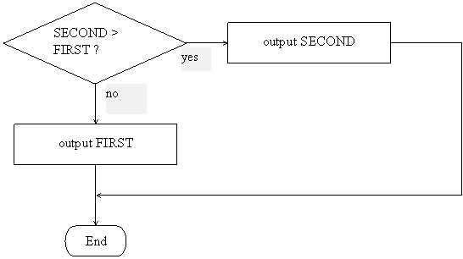
flowchart for a program that will output the larger of two input values.

Slide 65
The Algorithm
Input first number
Store this as FIRST
Input second number
Store this as SECOND
Subtract FIRST from SECOND
If the result is positive SECOND is bigger so go to subsection secondbigger
If not then First is bigger so load to accumulator and output
Stop
Subsection secondbigger:
Load SECOND to accumulator and output
Stop

Slide 66
LMC Code
Input a number and store at labelled location FIRST.
Input second number and store at location SECOND
SECOND is still in the accumulator so subtract FIRST
If the result is positive SECOND is bigger so branch to the label SECONDBIG
IF not FIRST is bigger so Load it to the accumulator and output the value.
Done so branch to the end of the program
This is the label SECONDBIG so load SECOND to the accumulator and output it
At the label PROGRAMEND halt the program
These are the storage labels for FIRST and
SECOND
INP STA FIRST INP STA SECOND SUB FIRST BRP SECONDBIG LDA FIRST OUT BRA PROGRAMEND SECONDBIG LDA SECOND OUT PROGRAMEND HLT FIRST DAT SECOND DAT

Slide 67
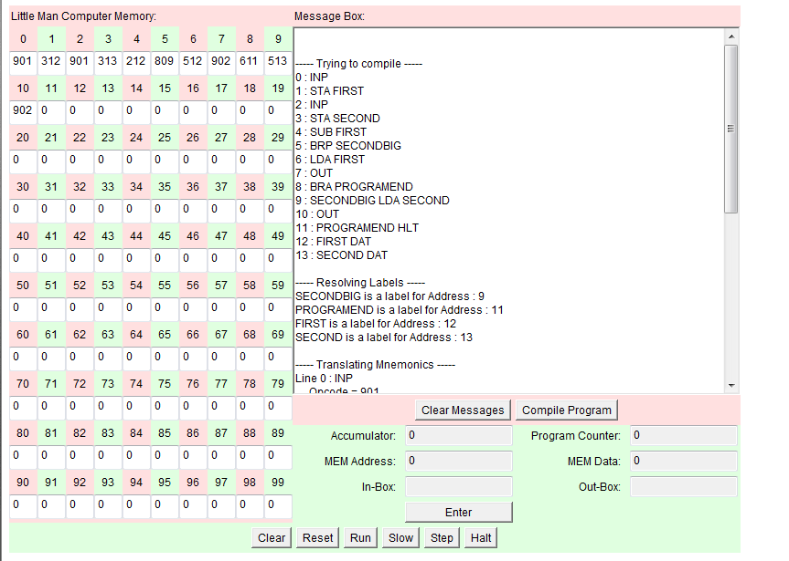

Slide 68
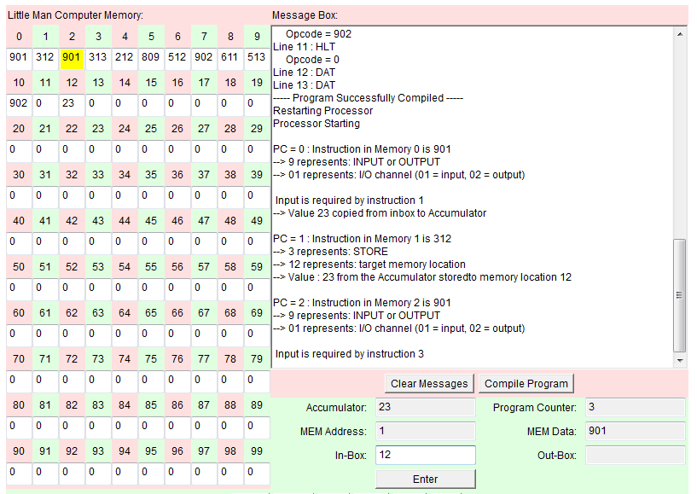
RUN
23 is entered and stored
12 is now entered into the inbox

Slide 69
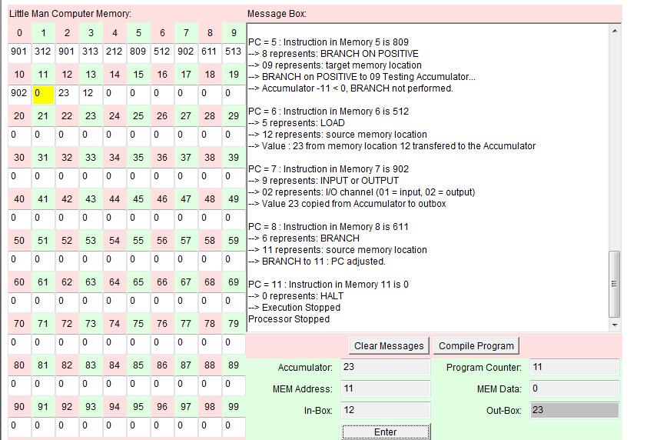
The program now runs and outputs the larger value 23 into the out-box

Slide 70
the first instruction has been placed in location 0
9 is I/O command and 01 means input, o2 means output, hence 901 waits for an input.
The value 23 is input by the user and copied into the accumulator to be dealt with.
3 means store the data so 312 says store the data in location 12, 23 is copied from the accumulator to location 12.
The next instruction is 901 so we need another input value.
The input value 12 is copied into the accumulator and the following instruction 313 says copy this value into location 13
We now have two input values 23 and 12 copied into locations 12 and 13.
Since the values are only copied from the accumulator, 12 is still in the accumulator so the next instruction, 212 means subtract what is found in location 12 from the value in the accumulator, in this case take 23 from 12
PC = 0 : Instruction in Memory 0 is 901
--> 9 represents: INPUT or OUTPUT
--> 01 represents: I/O channel (01 = input, 02 = output)
Input is required by instruction 1
--> Value 23 copied from inbox to Accumulator
PC = 1 : Instruction in Memory 1 is 312
--> 3 represents: STORE
--> 12 represents: target memory location
--> Value : 23 from the Accumulator stored to memory location 12
PC = 2 : Instruction in Memory 2 is 901
--> 9 represents: INPUT or OUTPUT
--> 01 represents: I/O channel (01 = input, 02 = output)
Input is required by instruction 3
--> Value 12 copied from inbox to Accumulator
PC = 3 : Instruction in Memory 3 is 313
--> 3 represents: STORE
--> 13 represents: target memory location
--> Value : 12 from the Accumulator stored to memory location 13
PC = 4 : Instruction in Memory 4 is 212
--> 2 represents: SUBTRACT
--> 12 represents: source memory location
--> Value : 23 from memory location 12 subtracted from the Accumulator

Slide 71
PC = 5 : Instruction in Memory 5 is 809
--> 8 represents: BRANCH ON POSITIVE
--> 09 represents: target memory location
--> BRANCH on POSITIVE to 09 Testing Accumulator...
--> Accumulator -11 < 0, BRANCH not performed.
PC = 6 : Instruction in Memory 6 is 512
--> 5 represents: LOAD
--> 12 represents: source memory location
--> Value : 23 from memory location 12 transferred to the Accumulator
PC = 7 : Instruction in Memory 7 is 902
--> 9 represents: INPUT or OUTPUT
--> 02 represents: I/O channel (01 = input, 02 = output)
--> Value 23 copied from Accumulator to outbox
PC = 8 : Instruction in Memory 8 is 611
--> 6 represents: BRANCH
--> 11 represents: source memory location
--> BRANCH to 11 : PC adjusted.
PC = 11 : Instruction in Memory 11 is 0
--> 0 represents: HALT
--> Execution Stopped
Processor Stopped
The next instruction is in location 5, this is 809, the 8 means branch if the value in the accumulator is positive to location 9.
BUT
The value in the accumulator is 12-23 so it is negative and the next instruction is used, instruction 6. This is 512, the 5 means load and the location to load from is 12, so the value in location 12 is put into the accumulator, the accumulator now contains 23.
Instruction 7 is another 9, so I/O but 02 means output, so this instruction says output the value in the accumulator , ie output 23.
Instruction 8 is a branch to instruction so 611 means go to instruction 11 missing out 9 and 10.
Instruction 11 is 0 which means halt and the program stops.

Slide 72
The specimen task asks for a system to input two numbers then output the smaller then the larger.
We can modify the example to fulfil this requirement.
Input first number
Store this as FIRST
Input second number
Store this as SECOND
Subtract FIRST from SECOND
If the result is positive SECOND is bigger so go to subsection secondbigger
If not then FIRST is bigger so load to accumulator and output
Stop
Subsection secondbigger:
Load SECOND to accumulator and output
Stop
If the first number is bigger we simply need to load the second value and output before the stop command:
Similarly for the alternative situation.

Slide 73
0 : INP
1 : STA FIRST
2 : INP
3 : STA SECOND
4 : SUB FIRST
5 : BRP SECONDBIG
6 : LDA SECOND
7 : OUT
8 : LDA FIRST
9 : OUT
10 : BRA PROGRAMEND
11 : SECONDBIG LDA FIRST
12 : OUT
13 : LDA SECOND
14 : OUT
15 : PROGRAMEND HLT
16 : FIRST DAT
17 : SECOND DAT
The code is modified to output the smaller then the larger:
If the second is bigger then we will branch to SECONDBIG
Otherwise we load the second value and output. Then load the first and output
Similarly if second is bigger then we load first, then second

Slide 74
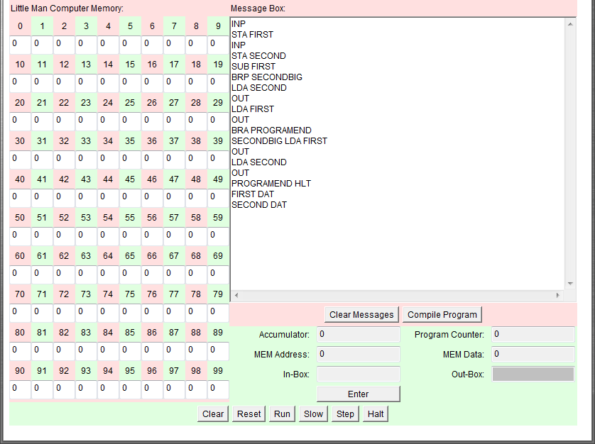
Code entered

Slide 75
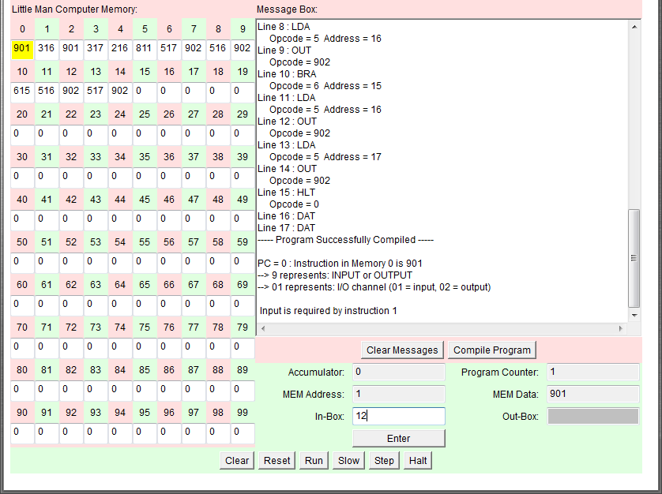
Code is compiled successfully
and 12 is entered.

Slide 76
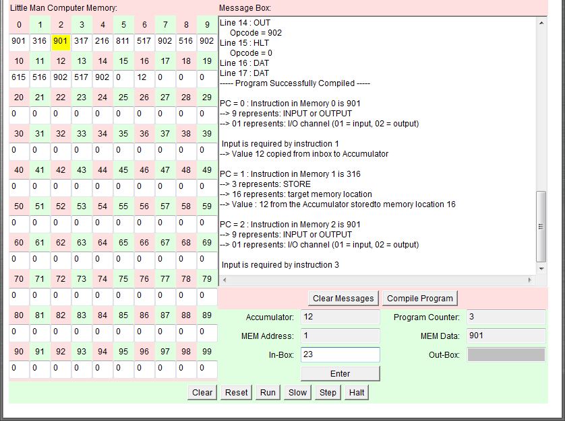
23 is entered

Slide 77
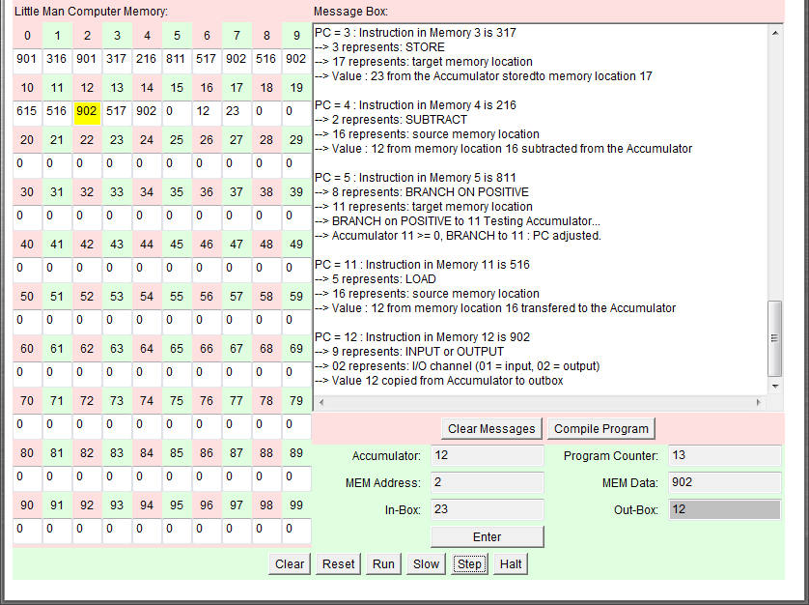
12 is output first

Slide 78
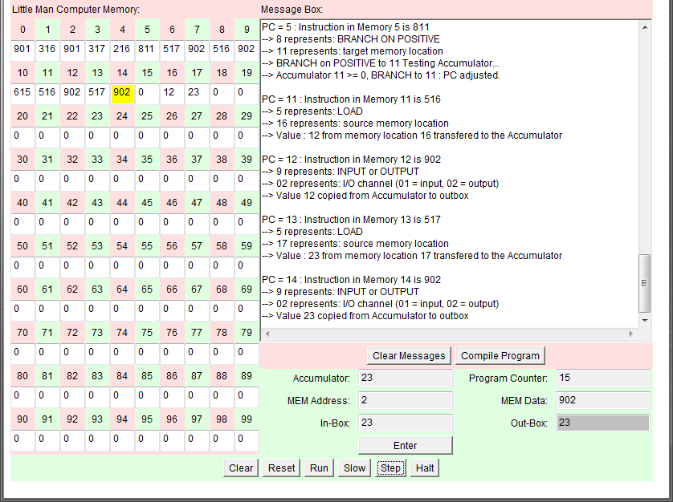
Then 23 is output

Slide 79
The sequence of screen shots shows that the process works and outputs the correct results.
The candidate has also explained how the code has been modified to achieve the desired result.
Alternatively the candidate could have shown the process very effectively using screen recording software such as camstudio.

Slide 80
Unit A453
Programming
Notes:
Please ensure the course title is shown on this slide

Slide 81
Unit A453
The programming unit is designed for the students to demonstrate the use of various standard programming techniques.
The tasks are set to make it likely candidates will use a good range of the techniques listed in the specification.
Notes:
You may wish to cover venue housekeeping (where the toilets are, where lunch will be served etc) and trainer introduction/s on this slide

Slide 82
Techniques
use variables, operators, inputs, outputs and assignments
use the three basic programming constructs used to control the flow of a program: Sequence; Conditionals; Iteration
use suitable loops including count and condition controlled loops
Use different types of data including Boolean, String, Integer and Real appropriately
use basic string manipulation
use basic file handling operations: open, read, write and close
and use arrays as appropriate when solving problems

Slide 83
Unit A453
The tasks in the sample material will require the candidate to do some coding.
It is clear not all techniques will be required to solve the problems. Candidates do NOT need to utilise all the techniques to score.
We are looking for effective and efficient use of a range of appropriate programming techniques

Slide 84
Unit A453
There will be a small choice of tasks.
Candidates cannot pick and choose sub tasks from different sets, the set of tasks must be completed as a unit.
Sets of tasks will be added and deleted from time to time but will be available for several sessions.

Slide 85
Unit A453
Candidates should plan their solution effectively and demonstrate the use of algorithms to define their solutions.
Testing is an essential element and must be demonstrated throughout the ‘report’
Evaluation of the solution using test results is also essential.

Slide 86
Unit A453
The work is marked by using a best fit approach comparing the student’s final solutions and reports against the marking guidance in the specification.
If a student fails to complete all the tasks then we need to consider them as equally weighted thus limiting the marks available. Otherwise they should be assessed as a single entity.

Slide 87
Assessment
The marking criteria are intended to provide guidance by describing typical work at a certain mark point, they are NOT tick lists.
Work matching the descriptor in the higher band will automatically have covered the lower bands for that element.
The overall mark should reflect the balance of marks in the mark bands.

Slide 88
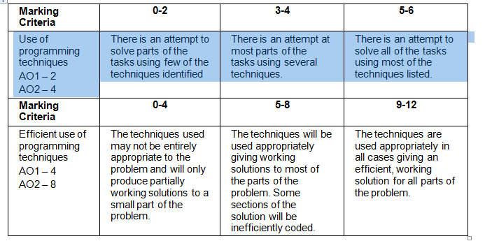
Programming Techniques

Slide 89
Unit A453
While there is a ‘report’, the nature of this report is flexible,
Students may submit video, printed output, screen shots, presentations, annotated code, other?
Evidence that supports your teacher assessment is what we require.

Slide 90
A453
Password strength sample task

Slide 91
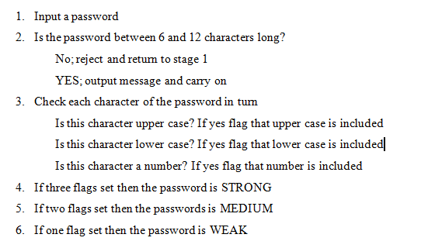
The basic requirements

Slide 92
REPEAT
INPUT the password
len=length of password
IF len <6 OR len >12 THEN
PRINT suitable error message
UNTIL len >=6 and <=12
PRINT password OK
Initialise upper, lower and number to 0
FOR i = 1 TO len
IF MID$(password, i, 1) is upper AND upper =0 THEN upper =1
ELSE
IF MID$(password, i, 1) is lower AND lower =0 THEN lower =1
ELSE
IF MID$(password, i, 1) is number AND number =0 THEN number =1
NEXT i
strength = upper+lower+number
CASE
strength = 1 then PRINT “WEAK”
strength = 2 then PRINT “MEDIUM”
strength = 3 then PRINT “STRONG”

Slide 93
We need a test strategy to use during development to show that the solution works at each stage.
Requirement: 6- 12 characters
Less than 6 | 6 exactly | >6 and <12 | 12 exactly | More than 12
qwert | qwerty | qwertyui | qwertyuiopas | qwertyuiopasd
5 characters should be rejected | 6 characters, boundary, should be OK | 8 characters, valid input should be OK | 12 characters, boundary, should be OK | 13 characters should be rejected
Weak, Medium and Strong identified:
Weak | Medium |  |  | Strong
qwerty QWERTY 123456 | Qwerty Awerty Zwerty | 3werty 3WERTY Q23456 | qwe456 1w3r5y QW345Y | QW34ty 12erTY
All lower / upper case/ numeric: weak reported | 1 upper case, rest lower, also test A and Z accepted Medium reported | All medium strength combinations | With differing quantities of numbers and letters | Both cases and numeric used, Strong reported

Slide 94
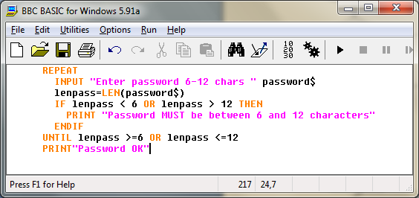
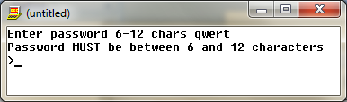


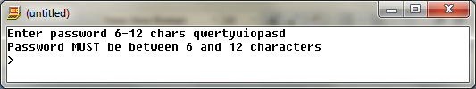
The code should be tested as it is developed, here the length is checked with 5, 6,12 and 13 char passwords.
The evidence shows that this section of the code works and we can move on.

Slide 95
This solution uses the fact that all characters have a unique ASCII value
A is 65, B is 66 ... up to Y which is 90
a is 97, b is 98 ... up to y which is 122
0 is 48, 1 is 49 ... Up to 9 which is 57
So if the ASCII value of each character in the password is checked then we can identify if it is upper, lower or numeric.
Using LEN to check the length of the password and a simple loop from 1 to LEN(password) with the MID$ command I can check each character individually
If I identify an upper case I will set a flag once
Similarly with lower case and numeric.
If only 1 flag is set it will be WEAK, 2 it will be MEDIUM, 3 it will be STRONG

Slide 96
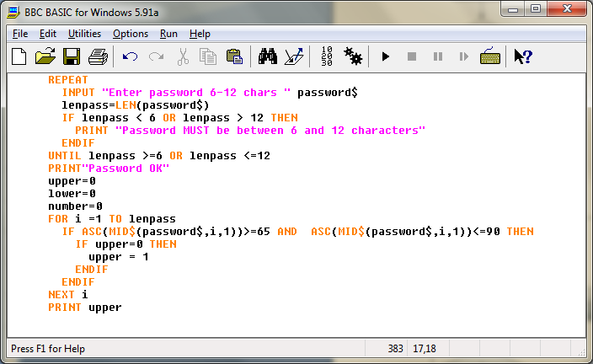



Add the next section of code to check for upper case and test it with suitable test data: for example
qwerty, should return 0
Awerty should return 1 and checks that A is included in the range
Zwerty should return 1 and checks that Z is included etc.
*Similarly for lower case and numeric data in the test strategy*

Slide 97
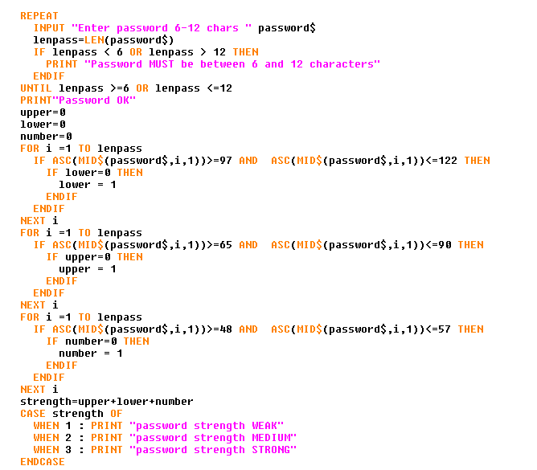
The code that was used and tested for upper case is simply copied and pasted then modified accordingly and checked at each stage.

Slide 98
Get password
Find length of password
Check length >=6, <=12
If not print error message
If error return to get password otherwise Print OK
Initialise variables
By checking each character in the string for ASCII values
97-122 for a-z,
Identify if the character is lower,
If one of these has not already been found flag by setting the variable to 1, otherwise ignore.
Repeat process for upper and number using
65-90 for A-Z and
48-57 for 0-9
Add together the values for lower, upper and number to get a strength value.
Use the CASE command to respond according to the numeric value

Slide 99
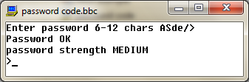
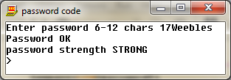
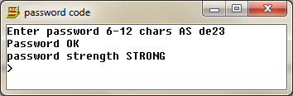
We now have basic functionality but we need to complete some final product testing with a range of data and typical end users.
Evidence of the initial test data being used and dealt with accordingly is evident in the development:
Further testing is completed with a range of valid and invalid data:
Test | Data | Expected | Actual / Comment
To see what happens with special characters | ASde/> | Since /> are not checked they will not set any flag hence MEDIUM | Medium, as expected: Code should be modified to reject special characters
To see what happens if spaces are used | AS de23 | Since space has an ASCII value it will be accepted and rated as STRONG | Strong as expected: Code should not accept space and should be modified
Typical strong password | 17Weebles | Strong, valid data | Strong.

Slide 100
Other issues from testing and end user testing:
The whole point of a password is for security, the password is displayed when typed in, this is a problem.
The code should be modified to display * characters instead of the input values.

Slide 101
Using ASCII values to check the case etc works extremely well and this could be extended to reject non alphanumeric characters by examining the password after input for characters out of range returning the user to the input screen with a suitable error message.
From the test data provided it is clear that the code segment identifies the basic requirements:
6-12 characters
Upper, lower and numeric cases effectively and, through the use of flags can identify weak, medium or strong passwords.
Also from the testing it can be seen that the system also accepts spaces and special characters since, though does not flag any value to these. The code should be modified accordingly to reject these.
The testing also suggests that the password input should be masked if it is to be of any real value, such a modification can easily be completed by overwriting the input area with * characters.
This code is functional and could be used as a module in a larger program if suitably modified as identified in the test section.

Slide 102
Now the system works, if there is time available, candidates can add any of the extra items identified in the design and test stages such as
Possible improvements:
Check data on entry for character types.
Check data on entry for invalid characters.
blanking the password on entry by replacing the characters with *’s
providing a more interesting or ‘friendly’ interface
However we are primarily looking for the basic functionality of the system and efficient use of the coding techniques.

Slide 103
The Report
The report is the collection of evidence for the process from the initial designs through development and testing to evaluation.
It can be in any suitable form but must provide evidence of the process, not just the final product.
A copy of the final working solution will be welcome, preferably as an executable.

Slide 104
Unit A453
While there is a ‘report’, the nature of this report is flexible,
Students may submit video, printed output, screen shots, presentations, annotated code, other
Evidence that supports your teacher assessment is what we require.

Slide 105
Unit A453
Encouraging results so far
Wide variety of approaches seen
C++, VB, Python, JavaScript and mixtures
Some well designed algorithms
Presented in various ways
Marking has been realistic

Slide 106
Units A452 and 453
We are encouraging students (and schools) to submit work through the coursework repository.
We are happy to take ‘reports’ in any suitable format we can use without having to own any specific software;
Video, Multi-media presentations, Web Sites, others?
OH and word processed documents are fine

Slide 107
Concerns / FAQ
Is it harder than ICT?
How do we present Controlled Assessment work?
How do we mark it?
What support / books are there?
Implications for KS3
Implications for ICT
Implications for A level

Slide 108
Concerns / FAQ
Is it harder than ICT?
No – it might be more challenging!
Much evidence that the candidates enjoy it
We expect good results
The requirements are clear cut
Well prepared students should be able to hit the bull’s eye
So far, much work of a high standard has been presented

Slide 109
Concerns / FAQ
How do we present Controlled Assessment work?
Any way that demonstrates the achievements of the students
No need for vast amounts of reports
But needs to be presented in a logical manner
Ideally use repository

Slide 110
Concerns / FAQ
How do we mark it?
Use the mark bands
Best fit
Quite easy to assign work to a band
Overall judgement for all the tasks
Need to complete all the tasks for highest marks
Very few adjustments made so far

Slide 111
Concerns / FAQ
What support / books are there?
Hodder DL (under review)
New Hodder book
Lulu book
Many web sites
The web!

Slide 112
Concerns / FAQ
Implications for KS3
We’re not going to tell you what to do – Michael Gove
Scope for innovation
Computational thinking must be the way forward
algorithms
programming
Any exposure to these is essential and beneficial

Slide 113
Concerns / FAQ
Implications for KS3
Possible approaches
http://www.computingatschool.org.uk/index.php?id=cacfs
Cambridge Nationals Unit 8 – programming
www.cambridgenationals.org.uk
But - GCSE assumes no prior knowledge

Slide 114
Concerns / FAQ
Implications for ICT
Expect changes to ICT in the medium to long term
View of ICT will need to change
?????

Slide 115
Concerns / FAQ
Implications for A level
Expect changes here, too

Slide 116
From the message boards
We started the OCR Computing course last September with a single group of 28 students (other classes still doing Nationals and the rebranded Cambridge version next September).
The kids absolutely love it and are doing really well.

Slide 117
From the message boards
In any school I know, where kids are given the choice, Computing wins hands-down. Might be the 'newness'. Might be the fact more teachers enjoy Computing more. Might be the fact Computing can get you a job...

Slide 118
OCR support
OCR Website – www.ocr.org.uk
Customer Contact Centre (General)
Tel: 01223 553998 Fax: 01223 552627
Email: general.qualifications@ocr.org.uk
Customer Contact Centre (Vocational)
Tel: 024 7685 1509 Fax: 024 7642 1944
Email: vocational.qualifications@ocr.org.uk

Slide 119
Support and Resources
From www.ocr.org.uk
Schemes of work
Sample lessons
Specimen assessment material
Specification
E-communities

Slide 120
Support available
INSET courses
Access to the Qualifications Manager and Senior Assessors for consultation
Coursework consultancy
“Communities”
email self help groups

Slide 121
OCR Discussion List
There is an official OCR discussion list for the GCSE Computing:
http://community.ocr.org.uk/community/gcse_computing/home
Has webspace with documents / papers

