Slide 1
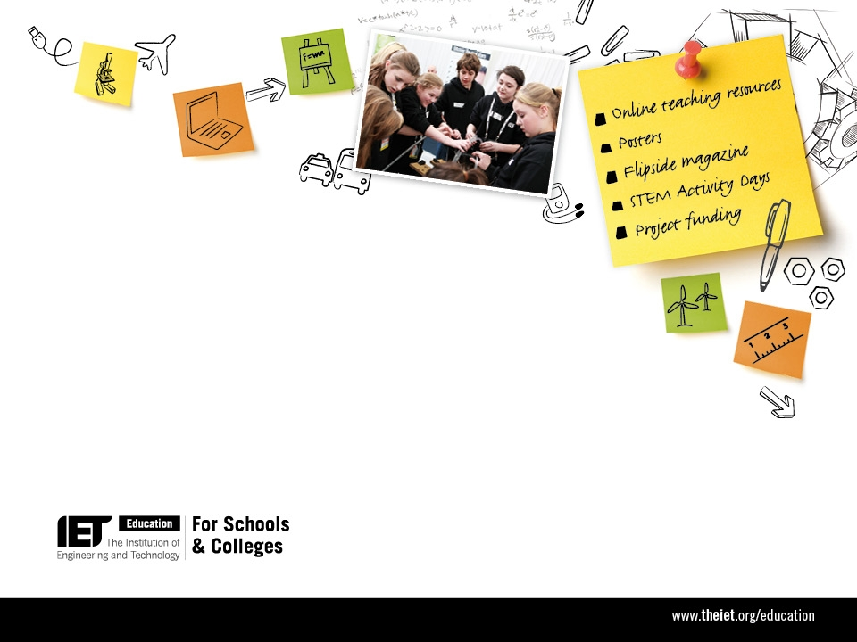

Inspiring future engineers
Notes:
The IET is a global professional members organisation for the engineering and technology community. Based in the UK it has over 150,000 members in 127 countries. The UK and global engineering community have a desperate need to encourage more young people to work within the sector at almost any level, whether it be as a mechanic, technician or professional engineer. According to the latest Engineering UK annual report by 2020 we need to double the number of apprentices and double the number of those with level 4+ qualifications (HNCs, Foundation degrees etc.) just to meet the demands from industry. The jobs are skilled, interesting, creative and rewarding and the IET’s members want to encourage young people to enter the sector for the sake of the UK and other economies and also to enable them to make the most of their own potential.
The IET’s Education for Schools and Colleges programme has a simple premise – capture the enthusiasm of young people from as early an age as possible; nurture that enthusiasm and help them to develop practical, creative and team working skills alongside their academic learning; and, to ensure that they are able to make informed decisions when they come to make decisions about their university courses or apprenticeships and future careers.
As a charity almost all of the IET Education programme’s offerings are FREE to schools.

Slide 2

The IET want…
STEM subjects taught in an engineering context AND
Better careers information advice & guidance
Teachers, students and parents with a better understanding of the engineering and technology sectors
Students with more employability skills and practical experience
More science and engineering students/apprentices
More women in UK engineering
Notes:
As Engineering is rarely taught as an explicit subject and most universities and employers are looking for recruits into engineering that are numerate and have the sort of qualities and skills that would make them good engineers the IET tend to develop materials and deliver programmes that support students and teachers in science, maths, design and technology and ICT/computing. We use these to try to place those subjects within an engineering and technology context so that students can see how their classroom learning is relevant to real-life applications… and those applications are broad – the IET’s membership covers 5 main sectors: transport, energy, information and communications, the built environment and design& production. With such breadth there is something about technology and engineering that should appeal to everyone and anyone.
Even for those students without the ability or wish to become engineers then fostering an understanding of engineering and technology and how it effects their lives will help to make them more technologically literate and better informed decision-makers
Good careers information is essential. The IET is aware that many young people have huge misconceptions about engineers and engineering. Whilst they live in an engineered world and are great users of technology they do not necessarily see how they can be part of pushing it forward. Good careers information can help to address that by helping them to better understand the range of opportunities available to them and the different ways that they can go about achieving these goals if they choose to.
As an outcome to the IET’s efforts it is hoped that not only the students but the also the teachers and parents have a better understanding of what it is to work in engineering and what engineering is – its not necessarily a dirt, low-skilled job
Students will, as well as their academic qualifications, have started to develop the sort of skills that make them valuable to employers such as presentation skills, team working, project management and so on and to be able to creative apply their academic learning
That we will end up with more STEM students and apprentices
And, not least of all, that more young women will be inspired to enter the sector, to help address the appalling levels of under-representation and to positively influence the development and management of this economically-vital sector

Slide 3
Key messages
Engineering is inclusive and open to all
Engineering is fascinating and challenging
Parents
Engineering shapes our world
Students
Engineering has a hugely positive impact on our lives and well-being
Teachers
Lecturers
Opinion formers
Engineering offers a wide range of rewarding careers
Choosing STEM and D&T subjects leads to more course and career options
Notes:
Here are the wide-range of audiences that the IET Education programme is trying to reach. The IET cannot just restrict its efforts to the students as to reach all the millions of students in UK, let alone globally would be an enormous task. The IET tries to engage the teachers and lecturers so that the teachers are informed and enthused about engineering and can act as engineering ambassadors or evangelists to many groups of students; it tries to engage the parents and families of the students who can be huge influencers on the decisions that young people make about their courses and careers; and, it tries to get these messages out to those who determine education and training policy and spending priorities.
The last of these messages is especially important as the subject choices made at 14, 16 or 18 can be decisive as to what options remain open to a young person as they move on to the next stage of their education. For a career in engineering choosing to continue with the STEM subjects, specially maths is particularly important.

Slide 4
Why use engineering to teach?
Classroom benefits…
Practical application of academic learning
Real-life contextualisation of STEM subjects
Development of practical and employability skills
Can lead to…
Opportunities to engage with business and industry
Rewarding and valuable courses, training and qualifications for students
High demand for mechanics, technicians and engineers means opportunities for a wide range of abilities
Notes:
So, with all the pressures on them why would teachers want to try to teach their subjects in an engineering context?
Not only are there advantages in the classroom…
But there are longer term benefits as well such as building links with industry and providing students with genuinely valuable training and qualifications that employers actually want. And there are demands for people within the engineering sector at all levels – it is predicted that the greatest amount of job growth over the next decade or so will be at the Technician level.

Slide 5








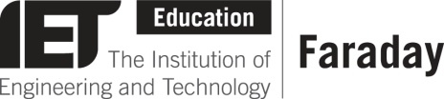

STEM Enhancement & Enrichment
direct to students
building links between education and engineers
magazine
mobile app
STEM Ambassadors
teacher support & CPD
flipside.theiet.org
science fair/class activities
STEM Enhancement & Enrichment
careers information
funding
careers information
IET/IOP/STFC School Grants
theiet.org/education
scholarships
STEM teaching resources
skills development & competition
‘Engineering Explained’ interactive shows
lesson activities
posters
video case studies
Challenge Days
Global robotics competition – UK & Ireland
engineer profiles
Flipside for Teachers
games
Challenge Days in a Box
ietfaraday.org
ietfaraday.org
firstlegoleague.co.uk
Notes:
The IET Education programme intentionally offers schools a wide-range of different resources and activities of differing levels of demand depending upon what will appeal to the teacher or the students or fit within the time or financial resources that they have.
1. Flipside magazine – a professionally produced, high-quality publication that inspires and fascinates teenagers about the world around us, showing that fact is often stranger than fiction. This goes free to every UK secondary school library and is available to buy on subscription. There is also a website and the first Flipside app – Flipside 10’s is available through the usual app stores
2. The IET uses real engineers and engineering to inspire young people so IET members are used as Ambassadors and Role-models. The IET provides them with many activities and resources to help with science fairs, careers fair and to support classroom learning
3. Funding can be a challenge for schools, students and those wishing to run projects for schools so the IET provides a range of project funding programmes and scholarships for university students on IET accredited courses
4. The IET supports a wide-range of providers of teacher training and STEM Enhancement & Enrichment activities. This helps to enhance teacher knowledge and build the skills and enthusiasm of students with an interest in engineering. The partnerships include Engineering UK with whom the IET collaborate on the development of the Tomorrow’s Engineers careers resources and activity programmes and the delivery of the Big Bang Fairs
5. The IET engages directly with students through the IET Faraday Challenge Day Competition and the FIRST® LEGO® League global robotics competition. These competitions develop many skills including creativity, team working, project management, presentation and problem solving as well as enhancing their academic learning.
6. The IET Faraday programme is the IET’s range of classroom learning resources that includes video case-studies of cutting edge engineering; profiles of the engineers involved; lesson activities of various lengths matched to secondary curricula for England, Northern Ireland, Scotland and Wales for each of the STEM subjects; ordering facilities and PDF versions of the careers resource, classroom posters and the new Flipside for Teachers poster/magazine; and, online games. It also includes instructions on how to run off-timetable STEM activity days modeled on the IET Faraday Challenge Day competition

Slide 6
For more information:
email schools@theiet.org
call 01438 767373
Visit:
IET Education theiet.org/education
IET Faraday ietfaraday.org
FIRST® LEGO® League firstlegoleague.co.uk
Notes:
There are no easy solutions to meeting the challenges of changing the perceptions around engineering and encouraging young people to choose the appropriate courses and careers – it is a present and on-going challenge for many years to come. Whilst the current state of the economy is helping by driving a greater uptake of maths and science subjects at school this trend needs to be sustained and grown long into the future.

